Slide 1
Pythons
(for coding)

Slide 2
Let’s get started
Can you show me a Python?
Looks like this:
print “Hello, world.”
Says this:
Hello, world.

Slide 3

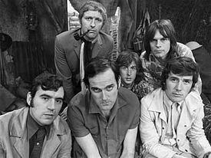
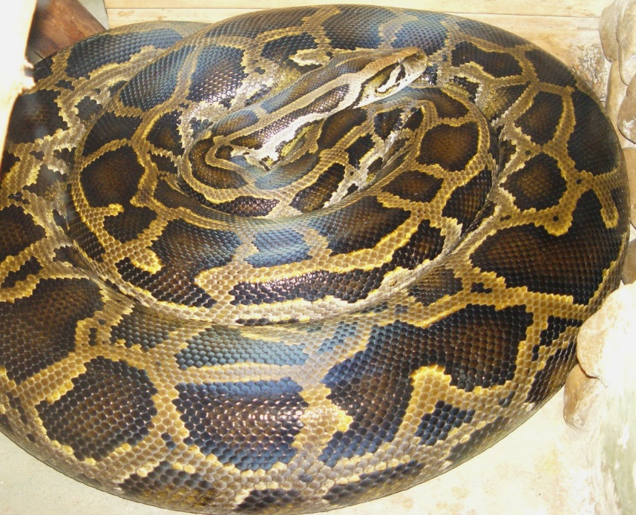

…or this
…or this

Slide 4
Some quick group info
We have a weekly meeting on Tuesdays
We have a mailing list (you’re probably on it):
studygroup001@
We have a slack channel: studygroup001.slack.com
We have a book we’re studying: Think Python 2nded. by Allen Downey
You can get the book here: http://www.greenteapress.com/thinkpython/
We have an editor: IDLE
https://www.python.org/downloads/
We have a version of Python for use: v.3.6.0 (Ubuntu is 3.5.2 right now)
https://www.python.org/downloads/

Slide 5
Goals for the group
Learn to code in Python
Have fun doing it
Read one chapter a week in Think Python
Join on the call for a brief review of the chapter
Talk about what we learned and questions we may have

Slide 6
Natural vs. Formal Languages
Formal languages
Designed by people for specific applications
Programming languages are formal languages designed to express computations
Formal languages tend to have strict rules about syntax
Eg. 3 + 3 =6
Natural Languages
Full of Ambiguity
Often use Redundancy to make up for ambiguity and reduce misunderstandings
Lack Literalness, Natural languages are full of idiom and metaphor
Eg. “The penny dropped.” (means someone realized something after a period of confusion)
In contrast, Formal languages mean exactly what they say.

Slide 7
How to read a program (suggestions)
Not a good idea to read from top to bottom, left to right
Instead:
Learn to parse the program in your head by
Identifying tokens
Interpreting the structure
Finally details matter
Small errors in spelling and punctuation, which you can get away with in natural languages can make a big difference in a formal langue
FORTUNATELY THERE ARE TOOLS TO HELP!

Slide 8
Parsing
Parsing:
(eg. When you read a sentence in English or a statement in a formal language and you have to figure out what is the structure of the sentence (in a natural language, you do this subconsciously)

Slide 9
Debugging
Some debugging tips
Programming, and especially debugging, sometimes brings out strong emotions. If you are struggling with a difficult bug, you might feel angry , despondent or embarrassed.
There is evidence that people naturally respond to computers as they were people

Slide 10
Python
Let’s get coding
What we’ll use? Python 3.5.2 and IDLE3
Where you can get it? https://www.python.org/downloads/
Create a hello world program? (demo)
Bring someone else’s program for use within yours (import example)
Get some help?
help(something)
What can I ask for help on?
dir(something)
Can you give me an example (I’m on the CLI of a router and need to know now)?
import(sys), dir(sys), help(sys), help(sys.version_info)
Can you just let me read the docs (for public python modules)?
http://docs.python.org/

