Slide 1

QUALITY EDUCATION; SDG 4
Predicting Student performance with machine learning

Slide 2
PREDICTING STUDENT PERFORMANCE WITH MACHINE LEARNING
Many students face academic challenges unnoticed until poor performance is irreversible.
Traditional identification methods are reactive, not proactive.
ML helps predict student performance early, enabling intervention.
SDG 4 Goal is to ensure inclusive and equitable education for all.

Slide 3
DATASET AND FEATURES
DATASET: StudentsPerformance.csv
Key Features Used: Gender, parental education, test preparation, and subject scores
Focus on reading and math scores as predictors of student success.

Slide 4
ML APPROACH
Model Used:
Linear Regression.
Training Process:
Feature selection and data preprocessing.
Model training and evaluation.
Performance Metrics:
R² score:0.73 (explains 73% of variance in math scores)
Mean Squared Error (MSE): 72.74 (~8.5-point average prediction error

Slide 5
RESULTS AND INSIGHTS
Observed Patterns:
Strong correlation between reading and math performance.
Students with strong reading skills tend to excel in math.
Implications for schools:
Better literacy programs = improved math outcomes.
Early intervention strategies based on predicted performance

Slide 6
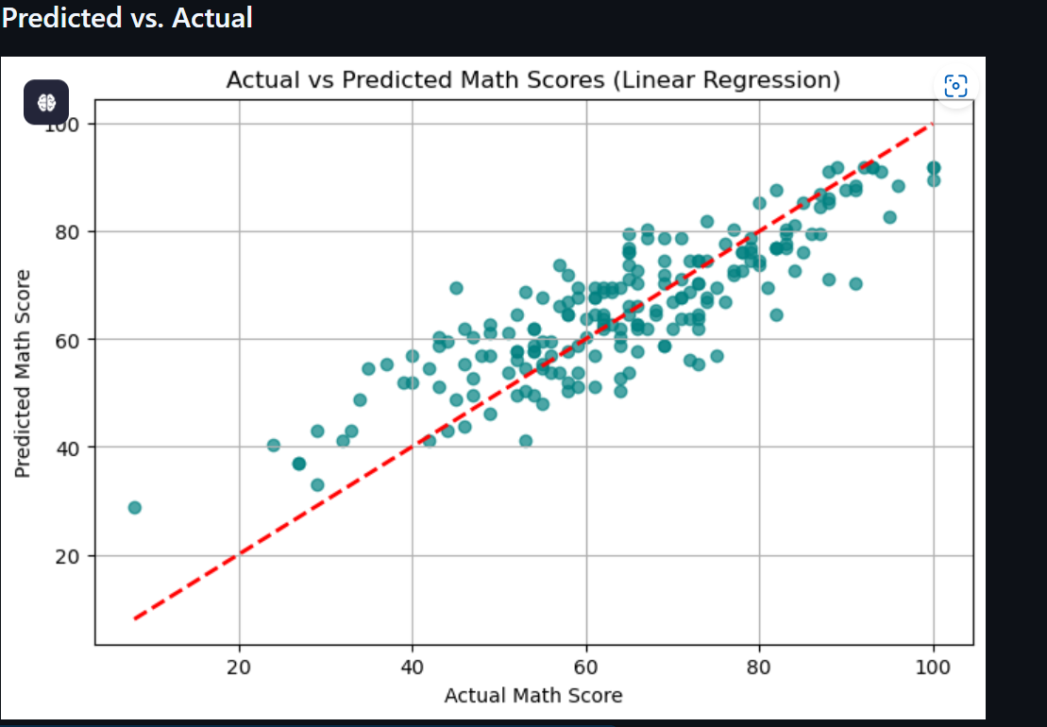
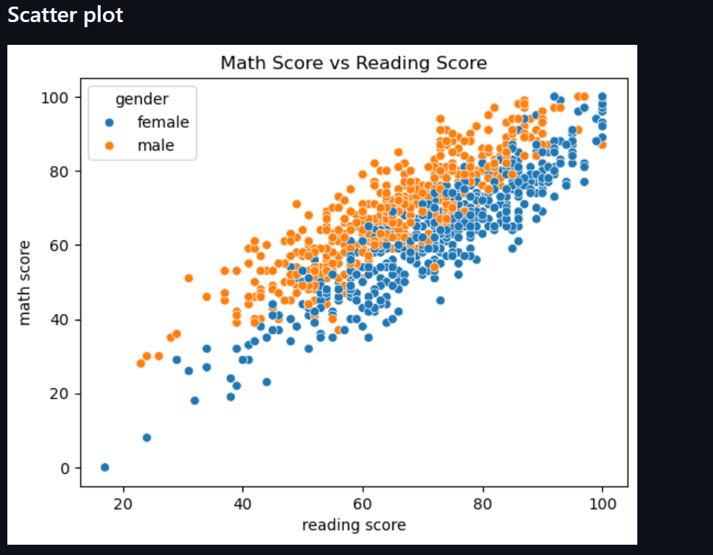
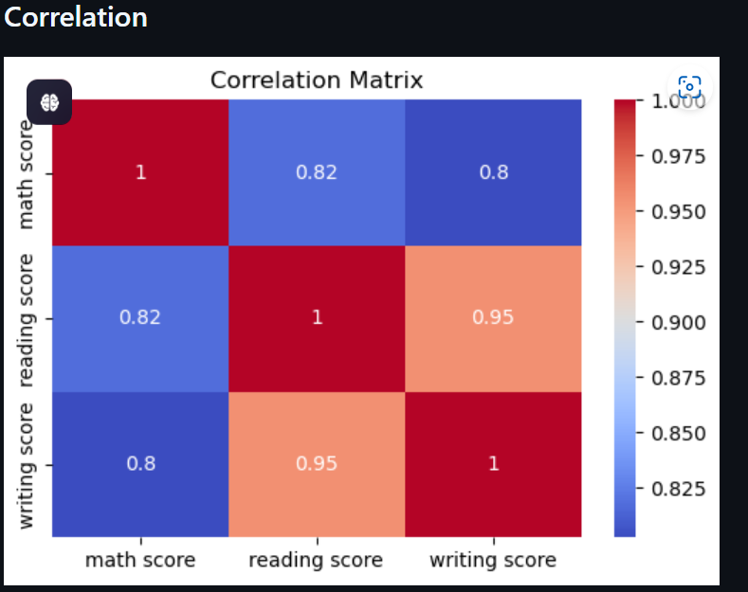
RESULTS AND INSIGHTS VISUALS

Slide 7
ETHICAL CONSIDERATIONS
Bias Risks:
Model fairness across different demographic groups.
Privacy Concerns:
Handling student data responsibly
Intervention Strategies:
Using predictions ethically to support, not penalize, students.

Slide 8
CONCLUSION
Key Takeaways:
ML predicts performance trends to support struggling students early.
Schools can tailor interventions for higher retention rates.
Future Improvements:
Testing more complex models (e.g., Decision Trees).
Expanding dataset for broader student demographics.

