Slide 1
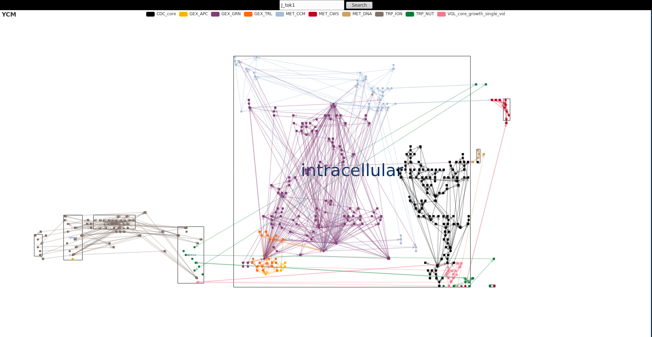
Visualization of a Whole-Cell Model by Arne Hoffmann

Slide 2
Content
Layout
Color Selection
Edges
Information Presentation
Prototype

Slide 3
1. Layout:
Quality
Avoid visual anomalies
  for example edge crossing and edges with sharp bends
Short edges
Symmetry

Slide 4
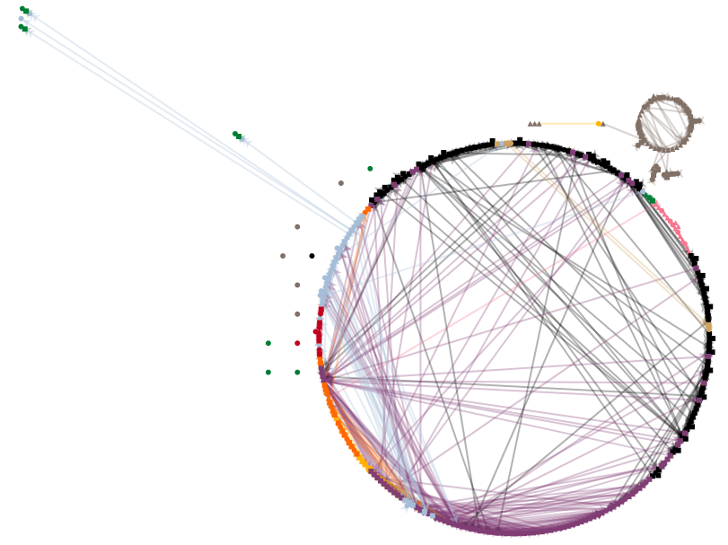
1. Layout:
Circular

Slide 5
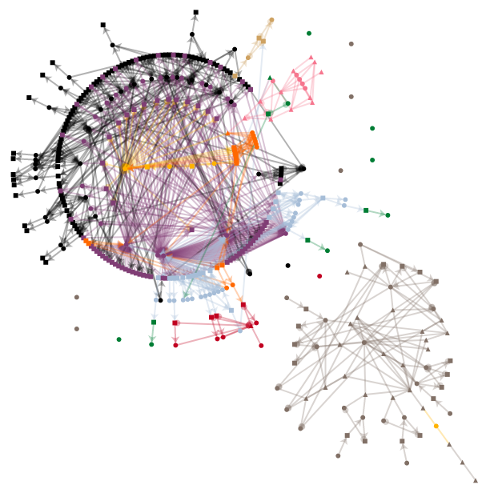
1. Layout:
Radial

Slide 6
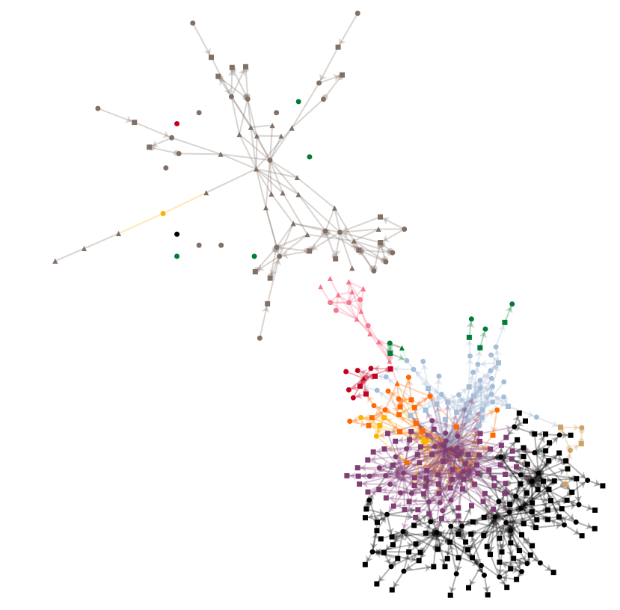
1. Layout:
Force-Directed

Slide 7
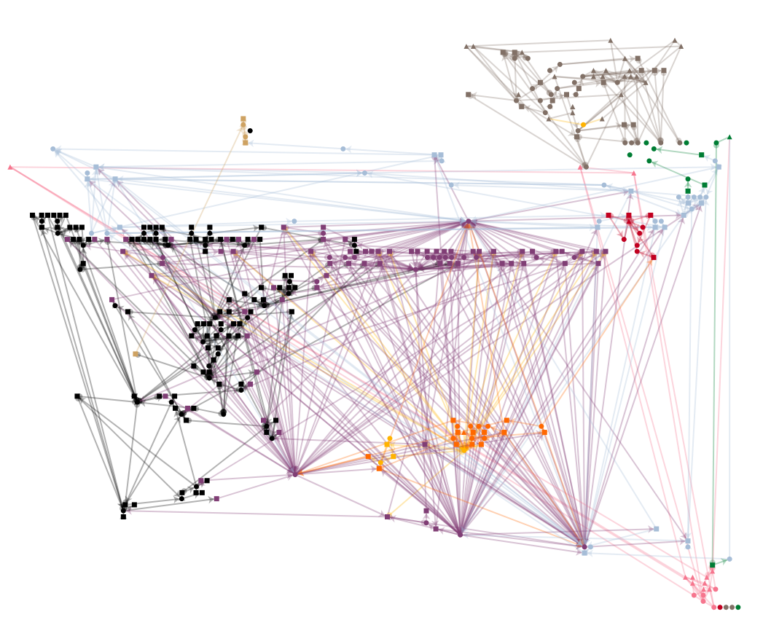
1. Layout:
GraphViz Dot

Slide 8
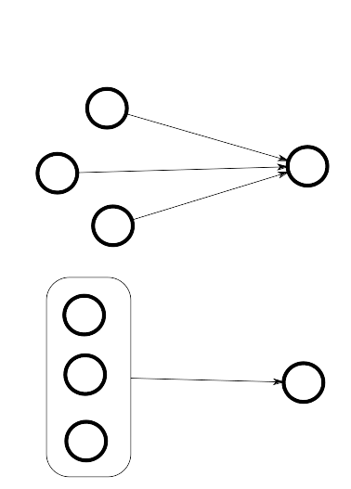
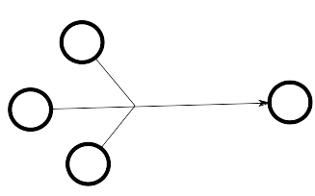
2. Edge Reduction
Edge Types
Edge Compression
Edge Bundling
normal
compressed
bundeled

Slide 9
4. Interaction
Pan&Zoom
Neighbor Highlighting
Search Nodes
Displaying Node Information

Slide 10
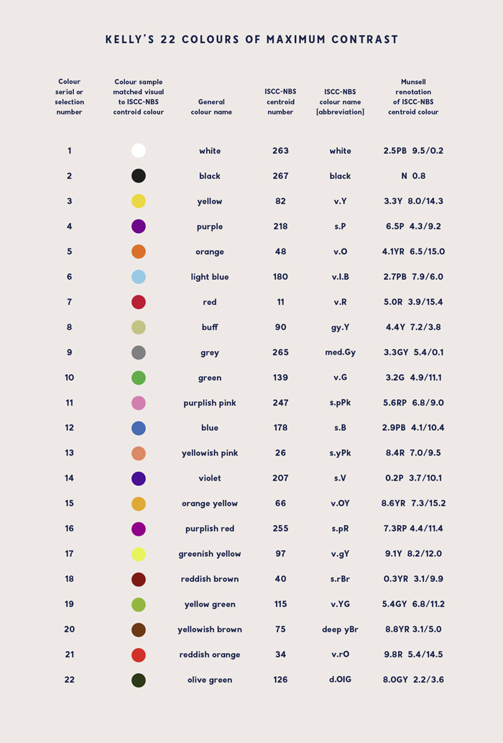
2. Colours

