Slide 1
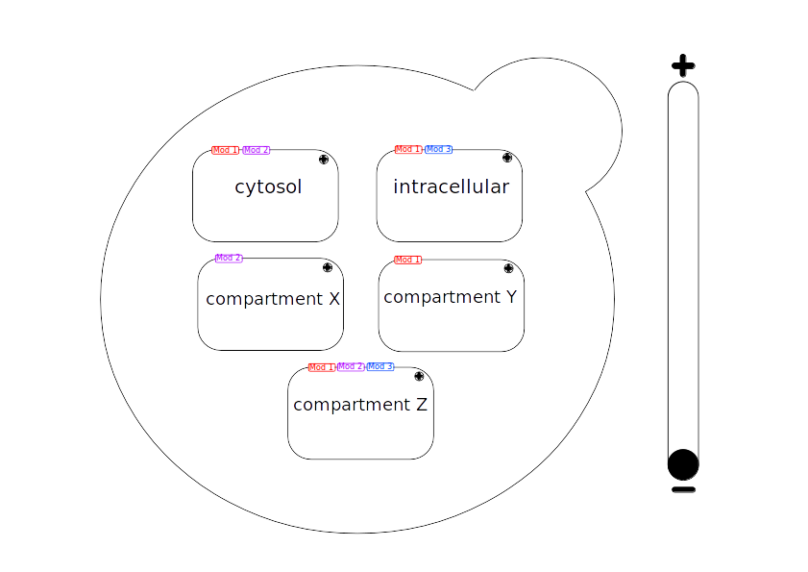

Mockup Top-Layer color coded modules

Slide 2
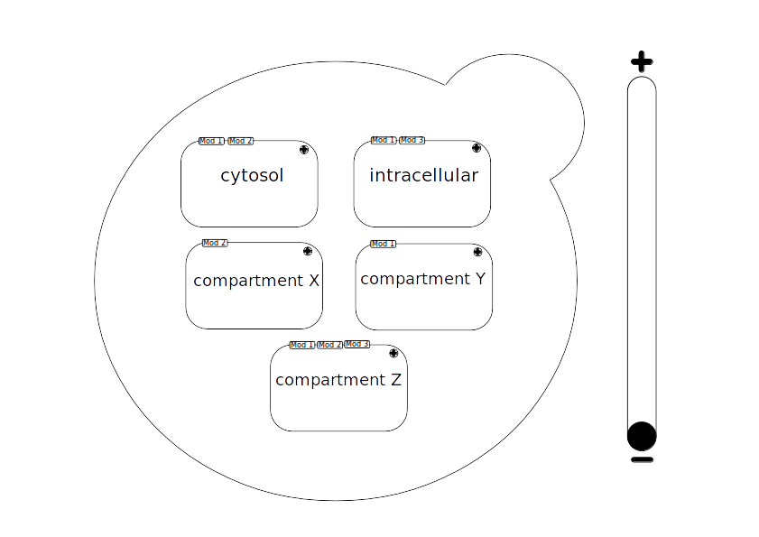
Mockup Top-Layer no color coded modules

Slide 3
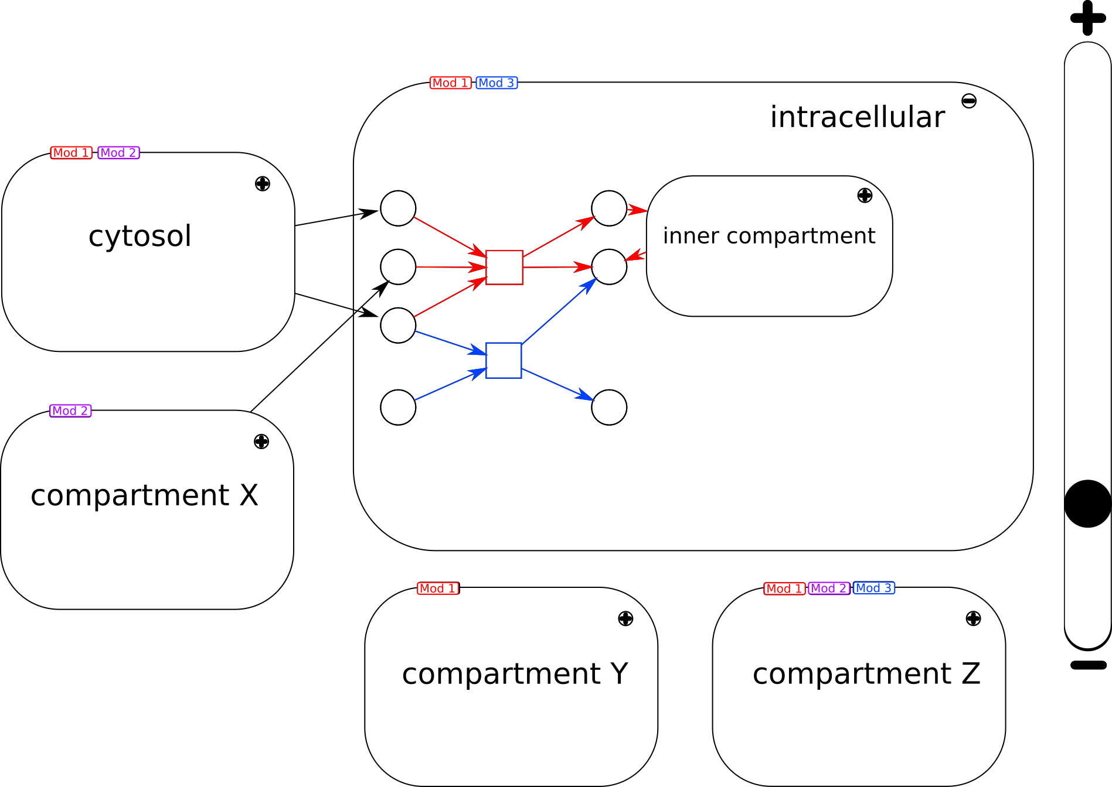
Mid-Layers

Slide 4
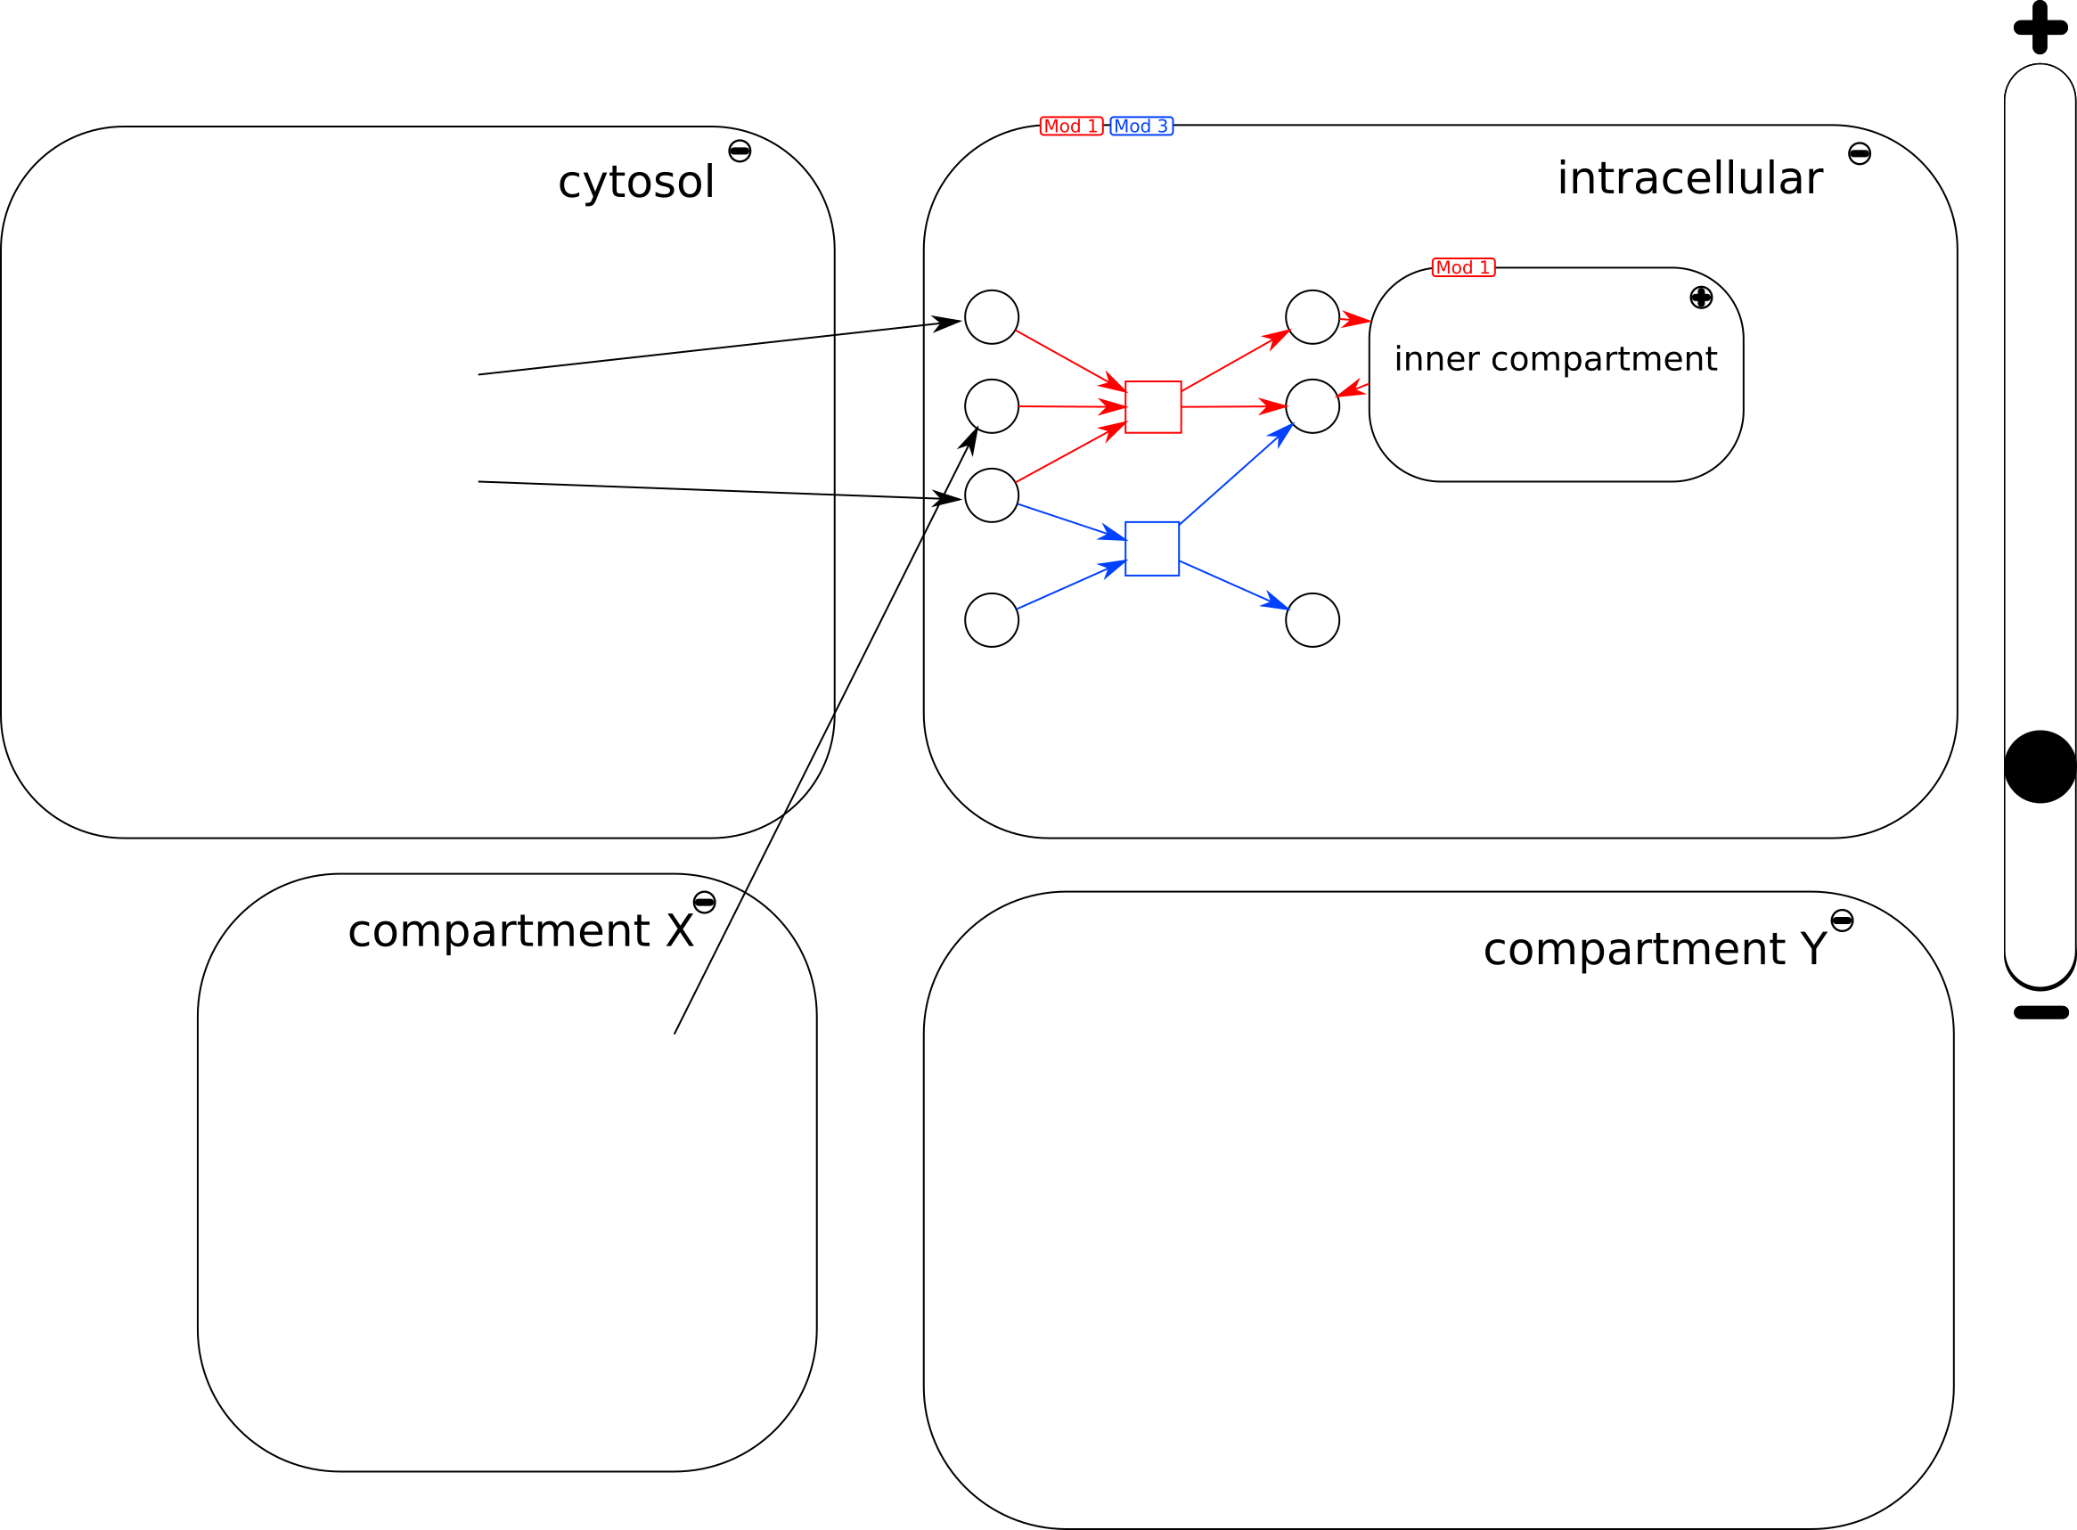
Mid-Layers

Slide 5
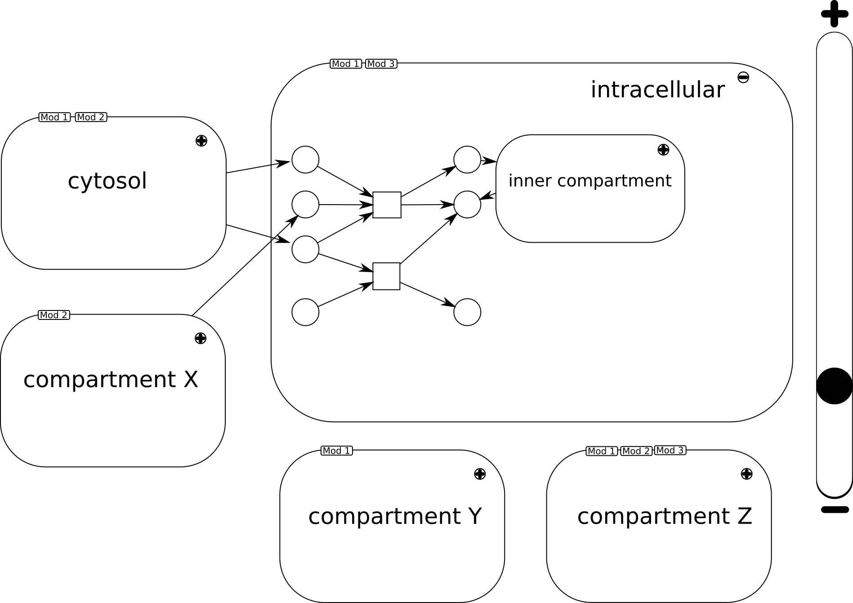
Mid-Layers

Slide 6
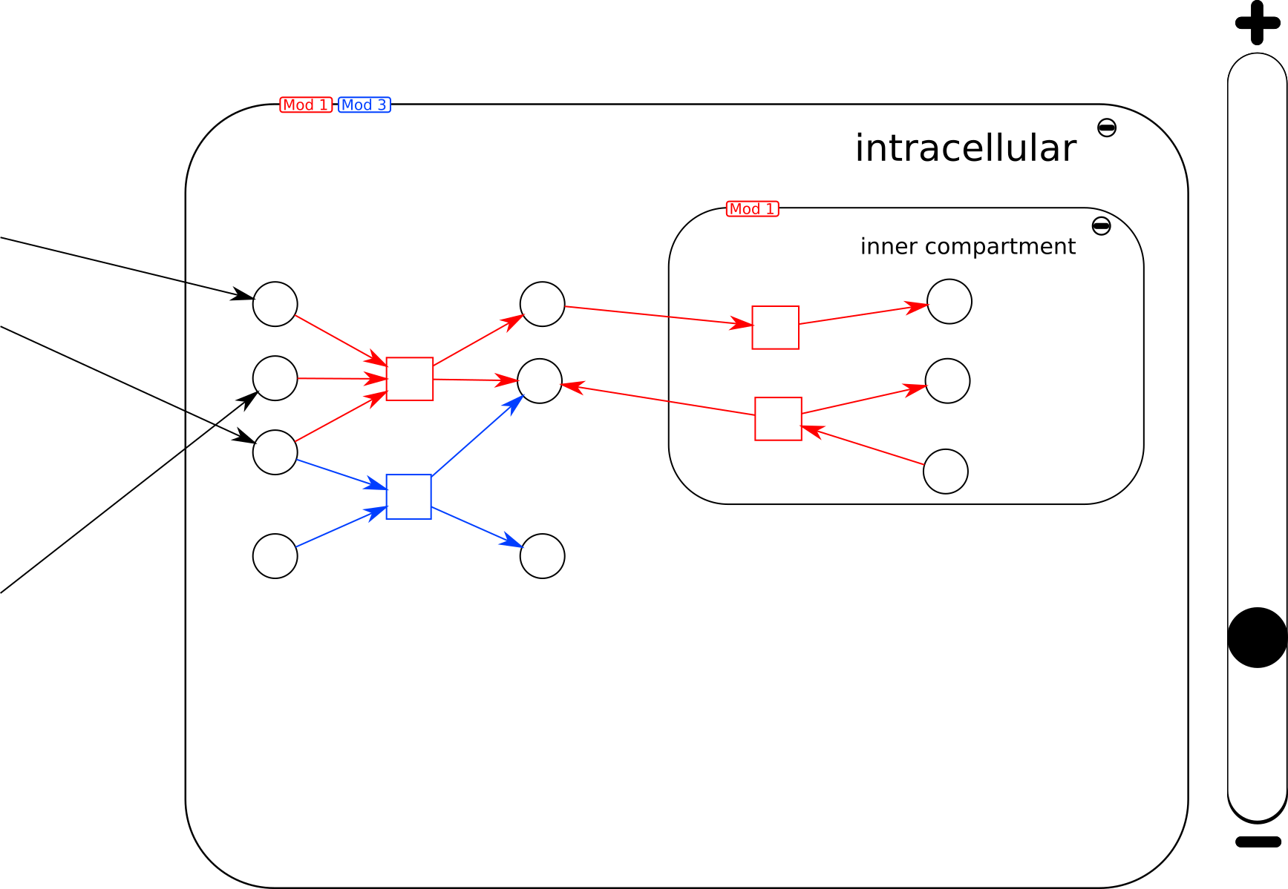
Mid-Layer

Slide 7
Bottom-Layer

