Slide 1
Channel Control Attack

Slide 2
Single channel manipulation
Two channels manipulation
Three channels manipulation

Slide 3
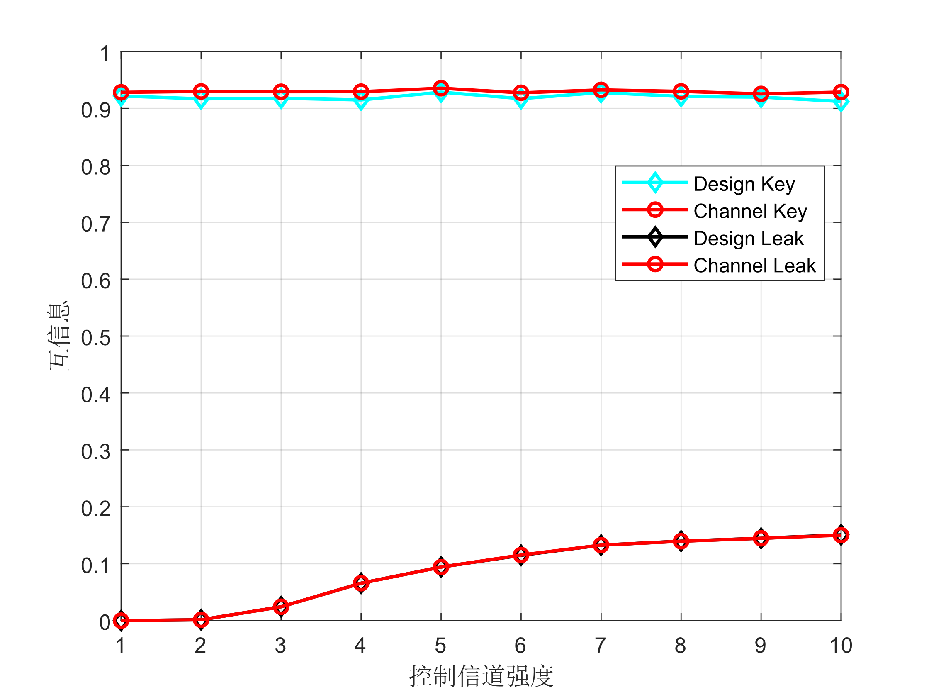
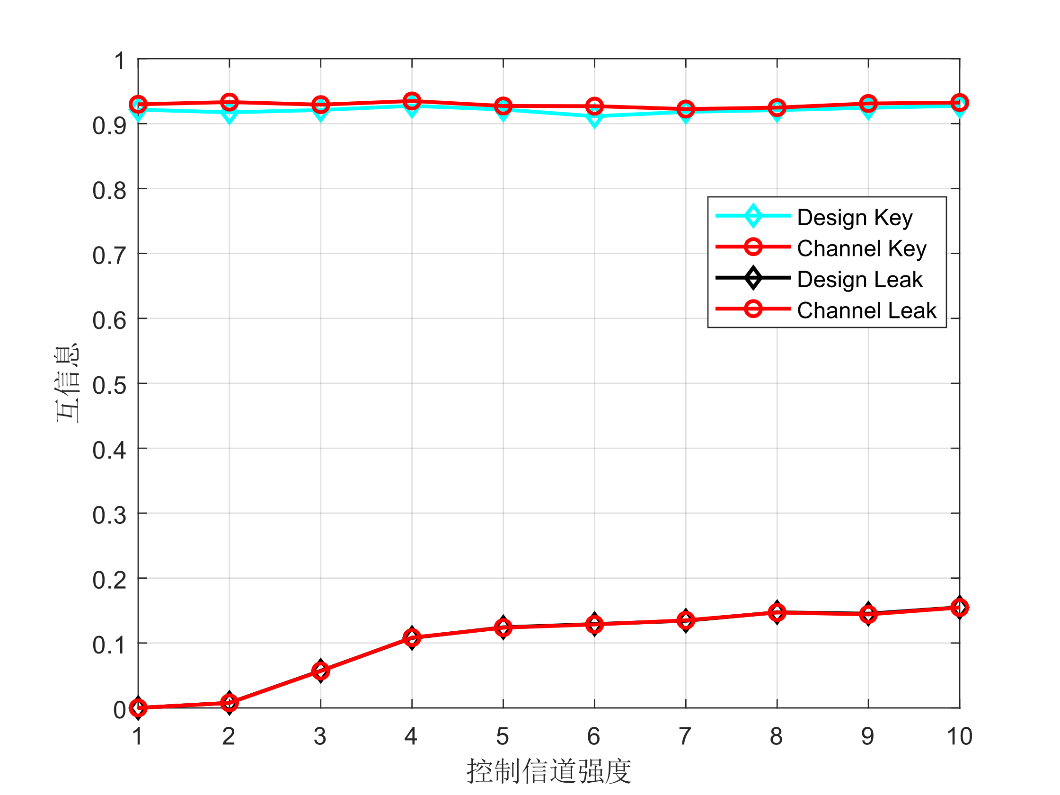
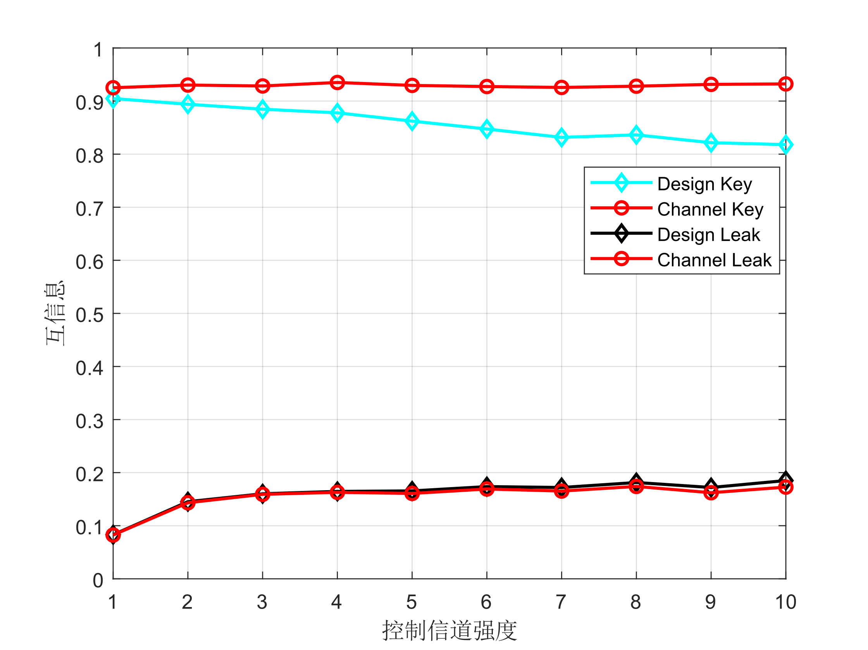
Single channel manipulation
Manipulate h1
Manipulate h2
Manipulate h12

Slide 4
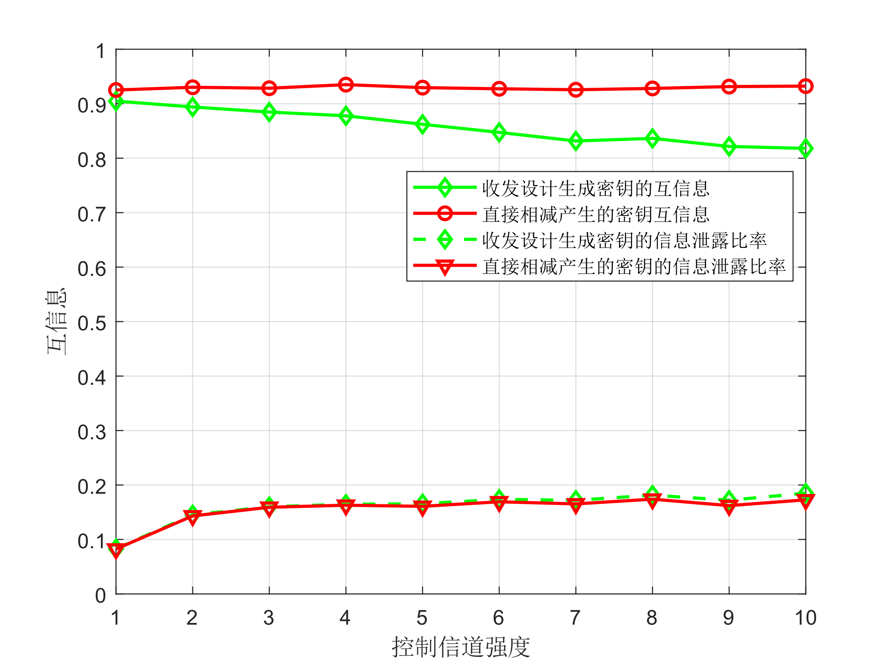
Single channel manipulation
To show the worst-case security of our model, we choose the smallest difference between MI(Mutual-Information) of Keys and MI of Leak Message.
Conclusions:
The ‘h12’ channel is the most sensitive channel, since the noise power is fixed.
With the increase of the channel gain mastered by Mallory, MI of Keys is slightly influenced, however, the MI of Leak-Message increases as channel gain grows.
The reason why the MI of Keys decreases when channel gain increases is unknown yet.

Slide 5
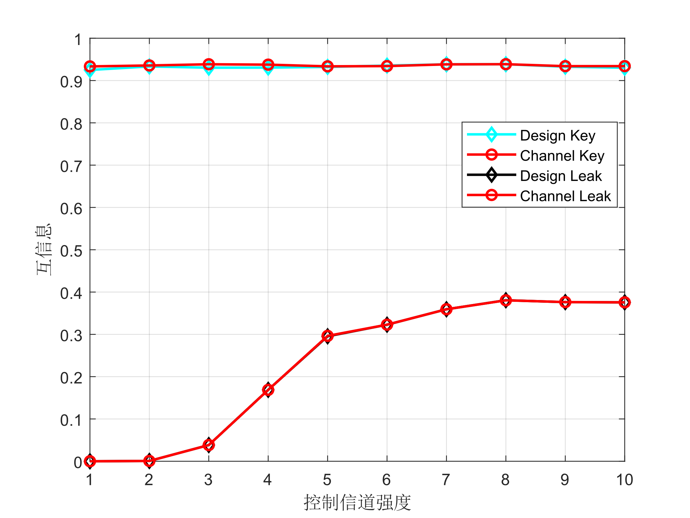
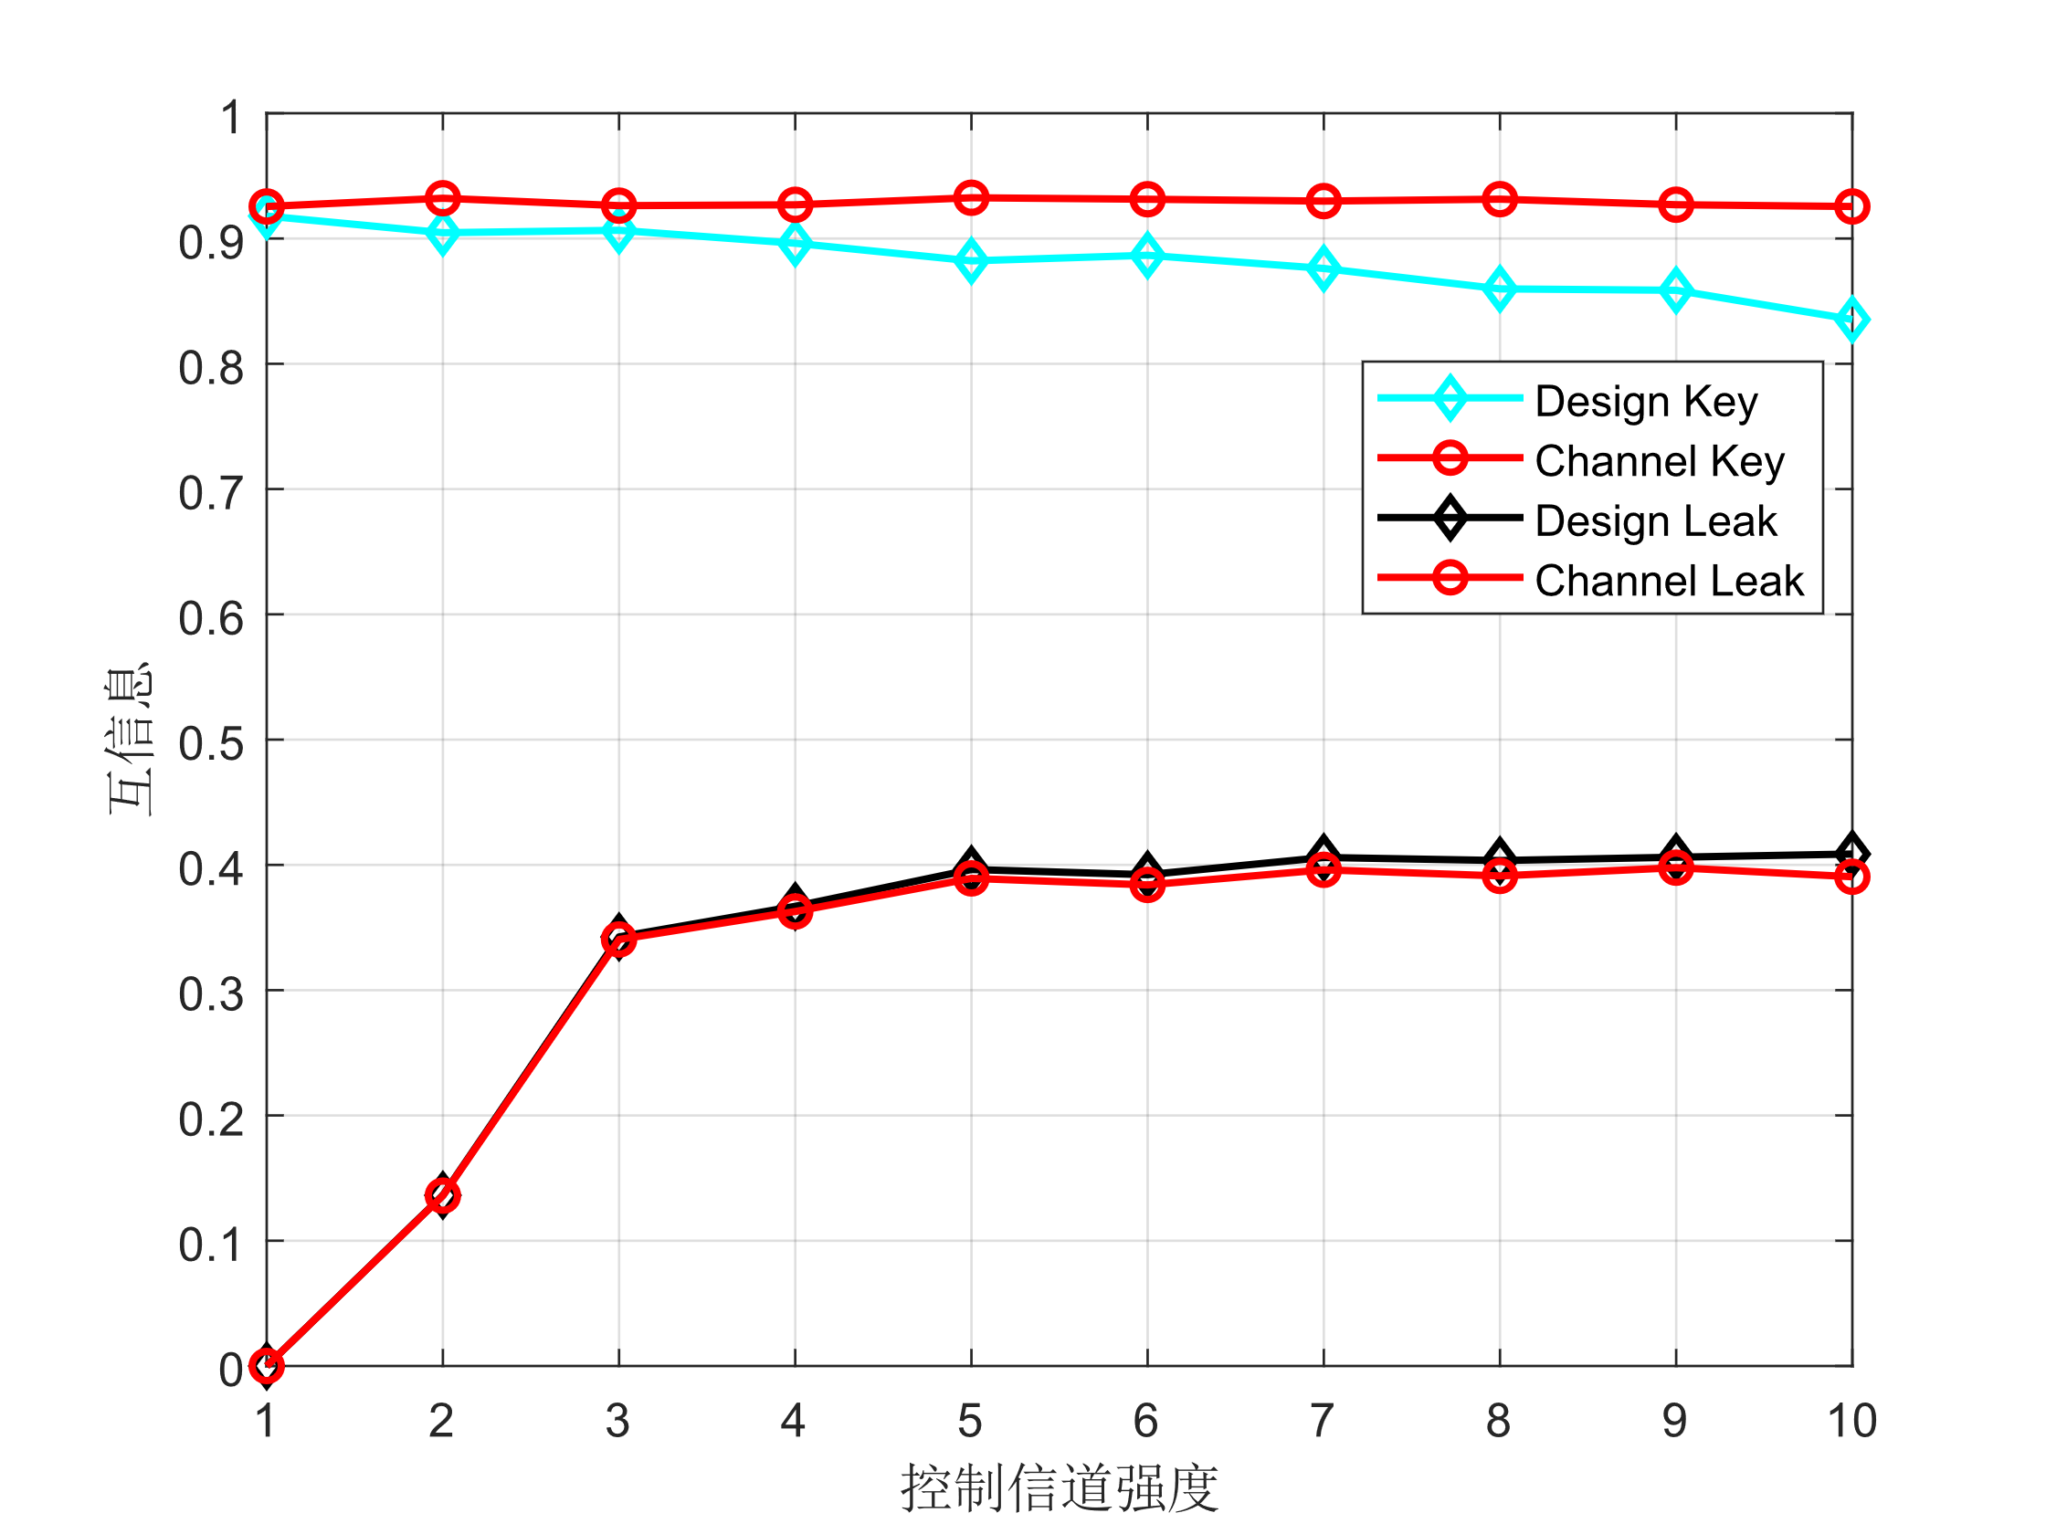
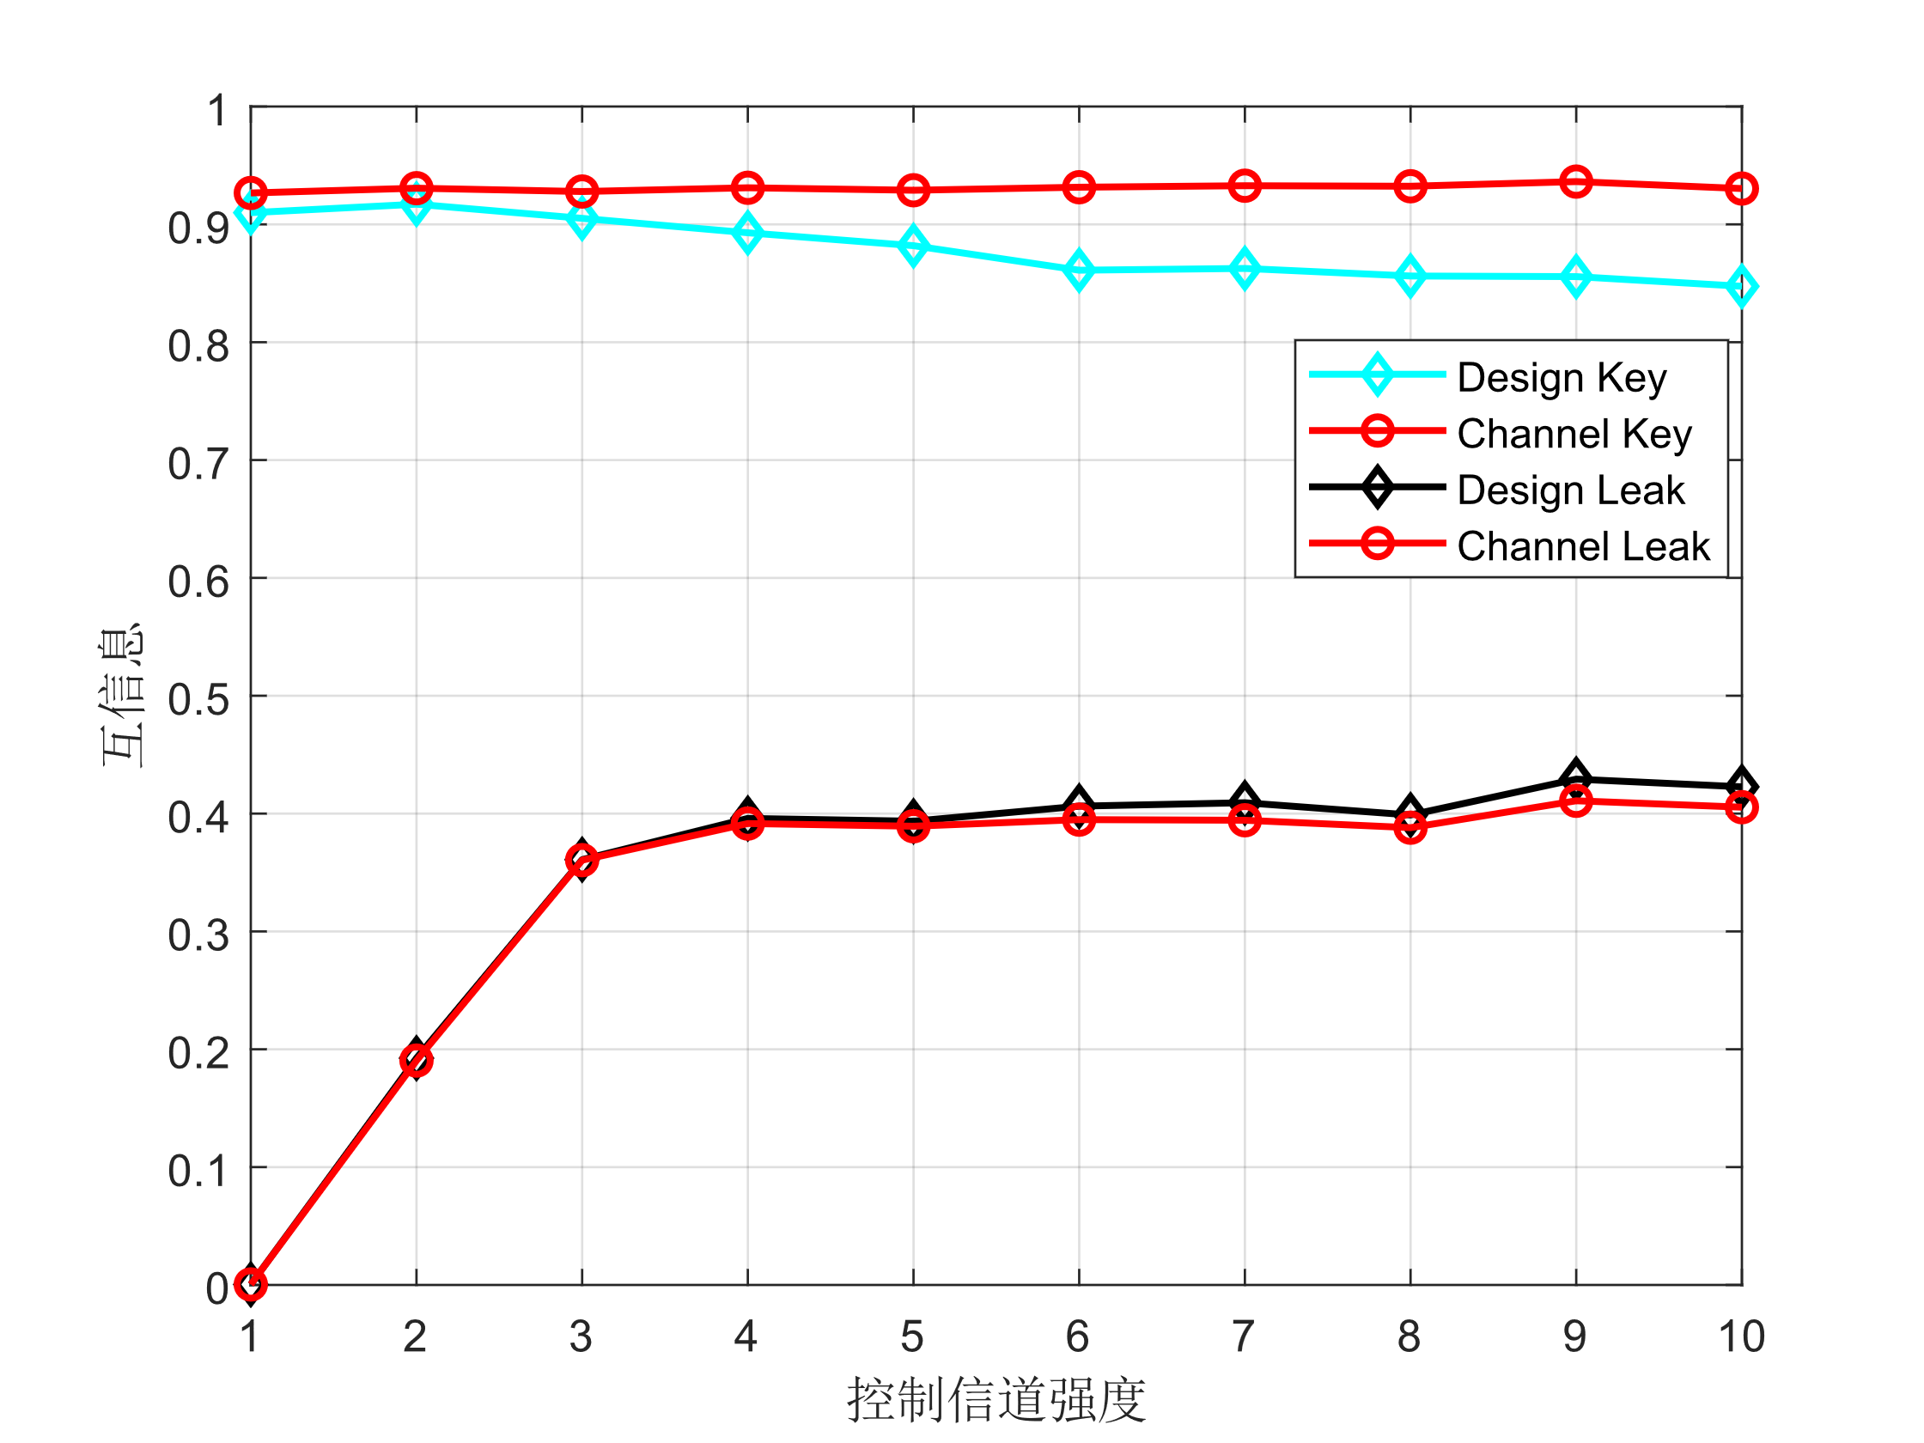
Two channels manipulation
Manipulate h1h2
Manipulate h1h12
Manipulate h2h12

Slide 6
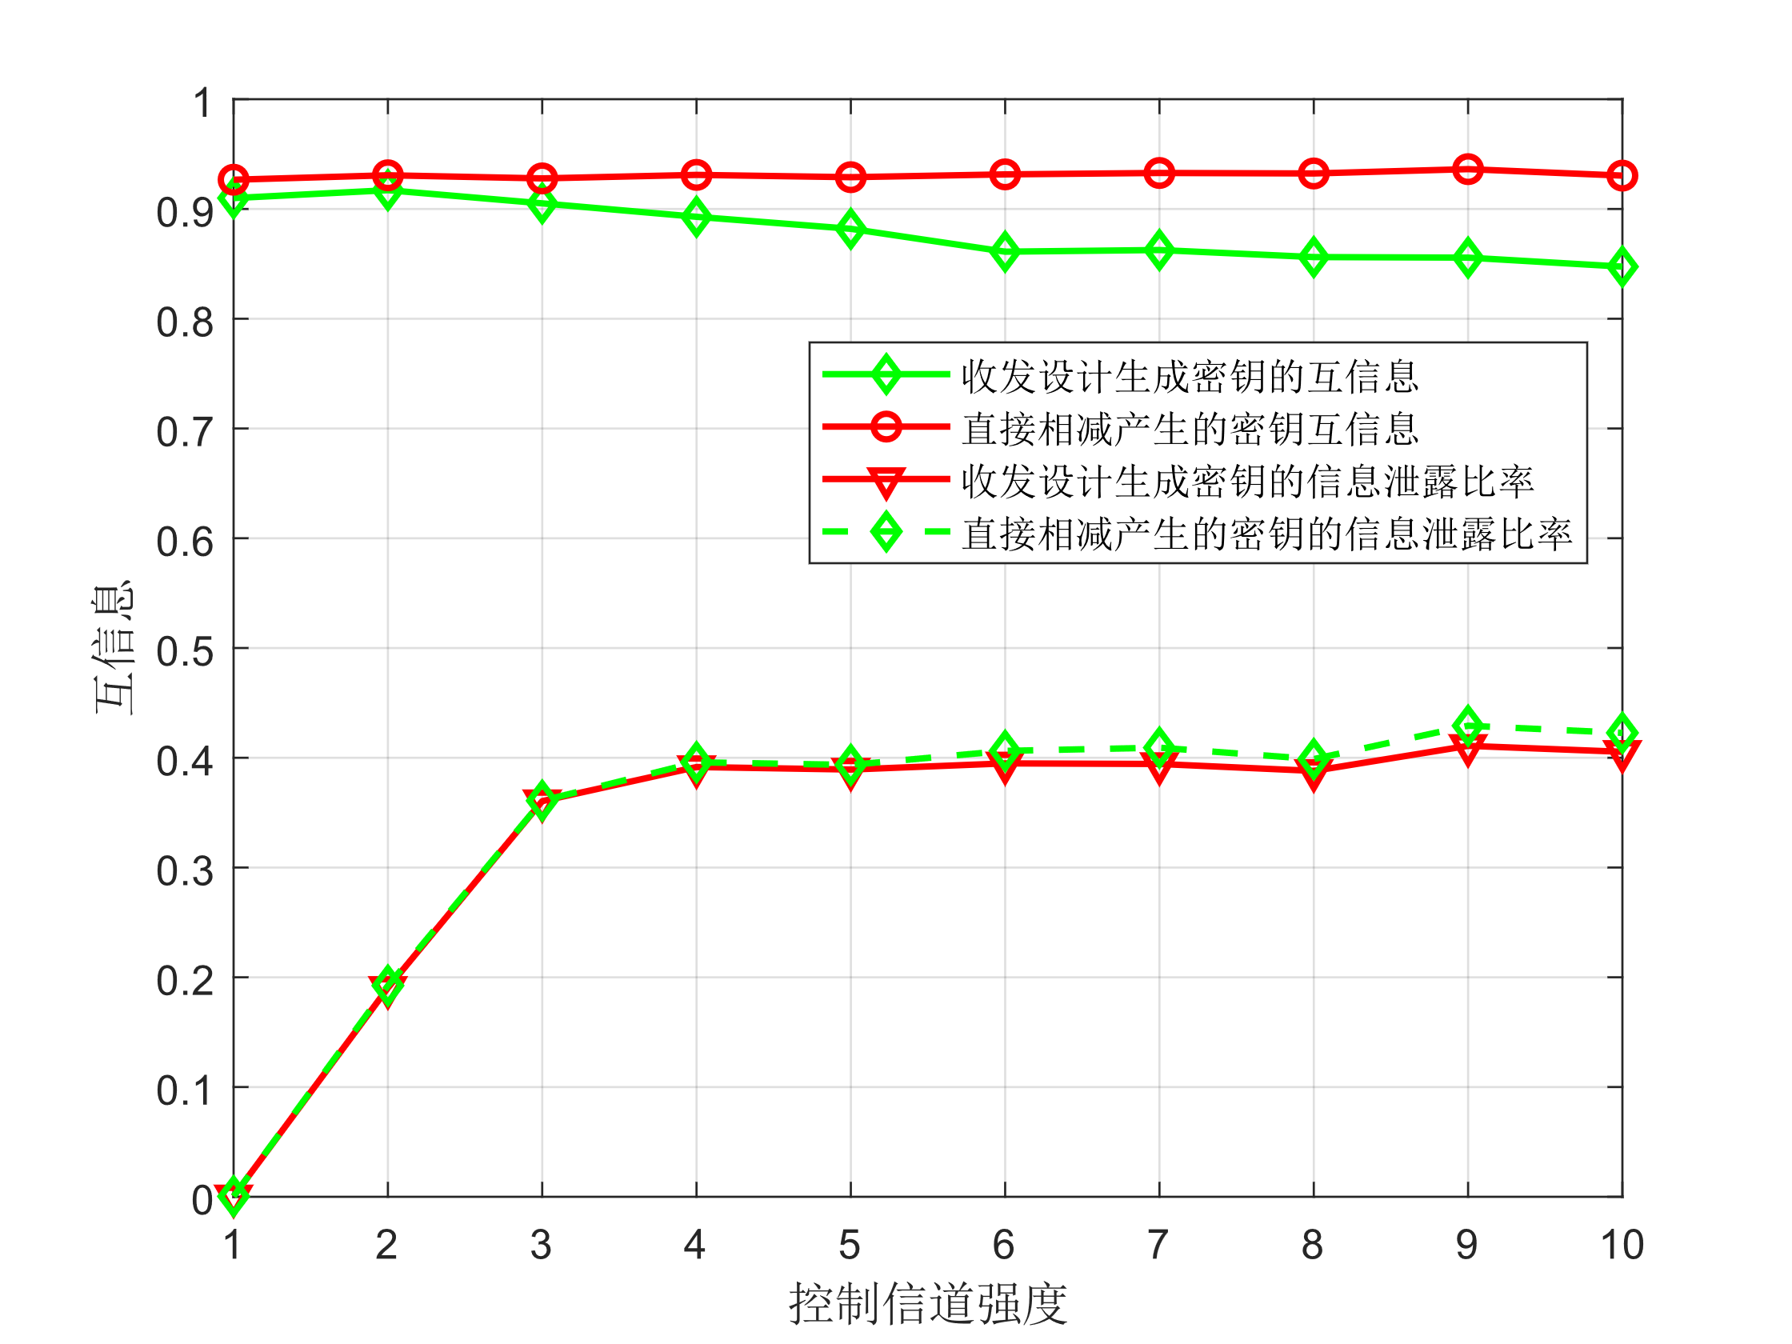
Two channels manipulation
To show the worst-case security of our model, we choose the smallest difference between MI(Mutual-Information) of Keys and MI of Leak Message.
Conclusions:
The ‘h2h12’ manipulation is the most dangerous situation.
With the increase of the channel gain mastered by Mallory, MI of Keys is slightly influenced, however, the MI of Leak-Message increases as channel gain grows.

Slide 7
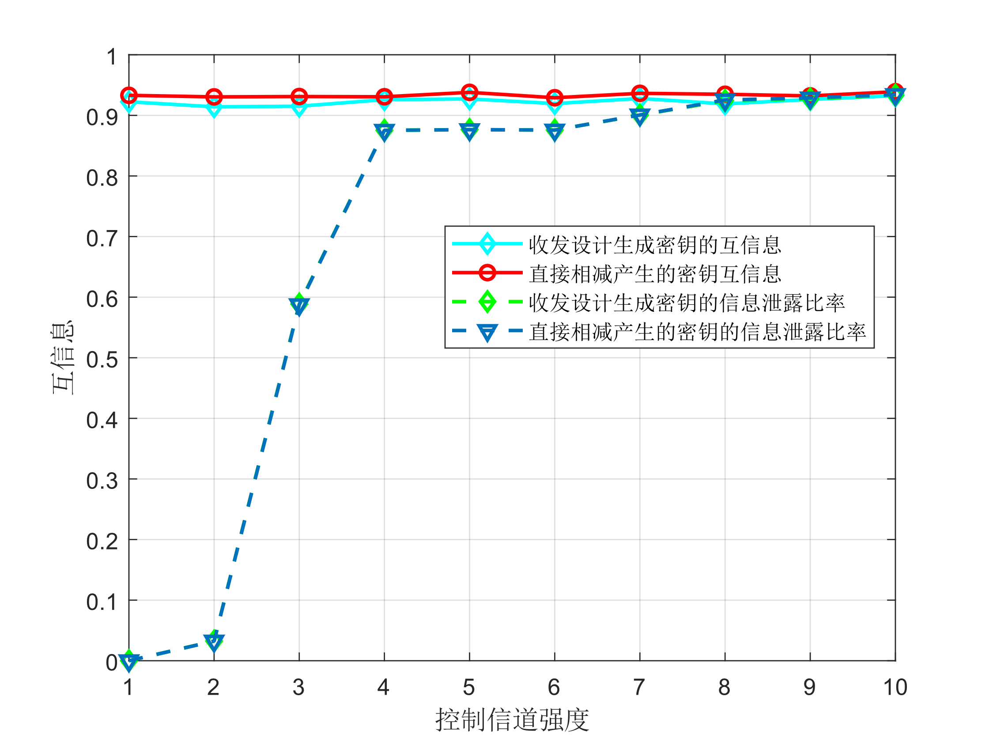
Three channels manipulation
Conclusions:
With the increase of the channel gain mastered by Mallory, MI of Keys is slightly influenced, however, the MI of Leak Message increases significantly as channel gain grows.
Mallory may compromise nearly the whole key information as the channel gain becomes very high.

Slide 8
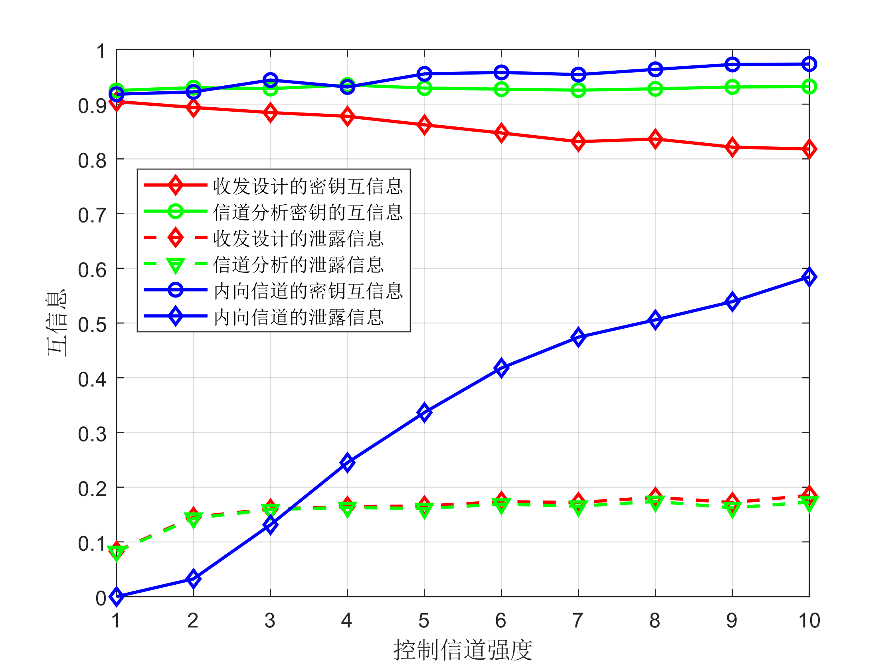
Tri-Channel vs. Traditional
We compare Single Channel Manipulation with Traditional CCA.
Conclusions:
The MI of Keys: Traditional > Channel Analysis > Joint Transceiver Design
The MI of Leak Message: Traditional > Joint Transceiver Design> Channel Analysis
The Channel Analysis method is theoretically the optimal solution of the model since we can directly obtain the tri-channel information. The Joint Transceiver Design method is very close to the ideal method.

Slide 9
Forge as RF

Slide 10
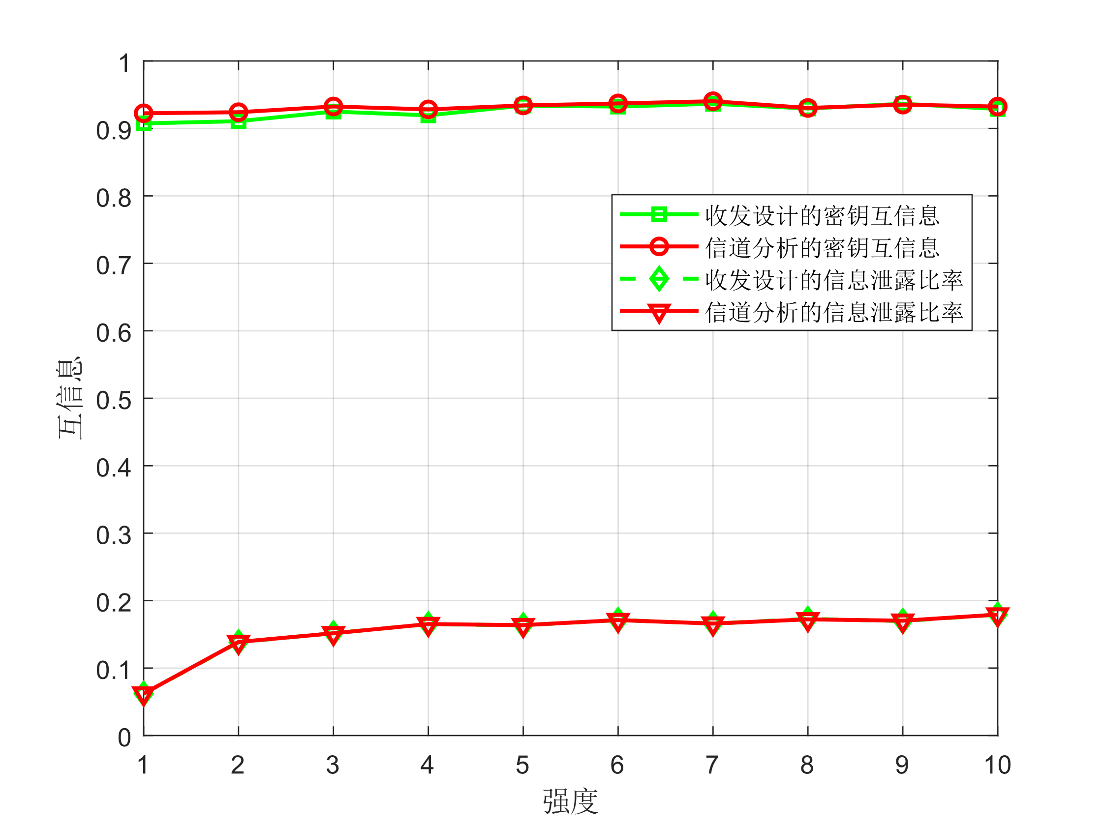
Forge as RF
We magnify the signal strength of s(t), to study the key generation and information leakage.
Conclusions:
The MI of Keys: Channel Analysis > Joint Transceiver Design
The MI of Leak Message: Joint Transceiver Design> Channel Analysis
With the increase of the channel gain mastered by Mallory, MI of Keys is hardly influenced, however, the MI of Leak-Message increases slightly as channel gain grows.

