Slide 1
Data Drift Detection Using KS Test

Slide 2
Introduction to Data Drift
Data drift occurs when the statistical properties of data change over time, potentially affecting model performance. Detecting data drift is essential for maintaining model accuracy.

Slide 3
What is KS Test?
The Kolmogorov-Smirnov (KS) test is a non-parametric test that compares the cumulative distribution functions (CDFs) of two datasets to determine if they come from the same distribution.

Slide 4
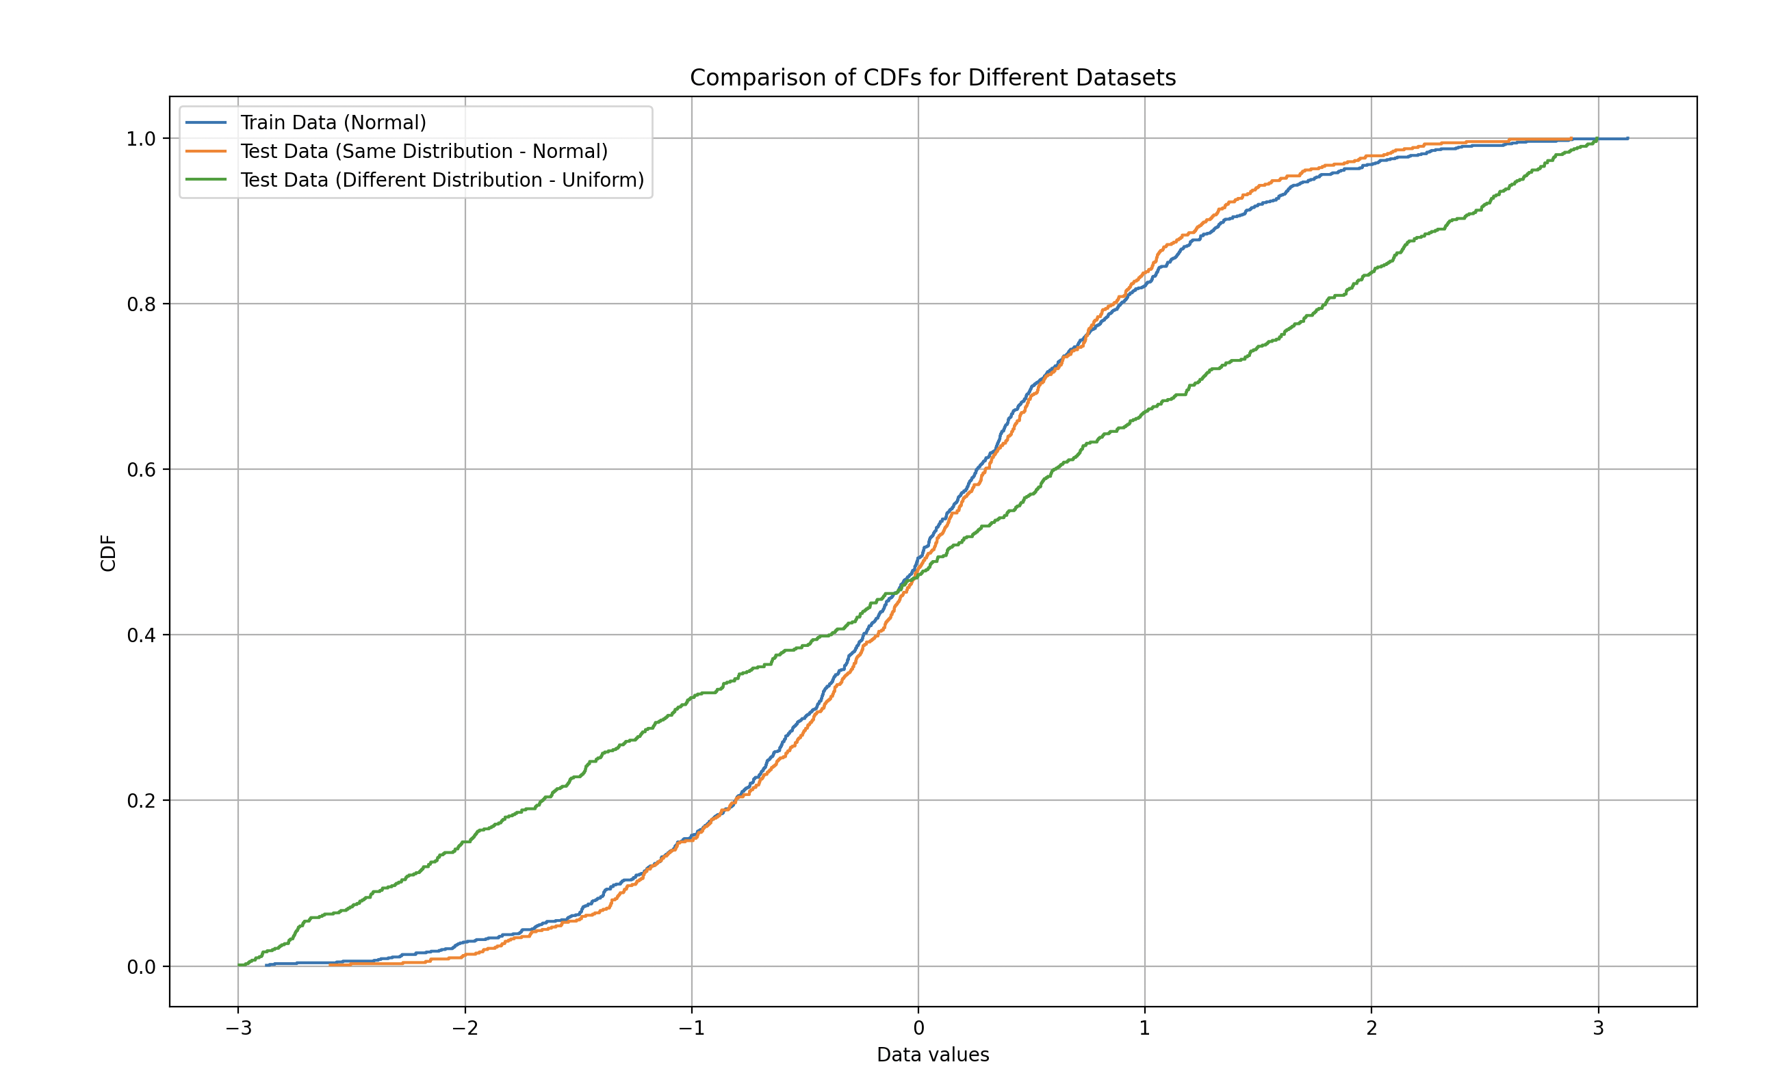
Example of the cumulative distribution functions (CDFs)
The Kolmogorov-Smirnov (KS) test is a non-parametric test that compares the cumulative distribution functions (CDFs) of two datasets to determine if they come from the same distribution.
Github:

Slide 5
Step 1: Loading Data
Load historical EUR/USD data using pandas.
Select a subset for training (rows 1000-3000) and testing (rows 3000-3500).
Github:

Slide 6
Step 2: Calculating Log Returns
Log returns are calculated using the formula: log(prices / prices.shift(1)).

Slide 7
Step 3: Fitting and Comparing
Fit the KS detector using the training data.
Compare the test data to detect data drift.
Interpret the p-value to decide if drift occurred.

Slide 8
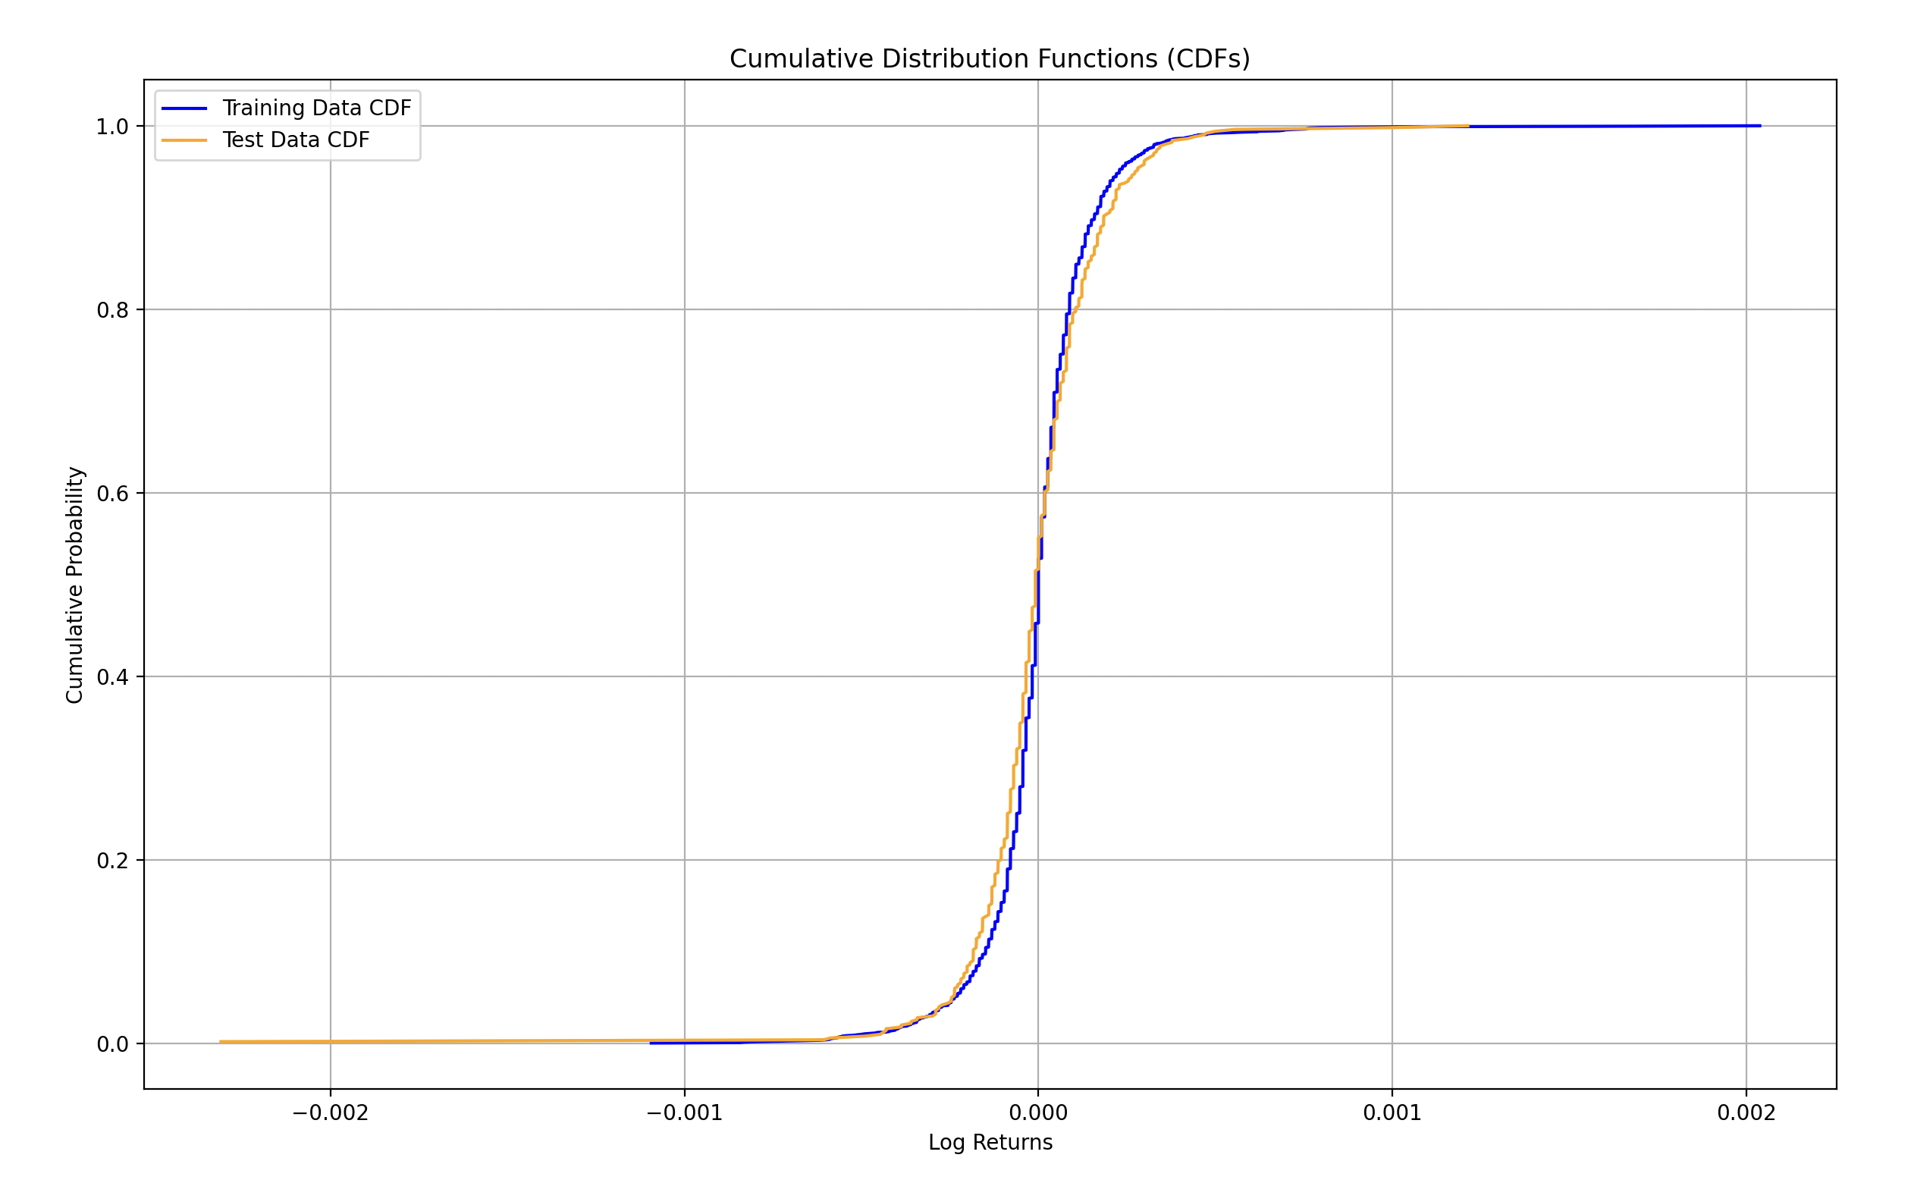
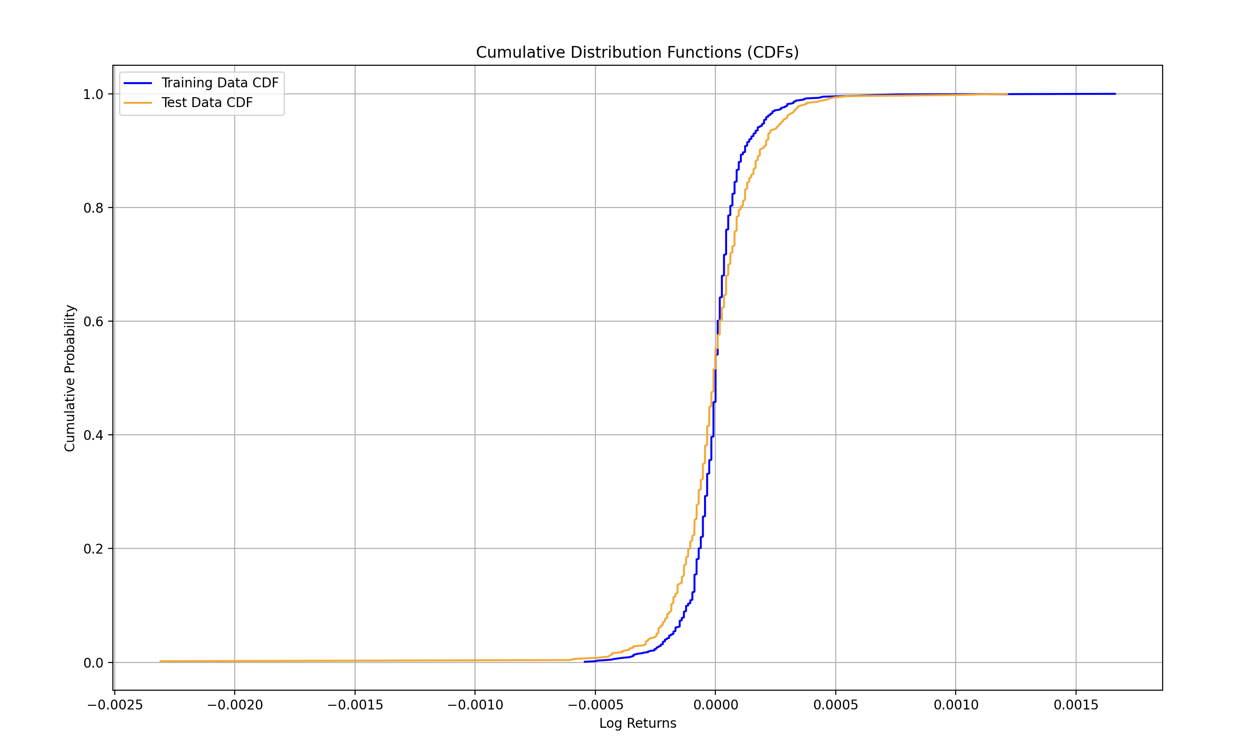
Visualizing Results
CDFs of the training and test log returns are plotted to visually compare distributions.
Without data drift P value is higher than threshold
With data drift P value is lower than threshold

Slide 9
Conclusion
A low p-value (<= 0.005) indicates data drift.
Visualizing the CDFs helps understand how the distributions differ.
Regular drift detection ensures model reliability.

