Slide 1

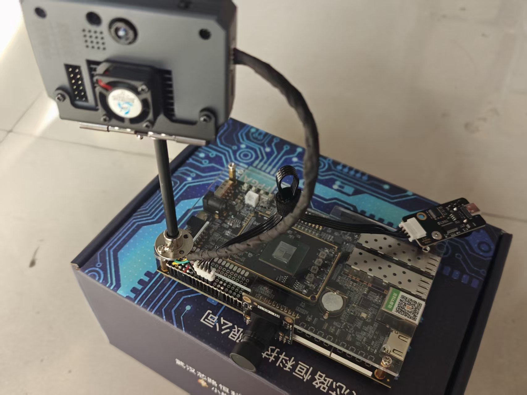

项目简介
马东超、柳俊贤、张博城
智察考场
天津仁爱学院
AC自动机 编号40843
FPGA＋K230＋语音助手协同监考
PC复核交互层
Agent、JoyCode与网页登录
串口事件 / 网口图像
Artix-7 XC7A200T / Vivado 2018.3
面向单考位纸笔考试，系统将疑似手机、紫书、扭头和摄像遮挡提示，与前后画面关联，帮助老师快速查证。
FPGA实时主控与证据保存
状态控制、HDMI、语音、DDR
系
指标 | 用量 / 余量 | 占比
LUT | 41440 | 30.97%
寄存器 | 44643 | 16.68%
BRAM | 70.5 | 19.32%
DSP | 3 | 0.41%
建立余量 | +0.374 ns | —
保持余量 | +0.027 ns | —
统
验
创
证
身份核验
›
确认开考
›
考试监测
›
证据复核
UART 115200
DVP RGB565
新
结
K230摄像头
人脸与行为识别
OV5640摄像头
显示与历史画面
核
果
心
单考位纸笔考试场景
设
系统框图与核心设计
计
两路摄像头，各司其职
FPGA实时主控与证据链
独立完成考试状态、计时、显示和语音排队。
OV5640画面进入DDR历史缓存，关联报警前后各2秒画面。
事件通过串口、图像通过以太网送至PC，以同一事件标识核对回放。
实
功能与工程验证
K230负责人脸、手机、紫书与头部动作识别，通过UART向FPGA发送结果。
OV5640直接连接FPGA，提供720p显示画面和320×180历史图像。
时
证
测试项目 | 结果
RTL自检记录 | 163 / 163通过
PC本地回归 | 122 / 122通过
Flash整片读回 | 16 MiB一致
现场功能复测 | 身份、告警、回放通过
据
保
存
核心特色
实时控制由FPGA完成，连续或不同报警可排队播报。
98%有效画面近黑，连续30帧确认遮挡。
FPGA Flash与K230 SD支持上电自启动。
Agent与JoyCode复核
Agent用于日常问答，JoyCode用于专业复核。
支持Skills、Rule、Prompt和MCP配置。
两者共用证据工具，由老师查看原图复核。
建立余量：+0.134 提高到 +0.374 ns
当前建立 / 保持失败端点均为0
证据复核示例：41/41帧完整，工具列32帧，AI抽样3帧；老师结合原图复核。
Notes:
Template: D:/AMD_poster_template.pptx, original slide, original master, AMD marks, introduction header, vertical design/result bars, rounded description boxes and region placement retained. Construction grid/guides and yellow instructional labels removed. Unrelated example content replaced. School emblem cropped proportionally from https://www.tjrac.edu.cn/images/logo.png (official homepage https://www.tjrac.edu.cn/), white mark displayed on blue for contrast, no redraw. Prototype supplied by the team: data/showcase/prototype_overview.jpg. Metrics: build/reports/quality_current/utilization.rpt and timing.rpt. Baseline timing: build/reports/accepted_current/timing.rpt. RTL 163 distinct self-check records: sim/verification_summary.json. PC 122 local tests: sim/results/quality_pc/result.json. Flash 16 MiB readback: board/verification/quality_flash_readback.json. Field functional retest: board/verification/quality_field_acceptance.json. Resource and timing are implementation reports for the programmed build. Simulation, PC regression and user field feedback have separate scopes. 41/32/3 are different views of one recorded event, not an accuracy statistic. Bilingual pages intentionally use the same layout and images.

Slide 2
INTRODUCTION
Dongchao Ma, Junxian Liu, Bocheng Zhang
ExamGuard
Tianjin Ren'ai College
AC Automaton Team 40843
FPGA + K230 + Voice Assistant
PC REVIEW INTERFACE
Agent, JoyCode and web login
Serial events / Ethernet images
Artix-7 XC7A200T / Vivado 2018.3
For paper exams at a single desk, ExamGuard links suspected phones, purple books, head turns and camera occlusion to images for teacher review.
FPGA CONTROL AND EVIDENCE
Exam states, HDMI, voice and DDR
C
Metric | Used / slack | Usage
LUT | 41440 | 30.97%
Registers | 44643 | 16.68%
BRAM | 70.5 | 19.32%
DSP | 3 | 0.41%
Setup slack | +0.374 ns | —
Hold slack | +0.027 ns | —
R
R
E
E
Identity
›
Exam start
›
Monitoring
›
Review
UART 115200
DVP RGB565
A
S
K230 CAMERA
Identity and event cues
OV5640 CAMERA
Display and history
T
U
I
L
A complete paper-exam workflow
V
T
System architecture and FPGA design
E
Two cameras, separate roles
FPGA control and evidence
Controls exam states, timing, HDMI and voice queues.
DDR history links images from 2 s before and after an event.
Serial events and Ethernet images share an event reference for replay.
D
Functional and engineering tests
K230 detects identity and suspected objects or head turns, then sends cues to the FPGA over UART.
OV5640 feeds the FPGA directly for 720p display and 320×180 history images.
E
S
Test | Result
RTL self-check records | 163 / 163 pass
Local PC regression | 122 / 122 pass
Full Flash readback | 16 MiB match
On-board functional retest | Identity, alerts, replay pass
I
G
N
Key features
FPGA control queues repeated and different voice alerts.
Occlusion requires 98% near-black pixels for 30 frames.
FPGA Flash and K230 SD start at power-on.
Agent and JoyCode review
Agent handles daily queries. JoyCode uses custom Skills, Rule, Prompt and MCP. Both share evidence tools for teacher review.
Setup slack: +0.134 to +0.374 ns
Current setup / hold failing endpoints: 0 / 0
Example: 41/41 verified frames, 32 listed, 3 sampled by AI. Teachers review original images.
Notes:
Template: D:/AMD_poster_template.pptx, original slide, original master, AMD marks, introduction header, vertical design/result bars, rounded description boxes and region placement retained. Construction grid/guides and yellow instructional labels removed. Unrelated example content replaced. School emblem cropped proportionally from https://www.tjrac.edu.cn/images/logo.png (official homepage https://www.tjrac.edu.cn/), white mark displayed on blue for contrast, no redraw. Prototype supplied by the team: data/showcase/prototype_overview.jpg. Metrics: build/reports/quality_current/utilization.rpt and timing.rpt. Baseline timing: build/reports/accepted_current/timing.rpt. RTL 163 distinct self-check records: sim/verification_summary.json. PC 122 local tests: sim/results/quality_pc/result.json. Flash 16 MiB readback: board/verification/quality_flash_readback.json. Field functional retest: board/verification/quality_field_acceptance.json. Resource and timing are implementation reports for the programmed build. Simulation, PC regression and user field feedback have separate scopes. 41/32/3 are different views of one recorded event, not an accuracy statistic. Bilingual pages intentionally use the same layout and images.

