Slide 1
A MINI Project Report on
STUDENT
BUS PASS MANAGEMENT SYSTEM
Under the esteemed guidance
Mrs. U. Rajini,
Asst Professor,
Dept of MCA.
Submitted by :
Md.Hussain
(14501F0021)

Slide 2
CONTENTS
ABSTRACT
EXISTING SYSTEM
PROPOSED SYSTEM
MODULES
SOFTWARE REQUIREMENTS
HARDWARE REQUIREMENTS
SYSTEM DESIGN
OUTPUT SCREENS

Slide 3
ABSTRACT
This System is used to maintain the bus pass for students .
With this system we can reduce the multiple steps involved in creating students bus pass .
It reduces the time taken for creating a student bus pass.
It helps in reducing the chances of manipulating the data .
It reduce the need of students physical presence at bus pass counter.
The created bus pass ID of a student is based on the College ID.
If the student loses the bus pass, the new one is issued with out any delay.

Slide 4
EXISTING SYSTEM
In the Existing system multiple steps are involved in creating students bus pass ex: Verification, Id card generation and finally Ticket will be generated.
The generated Bus pass ID is Complex, which is not easy for a student to remember.
If the students lose the bus pass, a new pass is not easily issued. They need to reapply as fresher for student bus pass.

Slide 5
PROPOSED SYSTEM
In the Proposed System we can reduce the multiple steps in the process of creating a new Bus pass.
It helps in reducing the chances of manipulating the data .
The generated Bus pass ID is similar to student’s Roll Id which is easy remember ex:S16PVPMCA101.
If the students lose the bus pass, a new pass is issued easily based on Student bus pass ID.
We can find all expired bus pass tickets and also the students details.

Slide 6
MODULES
Students Verification .
Colleges Data Entry.
Bus Pass ID card And Ticket Generation.
Students Data Entry.
Bus Pass Data Entry.
Expired Tickets Details.

Slide 7
Modules Description
1.Students Verification : This module is used for Verifying the students details.
2. Colleges Data Entry : This module is used for maintaining the College details.
3.Bus Pass ID card And Ticket Generation: This is used for generating Bus Pass ID card and Ticket.

Slide 8
Cont….
4. Student Data Entry : This is helpful for maintaining the students details.
5. Bus Pass Data Entry: This is helpful for entering and maintaining the students bus pass data.
6.Expired Tickets Details : This is helpful for viewing the Expired Tickets.

Slide 9
Hardware Requirements
Processor : Intel PIV
RAM : 2GB RAM
Hard disk : 2GB or more

Slide 10
Software Requirements
Database : ORACLE10G.
Tools : Visual Studio.
Operating System : Windows 7.

Slide 11
SYSTEM DESIGN
UML DIAGRAMS
DATABASES

Slide 12
UML DIAGRAMS
Class Diagram
Use Case Diagram
Sequence Diagram
Collaboration Diagram
Activity Diagram
State Chart Diagram
Component Diagram
Deployment Diagram

Slide 13
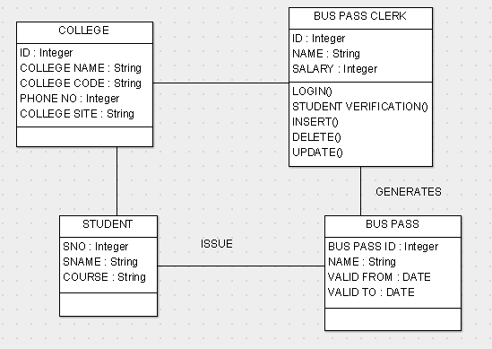
1. Class Diagram

Slide 14
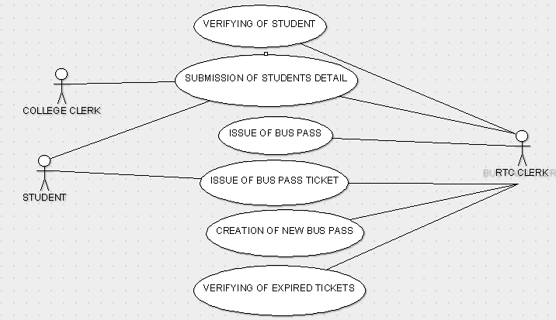
2.Use Case Diagram

Slide 15
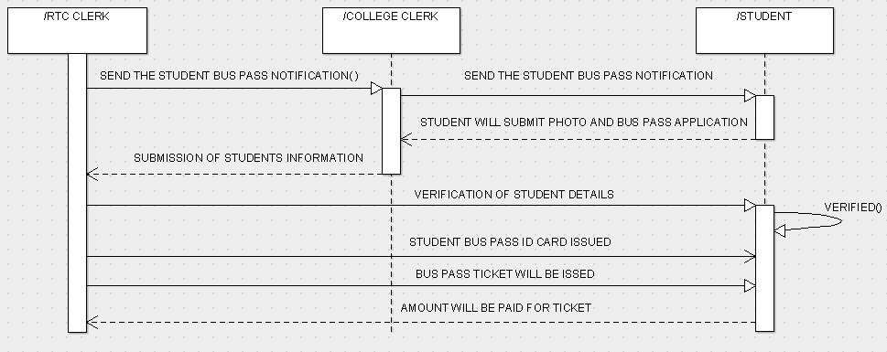
3.Sequence diagram

Slide 16
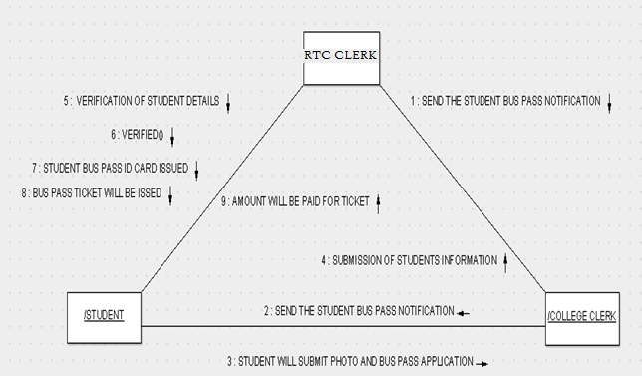
4.Collaboration Diagram

Slide 17
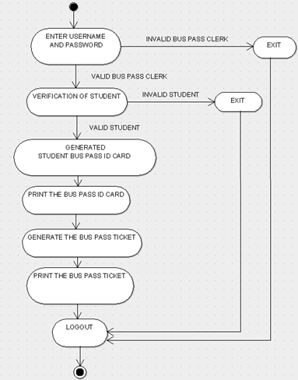
5.Activity diagrams

Slide 18
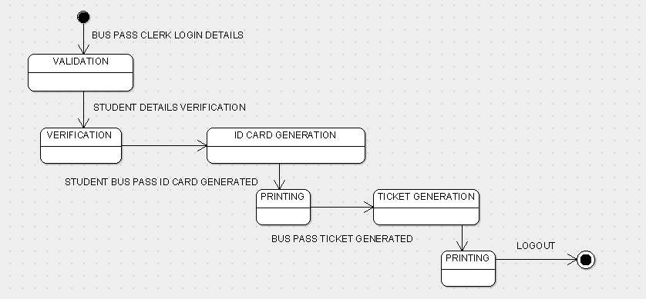
6.State Chart Diagram

Slide 19
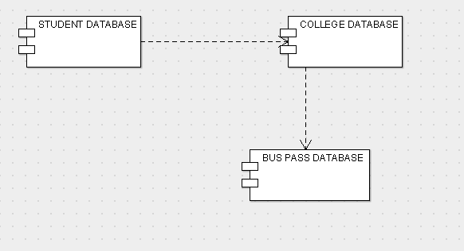
7.Component Diagram

Slide 20
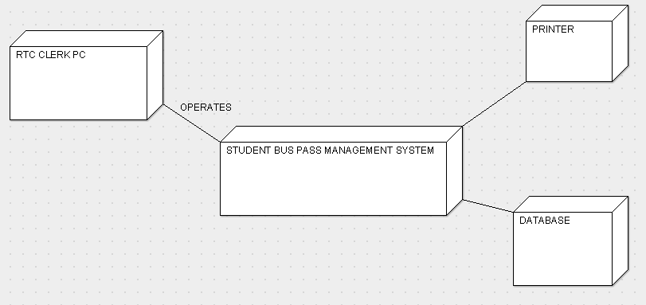
8.Deployment Diagram

Slide 21
DATABASES
1.College Table.
2.Student Table.
3.Buspass Table.

Slide 22
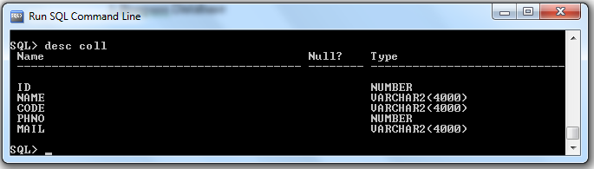
1.College Table

Slide 23
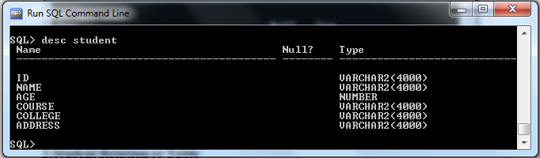
2.Student Table

Slide 24
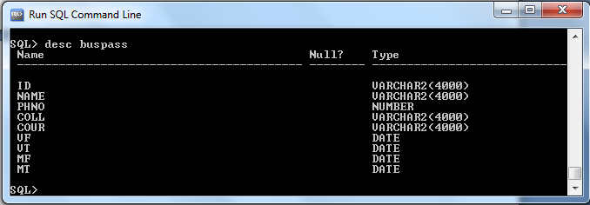
3.Buspass Table

Slide 25
OUTPUT SCREENS

Slide 26
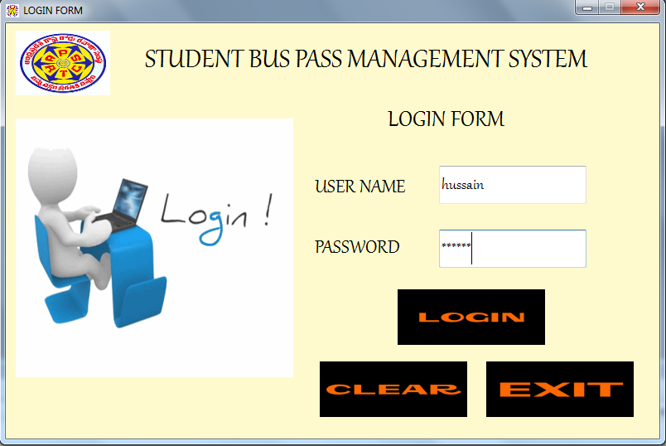
1.Login Form

Slide 27
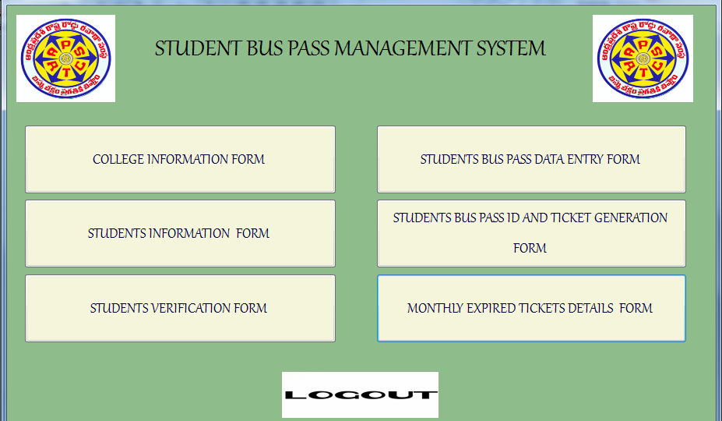
2.Main Form.

Slide 28
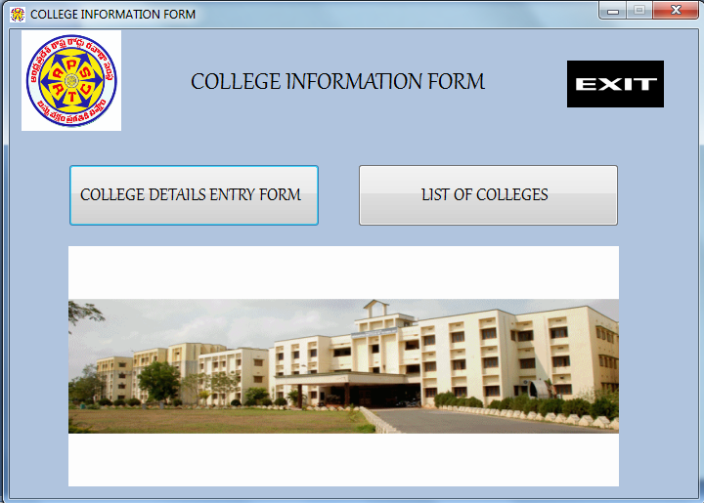
3.Colleges Details Form

Slide 29
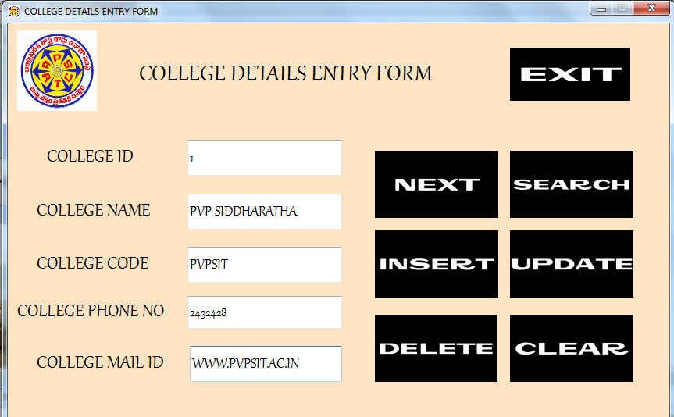
College Details Entry Form

Slide 30
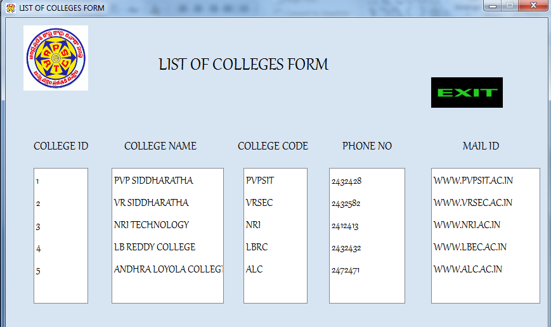
List of Colleges form

Slide 31
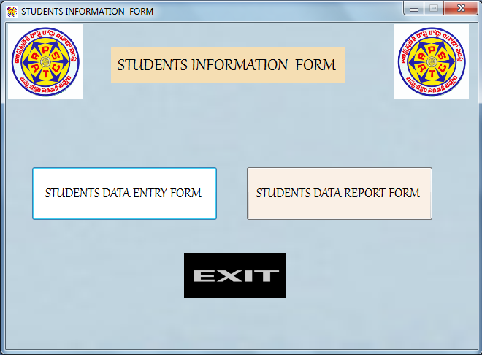
4.Students Information Form.

Slide 32
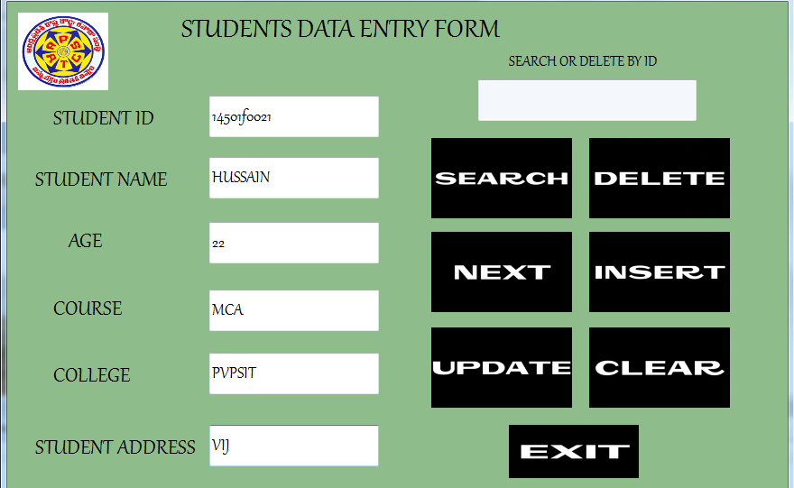
Students Data Entry Form

Slide 33
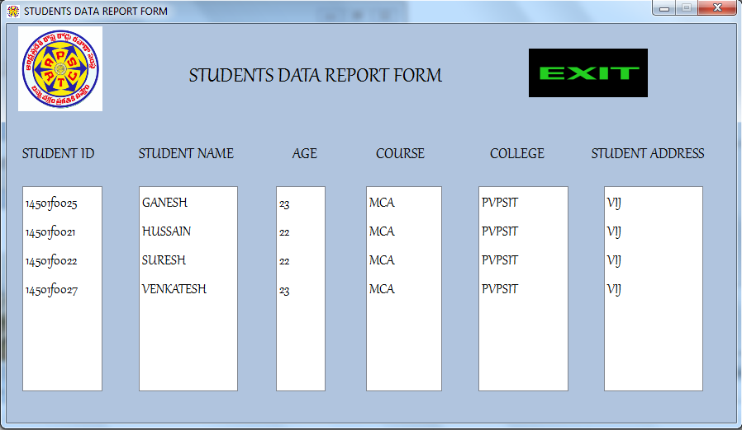
Students Data Report Form

Slide 34
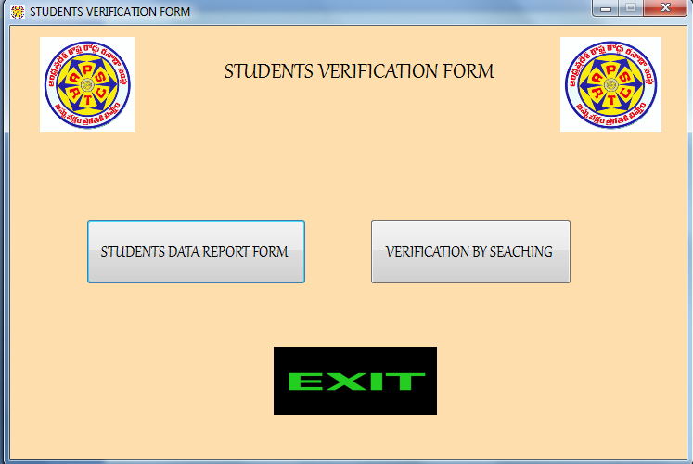
5.Students Verification Form

Slide 35
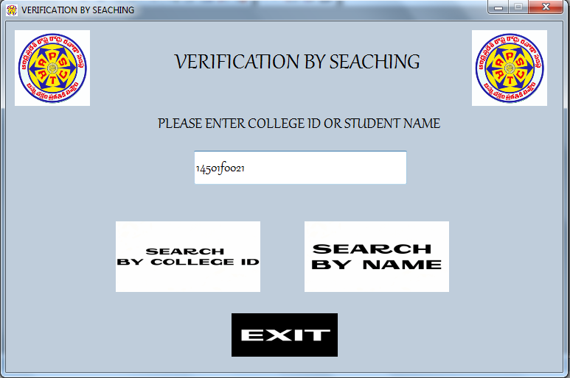
Verification By Searching

Slide 36
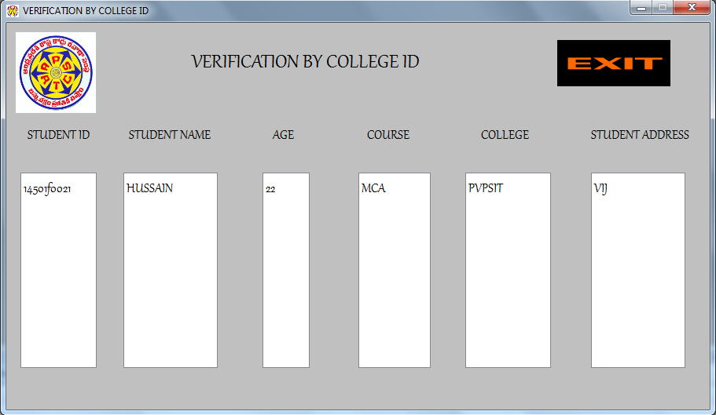
Verified By College Id

Slide 37
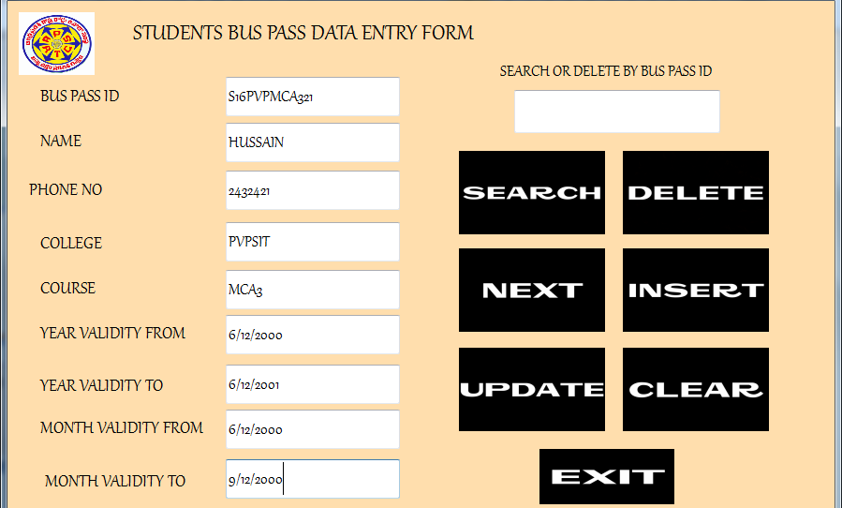
6.Bus Pass Data Entry Form

Slide 38
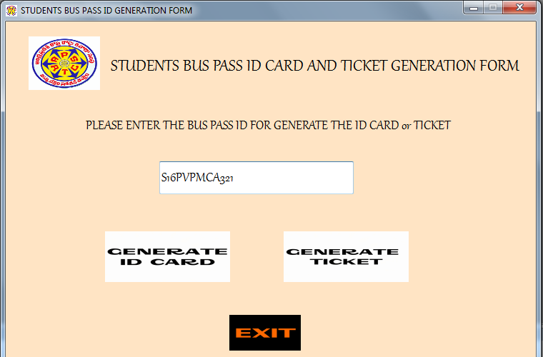
7.Bus Pass ID card Generation Form

Slide 39
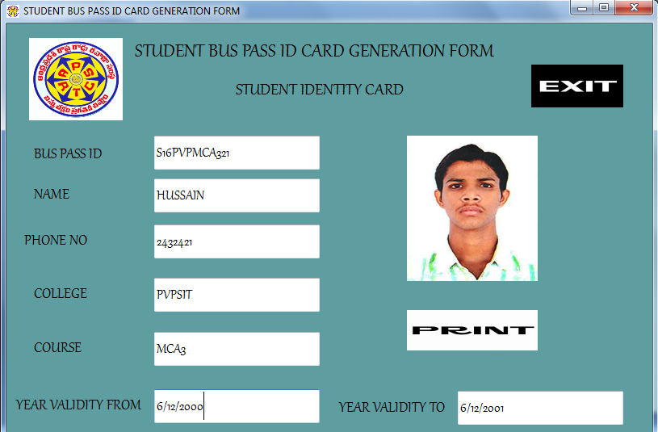
Student Bus Pass Id Card

Slide 40
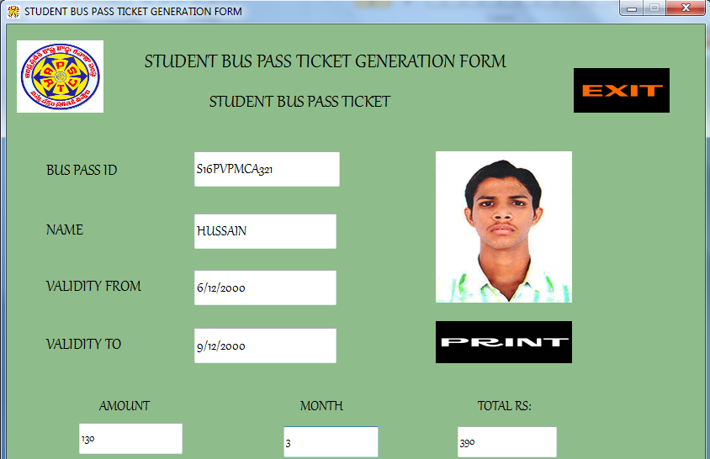
Ticket Generation Form

Slide 41
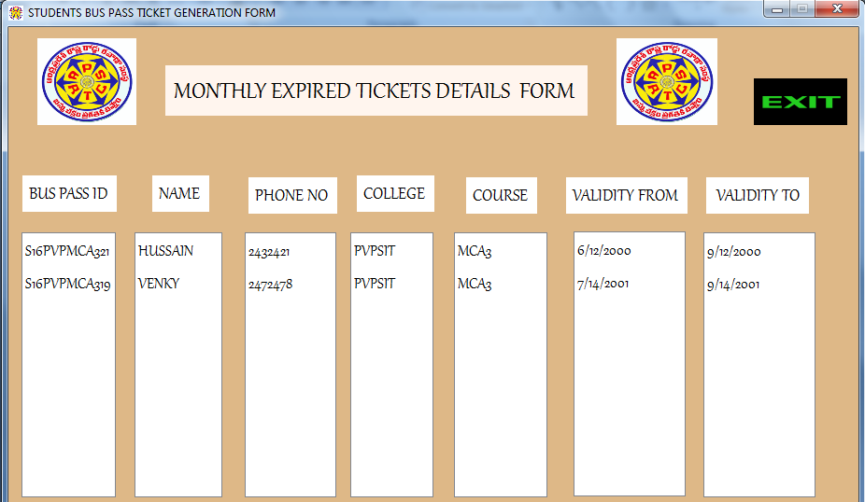
8.Expired Tickets Details Form

Slide 42
THANK YOU

