Slide 1



Revisiting COVID-19
Chest X-ray Severity Prediction
Reproducibility, critical assessment and model extensions
DSA5206 Group Project
31 October 2026
Notes:
本次汇报对应 Cohen 等人 2020 年的胸片严重程度研究。内容连接 Part I 的复现与 Part II 的评估及扩展。主讲页为 1–27，28–39 为完整配置、参数和来源附录。图表数据来自已运行的实验，不是示意结果。
Sources
https://doi.org/10.7759/cureus.9448
https://github.com/ModaYoung/DSA5206

Slide 2
Study
Assessment
Experiments
Discussion
Three questions guide the assessment
01
02
03
Can we reproduce it?
The strongest original configurations give similar errors in our rerun.
How far do the claims go?
The study predicts expert imaging scores. Clinical benefit needs other evidence.
Can another model help?
BioViL-based features lower internal error. The best configuration still depends on the split.
Study design, assessment and comparison use the same scored cohort.
2
Notes:
老师要求先运行作者方法，再用课堂清单判断证据是否充分，最后比较替代方法。这里的三问对应本次汇报的逻辑。两个最低误差是探索性排行榜结果，后面会同时呈现训练内选模的误差。
Sources
https://doi.org/10.7759/cureus.9448
https://github.com/ModaYoung/DSA5206

Slide 3
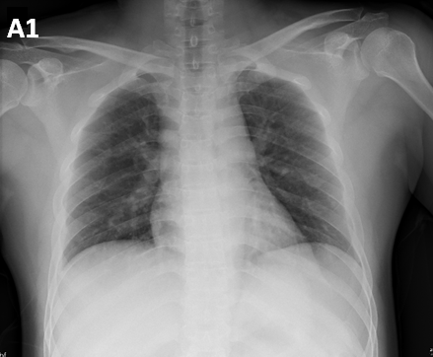
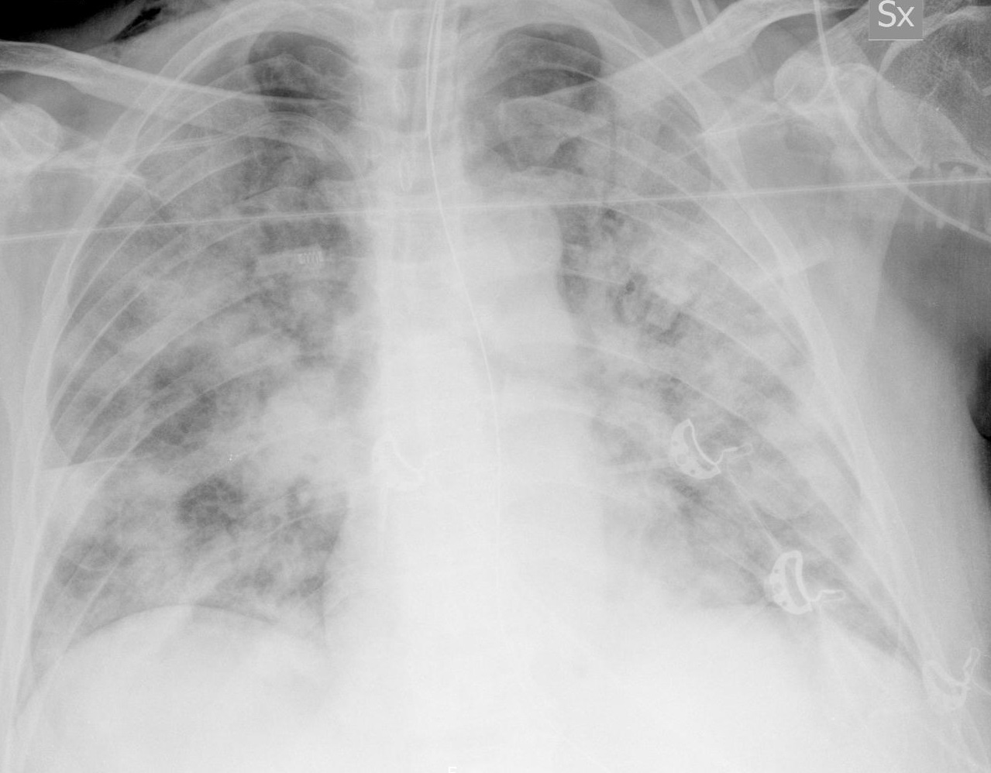
Study
Assessment
Experiments
Discussion
The target is an expert radiographic score
94 images
65 patients
Extent 0–8
Opacity 0–6
Mean scores from
three expert raters
Low extent
High extent
Extent 0.0 Opacity 0.0
Extent 8.0 Opacity 5.0
Example images illustrate the scoring task. They do not establish diagnostic performance.
3
Notes:
左侧两个真实影像来自本次固定队列，均有完整评分，且在后来保存的元数据中仍标注为 PA。病变范围和浑浊程度是两个连续影像评分。它们不能直接解释为 COVID 诊断、死亡风险或治疗获益。每例的评分是三位专家的均值。
Examples:
1-s2.0-S1684118220300682-main.pdf-002-a1.png
6C94A287-C059-46A0-8600-AFB95F4727B7.jpeg
Sources
https://doi.org/10.7759/cureus.9448
https://github.com/ieee8023/covid-chestxray-dataset/tree/196143d3dd32a2a43ad51d6891d460aaf690d741
https://github.com/mlmed/covid-severity/blob/master/covid-severity-scores.csv

Slide 4
Study
Assessment
Experiments
Discussion
The original method learns a small regression head
Frozen DenseNet121
Extract features
Linear regression
Predict two scores
01
02
03
04
Chest radiograph
Normalize and crop
1, 4, 18 or 1024
features
The severity labels train the regression head. The image encoder stays frozen.
4
Notes:
原论文使用预训练 DenseNet，并不在 94 张评分影像上重新训练整个网络。高维池化特征有 1024 维，疾病输出有 18 维，进一步选 4 个或只选 Lung Opacity 一个输出。1+1 参数指最后的一元回归及截距，不是整套深度网络的参数量。输出使用 sigmoid 之前的 logits。
Sources
https://doi.org/10.7759/cureus.9448
https://github.com/mlmed/covid-severity
https://github.com/mlmed/torchxrayvision

Slide 5
Study
Assessment
Experiments
Discussion
Metadata versions change the apparent cohort
Version or join | Scored matches | View labels
Fixed 30 March 2020 snapshot | 94 images, 65 patients | 94 labelled PA
Later public metadata | 93 scored matches | 82 PA, 8 AP, 3 AP Supine
Original score file | 94 labelled images | Scores joined by filename
What changed
Why retain the snapshot
One scored filename has no later metadata row. Eleven view labels changed.
It reconstructs the historical analysis. It does not prove that old metadata are more accurate.
Historical reconstruction and evaluation with revised view labels answer different questions.
5
Notes:
图像和元数据来自 ieee8023/covid-chestxray-dataset 的固定提交 196143d3dd32a2a43ad51d6891d460aaf690d741。标签来自作者 covid-severity-scores.csv。后来元数据中 ciaa199.pdf-001-c.png 无匹配行，有 11 条 PA 标注变为 AP/AP Supine。用最新版再筛 PA 会得到不同队列。组员本地 metadata_2020.csv 未发布在仓库，因此无法确认其每一行的顺序和患者映射都与本次相同。
Sources
https://github.com/ieee8023/covid-chestxray-dataset/tree/196143d3dd32a2a43ad51d6891d460aaf690d741
https://github.com/mlmed/covid-severity/blob/master/covid-severity-scores.csv
https://github.com/apothecary11/DSA5206-GROUP-PROJECT/tree/f2127e6b8f0ae84eef618a308adb657be0cb65c0

Slide 6
Study
Assessment
Experiments
Discussion
Clinical fields remain incomplete
The regression inputs are complete
All 94 images, patient identifiers and both targets are present.
Age, sex and clinical outcomes stay missing and are not model inputs.
Counts refer to image records. Missing clinical fields constrain outcome and longitudinal analyses.
6
Notes:
缺失数量按 94 条影像记录统计，不等于缺失患者数。年龄缺 25，性别缺 17，生存状态缺 62，时间偏移缺 16。影像、患者编号和两项评分均完整，因此可以做按患者划分的影像回归。没有把未知生存状态当成存活，也没有填造临床数值。208 张扩展可视化影像中仅 94 张有专家评分，另外 114 张未评分不是丢图。
Sources
https://github.com/ModaYoung/DSA5206
https://github.com/ieee8023/covid-chestxray-dataset/tree/196143d3dd32a2a43ad51d6891d460aaf690d741
https://github.com/mlmed/covid-severity/blob/master/covid-severity-scores.csv

Slide 7
Study
Assessment
Experiments
Discussion
The strongest original configurations reproduce closely
Target and configuration | Paper MAE | Our original-method rerun | Group notebook
Extent, OLS on 1 output | 1.14 | 1.165 ± 0.104 | 1.161 ± 0.102
Opacity, OLS on 4 outputs | 0.76 | 0.766 ± 0.072 | 0.761 ± 0.071
Opacity, OLS on 18 outputs | 0.86 | 0.917 ± 0.123 | 0.897 ± 0.122
Extent, intercept-only mean | 2.00 | 2.072 ± 0.167 | 2.072 ± 0.167
Agreement is strongest for the low-dimensional references.
Matching 94 images is necessary. Row order, grouping, feature extraction and the software environment also matter.
New alternative models are compared with these rerun baselines on identical patient splits.
7
Notes:
三列分别是原论文数值、本次原方法重跑，以及组员 notebook 已保存的输出，不能混成一组实验。OLS 1 的 extent 和 OLS 4 的 opacity 与论文接近。18 维 opacity 与基线仍存在差异。公共队列、权重、预处理、logit 定义、数据顺序和患者划分都可能贡献差异，目前没有逐项排除所有来源。Group notebook reviewed commit f2127e6b8f0ae84eef618a308adb657be0cb65c0。
Sources
https://doi.org/10.7759/cureus.9448
https://github.com/apothecary11/DSA5206-GROUP-PROJECT/tree/f2127e6b8f0ae84eef618a308adb657be0cb65c0
https://github.com/ModaYoung/DSA5206

Slide 8
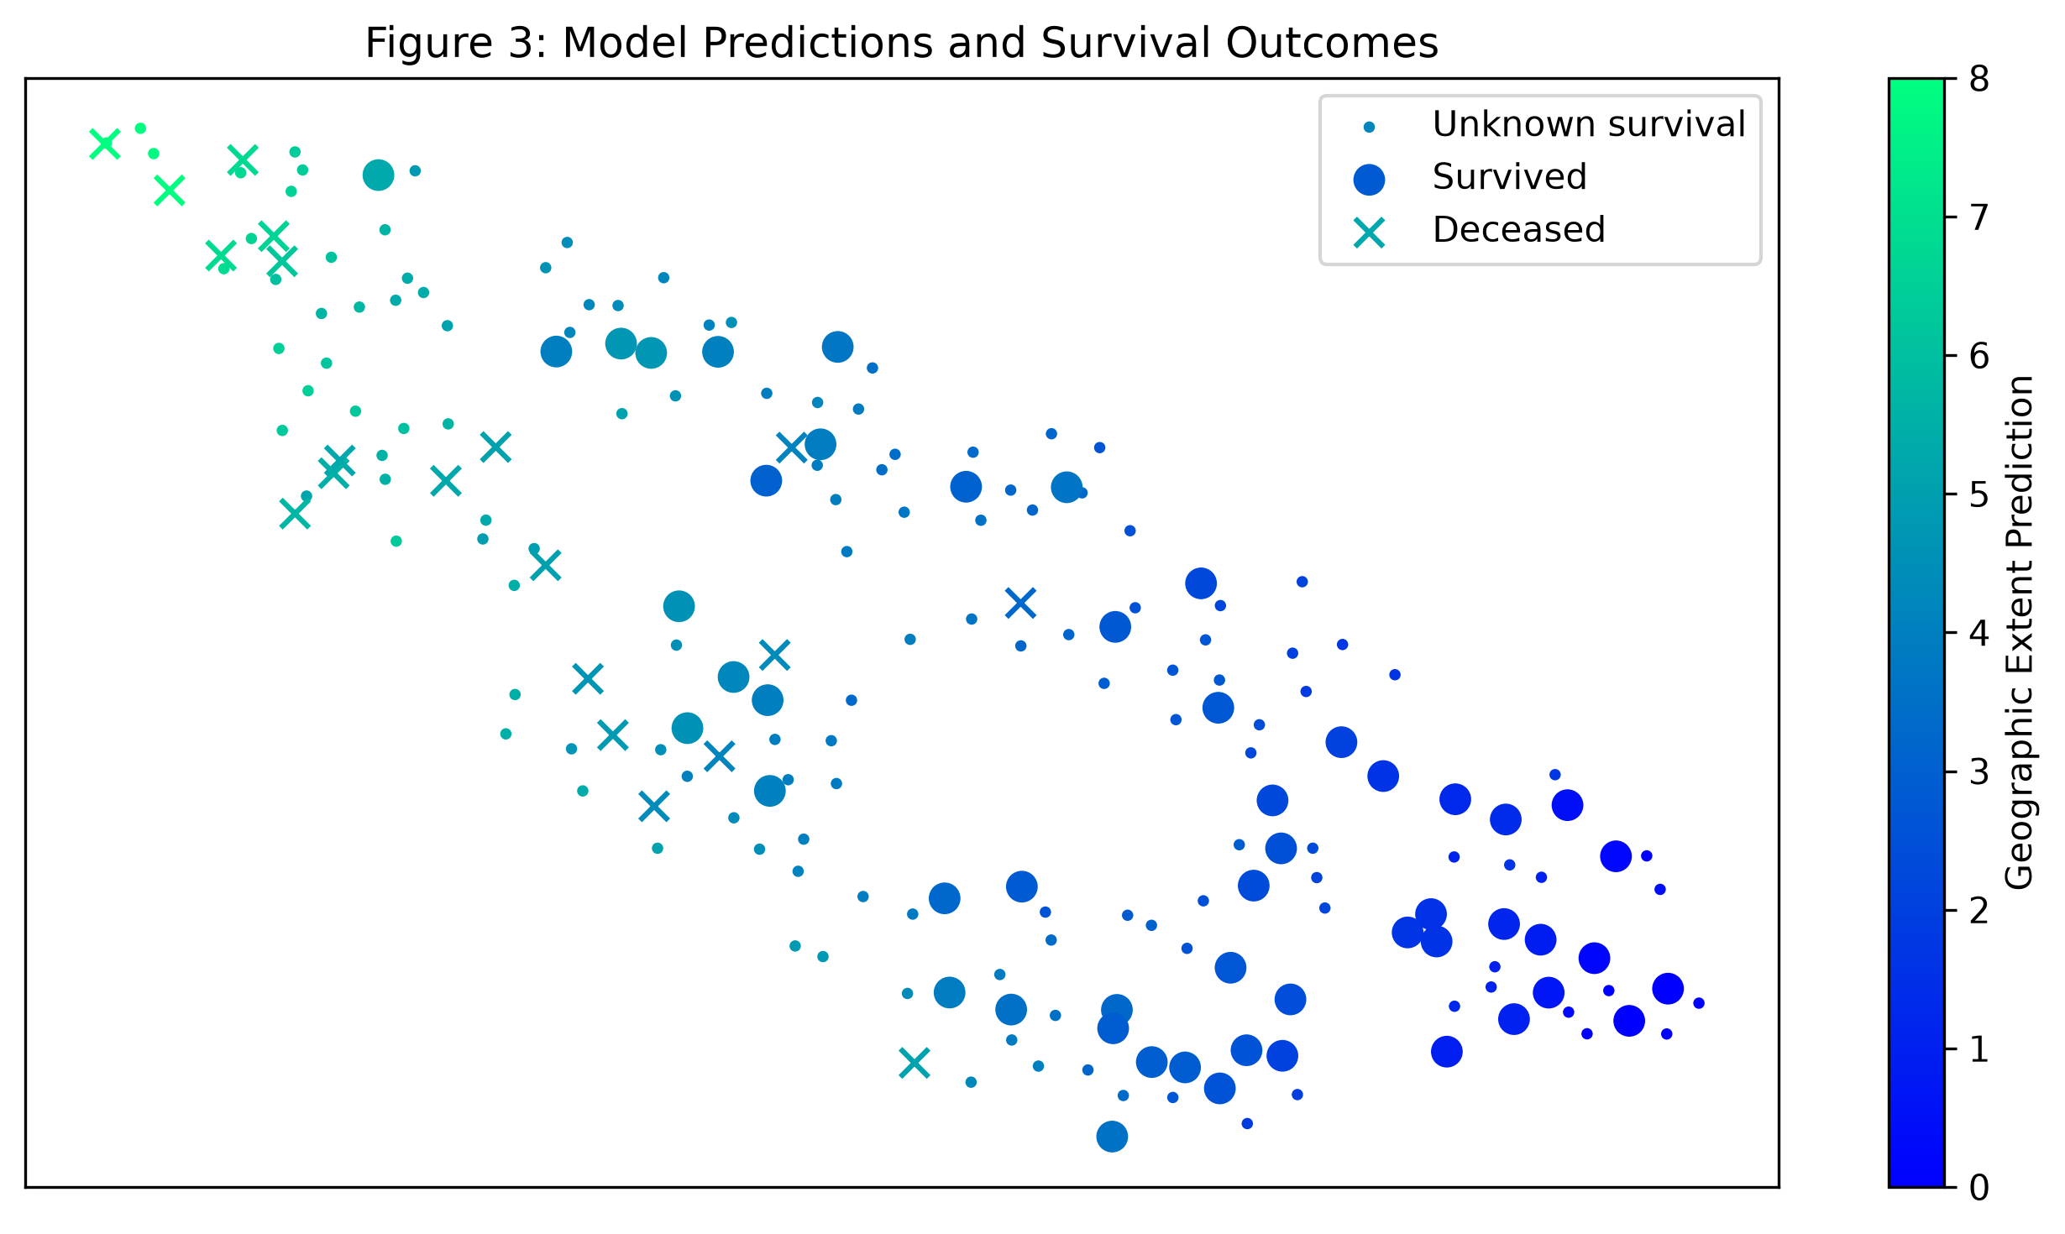
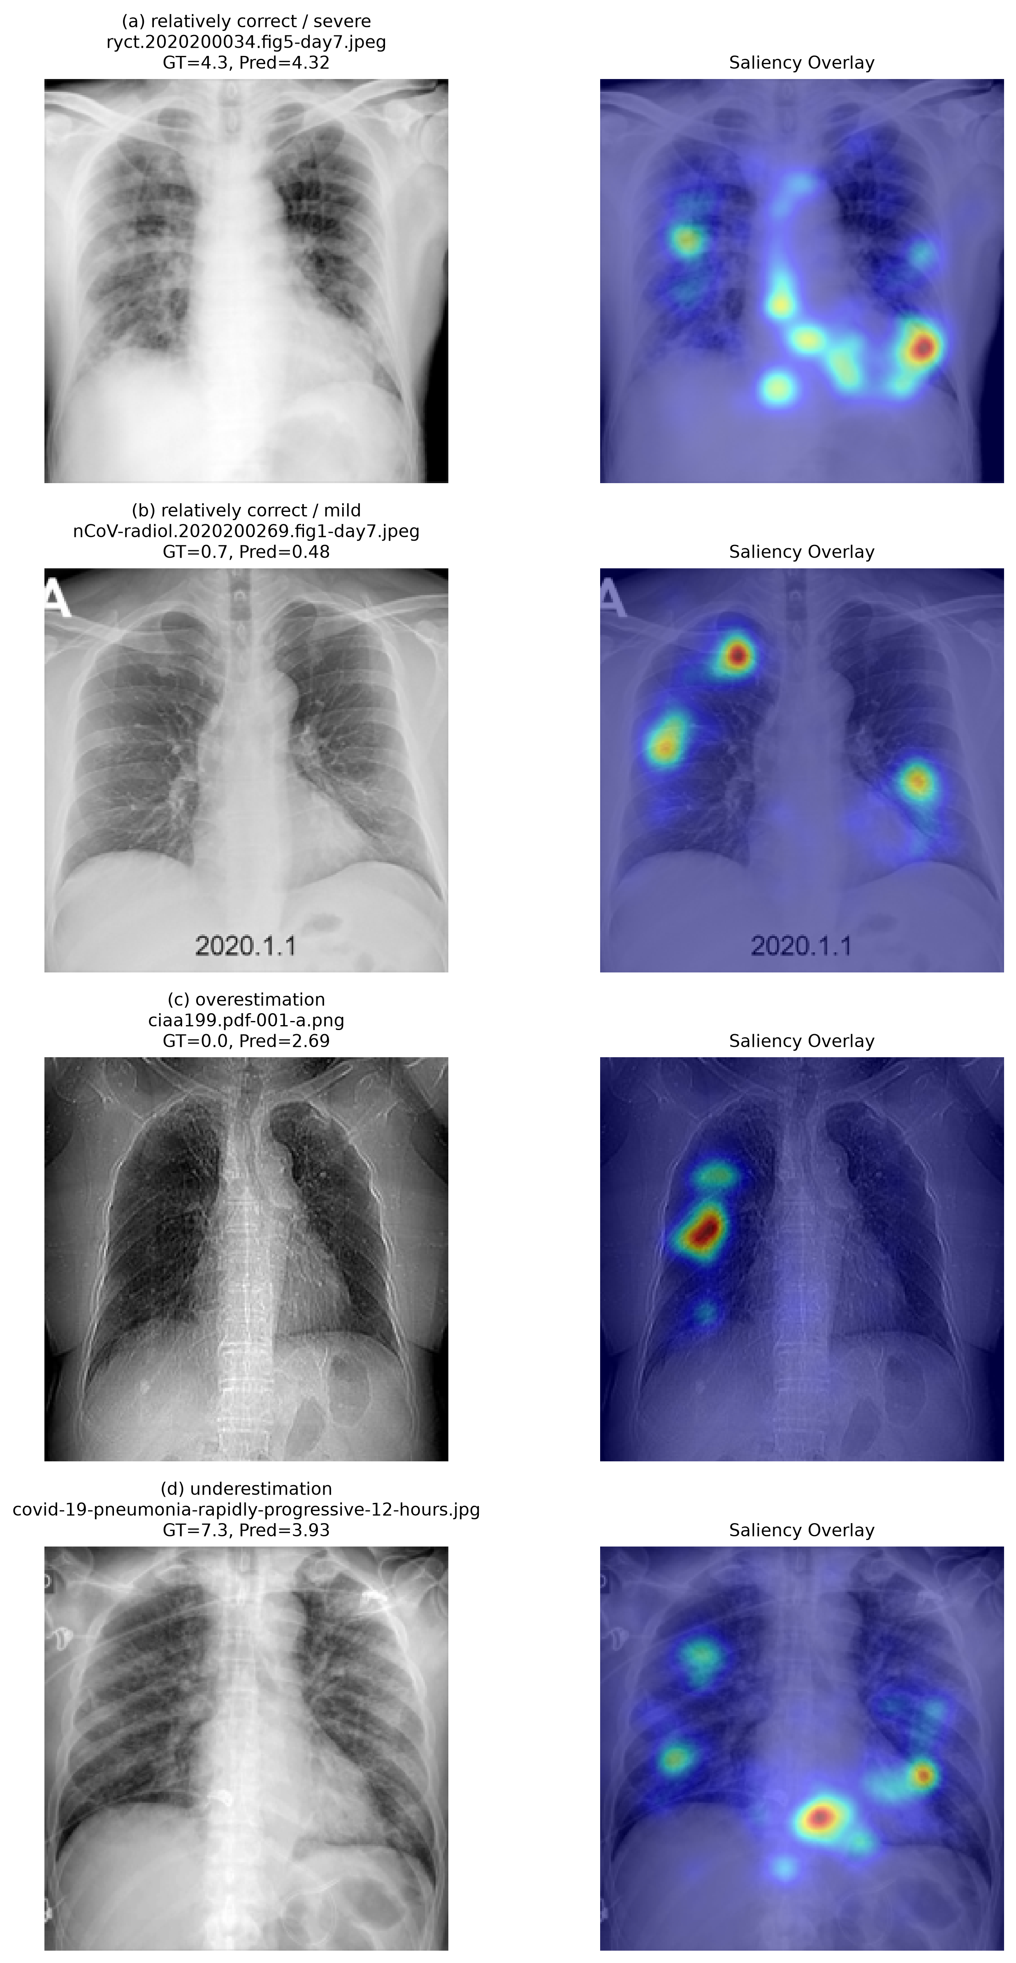
Study
Assessment
Experiments
Discussion
Visual fidelity varies more than average error
t-SNE
Gradient saliency
The paper states 208 images. The author notebook stores a 199-image run.
Cases, cropping, weights and smoothing affect the heatmap. Visual plausibility needs validation.
Graphics reproduced by the group. They illustrate limits of exact visual replication.
8
Notes:
这里引用组员原有 Figure 3 和 Figure 4 复现图，以讨论 Part I 的还原程度，不是新增模型实验的图。论文写 208 张用于可视化，作者公开 notebook 的已保存输出为 199 张。t-SNE 布局对样本和参数敏感，旋转或镜像本身不代表模型失效。梯度图还受个例、裁剪、归一化和平滑影响。原文所述 5×5 核与代码 Gaussian sigma=5 也不是同一规格。我们只能把这些图称为近似可视化复现，不能用其外观证明临床有效性。
Sources
https://doi.org/10.7759/cureus.9448
https://github.com/apothecary11/DSA5206-GROUP-PROJECT/tree/f2127e6b8f0ae84eef618a308adb657be0cb65c0
https://github.com/mlmed/covid-severity

Slide 9
Study
Assessment
Experiments
Discussion
Data collection has oversight and sampling limits
1 Ethical approval
CERSES-20-058-D and consent handling are reported.
Source-level reuse still needs traceable attribution.
2 Data collection
The public collection is a convenience sample.
International sources do not establish representativeness.
3 Data quality
Three experts provide labels, with reader disagreement.
Clinical fields remain incomplete.
Classroom checklist from Lecture 9. These judgments assess the original 2020 study.
9
Notes:
1. Is the data collection approved?
论文报告伦理批准 CERSES-20-058-D，以及知情同意已取得或获豁免。应评价为伦理信息已报告，不能因为没有看到试验注册号就断言研究未获伦理批准。
Evidence: The Human Subjects statement reports approval CERSES-20-058-D and states that consent was obtained or waived. Images were collected from existing public sources and de-identified before analysis. [1, pp. 2 and 7]
Assessment: This supports ethical oversight of the retrospective study. Public availability alone would not establish permission for every secondary use. No prospective study registration is reported; that reporting gap should not be treated as evidence that the study lacked ethics approval.
Improvement: Retain the approval identifier, data attribution and applicable source terms. A future prospective clinical evaluation would require an appropriate protocol and approvals.
2. Is the data collected properly?
94 张影像来自公开病例集合，来源国际化，但属于便利样本。多来源不等于有代表性的多中心验证，也不能保证能够推广到日常连续就诊患者。
Evidence: The study uses 94 PA chest radiographs from a public collection, sourced internationally from December 2019 to March 2020. Patients were reported COVID-19 positive, mostly by RT-PCR. [1, p. 2, Section 2.1]
Assessment: The collection is a small convenience sample assembled partly from publications and image-sharing platforms, rather than a defined consecutive clinical cohort. International sources provide diversity but do not establish representative sampling or independent external validation. Exclusion rules and the patient flow are insufficiently detailed.
Improvement: Publish a case flow, patient-level denominators, acquisition settings and inclusion criteria. Validate on consecutive cases from hospitals not involved in model development.
3. Is the data of good quality?
专家评分可靠性是优点，但 opacity 的评分一致性较低。我们的历史快照中评分完整，年龄缺失 25 条、性别缺失 17 条，因此不能把无缺失泛化到全部临床资料。这些缺失变量未用于本次模型。
Evidence: Three blinded experts, including two experienced chest radiologists, scored geographic extent and opacity. Fleiss' kappa was 0.71 for extent and 0.45 for opacity. The paper states that there was no missing data. [1, p. 2, Sections 2.1 and 2.2]
Assessment: Expert review provides a defensible reference for radiographic severity, although opacity labels show appreciable reader disagreement. A mean expert score is not a clinical outcome. In our fixed public snapshot all 94 targets are present, but age is missing for 25 image records and sex for 17; the paper's missingness statement should therefore not be generalized to all clinical metadata.
Improvement: Report missingness separately for targets and covariates, distinguish images from patients, inspect duplicates and image artifacts, and account for reader variability when interpreting model error.
Sources
https://doi.org/10.7759/cureus.9448
DSA5206 Lecture 9, p. 11 and pp. 14–21

Slide 10
Study
Assessment
Experiments
Discussion
The design suits few labels but leaves comparison gaps
4 Preprocessing
Cropping, normalization and 224-pixel input are specified.
Their sensitivity to acquisition differences is untested.
5 Model choice
Frozen transfer learning limits new parameters.
The paper compares few alternative regressors.
6 Data splitting
All scans from a patient stay in one partition.
Repeated internal splits do not test a new hospital.
Classroom checklist from Lecture 9. These judgments assess the original 2020 study.
10
Notes:
4. How is data preprocessed?
中心裁剪、224×224 缩放和像素归一化描述清楚。潜在问题是外周肺野被裁掉或细节损失。新增标准化或 PCA 时，应仅在训练折拟合；本实验已遵守这一点。
Evidence: Images are center-cropped where needed, resized to 224 by 224 pixels and scaled to approximately -1024 to 1024. The pretrained network is frozen before generating features for the regression models. [1, pp. 2-3, Sections 2.4 and 2.5]
Assessment: This gives a reproducible basic pipeline. However, center-cropping can remove peripheral anatomy, and resizing can obscure small findings. The study does not establish robustness to these choices, acquisition artifacts or differences in radiographic views. Frozen feature extraction does not itself require fitting on the COVID-19 test labels.
Improvement: Record implementation versions and test clinically plausible preprocessing changes. Any fitted scaler, PCA or feature selector introduced in an extension must be fitted within training folds only.
5. What ML models are used?
方法是冻结 DenseNet 加线性回归，并非用 94 张图重新训练大型网络。1+1 只表示新拟合回归头的参数。高维普通回归较差，不足以证明高维特征本身没有价值。
Evidence: DenseNet was pretrained on 88,079 non-COVID-19 images from seven datasets. Frozen representations of 1024, 18, 4 or 1 dimensions feed ordinary linear regression, alongside an intercept-only baseline. The task outputs are pre-sigmoid logits. [1, pp. 2-4 and Figure 1]
Assessment: Learning only a small regression head is appropriate for scarce labels. The reported 1+1 parameter count describes the new regression head, not the whole pretrained network. Comparing unregularized high-dimensional regression with a single feature does not establish that high-dimensional representations contain less useful information.
Improvement: Compare regularized regressors on the same frozen features and patient splits. We test Ridge regression and RBF support vector regression, with training-only hyperparameter selection.
6. How is the data split?
同一患者全部影像留在同一侧，能够避免最直接的患者泄漏。50 次测试集会重叠，不能当作 50 个独立样本。本实验保存划分，并在每个训练集内用五折患者分组验证选参。
Evidence: The 94 images are repeatedly divided approximately 50/50, keeping all timepoints of the same patient together. Table 1 summarizes 50 random train/test splits. [1, pp. 3-4, Section 2.5 and Table 1]
Assessment: Patient grouping addresses direct leakage between repeated scans. The image counts need not be exactly balanced because the allocation is by patients. Repeated test sets overlap, so their results are dependent. Ranking feature configurations on the same repeated test sets also leaves uncertainty about model-selection optimism.
Improvement: Save patient split manifests, reserve test predictions for evaluation and tune alternatives using nested grouped validation. For deployment claims, add hospital-level or temporal external testing.
Sources
https://doi.org/10.7759/cureus.9448
DSA5206 Lecture 9, p. 11 and pp. 14–21

Slide 11
Study
Assessment
Experiments
Discussion
Reported metrics need error and explanation checks
7 Metrics
MAE is interpretable in score units.
Correlation and split SD do not establish calibration or certainty.
8 Explanations
Saliency and t-SNE support exploratory inspection.
Neither validates causal reliance on lung pathology.
9 Reproducibility and generalization
Public resources enable a broad rerun.
Data versions and an external cohort remain unresolved.
Classroom checklist from Lecture 9. These judgments assess the original 2020 study.
11
Notes:
7. Are the metrics appropriate?
MAE、MSE、R² 和相关系数适合回归任务；相关系数 0.8 不能写成准确率 80%。50 次划分的标准差不是置信区间，还需检查高评分低估和预测校准。
Evidence: Table 1 reports MAE, MSE, R-squared and Pearson correlation as means and standard deviations over 50 splits. Figure 2 compares predictions with expert scores and shows systematic overestimation at low scores and underestimation at high scores. [1, p. 4]
Assessment: MAE is interpretable in score units and MSE emphasizes extreme errors. Pearson correlation is not accuracy and can remain high despite miscalibration. Split standard deviations are not confidence intervals. The clinical significance of a one-point error is not established, and subgroup performance and prediction intervals are absent.
Improvement: Use held-out MAE as the primary endpoint, retain complementary metrics and inspect score-stratified signed errors. State the dependence of repeated splits and avoid claiming statistical superiority from a small mean difference alone.
8. Are the results explainable?
热图和 t-SNE 提供直观解释，但没有验证解释忠实性。热图好看不能证明模型利用了真正病灶；生存状态在 t-SNE 上聚集，也不能证明死亡风险预测有效。
Evidence: Figure 4 displays smoothed input-gradient saliency for selected correct and incorrect predictions; Figure 3 visualizes four-dimensional features with t-SNE and survival markers. The authors acknowledge limitations of saliency maps. [1, pp. 3, 5-6]
Assessment: These plots help inspect plausibility, but visually plausible heatmaps do not prove causal reliance on pathology. The t-SNE image is exploratory and does not validate outcome prediction. The public code uses squared gradients with Gaussian sigma 5, whereas the paper describes a 5 by 5 kernel; those are different specifications.
Improvement: Disclose case-selection and smoothing rules, test image-region occlusion and model randomization, and measure sensitivity to text or borders. Avoid interpreting t-SNE clusters as proof of mortality prediction.
9. Are the results reproducible and generalizable?
公开数据和代码是优点，但历史 metadata 与软件版本变化阻碍完全一致复刻。本次已固定数据提交、权重校验值和划分。内部数值接近不能替代独立医院或时间队列验证。
Evidence: The authors release data, severity labels, code and model resources. The group notebook reproduces the broad Table 1 ranking. The paper calls for new cohorts with the same scoring system. [1, pp. 1 and 6; 4-5]
Assessment: Open resources enable verification, but exact recreation is affected by changing metadata and software. The paper describes 208 visualization images while the supplied author notebook stores 199. The group repository does not include its custom metadata_2020.csv or a pinned environment. None of these facts establishes performance on a genuinely new hospital cohort.
Improvement: Our experiment fixes a public 2020 commit, records checksums, caches features and publishes split manifests and versions. External validation remains a required next step; close internal reproduction does not demonstrate it.
Sources
https://doi.org/10.7759/cureus.9448
DSA5206 Lecture 9, p. 11 and pp. 14–21

Slide 12
Study
Assessment
Experiments
Discussion
Clinical relevance exceeds the evidence for deployment
10 Clinical context
Serial imaging scores could support monitoring.
The study does not measure treatment benefit.
11 Limitations
Small samples, selection bias and label uncertainty remain.
Portable AP scans and clinical outcomes need separate testing.
12 Deployment
Routine use needs prospective workflow evaluation.
Multicenter validation and failure handling are still required.
Classroom checklist from Lecture 9. These judgments assess the original 2020 study.
12
Notes:
10. Is there an appropriate clinical context?
自动量化胸片病变有临床意义，但评分接近专家不等于改善治疗或降低死亡率。研究使用 PA 片，不能直接推及 ICU 常见的便携 AP 片。
Evidence: The paper proposes assisting serial monitoring and escalation or de-escalation of care, especially in intensive care. Its supervised targets are radiographic extent and opacity. The discussion acknowledges uncertainty about their relationship with functional and clinical outcomes. [1, pp. 1 and 6]
Assessment: Quantitative CXR scoring is a clinically understandable research task. However, agreement with radiologists' scores does not show improved management, reduced mortality or safe triage. Restriction to PA images also limits direct applicability to portable AP examinations in intensive care.
Improvement: Define intended users, acquisition settings and decision points. Evaluate the added value over expert scoring and clinical variables in prospective workflows before claiming clinical benefit.
11. What are its limitations?
主要限制包括小样本、便利抽样、标注不一致、外部验证缺失及个体不确定性未知。两个分数都来自同一个特征，也限制了它们独立变化的表达能力。新增模型实验只能解决部分方法学问题。
Evidence: The discussion identifies small sample size, sampling bias, difficulty obtaining labels, the need for new cohorts and uncertain linkage to clinical outcomes. Figure 2 illustrates errors at the extremes. [1, pp. 4 and 6]
Assessment: Additional concerns are limited patient numbers, reader disagreement, incomplete demographic reporting, lack of independent external testing, no formal uncertainty estimates for individual predictions and limited alternative regressors. For one-feature models both predicted scores are affine functions of the same scalar and cannot vary independently.
Improvement: Prioritize external validation, patient-level reporting and error analysis by score and acquisition setting. Our alternative-model comparison addresses only one limitation: the narrow regression comparison; it does not resolve the clinical evidence gaps.
12. Is the method ready for deployment?
结论应为有价值的回顾性概念验证，但尚未证明可临床部署。后续需要外部和前瞻性验证、人机协作评价、失败处理及持续监测，不能据现有结果直接自动决定治疗。
Evidence: The authors caution against premature implementation and state that diagnostic performance requires appropriate clinical evaluation. The study is a retrospective proof of concept without a prospective workflow or clinical impact trial. [1, p. 6, Discussion]
Assessment: The evidence supports a research tool for approximating expert radiographic scores. It does not establish safe autonomous decisions, stable performance across hospitals and devices, or effective human-AI use. Output values can fall outside the score range, and the implications of severe underestimation have not been resolved.
Improvement: Require independent multicenter and temporal validation, prospective human-AI evaluation, uncertainty and failure handling, monitoring for drift and a defined accountable clinical workflow before routine use.
Sources
https://doi.org/10.7759/cureus.9448
DSA5206 Lecture 9, p. 11 and pp. 14–21

Slide 13
Study
Assessment
Experiments
Discussion
The extension changes both the head and the representation
01
02
03
Regression heads
Ridge and SVR first test the original frozen DenseNet features.
Preprocessing
Score bounds, variance filtering and PCA test the unstable high-dimensional pipeline.
Image encoders
BioViL, BioViL-T and RAD-DINO test different pretrained representations.
27 new configurations extend the initial 9 configurations. Every result remains available.
13
Notes:
第一轮只在相同 DenseNet 特征后换 Ridge 与 SVR，不能判断医学影像表示近年的进展。第二轮同时加入高维稳定性处理和三个公开编码器。所有新配置都是完整流程的比较，不把分数截断或输入分辨率变化带来的收益全部归给模型架构。扩展设计参考了初始实验和已诊断的失败，所以属于探索性分析。
Sources
https://github.com/ModaYoung/DSA5206
https://doi.org/10.7759/cureus.9448

Slide 14
Study
Assessment
Experiments
Discussion
Four frozen encoders supply different features
DenseNet121
1, 4, 18, 1024 features
BioViL 2022
2048 pooled / 128 proj.
Frozen
features
BioViL-T 2023
512 pooled / 128 proj.
RAD-DINO 2024/25
768 CLS features
Feature extraction uses each checkpoint’s native preprocessing and no severity-label fine-tuning.
14
Notes:
使用公开权重，不重新训练编码器，也不声称重跑了这些基础模型的完整预训练论文。BioViL 使用 512 缩放、480 中心裁剪，BioViL-T 使用 512 缩放、448 裁剪且仅输入当前影像。RAD-DINO 使用公开模型卡配套的 518 像素处理器和 CLS token，公开 checkpoint 与原论文含私有数据的版本不同。各自原生预处理也不同，因此收益属于编码器、预处理和回归的完整流程。
Sources
https://arxiv.org/abs/2204.09817
https://arxiv.org/abs/2301.04558
https://doi.org/10.1038/s42256-024-00965-w
https://huggingface.co/microsoft/rad-dino

Slide 15
Study
Assessment
Experiments
Discussion
The 27 new configurations cover distinct modeling choices
Feature family | New configurations | Question tested
OLS references | 4 bounded OLS variants | How much comes from score bounds?
DenseNet logits | 6 robust, kernel and tree variants | Does a different regression form help?
DenseNet 1024 | 5 high-dimensional variants | Does preprocessing stabilize the fit?
BioViL | 4 pooled or projected variants | Do image-report features help?
BioViL-T | 4 pooled or projected variants | Does the released feature set transfer?
RAD-DINO | 4 high-dimensional variants | Do image-only features transfer?
All regressors and parameter grids appear in the appendix. No unsuccessful configuration is removed.
15
Notes:
新增配置数为 4+6+5+4+4+4=27。连同第一轮 9 组共有 36 组实际配置。不同的维度、缩放和回归头属于不同配置，不把它们称作 36 种独立模型架构。附录逐行列出每个配置的两项 MAE 和 R²，参数网格也完整保留。
Sources
https://github.com/ModaYoung/DSA5206

Slide 16
Study
Assessment
Experiments
Discussion
Both tuning and family selection stay inside training
Tune parameters
5 grouped training folds
Evaluate once
On outer test patients
01
02
03
04
Split patients
50 repeated half splits
Choose a family
Use inner validation MAE
Scaling, variance filtering and PCA are fitted within training folds.
All preprocessing fits within training. Repeated test sets overlap, so split SD is descriptive.
16
Notes:
外层重复 50 次按患者分组的半数训练、半数测试划分，所有方法共享同一划分。内层在每轮训练患者中做五折 GroupKFold，选择参数和模型家族。Training selected OLS 从 bounded OLS 1/4 中选，modern 从 12 个现代编码器配置中选，all 从 27 个新增配置中选。排行榜冠军是看到外层结果后观察到的最佳配置，因此另外标为探索性。扩展在初始实验之后设计，嵌套选模不能把重复研究同一队列变成独立外部验证。
Sources
https://github.com/ModaYoung/DSA5206
https://scikit-learn.org/1.5/auto_examples/model_selection/plot_nested_cross_validation_iris.html

Slide 17
Study
Assessment
Experiments
Discussion
BioViL features lower extent error by 31%
Method | Mean ± SD
Bounded OLS | 1.107 ± 0.110
BioViL PCA Ridge | 0.763 ± 0.073
Modern selector | 0.827 ± 0.120
31.1% lower MAE
Versus the same score bounds
50 matched patient splits. Bars show mean MAE. Table SD describes overlapping splits.
17
Notes:
Geographic Extent。观察到的最佳现代模型是 BioViL PCA ridge，平均 MAE 0.763 ± 0.073。比较对象 Bounded OLS 1 已加相同分数范围约束，以分离简单截断的收益。原论文方法的重跑 raw MAE 也单列。最低数字来自完整排行榜的观察性排名，不能当作已独立验证的唯一最佳模型。Modern selector 的每轮模型选择仅用训练内验证。
Sources
https://github.com/ModaYoung/DSA5206
https://doi.org/10.7759/cureus.9448

Slide 18
Study
Assessment
Experiments
Discussion
BioViL-T features lower opacity error by 11%
Method | Mean ± SD
Bounded OLS | 0.745 ± 0.072
BioViL-T PCA Ridge | 0.662 ± 0.058
Modern selector | 0.701 ± 0.080
11.2% lower MAE
Versus the same score bounds
50 matched patient splits. Bars show mean MAE. Table SD describes overlapping splits.
18
Notes:
Opacity。观察到的最佳现代模型是 BioViL-T PCA ridge，平均 MAE 0.662 ± 0.058。比较对象 Bounded OLS 4 已加相同分数范围约束，以分离简单截断的收益。原论文方法的重跑 raw MAE 也单列。最低数字来自完整排行榜的观察性排名，不能当作已独立验证的唯一最佳模型。Modern selector 的每轮模型选择仅用训练内验证。
Sources
https://github.com/ModaYoung/DSA5206
https://doi.org/10.7759/cureus.9448

Slide 19
Study
Assessment
Experiments
Discussion
A wider search does not always improve model selection
Opacity MAE rises from 0.701 to 0.743 when selection expands from 12 to 27 candidates.
The same inner folds choose parameters and families. These procedures include model-selection error.
19
Notes:
这里比较观察到的冠军与真正训练内选模程序。对于 opacity，只在现代编码器中选择得到 0.701，而在所有 27 个新增配置中选择得到 0.743，几乎与 bounded OLS 的 0.745 持平。更多候选方法增加了内层排名的不确定性。这一结果要保留，不能只展示事后最好的 0.662。Extent 选模结果仍明显优于原参考，但也高于事后最好的 0.763。
Sources
https://github.com/ModaYoung/DSA5206
https://scikit-learn.org/1.5/auto_examples/model_selection/plot_nested_cross_validation_iris.html

Slide 20
Study
Assessment
Experiments
Discussion
Extent gains persist across more test partitions
Target | Choice | Median ΔMAE
Extent | Observed best | -0.359
Extent | Selector | -0.289
Opacity | Observed best | -0.080
Opacity | Selector | -0.040
Split win rates and median differences summarize dependent resampling results.
20
Notes:
胜率表示相同外层测试患者上替代方法的 MAE 更低的比例。Extent 最佳候选 50 次均优于 bounded OLS 1，但这些分区重复使用患者，不能将 50/50 当成 50 个独立试验来做显著性结论。Opacity 的稳定性较弱，尤其全候选选模只在一半分区胜出。右表给每轮 MAE 差值的中位数，负数有利于替代方法。全部四分位数和条件 bootstrap 结果在数据文件中。
Sources
https://github.com/ModaYoung/DSA5206

Slide 21
Study
Assessment
Experiments
Discussion
The first high-dimensional Ridge pipeline failed visibly
−169.902
Predicted extent for a true score of 0
01
Training feature SD 0.00000592
02
Test feature value 0.278
03
Standardized value near 46,990
The repair compares complete pipelines, including score bounds.
The extreme prediction remains in the initial metrics. New pipelines retain their raw predictions.
21
Notes:
第一轮标准化 Ridge 1024 在 seed 27 对 ciaa199.pdf-001-c.png 预测 extent=-169.902。一个训练中近乎常量的特征在测试中偏移，标准化后放大约 46990 倍。独立 Cholesky 与 SVD 求解结果差小于 1e-12，因此不是简单更换求解器能消除的问题。新增无缩放、训练内方差阈值 1e-6 和 PCA 流程均保留原失败作为对照，同时采用分数范围约束，因此不能把全部改善只归给过滤步骤。设计受已观察到的失败启发，属于探索性修订。
Sources
https://github.com/ModaYoung/DSA5206

Slide 22
Study
Assessment
Experiments
Discussion
Image-level predictions show the remaining dispersion
Each point averages a scan’s out-of-sample predictions. This is a resampling visualization.
22
Notes:
每个点是一张影像，共 94 张。纵轴先对这张影像在所有被留出测试的轮次中求平均，只用于可视化重复预测行为，不能当成一套单一训练模型在独立新测试集上的预测。虚线是预测等于专家评分。Opacity 点更分散，而且高分处仍有低估。这里只比较影像评分，不把它扩展到病死率或治疗效果。
Sources
https://github.com/ModaYoung/DSA5206

Slide 23
Study
Assessment
Experiments
Discussion
High-score cases still show systematic underestimation
High-opacity MAE changes only from 0.808 to 0.777 for the observed best pipeline.
High-score strata are exploratory: extent ≥6 and opacity ≥4. Negative bias indicates underestimation.
23
Notes:
这里画平均有符号误差，负值代表低估。新特征减轻了高分影像的偏差，但未消除。Extent 高分 MAE 从 1.498 降为 0.678，而 opacity 高分 MAE 仅从 0.808 降为 0.777，总体误差的相对改善并不等于高分组同样改善。探索性高分标准为 extent≥6（18张）和 opacity≥4（22张），不是经临床验证的重症阈值。
Sources
https://github.com/ModaYoung/DSA5206

Slide 24
Study
Assessment
Experiments
Discussion
Larger training folds support the representation-level gain
Configuration | Extent MAE | Opacity MAE
Bounded OLS 1 | 1.097 | 0.779
Bounded OLS 4 | 1.057 | 0.723
BioViL PCA ridge | 0.742 | 0.678
BioViL-T PCA ridge | 0.752 | 0.668
BioViL-T projected SVR | 0.793 | 0.624
Training selected modern | 0.754 | 0.658
Training selected all | 0.754 | 0.658
The best opacity configuration changes to projected SVR.
Every patient is tested once. These are pooled MAEs, not the unweighted mean of five fold MAEs.
24
Notes:
五折外层患者验证中，每位患者只进入一次测试折，汇总 94 张影像的唯一外层预测，训练患者比例约为 80%，比主实验的半数训练更多。BioViL PCA extent pooled MAE 为 0.742；BioViL-T projected SVR 的 opacity pooled MAE 为 0.624，低于主实验排行榜最佳 PCA Ridge 的 0.668。结果更支持 BioViL 表示对本任务有帮助，而不是所有条件下同一个回归配置都最佳。训练内 modern/all 选择在本设置中均约 0.754 和 0.658。此为同队列敏感性分析，不是外部验证。
Sources
https://github.com/ModaYoung/DSA5206

Slide 25
Study
Assessment
Experiments
Discussion
The gain depends on the representation and the task
What the experiments show
What remains a hypothesis
BioViL-based pipelines lead this cohort.
Pretraining objectives may preserve different severity information.
PCA Ridge works better than the tested 128-dimensional projections for extent.
Native crop and resolution also differ between encoders.
RAD-DINO trails the bounded references in all four main configurations.
A new cohort must test the selected complete pipeline.
25
Notes:
数据支持的是本队列上的完整特征提取和回归流程收益。不能单凭结果断言图文预训练天然优于图像自监督，也不能说 Transformer 不适合胸片。预训练数据、目标、投影和输入预处理同时不同。128 维对齐投影可能丢掉对连续严重程度有用的信息，这只是待检验机制。原方法少量病理输出本身已与评分接近，所以是值得保留的强参考。
Sources
https://github.com/ModaYoung/DSA5206
https://arxiv.org/abs/2204.09817
https://arxiv.org/abs/2301.04558
https://doi.org/10.1038/s42256-024-00965-w
https://huggingface.co/microsoft/rad-dino

Slide 26
Study
Assessment
Experiments
Discussion
Further validation needs new evidence
New hospital patients and portable AP scans
A fixed protocol for the revised-view PA subset
Remaining
questions
Prospective score use and clinically meaningful error limits
Pretraining membership audit and external calibration
The current extension remains exploratory and internal to 65 patients.
26
Notes:
以上是尚未运行或尚未解决的下一步，不混入已实现优化。新医院队列优先于继续在同一批 65 位患者上搜索。由于后来 11 条 view 标注变化，按修订元数据筛出的 PA 子集值得单独敏感性验证，但本次未做。也未微调整个编码器、验证临床结局、完成所有预训练影像的像素级成员审计或开展前瞻性工作流试验。
Sources
https://github.com/ModaYoung/DSA5206
https://doi.org/10.7759/cureus.9448

Slide 27
BioViL features improve
internal score prediction
Extent MAE 0.763 Opacity MAE 0.662
The observed leaders still need independent patient validation.
DSA5206 Group Project
31 October 2026
Notes:
结论分成两层：原论文低维方法的主要定量结果可较好复现，但数据、解释和部署证据有限；扩展比较中 BioViL 系列降低了内部评分误差，病变范围的改善较稳定。两个最低值属于观察到的最佳配置，并同时有训练内选模、失败保留和五折敏感性结果作为限定。讲完本页后可结束主讲，后续 12 页为完整附录。
Sources
https://github.com/ModaYoung/DSA5206
https://doi.org/10.7759/cureus.9448

Slide 28
A
Complete experiments and audit trail
Notes:
附录提供全部配置、互补指标、超参数和来源，便于答辩追问。配置数与训练次数在单独审计页列明。
Sources
https://github.com/ModaYoung/DSA5206

Slide 29
Study
Assessment
Experiments
Discussion
The initial nine configurations remain in the record
Configuration | Extent MAE | Opacity MAE | Extent R² | Opacity R²
Mean baseline | 2.072 ± 0.167 | 1.289 ± 0.104 | -0.087 | -0.084
Published OLS 1 | 1.165 ± 0.104 | 0.788 ± 0.062 | 0.598 | 0.585
Published OLS 4 | 1.184 ± 0.121 | 0.766 ± 0.072 | 0.598 | 0.589
Published OLS 18 | 1.323 ± 0.196 | 0.917 ± 0.123 | 0.485 | 0.386
Published OLS 1024 | 1.355 ± 0.127 | 1.020 ± 0.094 | 0.459 | 0.277
Ridge 4 | 1.213 ± 0.128 | 0.770 ± 0.074 | 0.586 | 0.584
Ridge 18 | 1.241 ± 0.193 | 0.829 ± 0.103 | 0.551 | 0.516
Ridge 1024 | 1.419 ± 0.633 | 0.931 ± 0.515 | -1.894 | -3.745
RBF SVR 4 | 1.272 ± 0.202 | 0.893 ± 0.102 | 0.512 | 0.429
All main comparisons use identical patient splits. MAE is mean ± split SD.
29
Notes:
本表保留所有配置，数字是 50 次主实验划分的均值和 SD。R² 为各划分 R² 的均值，可能为负。第一轮未截断，新实验全部采用已知分数范围，同时保留原始预测。配置的参数在各训练集内部选择，不是固定为一个事后最优值。完整的 MSE、Pearson、患者加权误差、预测和所选参数都在仓库 results/expanded/ 与原始 results/ 中。
Configurations:
Mean baseline
Published OLS 1
Published OLS 4
Published OLS 18
Published OLS 1024
Ridge 4
Ridge 18
Ridge 1024
RBF SVR 4
Sources
https://github.com/ModaYoung/DSA5206

Slide 30
Study
Assessment
Experiments
Discussion
Bounded references and low-dimensional alternatives
Configuration | Extent MAE | Opacity MAE | Extent R² | Opacity R²
Bounded OLS 1 | 1.107 ± 0.110 | 0.772 ± 0.067 | 0.622 | 0.593
Bounded OLS 4 | 1.117 ± 0.114 | 0.745 ± 0.072 | 0.627 | 0.602
Bounded OLS 18 | 1.218 ± 0.159 | 0.876 ± 0.112 | 0.543 | 0.430
Bounded OLS 1024 | 1.269 ± 0.143 | 0.979 ± 0.087 | 0.502 | 0.320
DenseNet4 Huber | 1.149 ± 0.124 | 0.760 ± 0.075 | 0.605 | 0.591
DenseNet18 ElasticNet | 1.164 ± 0.134 | 0.785 ± 0.090 | 0.593 | 0.559
DenseNet4 kernel ridge | 1.162 ± 0.201 | 0.808 ± 0.120 | 0.575 | 0.517
DenseNet4 extra trees | 1.179 ± 0.143 | 0.856 ± 0.100 | 0.575 | 0.500
DenseNet4 random forest | 1.205 ± 0.145 | 0.859 ± 0.096 | 0.561 | 0.485
DenseNet4 gradient boosting | 1.280 ± 0.145 | 0.886 ± 0.116 | 0.511 | 0.447
All main comparisons use identical patient splits. MAE is mean ± split SD.
30
Notes:
本表保留所有配置，数字是 50 次主实验划分的均值和 SD。R² 为各划分 R² 的均值，可能为负。第一轮未截断，新实验全部采用已知分数范围，同时保留原始预测。配置的参数在各训练集内部选择，不是固定为一个事后最优值。完整的 MSE、Pearson、患者加权误差、预测和所选参数都在仓库 results/expanded/ 与原始 results/ 中。
Configurations:
Bounded OLS 1
Bounded OLS 4
Bounded OLS 18
Bounded OLS 1024
DenseNet4 Huber
DenseNet18 ElasticNet
DenseNet4 kernel ridge
DenseNet4 extra trees
DenseNet4 random forest
DenseNet4 gradient boosting
Sources
https://github.com/ModaYoung/DSA5206

Slide 31
Study
Assessment
Experiments
Discussion
Five DenseNet high-dimensional alternatives
Configuration | Extent MAE | Opacity MAE | Extent R² | Opacity R²
DenseNet1024 unscaled ridge | 1.152 ± 0.138 | 0.813 ± 0.096 | 0.609 | 0.545
DenseNet1024 filtered ridge | 1.146 ± 0.135 | 0.758 ± 0.086 | 0.616 | 0.599
DenseNet1024 PCA ridge | 1.177 ± 0.153 | 0.816 ± 0.073 | 0.587 | 0.541
DenseNet1024 PLS | 1.176 ± 0.148 | 0.817 ± 0.086 | 0.585 | 0.534
DenseNet1024 normalized SVR | 1.188 ± 0.147 | 0.878 ± 0.099 | 0.593 | 0.476
All main comparisons use identical patient splits. MAE is mean ± split SD.
31
Notes:
本表保留所有配置，数字是 50 次主实验划分的均值和 SD。R² 为各划分 R² 的均值，可能为负。第一轮未截断，新实验全部采用已知分数范围，同时保留原始预测。配置的参数在各训练集内部选择，不是固定为一个事后最优值。完整的 MSE、Pearson、患者加权误差、预测和所选参数都在仓库 results/expanded/ 与原始 results/ 中。
Configurations:
DenseNet1024 unscaled ridge
DenseNet1024 filtered ridge
DenseNet1024 PCA ridge
DenseNet1024 PLS
DenseNet1024 normalized SVR
Sources
https://github.com/ModaYoung/DSA5206

Slide 32
Study
Assessment
Experiments
Discussion
Eight BioViL and BioViL-T alternatives
Configuration | Extent MAE | Opacity MAE | Extent R² | Opacity R²
BioViL pooled ridge | 0.825 ± 0.093 | 0.700 ± 0.055 | 0.796 | 0.655
BioViL PCA ridge | 0.763 ± 0.073 | 0.681 ± 0.060 | 0.820 | 0.663
BioViL projected ridge | 0.967 ± 0.107 | 0.819 ± 0.080 | 0.721 | 0.535
BioViL projected SVR | 0.927 ± 0.088 | 0.822 ± 0.078 | 0.726 | 0.516
BioViL-T pooled ridge | 0.801 ± 0.110 | 0.668 ± 0.079 | 0.807 | 0.694
BioViL-T PCA ridge | 0.791 ± 0.095 | 0.662 ± 0.058 | 0.812 | 0.702
BioViL-T projected ridge | 0.929 ± 0.113 | 0.734 ± 0.082 | 0.749 | 0.600
BioViL-T projected SVR | 0.861 ± 0.089 | 0.728 ± 0.076 | 0.783 | 0.620
All main comparisons use identical patient splits. MAE is mean ± split SD.
32
Notes:
本表保留所有配置，数字是 50 次主实验划分的均值和 SD。R² 为各划分 R² 的均值，可能为负。第一轮未截断，新实验全部采用已知分数范围，同时保留原始预测。配置的参数在各训练集内部选择，不是固定为一个事后最优值。完整的 MSE、Pearson、患者加权误差、预测和所选参数都在仓库 results/expanded/ 与原始 results/ 中。
Configurations:
BioViL pooled ridge
BioViL PCA ridge
BioViL projected ridge
BioViL projected SVR
BioViL-T pooled ridge
BioViL-T PCA ridge
BioViL-T projected ridge
BioViL-T projected SVR
Sources
https://github.com/ModaYoung/DSA5206

Slide 33
Study
Assessment
Experiments
Discussion
Four RAD-DINO alternatives
Configuration | Extent MAE | Opacity MAE | Extent R² | Opacity R²
RAD-DINO ridge | 1.365 ± 0.167 | 0.859 ± 0.108 | 0.481 | 0.474
RAD-DINO PCA ridge | 1.480 ± 0.208 | 0.951 ± 0.127 | 0.409 | 0.369
RAD-DINO normalized SVR | 1.697 ± 0.193 | 1.061 ± 0.119 | 0.253 | 0.237
RAD-DINO PLS | 1.358 ± 0.164 | 0.862 ± 0.110 | 0.485 | 0.470
All main comparisons use identical patient splits. MAE is mean ± split SD.
33
Notes:
本表保留所有配置，数字是 50 次主实验划分的均值和 SD。R² 为各划分 R² 的均值，可能为负。第一轮未截断，新实验全部采用已知分数范围，同时保留原始预测。配置的参数在各训练集内部选择，不是固定为一个事后最优值。完整的 MSE、Pearson、患者加权误差、预测和所选参数都在仓库 results/expanded/ 与原始 results/ 中。
Configurations:
RAD-DINO ridge
RAD-DINO PCA ridge
RAD-DINO normalized SVR
RAD-DINO PLS
Sources
https://github.com/ModaYoung/DSA5206

Slide 34
Study
Assessment
Experiments
Discussion
The winning pipelines have different error profiles
Target | MAE | MSE | R² | Pearson r | Patient MAE | High-score MAE
Extent OLS | 1.107 | 2.047 | 0.622 | 0.812 | 1.078 | 1.498
Extent Best | 0.763 | 0.973 | 0.820 | 0.914 | 0.787 | 0.678
Opacity OLS | 0.745 | 0.871 | 0.602 | 0.794 | 0.769 | 0.808
Opacity Best | 0.662 | 0.653 | 0.702 | 0.853 | 0.671 | 0.777
Patient weighting and high-score error qualify the headline image MAE.
34
Notes:
MAE 衡量平均分数误差，MSE 对极端误差更敏感，R² 可能为负，Pearson 只衡量线性相关。Patient MAE 先在每位患者内部平均影像误差，再对患者平均，减少多张影像患者的权重。High-score MAE 的分组阈值是探索性的，不能称作临床重症分类性能。表中均为外层主实验的划分均值。
Sources
https://github.com/ModaYoung/DSA5206

Slide 35
Study
Assessment
Experiments
Discussion
Classic regressors use training-only parameter grids
Method | Grid or fixed specification
Huber on 4 logits | ε: 1.1, 1.35, 1.75 α: 0.01, 1, 10
ElasticNet on 18 logits | α: 0.01, 0.1, 1 L1 ratio: 0.1, 0.5, 0.9
RBF kernel Ridge on 4 logits | α: 0.01, 0.1, 1 γ: 0.01, 0.1, 1
Extra Trees on 4 logits | 80 trees leaf size: 1, 3, 5 feature fraction: 0.5, 1
Random forest on 4 logits | 80 trees leaf size: 1, 3, 5
Histogram gradient boosting | 100 iterations 5 samples per leaf Leaf nodes: 3, 7 L2: 0, 1, 10
The complete locked protocol is results/expanded/protocol.json.
35
Notes:
所有参数只通过外层训练患者中的五折分组验证选择。Huber、ElasticNet、kernel Ridge 的标准化在 Pipeline 内；树方法使用原始低维特征。此表是扩展实验的网格。第一轮 Ridge α 为 0.01–10000，SVR 网格 C 为 0.1/1/10/100、ε 为 0.1/0.3、γ 为 scale/0.1，仍完整保存在 results/protocol.json。
Sources
https://github.com/ModaYoung/DSA5206

Slide 36
Study
Assessment
Experiments
Discussion
Feature pipelines use the same declared small-sample controls
Pipeline | Declared choices
Ridge on frozen vectors | α: 0.001, 0.01, 0.1, 1, 10, 100, 1000
PCA plus Ridge | Components: 2, 5, 10, 15 Ridge α: 0.01, 1, 100
PLS | Components: 1, 2, 4, 8 No feature scaling
RBF SVR | C: 1, 10, 100 ε: 0.1, 0.3 γ: scale, 1
High-dimensional controls | Unscaled Ridge, variance >0.000001 then scaling, PCA, PLS or L2 normalization before SVR
Known score range | Extent clipped to 0–8 Opacity clipped to 0–6 The same bounds apply in inner scoring and outer testing
36
Notes:
Ridge 使用 SVD 求解器。PCA 在每个内层训练折拟合，n_components 与 alpha 同时通过验证选择。PLS scale=False。BioViL 和 BioViL-T 的投影特征已 L2 归一化，投影 Ridge 和投影 SVR 不额外标准化；RAD-DINO 和 DenseNet 的高维 SVR 先按样本 L2 归一化。方差过滤只用训练数据，阈值依据初始失败诊断后声明为探索性敏感性方案。原始未截断预测与所有警告保留。
Sources
https://github.com/ModaYoung/DSA5206

Slide 37
Study
Assessment
Experiments
Discussion
The audit trail records 3,870 benchmark outer fits
Stage | Actual outer fits | Evaluation purpose
Initial 9 configurations | 900 | 2 targets × 9 × 50 patient splits
Expanded 27 configurations | 2,700 | 2 targets × 27 × 50 patient splits
Fivefold sensitivity | 270 | 2 targets × 27 × 5 patient folds
Selectors | No extra candidate fits | Reuse training-chosen candidates and held-out predictions
Frozen data, features and weights have recorded hashes.
3,300 expanded metric rows passed independent recomputation and grouping checks.
Code, tables and complete predictions: github.com/ModaYoung/DSA5206
37
Notes:
3870 仅统计比较实验的外层拟合，不包含额外内层调参拟合，也不把选模程序复用候选预测算成新拟合。另有两次 OLS 线程敏感性诊断拟合不在 benchmark 计数中。重新计算了扩展 50 次和五折共 3300 条指标记录，验证患者分离、标签对齐、特征哈希、范围约束和训练内选模。初始 OLS 1/4/18 与范围修订的 raw 预测一致。OLS1024因 BLAS 线程从2改1产生最大0.000808差异，已通过分别按1/2线程重跑复现。
Encoder revisions and hashes:
{
"biovil": {
"repository": "microsoft/BiomedVLP-CXR-BERT-specialized",
"revision": "d233f2f4e145bba80c80c60af67349873b81c623",
"weight_file": "biovil_image_resnet50_proj_size_128.pt",
"weight_sha256": "118c4bb1c16d4e69b7c9b7f2ff5b2c0a79242059acf20bd2ed3068045b8f6b98",
"features_sha256": "9465be921213cad38a357fdcd5994bbc49a2e69265baa422a29e1269d01d81ab",
"preprocessing": "official hi-ml-multimodal 0.2.2 loader minmax uint8 grayscale; resize short side 512; center crop 480; ToTensor; repeat 3 channels; single image",
"shapes": {
"pooled": [
94,
2048
],
"projected": [
94,
128
]
},
"seconds": 216.71799999999348,
"frozen": true,
"labels_used_for_feature_extraction": false
},
"biovil_t": {
"repository": "microsoft/BiomedVLP-BioViL-T",
"revision": "301f526e823b805d3fe712d0cf06a66f042789c5",
"weight_file": "biovil_t_image_model_proj_size_128.pt",
"weight_sha256": "b2399d73dc2a68b9f3a1950e864ae0ecd24093fb07aa459d7e65807ebdc0fb77",
"features_sha256": "a2b017b37ed8cefd533822e86d24ef1cbbbaf7d4d68fc2edbccabcc36d033dc5",
"preprocessing": "official hi-ml-multimodal 0.2.2 loader minmax uint8 grayscale; resize short side 512; center crop 448; ToTensor; repeat 3 channels; single image",
"shapes": {
"pooled": [
94,
512
],
"projected": [
94,
128
]
},
"seconds": 198.20300000003772,
"frozen": true,
"labels_used_for_feature_extraction": false
},
"rad_dino": {
"repository": "microsoft/rad-dino",
"revision": "110cbc18d5133582e320b43d53bf5c44e410c936",
"weight_file": "model.safetensors",
"weight_sha256": "dbfb9f54459c38773505de64a6ab7807bdcb392610fe1e697166342e43fb91ae",
"features_sha256": "ab73b2299484f39987f7a617af45f272ca35801a4a67edc2fe51c0773c9208d5",
"preprocessing": {
"processor": {
"_processor_class": null,
"image_processor_type": "BitImageProcessor",
"do_resize": true,
"size": {
"shortest_edge": 518
},
"resample": 3,
"do_center_crop": true,
"crop_size": {
"height": 518,
"width": 518
},
"do_rescale": true,
"rescale_factor": 0.00392156862745098,
"do_normalize": true,
"image_mean": [
0.5307,
0.5307,
0.5307
],
"image_std": [
0.2583,
0.2583,
0.2583
],
"do_convert_rgb": true
},
"feature": "final normalized CLS token; native checkpoint resolution; no target fine tuning"
},
"shapes": {
"cls": [
94,
768
]
},
"seconds": 147.36000000004424,
"frozen": true,
"labels_used_for_feature_extraction": false
}
}
Software:
{
"numpy": "2.2.6",
"pandas": "3.0.1",
"scipy": "1.14.1",
"scikit-learn": "1.5.2",
"torch": "2.5.1+cpu",
"torchvision": "0.20.1+cpu",
"torchxrayvision": "1.3.5",
"transformers": "4.48.3",
"huggingface-hub": "0.36.2",
"hi-ml-multimodal": "0.2.2",
"safetensors": "0.8.0"
}
Sources
https://github.com/ModaYoung/DSA5206

Slide 38
Study
Assessment
Experiments
Discussion
References for the study and the new encoders
Cohen et al. 2020
Predicting COVID-19 Pneumonia Severity on Chest X-ray With Deep Learning. Cureus 12:e9448.
Boecking et al. 2022
Making the Most of Text Semantics to Improve Biomedical Vision-Language Processing. ECCV.
Bannur et al. 2023
Learning to Exploit Temporal Structure for Biomedical Vision-Language Processing. CVPR.
Pérez-García et al. 2025
Exploring scalable medical image encoders beyond text supervision. Nature Machine Intelligence 7:119–130.
Zhang Louxin 2026
DSA5206 Lecture 9. Checklist on p. 11, elaborated on pp. 14–21.
38
Notes:
研究原文和后续编码器论文用于理解方法来源。所有本项目新模型数值都来自实际保存的实验输出，不引用这些编码器论文中不同任务的分数来替代本次测试结果。课堂 checklist 严格采用第九讲，不以 CLAIM 等外部清单替代。
Sources
https://doi.org/10.7759/cureus.9448
https://arxiv.org/abs/2204.09817
https://arxiv.org/abs/2301.04558
https://doi.org/10.1038/s42256-024-00965-w

Slide 39
Study
Assessment
Experiments
Discussion
Data and software sources remain separately identifiable
Historical image snapshot
ieee8023/covid-chestxray-dataset
Commit 196143d3dd32a2a43ad51d6891d460aaf690d741
Severity scores and original code
mlmed/covid-severity
Scores are means from three experts. Original label attribution is retained.
TorchXRayVision and hi-ml
mlmed/torchxrayvision and microsoft/hi-ml
Public pretrained image encoders with documented preprocessing.
Public RAD-DINO checkpoint
huggingface.co/microsoft/rad-dino
Released weights differ from the original paper checkpoint.
Group reproduction and this extension
apothecary11/DSA5206-GROUP-PROJECT
ModaYoung/DSA5206
39
Notes:
保留影像、评分、元数据、软件和模型各自的来源和条款，不宣称这些原始材料归本项目所有。原始模板只作为版式参考，保持不变。图片示例采用公开去标识胸片。所有预训练模型权重通过原作者来源下载，没有在本仓库重新分发。
Sources
https://github.com/ieee8023/covid-chestxray-dataset/tree/196143d3dd32a2a43ad51d6891d460aaf690d741
https://github.com/mlmed/covid-severity/blob/master/covid-severity-scores.csv
https://github.com/mlmed/covid-severity
https://github.com/mlmed/torchxrayvision
https://huggingface.co/microsoft/rad-dino
https://github.com/apothecary11/DSA5206-GROUP-PROJECT/tree/f2127e6b8f0ae84eef618a308adb657be0cb65c0
https://github.com/ModaYoung/DSA5206

