Slide 1
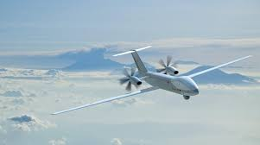
Unmanned aerial vehicle
(UAV)
By 1523889

Slide 2
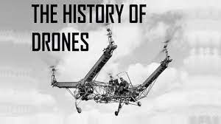
INTRODUCTION

Slide 3
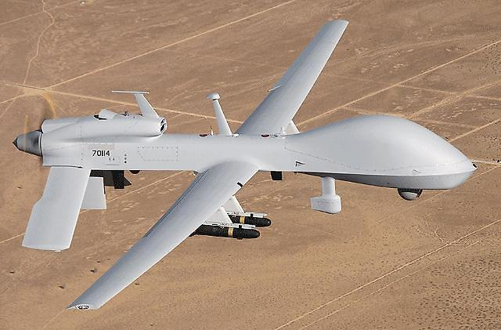
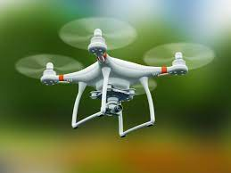
An unmanned aerial vehicle (UAV) is an aircraft that carries no human pilot or passengers. sometimes called “drones” .It can be fully or partially autonomous but are more often controlled remotely by a human pilot.

Slide 4
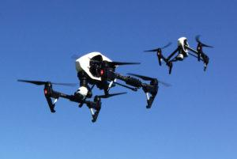
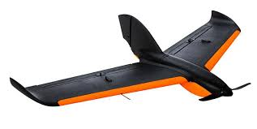
UAV TYPES
1-MULTI-ROTOR
2-FIXED-WING

Slide 5
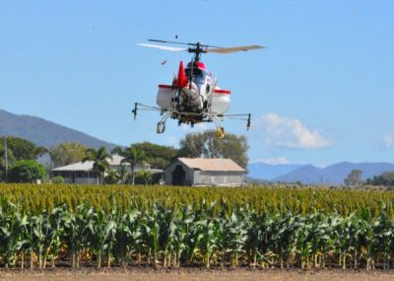
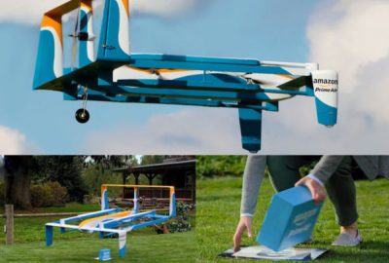
UAV TYPES
3-SINGLE-ROTOR HELICOPTER
4-FIXED-WING HYBRID VTOL

Slide 6
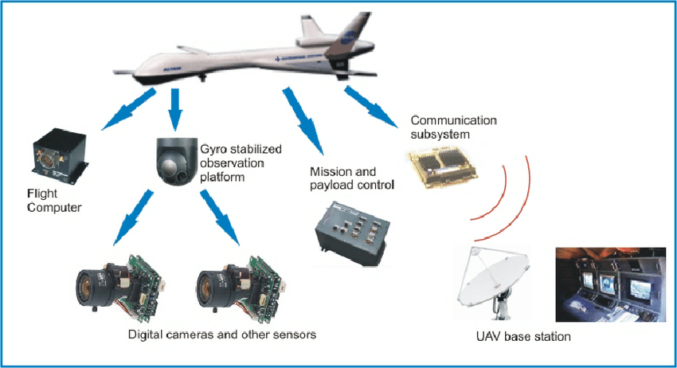
PHYSICAL DESIGN

Slide 7
Main Components:
The main components of a UAV can be divided into three main categories:
The aerial platform, which includes the airframe, the navigation system, the power system, and the payload.
The ground control station (GCS), which allows the human control from a remote emplacement.
The communication system,, which supports the communication between the other two components.

Slide 8
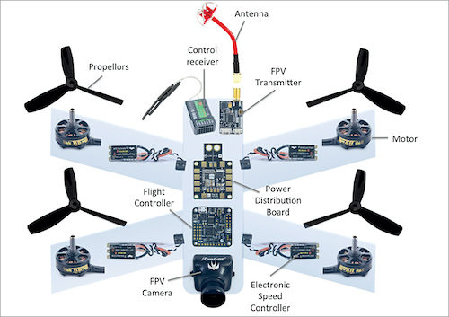

Slide 9
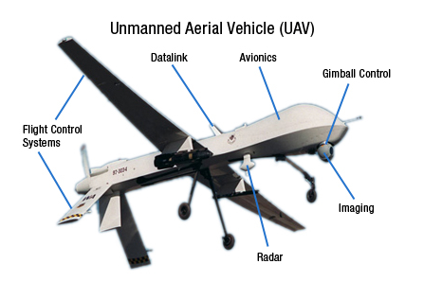

Slide 10
Locomotion system & actuators

Slide 11
Motors
Generally, brushed motors are used in the smallest drones, whereas larger drones and UAVs will use brushless motors, as they can carry the extra weight of the additional electronics. Brushless drone motors also require an electronic speed controller (ESC) to operate.

Slide 12
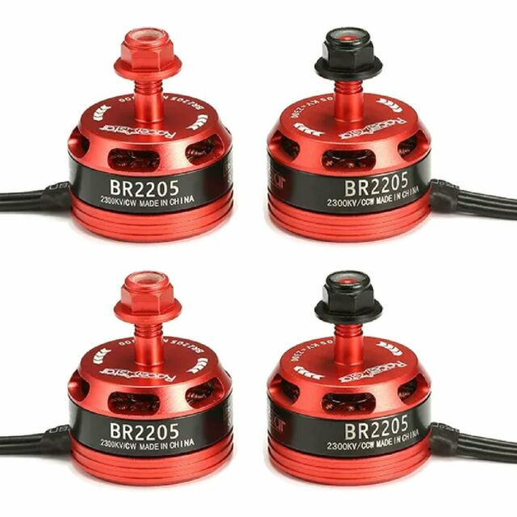
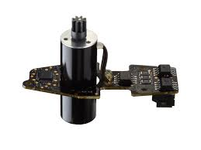
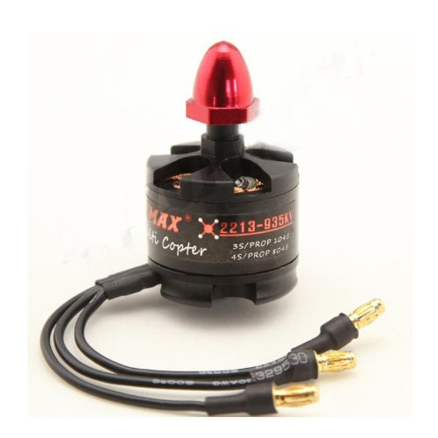
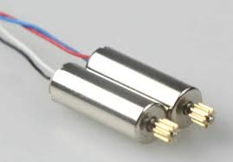
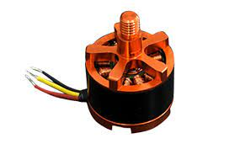
5 Best Recommendation for Drone Motors
Coolplay syma x5c-1 x5c x5 motors.
Hobbymate quadcopter kit motor.
Parrot AR Drone 2.0 motor.
Hobbypower A2212 brushless motor.
Emax Mt2213 brushless motor.

Slide 13
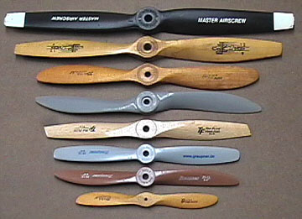
Propellers
Propellers are devices that transform rotary motion into linear thrust. Drone propellers provide lift for the aircraft by spinning and creating an airflow, which results in a pressure difference between the top and bottom surfaces of the propeller.

Slide 14
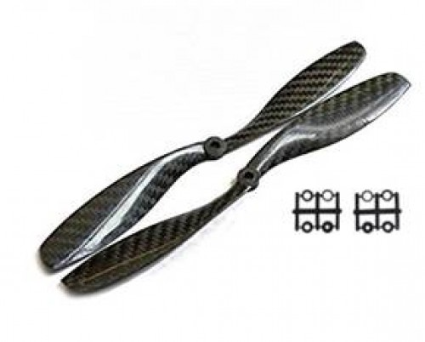
UAV propeller blades are made from a variety of different materials including carbon fiber, wood and plastic.
Carbon fiber blades have many advantages, including less vibration due to their stiffness, they are lighter and stronger than plastic, which also means less inertia, thus faster speed change. Wooden blades are heavier and less responsive to speed changes.

Slide 15
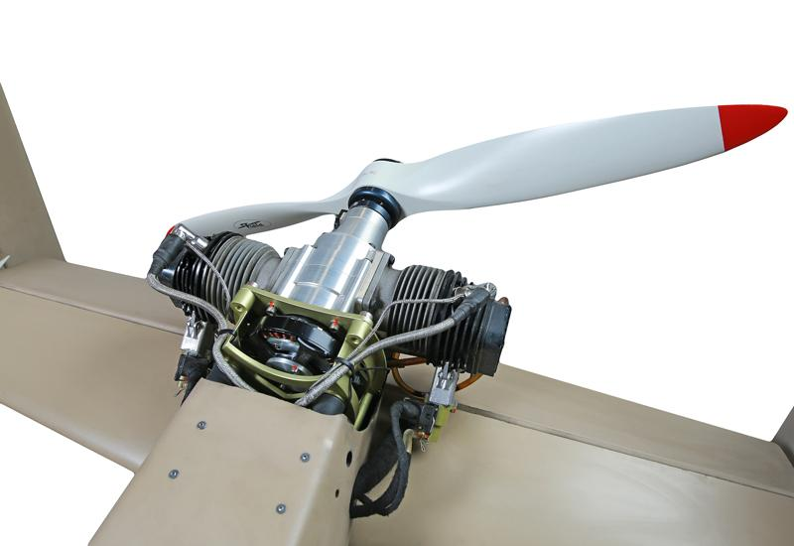
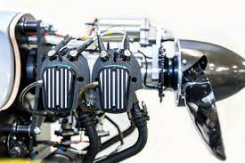
Engine
•engine is equipped with a microprocessor ignition for easy starting and smooth running in all modes of engine speed.
• 4-stroke propulsion system with OHV and 2 valves per cylinder

Slide 16
Navigation system (sensors & control

Slide 17
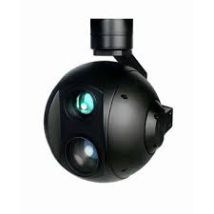
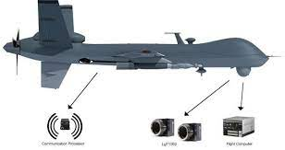
Camera For surveillance purpose

Slide 18
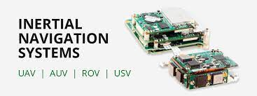
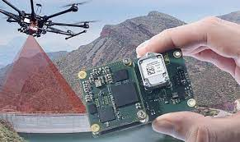
Inertial navigation system
•contains of gyroscope and accelerometer
•To know the acceleration and roll pitch yaw of the UAV

Slide 19
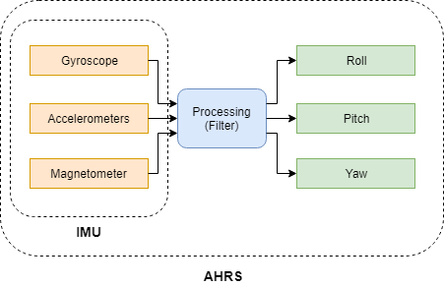
Attitude and Heading Reference System (AHRS).
Attitude and Heading Reference System (AHRS). Consists of sensors (gyroscopes, accelerometers and magnetometers) that provide attitude information for the platform. The difference between an IMU and an AHRS is the post processing system. The IMU reports data to an additional device that computes attitude and heading. These computers usually use Kalman filters to estimate

Slide 20
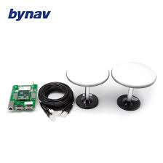
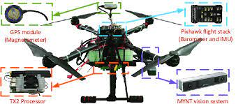
GPS
GPS drones are equipped with a GPS module that allows them to know their location relative to a network of orbiting satellites. Connecting to signals from these satellites allows the drone to perform functions such as position hold, autonomous flight, return to home, and waypoint navigation12

Slide 21
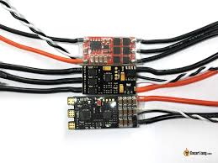
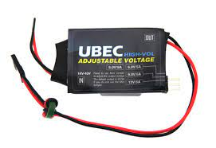
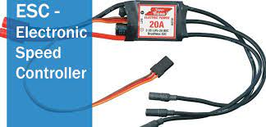
Ubec module & Electronic speed controller
Electronic speed controller : control the speed of actuator (motor)
Ubec :control the power

Slide 22
Data Collection

Slide 23
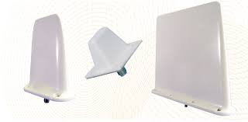
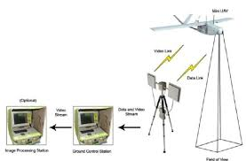
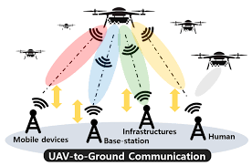

Slide 24
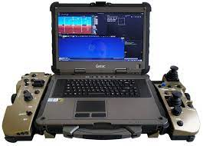
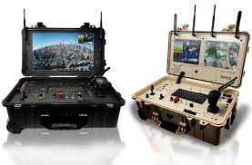
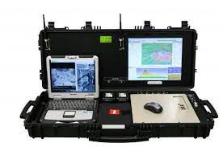
Ground Control Units (GCU)

Slide 25
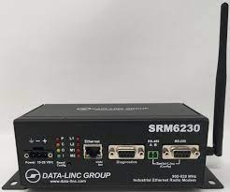
Radio Data Link
•High-Power Long-Range Broadband for Radio communication with UAV

Slide 26
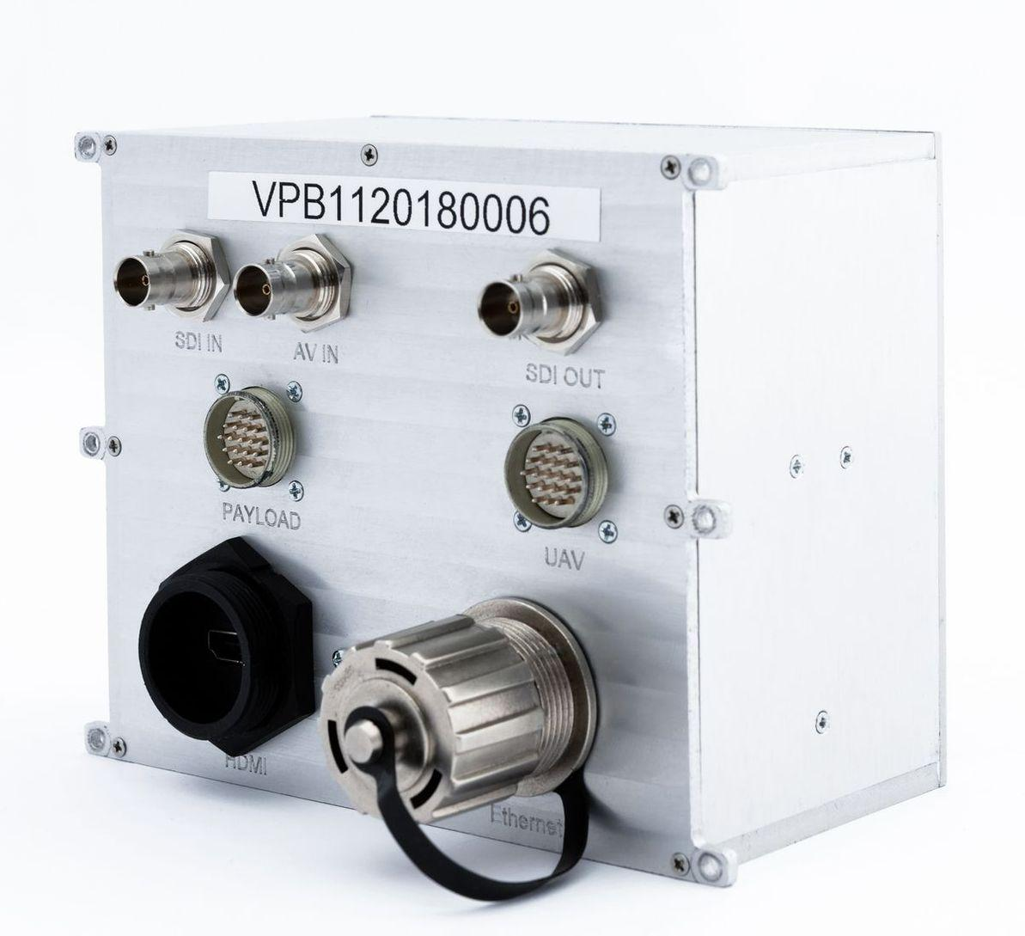
Video Processing System
To give video in real time

Slide 27
Power management

Slide 28
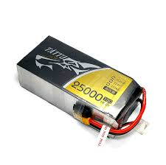
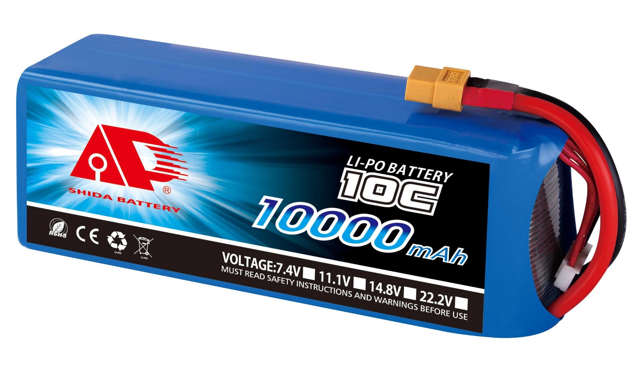
Used for small UAV

Slide 29
THANK YOU

