Slide 1
Remotely operated underwater vehicle
ROV
By 1523889

Slide 2
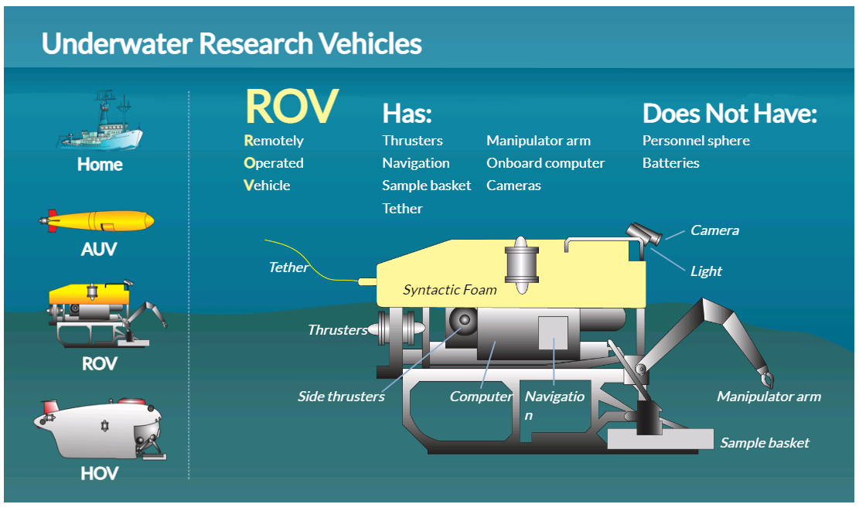

Slide 3
History
Remotely operated vehicles were first tested in the 1960's by the U.S.
Navy to retrieve sunken data. In 1966, the Navy’s Cable-controlled Underwater Recovery Vehicle (CURV) successfully recovered an atomic bomb that went missing off the coast of Spain.
In 1973, the crew from Pisces – a notable deep-sea submarine that sunk off the coast of Ireland - was saved by a remotely operated vehicle. Over the course of the following decade, underwater ROVs became a crucial system used in various industries.
Work class ROVs were the pioneers and are still being widely used today. Observation ROVs are the newest to the market; however, they have filled the gap, specializing in shallow water observation and inspections.

Slide 4
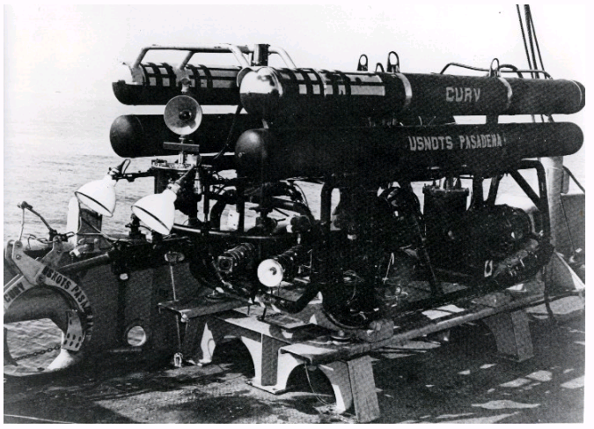

Slide 5
Some of issues facing ROV :
Water temperature
•Water Pressure
•Sea water
•Buoyance

Slide 6
Introduction:
ROVs have been used for underwater intervention, repair, and maintenance operations in offshore industries, including oil and gas industries, marine structures, marine sciences, naval defense, marine renewable energy, and scientific purposes.
ROVs are employed for tracking mines and are programmed to carry out high-risk tasks, executing algorithms related to prediction, diagnosis, and classification

Slide 7
Physical design

Slide 8
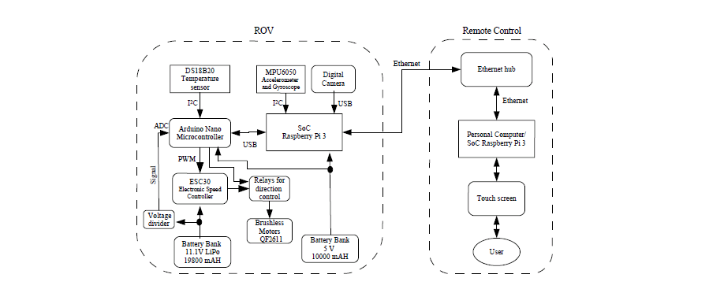
Electronic Design

Slide 9
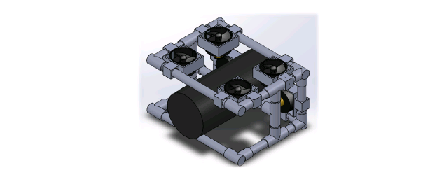
Mechanical Design

Slide 10
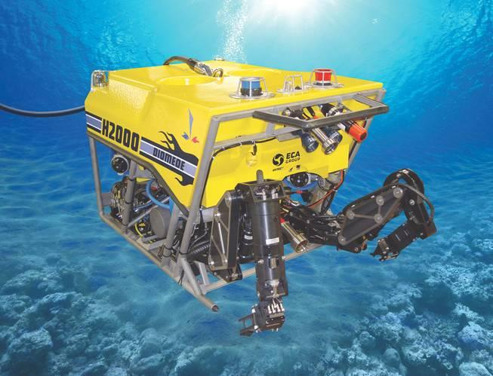
Classification of ROV
Work Class ROV :A work class ROV is used for ocean floor exploration and inspections at depths that divers are often unable to reach.

Slide 11
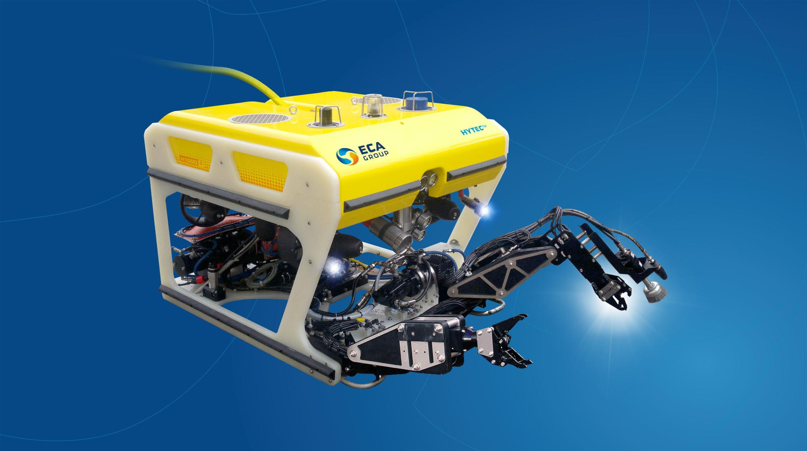
Light Work Class ROV
A light work class ROV is ideal for moderate to deep depths; the ROV is deployed from ships in lieu of divers to explore.

Slide 12
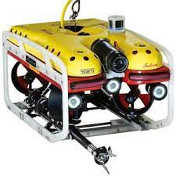
Observation Class ROV
An Observation Class ROV is small in size, used to explore lakes, rivers and coastal waters. They are often used to test water safety prior to a diver entering the water during missions and conducting inspections

Slide 13
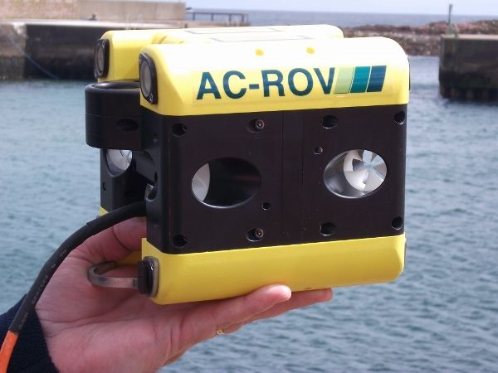
Micro or Mini ROV
The micro or mini ROV is the smallest class, often used to inspect hard to reach areas at shallow depths, such as pipe systems and submerged infrastructure.

Slide 14
Locomotion system & actuators

Slide 15
Important feature for actuators :
Temperature
Good material
how deep can go
anti-corrosion
lightweight
Connector
Power supply

Slide 16
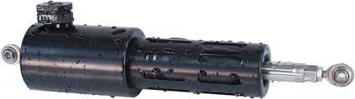
Underwater linear Actuator

Slide 17
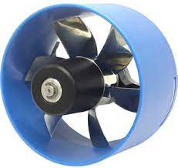
Thruster
The core motor design is a three-phase brushless outrunner motor.It eliminates the need for shaft seals, magnetic couplings, and air- or oil-filled compartments, making the thruster naturally pressure tolerant

Slide 18
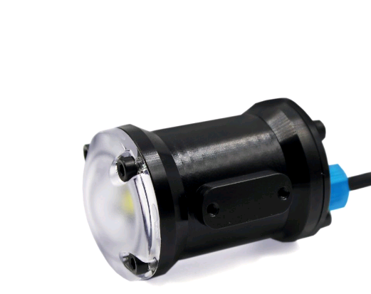
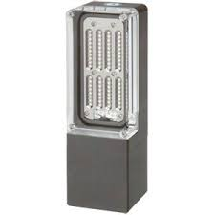
Led

Slide 19
Navigation system (sensors & control

Slide 20
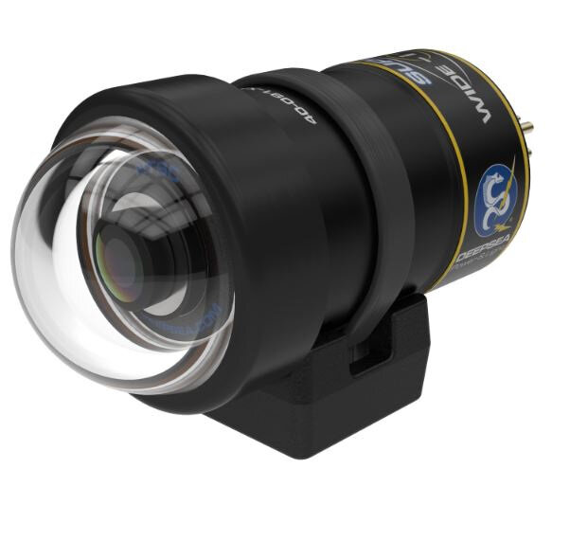
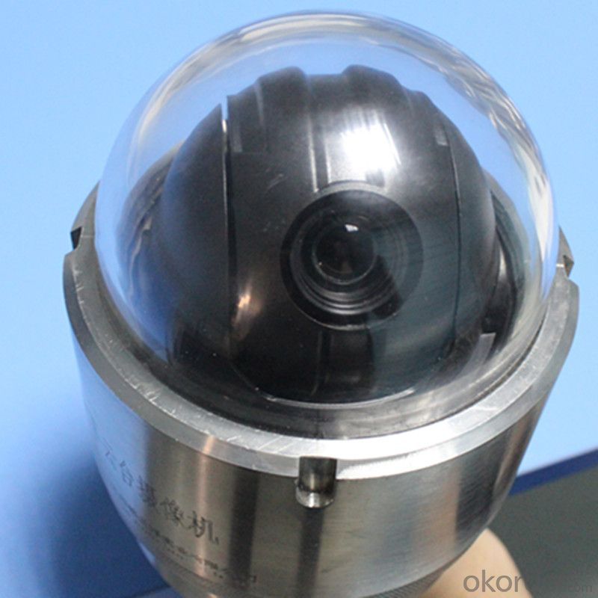
Camera
To know the depth and zooming.

Slide 21
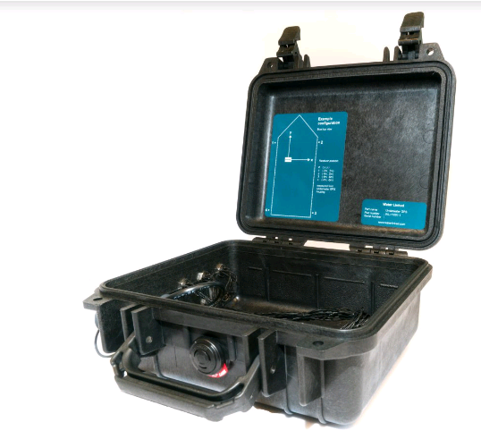
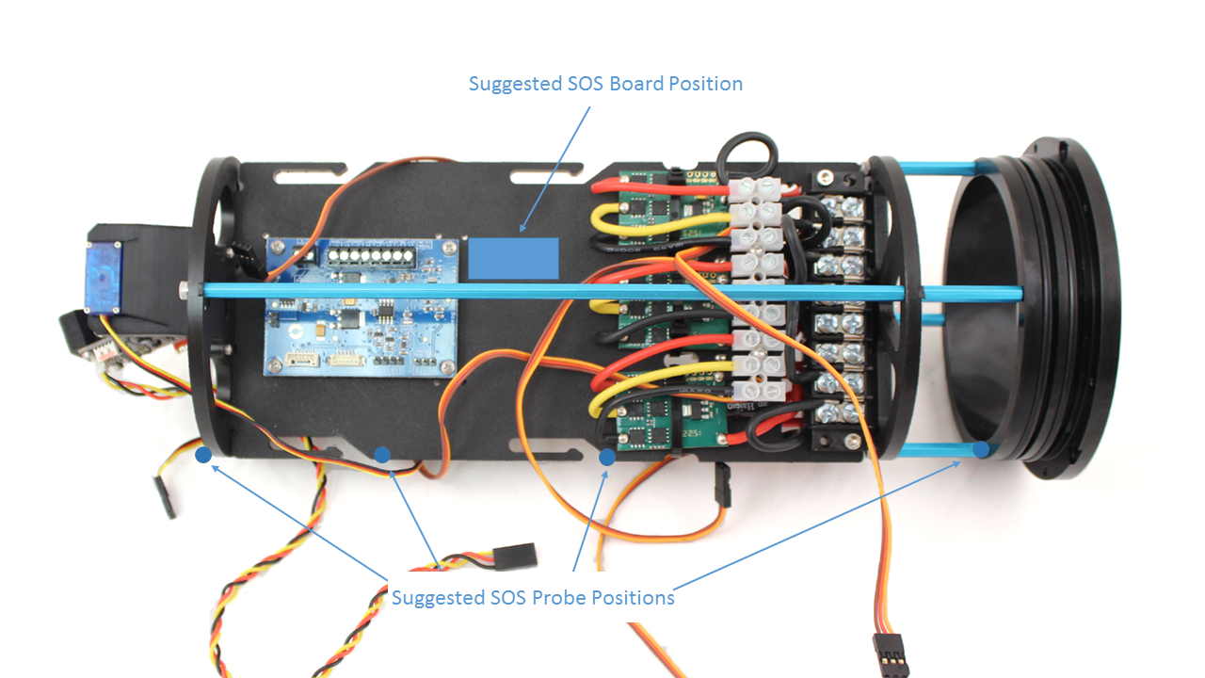
Leakage sensor and GPS
To give alarm if the water get inside the ROV.
GPS to locate the ROV position.

Slide 22
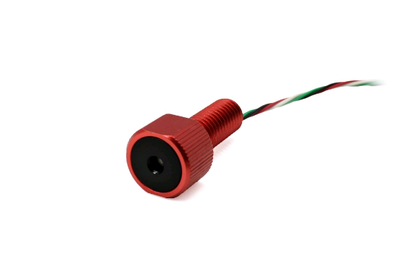
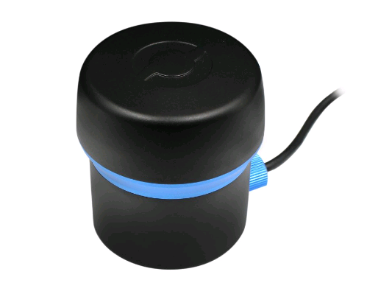
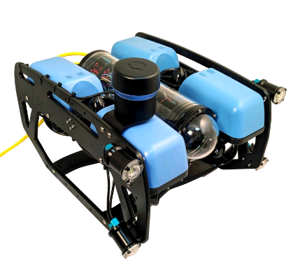
Depth sensor and sonar
Sonar to detect object and location .

Slide 23
Data Collection & transmission

Slide 24
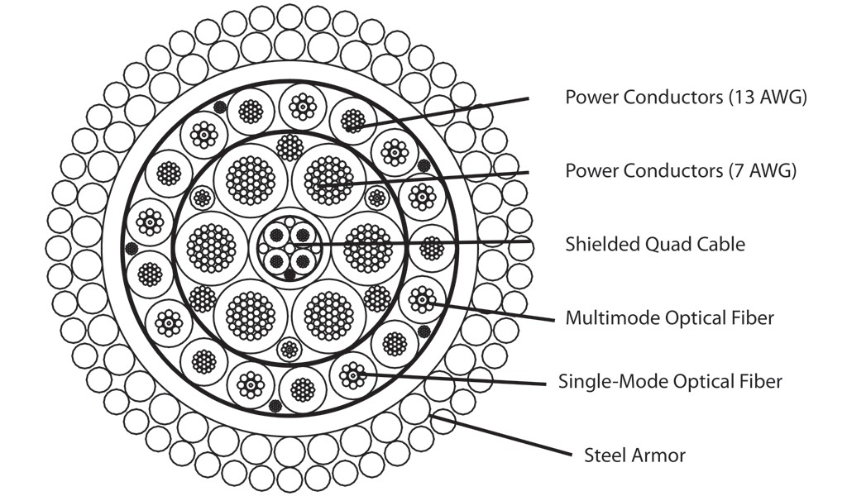

Slide 25
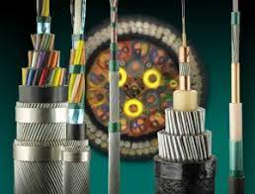
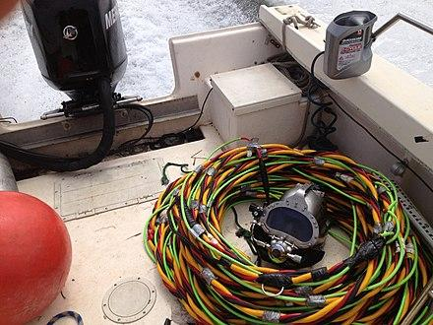
Umbilical cord using to transfer data

Slide 26
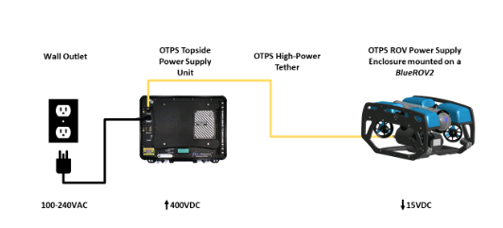
Power management

Slide 27
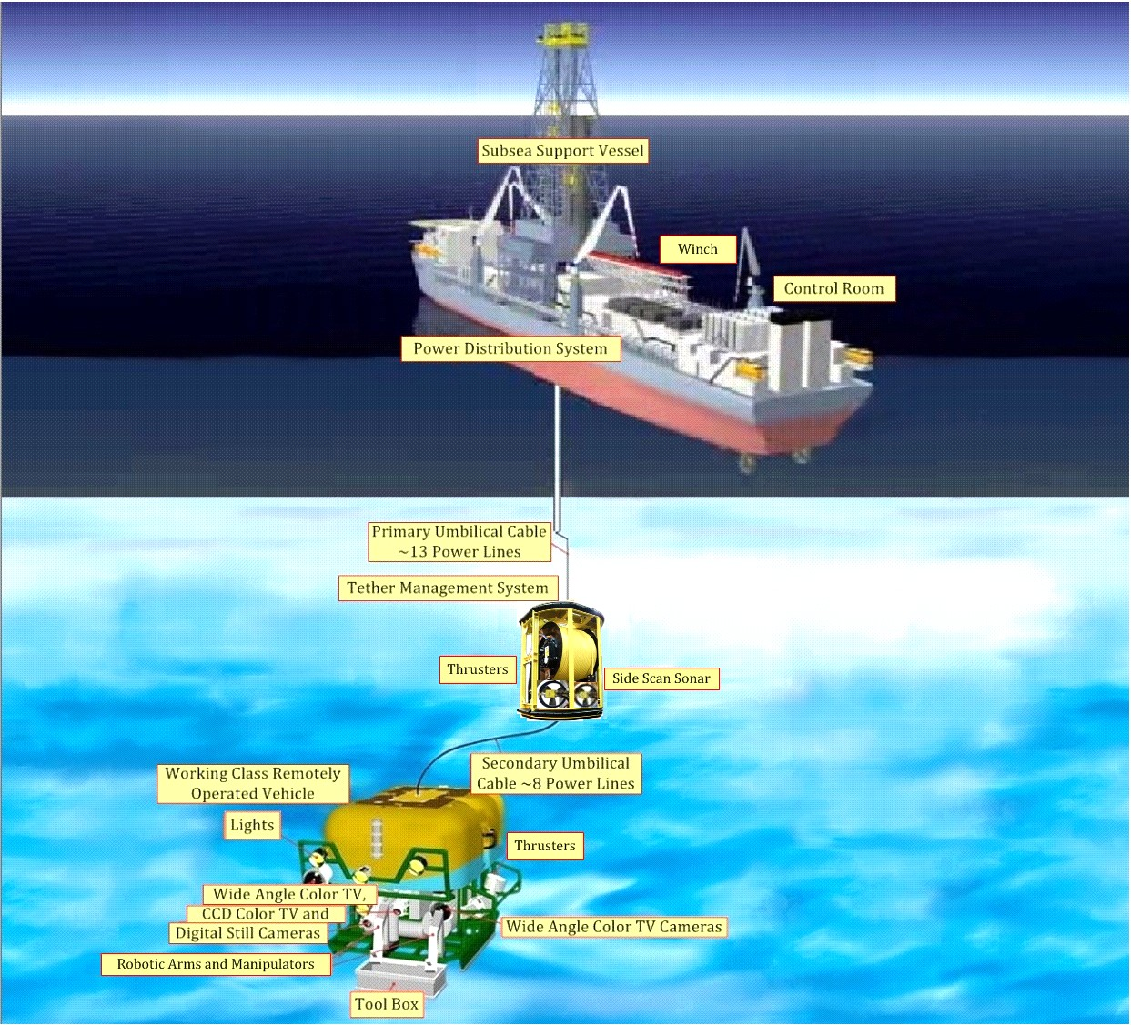

Slide 28
THANK YOU

