Slide 1
Automated Guided Vehicle
AGVs
Matric: 1523889

Slide 2
Introduction and history
What is an AGV ?
It is an Automated Guided Vehicle system (AGVs), is a material handling system that uses independently operated ,self-propelled vehicles guided along defined pathways on the floor. We cloud say is a portable robot that follows along marked long lines.Sometimes called self-guided vehicles.
Arthur “Mac” Barrett built the first automatic guided vehicle in 1953 by modifying a towing tractor so that it followed an overhead wire. His company, Barrett Electronics Corporation, debuted his driverless vehicle in 1954, calling it the Guide-o-Matic. Essentially, the Guide-o-Matic was a tow truck that automatically followed a wire embedded in the floor.

Slide 3
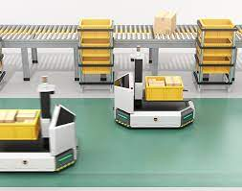
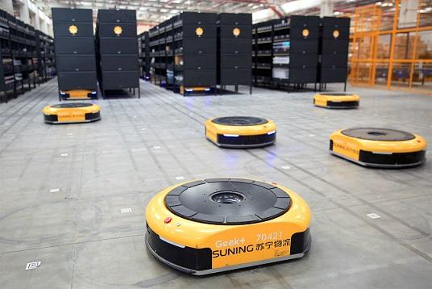
Example of AGV

Slide 4
Benefits of AGVs
Increase efficiency and productivity
Consistent costs
Flexibility
Less space required
Improved safety

Slide 5
PHYSICAL DESIGN

Slide 6
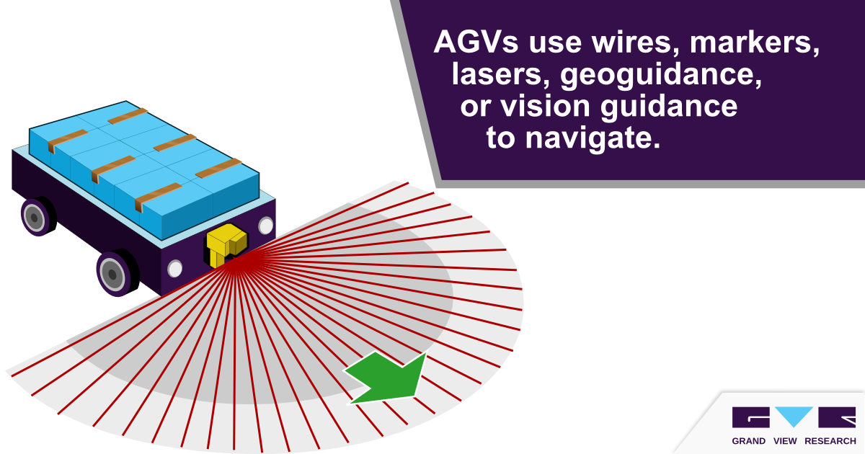

Slide 7
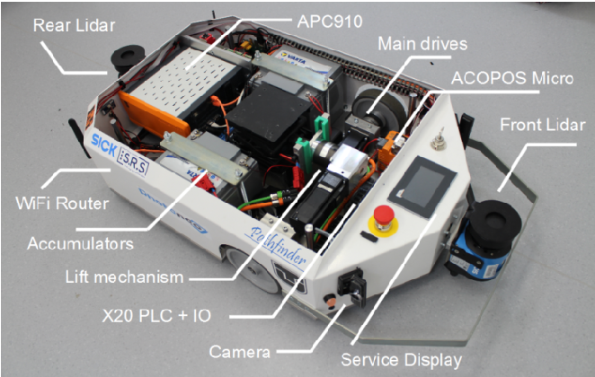

Slide 8
LOCOMOTION SYSTEM & ACTUATORS

Slide 9
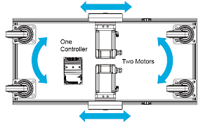
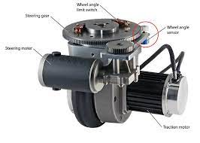
Actuators is to enable the AGV to move
This is steering wheel , it able to move and steer at the same time allowing the movement of the agv

Slide 10
NAVIGATION SYSTEM and CONTROL

Slide 11
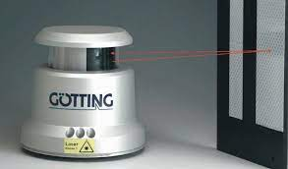
Laser scanner
•Mainly used for object detection, localization and mapping
•Very useful one for all sensor
•Heavily used in modern AGV
Currently using the laser scanner

Slide 12
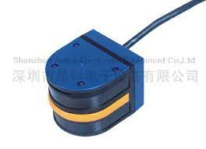
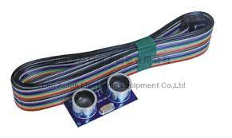
Radar & Omnibearing Infrared sensor

Slide 13
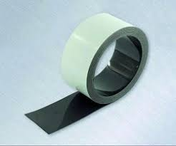
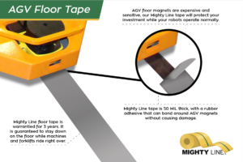
Magnetic tape

Slide 14
Data Collection & transmission

Slide 15
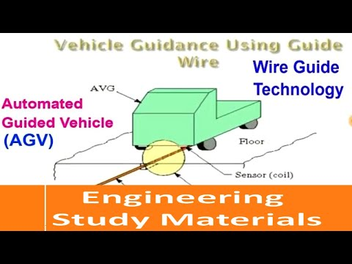
Radio wave wire AGV
Work as the magnetic tape and sensor but using radio wave and transmit signal using it to be processed

Slide 16
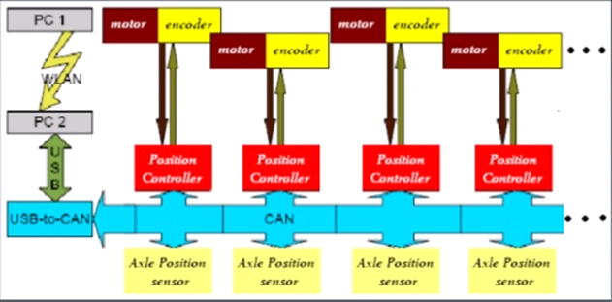
The input from the sensors will be transmitted to a single database to be processed and the instructor is given simultaneously.

Slide 17
Power Management

Slide 18
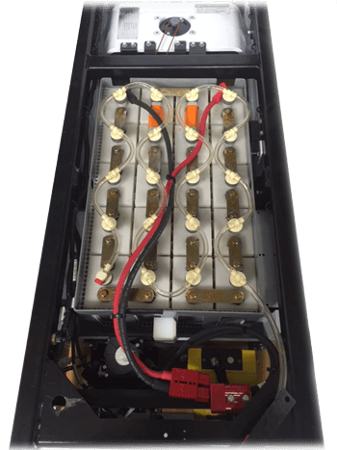
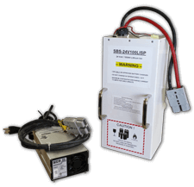
Main source is battery. And high capacity, maintenance-free, and long working time

Slide 19
THANK YOU

