Slide 1
NIKE SALES DATA ANALYSIS PROJECT
Data Inspection • Data Cleaning • Processing • EDA • Visualization
P. Ganesh • S. Sai Kumar • T. Indravathi • S. Jyothirmayi • M. Anjali
Course: Data Analytics | Tools: Python, Pandas, NumPy, Matplotlib, Seaborn

Slide 2
1. Project Overview
Business context, dataset structure and analytical objective
• Objective: transform raw Nike sales records into reliable business insights.
• Business questions: revenue performance, product demand, regional performance and sales-channel contribution.
• Dataset size: 2,500 rows and 13 columns before cleaning.
• Key fields include Order_ID, Product_Line, Product_Name, Units_Sold, MRP, Revenue, Order_Date, Sales_Channel, Region and Profit.
Dataset Snapshot
• Rows: 2,500
• Columns: 13
• Categorical fields: 7
• Numeric fields: 6
• Sales channels: Online, Retail
• Product lines: Soccer, Basketball, Running, Lifestyle, Training
2

Slide 3
2. Data Inspection & Quality Assessment
The notebook checks completeness, validity and consistency before analysis
Dataset Size
2,500 × 13
Duplicate Rows
0
Missing Size
510
Missing Units
1,235
• Missing values were present in Size, Units_Sold, MRP, Discount_Applied and Order_Date.
• Order_Date appeared in mixed formats and was initially stored as object/text.
• Region labels were inconsistent: Bengaluru/Bangalore and Hyderabad/Hyderbad/Hyd.
• The notebook also checked for negative Units_Sold, invalid MRP values and negative Profit.
3

Slide 4
3. Data Cleaning & Processing
Preparing the dataset for reliable business analysis
1
Remove duplicates
drop_duplicates()
2
Handle missing values
dropna()
3
Fix date type
pd.to_datetime(..., format='mixed')
4
Standardize text
strip() + title()
5
Engineer features
Discount_Value, Month, Year
Feature engineering created Discount_Value and extracted Month, Month_Name and Year for trend analysis.
4

Slide 5
4. Key Performance Indicators
Headline results from the cleaned analysis dataset
Total Revenue
427,503.51
Total Profit
164,980.86
Units Sold
201
Online Revenue
225,888.17
Retail Revenue
201,615.34
Online Share
52.8%
Note: Units_Sold is only 201 after missing-value removal, so this metric should be interpreted together with the cleaning decision.
5

Slide 6
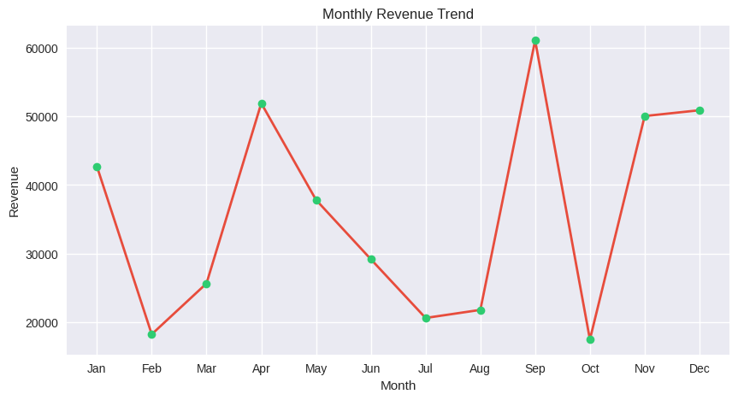
5. Monthly Revenue Trend
Line chart generated in the notebook
Highest month: September (61,029.27) | Lowest month: October (17,526.84)
6

Slide 7
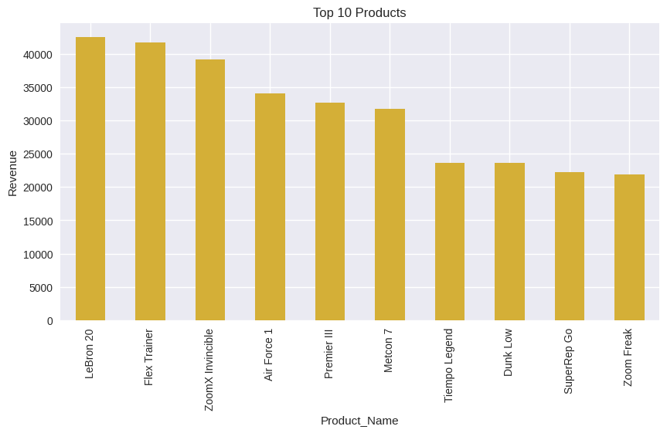
6. Top 10 Products by Revenue
Bar chart generated from Product_Name × Revenue aggregation
Top performer: LeBron 20 (42,527.70), followed closely by Flex Trainer (41,692.48).
7

Slide 8
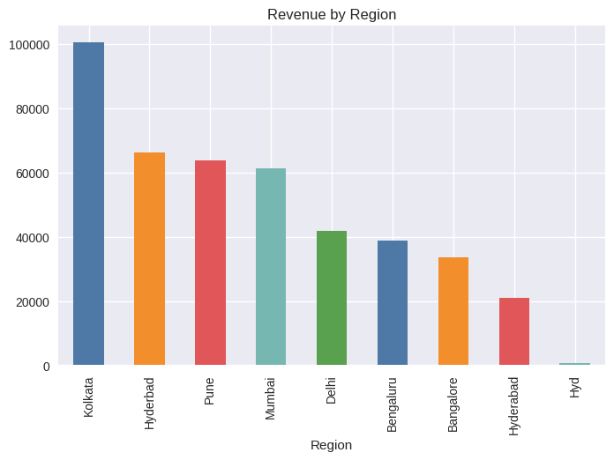
7. Revenue by Region
Regional revenue aggregation from the notebook
Kolkata leads revenue (100,534.03). The results also reveal inconsistent city labels that should be standardized before regional comparisons.
8

Slide 9
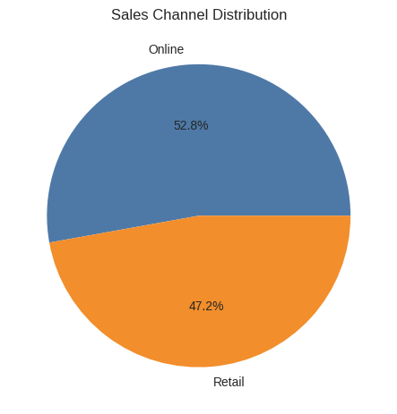
8. Sales Channel & Product-Line Profit
Channel mix visualization plus profit aggregation
Product Line | Profit
Soccer | 48,098.18
Basketball | 42,415.01
Running | 28,077.19
Lifestyle | 27,101.28
Training | 19,289.20
Soccer generates the highest product-line profit (48,098.18).
9

Slide 10
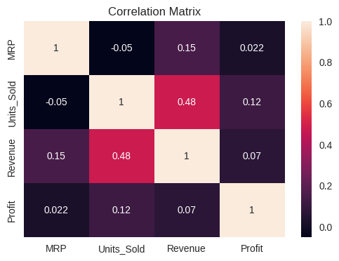
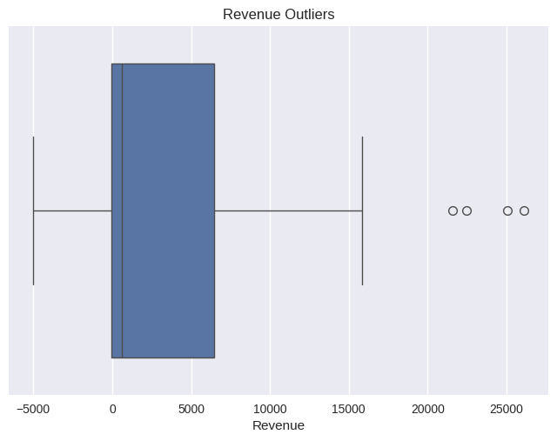
9. Relationship Analysis & Outliers
Two additional diagnostic visuals included in the notebook
Correlation heatmap: MRP, Units Sold, Revenue and Profit. | Box plot: identifies unusual Revenue observations.
10

Slide 11


