Slide 1
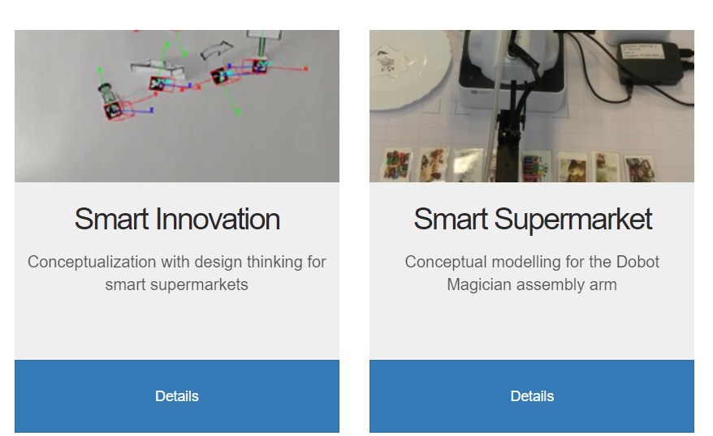



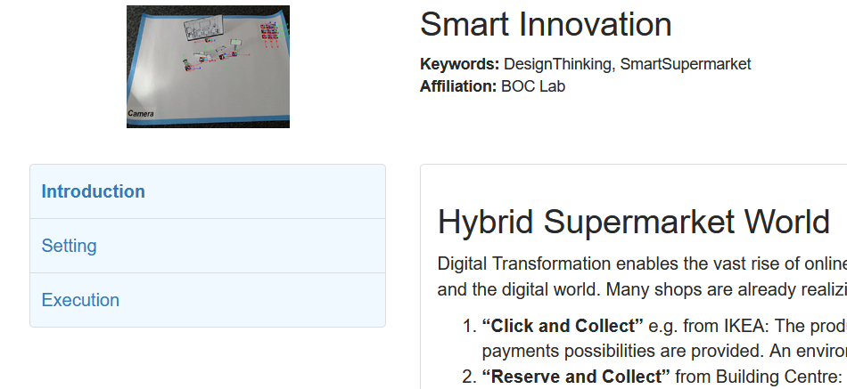
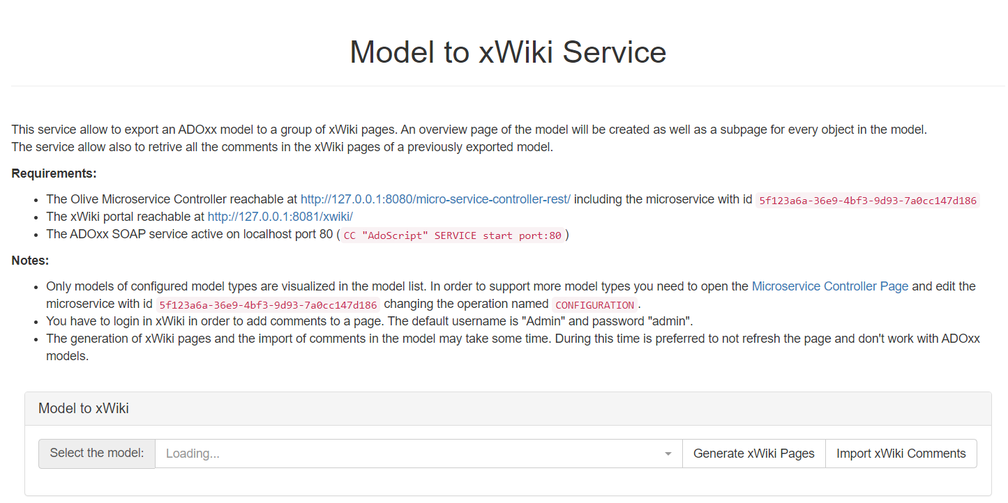

Olive Frontend using GitLab as CMS
Application Server (Apache/nginx/iis/…)
Olive Microservice Controller
GitLab
Project 1
Micro-Frontend UI Modules
…
Projects Retrieval Service
Project 2
Grid Module
…
Content Retrieval Service
Project Module
…
Project n
…
Module
…
…
Web Users
System Administrator
Content Editors

