Slide 1
Python Script Generation
Eduardo Armenta, Landon Carpenter, Matthew Moriarty

Slide 2

Agenda
Motivation
Goals
Use cases
Example & sample
Model structure
Progress
Remaining work
Conclusion

Slide 3

Motivation
“The Unreasonable Effectiveness of Recurrent Neural Networks”
- Andrej Kaparthy
Reads in Shakespeare and generates its own text with the author’s trademark way of writing
How can we turn this into a useful application?

Slide 4




Goals
Create a neural language model that trains on Python text data and generates Python scripts
Prompt the model with a task and have it generate the code that solves the task
Get working results for our code generation solution

Slide 5






Use cases
Focus of the presentation
Code translation
Coding in new language
Learning tool for beginners
Conforming to coding rules
Improving quality
Increases speed

Slide 6
Example
Input
“Write a function that computes the maximum value of three integers”
Output
def maximum(num1, num2, num3):
max = num1
if num2 > max:
max = num2
elif num3 > max:
max = num3
return max

Slide 7
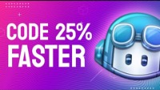
Sample
GitHub copilot: 2:20 minute mark

Slide 8
Model structure pt. 1
Model
Characteristics
Applications
RNN
Multiple connected layers
Exploding/diminishing gradient problems
Computationally demanding
Time-series forecasting
Text generation
Machine Translation
BERT
Bidirectional context
Attention layer
Lacks a decoder
Question answering
Sentence prediction
Document classification
GPT
Attention layer
Encoder and decoder
Capable of handling long sequences
Sentence prediction
Document summarization
Text generation

Slide 9
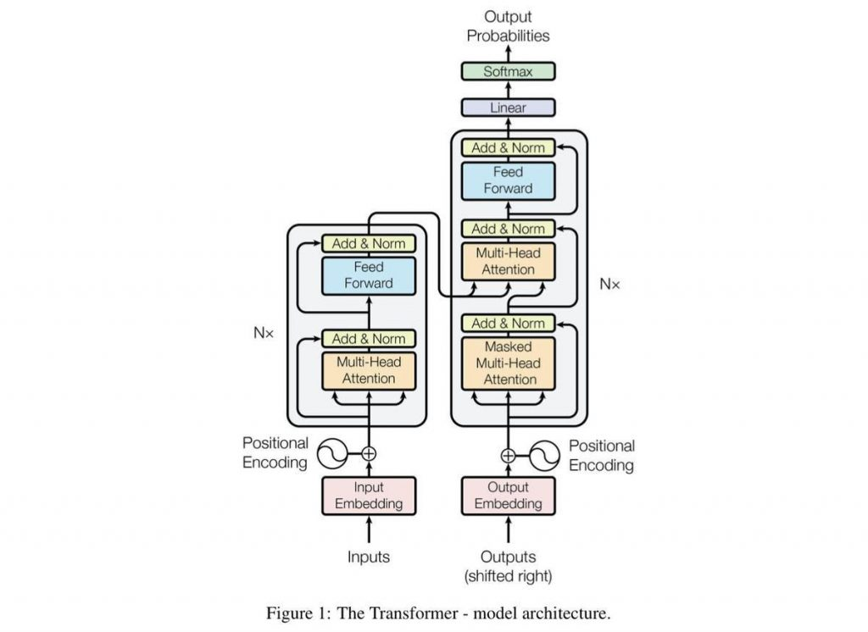

Model structure pt. 2
Encoder
Encodes textual input into a numeric vector space
This space is then learned by the model through the training process
a
Decoder
Decodes learned representations into textual output
Paired with the Encoder, allows us to start and end with text, creating a model suitable for text generation

Slide 10
Progress pt. 1
Obtain Data
5000 samples of python text
Preprocess Data
Obtain data
We obtained approximately 5,000 samples of Python text data from this repository*
The data itself is made up of a collection of prompts and their coded solutions
# write a python function to add two user provided numbers and return the sum
def add_two_numbers(num1, num2):
sum = num1 + num2
return sum
* Building a Python Code Generator
Put into data frame as one string
Encode + Batch
Encode strings and batch them
Train Model
Train model with python text
Generate + Decode
Generate output and decode it python text
Test Model
Make sure output solves prompts

Slide 11

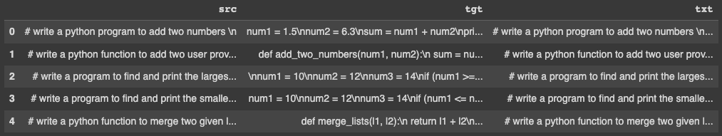
Progress pt. 2
Obtain Data
5000 samples of python text
Preprocess Data
Preprocess Data
We first parsed the text data to extract the prompts and associated coded solutions and put them into a data frame, but the model wouldn’t train
We then concatenated the data into one string, which proved to be the solution
Put into data frame as one string
Encode + Batch
Encode strings and batch them
Train Model
Train model with python text
Generate + Decode
Generate output and decode it python text
Test Model
Make sure output solves prompts

Slide 12
Progress pt. 3
Obtain Data
5000 samples of python text
Preprocess Data
Encode + Batch
Our model trains best when the data is batched, so we created a function to batch our data into a desired batch size
We later realized that the data_loader function from Torch both batches and tokenizes the data for us, giving us a vector of the encoded text
Put into data frame as one string
Encode + Batch
Encode strings and batch them
Train Model
Train model with python text
Generate + Decode
Generate output and decode it python text
Test Model
Make sure output solves prompts

Slide 13

Progress pt. 4
Obtain Data
5000 samples of python text
Preprocess Data
Train Model
a
Successes
Utilizing prior knowledge for training neural networks (BERT)
Trained with our Python text data
Took 1.5 hours (5 epochs)
Improvement opportunities
A
Reduce the training time
Add masks to the encoding, as we only used ids for now
Do data augmentation to have more than 5000 training data points
Put into data frame as one string
Encode + Batch
Encode strings and batch them
Train Model
Train model with python text
Generate + Decode
Generate output and decode it python text
Test Model
Make sure output solves prompts

Slide 14
Progress pt. 5.1
Obtain Data
5000 samples of python text
Preprocess Data
Generate + Decode
Success in generating text output using the pre-trained model
This leaves the training loop as the only remaining obstacle to generate Python code for a given prompt
Example Input
a
# write python code that creates a dictionary...
Example Output
s
..., so if you run in an environment using the Python language, we will see something similar.
Put into data frame as one string
Encode + Batch
Encode strings and batch them
Train Model
Train model with python text
Generate + Decode
Generate output and decode it python text
Test Model
Make sure output solves prompts

Slide 15
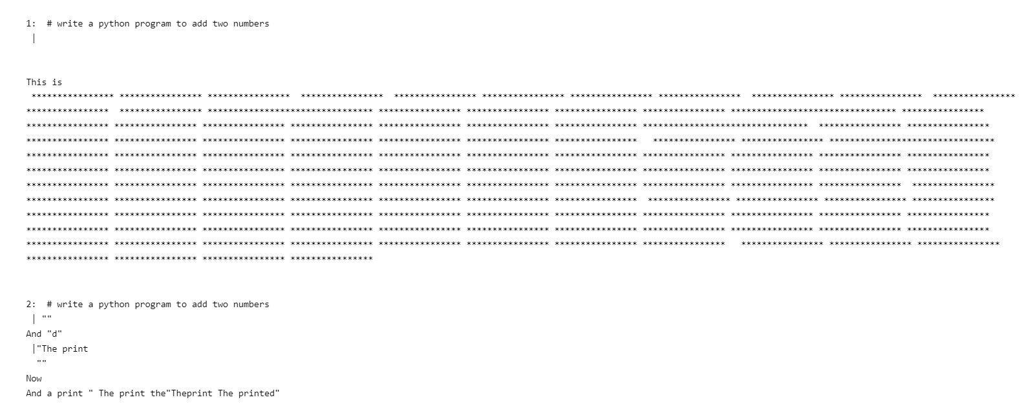
Progress pt. 5.2
First iteration
First output generation from our model
Trained on 10 lines

Slide 16
Progress pt. 5.3
Generate + Decode
Input
“<|start|> # write a python function to merge two given lists into a single list \n |”
Output
def merge_lists(l1, l2):
results = list(zip(l1,l2))
return result
“<|start|> # create python for
loop that prints the entire
alphabet \n |”
for alphabet in range(0,len(str1)):
print( alphabet[0])

Slide 17
Progress pt. 6.1
Obtain Data
5000 samples of python text
Preprocess Data
Test Model
Classic performance metrics are unneeded here, as a more subjective evaluation is required to evaluate model performance
We will evaluate our model on the following characteristics:
Put into data frame as one string
Encode + Batch
Encode strings and batch them
Train Model
Ability to Solve Prompt
Conciseness of Solution
Variable Consistency
Syntax Adherence
Train model with python text
Generate + Decode
Generate output and decode it python text
Test Model
Make sure output solves prompts

Slide 18
Progress pt. 6.2
Test Model
To test the model, we prompted it with different tasks we wanted it to solve and assessed the output
Scoring can be:
We see the results as a relative success. More data would lead to better performance
3
3
1: unusable
2: runs but doesn’t solve
3: solves the prompt
4

Slide 19




Remaining work
Finetune model
Augment data
Automate
Optimize code
Create masked inputs to improve model performance and optimize the hyperparameters to get best results
5000 samples of Python might not be enough to get better results. Augmenting the data will give us more to work with
Figure out a way to automate the model deployment, since we are now running it directly from the Python notebook
Improve efficiency of the model’s runtime and work on the clarity of the written code by adding comments

Slide 20



Training for GPT2, or any Neural Network model, requires an advanced understanding of the underlying mechanisms that make it work
Conclusions
Optimizing training time is of paramount importance, as it reduces time usage and expenses by a significant amount
The success of GPT2 and GPT3 could pave the way for newer architectures in the realm of Natural Language Processing

Slide 21
Questions or comments?

Slide 22
Thanks!

