Slide 1

Overcoming Barriers to Confidential Computing as a Universal Platform
John Manferdelli, VMware
jmanferdelli@vmware.com
June 29, 2023

Slide 2
CC Provides a Foundation for Security
Isolation and measurement
Program address space isolated
Program hashed to give non-forgeable identity
Four capabilities of a Confidential Computing:
Isolation. Program address space and computation.
Measurement. Use cryptographic hash to create an unforgeable program identity.
Secrets. Isolated storage and exclusive program access. (aka, “sealed storage”).
Attestation. Enable remote verification of program integrity and secure communication with other such programs.
Secrets
Seal: protect a secret for this measurement
Unseal: restore a secret for this measurement
Attestation
Statement signed by a trusted party (HW) that specifies
Program identity (measurement) program
Hardware protection (isolation, integrity, confidentiality) guarantees
Statement attributable to isolated entity
CC provides principled security wherever your programs run and wherever your data resides even if you don’t operate the computers the programs run on.

Slide 3
The Promise of Confidential Computing
Security enablement anywhere (cloud or not)
Standard platform components (key store, storage, time, IAM)
Secure shared data access (Regulators: GDPR, Health, Finance)
Safe program execution (“A safe place to stand in the cloud”)
Zero Trust
Secure privacy preserving service enablement (Data Economy)
Secure collaborative machine learning
Secure Motion planning as a service
Secure Auctions
Secure infrastructure management
Secure Kubernetes container management
Secure Document sharing
Platforms for sensitive edge services
Edge sensor collection
Caching services and the “extended internet”

Slide 4
Barriers to Confidential Computing Adoption
“In the future, all programs will be Confidential Computing Programs” -- Intel
Hardware
Software
TEE availability
Programs are not “portable” across platform technologies
Writing or converting programs to CC is difficult!
Different code for different programs
Complicated support code raises a security problem and you can’t start right away
No “copy and paste” to get started with a secure program
Cooperating programs require flexible management infrastructure to support many program providers and different security requirements.
Trust policy often embedded in program (Bad!)
Policy difficult to write, understand or audit
What is the “Linux” for Confidential Computing?”

Slide 5
Software Tedium: All that Work
Generating, rotating and managing lots of keys
Authoring, managing and enforcing program policy universally understood by all “trusted programs”
Binding security policy to pre-authored program
Verifying policy compliance with absolute assurance
Securely storing and recovering secrets and data
Securely communicating with other unforgeably identified Confidential Computing Programs
Operating on different Confidential Computing platforms without application changes
Rapid CC enablement of existing “well written” programs
Preserving existing deployment models
Providing scalable support managing related distributed components (including upgrade and new components)
Enabling features with secure code and appropriate, agile logging, encryption and authentication primitives
Earlier SDK’s help but don’t do it all.

Slide 6
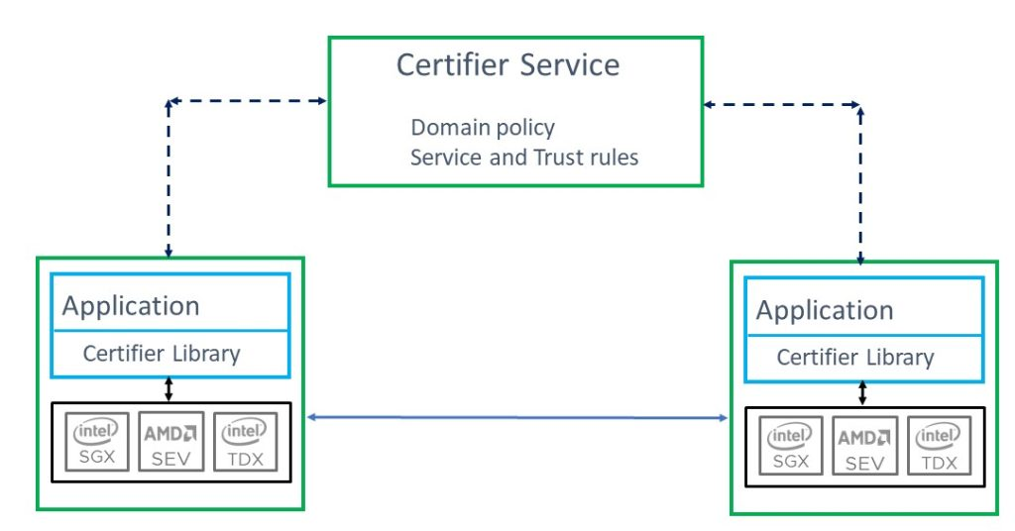
The Certifier Framework
Open-source framework for Confidential Computing
Decreases time to build applications
Avoids need to port application
Already supports SGX (via Open Enclaves or Gramine), AMD-SEV-SNP, Arm CCA, RISC-V Keystone, and soon TDX.
Simple API for most applications but complete support for “edge” cases
Simple and secure management: simple “embarrassingly parallel” server support infrastructure to support policy management
No deployment changes
Audited comprehensible policy
Efficient introduction of new components and upgrades
Enable new services and use models for Data Economy, high security applications and regulatory regimes

Slide 7
Certifier Framework Architecture
Taking the devil out of the details
Application
with policy enforcement
CC enabled app or service runs everywhere
Certifier Library
Measurement
Sealing
Attest/Verify
Certifier Service
Crypto
Secure Key Exchange
Trust Negotiation
Service runs anywhere
Under your desk
In the cloud
At a “service provider”
Selectable security control
Identity Management
Application Upgrade
Secure Channel
Platform Attestation Service
Policy Management
Secure Data Storage
Application Migration
AMD SEV
Intel
SGX
Intel
TDX
Arm
CCA
Islet
RISC-V Keystone
. . .
App Enclave

Slide 8

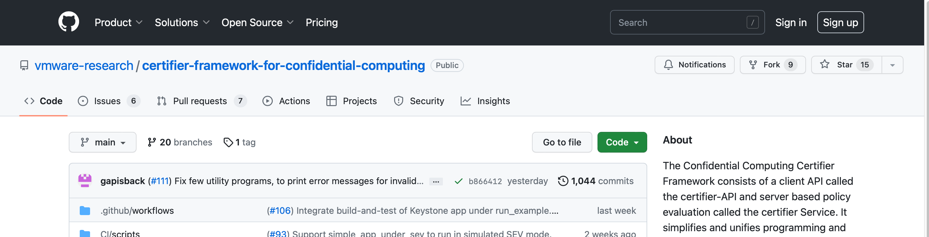
Join the party
Open-Source project
github.com/vmware-research/certifier-framework-for-confidential-computing
Apache license
Contributions and new contributors are welcome
Make Confidential Computing an open Universal Platform

Slide 9
Confidential Computing and the Certifier Framework
Verifiably secure operational properties, including confidentiality, integrity and policy compliance, no matter where program runs. Safe against malware and “insiders.”
Before CC: developer/deployer must:
Write applications correctly
Deploy the program safely (no changes)
Configure operating environment correctly
Ensure other programs can’t interfere with safe program execution
Generate and deploy keys safely
Protect keys during use and storage
Ensure data is not visible to adversaries and can’t be changed in transmission or storage
Ensure trust infrastructure is reliable
Audit to verify this all happened
Consequence: App writer/deployer entirely reliant on provider for all security --- unverifiable
With CC: developer deployer must:
Write the application correctly
For every backend
Manage migration
Support each providers deployment model
Implement all the crypto
Implement secure communications and storage
Make it scalable and upgradable
Implement the trust policy
Maintain trust policy
Different for every app/deployer
Make it scalable
Consequence: You can have safe application but it’s platform dependent and a lot of work
With CC & Certifier: developer/deployer must:
Write the application correctly using Certifier APIs
Write the trust policy
Use Certifier Service to manage it!
Consequence: You write the application once. Need only add a few dozen lines of code to enable CC protection. Trust policy is independent of application. Can move to another “backend” effortlessly
Thanks to David Wagner
Notes:
The ability to run programs locally and remotely that protect the integrity of the processing and the confidentiality of any data processed with the additional ability to “prove” over an insecure communications channel all these properties to a remote entity; this allows data to be shared securely between remotely located secure compartments.
Protects against:
Malicious or careless insiders (e.g.-admins)
Malicious programs running on the same platform
The studied basic confidential computing mechanism requires four capabilities from a platform:
The ability to isolate the address space and computation space of a designated program (an OS, application or container).
The ability to measure the program and provide an unforgeable identity (e.g.- a cryptographic hash of the program)
The ability to protect secrets for an isolated, measured program (i.e. - only the program gets access to its secrets). This is called “sealed storage.”
The ability to verify remotely that a statement comes from a program with a specific measurement on a platform that guarantees isolation and secret storage properties above. This is called “attestation” and it allows secured programs to communicate securely with other such programs.
These mechanisms were identified in the early 2000’s and were used in the TPM.

Slide 10
Thank you!
John Manferdelli <jmanferdelli@vmware.com>

Slide 11
Overcoming Barriers to Confidential Computing as a Universal Platform
Abstract: Confidential Computing (CC) provides simple, principled confidentiality and integrity for workloads wherever they run. Within multi-cloud infrastructures, it opens the door for a universal distributed computing solution that addresses verifiable program isolation, programs as authenticated security principals, secure key management, trust management, and the ability to prove these security properties cryptographically “over the wire” to relying parties using attestation. Yet the adoption of confidential computing has been slowed by the difficulty of writing CC-enabled programs quickly and securely, and across hardware technologies. Manferdelli will describe issues and requirements for a universal programming platform and introduce the open source “Certifier Framework for Confidential Computing” that provides a step towards overcoming development barriers.

