Slide 1
Stereo vision
Laurie Marceau

Slide 2
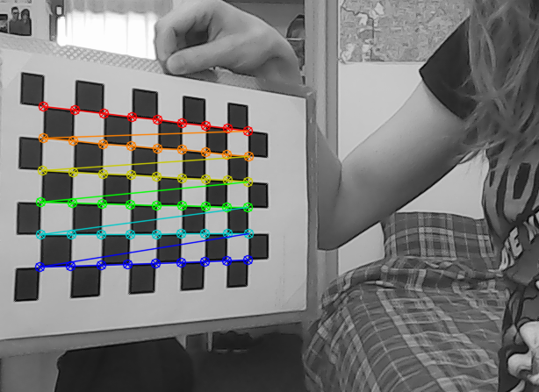
Stereo vision - Calibration
Intrinsic calibration of a camera

Slide 3
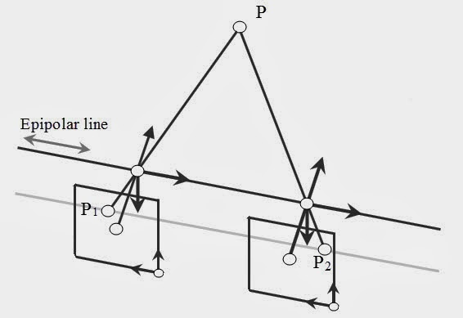
Stereo vision - Calibration
Extrinsic calibration of the cameras

Slide 4
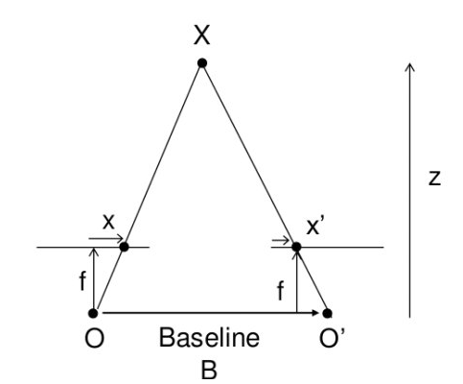
Stereo vision – Disparity map
What is disparity?
What is disparity?
Z = f * b / d where d = x' - x

Slide 5
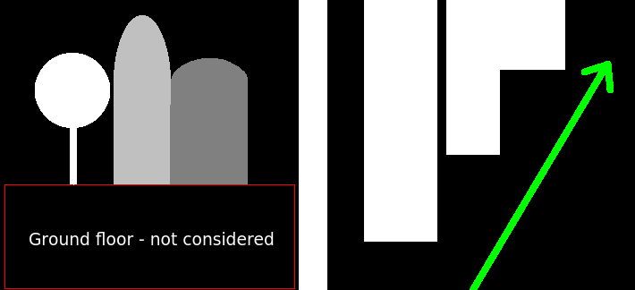
Stereo vision – Top view of depth map
Tool to help the car decide where to go
Theoretical top view

Slide 6
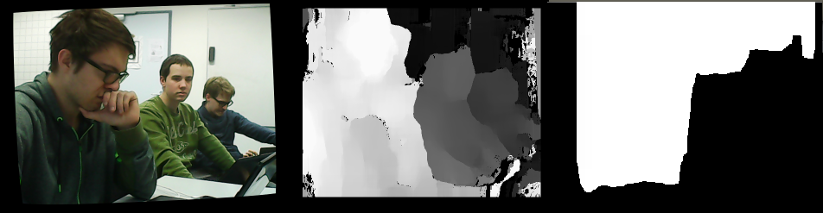
Stereo vision – Top view of depth map
Tool to help the car decide where to go
Rectified image Disparity map Top view

Slide 7
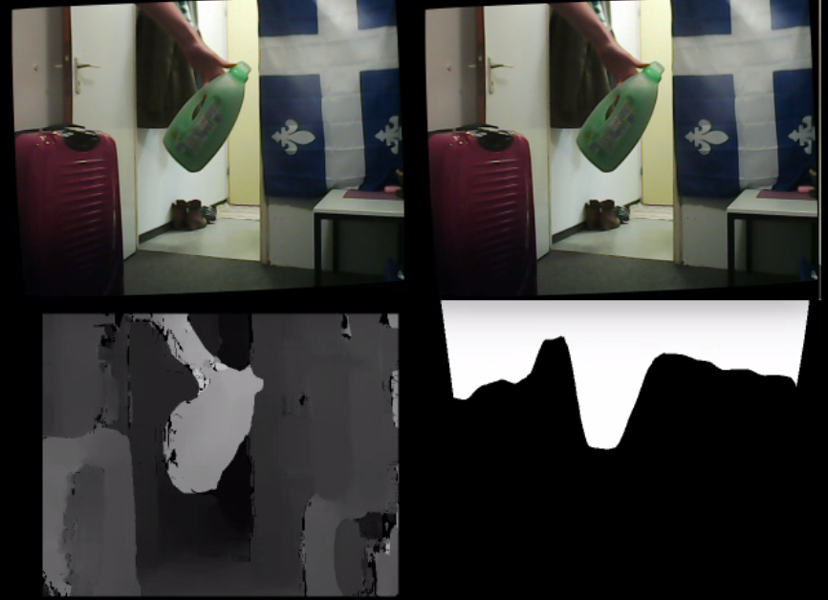
Stereo vision – Final result
https://youtu.be/H497a5wq_IY

