Slide 1

Sensor Fusion
Fang Yuan
28.06.2016

Slide 2

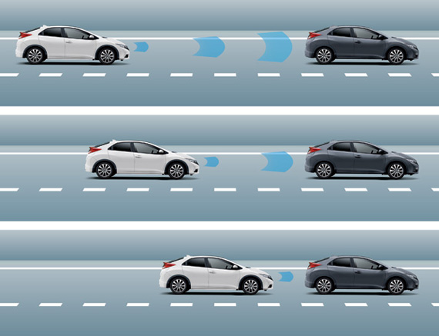
Introduction
Goal: estimate the states of moving object using sensor measurements to avoid hitting it
Introduction
Methods
Results
Discussion

Slide 3

Introduction
Problems with state estimation:
How to deal with inaccurate sensor measurements?
How to integrate measurements of different sensors?
Introduction
Answer:
Methods
Results
Discussion

Slide 4




Sensor Fusion Framework
Sensors involved in the iron car sensor fusion framework:
Introduction
Methods
Results
Kalman Filter
Discussion

Slide 5
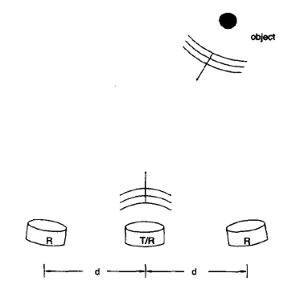
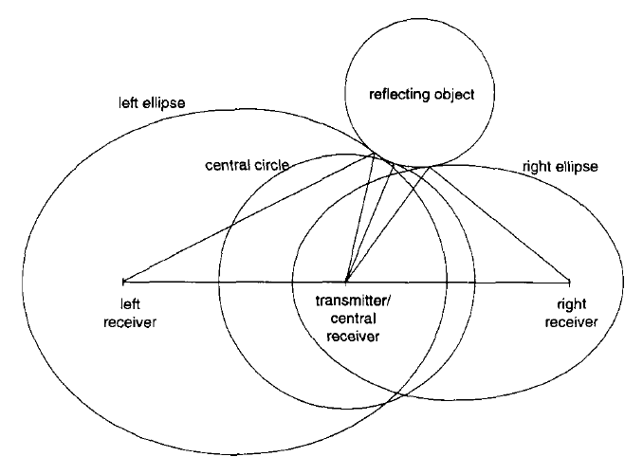
Ultrasonic Sensor
Special setup of ultrasonic sensor:
Introduction
Methods
Results
Discussion
1 transmitter + 3 receivers
triangulation relating sensor measurements and object distance
H. Peremans, K. Audenaert and J. M. Van Campenhout, ''A High-Resolution Sensor Based on Tri-aural Perception'', IEEE Transactions on Robtoics and Automation, Vol.9, No.1, February 1993.

Slide 6
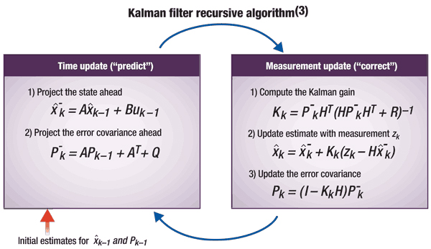
Extended Kalman Filter
We use extended kalman filter (EKF) to deal with non-linearities in the measurement model.
The framework consists of three iterative steps:
1. predict the states for the next time step
2. correct the prediction using ultrasonic measurements
3. correcr the prediction using depth map information
Introduction
Methods
Results
Discussion

Slide 7





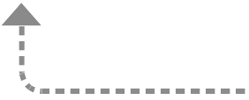

Code Structures
Introduction
kfilter c++ library modified
offers EKF functionalities given iron car model
Methods
Results
Discussion
simulates noisy sensor measurements

Slide 8


EKF simulation – position
Introduction
Methods
Results
Discussion

Slide 9
EKF simulation – velocity
Introduction
Methods
Results
Discussion

Slide 10
EKF simulation – acceleration
Introduction
Methods
Results
Discussion

Slide 11
Simulated EKF Demo
Introduction
Methods
Results
Discussion

Slide 12
Future Work
set up the ultrasonic sensors
develop algorithms to extract distance information from depth map
add camera and/or radar to the sensor fusion framework
Introduction
Methods
Results
Discussion

Slide 13
Thanks for your attention!

