Slide 1
Introduction to Model Description Language: a new pharmacometric standard
Material prepared by:
Mike K Smith, Stuart Moodie & Zinnia P Parra-Guillen

Slide 2
Agenda
Overview of MDL
Structure, components
Model Object
IDV, Covariates, Variability, Variability levels, Group variables, RV definition, individual variables, model prediction, compartments, DEQ, Observation blocks.
Parameter Object
Data Object
Prior Object
Design Object

Slide 3




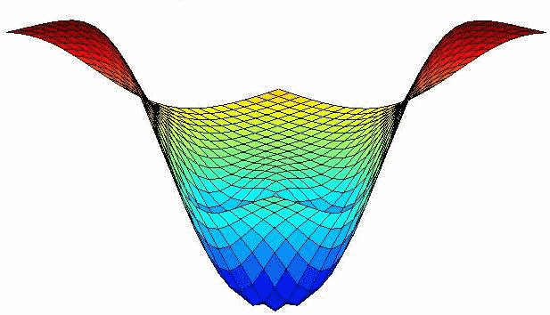

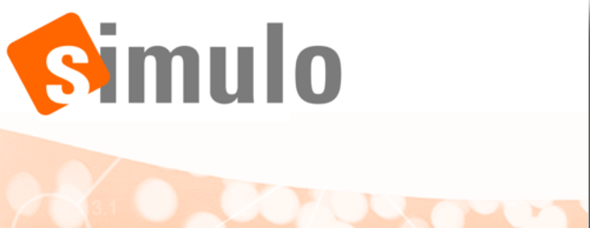








Motivation
Estimation
Model evaluation
Simulation/ Prediction
Optimal Design
PFIM
PopED
“…But I only use NONMEM…”
Notes:
Different and growing number of tools & languages currently available (e.g NMTRAN for Nonmem or MLXTRAN for Monolix)
Lack of language standards in the pharmacometrics field
Modelling and simulation tasks ofen require the use of multiple tools, which are not always interoperable
Recoded of models needed

Slide 4
Motivation
DDMoRe standards facilitate understanding and knowledge sharing across tools:
We all “know” what a 1 compartment Pop PK model looks like
BUT if we ask 10 modellers to encode it across the tools listed previously, would we get the same or a consistent model across these?

Slide 5
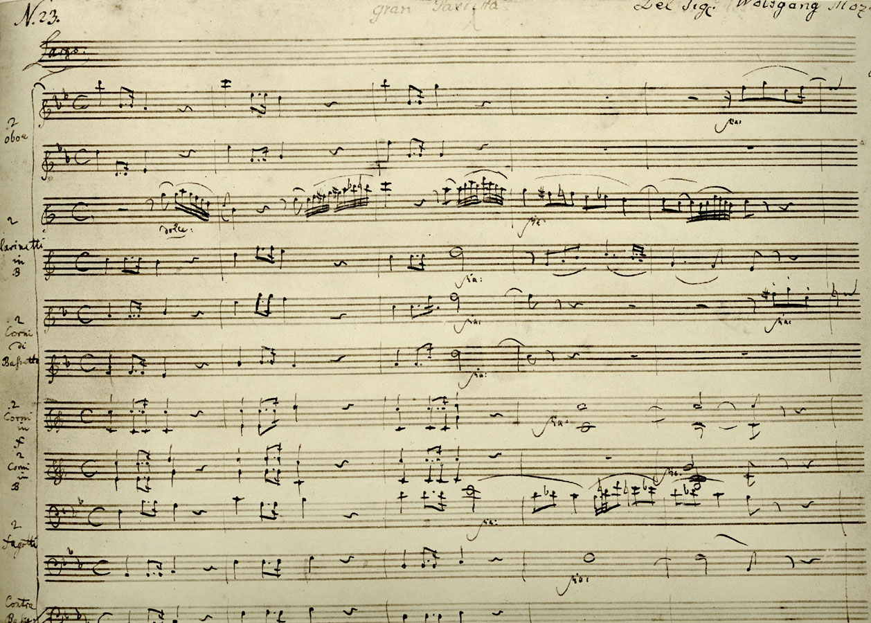
Composer’s own notation

Slide 6
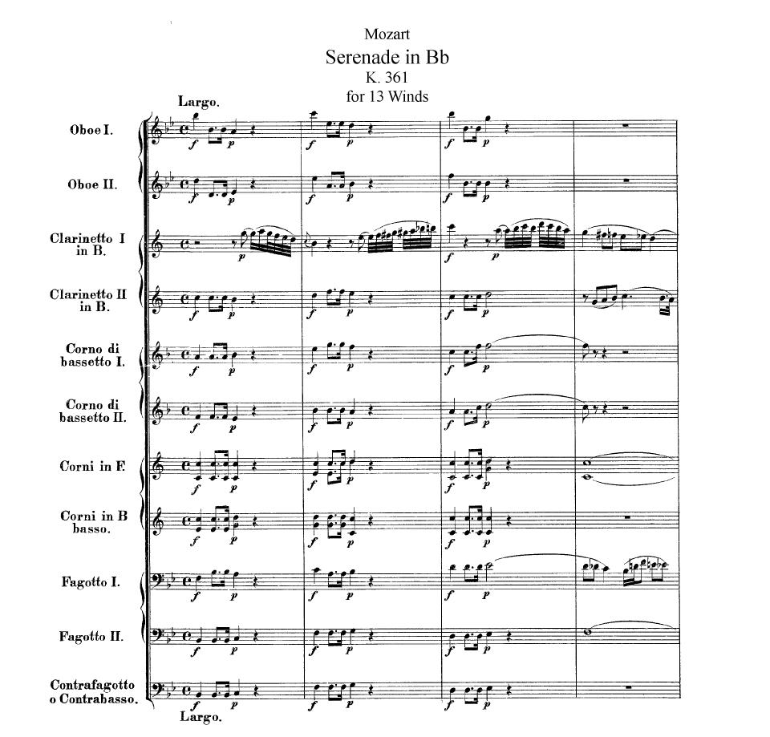
Standard notation
Notes:
Standards make it easier, clearer to see what’s going on.
Clear intentions / unambiguous.
Composer’s shortcuts are written out in full.
Intended for others to use.
NB: HOW TO PLAY IT is still open to artistic input.

Slide 7
Motivation
DDMoRe standards facilitate understanding and knowledge sharing across tools:
We all “know” what a 1 compartment Pop PK model looks like
BUT if we ask 10 modellers to encode it across the tools listed previously, would we get the same or a consistent model across these?
DDMoRe standards facilitate workflow
Standard output means that modelling outputs can be converted and passed to model diagnostic code that is agnostic about the tool used for estimation.
E.g. BUGS output -> xpose object

Slide 8
Motivation
DDMoRe standards facilitate understanding and knowledge sharing across tools:
We all “know” what a 1 compartment Pop PK model looks like
BUT if we ask 10 modellers to encode it across the tools listed previously, would we get the same or a consistent model across these?
DDMoRe standards facilitate workflow
Standard output means that modelling outputs can be converted and passed to model diagnostic code that is agnostic about the tool used for estimation.
DDMoRe standards facilitate interoperability
Encode the model once, use it in whatever tools you like.
Conversion of the MDL / PharmML to many different target tools.

Slide 9
DDMoRe Standards
MDL: Model Description Language
What the modeller uses to describe and encode the model
Emphasis on language being clear and consistent, rather than concise.
PharmML: Pharmacometrics Markup Language
Basis for interoperability between software
Includes ProbOnto (Probability distribution Ontology) which defines probability distributions and how they are related.
SO: Standard Output
XML standard for modelling and simulation output.

Slide 10
Model Description Language Definition
Human readable and writable language
Standards to describe pharmacometric models and tasks
Consistent description of models
Facilitate communication and understanding across pharmacometricians and disciplines
Target tool independent
Eliminate (as much as possible) target software specific “tricks”
Modular structure
Define in a single text file
Flexibility, re-usability and interchange
Notes:
The MDL is a human writeable and human readable language to express the information required to describe pharmacometric models and tasks using these models.
Offers a standard for coding models and executing tasks.
It is independent of any specific target modelling software.
This allows the user to specify the model in a consistent manner and facilitates understanding of the model and associated tasks, regardless of the software used to build the model.
New modelling applications may take advantage of the standard without having to re-invent how to describe common modelling processes.
An important concept in the MDL is the separation of data, parameters, model and task descriptions in terms of separate objects.

Slide 11
Model Description Language Structure
The MDL has 7 objects
Data Object: describes the source of the data and the attributes of each of the data variables
Design Object: describes the trial design and may substitute the data object
Parameter Object: provides (initial) values for the model structural and variability parameters
Prior Object: provides prior distributions for model parameters.
Model Object: defines the structural and statistical model equations based on the data input variables and parameters
Task Properties Object: provides properties which are used to interface with the TEL
Modelling Object Group: specifies the objects that constitute the MOG

Slide 12
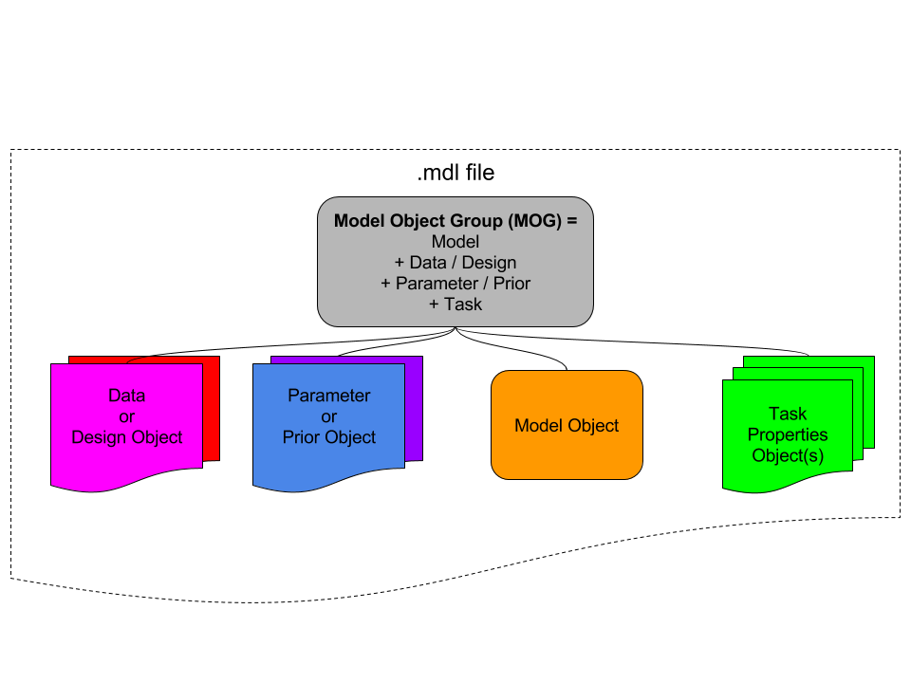
Model Description Language Structure
Notes:
There are 5 MCL objects: data, design, parameters, model and tasks that are combined to specify the MOG, which parts are required will depend on the specified task
The TOG defines the tasks to be executed via TEL commands taking as arguments the MOG and returning an standardised output
Objects groups can be retrieved as a whole or in part

Slide 13
Modularity – example workflow
Estimation = Data + Parameters + MODEL + Monolix Task Properties
Bayesian estimation = Data + Priors + MODEL + BUGS Task
VPC = Data + Final Parameters + MODEL + NONMEM Task Properties
Prediction / simulation = Design + Final Parameters + MODEL + Simulation Task Properties
Optimal design / evaluation = Design + Final Parameters + MODEL + PFIM / PopED Task Properties

Slide 14
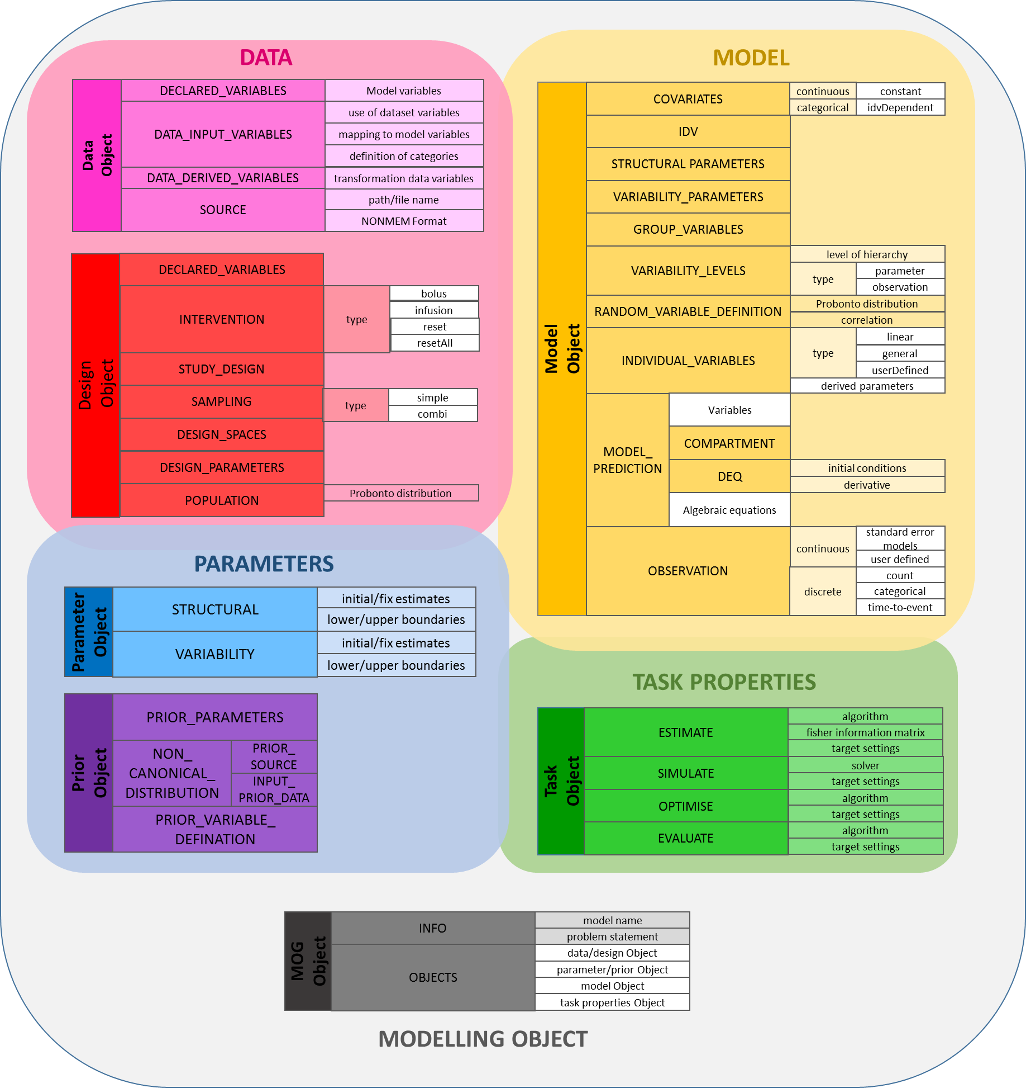
Model Description Language Structure

Slide 15
Model Description Language Structure
DATA
Data Object
DECLARED_VARIABLES
Model variables
DATA_INPUT_VARIABLES
use of dataset variables
mapping to model variables
Data can be provided via an external dataset (Data Object) or specifying a design (Design Object)
The Data Object defines variables used for modelling tasks and its use, as well as the source of the data
For simulation or optimal design tasks, data might be specified via the Design Object
definition of categories
DATA_DERIVED_VARIABLES
transformation data variables
SOURCE
path/file name
NONMEM Format
Design Object
DECLARED_VARIABLES
INTERVENTION
type
bolus
infusion
reset
resetAll
STUDY_DESIGN
SAMPLING
type
simple
DESIGN_SPACES
combi
DESIGN_PARAMETERS
POPULATION
Probonto distribution

Slide 16
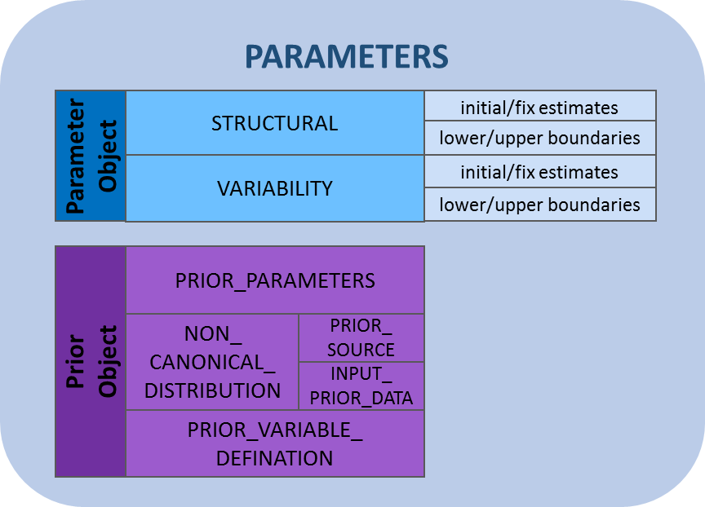
Model Description Language Structure
Collects all the relevant model parameter values
Structural and variability parameters are kept separated
Could be used as a library of parameters
Parameter attributes might be over-written ddmore R package
Prior distributions defined for all model parameters, may include fixed values.

Slide 17
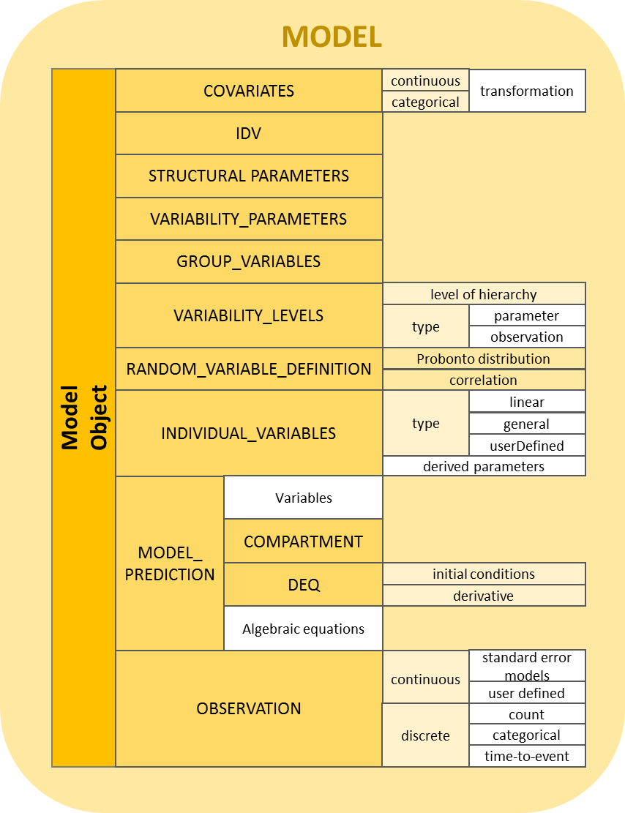
Model Description Language Structure
Defines the structural and statistical part of the model
Independent of target software language
Wide variety of models and different ways of encoding them
Blocks to be used according to the content and context of the model
Specified models might not be usable with all target software

Slide 18
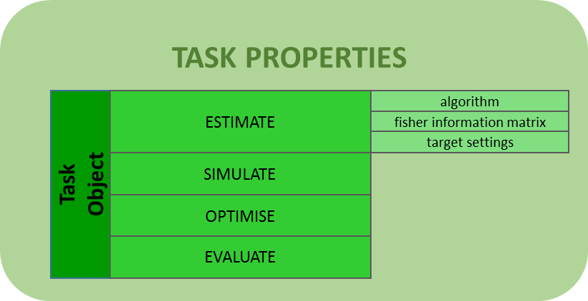
Model Description Language Structure
Provide general settings and options regarding a specific tasks
Provide specific settings for concrete target tools

Slide 19
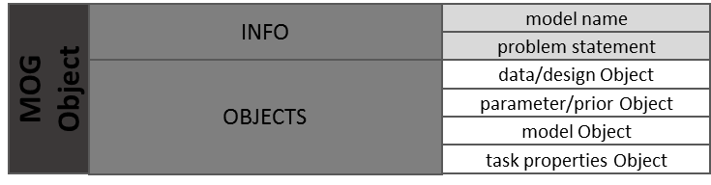
Model Description Language Structure
Combine objects needed to perform a concrete task
Validation across objects is performed at this level in the MDL-IDE

Slide 20
Modularity – recall…
Estimation = Data + Parameters + MODEL + Monolix Task Properties
Bayesian estimation = Data + Priors + MODEL + BUGS Task
VPC = Data + Final Parameters + MODEL + NONMEM Task Properties
Prediction / simulation = Design + Final Parameters + MODEL + Simulation Task Properties
Optimal design / evaluation = Design + Final Parameters + MODEL + PFIM / PopED Task Properties

Slide 21
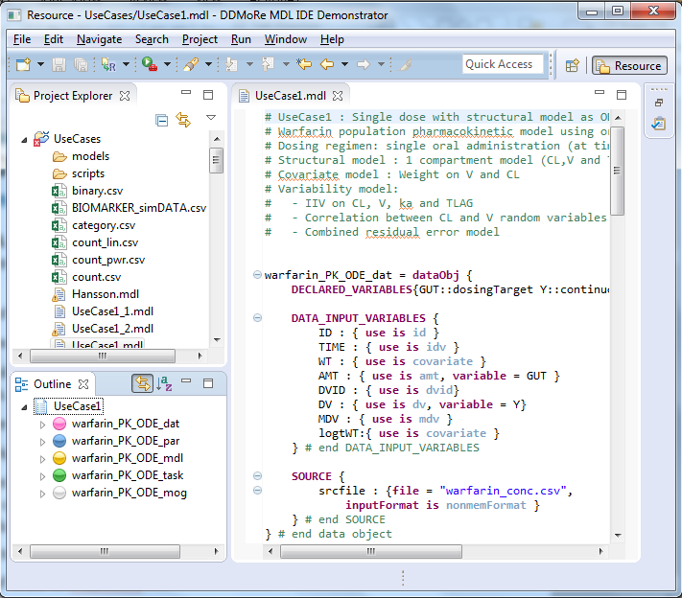
MDL-IDE Overview
The MDL Integrated Development Environment (MDL-IDE) provides the framework within which files containing MDL code can be created and edited
File browser, with warnings & errors flagged
Outline showing MDL structure – “jump to…” functionality.
User-friendly, highly customisable
Syntax highlighting
Advanced and immediate validation engine
Valid MDL -> valid PharmML
Export of MDL to PharmML file
Many more features…

Slide 22
Introduction: warfarin Pop PK (Use Case 1)
Features:
Single dose with structural model as ODEs.
Dosing regimen: single oral administration (at time 0)
Structural model : 1 compartment model (CL,V and TLAG)
Covariate model : Weight on V and CL
Variability model:
IIV on CL, V, ka and TLAG
Correlation between CL and V random variables
Combined residual error model

Slide 24
MDL – How is it different?
Model describes WHAT rather than HOW and INDEPENDENT (as much as possible) from the Data
E.g. If there is >1 outcome then express model of each outcome.
E.g. If outcomes are categorical, then define what the categories are rather than relying on conditioning in the Observation definition
Aim to be clear and consistent rather than concise:
Some things which may be implicit in other languages have to be explicit.

Slide 25
MDL – How is it different?
Definition of dataset variables and their use in the model
DATA_INPUT_VARIABLES{
ID : { use is id }
TIME : { use is idv }
WT : { use is covariate }
AGE : { use is covariate }
SEX : { use is catCov withCategories{female when 0,
male when 1} }
AMT : { use is amt, variable = GUT }
DVID : { use is dvid }
DV : { use is dv, define={1 in DVID as CP_obs,
2 in DVID as PCA_obs} }
MDV : { use is mdv }
}# end DATA_INPUT_VARIABLES

Slide 26
MDL – How is it different?
Definition of random variables
RANDOM_VARIABLE_DEFINITION(level=ID) {
ETA_CL ~ Normal(mean = 0, sd = PPV_CL)
ETA_V ~ Normal(mean = 0, sd = PPV_V)
ETA_KA ~ Normal(mean = 0, sd = PPV_KA)
:: {type is correlation, rv1=ETA_CL, rv2=ETA_V, value=CORR_CL_V}
ETA_TLAG ~ Normal(mean = 0, sd = PPV_TLAG)
} # end RANDOM_VARIABLE_DEFINITION

Slide 27
MDL – How is it different?
Definition of random variables
RANDOM_VARIABLE_DEFINITION(level=ID) {
ETA_CL ~ StudentT1(mean=0, scale = PPV_CL, degreesOfFreedom = DF)
ETA_V ~ Normal(mean = 0, sd = PPV_V)
ETA_KA ~ Normal(mean = 0, sd = PPV_KA)
:: {type is correlation, rv1=ETA_CL, rv2=ETA_V, value=CORR_CL_V}
ETA_TLAG ~ Normal(mean = 0, sd = PPV_TLAG)
} # end RANDOM_VARIABLE_DEFINITION

Slide 28


MDL – How is it different?
To support interoperability , some relationships need to be more explicit (when they can be)...
$${CL}_{i}=CL×{\left(\frac{WT}{70}\right)}^{β_{CL}}×e^{η_{i}}$$
$$\log\left({CL}_{i}\right)=log\left(CL×{\left(\frac{WT}{70}\right)}^{β_{CL}}\right)+ η_{i}$$
INDIVIDUAL_VARIABLES{
CL : { type is linear, trans is ln,
pop = POP_CL,
fixEff = [{coeff =BETA_CL_WT, cov =logtWT}],
ranEff = ETA_CL )
...
} # end INDIVIDUAL_VARIABLES

Slide 29
MDL – How is it different?
Similarly, for residual error models
OBSERVATION{
CP_obs : {type is combinedError1,
additive = RUV_ADD, proportional = RUV_PROP,
prediction = CC, eps = EPS_CP )
PCA_obs : {type is additiveError,
additive = RUV_FX,
eps = EPS_PCA, prediction = PCA )
}# end OBSERVATION

Slide 30
MDL – How is it different?
BUT user-defined error models can also be implemented
Here the DV and prediction Y are on the log scale.
OBSERVATION {
W = sqrt(RUV_PROP^2+RUV_ADD^2/CC^2)
Y : {type is userDefined,
value = ln(CC)+W*EPS_Y,
weight = W,
prediction = ln(CC)}
} # end OBSERVATION

Slide 31
MDL – How is it different?
Definition of variability levels
warfarin_PK_BOV_dat = dataObj{
DATA_INPUT_VARIABLES{
ID : { use is id }
TIME : { use is idv }
OCC : { use is varLevel }
DV : { use is dv, variable = Y }
…
}# end DATA_INPUT_VARIABLES
…
}
warfarin_PK_BOV_par = mdlObj{
…
VARIABILITY_LEVELS{
ID : { level=3, type is parameter }
OCC : { level=2, type is parameter }
DV : { level=1, type is observation }
}
…
}

Slide 32
MDL – Some things are easier…
RANDOM_VARIABLE_DEFINITION(level=ID){
eta_BSV_CL~ Normal(mean=0, var=PPV_CL)
}# end RANDOM_VARIABLE_DEFINITION
RANDOM_VARIABLE_DEFINITION(level=OCC){
eta_BOV_CL~ Normal(mean=0, var=BOV_CL)
}# end RANDOM_VARIABLE_DEFINITION
INDIVIDUAL_VARIABLES{
CL : {type is linear, trans is ln, pop = POP_CL, fixEff = {coeff=BETA_CL_WT, cov=logtWT} , ranEff = [eta_BSV_CL, eta_BOV_CL ]}
}# end INDIVIDUAL_VARIABLES

Slide 33
MDL – Some things are easier…
MDL uses the ProbOnto knowledge base for statistical distributions used in Random Variable Definitions.
MODEL_PREDICTION{
lnLAMBDA = ln(BASECOUNT) + BETA*CP
LAMBDA = exp(lnLAMBDA)
}
RANDOM_VARIABLE_DEFINITION(level=DV){
Y ~ Poisson1(rate=LAMBDA)
}
OBSERVATION{
:: {type is count, variable = Y}
}# end ESTIMATION

Slide 34
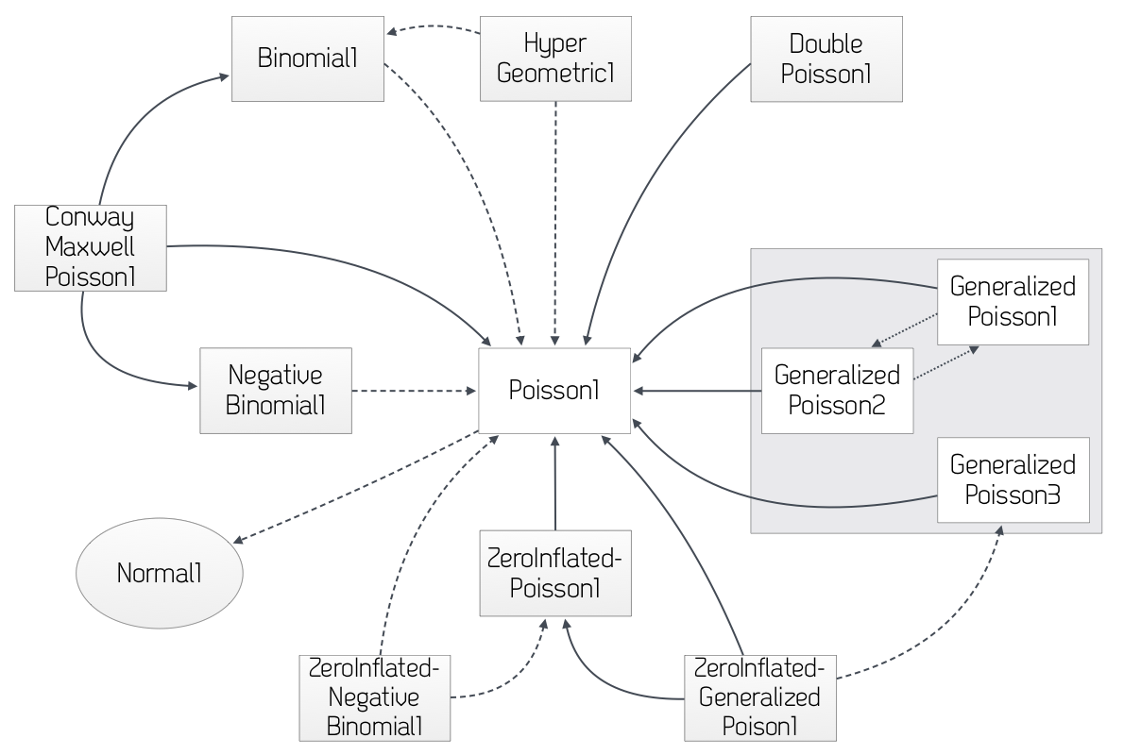
MDL – ProbOnto

Slide 35
MDL – Differential equations and Compartments
Specifying the PK model can be done using compartment definitions (like Monolix’s PK Macros).
MODEL_PREDICTION{
COMPARTMENT{
INPUT_KA : {type is depot, to=CENTRAL, ka=KA, tlag=TLAG}
CENTRAL : {type is compartment }
:: {type is elimination, from=CENTRAL, v=VC, cl=CL}
PERIPHERAL: {type is distribution, from=CENTRAL,
kin=Q/VC, kout=Q/VP}
}# end COMPARTMENT
CC=CENTRAL/VC
}# end MODEL_PREDICTION

Slide 36
UseCases
Use Cases demonstrate functionality, model features.
Warfarin Pop PK used as the basis.
UseCase1 – Structural model with differential equations
UseCase2 – Analytical solution
UseCase3 – Joint model of PK and PD (>1 outcome)
UseCase4 – IV and oral administration
UseCase5 – Covariate models including categorical covariate
UseCase6 – Correlation between V, CL, KA
UseCase7 – Structural model specified by Compartments
UseCase8 – Between-occasion variability
UseCase9 – Infusion rates
Interoperable UseCase
Valid MDL
In progress

Slide 37
UseCases (continued)
UseCase10 – 2 distribution compartments
UseCase11 – Poisson count
UseCase12 – Categorical outcome
UseCase13 – Binary outcome
UseCase14 – Time to event (Exact time of event known)
UseCase15 – log-transformed DV
UseCase16 – BLQ handling
UseCase17 – Steady State Pharmacokinetics
Interoperable UseCase
Valid MDL
In progress

Slide 38
UseCases (continued)
UseCase18 – Interpolation of covariates
UseCase19 – L2 handling
UseCase20 – Transit compartment for absorption
UseCase21 – Mixture models
UseCase22 – Complex PK (>1 absorption compartment)
UseCase23 – Conditional observation model
Monolix example models
NONMEM example models
BUGS example models
PharmML example models
Interoperable UseCase
Valid MDL
In progress

Slide 39
MDL – FAQs
“I’m only using 1 tool for modelling, why should I express my model in MDL?”
Perhaps you’re only using 1 tool for estimation, but you may use other tools for simulation / prediction / optimal design…
Model communication.
You probably wish to share your model with others for peer review or collaboration.
They may not have the software you have…
If you’ve programmed all your modelling and simulation tasks in SAS then you may want to consider MDL for model communication / sharing with others…
They may not be familiar with the “tricks” necessary for your favourite software.

Slide 40
MDL - FAQs
“The language feature you describe isn’t available in software X…”
E.g. ETA_CL_V ~ MultivariateStudentT1( … )
It should at least be clear from the MDL WHAT the model is doing…
It should be possible to go from the MDL to at least ONE tool that supports that feature…
Reproducibility through MDL should mean that it’s possible to recreate the model in the tool that you’ve used.
No hidden tricks.
Interoperability should mean that you can switch tools (seamlessly) when necessary.

Slide 41


Slide 42
Recap on MDL
Pharmacometric standard language to describe the HOW
Modular structure to faciliate re-use
How can we integrate MDL in our pharmacometric workflows?
Simeoni model as an example

Slide 43
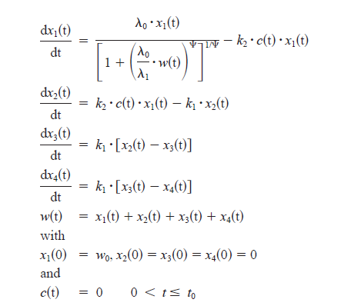
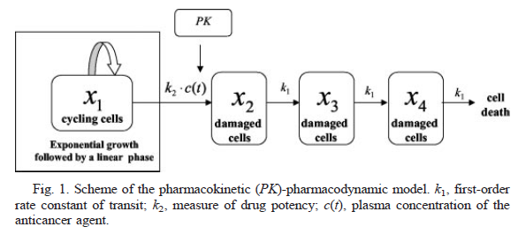
Simeoni model – an example
Simeoni et al. Cancer Res 2004

Slide 44
Simeoni model – an example
MODEL_PREDICTION{
DEQ{
# TGI model
X1:{deriv=(LAMBDA0*X1/ ((1+(WTOT*LAMBDA0/LAMBDA1)^PSI)^(1/PSI))) - K2*C*X1, init=W0}
X2:{deriv=K2*C*X1-K1*X2, init=0}
X3:{deriv=K1*X2-K1*X3, init=0}
X4:{deriv=K1*X3-K1*X4, init=0}
WTOT=X1+X2+X3+X4
}
}
Simeoni et al. Cancer Res 2004

Slide 45
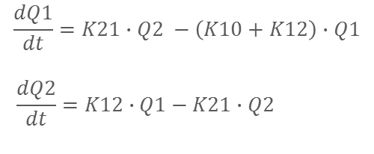
Simeoni model – an example
MODEL_PREDICTION{
DEQ{
# PK model
C=Q1/V1
Q1:{deriv=K21*Q2-(K10+K12)*Q1, init=0}
Q2:{deriv=K12*Q1-K21*Q2, init=0}
# TGI model
X1:{deriv=(LAMBDA0*X1/ ((1+(WTOT*LAMBDA0/LAMBDA1)^PSI)^(1/PSI))) - K2*C*X1, init=W0}
X2:{deriv=K2*C*X1-K1*X2, init=0}
X3:{deriv=K1*X2-K1*X3, init=0}
X4:{deriv=K1*X3-K1*X4, init=0}
WTOT=X1+X2+X3+X4
}
}
$$\frac{dQ1}{dt}=K21∙Q2 −\left(K10+K12\right)∙Q1$$
$$\frac{dQ2}{dt}=K12∙Q1−K21∙Q2$$
Simeoni et al. Cancer Res 2004

Slide 46
Simeoni model - Model Object
simeoni2004_mdl = mdlObj{
IDV { T }
VARIABILITY_LEVELS{
DV : { level=1, type is observation }
}
STRUCTURAL_PARAMETERS{
LAMBDA0_POP
LAMBDA1_POP
K1_POP
K2_POP
W0_POP
K10_POP
K12_POP
K21_POP
V1_POP
PSI_POP
}
VARIABILITY_PARAMETERS{
CV
}
Define the independent variable
Define the levels of variability
Define which parameters are used in the model

Slide 47
Simeoni model - Model Object
INDIVIDUAL_VARIABLES{
LAMBDA0 = LAMBDA0_POP
LAMBDA1 = LAMBDA1_POP
K1 = K1_POP
K2 = K2_POP
W0 = W0_POP
K10 = K10_POP
K12 = K12_POP
K21 = K21_POP
V1 = V1_POP
PSI = PSI_POP
}
MODEL_PREDICTION{…
}
RANDOM_VARIABLE_DEFINITION (level=DV) {
eps_RES_W ~ Normal(mean=0, var=1)
}
OBSERVATION {
Y : {type is proportionalError, proportional=CV, eps=eps_RES_W, prediction= WTOT}
}
}
In this model, no IIV is present, therefore individual parameters are equal to the structural ones
Define the distribution of the residual error variability and the link between model prections and residual error

Slide 48
Simeoni model – Data Object
DECLARED_VARIABLES{Y::continuousObs
Q1::dosingTarget}
DATA_INPUT_VARIABLES{
ID:{use is id}
TIME:{use is idv}
DV:{use is dv, variable= Y}
AMT:{use is amt, variable=Q1}
CMT:{use is cmt}
MDV:{use is mdv}
}
SOURCE{
scrfile : {
file="Simulated_PAGE_estimation.csv",
inputFormat is nonmemFormat
}
}
}
Declare variables defined in the model object, and ist type
Define the dataset variables and their intended use in the model
Provide the file name and ist path if needed

Slide 49
Simeoni model – Parameter Object
simeoni2004_par = parObj{
STRUCTURAL{
LAMBDA0_POP : {value=0.3, lo=0 }
LAMBDA1_POP : {value=0.7, lo=0}
K1_POP : {value=0.7, lo=0 }
K2_POP : {value=0.5, lo=0}
W0_POP : {value=0.02, lo=0 }
K10_POP : {value=0.868*24, fix=true}
K12_POP : {value=0.006*24, fix=true}
K21_POP : {value = 0.0838*24, fix=true}
V1_POP : {value=0.81, fix=true}
PSI_POP : {value=20, fix=true}
}
VARIABILITY{
CV : {value=0.1, lo=0}
}
}
Provide initial estimates and boundaries for the model structural and variability parameters.
Parameters can be fixed at this level

Slide 50
Simeoni model – Design Object
simeoni2004_design = designObj{
DECLARED_VARIABLES{
Q1::dosingTarget
Y::continuousObs
}
INTERVENTION{
treated : {type is bolus, input=Q1, amount=30*10^6, doseTime=0}
control : {type is bolus, input=Q1, amount=0, doseTime=0}
}
}
SAMPLING{
sampleControl : {type is simple, sampleTime=[0,4,36,40],
outcome = Y}
sampleTreated : {type is simple, sampleTime=[0,20,55,60],
outcome = Y}
}
Declare variables defined in the model object, and ist type
Define dosing schedule to evaluate
Define the sampling times and variables

Slide 51
Simeoni model – Design Object
STUDY_DESIGN{
treatedArm : {armSize = 1, interventionSequence = {admin=treated, start=0},
samplingSequence = {sample=sampleTreated,start=0}}
controlArm : {armSize = 1,
interventionSequence = {admin=control, start=0},
samplingSequence={sample=sampleControl,start=0}}
}
}
Define the size of the study groups and link them to their intervation and sampling schema

Slide 52
Simeoni model – Prior Object
simeoni2004_pri = priorObj{
PRIOR_PARAMETERS{
# log scale
MU_LAMBDA0_POP = -1.4
MU_LAMBDA1_POP = -1.3
MU_K1_POP = -1.2
MU_K2_POP = -3.2
MU_W0_POP = -3.9
# variances
SIGMA_LAMBDA0_POP = 0.8
SIGMA_LAMBDA1_POP = 1.2
SIGMA_K1_POP = 1.8
SIGMA_K2_POP = 1.4
SIGMA_W0_POP = 3.2
a_CV2 = 195 #so that IC95% for CV: 0.08-0.09;
mean_gamma=a/b, var_gamma=a/(b^2)
b_CV2 = 1.4
}
Define the parameter values for the priors and their uncertainty

Slide 53
Simeoni model – Prior Object
PRIOR_VARIABLE_DEFINITION{
logLAMBDA0_POP ~ Normal(mean=MU_LAMBDA0_POP,
var=SIGMA_LAMBDA0_POP)
logLAMBDA1_POP ~ Normal(mean=MU_LAMBDA1_POP,
var=SIGMA_LAMBDA1_POP)
logK1_POP ~ Normal(mean=MU_K1_POP, var=SIGMA_K1_POP)
logK2_POP ~ Normal(mean=MU_K2_POP, var=SIGMA_K2_POP)
logW0_POP ~ Normal(mean=MU_W0_POP, var=SIGMA_W0_POP)
LAMBDA0_POP = exp(logLAMBDA0_POP)
LAMBDA1_POP = exp(logLAMBDA1_POP)
K1_POP = exp(logK1_POP)
K2_POP = exp(logK2_POP)
W0_POP = exp(logW0_POP)
invCV2 ~ Gamma1(shape=a_CV2, scale=b_CV2)
CV = sqrt(1/invCV2)
}
}
Define the distribution of the priors of the model parameters

Slide 54
Pharmacometric Workflow
Exploratory data analysis
Estimation with NONMEM
Estimation with Monolix
Estimation with WinBUGS
Comparison of estimates
Diagnostics in Xpose using Monolix output
(VPC using Monolix estimates – NOT SHOWN)
Prediction / Simulation using simulx
Evaluate design using PFIM
Optimise design using PFIM

Slide 55
Pharmacometric Workflow - HOW?
“ddmore” R package”

Slide 56
ddmore R package
Set of functions included in an R package: ddmore
Provides the functions and functionality required to work with MDL Objects and write modelling & simulation workflows
Write and execute R scripts within the MDL-IDE
R console (StatET) within MDL-IDE (Eclipse)
Reproducibility through R using e.g. knitr
Link through R to many existing packages (e.g. xpose, simulx, ggplot2, knitr,…)
Notes:
Similar way to a declaration of an R function with a keyword

Slide 57


ddmore R package - R functions
The different set of functions within the ddmore package allows the user to:
Retrieve and modify different elements of a .mdl file
Define and execute M&S tasks using a MOG
Create new MOGs “on the fly” and write to .mdl
Write contents of MOG to PharmML
Query and extract information from the Standard Output (SO) object
Convert MDL / MOG and SO object to other R package standards e.g. Xpose, mlxR (simulx).
→ All these tasks can be integrated in a single R script
Notes:
S4 class R objects provide a well defined and understood structure that allows the implementation of methods
Methods understood as computations to be performed on the objects

Slide 58
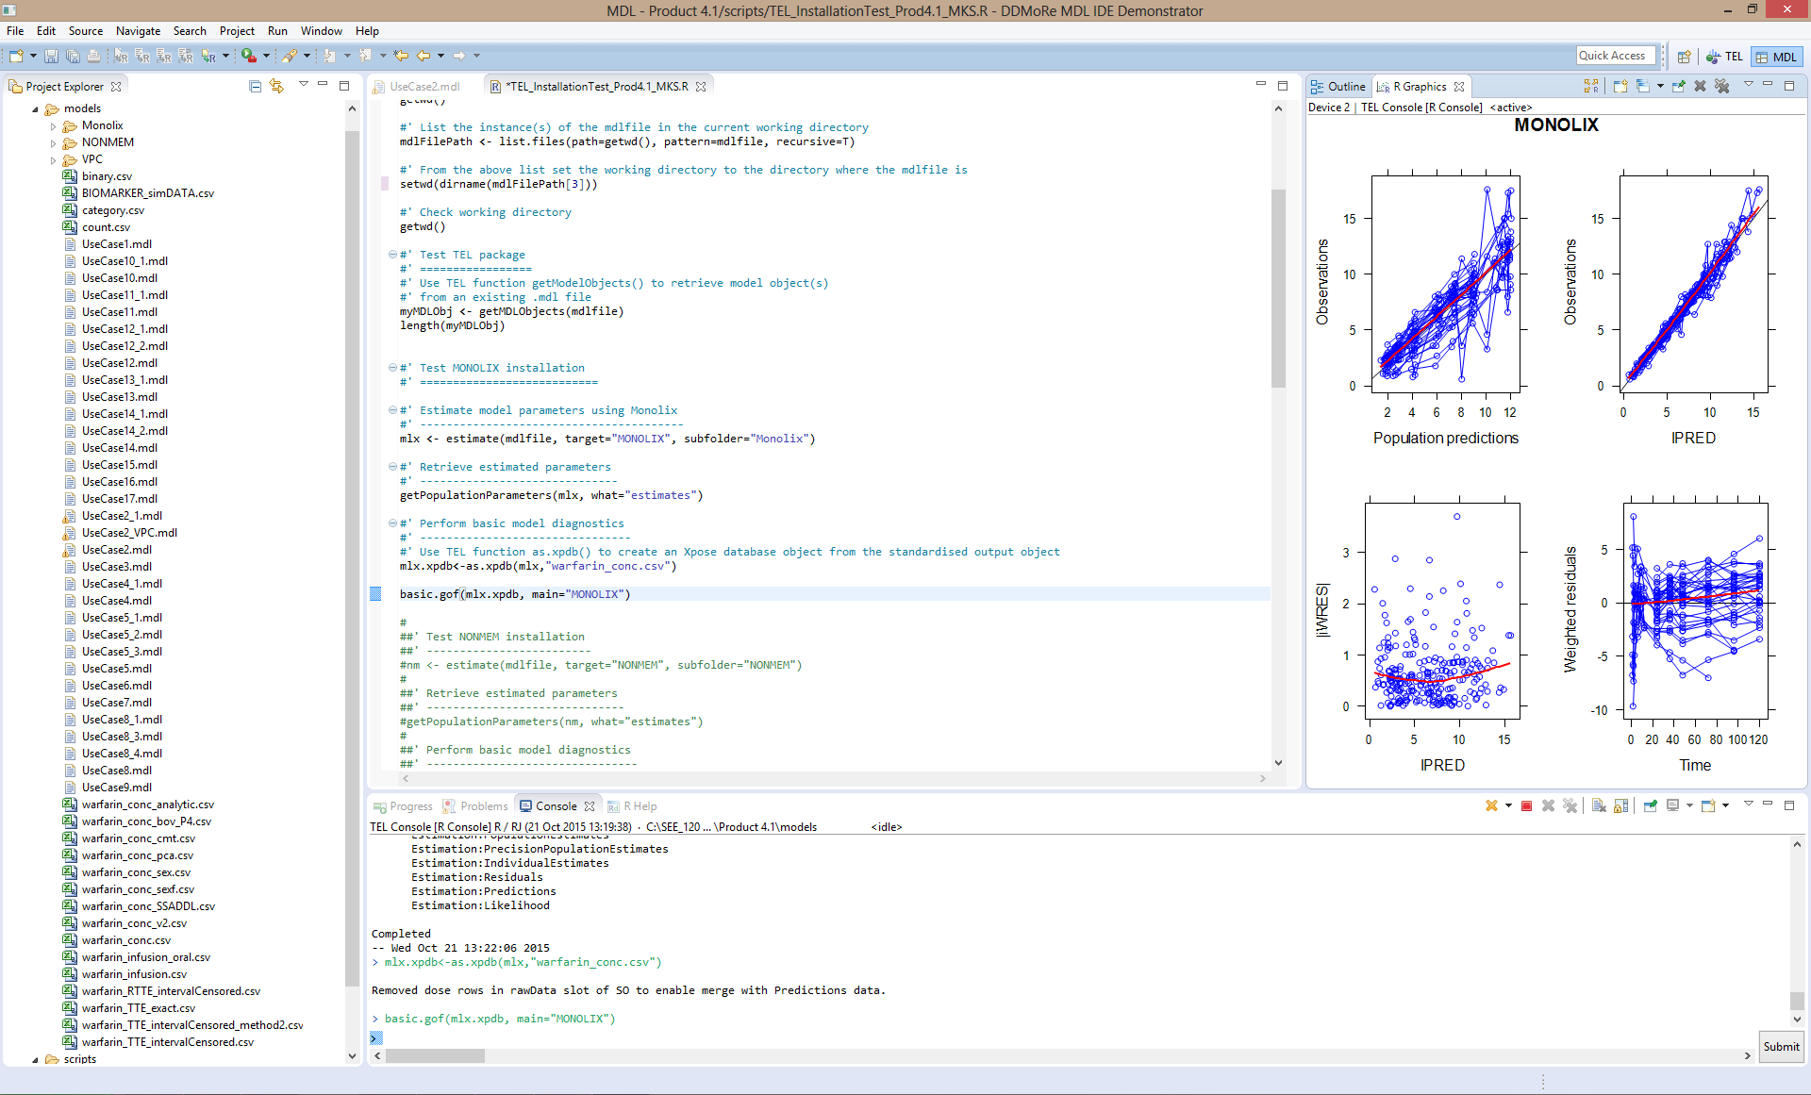
MDL-IDE integrated in the SEE
File browser

Slide 59
MDL-IDE integrated in the SEE
R script
R console

Slide 60
MDL-IDE integrated in the SEE
Xpose diagnostics
Following Monolix estimation

Slide 61
Demonstration

Slide 62
Resources
YouTube clips for installation and testing of demonstrator:
https://www.youtube.com/playlist?list=PL_GGUkhbiP3t0Q7wTqkQdMAw7yuC8xWa-
MDL User Guide documentation:
http://ddmore.eu/instructions/user-guides

