Slide 1
Introduction to Model Description Language: a new pharmacometric standard
Material prepared by:
Mike K Smith, Stuart Moodie & Zinnia P Parra-Guillen

Slide 2
Agenda
Lecture: Overview of MDL (getting started with MDL)
Structure, components
Model Object
IDV, Covariates, Variability, Variability levels, Group variables, RV definition, individual variables, model prediction, compartments, DEQ, Observation blocks.
Parameter Object
Data Object
Hands – on with the MDL-IDE
Use Case 1 - Looking at an entire model, combining model objects
Use Case 5 – Specifying covariates, covariate transformations, categorical covariates
Exercise – fixing a “broken” model
(Depending on time – UseCase4. Moving from ODEs to compartments and ensuring the models are equivalent)

Slide 3
Agenda (2)
Lecture: A deeper understanding of MDL – why is it written like that?
Declarative nature of MDL
Declaring variables & a further look at the Data Object
List objects, defining types
Using Use Case 5 example
Random variable definition & ProbOnto
Using “anonymous lists” i.e. ::
Category definition
Non-continuous outcomes e.g. Poisson (Use Case 11)
Conditions and piecewise functions.
Properly dealing with multiple outcomes WITHOUT using DVID
Dealing with piecewise residual errors.
Property definitions
“use is…”, “type is..”
MDL Grammar
MDL User Guide

Slide 4
Learning Objective
By the end of the tutorial, attendees will
be able to understand and use concepts presented in the MDL User Guide to encode model
will be familiar with the MDL Editor and will be able to use its features to edit and troubleshoot MDL issues
have a basic grasp of MDL sufficient for them to encode simpler models and to troubleshoot when models are incorrectly specified
understand MDL grammar and constructs well enough to be able to use the MDL User Guide to help encode more intermediate / advanced features in MDL.

Slide 5




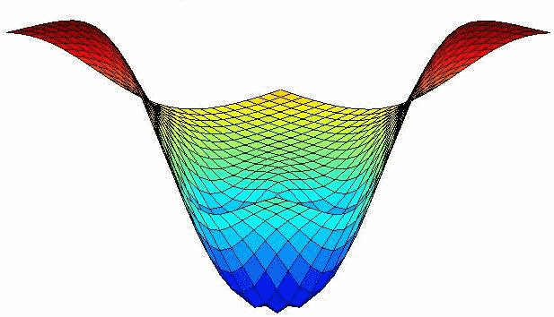

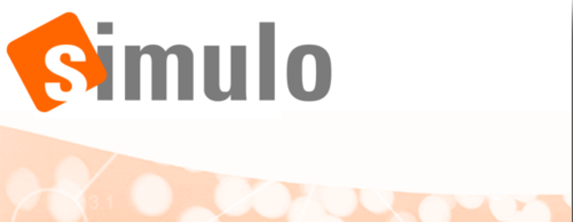








Motivation
Estimation
Model evaluation
Simulation/ Prediction
Optimal Design
PFIM
PopED
“…But I only use NONMEM…”
Notes:
Different and growing number of tools & languages currently available (e.g NMTRAN for Nonmem or MLXTRAN for Monolix)
Lack of language standards in the pharmacometrics field
Modelling and simulation tasks ofen require the use of multiple tools, which are not always interoperable
Recoded of models needed

Slide 6
DDMoRe Standards
MDL: Model Description Language
What the modeller uses to describe and encode the model
Emphasis on language being clear and consistent, rather than concise.
PharmML: Pharmacometrics Markup Language
Basis for interoperability between software
Includes ProbOnto (Probability distribution Ontology) which defines probability distributions and how they are related.
SO: Standard Output
XML standard for modelling and simulation output.
All DDMoRe standards are Open Source

Slide 7
Motivation
DDMoRe standards facilitate understanding and knowledge sharing across tools:
We all “know” what a 1 compartment Pop PK model looks like
BUT if we ask 10 modellers to encode it across the tools listed previously, would we get the same or a consistent model across these?

Slide 8
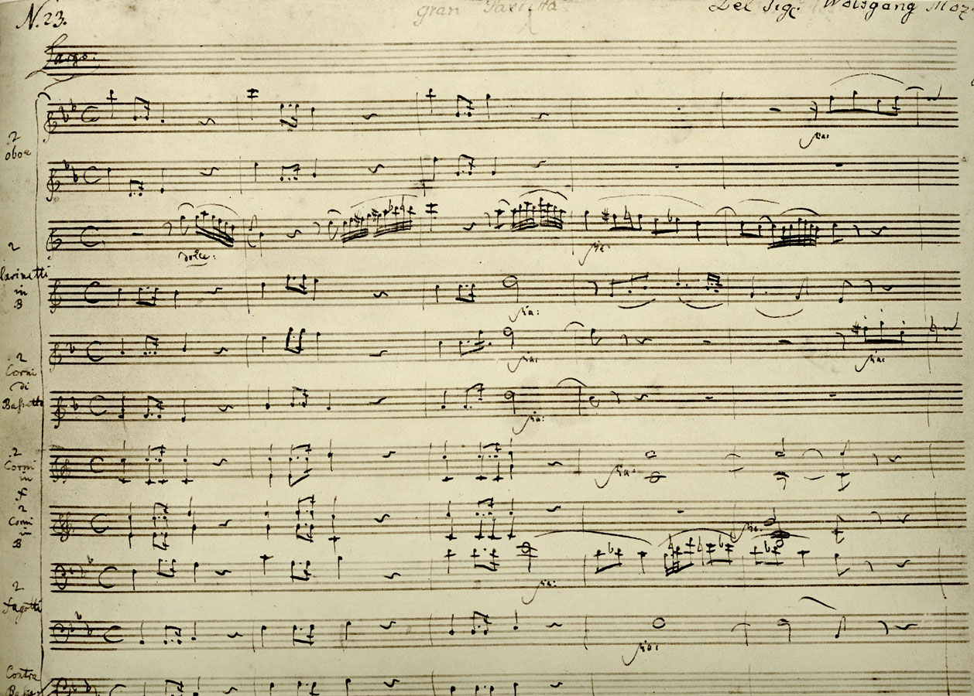
Composer’s own notation

Slide 9
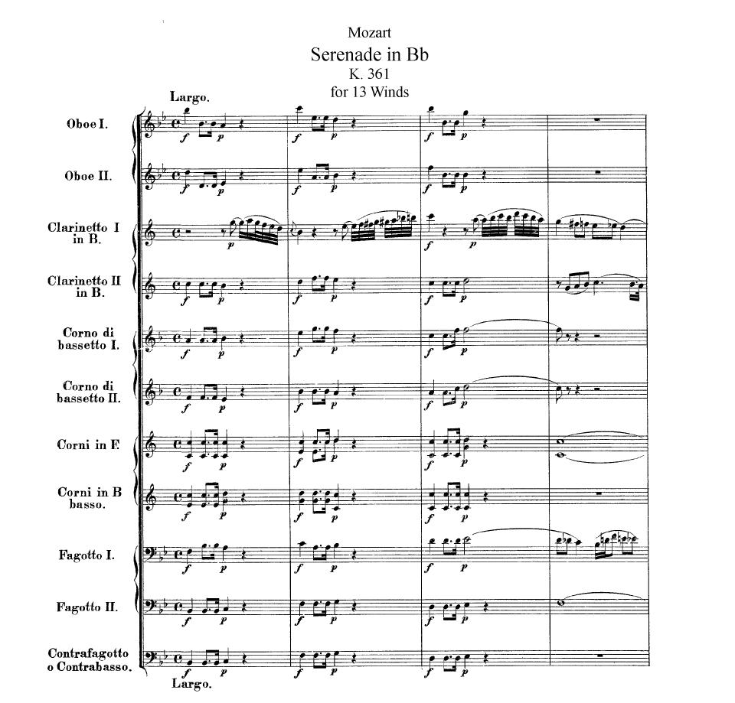
Standard notation
Notes:
Standards make it easier, clearer to see what’s going on.
Clear intentions / unambiguous.
Composer’s shortcuts are written out in full.
Intended for others to use.
NB: HOW TO PLAY IT is still open to artistic input.

Slide 10
Motivation
DDMoRe standards facilitate interoperability
Encode the model once, use it in whatever tools you like.
Conversion of the MDL / PharmML to many different target tools.
Today
MDL -> PharmML -> target tool conversion via IOR R package + converter software (Java).
Target software:
NONMEM, Monolix, WinBUGS, PFIM, PopED
Conversion software is “work in progress”
Some features in MDL / PharmML are not supported by some converters

Slide 11
Motivation
DDMoRe standards facilitate workflow
Standard output means that modelling outputs can be converted and passed to model diagnostic code that is agnostic about the tool used for estimation.
E.g. BUGS output -> xpose object
Automated conversion facilitates unbroken workflow
Estimation -> Diagnostics -> Simulation -> Optimal design
Agnostic to tools used to perform the task

Slide 12
DDMoRe Standards
MDL: Model Description Language
What the modeller uses to describe and encode the model
Emphasis on language being clear and consistent, rather than concise.
PharmML: Pharmacometrics Markup Language
Basis for interoperability between software
Includes ProbOnto (Probability distribution Ontology) which defines probability distributions and how they are related.
SO: Standard Output
XML standard for modelling and simulation output.

Slide 13
Model Description Language Definition
What the modeller works with
Standards to describe pharmacometric models and tasks
Consistent description of models
Facilitate communication and understanding across pharmacometricians and disciplines
Target tool independent
Eliminate (as much as possible) target software specific “tricks”
Modular structure
Could swap Data Objects, Task Objects, Prior instead of Parameter Objects
Flexibility, re-usability and interchange
Notes:
The MDL is a human writeable and human readable language to express the information required to describe pharmacometric models and tasks using these models.
Offers a standard for coding models and executing tasks.
It is independent of any specific target modelling software.
This allows the user to specify the model in a consistent manner and facilitates understanding of the model and associated tasks, regardless of the software used to build the model.
New modelling applications may take advantage of the standard without having to re-invent how to describe common modelling processes.
An important concept in the MDL is the separation of data, parameters, model and task descriptions in terms of separate objects.

Slide 14
Model Description Language Structure
The MDL has 7 objects
Data Object: describes the source of the data and the attributes of each of the data variables
Design Object: describes the trial design and may substitute the data object
Parameter Object: provides (initial) values for the model structural and variability parameters
Prior Object: provides prior distributions for model parameters.
Model Object: defines the structural and statistical model equations based on the data input variables and parameters
Task Properties Object: provides properties which are used to interface with the TEL
Modelling Object Group: specifies the objects that constitute the MOG

Slide 15
Modularity – example workflow
Estimation = Data + Parameters + MODEL + Monolix Task Properties
Bayesian estimation = Data + Priors + MODEL + BUGS Task
VPC = Data + Final Parameters + MODEL + NONMEM Task Properties
Prediction / simulation = Design or Data + Final Parameters + MODEL + Simulation Task Properties
Optimal design / evaluation = Design + Final Parameters + MODEL + PFIM / PopED Task Properties

Slide 16
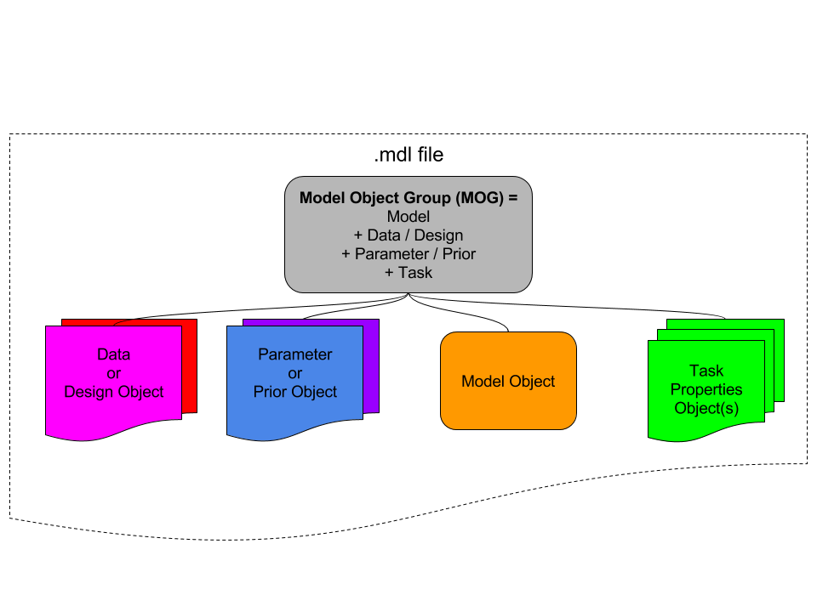
Model Description Language Structure
Notes:
There are 5 MCL objects: data, design, parameters, model and tasks that are combined to specify the MOG, which parts are required will depend on the specified task
The TOG defines the tasks to be executed via TEL commands taking as arguments the MOG and returning an standardised output
Objects groups can be retrieved as a whole or in part

Slide 17
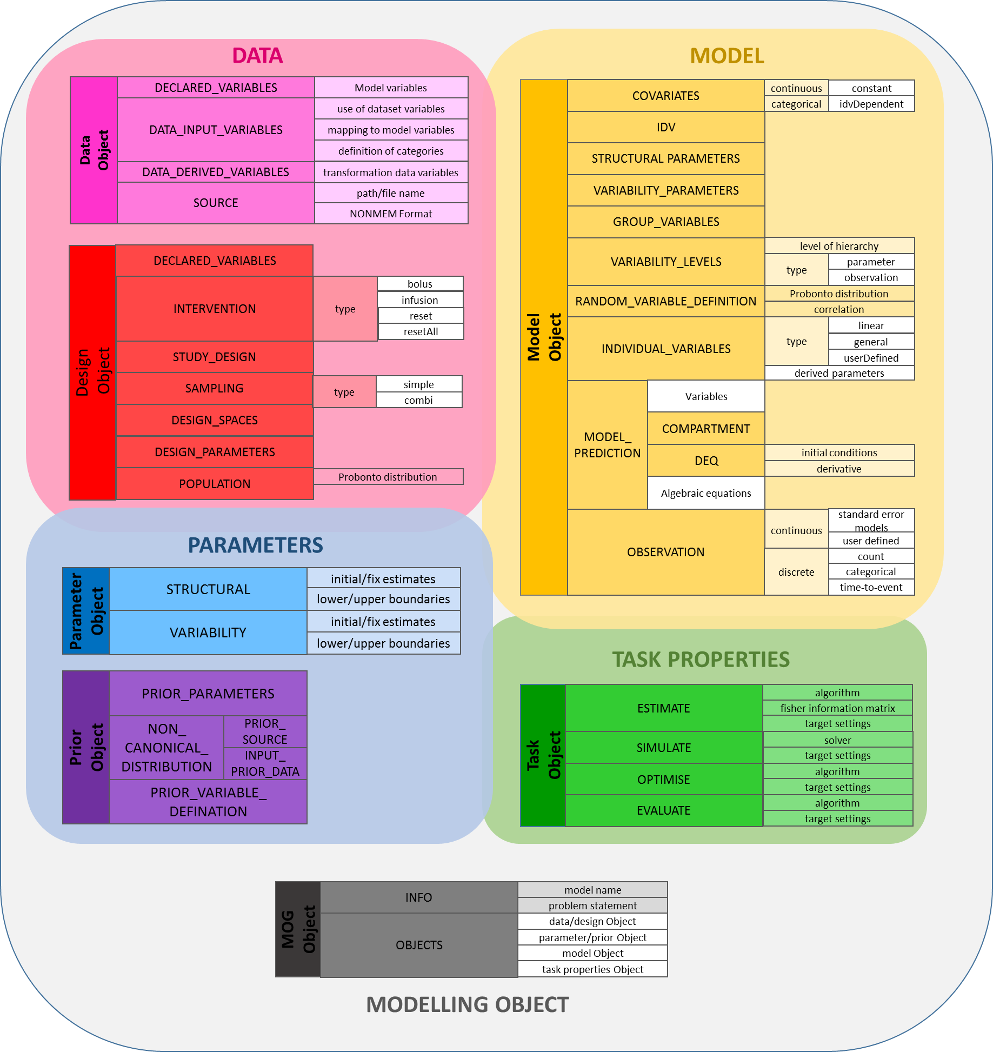
Model Description Language Structure

Slide 18
Model Description Language Structure
DATA
Data Object
DECLARED_VARIABLES
Model variables
DATA_INPUT_VARIABLES
use of dataset variables
mapping to model variables
Data can be provided via an external dataset (Data Object) or specifying a design (Design Object)
The Data Object defines variables used for modelling tasks and its use, as well as the source of the data
For simulation or optimal design tasks, data might be specified via the Design Object
definition of categories
DATA_DERIVED_VARIABLES
transformation data variables
SOURCE
path/file name
NONMEM Format
Design Object
DECLARED_VARIABLES
INTERVENTION
type
bolus
infusion
reset
resetAll
STUDY_DESIGN
SAMPLING
type
simple
DESIGN_SPACES
combi
DESIGN_PARAMETERS
POPULATION
Probonto distribution

Slide 19
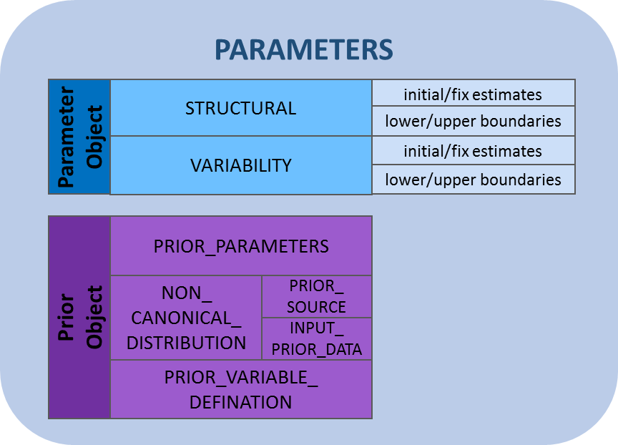
Model Description Language Structure
Collects all the relevant model parameter values
Structural and variability parameters are kept separated
Could be used as a library of parameters
Parameter attributes might be over-written ddmore R package
Prior distributions defined for all model parameters, may include fixed values.

Slide 20
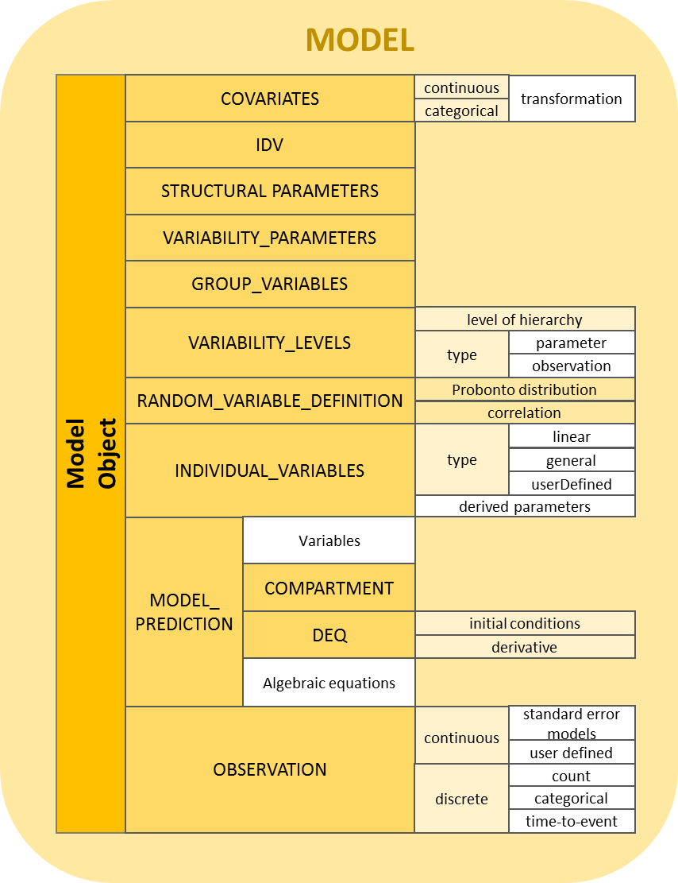
Model Description Language Structure
Defines the structural and statistical part of the model
Independent of target software language
Wide variety of models and different ways of encoding them
Blocks to be used according to the content and context of the model
Specified models might not be usable with all target software

Slide 21
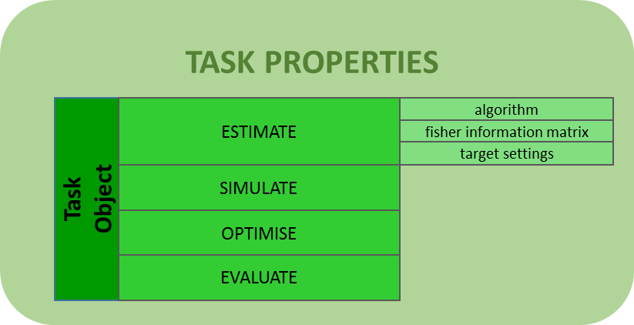
Model Description Language Structure
Provide general settings and options regarding a specific tasks
Provide specific settings for concrete target tools

Slide 22
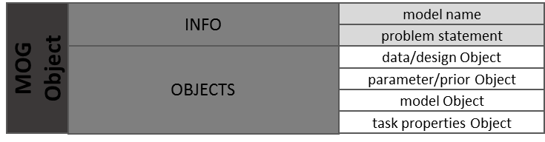
Model Description Language Structure
Combine objects needed to perform a concrete task
Validation across objects is performed at this level in the MDL-IDE

Slide 23
Modularity – recall…
Estimation = Data + Parameters + MODEL + Monolix Task Properties
Bayesian estimation = Data + Priors + MODEL + BUGS Task
VPC = Data + Final Parameters + MODEL + NONMEM Task Properties
Prediction / simulation = Design or Data + Final Parameters + MODEL + Simulation Task Properties
Optimal design / evaluation = Design + Final Parameters + MODEL + PFIM / PopED Task Properties

Slide 24
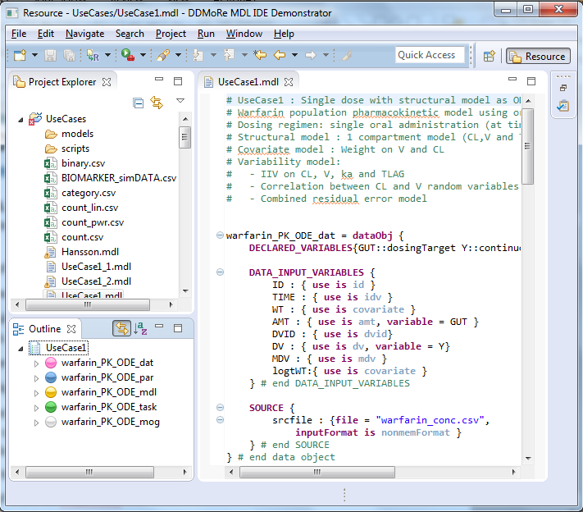
MDL-IDE Overview
The MDL Integrated Development Environment (MDL-IDE) provides the framework within which files containing MDL code can be created and edited
File browser, with warnings & errors flagged
Outline showing MDL structure – “jump to…” functionality.
User-friendly, highly customisable
Syntax highlighting
Advanced and immediate validation engine
Valid MDL -> valid PharmML
Export of MDL to PharmML file
Many more features…

Slide 25
MDL – Key attributes
Aim to be clear and consistent rather than concise:
Some things which may be implicit in other languages have to be explicit in MDL.
MDL has NO reserved variable names
+ve Use names that mean something in YOUR context
+ve Makes it easier to express models without employing “tricks”
-ve CANNOT / DO NOT infer meaning just from variable names
-ve Need to be explicit what these variables ARE and what they DO
Each object in MDL is self-contained in its declaration and definitions.
MDL describes WHAT rather than HOW

Slide 26
MDL – Key attributes
MDL is a “declarative” language rather than “imperative”
What does this mean and why should I care?
Variables should be defined ONCE only
Variables appear on the left-hand-side of “=“, “:”, “~”
If… then… else… conditionals appear on the RIGHT of equations NOT on the left / as wrappers around assignments.
But better to use piecewise functions if possible

Slide 27
Introduction: warfarin Pop PK (Use Case 1)
Features:
Single dose with structural model as ODEs.
Dosing regimen: single oral administration (at time 0)
Structural model : 1 compartment model (CL,V and TLAG)
Covariate model : Weight on V and CL
Variability model:
IIV on CL, V, KA and TLAG
Correlation between CL and V random variables
Combined residual error model

Slide 28
Hands-on – UseCase1

Slide 29
Understanding UseCase1
Model definitions need to map into Data (or Design) Object attributes
IDV
COVARIATES
VARIABILITY_LEVELS
MODEL_PREDICTION inputs e.g. dosing (implicit in UseCase1, explicit in UseCase2)
Model parameters need to map into Parameter (or Prior) Object parameters
RATEIN definition if… then… else… dictates that this model does not handle beyond single dosing.
Additional doses would not have TLAG honoured (as T would be >= TLAG)

Slide 30
UseCase5
Features:
Single dose with structural model as Compartments.
Dosing regimen: single oral administration (at time 0)
Structural model : 1 compartment model (CL,V and TLAG)
Covariate model : Weight on V and CL, SEX on CL, AGE on CL
Variability model:
IIV on CL, V, KA and TLAG
Correlation between CL and V random variables
Combined residual error model

Slide 31
Hands-on – UseCase5

Slide 32
Extending UseCase1 -> UseCase5
Categorical covariate:
In Data Object:
DATA_INPUT_VARIABLES {
SEXF : {use is catCov withCategories {female when 1,
male when 0} }
In Model Object:
COVARIATES{
SEXF withCategories {female, male}
}
INDIVIDUAL_VARIABLES {
CL : {type is linear, trans is ln, pop = POP_CL,
fixEff = {coeff = POP_FCL_FEM, catCov = SEXF.female},
ranEff = ETA_CL }

Slide 33
Extending UseCase1 -> UseCase5
Use COMPARTMENT block rather than ODEs
Makes specification of PK models easier
Analogous to Monolix PK Macros
COMPARTMENT {
INPUT_KA : {type is depot, to=CENTRAL, ka=KA, tlag=TLAG}
CENTRAL : {type is compartment}
:: {type is elimination, from=CENTRAL, v=V, cl=CL}
}# end COMPARTMENT
CC = CENTRAL / V

Slide 34
Extending UseCase1 -> UseCase5
Dosing to PK COMPARTMENT definition rather than ODE compartment
Depot compartment definition handles repeated dosing appropriately.
DECLARED_VARIABLES{ INPUT_KA :: dosingTarget }
DATA_INPUT_VARIABLES {
AMT : { use is amt, variable = INPUT_KA }
}

Slide 35
Extending UseCase1 -> UseCase5
Vector of fixEff coefficients:
INDIVIDUAL_VARIABLES {
CL : {type is linear, trans is ln, pop = POP_CL,
fixEff = [ {coeff = BETA_CL_WT, cov = logtWT},
{coeff = POP_FCL_FEM, catCov = SEXF.female },
{coeff = BETA_CL_AGE, cov = tAGE} ],
ranEff = ETA_CL }

Slide 36
Hands-on – Broken model
The “broken.mdl” example has several problems that need to be fixed.
Use the MDL Editor to identify and fix the problems
Hint: UseCase5 is the “fixed” version

Slide 37
UseCase4 / 4_1 / 4_2 / 4_3
Features:
Single dose with ODEs / Compartments / mix
Dosing regimen: intravenous infusion followed by single oral administration
Structural model : 1 compartment model (CL,V and TLAG)
Covariate model : Weight on V and CL
Variability model:
IIV on CL, V, KA, FOral and TLAG
Correlation between CL and V random variables
Combined residual error model

Slide 38
UseCase4
warfarin_PK_IVPO_dat = dataObj {
DECLARED_VARIABLES{
GUT :: dosingTarget
CENTRAL :: dosingTarget
}
DATA_INPUT_VARIABLES{
TIME: { use is idv }
RATE: { use is rate }
CMT: { use is cmt }
AMT: { use is amt, define={1 in CMT as GUT, 2 in CMT as CENTRAL} }
}
DATA_DERIVED_VARIABLES{
DT : { use is doseTime, idvColumn=TIME, dosingVar=GUT }
}
}

Slide 39
UseCase4
MODEL_PREDICTION {
DT # DT = Dosing time
DEQ{
RATEIN = if(T-DT >= TLAG) then GUT * KA
else 0
GUT : { deriv = (- RATEIN), init = 0, x0 = 0 }
CENTRAL : { deriv = (RATEIN * FORAL - CL * CENTRAL / V),
init = 0, x0 = 0 }
}
CC = CENTRAL / V
}

Slide 40
UseCase4_1
Data Object doesn’t require DATA_DERIVED_VARIABLES{ } block.
In Model Object:
MODEL_PREDICTION{
COMPARTMENT {
INPUT_KA : {type is depot, to=CENTRAL, ka=KA,
tlag=TLAG, finput=FORAL}
INPUT_CENTRAL : {type is direct, to = CENTRAL}
CENTRAL : {type is compartment}
:: {type is elimination, from=CENTRAL, v=V, cl=CL}
}
CONC=CENTRAL/V }

Slide 41
UseCase4_2
In Model Object:
MODEL_PREDICTION {
COMPARTMENT{
INPUT_KA : {type is depot, to=CENTRAL, ka=KA, tlag=TLAG,
input=FORAL}
INPUT_CENTRAL : {type is direct, to = CENTRAL}
}
DEQ{
CENTRAL : { deriv =( - CL * CENTRAL / V), init = 0, x0 = 0 }
}
CC = CENTRAL / V
}

Slide 42
UseCase4_3
In Model Object:
MODEL_PREDICTION {
COMPARTMENT{
INPUT_KA : {type is direct, to = GUT, tlag=TLAG
finput=FORAL,}
INPUT_CENTRAL : {type is direct, to = CENTRAL}
}
DEQ{
GUT : { deriv =(- GUT * KA), init = 0, x0 = 0 }
CENTRAL : { deriv =(GUT * KA - CL * CENTRAL / V), init = 0, x0 = 0 }
}
CC = CENTRAL / V
}

Slide 44
Recap: Agenda (2)
Lecture: A deeper understanding of MDL – why is it written like that?
Declarative nature of MDL
Declaring variables & a further look at the Data Object
List objects, defining types
Using UseCase 5 example
Using “anonymous lists” i.e. ::
Random variable definition & ProbOnto
Category definition
Non-continuous outcomes e.g. Categorical (UseCase 13)
Conditions and piecewise functions.
Properly dealing with multiple outcomes WITHOUT using DVID (UseCase3)
Dealing with piecewise residual errors.
Property definitions
“use is…”, “type is..”
MDL Grammar
MDL User Guide
MDL Reference Guide

Slide 45
A deeper understanding of MDL
Because there are no reserved variable names in MDL, we need to be clear what each variable does.
Each of the objects (Data, Parameters, Model, Design, Prior) are self-contained, linked only via the MOG definition.
Each variable appears ONCE on the left hand side of a “=“, “:”, “~”

Slide 46
DECLARED_VARIABLES
We define the use of data items:
MDL User Guide section 2.2
To link Data Object with Model Object variables, we link via “variable” with 1:1 or “define” when 1:many
DECLARED_VARIABLES then defines the type of these variables

Slide 47
Defining items
“=“ typically only used to assign values or calculated values to variables.
“:” used to define attributes of a variable in a list.
PCA0 : {type is linear, trans is ln, pop = POP_PCA0, ranEff = ETA_PCA0 }

Slide 48
List items
The type of the list is defined by a combination of its
owning block
key attribute
key value
E.g. DATA_INPUT_VARIABLES with use is amt and use is dv MUST have an associated variable or define argument.

Slide 49
Anonymous lists
Start the list with “::” i.e. no left hand side variable name.
VARIABILITY_PARAMETERS {
PPV_CL
PPV_V
CORR_CL_V
}
RANDOM_VARIABLE_DEFINITION(level=ID) {
ETA_CL ~ Normal(mean=0, sd = PPV_CL)
ETA_V ~ Normal(mean = 0, sd = PPV_V)
:: {type is correlation, rv1=ETA_CL, rv2=ETA_V, value=CORR_CL_V}
}

Slide 50
Anonymous lists
RANDOM_VARIABLE_DEFINITION(level=DV){
Y ~ Poisson1(rate=LAMBDA)
}
OBSERVATION{
:: {type is count, variable = Y}
}

Slide 51
Random variable definition (1)
See MDL User Guide section 9.6.2
RANDOM_VARIABLE_DEFINITION(level=ID) {
ETA_CL ~ Normal(mean=0, sd = PPV_CL) #Normal1
ETA_V ~ Normal(mean = 0, var = PPV_V) #Normal2
ETA_KA ~ LogNormal3(median = 0,
stdevLog = PPV_KA)
}

Slide 52
Random variable definition (2)
Multiple levels of random variables are possible: e.g. Between occasion variability, population level variability (UseCase8)
VARIABILITY_LEVELS{
ID : { level=3, type is parameter }
OCC : { level=2, type is parameter }
DV : { level=1, type is observation }
}
RANDOM_VARIABLE_DEFINITION(level=ID){
eta_BSV_CL~ Normal(mean=0, var=BSV_CL)
}
RANDOM_VARIABLE_DEFINITION(level=OCC){
eta_BOV_CL~ Normal(mean=0, var=BOV_CL)
}
INDIVIDUAL_VARIABLES{
CL : {type is linear, trans is ln, pop = POP_CL, fixEff = {coeff=BETA_CL_WT, cov=logtWT} , ranEff = [eta_BSV_CL, eta_BOV_CL ]}

Slide 53
INDIVIDUAL_VARIABLES
Define the relationship between population parameters, fixed effects (covariates etc. if needed) and random effects.
type is linear defines that the relationships are linear (after transformation). See MDL User Guide section 4.9.1
type is general defines that random effects are additive after transformation, but the user supplies the relationship between population parameters, covariates etc. in the GROUP_VARIABLES block. See MDL User Guide section 4.9.2
Can also define by equations (as a last resort)
e.g. CL=POP_CL * (WT/70)^0.75 * exp(eta_PPV_CL)
Can define INDIVIDUAL_VARIABLE in a RANDOM_VARIABLE_DEFINITION block then use “anonymous lists” to assign:
:: {type is rv, variable = CL}

Slide 54
Category definition
Data Object (UseCase5)
DATA_INPUT_VARIABLES {
SEXF : {use is catCov withCategories {female when 1,
male when 0} }
Model Object
COVARIATES{
SEXF withCategories {female, male}
}
INDIVIDUAL_VARIABLES {
CL : {type is linear, trans is ln, pop = POP_CL, fixEff = {coeff = POP_FCL_FEM, catCov = SEXF.female }
}
Maps data values to categories
Defines categories expected
Enumerated category within variable

Slide 55
Category definition - observations
Data Object (UseCase12):
DECLARED_VARIABLES{ Y withCategories{none, event} }
DATA_INPUT_VARIABLES{
DV:{ use is dv, define={ Y.none when 0, Y.event when 1} }
Model Object:
RANDOM_VARIABLE_DEFINITION(level=DV){
Y withCategories {none, event} ~ Bernoulli1(probability=P1)
}
OBSERVATION{
:: {type is discrete, variable = Y }
}

Slide 56
>1 outcome / observation
In Data Object (UseCase3):
DECLARED_VARIABLES{CP_obs::observation PCA_obs::observation}
DATA_INPUT_VARIABLES{
DVID : { use is dvid }
DV : { use is dv, define={1 in DVID as CP_obs,
2 in DVID as PCA_obs} }
In Model Object:
OBSERVATION{
CP_obs : {type is combinedError1, additive = RUV_ADD, proportional = RUV_PROP, eps = EPS_CP, prediction = CC }
PCA_obs : {type is additiveError, additive = RUV_FX, eps = EPS_PCA, prediction = PCA }
}

Slide 57
Conditional assignment
If… then… else… should go on the right hand side of assignment
elseif… then… also available for additional conditions
Useful for assigning different list definitions depending on the condition.
Remember to include else… to ensure that the variable always has attributes assigned to it.
piecewise{{ <value> when <condition>; … ; otherwise <value>}}
MDL User Guide section 9.1.4.4
Defines a discontinuous function
Conditions MUST NOT overlap!
Useful for assigning different values

Slide 58
Conditional assignment (2)
In Model Object (UseCase21_1):
INDIVIDUAL_VARIABLES {
CL : if(POP==1) then {type is linear, trans is ln, pop = POP_CL + POP_CL2, fixEff = {coeff=BETA_CL_WT, cov=logtWT} , ranEff = ETA_CL}
else {type is linear, trans is ln, pop = POP_CL, fixEff = {coeff=BETA_CL_WT, cov=logtWT} , ranEff = ETA_CL}

Slide 59
Conditional assignment (3)
In Model Object:
OBSERVATION{
CC_obs : {type is combinedError1,
additive = RUV_ADD,
proportional = piecewise{{
RUV_PROP1 when ((STUDY==200) || (STUDY==201));
RUV_PROP2 when STUDY==300;
otherwise RUV_PROP3 }},
eps = eps_RUV_EPS1,
prediction = CC }
}

Slide 60
“use is…”
MDL User Guide section 2.2
Use | Defines
id | Individual identifier. Typically subject ID in clinical trials. Defines the indvidual level of parameter variability.
idv | Independent variable. Typically TIME. In the Model Object, the reserved variable T is used as the integrator variable in the specification of differential equations.
amt | Dose amount
dv | Dependent variable
varLevel | Defines a level of variability in the model. Not required for DATA_INPUT_VARIABLES with use is id or use is dv . Used to define all other variability levels such as interoccasion variability.
covariate | Covariate for use in definition of fixed effect variable
catCov | Categorical covariate for use in definition of fixed effect variables based on categories
variable | Defines any model input not covered by other types. Corresponds to the “regressor” variable type in Monolix.
dvid | Dependent variable identifier when there is more than one type of observation.
evid | Event identifier. This type is defined in MDL, but not yet implemented by converters in the current SEE.
mdv | Missing dependent variable
cmt | Compartment identifier
ss | Steady State indicator
ii | Inter-dose interval i.e. time between repeated doses
addl | Number of additional doses in repeated dose administration
rate | Zero-order input rate
ignore | Ignores a data variable

Slide 61
“type is…”
COVARIATES (MDL UserGuide 4.3)
COVARIATES (type is idvDependent) {…}
VARIABILITY_LEVELS (MDL UserGuide 4.6)
type is parameter | observation
RANDOM_VARIABLE_DEFINITION (MDL UserGuide 4.8)
type is correlation | covariance
INDIVIDUAL_VARIABLES (MDL UserGuide 4.9)
type is linear | general | rv
COMPARTMENTS (MDL UserGuide 4.10)
type is depot | direct | compartment | distribution | effect | elimination | transfer
OBSERVATION (MDL UserGuide 4.12)
type is additiveError | proportionalError | combinedError1 | combinedError2 | userDefined

Slide 62
MDL User Guide & Reference
User Guide explains what should go in each block, statement
From a user’s perspective, not the comprehensive “grammar”
User Community contributions welcome via GitHub:
https://github.com/ModelDefinitionLanguage/MDLUserGuide
Please feel free to update and submit a pull request for typos, errors.
Please submit suggestions via “Issues”.
MDL Reference Guide is the complete guide to the grammar.
i.e. what is implemented behind the scenes in the MDL Editor
https://github.com/ModelDefinitionLanguage/MDLUserGuide/blob/master/mdl_reference.pdf

Slide 63
MDL Perspective in CPT:PSP
Model Description Language (MDL): A Standard for Modeling and Simulation
https://doi.org/10.1002/psp4.12222

Slide 64
DDMoRe Language Standards
All DDMoRe standards are open for the community to contribute.
What features are missing from MDL that YOU would like to see?
BLQ handling
“L2” handling
Markov models
…?
Submit suggestions to GitHub:
https://github.com/ModelDefinitionLanguage/website/issues

Slide 66
UseCases
Use Cases demonstrate functionality, model features.
Warfarin Pop PK used as the basis.
UseCase1 – Structural model with differential equations
UseCase2 – Analytical solution
UseCase3 – Joint model of PK and PD (>1 outcome)
UseCase4 – IV and oral administration
UseCase5 – Covariate models including categorical covariate
UseCase6 – Correlation between V, CL, KA
UseCase7 – Structural model specified by Compartments
UseCase8 – Between-occasion variability
UseCase9 – Infusion rates
Interoperable UseCase
Valid MDL
In progress

Slide 67
UseCases (continued)
UseCase10 – 2 distribution compartments
UseCase11 – Poisson count
UseCase12 – Categorical outcome
UseCase13 – Binary outcome
UseCase14 – Time to event (Exact time of event known)
UseCase15 – log-transformed DV
UseCase16 – BLQ handling
UseCase17 – Steady State Pharmacokinetics
Interoperable UseCase
Valid MDL
In progress

Slide 68
UseCases (continued)
UseCase18 – Interpolation of covariates
UseCase19 – L2 handling
UseCase20 – Transit compartment for absorption
UseCase21 – Mixture models
UseCase22 – Complex PK (>1 absorption compartment)
UseCase23 – Conditional observation model
Monolix example models
NONMEM example models
BUGS example models
PharmML example models
Interoperable UseCase
Valid MDL
In progress

Slide 70
MDL – FAQs
“I’m only using 1 tool for modelling, why should I express my model in MDL?”
Perhaps you’re only using 1 tool for estimation, but you may use other tools for simulation / prediction / optimal design…
Model communication.
You probably wish to share your model with others for peer review or collaboration.
They may not have the software you have…
If you’ve programmed all your modelling and simulation tasks in SAS then you may want to consider MDL for model communication / sharing with others…
They may not be familiar with the “tricks” necessary for your favourite software.

Slide 71
MDL - FAQs
“The language feature you describe isn’t available in software X…”
E.g. ETA_CL_V ~ MultivariateStudentT1( … )
It should at least be clear from the MDL WHAT the model is doing…
It should be possible to go from the MDL to at least ONE tool that supports that feature…
Reproducibility through MDL should mean that it’s possible to recreate the model in the tool that you’ve used.
No hidden tricks.
Interoperability should mean that you can switch tools (seamlessly) when necessary.

Slide 72
MDL Structure hierarchy
Object definitions describe which Blocks are valid within each Object.
Block definitions describe
what arguments are associated with the block
what types of statements can be made within the block
what sub-blocks are permitted within the block
what list types are to be used with the block
what properties are permitted within the block.

Slide 73
List types define
whether the list can be anonymous i.e. using ::{ type is … }
whether the list can define categories
what types are associated with the list i.e. type is …
what attributes are permitted withing the list.
what the “signature” of the list looks like, including identifying which attributes are optional.
NB: list type names do not necessarily match the names used in MDL e.g. in defining individual parameters we type CL : {type is linear, … } but the type of the list in the Reference Guide is “IndivParamLinear”. However the list type is given in the Block definition List table (left hand column) with the associated MDL key value in the right hand column.

Slide 74
Sublist definitions define the (small number of) cases where list types contain other lists, for example in definition of the fixed effect model within a IndivParamLinear list. The sublist definition defines:
what attributes are permitted within the sublist
the permitted signature of the sublist and which attributes are optional.
Function definitions define:
Arguments of the function
Type returned from the function.

Slide 75
Type definitions define
the types and associated type classes.
the keyword types and associated enumeration types. e.g. type is combinedError1; set algo is saem.

Slide 76
Demonstration

Slide 77
Resources
YouTube clips for installation and testing of demonstrator:
https://www.youtube.com/playlist?list=PL_GGUkhbiP3t0Q7wTqkQdMAw7yuC8xWa-
MDL User Guide documentation:
http://ddmore.eu/instructions/user-guides

