Slide 1

Information Federation with Concept Libraries
SMIF
Using threat and risk examples
Cory Casanave

Slide 2
Example Problem Space
There is a critical need to understand and mitigate threats and risks – to “connect the dots”.
The Landscape of threats is changing
Multiple attack vectors, cyber/physical and other
Advanced threats utilize multiple vulnerabilities
There are multiple communities addressing the same threats
Cyber/physical, emergency management, safety, defense, etc.
No comprehensive consistent semantic framework
Existing systems provide insular treatment of threat/risk relationships
Comprehensive system would allow system-of-systems interoperability (private/private, public/private)

Slide 3
What we need is an integrating framework that supports automated data mapping
Cyber
Crime
Terrorism
Critical Infrastructure
Natural
Disasters
Integrating Framework for Threats and Risks
Sharing & Analytics
Sharing & Analytics
Sharing & Analytics
Sharing & Analytics
Sharing & Analytics
An integrating framework that helps us deal with all aspects of a risk or incident
A federation of risk and threat information sharing and analytics capabilities

Slide 4
Primary classes of use cases
Transformation from one information sharing data format to another
Example: STIX Cyber Event to NIEM to a CAP Alert
Analytics of information federated from multiple sources
Examples:
Fusion center “connects the dots” between a stolen laptop (from NIEM) and a cyber incident (From STIX)
Bio hazard detected by automated instruments and collaborated by local health care professionals

Slide 5
Pivoting through a conceptual model
The conceptual pivoting approach
A common and growing approach to the data problem leverages abstraction: Defining a domain focused vocabulary with integrity rules and assertions as part of a conceptual model that captures domain semantics. Federation and integration is achieved by relating various logical and physical information structures to the conceptual model
Information federation and integration is achieved via a “pivot” through this conceptual semantic layer
This approach is used, in part, in existing standards such as CCTS (Core Components), ISO 20022 and is currently being utilized in OMG for finance.
In the majority of cases the “tool” used to represent these common semantics and links is a spreadsheet, but UML and OWL are also used.

Slide 6
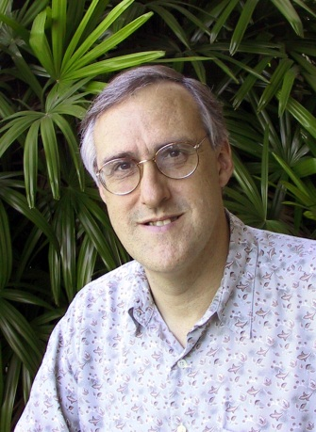
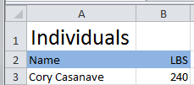

Example of “Pivoting” through a conceptual model
Concept of
“Cory Casanave”
There is an actual “Person”, Cory Casanave
There is a concept of this person shared in this room, right now
Here is one representation of him
“Person” is a shared concept, independent of data structures
There may also be shared agreement that Cory is a person and some other “facts”
“Cory Casanave” is a name for this person
He weighs 240 LBS
There are multiple data representations about Cory Casanave which may or may not agree
Those representations can be grounded in concepts (semantics), assisting federation
Concept of a
“Person”
<PersonType>
<NameText>Cory B. Casanave</NameText>
<Weight-LBS>234</Weight-LBS>
</PersonType>
XML
Representations
.
Excel
UML

Slide 7

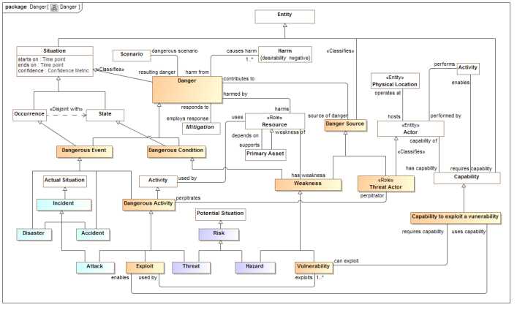
Conceptual Model Inputs
KDM
(Risk)
NIST Framework
Conceptual Model
NIEM
(General)
STIX
(Cyber)
OGC
(Geo)
EDXL
(Emergency)
FIBO (Finance)
SEI
(Safety)
CAL OES
(Health)
MAP
ISO
(Risk)
ISO
(Units)
RMS
(Custody)
STIX, NIEM, EDXL, Others

Slide 8
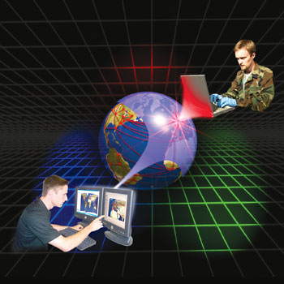
Federating Information
STIX
Cyber Information
Federated with the conceptual model
NIEM
(Justice and public safety)

Slide 9

Example - Snowmageddon
In January 2015 Massachusetts faced the Hazard of major winter storms across the region. Potential Harm from blizzards and winter storms includes negative economic impact, limited road accessibility, restricted emergency management, non-availability of utility, property damage, personal injury and death, and more.
The onset of a winter storm or blizzard was predicted by the National Weather Service (NWS).

Slide 10


Example of structuring risk information
In January 2015 Massachusetts faced the Hazard of major winter storms across the region.
Is formalized as
Is defined by
A data syntax and vocabulary
Maps To
<drn:PotentialDanger>Major winter storms</drn:PotentialDanger>

Slide 11
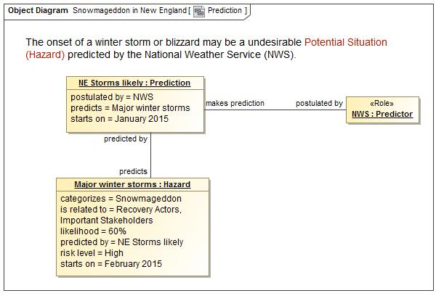
A Potential Storm? Who said this?

Slide 12
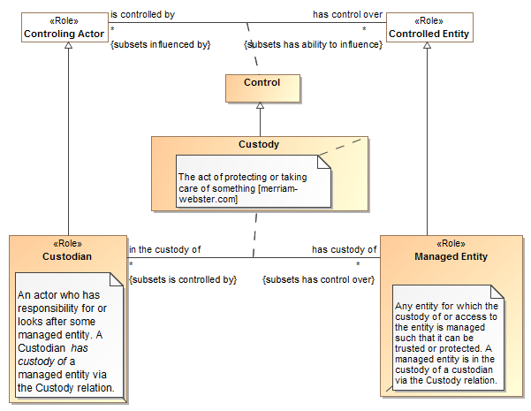
Example Snippet

Slide 13
Conceptual Model Layering
Operational threat situational awareness and response
Operational risk evaluation and mediation
Cross-risk/threat – specific “wide and shallow” risk and threat concepts/ E.G. Risk, threat, danger, consequence
Generic Library – Provides concepts and links across multiple viewpoints, not just threat/risk. E.G. Person, Objective
Kernel– Foundational concepts for modeling anything: Entities, Roles, Relations, Types, Information, Rules, Identity, Etc…
Subset of the model from SMIF

Slide 14
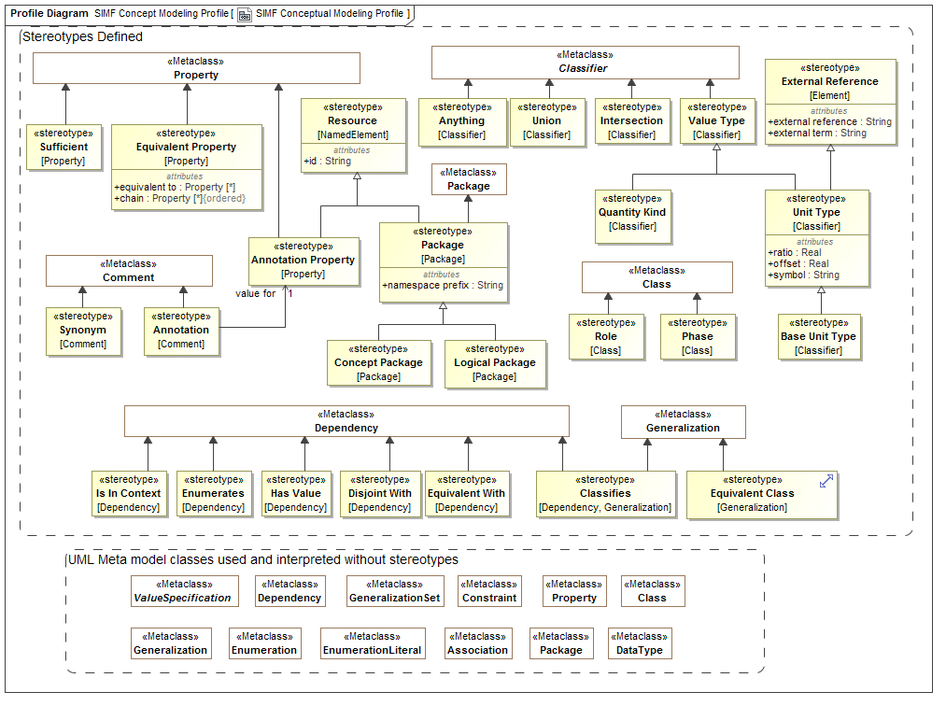

Slide 15
Critical Components – conceptual models and mappings
External
Conceptual Modeling Profile
Mapping Profile
XSD Profile
Depends On
Uses
Uses
Uses
Uses
Generic and threat-risk conceptual models
STIX/Cybox Mapping
STIX/Cybox UML XSD Import
NIEM Mapping
NIEM-UML
More…
More…

Slide 16
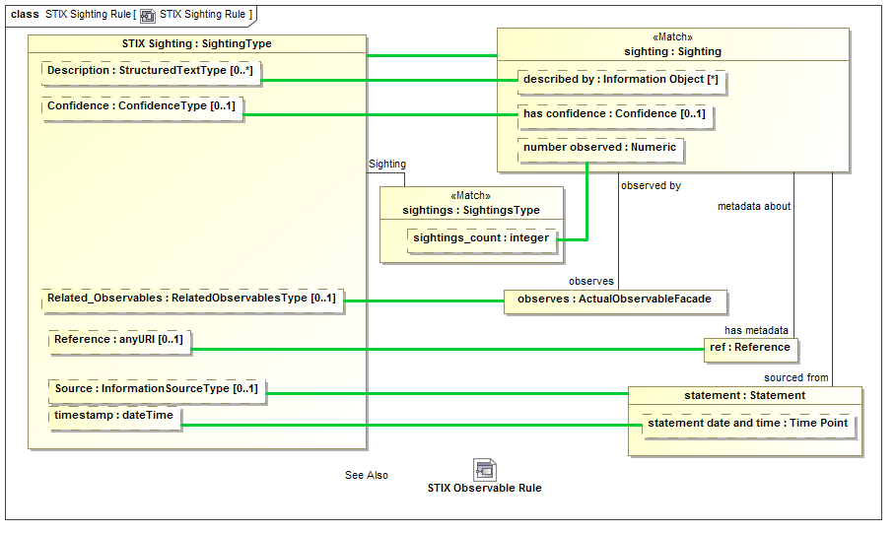
Mapping Example

Slide 17
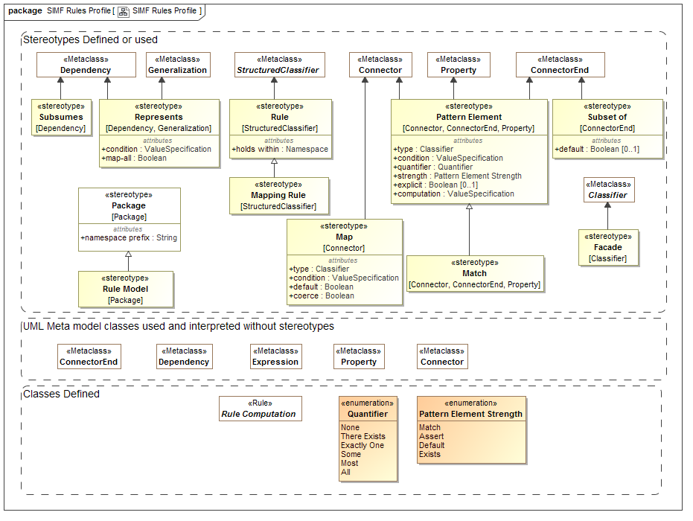

Slide 18


Implementing Semantic Federation
The Federation Engine

Slide 19
Perspectives of our knowledge
NIEM
View
STIX
View
KDM
View
Conceptual
View
How we want to see it
Situational Context
Risk
Context
What we want to trust and see
Federated Repository
Everything we know

Slide 20
Model Driven Secure Gateway
Information
Provider
Provider’s Gateway
Trusted Space
Web Browser
Gatelet
Application
Interface
API
Gatelet
Federation
Engine
Online User
Inerpol
Gatelet
GANG Data
Workflow
others
SQL DBMS
SQL
Gatelet
Rules
NIEM/Global
Gatelet
GANG IEPD
Port
Models
GANG
Data Exchange
Consumer’s Gateway
Consumer
System
Trusted Space
Federation
Engine
NIEM/Global
Gatelet
GANG IEPD
Port
GANG Data
CSV File
Exchange
CSV
Gatelet
Workflow
Rules
NLET IEPD
Port
others
Models

Slide 21
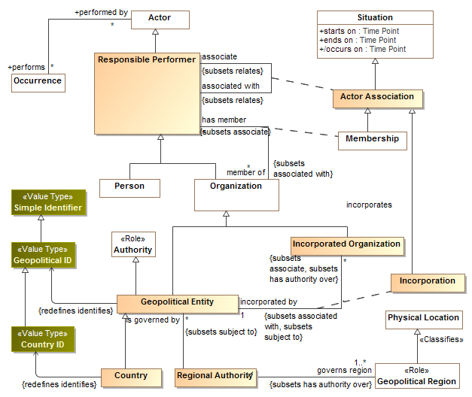

Slide 22
Questions?
On to examples

Slide 23
Backup

Slide 24
What is SMIF?
Semantic Information Modeling for Federation is an in-progress standards process within OMG
The goal of SMIF is to provide the modeling capabilities to support information federation by leveraging conceptual and logical information modeling with model bridging relations
An important goal of SMIF is to extend the economic lifecycle of many existing running systems that were conceived and built in a time when there were insufficient true conceptual capabilities, by explicitly adding the often implicit semantics and linking the running data representations with a true conceptual model.
Another important goal of SMIF is not to replace any existing standard language but to build bridges between the SMIF Conceptual Schema and the various standard languages such that the users can save substantial amounts of money in their integration and federation efforts.
Issued Dec 2011 - OMG Document: ad/2011-12-10

Slide 25
Proposition
Problem statement
Federation (information sharing, interoperability, shared services, etc.) is the problem of this decade – it is costing productivity, lives and billions trillions of dollars annually. It is the pre-requisite to solving many problems in the large. It is a problem faced by most CIOs in government and industry.
We are calling this the “data problem”
A problem not solved…
None of the standards we have directly target this problem. Not: UML, OWL, LoD, E/R, SOA, DoDAF, XML Schema, Common Logic or SBVR , etc.
With all these solutions – we still have a pervasive problem!
While not ideal, the standards above can and are used for federation, but, they are all built for other purposes and repurposed to solve the data problem. Experts can pull these technologies together to solve a specific problem, we want to make it easy to do so with an integrated and standardized approach supporting mainstream solutions and internet-scale federation.
We can make a substantial dent in the data problem with new standards derived from current technologies and practices. This is the “SMIF” Initiative.

Slide 26
SMIF Principles
The intent of SMIF is not to replace other standards but to make it economically more feasible that various standards can cooperate.
In that sense SMIF is not a competitor to any existing OMG standard.
It is the aim of SMIF to extend the economic life of existing applications as well as to support new applications
It is the intention of the submission team to extensively test the proposed standard set of concepts and languages before submission and make the test results available.
SMIF does use conceptual models (reference models) as “pivot points” between different representations.
SMIF does assume that some concepts will be agreed on by some communities as some agreement is required for any communication.
SMIF does not assume any universal or all encompassing conceptual model

Slide 27
Pivoting through a conceptual model
The conceptual pivoting approach
A common and growing approach to the data problem leverages abstraction: Defining a domain focused vocabulary with integrity rules and assertions as part of a conceptual model that captures domain semantics. Federation and integration is achieved by relating various logical and physical information structures to the conceptual model
Information federation and integration is achieved via a “pivot” through this conceptual semantic layer
This approach is used, in part, in existing standards such as CCTS (Core Components), ISO 20022 and is currently being utilized in OMG for finance.
In the majority of cases the “tool” used to represent these common semantics and links is a spreadsheet, but UML and OWL are also used.

Slide 28
Example of “Pivoting” through a conceptual model
Concept of
“Cory Casanave”
There is an actual “Person”, Cory Casanave
There is a concept of this person shared in this room, right now
Here is one representation of him
“Person” is a shared concept, independent of data structures
There may also be shared agreement that Cory is a person and some other “facts”
“Cory Casanave” is a name for this person
He weighs 240 LBS
There are multiple data representations about Cory Casanave which may or may not agree
Those representations can be grounded in concepts (semantics), assisting federation
Concept of a
“Person”
<PersonType>
<NameText>Cory B. Casanave</NameText>
<Weight-LBS>234</Weight-LBS>
</PersonType>
XML
Representations
.
Excel
UML

Slide 29
SMIF Architecture
Model Bridging Relations
Subject focused conceptual models define the concepts, predicates, integrity rules and terms of a domain that can be related to each other
Kernel
Conceptual Domain Models
SMIF Scope
Solution focused logical information elements represent information structures and integrity rules that can use and extend other information
Logical Information
Models
Technology focused physical data schema are grounded in logical data models which define their context and semantics
Physical Data Schema

Slide 30
SMIF Components – conceptual models and mappings
Meta Model
Conceptual Modeling MetaModel
Mapping MetaModel
Schema Model
Depends On
Map To
View of
View of
View of
UML Representation
Conceptual Modeling UML Profile
Mapping UML Profile
Schema Model
(From IMM)
Depends On
Map To

Slide 31
Comparing SMIF and OWL
SMIF
OWL
Conceptual models defined for federation
Focus on understandable domain concepts
Includes mapping language - Assumes data is “messy”
N-Ary first class relationships
Provides for common restrictions and assertions
Context as a first-class concept
Intended to cross viewpoints
UML Profile understandable
Defines needed domain “meta concepts” like roles , phases and units
OWL can be generated and augmented
Ontologies defined for general inference
Focus on inference
Has no mapping language - Assumes data is consistent
Directed “triples” without identity
Provides more general restrictions and assertions
Limited to first order concepts
Intended to represent a viewpoint
UML Profile difficult
Common domain meta concepts are not part of the language
OWL is base language

