Slide 1
Precise Semantics of UML State Machines (PSSM)
RFP ad/2015-03-02 Revised Submission ad/2016-11-01
Errata ad/2016-12-03
Presentation to the ADTF 07 December 2016
Ed Seidewitz / Model Driven Solutions
Jérémie Tatibouet / CEA

Slide 2
Errata
Removed BAE as a submitter.
Made Unified Testing Profile a non-normative reference.
Corrected editorial and typographical errors found in Architecture Board review.

Slide 3
Submission Team
Submitters
Model Driven Solutions (Ed Seidewitz)
No Magic, Inc. (Nerijus Jankevicius)
Contributors
Airbus (Yves Bernard)
Simula Research Laboratory (Bran Selic)
LieberLieber (Daniel Siegl)
CEA – Commissariat à l’Energie Atomique (Jérémie Tatibouet)

Slide 4

Mandatory Requirements
Requirement | Response
6.5.1a Behavior state machine semantics (excluding redefinition and submachines) | All required elements Call events (synchronous calls)
6.5.1b Event data passing | Achieved using a parameter-passing approach for guard expressions and event behaviors.
6.5.1c Standalone and classifier behavior execution | Proposal is restricted to these two cases.
6.5.1d Consistency with PSCS | Achieved by defining PSSM execution model as an extension of the PSCS model.
6.5.1e Relationship to fUML | Achieved by defining PSSM execution model as an extension of the fUML model.
6.5.1f Extension of fUML base semantics (if necessary) | This was not found to be necessary.

Slide 5
Mandatory Requirements
Requirement | Response
6.5.2a Semantic variabilities | Proposal does not define any additional semantic variabilities.
6.5.2b Semantic variants | Proposal does not define any additional semantic variants.
6.5.3a UML 2 conformance | Proposed PSSM syntax subsets UML 2.5.1 abstract syntax.
6.5.3b fUML conformance | Proposed PSSM semantics are based on fUML 1.2.1.
6.5.3c PSCS conformance | Proposed PSSM semantics are based on PSCS 1.0.
6.5.3d Common Logic conformance | Not applicable, proposal does not extend the fUML base semantics.
6.5.4a Test suite | Proposal includes suite of 103 tests.
6.5.4b Test suite coverage | Current coverage is 100% of identified functional requirements.

Slide 6

Non-Mandatory Features
Feature | Response
6.6.1 Submachine states | Not included in the proposal.
6.6.2 Protocol state machine | Proposal includes a non-normative annex on protocol state machines.
6.6.3 State machine redefinition | Proposal discusses the semantics of state machine redefinition and includes its formal specification in the semantic model.
6.6.4 Asynchronous operation calls | Not included in the proposal.
6.6.5 Triggers with ChangeEvents | Not included in the proposal.
6.6.6 Alf for action language concrete syntax | Proposal uses Java as the action language. (Alf may be used in the future.)

Slide 7
Issues To Be Discussed
State machines for passive classes
Supported in several UML tools.
Semantics are not entirely consistent with active behavior machine semantics.
Discussed in informative annex in proposal.
Abstract syntax issues with passing event data
Event data passing to/from effect, entry, exit and do behaviors without changing UML abstract syntax.
Event data passing to transition guards require an abstract syntax change (made in UML 2.5.1).
Relationship to MARTE causality model
MARTE causality model based on UML 2.1 semantics.
Still seems generally consistent with UML 2.5 common behavior semantics.

Slide 8
Issues To Be Discussed
Relationship to OntoIOP
PSSM semantics could be integrated into DOL via the bUML base semantics, but this would be quite complex.
Could define logical semantics directly on some part of PSSM syntax, but submission team did not have resources to do so.
Relationship to SCXML
SCXML has a significant overlap with UML state machines, but there are differences.
Possible to define a mapping from a subset of UML state machine syntax to SCXML with consistent semantics.
Proof of concept implementation
Developed by CEA .
Integrated into the Eclipse Papyrus/Moka model execution framework, built on PSCS/fUML implementation.
Passes all 103 current PSSM tests, without violating any PSCS tests.

Slide 9
Conformance
Level Aspect | PSSM only | PSSM and PSCS
Syntax | PSSM abstract syntax is a superset of fUML abstract syntax PSSM abstract does not include PSCS abstract syntax | Union of PSSM abstract syntax and PSCS abstract syntax
Semantics | Execution tool must provide semantics consistent with PSSM execution model. Semantic conformance with fUML All PSSM tests pass except those related to triggers-with-ports references. | Execution tool must provide semantics consistent with PSSM and PSCS execution models. Semantic conformance with fUML All PSSM tests pass All PSCS tests pass

Slide 10


Submission Structure
PSSM test suite models conform to the PSSM syntax
Requirements
PSSM Syntax
PSSM Test suite
PSSM Semantic models captures semantics of PSSM syntax
Test execution enables semantic definition validation
Implementation is used to execute the test models defined within the test suite
Implementation
PSSM Semantic
PSSM semantics in Papyrus Moka model execution tool

Slide 11
PSSM Syntax

Slide 12
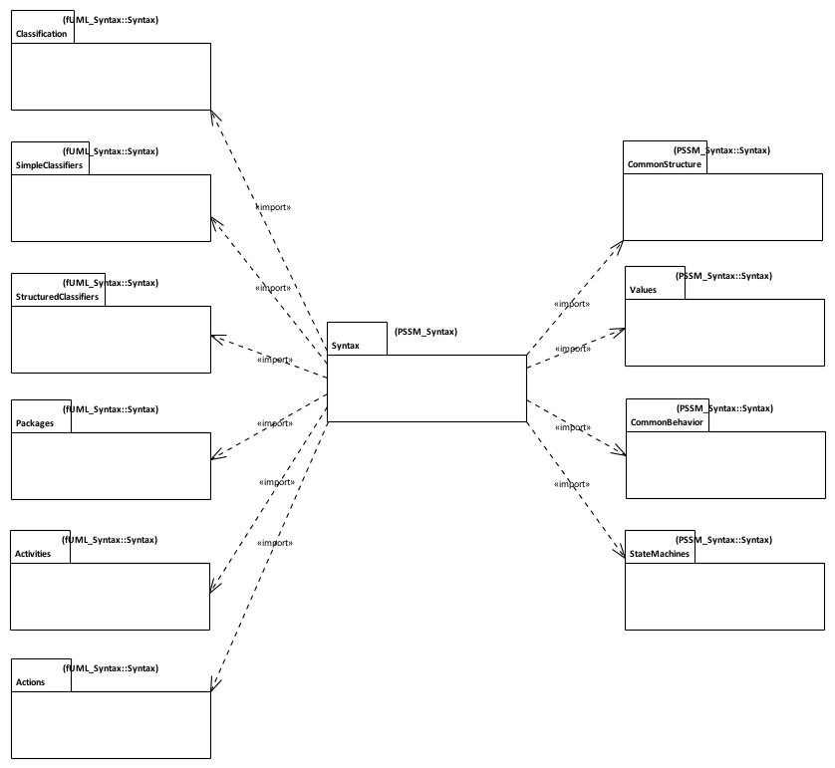
PSSM Syntax
Issue
fUML 1.2.1 abstract syntax is currently organized according to UML 2.4.1, not UML 2.5. Update provided with PSSM.
PSSM Syntax is a superset of fUML syntax
Syntax imported from fUML with additions
Additional Syntax for State Machines
Syntax imported without change from fUML.

Slide 13
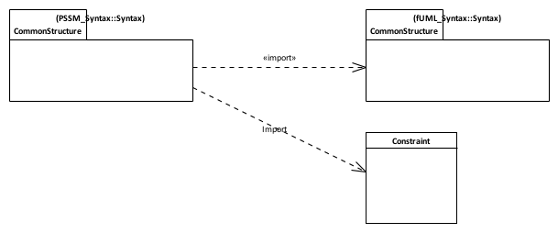
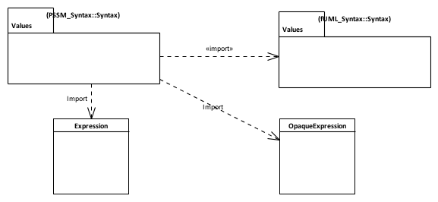

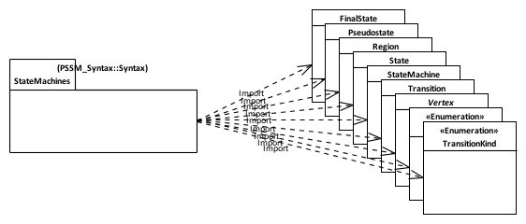
PSSM Syntax: Subsetting
An “else” guard is represented as an Expression with the symbol “else”.
Constraint can have a specification given as a an OpaqueExpression which can be associated to a Behavior.
Guards placed on transitions are defined as Contraints.
A transition can be associated with 0..* triggers. One of the Triggers can be for a CallEvent.
Behavior state machine syntax elements.

Slide 14
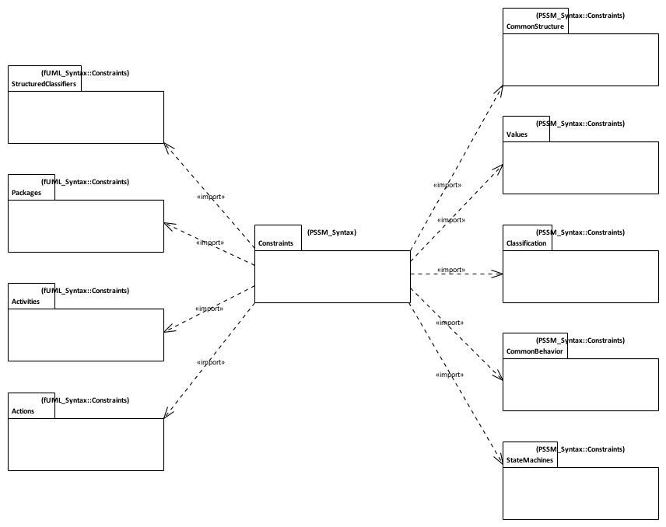
PSSM Syntax: Constraints
Constraints imported from fUML with additions / changes
Constraints imported without change from fUML.
Additional Syntax for State Machines

Slide 15
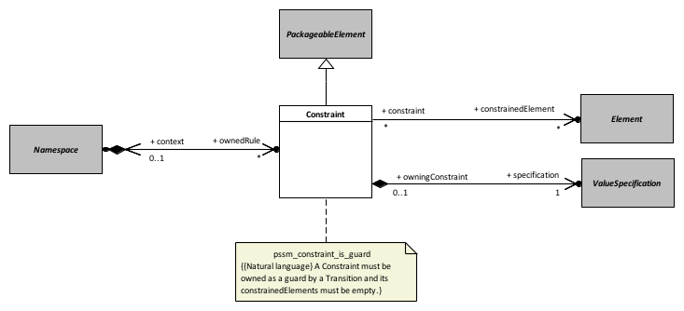
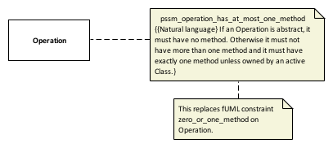
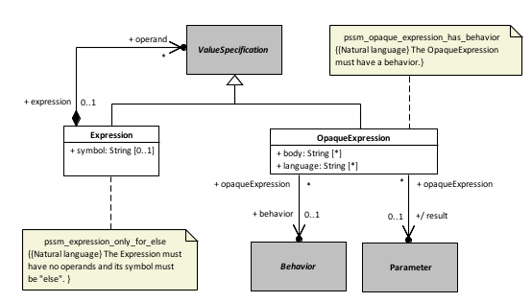
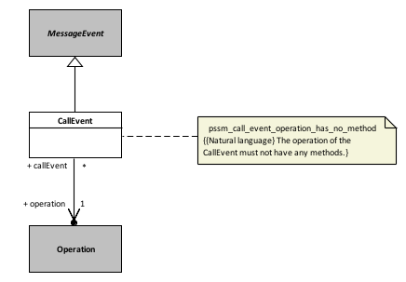
Constraints: Additions and Updates
Common Structure
Classification
Values
Common Behavior
Issue UMLR-92
UML/OCL spec mismatch - Constraint.context vs Constraint.constrainedElement
Resolved in UML 2.5.1.

Slide 16
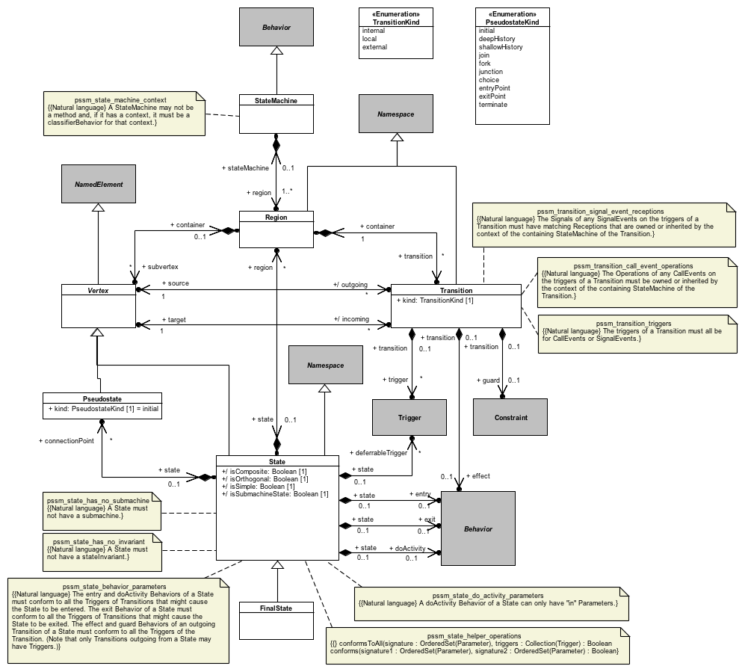
Constraints: Behavior State Machines
Issue UMLR-686
The behavior of an OpaqueExpression should be allowed to have input parameters. Resolved in UML 2.5.1.

Slide 17
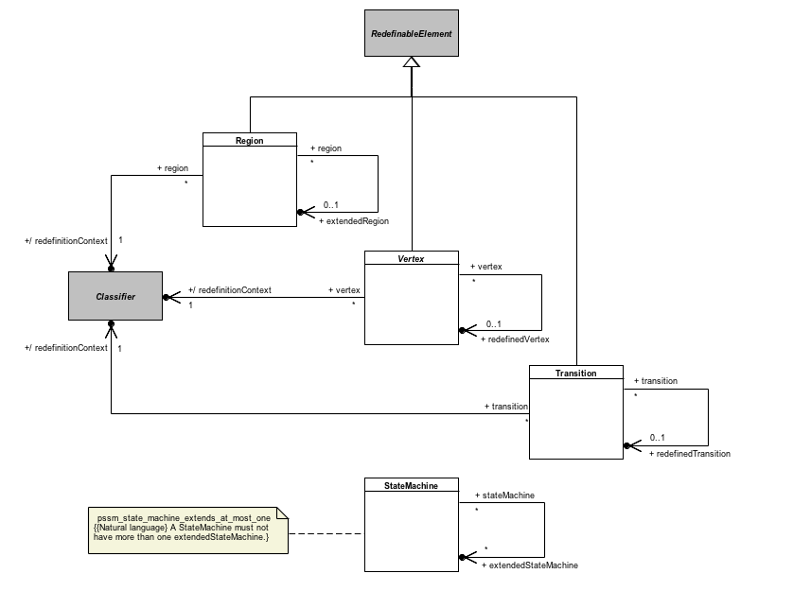
Constraints: State Machine Redefinition
Issue UMLR-685
UML 2.5: StateMachine Vertex needs to be made a kind of RedefinableElement instead of State. Resolved in UML 2.5.1.

Slide 18
PSSM Semantics

Slide 19
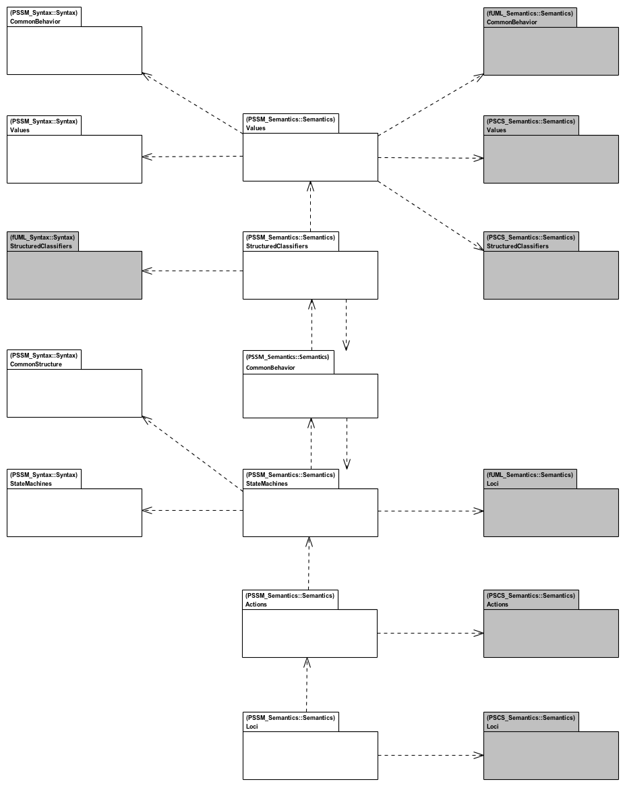
PSSM Semantics
fUML semantics packages
Issue
fUML 1.2.1 and PSCS 1.0 execution models are currently not organized around UML 2.5.
Update provided with PSSM.
PSSM syntax packages
PSSM semantics packages
PSCS semantics packages
Notes:
Alignment with UML 2.5 - PSSM semantic model is aligned with UML 2.5 package structure
PSSM Semantic model layout
Values - Semantic model elements extending fUML and PSCS semantics for values.
StructuredClassifiers - Semantic model elements extending fUML and PSCS semantics for structured classifiers.
Common behavior - Semantic model elements extending common behavior semantics for UML state-machines specific needs.
StateMachines - Semantic visitors capturing semantics of behavior state-machines meta-classes.
Loci - Semantic model elements extending fUML and PSCS semantics for instantiation.

Slide 20
Extensions to PSCS

Slide 21
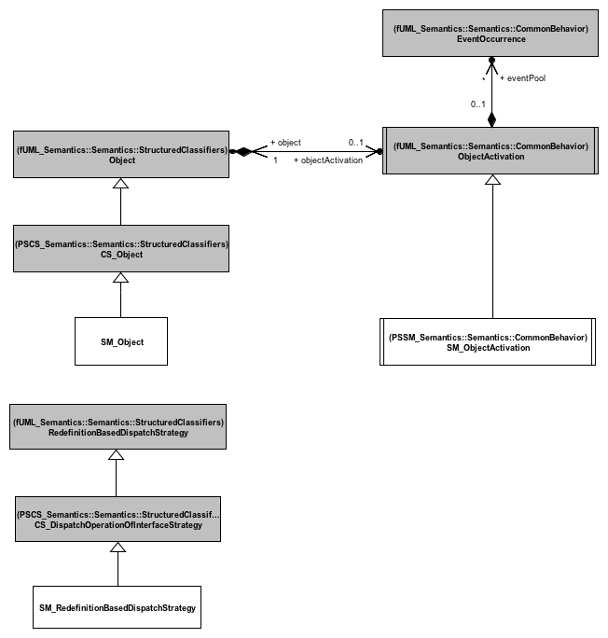
Extensions: Structured Classifier
Each time an SM_Object is created it is associated with an SM_ObjectActivation.
Enables handling of the situation where the behavior attached to the instantiated class is a state machine.
Extension introduced to deal with state machine specific events:
Completion Event
Deferred Event
Extension required to support call event semantics. [We get back to this point later in the presentation].

Slide 22
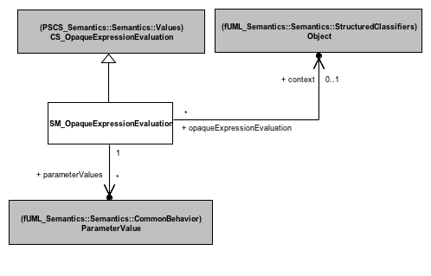
Extensions: Values
Behavior of an OpaqueExpression used to specify a guard needs context and parameters.
The context of the state machinel.
The context of the state machine.
Data embedded in the events that triggered the current RTC step.

Slide 23
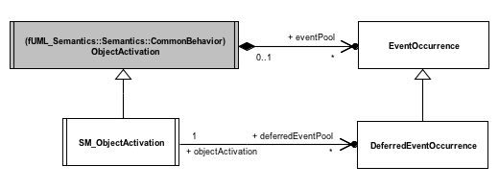
Extensions: Common Behavior (1/2)
A DeferredEventOccurrence is placed back in the regular eventPool when the deferring state leaves the current state machine configuration.
An EventOccurrence that is deferred is wrapped in a DeferredEventOccurrence.
A DeferredEventOccurrence is placed in the deferredEventPool when its event is declared as being deferred in the current state machine configuration.

Slide 24
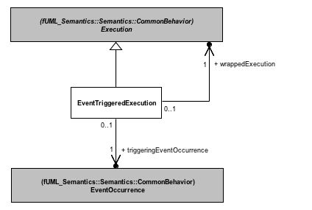
Extensions: Common Behavior (2/2)
Behavior Executions need to have access to event data.
Data is provided from this EventOccurrence.

Slide 25
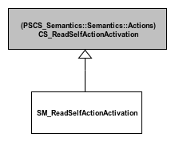
Extensions: Actions
Handles the special context of a DoActivityContextObject (described later), unwrapping it to obtain the state machine context.

Slide 26
State Machines Semantics

Slide 27
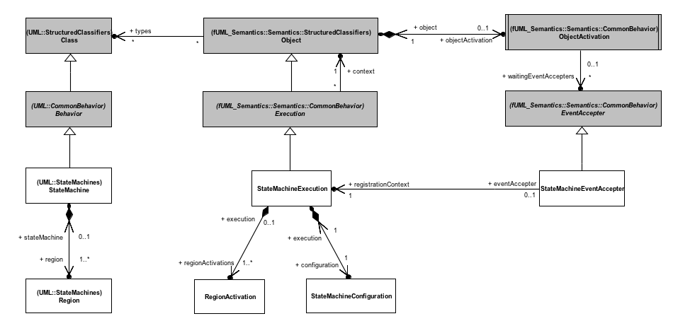
Semantics: State Machine Execution
A new type of Execution to execute a StateMachine.
Allows a StateMachine to accept events placed in the eventPool of the context of the StateMachine.
Set of Region activations owned by the Execution for a state machine.
Represents the current configuration (hierarchy of active States) of the executed StateMachine.
Notes:
Structured Classifiers
(none)
Values
Transition guards are Constraint
Constraint can have a specification which is a ValueSpecification
An OpaqueExpression is a kind of ValueSpecification which can be associated to a Behavior.
Common Behavior
Allow registration of completion events
Generated when a state completes
Allow handling of deferred events
Deferred events are event occurrences whose dispatching needs to be deferred in the current state-machine configuration.
Loci
(none)

Slide 28
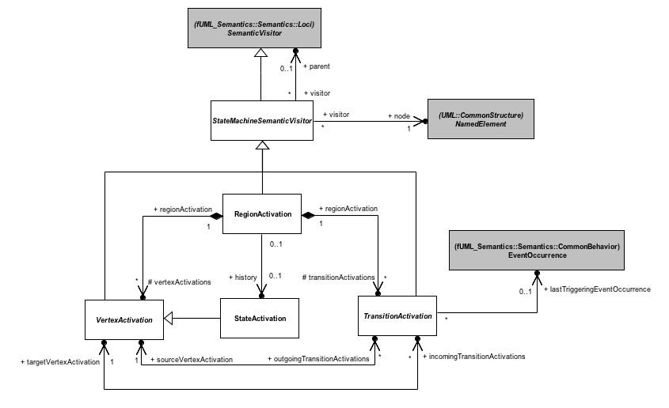
Semantics: State Machine Visitor
StateMachine SemanticVisitors are organized hierarchically. The root class provides common functionalities for all specializing StateMachine SemanticVisitors.
Captures the semantics of a Region. This visitor is responsible for instantiating visitors for all elements located in the visited Region.
Captures the base semantics of all kinds of Vertices.
Captures the base semantics of all kinds of Transition.

Slide 29
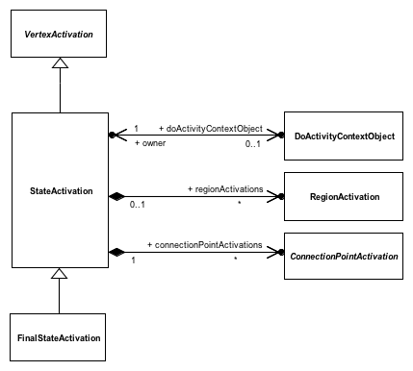
Semantics: State Activation
The StateSctivation references the context Object for the doActivity (if any) that was invoked from the State.
A StateActivation captures the semantics of a State, with specific entry and exit sequences.
A StateActivation owns RegionActivations if it is compositel
A StateActivation owns RegionActivations if it is compositel
A StateActivation may own ConnectionPointActivations if it is composite.
Captures the semantics of a FinalState. When reached, the region in which it is located is completed.

Slide 30
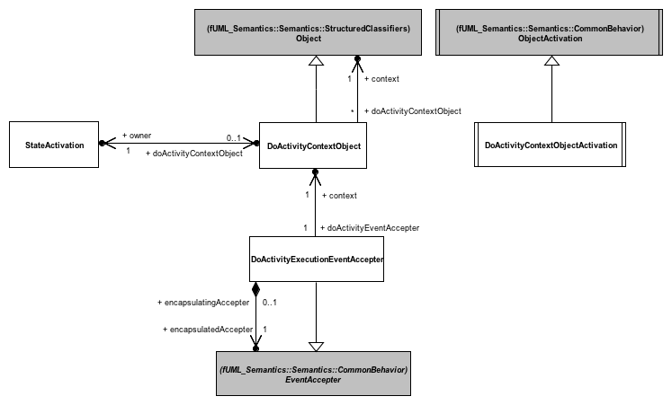
Semantics: doActivity Execution
The context Object of an executed doActivity. This Object itself has a context, which is the StateMachine context. This allows an executed doActivity to have access to the features (properties, operations, etc) available in the context.
Allows a doActivity to accept events from the state machine event pool.
Thread of execution on which the doActivity is actually executed.
Notes:
Two exceptional situations in which a doActivity has priority.

Slide 31
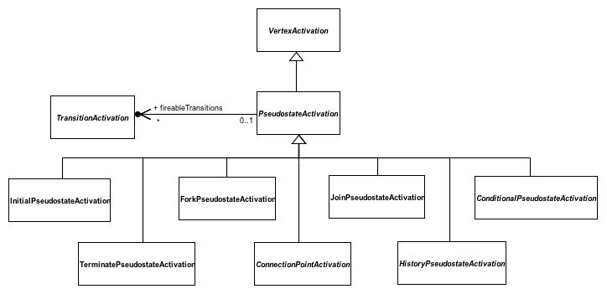
Semantics: Pseudostate Activation
Set of Transitions outgoing the Pseudostate which can be fired in the current step.
Captures the base semantics of all Pseudostates.
Captures the base semantics of entryPoint and exitPoint Pseudostates.
Captures the base semantics of shallowHistory and deepHistory Pseudostates.
Captures the base semantics of junction and choice Pseudostates.

Slide 32
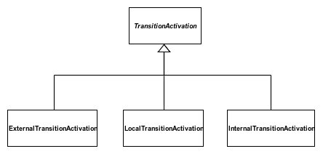
Semantics: Transition Activation Specializations
The firing sequence is common to al kinds of Transitions: exit source, execute effect (if any), enter target. Entry and exit sequences are specific to each kind of Transition.
The source is always exited and the target is always entered. Whenever the exit sequence or the enter sequence are performed, it might be required to propagate them to the parent vertex. This decision relies on the computed common ancestor.
The source is never exited and the target is never entered.

Slide 33
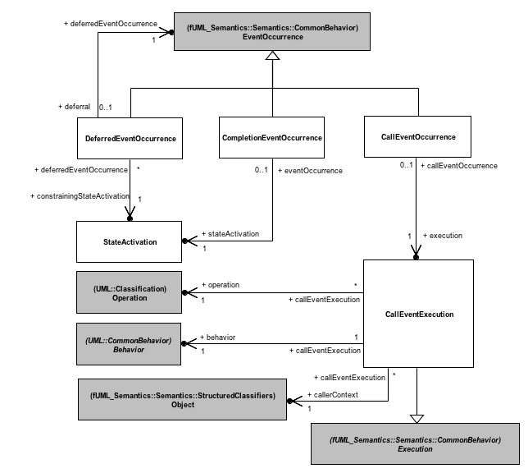
Semantics: Event Occurrences
A DeferredEventOccurrence references the original EventOccurrence being deferred and the StateActivation doing the deferral.
A CompletionEventOccurrence is generated upon the completion of a StateActivation. It references the StateActivation from which it was generated and can trigger a completion Transition outgoing that StateActivation.
CallEvents are not specific to StateMachines. PSSM provides semantics for synchronous Operation calls on active Objects.
When executed, sends a CallEventOccurrence to the target active Object. The Object from which the call was performed is suspended until the emitted CallEventOccurrence is dispatched (accepted or not).

Slide 34
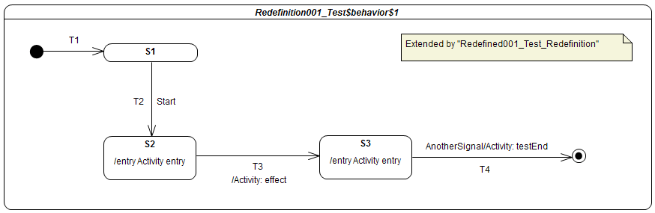
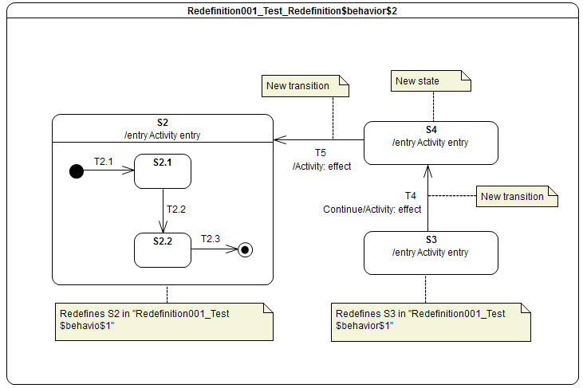

Semantics: State Machine Redefinition
S1
T1
T2 Start
T3 / effect
T5 AnotherSignal / testEnd
Dynamic computation of the runtime state machine
Account for extension and redefinition relationships.
Semantics are defined in:
The instantiation process of a RegionActivation.
TransitionActivation and StateActivation.

Slide 35
PSSM Test Suite
A Test framework and a set of 103 test cases validating the different parts of the state machines semantics

Slide 36
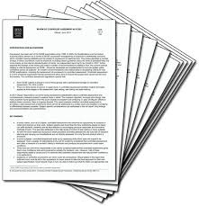



Test Suite: Development Approach
Check conformance of proof-of-concept implementation to the PSSM semantic model.
Stimulation sequence (activity)
Test model (state machine)
Proof-of-concept implementation
based on
Set of possible traces for the test case given the stimulation sequence
Trace generated by the semantic model implementation

Slide 37
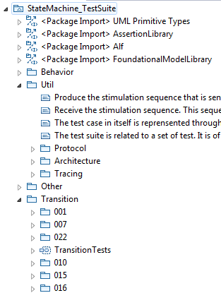
Test Suite: Semantic Model Assessment
Util package
Defines how a semantic test is designed
Defines how semantic tests are grouped into semantic test suites
Defines how elements composing a test interact
Other packages
Define test categories
Each category is related to particular part of state-machine semantics
Each category contains test cases
Each test case is defined to validate a specific semantic requirement
Library providing base elements to define semantic tests
Test category related to transition semantics
Semantic tests available in that category

Slide 38
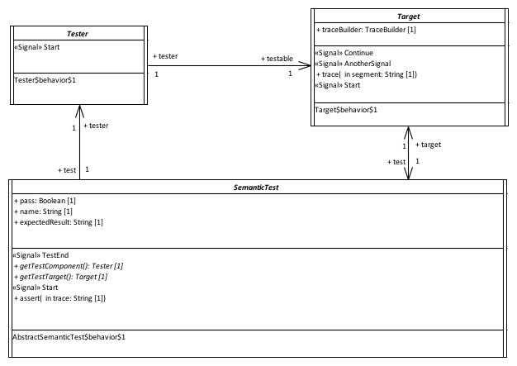

Test Suite: Semantic Test Architecture
Communications done by event passing
Provide a stimulation sequence (i.e., a set of event occurrences) to the Target.
Execute the state-machine under test and record the execution trace produce by this state-machine
The SemanticTest controls both the Tester and the Target. It is also responsible for the computation of the test verdict. The test verdict calculation is based on the comparison between the generated execution trace and the execution traces expected by the test.

Slide 39
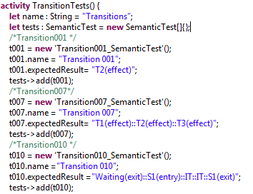
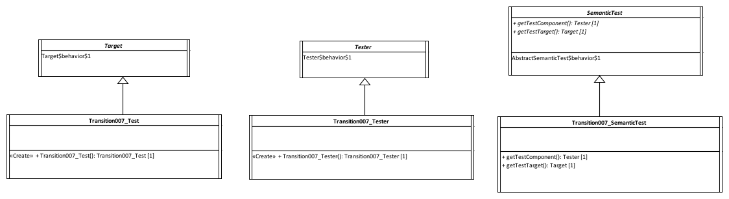
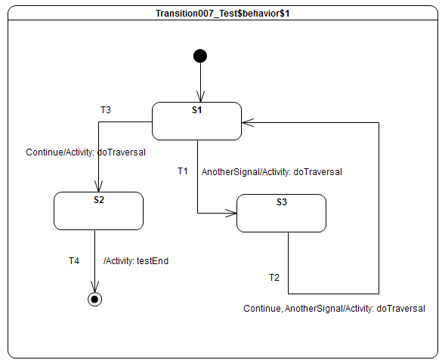
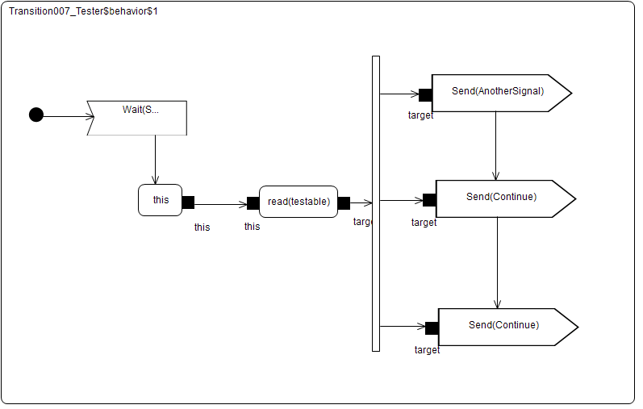
Test Suite: Example Test Definition
Semantic test is instantiated and registered in a semantic test suite.
Expected execution trace

Slide 40
Test Suite: Example Test Execution
Received event occurrences
AnotherSignal – S1
Continue – S3
Continue – S1
Expected trace
T1(effect)::T2(effect)::T3(effect)
Requirement
A transition may own a set of Triggers, each of which specifies an Event whose occurrence, when dispatched, may trigger traversal of a transition.
Step | Event Pool | Configuration | Fired transitions
1 | [] | [] – Initial RTC step | [InitialTransition]
2 | [AnotherSignal, CE(S1)] | [S1] | []
3 | [AnotherSignal] | [S1] | [T1]
4 | [Continue, CE(S3)] | [S3] | []
5 | [Continue] | [S3] | [T2]
6 | [Continue, CE(S1)] | [S1] | []
7 | [Continue] | [S1] | [T3]
8 | [CE(S2)] | [S2] | [T4]

Slide 41
PSSM Status

Slide 42
Status: Requirements Coverage
Full support of the requirements (technical work done)
Revised submission (focus on writing the specification document)
Initial submission

Slide 43
Next Steps
December 2016
Charter PSSM FTF
March 2017
Deliver fUML 1.3, PSCS 1.1, Alf 1.1
Outstanding functional issues
Updates for better integration of PSSM
Still based on UML 2.4.1
No sooner than December 2017
Deliver PSSM 1.0, fUML 1.4, PSCS 1.2, Alf 1.2
All aligned with UML 2.5.1 (or subsequent version)

