Slide 1
Precise Semantics of UML State Machines (PSSM)
RFP ad/2015-03-02 Initial Submission ad/2016-02-01 (Update)
Presentation to the ADTF 14 September 2016
Ed Seidewitz / Model Driven Solutions
Jérémie Tatibouet / CEA

Slide 2
Submission Team
Submitters
BAE Systems (Jeffrey Smith)
Model Driven Solutions (Ed Seidewitz)
No Magic, Inc. (Nerijus Jankevicius)
Contributors
Airbus (Yves Bernard)
Simula Research Laboratory (Bran Selic)
LieberLieber (Daniel Siegl)
CEA – Commissariat à l’Energie Atomique (Jérémie Tatibouet)

Slide 3

Mandatory Requirements
Requirement | Response
6.5.1a Behavior state machine semantics (excluding redefinition and submachines) | All required elements Call events (synchronous calls)
6.5.1b Event data passing | Proposal was made and incorporated to the semantic model
6.5.1c Standalone and classifier behavior execution | Proposal is restricted to these two cases.
6.5.1d Consistency with PSCS | Achieved by defining PSSM execution model as an extension of the PSCS model.
6.5.1e Relationship to fUML | Achieved by defining PSSM execution model as an extension of the fUML model.
6.5.1f Extension of fUML base semantics (if necessary) | This was not found to be necessary.

Slide 4
Mandatory Requirements
Requirement | Response
6.5.2a Semantic variabilities | Proposal does not define any additional semantic variabilities.
6.5.2b Semantic variants | Proposal does not define any additional semantic variants.
6.5.3a UML 2 conformance | Proposed PSSM syntax subsets UML 2.5 abstract syntax.
6.5.3b fUML conformance | Proposed PSSM semantics are based on fUML 1.2.1.
6.5.3c PSCS conformance | Proposed PSSM semantics are based on PSCS 1.0.
6.5.3d Common Logic conformance | Not applicable, proposal does not extend the fUML base semantics.
6.5.4a Test suite | Proposal includes suite of 98 tests.
6.5.4b Test suite coverage | Current coverage 100% of identified functional requirements.

Slide 5

Non-Mandatory Features
Feature | Response
6.6.1 Submachine states | Not included in the proposal.
6.6.2 Protocol state machine | Proposal includes a non-normative annex on protocol state machines.
6.6.3 State machine redefinition | Proposal discusses the semantics of state machine redefinition and includes its formal specification in the semantic model.
6.6.4 Asynchronous operation calls | Not included in the proposal.
6.6.5 Triggers with ChangeEvents | Not included in the proposal.
6.6.6 Alf for action language concrete syntax | Proposal uses Java as the action language. (Alf may be used in the future.)

Slide 6
Issues To Be Discussed
State machines for passive classes
Supported in several UML tools.
Semantics are not entirely consistent with active behavior machine semantics.
Discussed in informative annex in proposal.
Abstract syntax issues with passing event data
Event data passing to/from effect, entry, exit and do behaviors without changing UML abstract syntax.
Event data passing to transition guards require an abstract syntax change.
Relationship to MARTE causality model
MARTE causality model based on UML 2.1 semantics.
Still seems generally consistent with UML 2.5 common behavior semantics.

Slide 7
Issues To Be Discussed
Relationship to OntoIOP
Not yet addressed.
Relationship to SCXML
SCXML has a significant overlap with UML state machines, but there are differences.
Possible to define a mapping from a subset of UML state machine syntax to SCXML with consistent semantics.
Plan to provide such a mapping in the revised specification.
Proof of concept implementation
Developed by CEA .
Integrated into the Eclipse Papyrus/Moka model execution framework, built on PSCS/fUML implementation.
Passes all 98 current PSSM tests, without violating any PSCS tests.

Slide 8
Conformance
Level Aspect | PSSM only | PSSM and PSCS
Syntax | PSSM abstract syntax is a superset of fUML abstract syntax PSSM abstract does not include PSCS abstract syntax | Union of PSSM abstract syntax and PSCS abstract syntax
Semantics | Execution tool must provide semantics consistent with PSSM execution model. Semantic conformance with fUML All PSSM tests pass except those related to triggers with ports references. | Execution tool must provide semantics consistent with PSSM and PSCS execution models. Semantic conformance with fUML All PSSM tests pass All PSCS tests pass

Slide 9


Submission Structure
PSSM test suite models conform to the PSSM syntax
Requirements
PSSM Syntax
PSSM Test suite
PSSM Semantic models captures semantics of PSSM syntax
Test execution enables semantic definition validation
Implementation is used to execute the test models defined within the test suite
Implementation
PSSM Semantic
PSSM semantics in Papyrus Moka model execution tool

Slide 10
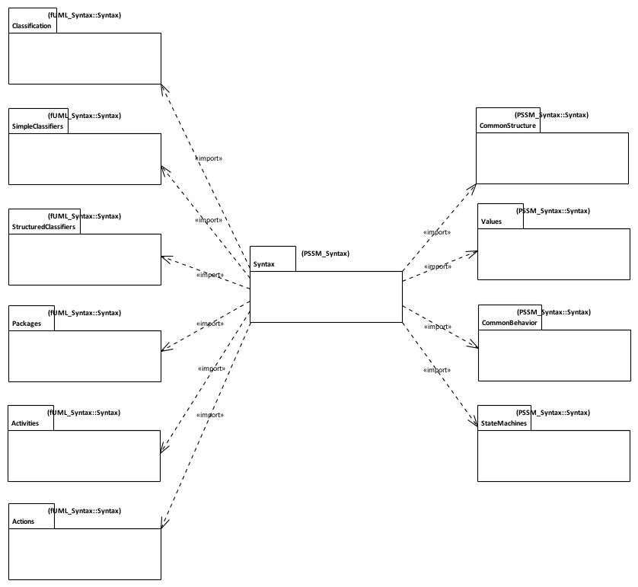
PSSM Syntax
Issue
fUML 1.2.1 abstract syntax is currently organized according to UML 2.4.1, not UML 2.5.
Syntax imported from fUML with additions
PSSM Syntax is a superset of fUML syntax
Additional Syntax for State Machines
Syntax imported without change from fUML.

Slide 11
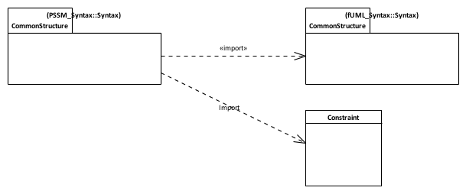
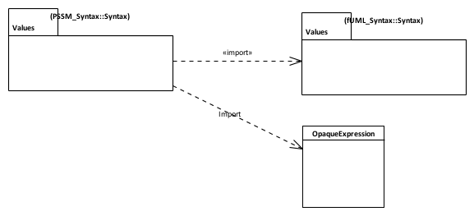

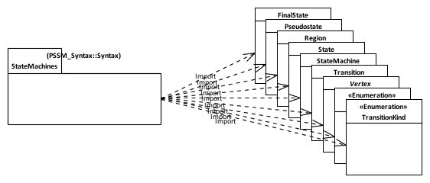
PSSM Syntax: Subsetting
Constraint can have a specification given as a an OpaqueExpression which can be associated to a Behavior
Guards placed on transitions are defined as Contraints
A transition can be associated with 0..* triggers. One of the Triggers can be for a CallEvent.
Behavior state machine syntax elements

Slide 12
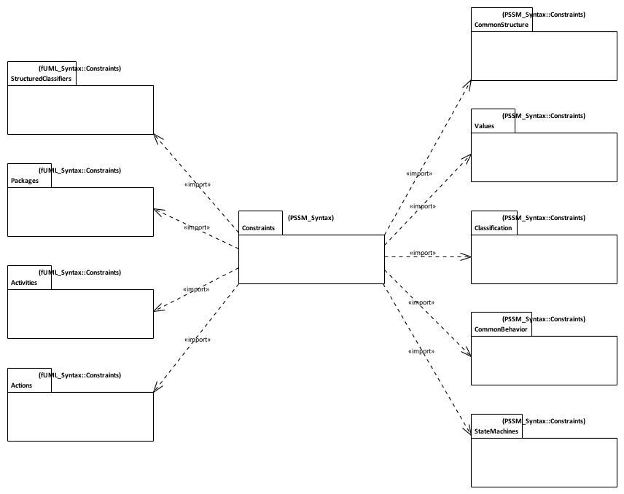
PSSM Syntax: Constraints
Constraints imported from fUML with additions / changes
Constraints imported without change from fUML.
Additional Syntax for State Machines

Slide 13
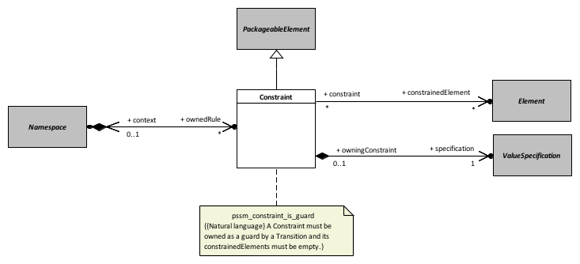
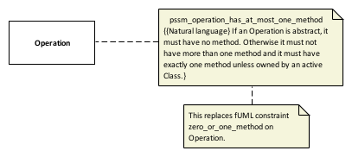
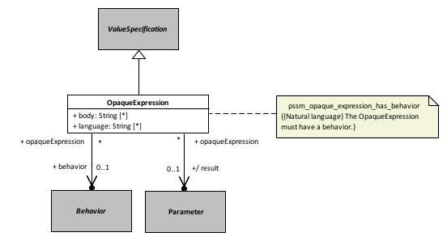
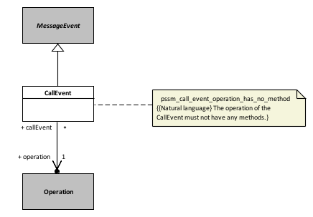
Constraints: Additions and Updates
Common Structure
Classification
Values
Common Behavior
Issue
Constraints are owned by the PSSM Values constraints package, not by the constrained elements. What is the OCL context?

Slide 14
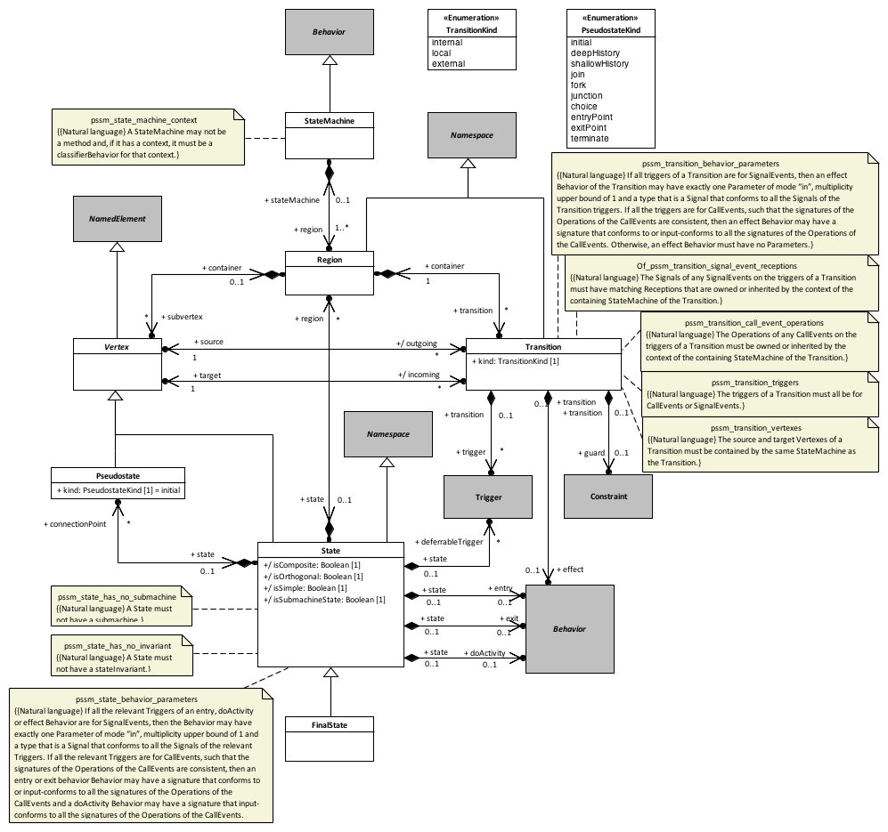
Constraints: Behavior State Machines

Slide 15
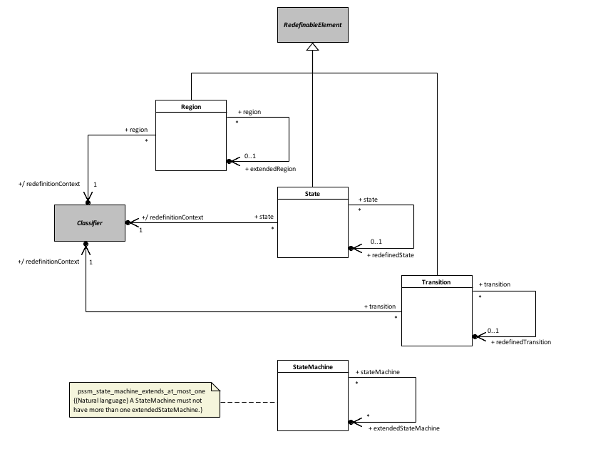
Constraints: State Machine Redefinition
Issue
When a Transition is redefined, its source and target must also be redefined. These may be Pseudostates, but Pseudostates are not currently redefinable.
Possible Solution
Make Vertex superclass of State and Pseudostate a RedefinableElement).

Slide 16
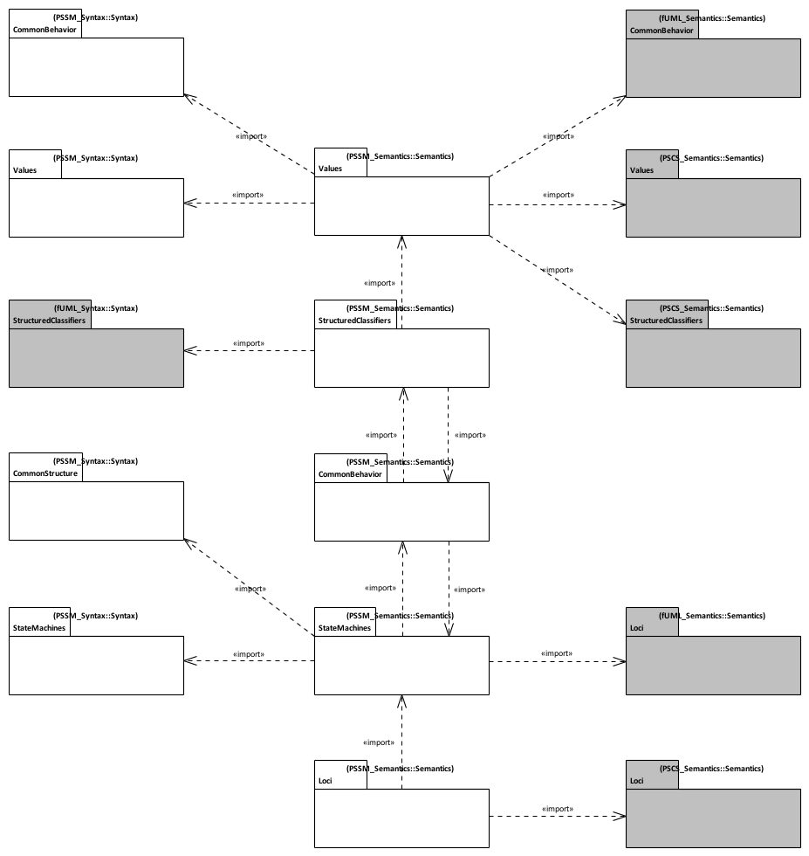
PSSM Semantics
PSSM syntax packages
fUML and PSCS semantics packages
Issue
fUML 1.2.1 and PSCS 1.0 execution models are currently not organized around UML 2.5.
PSSM semantics packages
Notes:
Alignment with UML 2.5 - PSSM semantic model is aligned with UML 2.5 package structure
PSSM Semantic model layout
Values - Semantic model elements extending fUML and PSCS semantics for values.
StructuredClassifiers - Semantic model elements extending fUML and PSCS semantics for structured classifiers.
Common behavior - Semantic model elements extending common behavior semantics for UML state-machines specific needs.
StateMachines - Semantic visitors capturing semantics of behavior state-machines meta-classes.
Loci - Semantic model elements extending fUML and PSCS semantics for instantiation.

Slide 17
Extensions to PSCS
Structured classifiers,
Values
Common behaviors
Loci

Slide 18
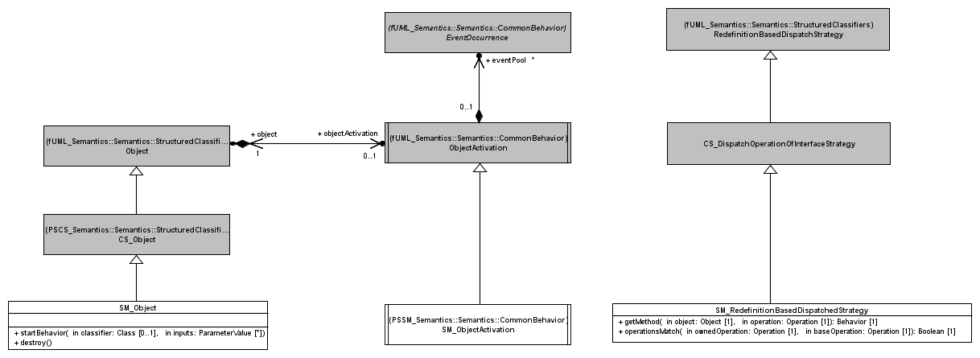
PSSM: Structured Classifiers
Common Behavior
In PSSM, a SM_Object is always associated to SM_ObjectActivation. This is ensured by the redefinition of startBehavior operation. SM_Object also redefines the destroy operation to make sure that in addition to the normal destruction process, the event pool is cleared.
PSSM extends the support for synchronous calls provided by fUML. In particular it adds a support for CallEvent which are generated in case a synchronous call is made on a operation without implementation. Dispatch and getMethod operations are redefined. The new dispatch ensures that if no method is returned then a particular type of execution is generated to capture the CallEvent semantics, in any other situation the semantics defined by fUML is preserved. The getMethod operation is redefined only to allow the null value to be returned.

Slide 19
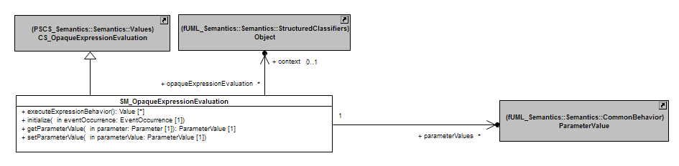
PSSM: Values
SM_OpaqueExpressionEvaluation provides a way to evaluate an OpaqueExpression that has a specification formalized as a Behavior.
Evaluation context
The context of the executed state machine
Access to members is allowed (e.g. operations)
Event data passing
Data embedded in the event occurrence which has triggered the RTC step are available in the evaluation process
The data are provided as input parameter values.

Slide 20
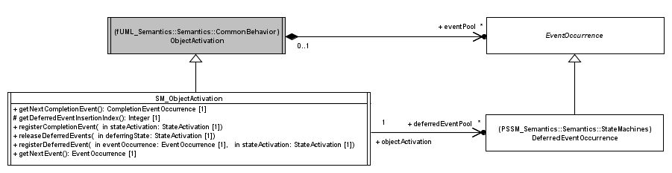
PSSM: Common Behavior (1)
SM_Object always have an SM_ObjectActivation. Such particular object activation enables handling of both completion events (state machine specific) and deferred events (not state machine specific but not available directly in fUML).
Operation getNextEvent is redefined to ensure that while there is completion event in the pool then they are dispatched before any other event according to their order of arrival.
Place an event occurrence in the deferred event pool
Event occurrences that were deferred by the given state activation are returned in the regular event pool. The order in which these events are returned to the pool is the order in which they were deferred.
DeferredEventOccurrence represents an event occurrence that is deferred by the executing state machine. Such events are placed in the in the deferred event pool of the state machine object activation.

Slide 21
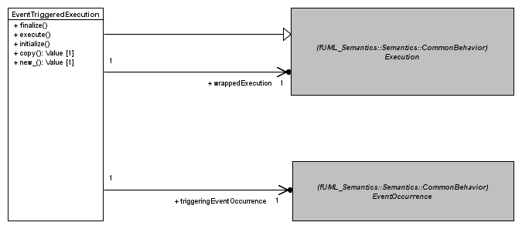
PSSM: Common Behavior (2)
EventTriggeredExecution is a specialization of an Execution. It enables a Behavior to be executed using data shipped by the event occurren that triggered the RTC in which it is executed.
Extract output parameter values
Extract input parameters values
The concrete execution for the executed behavior.
The execution process is different from what fUML specifies. The event occurrence that triggered the behavior execution is used to feed input parameter values. These parameters values are provide to the wrapped execution that corresponds to the interpreter for the behavior. The execution is executed. At the end output parameter values (if any) are extracted and made available through the wrapping execution.

Slide 22
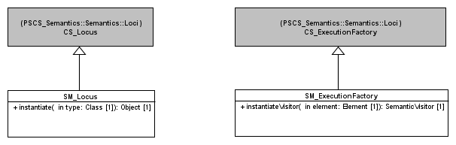
PSSM: Loci
Redefines instantiate operation to make sur that a Class that instantiated in the PSSM context is represented at runtime by an SM_Object.
Redefines instantiateVisitor operation. The redefinition establishes the mapping between state machine concepts and their semantic visitors.
Notes:
Structured Classifiers
(none)
Values
Transition guards are Constraint
Constraint can have a specification which is a ValueSpecification
An OpaqueExpression is a kind of ValueSpecification which can be associated to a Behavior.
Common Behavior
Allow registration of completion events
Generated when a state completes
Allow handling of deferred events
Deferred events are event occurrences whose dispatching needs to be deferred in the current state-machine configuration.
Loci
(none)

Slide 23
State Machines Semantics

Slide 24
Core
Base visitors defined to capture core semantics of UML state machines

Slide 25
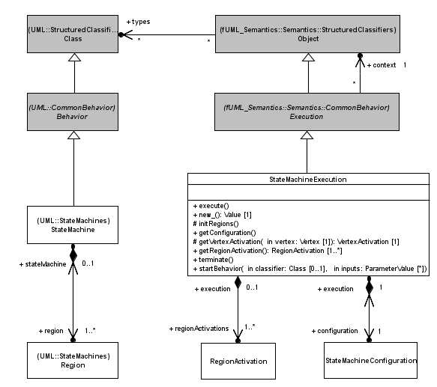
PSSM: State Machine Execution (1)
StateMachineExecution is the root visitor of the interpreter for a state-machine. It contains a set of Region Activation which themselves contains VertexActivation.
As it is a specialization of an Execution, a StateMachineExecution overrides the execute operation. The execution of this latter implies the (recursive) instantiation of the visitors for all models elements owned by the state machine and the simultaneous entry of all regions directly owned by the state machine
The termination the execution of a state machine implies the destruction of the complete hierarchy of visitors for the state-machine.
Visitors for the Regions directly owned by he state machine
Notes:
Structured Classifiers
(none)
Values
Transition guards are Constraint
Constraint can have a specification which is a ValueSpecification
An OpaqueExpression is a kind of ValueSpecification which can be associated to a Behavior.
Common Behavior
Allow registration of completion events
Generated when a state completes
Allow handling of deferred events
Deferred events are event occurrences whose dispatching needs to be deferred in the current state-machine configuration.
Loci
(none)

Slide 26
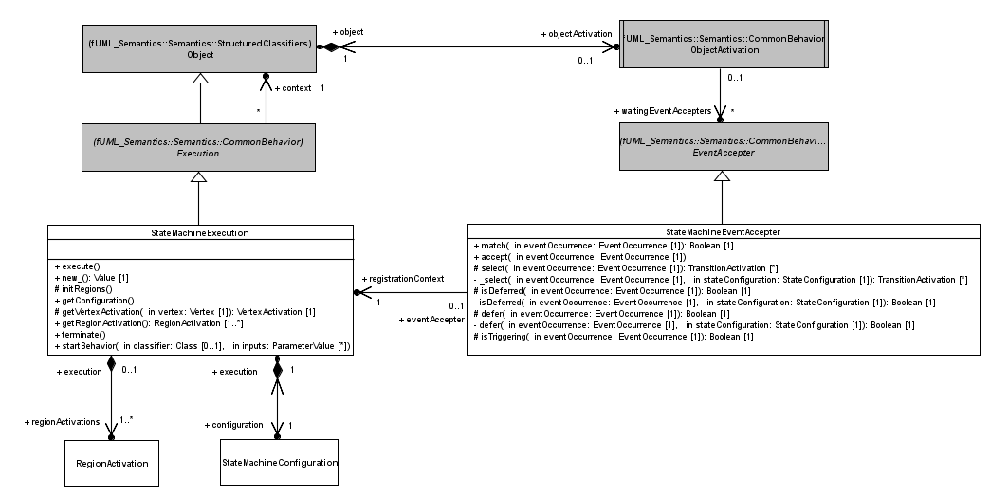
PSSM: State Machine Execution (2)
A StateMachineExecution can only register at most a single StateMachineEventAccepter. This event accepter can match and accept an event occurrence in two different situations:
The event occurrence is deferred in the current state machine configuration
One or more transitions are ready to fire in the current state machine configuration
Represent the hierarchy of active states of the executed state machine. The configuration is used during the dispatching phase to evaluate if the accepter registered by the state-machine matches the dispatched event occurrence
Notes:
Structured Classifiers
(none)
Values
Transition guards are Constraint
Constraint can have a specification which is a ValueSpecification
An OpaqueExpression is a kind of ValueSpecification which can be associated to a Behavior.
Common Behavior
Allow registration of completion events
Generated when a state completes
Allow handling of deferred events
Deferred events are event occurrences whose dispatching needs to be deferred in the current state-machine configuration.
Loci
(none)

Slide 27
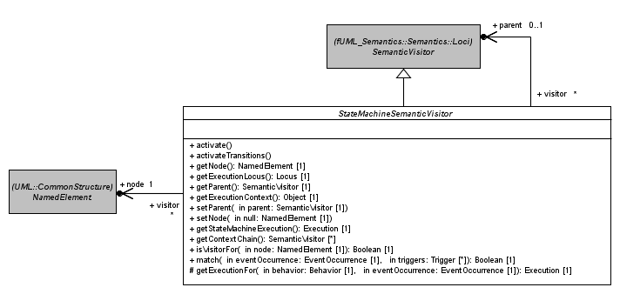
PSSM: State Machine Visitors (1)
StateMachineSemanticVisitor are organized as a tree. Hence it is always possible from a visitor to navigate to its parent.
Each visitor is associated to a NamedElement. This node is the visited state machine model element
PSSM defines an abstract semantic visitor that is the common ancestor for all visitors defined for all behavior state machines concepts. This visitors provides a set of basic operation (e.g., access parent visitor, instantiate sub-visitors, get execution context, etc) shared by all type of visitors.

Slide 28
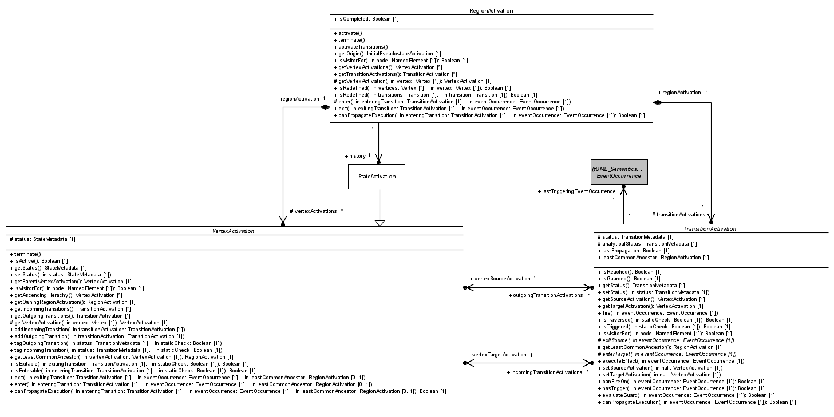
PSSM: State Machine Visitors (2)
RegionActivation captures the execution semantics of a Region. It owns a set of VertexActivation and TransitionActivation which are visitors for vertices and transitions owned by the Region.
VertexActivation captures the execution semantics that is common to all Vertex specializations. It references visitors for incoming and outgoing transitions of the referenced Vertex
TransitionActivation captures the execution semantics that is common to all kind (external, internal and local) of transitions. It references a source and a target VertexActivation

Slide 29
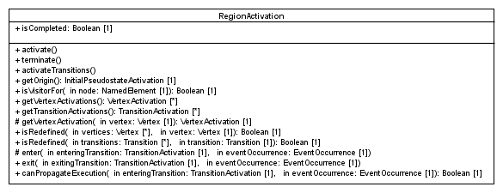
PSSM: State Machine Visitors (3)
False if the Region has no been completed (i.e., the final state was not reached), true otherwise.
Important operations
activate and activateTransitions
Instantiate visitors for vertices and transitions owned by the Region.
entry and exit
Capture semantics of entry (implicit or explicit) and exit (implicit or explicit) sequence of a Region
canPropagateExecution
Capture static analysis semantics when a region is encountered. If the region is entered explicitly then it can always propagate the execution. Conversely if its entered implicitly it can only propagate the execution if it exists an initial pseudo state and this latter can also propagate the execution.
Terminate
Implies the destruction of all visitors owned by the region.

Slide 30
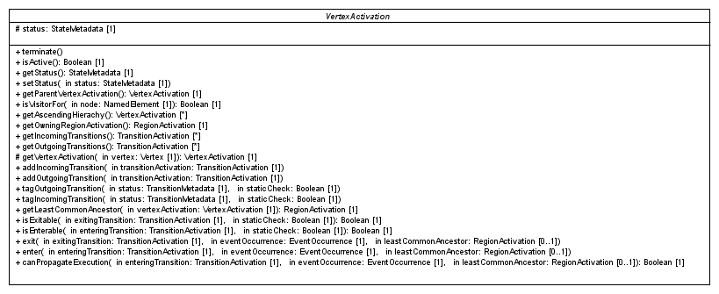
PSSM: State Machine Visitors (3)
Important operations
getLeastCommonAncestor
Determine the least common ancestor existing between two vertices. This ancestor is always a Region (i.e., the visitor for that Region).
isEnterable and isExitable
Some VertexActivation specializations redefine these operations to implementation constraints regarding their possibilities to be entered or exited.
enter and exit
VertexActivation specializations implement these operations to capture their entry and exit semantics.
canPropagateExecution
VertexActivation specializations redefine this operation to implement the static analysis logic.

Slide 31
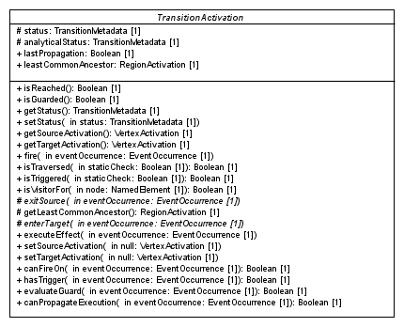
PSSM: State Machine Visitors (3)
Status of the transition activation in the runtime (NONE, REACHED, TRAVERSED)
Status of the transition activation at the static analysis time
Least common ancestor existing between the source and the target vertex activations. Computed only once, when the transition is fired for the first time.
Important operations
fire
Exit source, execute the effect (if any), enter the target.
exitSource and enterTarget
Semantics related to source exiting and target entering are specific to the different kind of transitions (External, Internal and Local).
evaluateGuard
Capture the semantics related to the evaluation of the transition guard.
canPropagateExecution
If the event triggering the transition is different from the last event used to trigger this latter then to consider that the propagation can be performed, the target vertex of the transition must be able to accept the propagation. If the current event and the last event are not different the last static analysis result is result is returned.

Slide 32
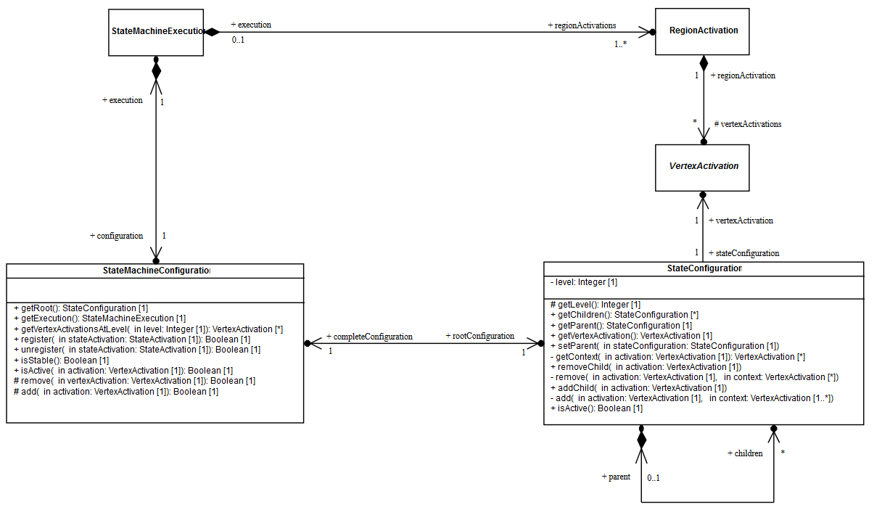
PSSM: State Machine Configuration
A StateMachine Configuration represents the hierarchy of activate states the currently executed state-machine is in.
Internal structure of a configuration is given as a hierarchy of StateConfiguration. Each StateConfiguration in the hierarchy designate a currently active state.
A StateMachineConfiguration always belongs to a StateMachineExecution
Usage of state machine configuration
Determine if an event occurrence is deferred
Determine if an event occurrence triggers one or more transitions
Constraint
The target configuration cannot be invalid
This is ensured by the static analysis performed before taking the decision to perform a step.

Slide 33
Vertex Activation Specializations
StateActivation, FinalStateActivation and all PseudoStateActivation

Slide 34
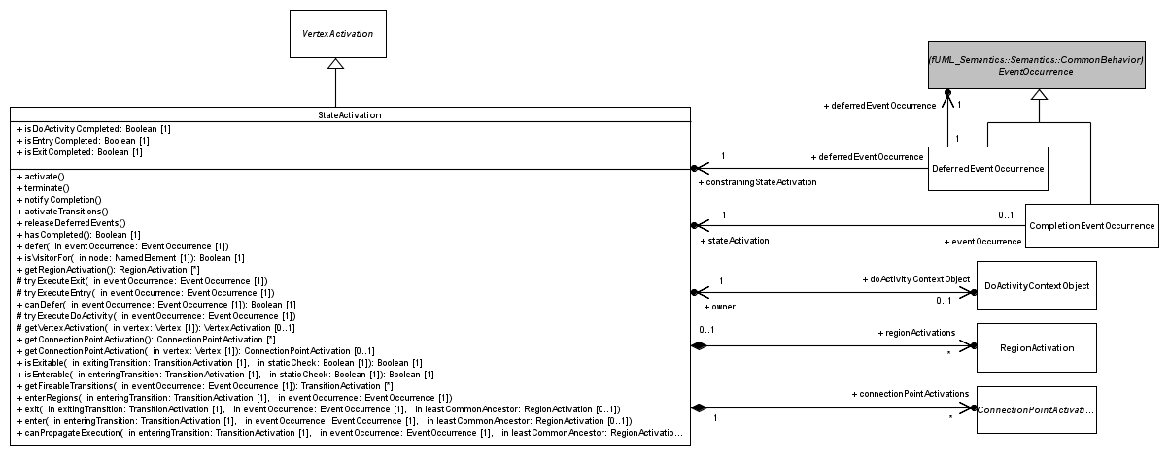
PSSM: State Activation (1)
A StateActivation captures the execution semantics of a State.
A StateActivation can be associated to a doActivityContextObject. If so, a doActivity is currently running at that state (i.e. it is not completed)
A StateActivation can be, if the state is composite, associated with a set of RegionActivation corresponding to visitors corresponding to the different Region of that State.
A StateActivation can be, if the state is composite and has entry or exit points associated with a set of EntryPointActivation or ExitPointActivation. These visitors capture semantics of both Entry and Exit points

Slide 35
PSSM: State Activation (2)
Boolean flag to determine if the state is ready to complete
A state activation can defer an event (see defer operation). The deferred event occurrence is placed in the deferred event pool. The state activation is also responsible for the release of the event it has deferred.
When the state completes a completion (see notifyCompletion operation) event is generated and associated to the state. The event occurrence is placed in the event pool

Slide 36
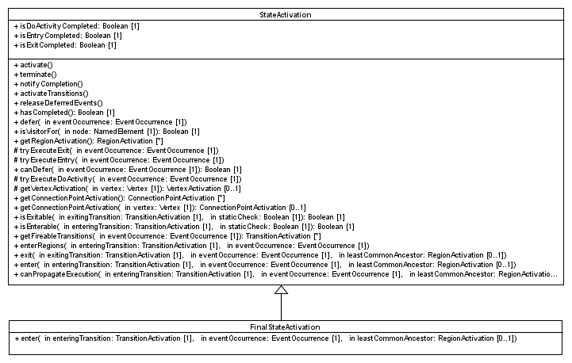
PSSM: Final State Activation
When a FinalStateActivation is entered the Region in which the Final is located is completed
Constraints
Cannot defer an event (no trigger is allowed)
Cannot enter regions (regions are not allowed in Final State)
Do not generate a completion event upon entry (a completion event is never associated to a final state)
Cannot be exited
Cannot execute entry, doActivity or exit (no behavior is allowed on a final state)

Slide 37
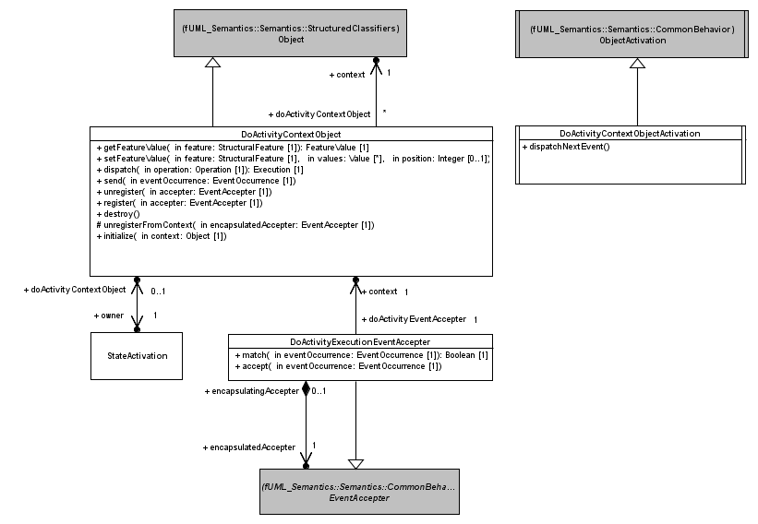
PSSM: Do Activity Execution (1)
An executed doActivity requires to have access to the same members than the state machine. Hence, its context object is the same that the one associated to the state machine.
A doActivity context object is always associate to a specific object activation. This object activation is responsible for checking the completion of the doActivity at the end of the RTC step.
Accepters registered by a doActivity are also available at the object activation associated to the context object of the do activity context object. This ensures that the doActivity is allowed to react to event occurrences available at the state machine event pool. When an event occurrence matches an event accepter registered by the doActivity a new RTC step is performed for that doActivity.
A doActivity context object is the context object of a running doActivity behavior. It ensures that operation calls, feature assignment, signal sending are routed directly the state-machine context object.

Slide 38
PSSM: Do Activity Execution (2)
General semantics
The state machine and its running doActivity behavior(s) compete to consume an event occurrence.
Problem
Hence it is impossible to guarantee that in some situations an event occurrence always trigger an RTC step in the doActivity rather than in the state machine.
Proposed resolution
A state machine is not allowed to defer an event occurrence for which a competing doActivity has already registered an accepter.
An event occurrence that has been deferred by the state machine can be used to trigger RTC in the doActivity (direct acceptance from).

Slide 39
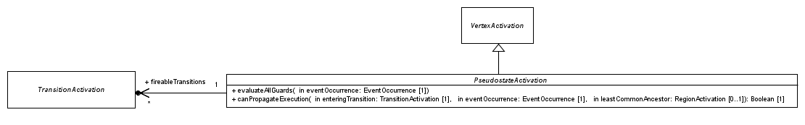
PSSM: Pseudo State Activations (1)
All pseudo state activations reference a set transition activations. This set is computed during static evaluation of execution path. It contains the transition activations which evaluated their transition guard to true. This information is used at the time the pseudo state activation is entered in order to decide which outgoing transitions must fire.
Abstract
PseudostateActivation is abstract hence it does not redefine entry or exit operations. Specializations of PseudostateActivation redefine these operations.
Static analysis and guard evaluation
evaluateAllGuard
Evaluate all guards of transitions outgoing the pseudo state. Transitions with guards evaluating to true are registered in the set of fireable transitions.
canPropagateExecution
Defines the general rule to evaluate if the execution can be propagated through this pseudo state at static analysis time.

Slide 40
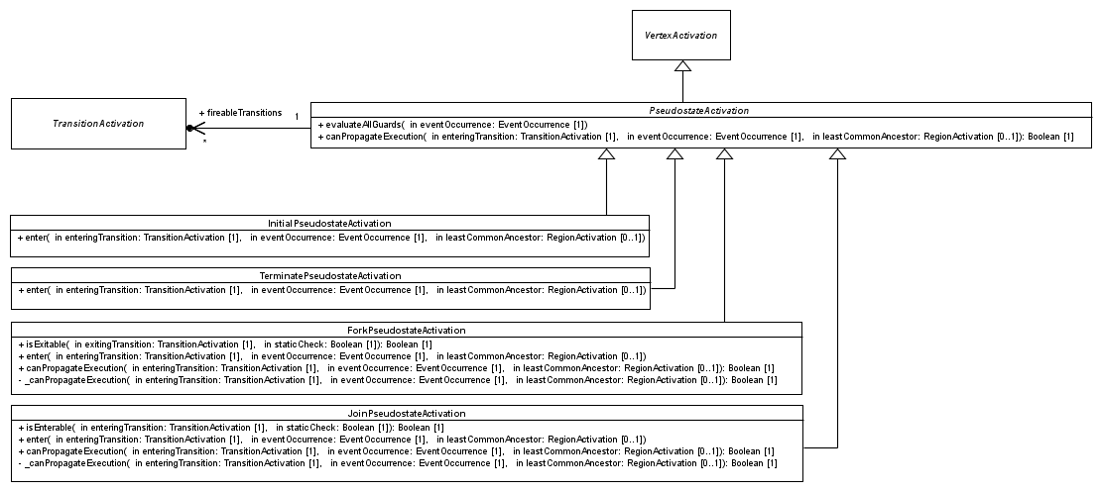
PSSM: Pseudo State Activations (2)
Captures the execution semantics of a pseudo state with the kind “initial”: the single outgoing transition is fired.
Captures the execution semantics of a pseudo state with the kind “terminate”: the state machine execution terminates. No exit behavior is executed. The complete hierarchy of visitors is destroyed.
Captures the execution semantics of a pseudo state with the kind “fork”: all transitions are fired concurrently. A fork pseudo state can only be exited when all of its outgoing transitions have been fired.
Captures the execution semantics of a pseudo state with the kind “join”: one of its outgoing transition is chosen to be fired. The join pseudo state can only be entered when all of its incoming transitions have been fired.

Slide 41
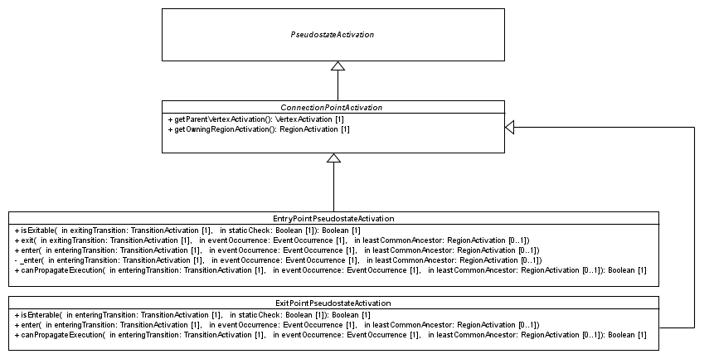
PSSM: Pseudo State Activations (3)
Captures execution semantics of a pseudo state with the kind “Entry”. If the owning state is orthogonal then the entry plays the role of a fork. Otherwise it acts like a Junction pseudo state.
Return the StateActivation which owns the ConnectionPointActivation.
Return the RegionActivation which owns the StateActivation owning the ConnectionPointActivation.
Captures the execution semantics of a pseudo state with the kind “Exit”. If all of its incoming transitions come from vertices located in different regions the exit point plays the role of a Join pseudo state. When entered, the exit point implies exiting its parent. Finally, one of its outgoing transition is chosen to be fired.

Slide 42
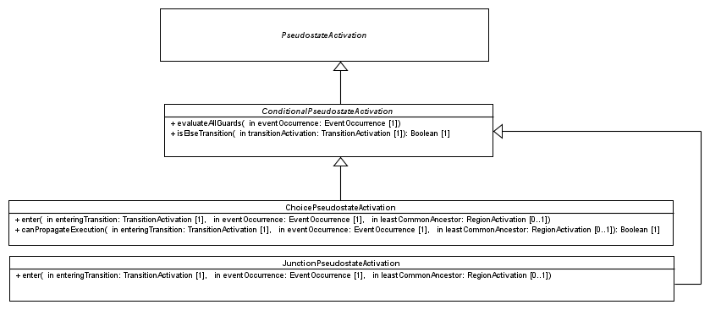
PSSM: Pseudo State Activations (5)
Redefines how guards are evaluated during static analysis to account for the existence of an “ELSE” transition. If no outgoing transitions had a guard evaluating to true then if it exists an “ELSE” transition the its visitor is added to the set of fireable transitions.
An “ELSE” has a guard whose specification is an Expression associated to the “else” symbol. The expression has no operand.
Conditional Pseudo State
Choice
Guards of outgoing transitions are not evaluated during static analysis. They are evaluated at the time the choice is reached by the execution.
Junction
Guards of outgoing transitions are evaluated during static analysis.

Slide 43
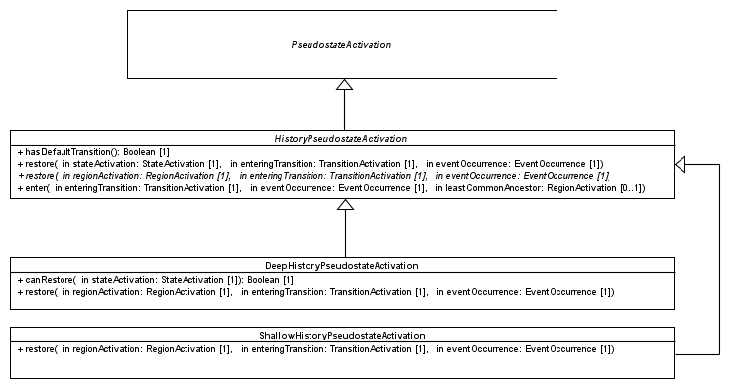
PSSM: Pseudo State Activations (6)
Determine if the history (deep or shallow) has an outgoing transition
Restore operations captures the execution semantics enabling the restoration of a state when an history pseudo state is executed.
History Pseudo state
Entering sequence and restoration process for a state are common to the both kinds of history (deep and shallow)
Shallow
In the context of a shallow history, only the top region (i.e. the one containing the history) can be restored. If this region has no history but a default transition, then this transition is fired. In all other cases, the region performs a default entry.
Deep
The restoration process is similar than the one performed for the shallow history. The difference is that the restoration process is propagated to the nested regions.s

Slide 44
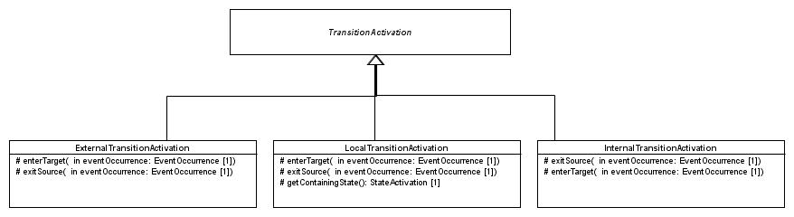
PSSM: Transition Activations (1)
Each specialization of TransitionActivation capture semantics of a kind of Transition, by redefining the exitSource and enterTarget operations.

Slide 45
PSSM: Transition Activations (2)
External
Exit source
If the source can be exited and the target can be entered,
The source is exited. The common ancestor rule applies. That means if the parent state is also required to be exited then it performs (after the source) its exiting sequence.
Otherwise, only the source is exited and the common ancestor does not applies.
Enter target
If the target can be entered, the target performs its entering sequence. The common ancestor rule applies. That means if parent state of the target also requires to be entered it performs is entering sequence.
Otherwise, if the source is contained in the target, the target is not re-entered but the region which contains (directly or indirectly) the source completes. If the target is ready to complete then it generates a completion event.

Slide 46
PSSM: Transition Activations (3)
Internal
The source state is never exited
The target state is never entered

Slide 47
PSSM: Transition Activations (4)
Local
Pre-requisite is to identify the containing state
Exit source
If the source is an entry point.
The entry point is exited. The common ancestor rule does not apply.
Otherwise
If the source contains the target, the current active state of the top region containing (directly or indirectly) the target is exited
If the source is not the containing state then it is exited and the common ancestor rule applies.
Enter target
If the target can be entered and is not the containing state
The target is entered and the common ancestor rule applies.

Slide 48
Event Occurrences
Event occurrences (specific and not specific to state machines) supported in the PSSM context

Slide 49
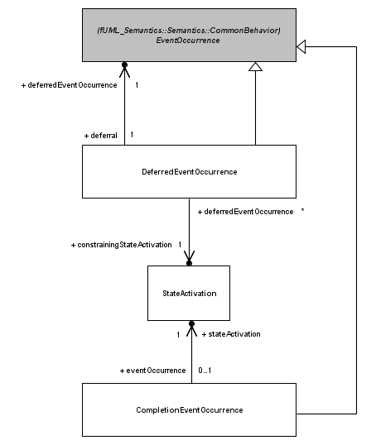
PSSM: Event Occurrences (1)
A DeferredEventOccurrence has a reference on the deferred event occurrence. In PSSM, both SignalEvent and CallEvent can be deferred
A DeferredEventOccurrence materializes the fact that a dispatched event occurrence has been deferred in the current state-machine configuration.
A DeferredEventOccurrence has a reference on the state which provoked the deferral. When this state will leave the state machine configuration, the deferred event will be returned to the event pool.
A completion event denotes the completion of a state. The scope of a completion is the state from which it was generated (i.e., it can only be used to trigger a completion transition outgoing that state).
CompletionEvent have priority over all other kind of events. This means they are always dispatched first.

Slide 50
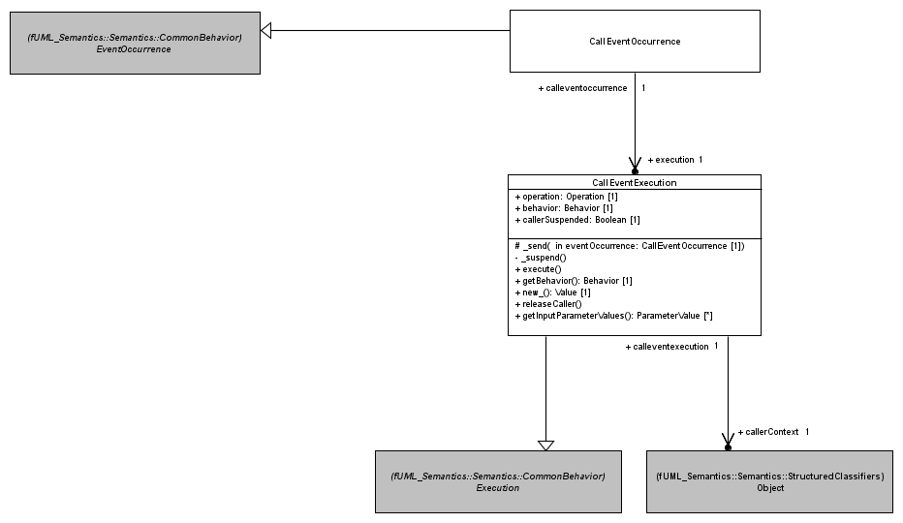
PSSM: Event Occurrences (2)
A CallEventOccurrence represent at the event pool of an object activation a request to perform a synchronous operation call.
A CallEventOccurrence references an execution which is of type CallEventExecution.
A CallEventExecution captures the execution semantics related to the realization of a synchronous call to an operation without implementation on an active object. The execution of the Execution consists in sending a CallEventOccurrence to the target and suspends the caller. The caller will only be allowed to continue its execution at the end of the RTC step in which the call event was dispatched. The caller may stay pending forever if it has no possibility to accept the CallEventOccurrence.
Context object corresponding to the caller

Slide 51
Event Data Passing
The passing of event occurrence data to behaviors executed in a RTC step

Slide 52
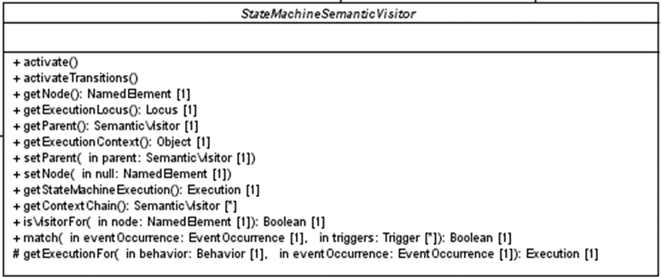
PSSM: Event Data Passing (1)
The operation getExecutionFor provides an the adequate execution for a behavior. If the behavior has parameters and data shipped by the provided event occurrence can be passed to these parameter the returned execution is an EventTriggeredExecution
EventTriggeredExecution is in charge of using the event occurrence to feed the wrapped execution parameters values and to retrieve output values that may be produced.
SignalEventOccurrence or CallEventOccurrence that triggered the execution of the behavior

Slide 53
PSSM: Event Data Passing (2)
Supported Event Occurrences
SignalEventOccurrence
The behavior must have one parameter
The parameter must have a type that conforms to the type of the signal instance referenced by the signal event occurrence.
CallEventOccurrence
Inputs
The signature of the behavior must input conform to the signature of the operation. In that case, parameter values provided for the operation are forwarded to parameter values of the behavior.
Outputs
The signature of the behavior also output conform to the signature of the operation. In that case output values produced by the behavior are also available for output parameters of the operation.

Slide 54
PSSM: Event Data Passing (3)
RTC Step
Event occurrence data are available for all behaviors executed in the step in which the event occurrence is dispatched.
Exit, Effect, Entry, doActivity and to all guards which have a specification described as a behavior.
Static analysis
When the static evaluation of paths takes place the event that may be dispatched is used in guard evaluation if required.
Parallelism
In case of a CallEvent, if output values are produced, then these values correspond to the output values produced by the last executed behavior.

Slide 55
State Machine Redefinition

Slide 56
PSSM: State Machine Redefinition (1)
The operation isVisitorFor enables a semantic visitor for to evaluate if it is the visitor for the state machine element provided as parameter. The evaluation is true if the node referenced by the visitor is the node provided as parameter. This operation is redefined by StateActivation, TransitionActivation and Region Activation
TransitionActivation
A TransitionActivation is a visitor for a transition if
The transition is the one referenced in the TransitionActivation
The transition is redefined (directly or indirectly) by the one referenced in the TransitionActivation.
StateActivation
A StateActivation is a visitor for a state if
The state is the one referenced in the StateActivation
The state is redefined (directly or indirectly) by the one referenced in the StateActivation.

Slide 57
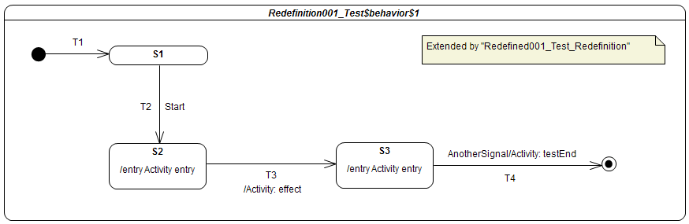
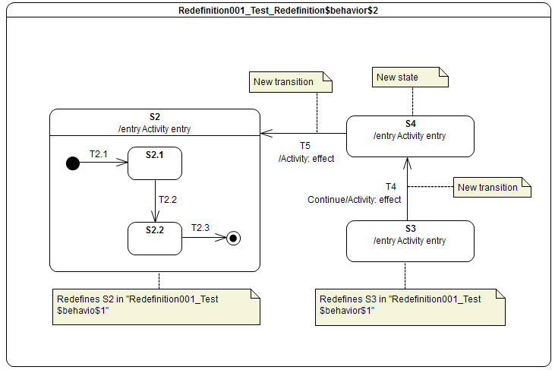
PSSM: State Machine Redefinition (2)
The computation of the final state machine that is going to be executed takes place during the instantiation process described for a Region. It relies on the extension relationships existing between regions and redefinition relationships existing between state and transitions.
S1
T1
T2 Start
T3 / effect
T5 AnotherSignal / testEnd
State machine computed from the redefinition and extension links

Slide 58
Semantic Model Testing
A Test framework and a set of ~100 test cases asserting the different parts of the state machines semantics

Slide 59
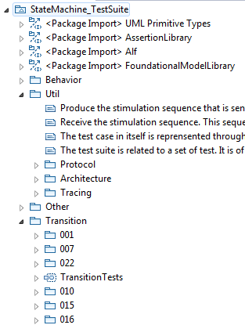
Test suite: Semantic Model assessment
Util package
Defines how a semantic test is designed
Defines how semantic tests are grouped into semantic test suites
Defines how elements composing a test interact
Other packages
Define test categories
Each category is related to particular part of state-machine semantics
Each category contains test cases
Each test case is defined to validate a specific semantic requirement
Library providing base elements to define semantic tests
Test category related to transition semantics
Semantic tests available in that category

Slide 60
Test Framework
Architecture and Test Specification example.

Slide 61
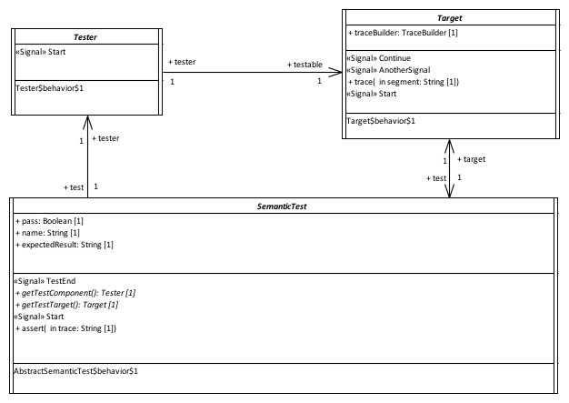

Test Suite: Semantic Test Architecture
Communications done by event passing
Provide a stimulation sequence (i.e., a set of event occurrences) to the Target.
Execute the state-machine under test and record the execution trace produce by this state-machine
The SemanticTest controls both the Tester and the Target. It is also responsible for the computation of the test verdict. The test verdict calculation is based on the comparison between the generated execution trace and the execution traces expected by the test.

Slide 62
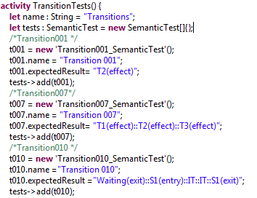
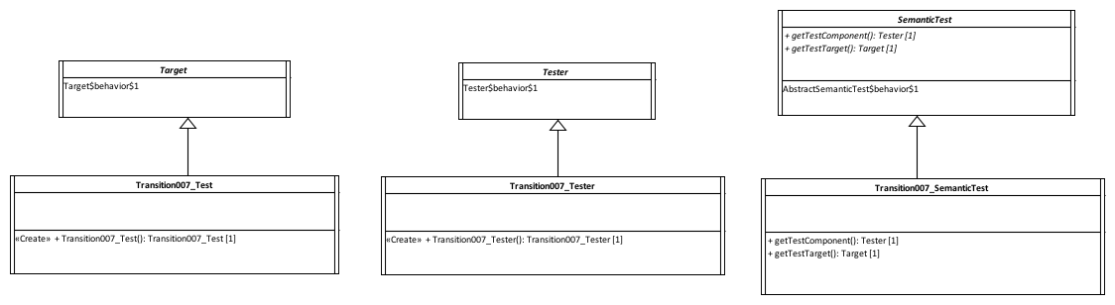
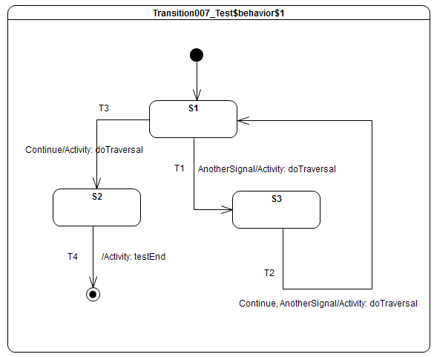
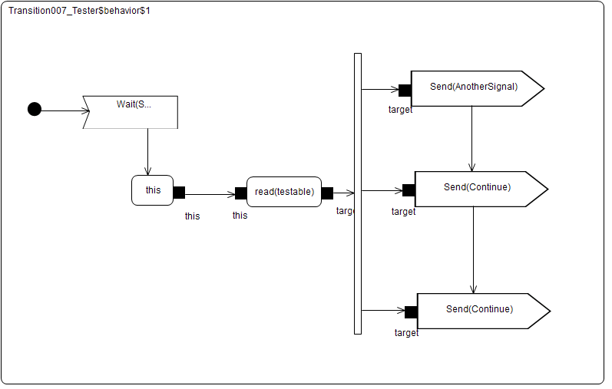
Test Suite: Example Test Definition
Semantic test is instantiated and registered in a semantic test suite.
Expected execution trace

Slide 63
Test Suite: Example Test Execution
Received event occurrences
AnotherSignal – S1
Continue – S3
Continue – S1
Expected trace
T1(effect)::T2(effect)::T3(effect)
Requirement
A transition may own a set of Triggers, each of which specifies an Event whose occurrence, when dispatched, may trigger traversal of a transition.
Step | Event Pool | Configuration | Fired transitions
1 | [] | [] – Initial RTC step | [InitialTransition]
2 | [AnotherSignal, CE(S1)] | [S1] | []
3 | [AnotherSignal] | [S1] | [T1]
4 | [Continue, CE(S3)] | [S3] | []
5 | [Continue] | [S3] | [T2]
6 | [Continue, CE(S1)] | [S1] | []
7 | [Continue] | [S1] | [T3]
8 | [CE(S2)] | [S2] | [T4]

Slide 64
Some Test Cases
Subset of test cases demonstrating the support provided by the semantic model regarding the requirements

Slide 65
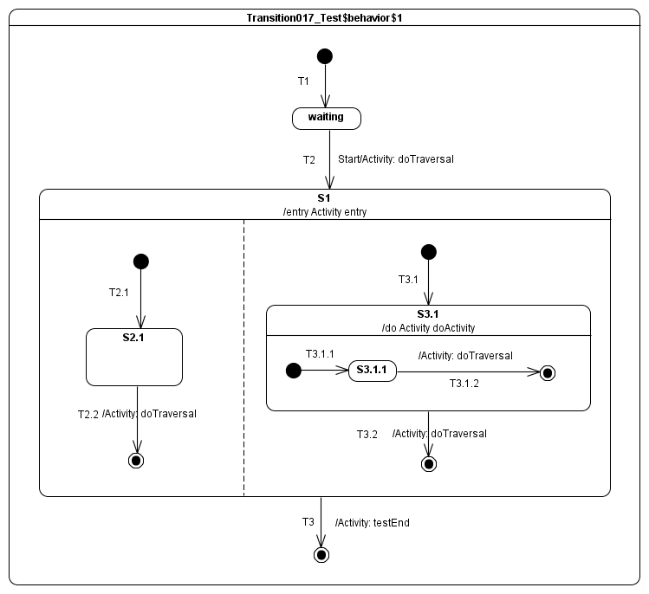
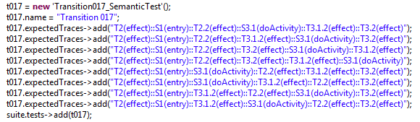
Test suite: Transition (Completion Event)
Intensive usage of completion events
Reception of Start signal event occurrence triggers T2
public activity doActivity(){
this.trace(“S3.1(doActivity)”);
}
Parallelism
Parallelism introduced in the model implies 8 valid execution traces

Slide 66
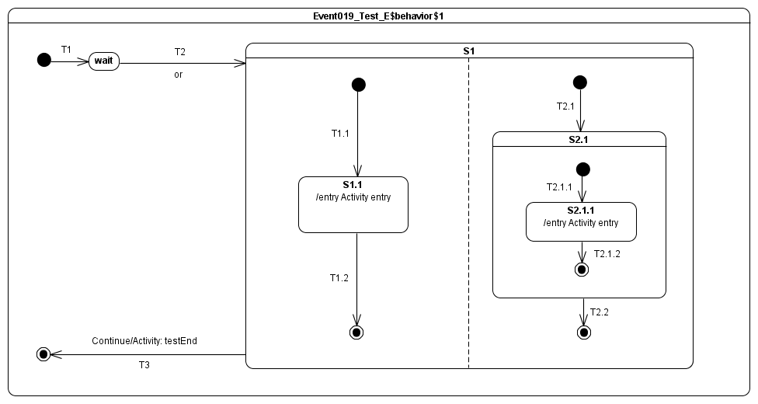
Test suite: Event (Call Event)
public or(in left: Boolean, in right : Boolean, out result: Boolean): Boolean;
Input and output conform to “or” operation. Implementation realize an OR operation between left and right parameters.
Input and output conform to “or” operation. Implementation realize an XOR operation between left and right parameters.
The last computed outputs are made available to the caller.

Slide 67
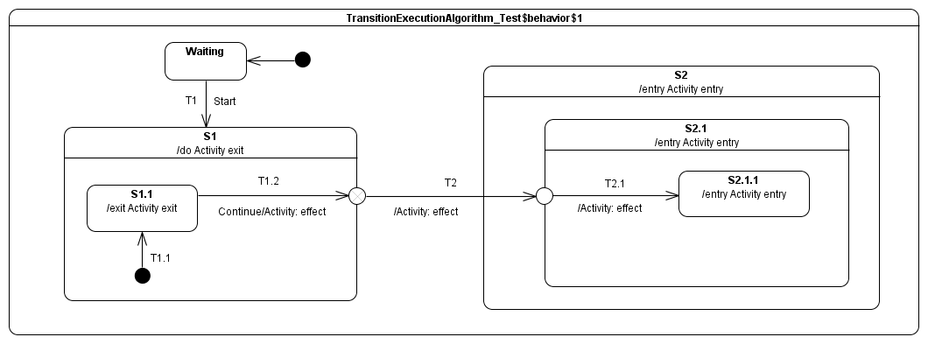

Test suite: Entry and Exit
Usage of Entry/Exit points, implicit/explicit entry and application of common ancestor rule
Implicit entry
Explicit entry and application of common ancestor rule

Slide 68
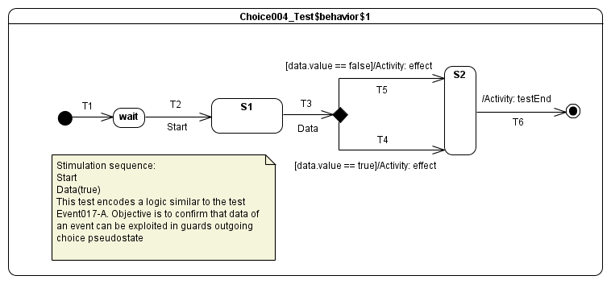

Test suite: Conditional Pseudo State (Choice)
Usage Data signal even occurrence property in guard evaluation
Usage of an else transition

Slide 69



Test suite: Conditional Pseudo State (Junction)
Junction used as a conditional node.
Junction used as a merge node.
During static analysis it is always possible to find a path to a valid state machine configuration. Hence T3 never fires.

Slide 70


Test suite: Deferred Events
Usage of deferred trigger in a hierarchal and orthogonal context
public activity ‘Deferred004_Tester_B$behavior$1’(){
accept(Start);
this.testable.AnotherSignal();
this.testable.Continue();
this.testable.Pending();
}

Slide 71


Test suite: Deep history
Default transition

Slide 72



Test suite: Redefinition (1)

Slide 73


Test suite: Redefinition (2)
T1
T1.1
T3 / testEnd

Slide 74


Test suite: Static Analysis

Slide 75
Current Status
Requirements coverage, remaining tasks and target delivery date

Slide 76
Status : Requirement Coverage
Full support of the requirements
Initial submission

Slide 77
Next Steps
Revised submission (Due in November)
Update clauses 7, 8 and 9 of the specification document
Clause 7: Abstract syntax
Clause 8: Semantic model (proof-reading)
Clause 9: Tests suite (34 new test descriptions required)
Alignment issues
Moving fUML and PSCS to UML 2.5
Context interpretation for OCL
Making Vertex a RedefinableElement
Abstract syntax updates for event data passing

