Slide 1
Precise Semantics of UML State Machines (PSSM)
Update
Presentation to the ADTF 14 September 2016
Ed Seidewitz / Model Driven Solutions
Jérémie Tatibouet / CEA

Slide 2
Submission Team
Submitters
BAE Systems (Jeffrey Smith)
Model Driven Solutions (Ed Seidewitz)
No Magic, Inc. (Nerijus Jankevicius)
Contributors
Airbus (Yves Bernard)
Simula Research Laboratory (Bran Selic)
LieberLieber (Daniel Siegl)
CEA – Commissariat à l’Energie Atomique (Jérémie Tatibouet)

Slide 3

Mandatory Requirements
Requirement | Response
6.5.1a Behavior state machine semantics (excluding redefinition and submachines) | All required elements Call events (synchronous calls)
6.5.1b Event data passing | Achieved using a parameter-passing approach for guard expressions and event behaviors.
6.5.1c Standalone and classifier behavior execution | Proposal is restricted to these two cases.
6.5.1d Consistency with PSCS | Achieved by defining PSSM execution model as an extension of the PSCS model.
6.5.1e Relationship to fUML | Achieved by defining PSSM execution model as an extension of the fUML model.
6.5.1f Extension of fUML base semantics (if necessary) | This was not found to be necessary.

Slide 4
Mandatory Requirements
Requirement | Response
6.5.2a Semantic variabilities | Proposal does not define any additional semantic variabilities.
6.5.2b Semantic variants | Proposal does not define any additional semantic variants.
6.5.3a UML 2 conformance | Proposed PSSM syntax subsets UML 2.5 abstract syntax.
6.5.3b fUML conformance | Proposed PSSM semantics are based on fUML 1.2.1.
6.5.3c PSCS conformance | Proposed PSSM semantics are based on PSCS 1.0.
6.5.3d Common Logic conformance | Not applicable, proposal does not extend the fUML base semantics.
6.5.4a Test suite | Proposal includes suite of 98 tests.
6.5.4b Test suite coverage | Current coverage is 100% of identified functional requirements.

Slide 5

Non-Mandatory Features
Feature | Response
6.6.1 Submachine states | Not included in the proposal.
6.6.2 Protocol state machine | Proposal includes a non-normative annex on protocol state machines.
6.6.3 State machine redefinition | Proposal discusses the semantics of state machine redefinition and includes its formal specification in the semantic model.
6.6.4 Asynchronous operation calls | Not included in the proposal.
6.6.5 Triggers with ChangeEvents | Not included in the proposal.
6.6.6 Alf for action language concrete syntax | Proposal uses Java as the action language. (Alf may be used in the future.)

Slide 6
Issues To Be Discussed
State machines for passive classes
Supported in several UML tools.
Semantics are not entirely consistent with active behavior machine semantics.
Discussed in informative annex in proposal.
Abstract syntax issues with passing event data
Event data passing to/from effect, entry, exit and do behaviors without changing UML abstract syntax.
Event data passing to transition guards require an abstract syntax change (to be made in UML 2.5.1).
Relationship to MARTE causality model
MARTE causality model based on UML 2.1 semantics.
Still seems generally consistent with UML 2.5 common behavior semantics.

Slide 7
Issues To Be Discussed
Relationship to OntoIOP
Not yet addressed.
Relationship to SCXML
SCXML has a significant overlap with UML state machines, but there are differences.
Possible to define a mapping from a subset of UML state machine syntax to SCXML with consistent semantics.
Proof of concept implementation
Developed by CEA .
Integrated into the Eclipse Papyrus/Moka model execution framework, built on PSCS/fUML implementation.
Passes all 98 current PSSM tests, without violating any PSCS tests.

Slide 8
Conformance
Level Aspect | PSSM only | PSSM and PSCS
Syntax | PSSM abstract syntax is a superset of fUML abstract syntax PSSM abstract does not include PSCS abstract syntax | Union of PSSM abstract syntax and PSCS abstract syntax
Semantics | Execution tool must provide semantics consistent with PSSM execution model. Semantic conformance with fUML All PSSM tests pass except those related to triggers-with-ports references. | Execution tool must provide semantics consistent with PSSM and PSCS execution models. Semantic conformance with fUML All PSSM tests pass All PSCS tests pass

Slide 9


Submission Structure
PSSM test suite models conform to the PSSM syntax
Requirements
PSSM Syntax
PSSM Test suite
PSSM Semantic models captures semantics of PSSM syntax
Test execution enables semantic definition validation
Implementation is used to execute the test models defined within the test suite
Implementation
PSSM Semantic
PSSM semantics in Papyrus Moka model execution tool

Slide 10
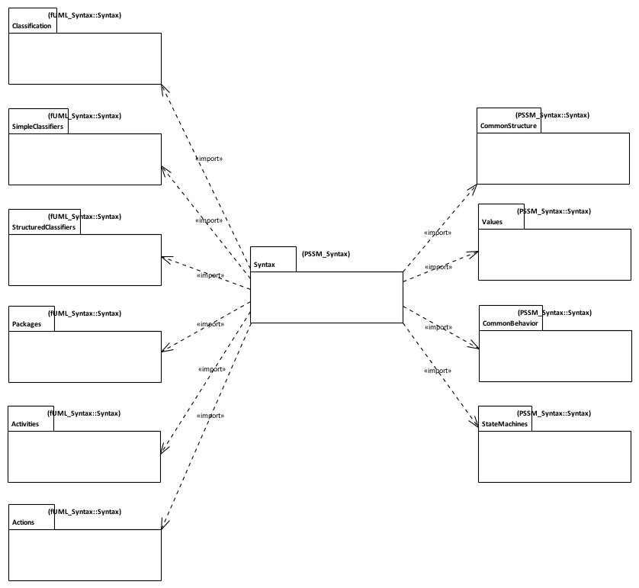
PSSM Syntax
Issue
fUML 1.2.1 abstract syntax is currently organized according to UML 2.4.1, not UML 2.5.
Syntax imported from fUML with additions
PSSM Syntax is a superset of fUML syntax
Additional Syntax for State Machines
Syntax imported without change from fUML.

Slide 11
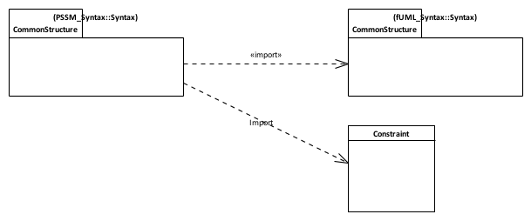
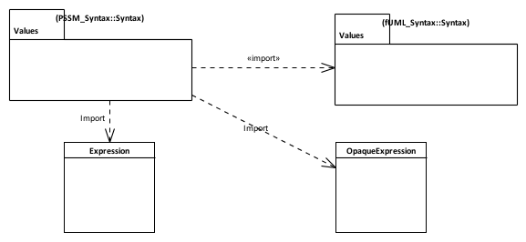

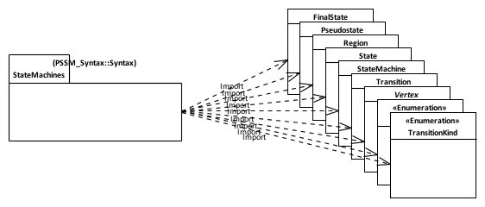
PSSM Syntax: Subsetting
An “else” guard is represented as an Expression with the symbol “else”.
Constraint can have a specification given as a an OpaqueExpression which can be associated to a Behavior.
Guards placed on transitions are defined as Contraints.
A transition can be associated with 0..* triggers. One of the Triggers can be for a CallEvent.
Behavior state machine syntax elements.

Slide 12
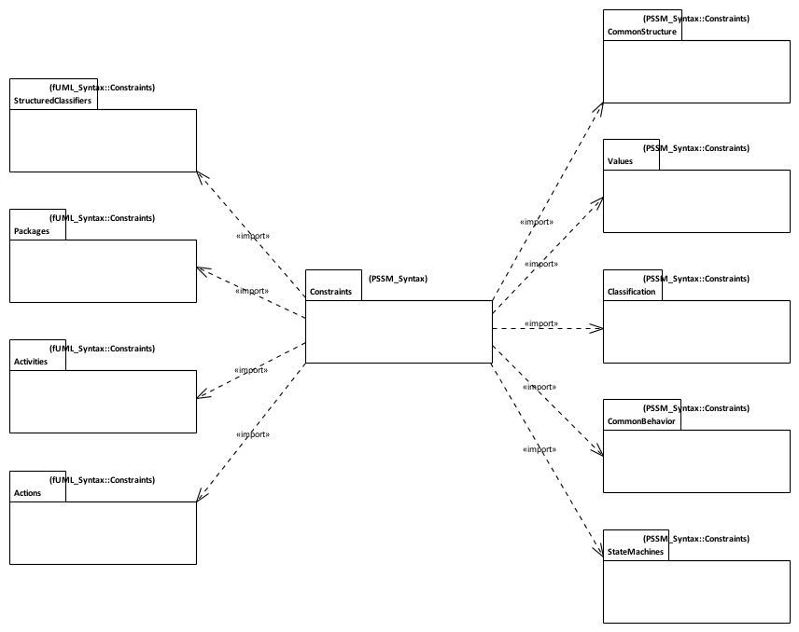
PSSM Syntax: Constraints
Constraints imported from fUML with additions / changes
Constraints imported without change from fUML.
Additional Syntax for State Machines

Slide 13
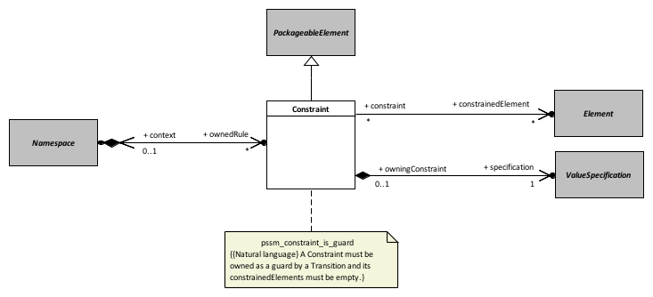
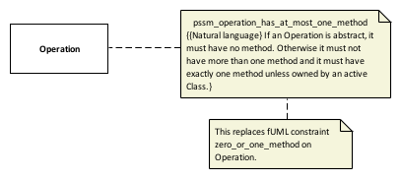
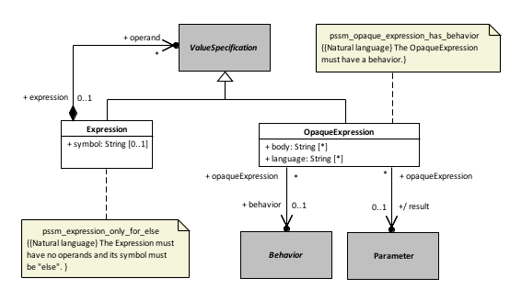
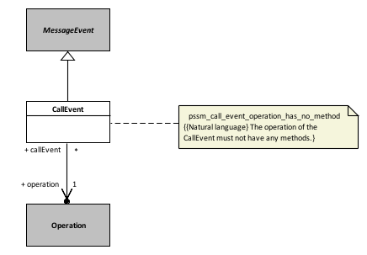
Constraints: Additions and Updates
Common Structure
Classification
Values
Common Behavior
Issue UMLR-92
UML/OCL spec mismatch - Constraint.context vs Constraint.constrainedElement

Slide 14
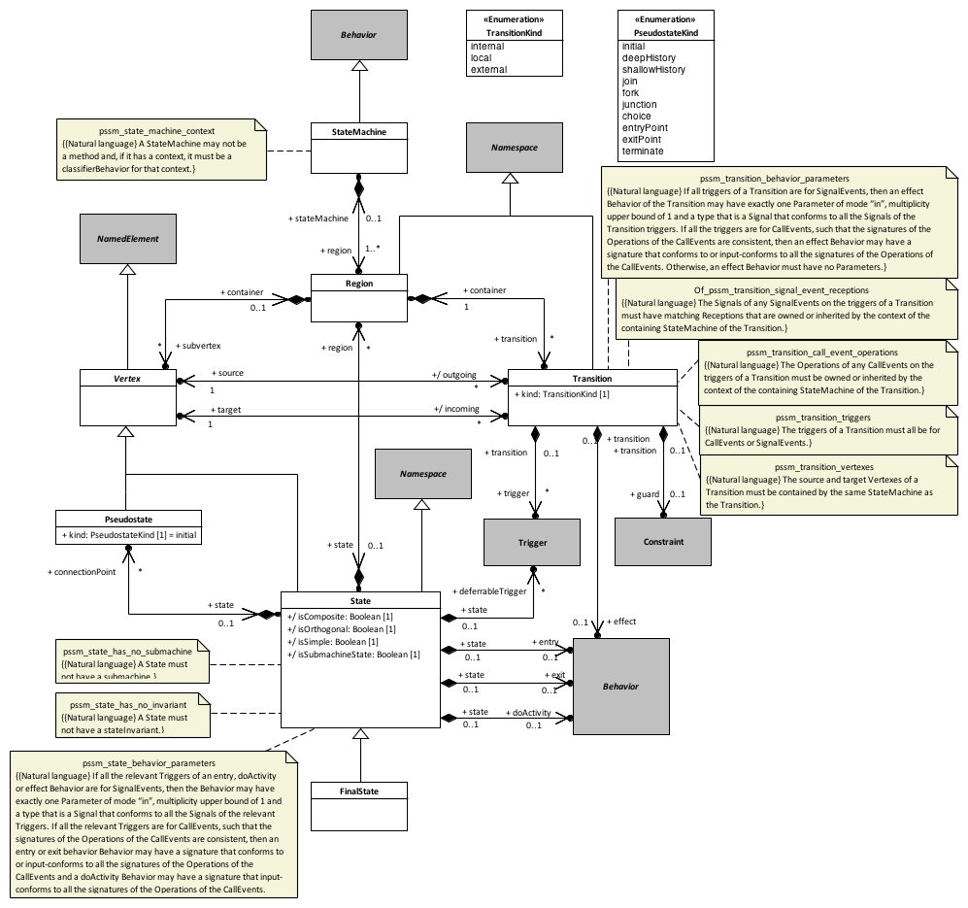
Constraints: Behavior State Machines
Issue UMLR-686
The behavior of an OpaqueExpression should be allowed to have input parameters

Slide 15
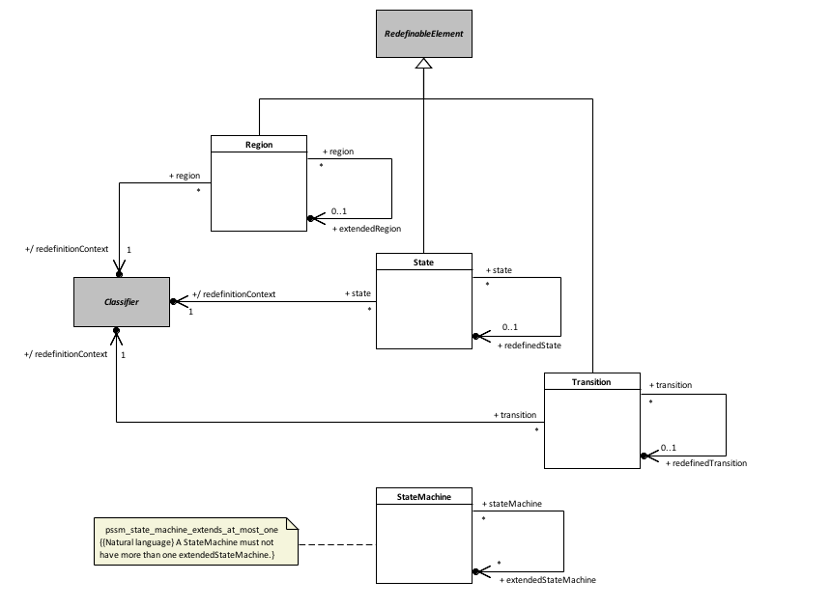
Constraints: State Machine Redefinition
Issue UMLR-685
UML 2.5: StateMachine Vertex needs to be made a kind of RedefinableElement instead of State

Slide 16
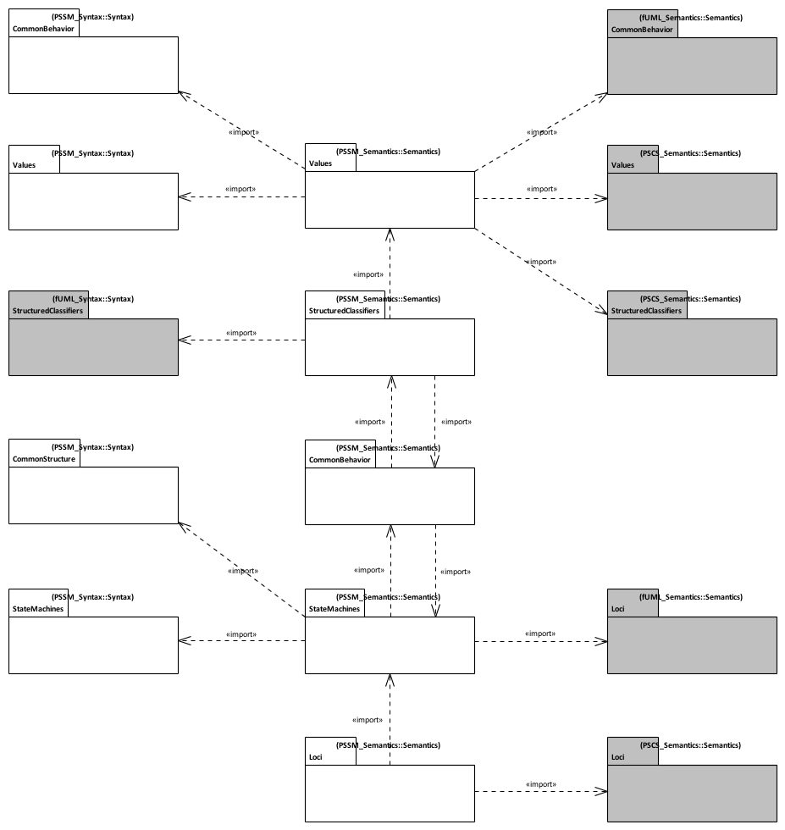
PSSM Semantics
PSSM syntax packages
fUML and PSCS semantics packages
Issue
fUML 1.2.1 and PSCS 1.0 execution models are currently not organized around UML 2.5.
PSSM semantics packages
Notes:
Alignment with UML 2.5 - PSSM semantic model is aligned with UML 2.5 package structure
PSSM Semantic model layout
Values - Semantic model elements extending fUML and PSCS semantics for values.
StructuredClassifiers - Semantic model elements extending fUML and PSCS semantics for structured classifiers.
Common behavior - Semantic model elements extending common behavior semantics for UML state-machines specific needs.
StateMachines - Semantic visitors capturing semantics of behavior state-machines meta-classes.
Loci - Semantic model elements extending fUML and PSCS semantics for instantiation.

Slide 17
Extensions to PSCS
Structured classifiers
Values
Common behaviors
Loci

Slide 18
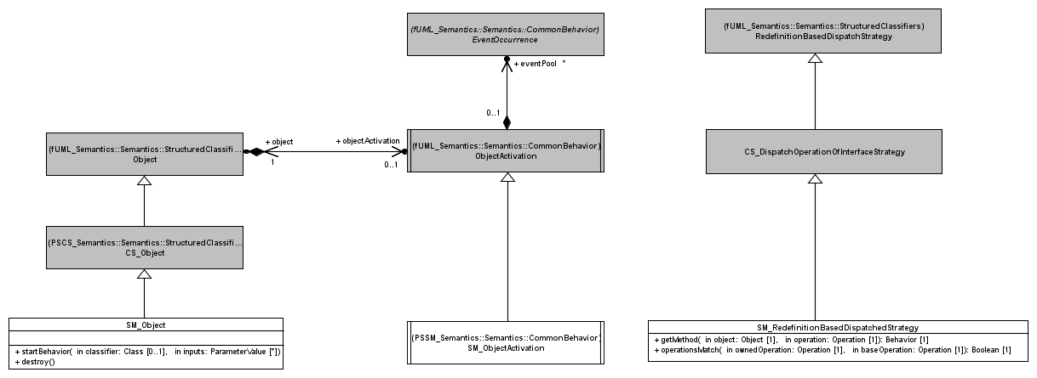
PSSM: Structured Classifiers
Common Behavior
In PSSM, a SM_Object is always associated to SM_ObjectActivation. This is ensured by the redefinition of the startBehavior operation. SM_Object also redefines the destroy operation to make sure that in addition to the normal destruction process, the event pool is cleared.
PSSM extends the support for synchronous calls provided by fUML. In particular, it adds support for CallEvents, which are generated when a asynchronous call is made on an Operation without a method. The dispatch and getMethod operations are redefined. The new dispatch ensures that if no method is returned, then a particular type of execution is generated to capture the CallEvent semantics; in any other situation the semantics defined by fUML is preserved. The getMethod operation is redefined only to allow the null value to be returned.

Slide 19
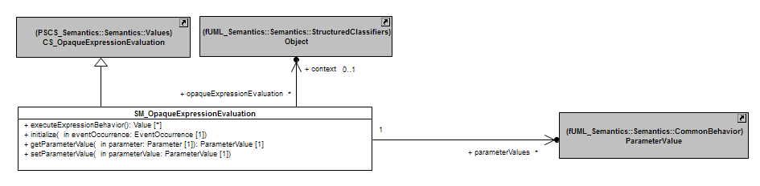
PSSM: Values
SM_OpaqueExpressionEvaluation provides a way to evaluate an OpaqueExpression that has a specification formalized as a Behavior.
Evaluation context
The context of the executed state machine
Access to members is allowed (e.g. operations)
Event data passing
Data embedded in the event occurrence which has triggered the RTC step are available in the evaluation process
The data are provided as input parameter values.

Slide 20
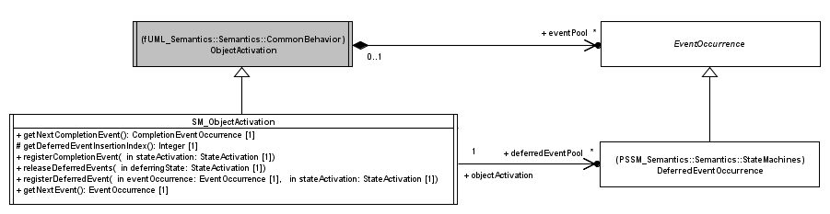
PSSM: Common Behavior (1)
SM_Object always has an SM_ObjectActivation. This object activation enables handling of both completion events (state machine specific) and deferred events (not state machine specific but not available directly in fUML).
Operation getNextEvent is redefined to ensure that, when there are completion events in the pool, then they are dispatched before any other event according to their order of arrival.
Place an event occurrence in the deferred event pool
Event occurrences that were deferred by the given state activation are returned to the regular event pool. The order in which these events are returned to the pool is the order in which they were deferred.
DeferredEventOccurrence represents an event occurrence that is deferred by the executing state machine. Such events are placed in the deferred event pool of the state machine object activation.

Slide 21
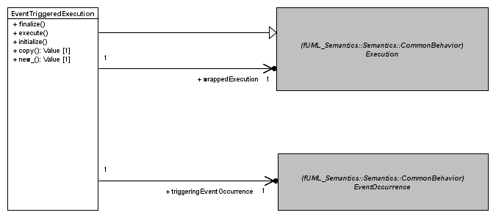
PSSM: Common Behavior (2)
EventTriggeredExecution is a specialization of an Execution. It enables a Behavior to be executed using data contained in the event occurrence that triggered the RTC in which it is executed.
Extract output parameter values (only in case of a CallEvent)
Extract input parameters values
The concrete execution for the executed behavior.
The execution process is different from what fUML specifies. The EventOccurrence that triggered the Behavior execution is used to feed input ParameterValues. These ParameterValues are provided to the wrapped Execution that corresponds to the interpreter for the Behavior. The execution is executed. At the end, output ParameterValues (if any) are extracted and made available through the wrapping Execution.

Slide 22
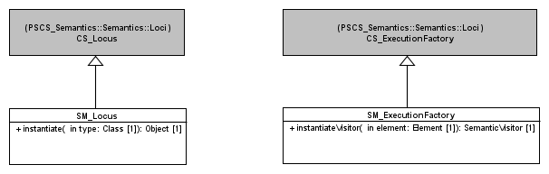
PSSM: Loci
Redefines the instantiate operation to make sure that a Class that is instantiated in the PSSM context is represented at runtime by an SM_Object.
Redefines the instantiateVisitor operation. The redefinition establishes the mapping between state machine concepts and their semantic visitors.
Notes:
Structured Classifiers
(none)
Values
Transition guards are Constraint
Constraint can have a specification which is a ValueSpecification
An OpaqueExpression is a kind of ValueSpecification which can be associated to a Behavior.
Common Behavior
Allow registration of completion events
Generated when a state completes
Allow handling of deferred events
Deferred events are event occurrences whose dispatching needs to be deferred in the current state-machine configuration.
Loci
(none)

Slide 23
State Machines Semantics

Slide 24
Core
Base visitors defined to capture core semantics of UML state machines

Slide 25
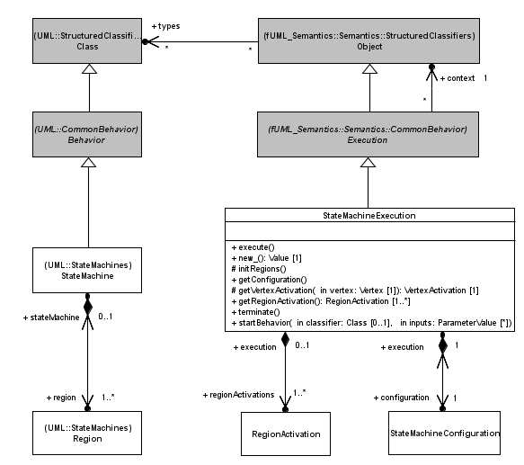
PSSM: State Machine Execution
StateMachineExecution is the root visitor of the interpreter for a StateMachine. It contains a set of RegionActivations that themselves contain VertexActivations.
As a specialization of an Execution, a StateMachineExecution overrides the execute operation. The execution of this operation implies the (recursive) instantiation of the visitors for all model elements owned by the state machine and the simultaneous entry of all regions directly owned by the state machine.
The termination the execution of a StateMachine implies the destruction of the complete hierarchy of visitors for the StateMachine.
Visitors for the Regions directly owned by the StateMachine
Notes:
Structured Classifiers
(none)
Values
Transition guards are Constraint
Constraint can have a specification which is a ValueSpecification
An OpaqueExpression is a kind of ValueSpecification which can be associated to a Behavior.
Common Behavior
Allow registration of completion events
Generated when a state completes
Allow handling of deferred events
Deferred events are event occurrences whose dispatching needs to be deferred in the current state-machine configuration.
Loci
(none)

Slide 26
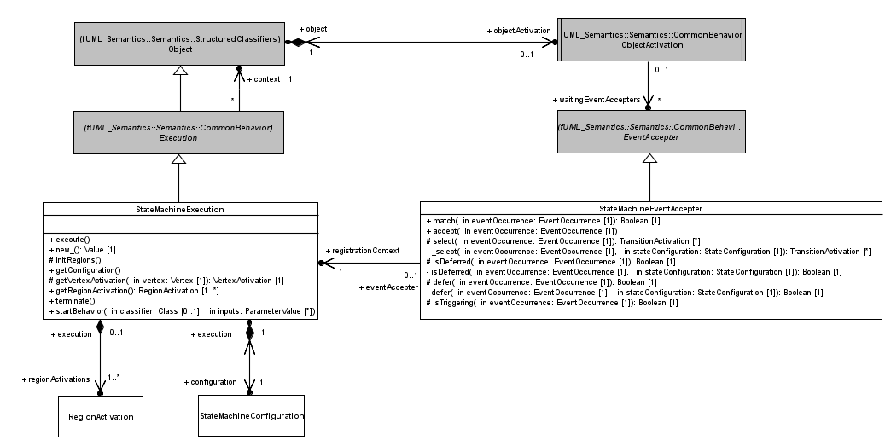

PSSM: Configuration and Accepter
During a “match” sequence, the static analysis ensures that at least one path to a stable configuration exists.
A StateMachineExecution can only register at most a single StateMachineEventAccepter. This event accepter can match and accept an EventOccurrence in two different situations:
The EventOccurrence is deferred in the current StateMachine configuration
One or more Transitions are ready to fire in the current StateMachine configuration
Represents the hierarchy of active States of the executing StateMachine. The configuration is used during the dispatching phase to evaluate if the accepter registered by the StateMachine matches the dispatched EventOccurrence
Notes:
Structured Classifiers
(none)
Values
Transition guards are Constraint
Constraint can have a specification which is a ValueSpecification
An OpaqueExpression is a kind of ValueSpecification which can be associated to a Behavior.
Common Behavior
Allow registration of completion events
Generated when a state completes
Allow handling of deferred events
Deferred events are event occurrences whose dispatching needs to be deferred in the current state-machine configuration.
Loci
(none)

Slide 27
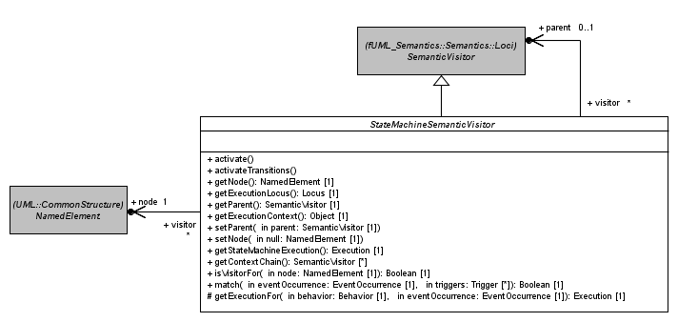
PSSM: State Machine Visitor
StateMachineSemanticVisitors are organized as a tree. Hence it is always possible from a visitor to navigate to its parent.
Each visitor is associated to a NamedElement. This node is the visited stateMachine model element.
PSSM defines an abstract SemanticVisitor that is the common ancestor for all visitors defined for all BehaviorStateMachine concepts. This visitor provides a set of basic operations (e.g., access parent visitor, instantiate sub-visitors, get execution context, etc.) shared by all types of visitors.

Slide 28
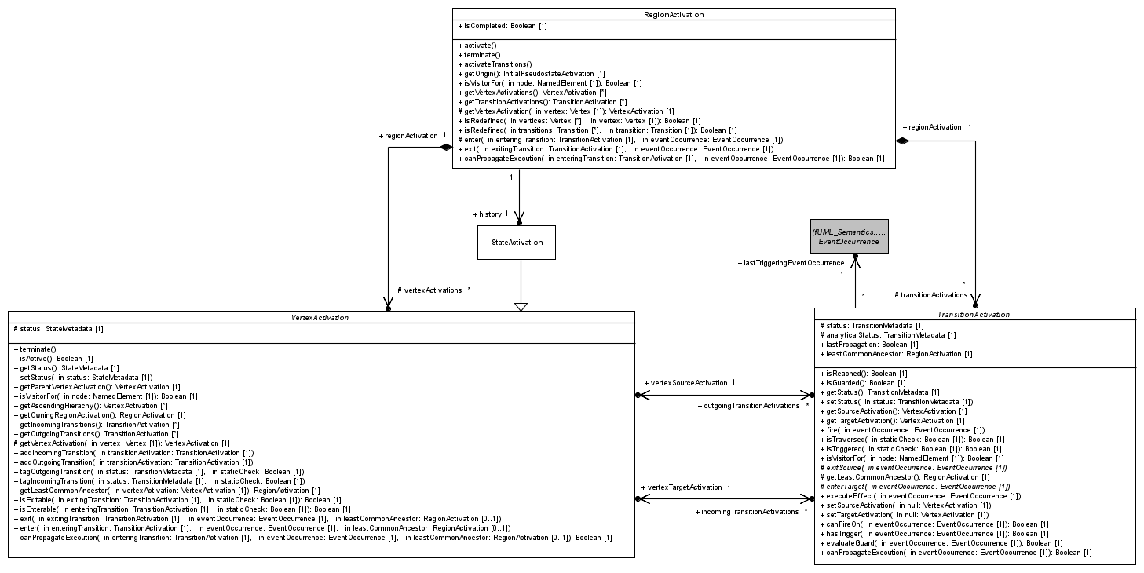
PSSM: Region Activation, Vertex Activation and Transition Activations
RegionActivation captures the execution semantics of a Region. It owns a set of VertexActivations and TransitionActivations, which are visitors for Vertices and Transitions owned by the Region.
VertexActivation captures the execution semantics that is common to all Vertex specializations. It references visitors for incoming and outgoing Transitions of the referenced Vertex
TransitionActivation captures the execution semantics that is common to all kinds (external, internal and local) of Transitions. It references source and target VertexActivations.

Slide 29
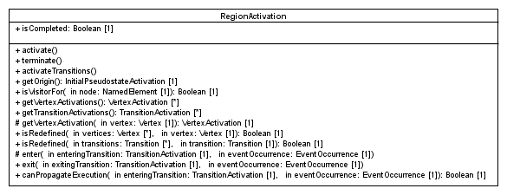
PSSM: Region Activation
False if the Region has not been completed (i.e., the final state was not reached), true otherwise.
Important operations
activate and activateTransitions
Instantiate visitors for Vertices and Transitions owned by the Region.
entry and exit
Capture semantics of the entry (implicit or explicit) and exit (implicit or explicit) sequences of a Region
canPropagateExecution
Captures static analysis semantics when a Region is encountered. If the Region is entered explicitly, then it can always propagate the execution. Conversely, if its entered implicitly it can only propagate the execution if an initial Pseudostate exists and this can also propagate the execution.
terminate
Implies the destruction of all visitors owned by the Region.

Slide 30
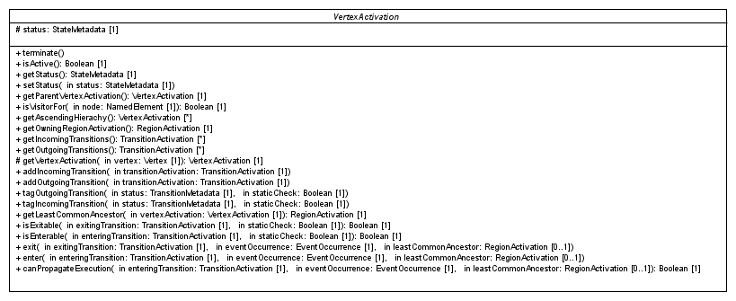
PSSM: Vertex Activation
Status of the VertexActivation in the runtime (IDLE or ACTIVE)
Important operations
getLeastCommonAncestor
Determine the least common ancestor existing between two Vertices. This ancestor is always a Region (i.e., the visitor for that Region).
isEnterable and isExitable
Some VertexActivation specializations redefine these operations to implementation constraints regarding their possibilities to be entered or exited.
enter and exit
VertexActivation specializations implement these operations to capture their entry and exit semantics.
canPropagateExecution
VertexActivation specializations redefine this operation to implement the static analysis logic.

Slide 31
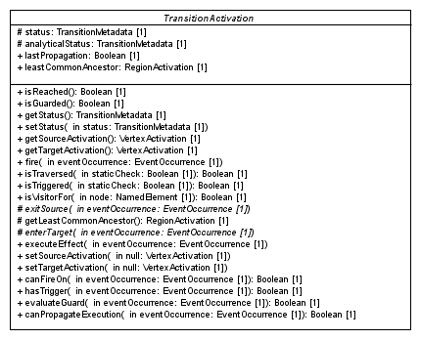
PSSM: Transition Activation
Status of the transition activation in the runtime (NONE, REACHED, TRAVERSED)
Status of the TransitionActivation at the static analysis time
Least common ancestor existing between the source and the target VertexActivations. Computed only once, when the Transition is fired for the first time.
Important operations
fire
Exit source, execute the effect (if any), enter the target.
exitSource and enterTarget
Semantics related to source exiting and target entering are specific to the different kinds of Transitions (external, internal and local).
evaluateGuard
Capture the semantics related to the evaluation of the Transition guard.
canPropagateExecution
If the event triggering the Transition is different from the last event used to trigger it, then to consider that the propagation can be performed, the target vertex of the Transition must be able to accept the propagation. If the current event and the last event are not different, the last static analysis result is returned.

Slide 32
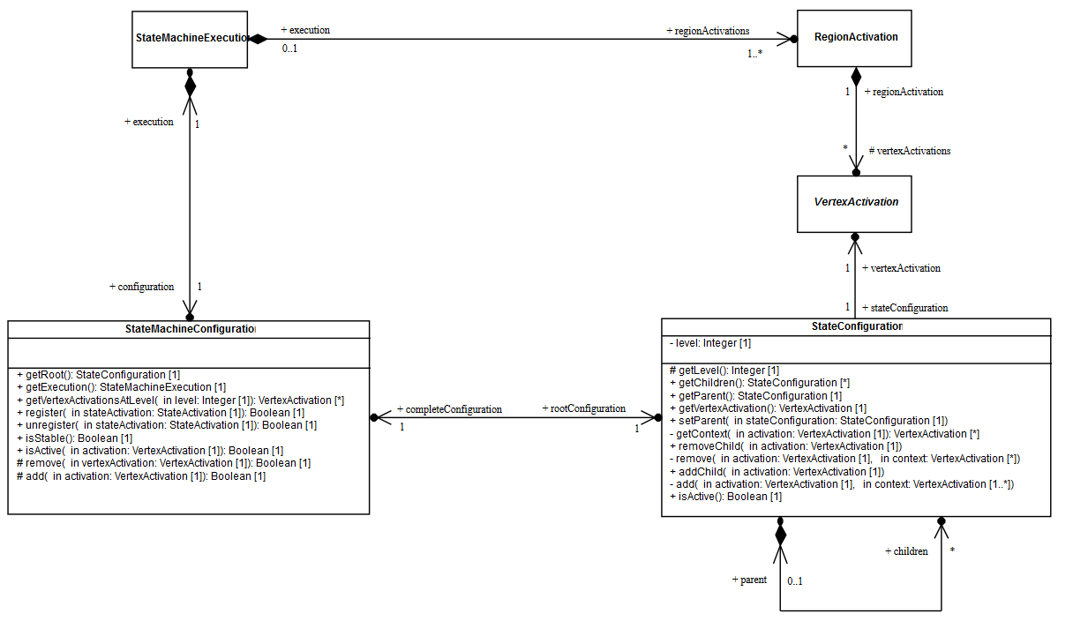
PSSM: State Machine Configuration
A StateMachine Configuration represents the hierarchy of activate States that the currently executing StateMachine is in.
Internal structure of a configuration is given as a hierarchy of StateConfigurations. Each StateConfiguration in the hierarchy designate a currently active State.
A StateMachineConfiguration always belongs to a StateMachineExecution.
Usage of state machine configuration
Determine if an EventOccurrence is deferred
Determine if an EventOccurrence triggers one or more Transitions
Constraint
The target configuration cannot be invalid
This is ensured by the static analysis performed before taking the decision to perform a step.

Slide 33
Vertex Activation Specializations
StateActivation, FinalStateActivation and all PseudostateActivation

Slide 34
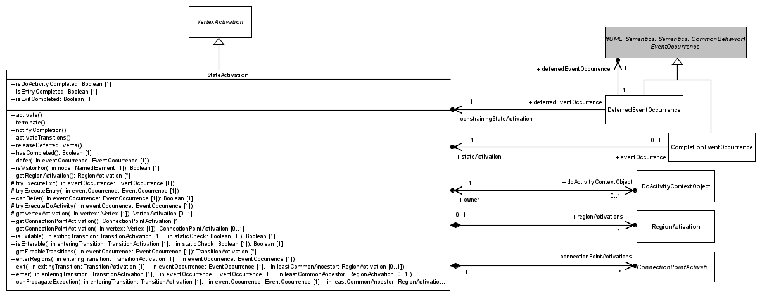
PSSM: State Activation
A StateActivation captures the execution semantics of a State.
A StateActivation can be associated to a DoActivityContextObject. If so, a doActivity is currently running at that State (i.e. it is not completed)
A StateActivation can be, if the State is composite, associated with a set of RegionActivation corresponding to visitors of the different Region of that State.
If the State is composite and has entry or exit points, a StateActivation can be associated with a set of EntryPointActivations or ExitPointActivations. These visitors capture semantics of both entry and exit points

Slide 35
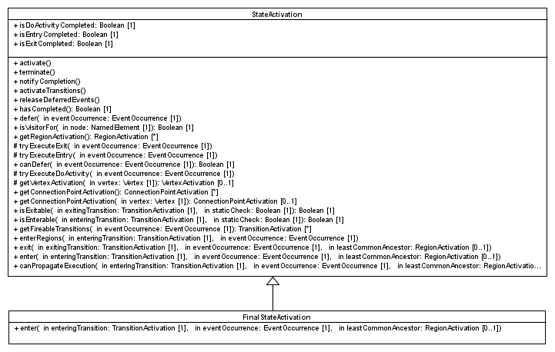
PSSM: Final State Activation
When a FinalStateActivation is entered the Region in which the FinalState is located is completed
Constraints
Cannot defer an EventOccurrence (no trigger is allowed)
Cannot enter Regions (Regions are not allowed in a FinalState)
Does not generate a completion event upon entry (a completion event is never associated with a FinalState)
Cannot be exited
Cannot execute entry, doActivity or exit (no behavior is allowed on a final state)

Slide 36
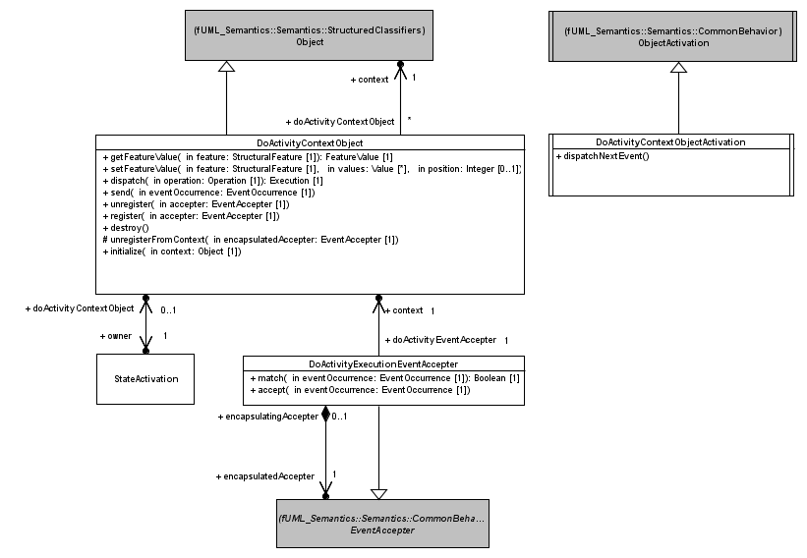
PSSM: Do Activity Execution
An executed doActivity has access to the same members as the StateMachine. Hence, its context Object is the same as the one associated with the StateMachine.
A DoActivityContextObject is always associated with a specific ObjectActivation. This ObjectActivation is responsible for checking the completion of the doActivity at the end of the RTC step.
Accepters registered by a doActivity are also available to the ObjectActivation associated with the context Object of the DoActivityContextObject. This ensures that the doActivity is allowed to react to EventOccurrences available in the StateMachine eventPool. When an EventOccurrence matches an EventAccepter registered by the doActivity, a new RTC step is performed for that doActivity.
A DoActivityContextObject is the context Object of a running doActivity Behavior. It ensures that operation calls, feature assignment, and signal sending are routed directly to the StateMachine context object.
Notes:
Two exceptional situations in which a doActivity has priority.

Slide 37
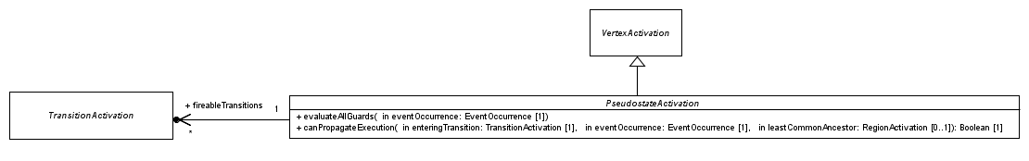
PSSM: Pseudostate Activation
All PseudostateActivations reference a set of TransitionActivations. This set is computed during static evaluation of the execution path. It contains the TransitionActivations whose Transition guard evaluated to true. This information is used at the time the PseudostateActivation is entered, in order to decide which outgoing transitions must fire.
Abstract
PseudostateActivation is abstract, hence it does not redefine entry or exit operations. Specializations of PseudostateActivation redefine these operations.
Static analysis and guard evaluation
evaluateAllGuards
Evaluate all guards of Transitions outgoing from the Pseudostate. Transitions with guards evaluating to true are registered in the set of fireable Transitions.
canPropagateExecution
Defines the general rule to evaluate if the execution can be propagated through this Pseudostate at static analysis time.

Slide 38
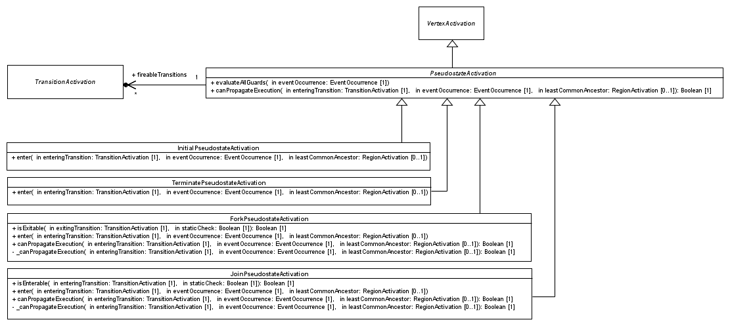
PSSM: Initial, Terminate, Fork and Join
Captures the execution semantics of a Pseudostate with the kind “initial”: the single outgoing Transition is fired.
Captures the execution semantics of a Pseudostate with the kind “terminate”: the StateMachine execution terminates. No exit behavior is executed. The complete hierarchy of visitors is destroyed.
Captures the execution semantics of a Pseudostate with the kind “fork”: all Transitions are fired concurrently. A fork Pseudostate can only be exited when all of its outgoing Transitions have been fired.
Captures the execution semantics of a Pseudostate with the kind “join”: one of its outgoing Transitions is chosen to be fired. The join Pseudostate can only be entered when all of its incoming Transitions have been fired.

Slide 39
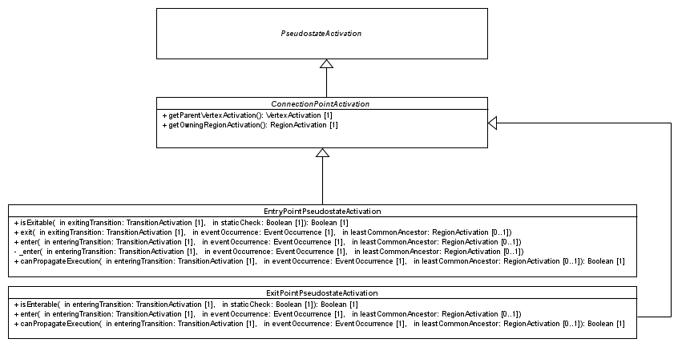
PSSM: Connection Point Pseudostate Activations
Captures execution semantics of a Pseudostate with the kind “entry”. If the owning State is orthogonal, then the entry plays the role of a fork. Otherwise, it acts like a junction Pseudostate.
Return the StateActivation which owns the ConnectionPointActivation.
Return the RegionActivation which owns the StateActivation owning the ConnectionPointActivation.
Captures the execution semantics of a Pseudostate with the kind “exit”. If all of its incoming Transitions come from Vertices located in different Regions, the exit point plays the role of a join Pseudostate. When entered, the exit point implies exiting its parent. Finally, one of its outgoing Transitions is chosen to be fired.

Slide 40
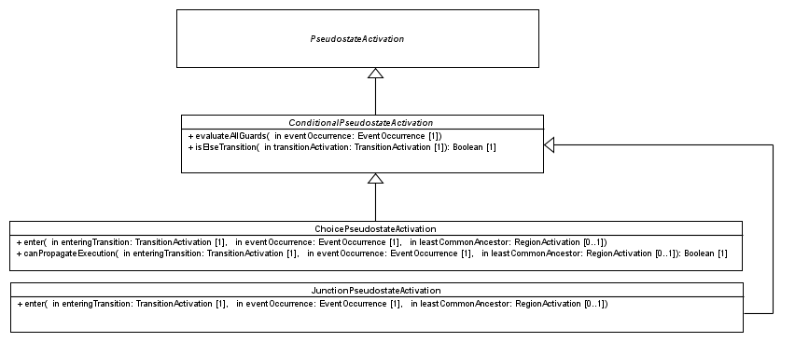
PSSM: Conditional Pseudostate Activations
Redefines how guards are evaluated during static analysis to account for the existence of an “else” Transition. If no outgoing Transitions have a guard evaluating to true, then, if an “else” Transition exists, a Visitor for it is added to the set of fireable Transitions.
An “else” Transition has a guard whose specification is an Expression with “else” as its symbol. The Expression has no operands.
Choice
guards of outgoing Transitions are not evaluated during static analysis. They are evaluated at the time the choice is reached by the execution.
Junction
guards of outgoing Transitions are evaluated during static analysis.

Slide 41
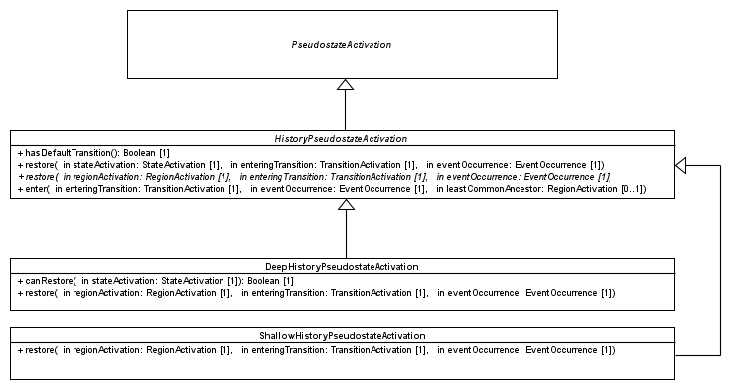
PSSM: History Pseudostate Activations
Determine if the history (deep or shallow) has an outgoing Transition
The restore operations capture the execution semantics enabling the restoration of a state when a history Pseudostate is executed.
Shallow
In the context of a shallow history, only the top Region (i.e. the one containing the history) can be restored. If this region has no history but a default Transition, then this Transition is fired. In all other cases, the Region performs a default entry.
Deep
The restoration process is similar than the one performed for the shallow history. The difference is that the restoration process is propagated to the nested Regions.

Slide 42
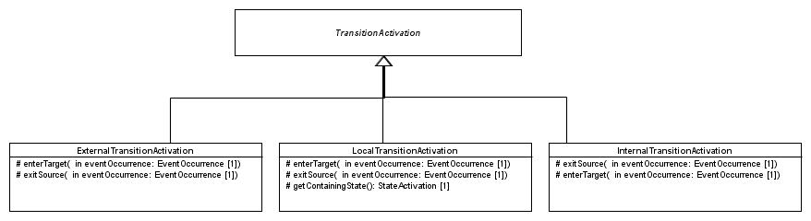
PSSM: Transition Activations
Each specialization of TransitionActivation capture semantics of a kind of Transition, by redefining the exitSource and enterTarget operations.
In general, if the target can be entered, then the common ancestor rule applies (i.e., the entry may also apply to parents – direct and indirect)
In general, if the target is not the containing State, it is entered and the common ancestor rule applies.
In general, if the target can be exited, the common ancestor rule applies (i.e., the exit may also apply to parent – direct and indirect)
In general, the source is not exited if it is the containing State. However the top Vertex that is located in the top Region that contains the target (maybe deeply nested) is exited.
The source is not exited and the target never entered.

Slide 43
Event Occurrences
Event occurrences (specific and not specific to state machines) supported in the PSSM context

Slide 44
PSSM: State Activation and Event Occurrence
A StateActivation can defer an EventOccurrence (see the defer operation). The deferred EventOccurrence is placed in the deferredEventPool. The StateActivation is also responsible for the release of the event it has deferred.
Boolean flags to determine if the State is ready to complete
When the State completes, (see notifyCompletion operation) a CompletionEventOccurrence is generated and associated to the State. The EventOccurrence is placed in the eventPool.

Slide 45
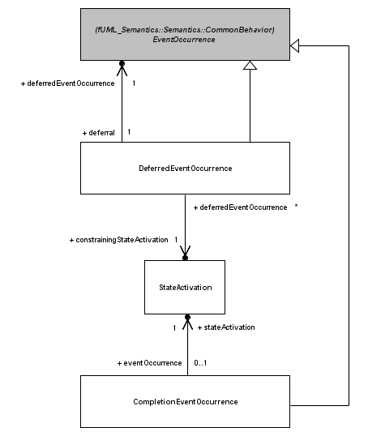
PSSM: Completion Event and Deferred Event Occurrence
A DeferredEventOccurrence has a reference to the deferredEventOccurrence. In PSSM, both SignalEventOccurrences and CallEventOccurrences can be deferred
A DeferredEventOccurrence materializes the fact that a dispatched EventOccurrence has been deferred in the current StateMachine configuration.
A DeferredEventOccurrence has a reference to the StateActivation that provoked the deferral. When this StateActivation leaves the StateMachine configuration, the deferred event is returned to the eventPool.
A CompletionEventOccurrence denotes the completion of a State. The scope of a completion is the State from which it was generated (i.e., it can only be used to trigger a completion Transition outgoing from that State).
CompletionEvent have priority over all other kind of events. This means they are always dispatched first.

Slide 46
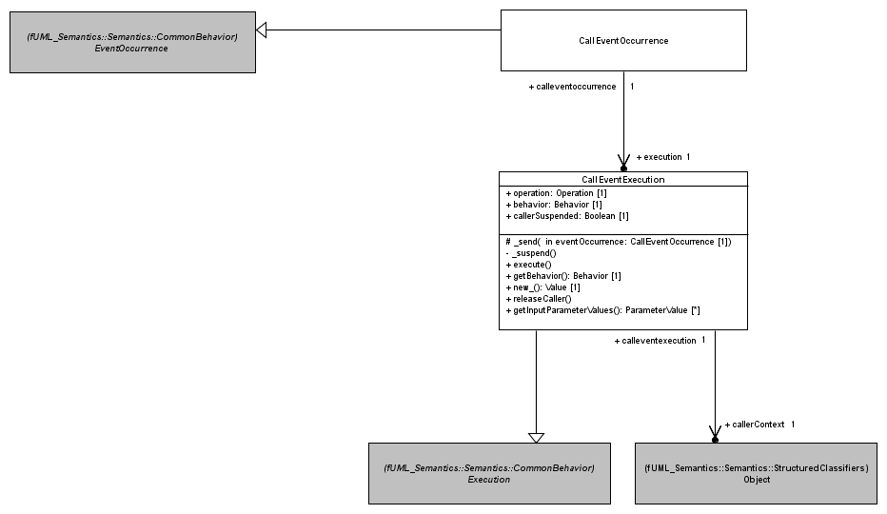
PSSM: Call Event Occurrence
In the eventPool of an ObjectActivation, a CallEventOccurrence represents a request to perform a synchronous operation call.
A CallEventOccurrence references an execution thatis of type CallEventExecution.
A CallEventExecution captures the execution semantics related to the realization of a synchronous call to an Operation without a method, on an active Object. The execution of the Execution consists in sending a CallEventOccurrence to the target and suspending the caller. The caller will only be allowed to continue its execution at the end of the RTC step in which the CallEventOccurrence was dispatched. The caller may stay pending forever if the StateMachine has no possibility to accept the CallEventOccurrence.
The context object corresponding to the caller

Slide 47
Event Data Passing
The passing of event occurrence data to behaviors executed in a RTC step

Slide 48
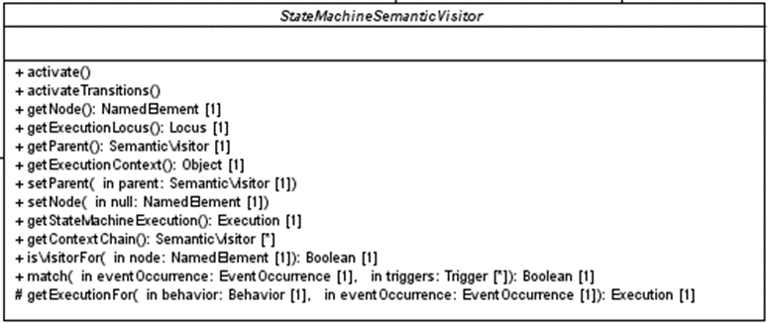
PSSM: Event Data Passing
The operation getExecutionFor provides an the adequate Execution for a Behavior. If the Behavior has Parameters, and data contained in the provided EventOccurrence can be passed to these Parameters, the returned Execution is an EventTriggeredExecution.
Extract output value(s). In case of parallelism, the output values are the values produced by the last executed Behavior.
Extract data from the EventOoccurrence and feed the input ParameterValue(s).
SignalEventOccurrence or CallEventOccurrence that triggered the execution of the Behavior

Slide 49
State Machine Redefinition

Slide 50
PSSM: State Machine Redefinition (1)
The operation isVisitorFor enables a SemanticVisitor to evaluate if it is the visitor for the StateMachine element provided as its parameter. The evaluation is true if the node referenced by the visitor is the node provided as the parameter. This operation is redefined by StateActivation, TransitionActivation and RegionActivation
TransitionActivation
A TransitionActivation is a visitor for a Transition if
The Transition is the one referenced by the TransitionActivation
The Transition is redefined (directly or indirectly) by the one referenced by the TransitionActivation.
StateActivation
A StateActivation is a visitor for a State if
The State is the one referenced in the StateActivation
The State is redefined (directly or indirectly) by the one referenced in the StateActivation.

Slide 51
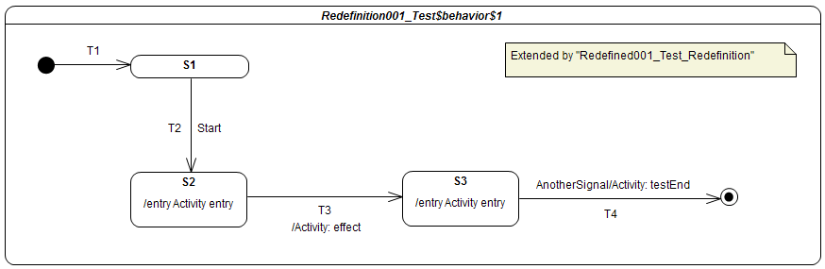
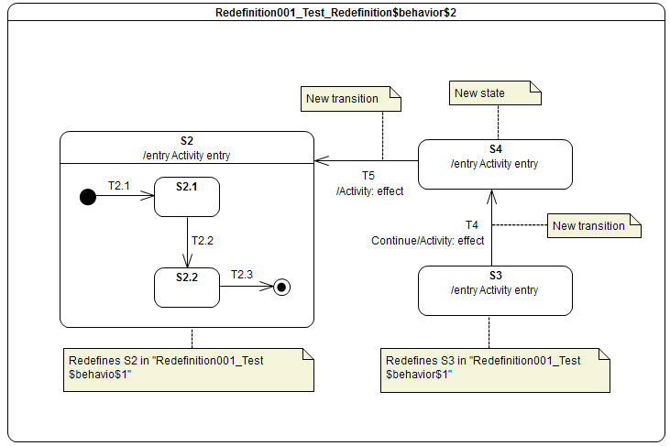
PSSM: State Machine Redefinition (2)
The computation of the final StateMachine that is going to be executed takes place during the instantiation process described for a Region. It relies on the extension relationships existing between Regions and redefinition relationships existing between States and Transitions.
S1
T1
T2 Start
T3 / effect
T5 AnotherSignal / testEnd
State machine computed from the redefinition and extension links

Slide 52
Semantic Model Testing
A Test framework and a set of 98 test cases asserting the different parts of the state-machine semantics

Slide 53
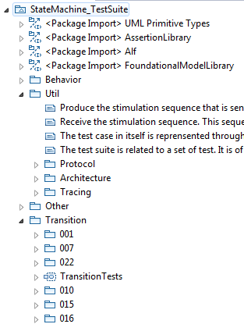
Test Suite: Semantic Model assessment
Util package
Defines how a semantic test is designed
Defines how semantic tests are grouped into semantic test suites
Defines how elements composing a test interact
Other packages
Define test categories
Each category is related to particular part of state-machine semantics
Each category contains test cases
Each test case is defined to validate a specific semantic requirement
Library providing base elements to define semantic tests
Test category related to transition semantics
Semantic tests available in that category

Slide 54
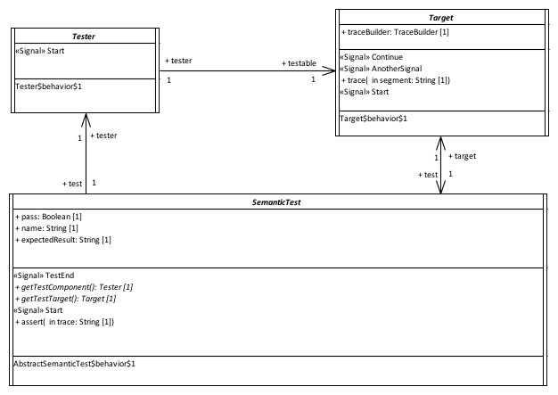

Test Suite: Semantic Test Architecture
Communications done by event passing
Provide a stimulation sequence (i.e., a set of event occurrences) to the Target.
Execute the Statemachine under test and record the execution trace produce by this StateMachine
The SemanticTest controls both the Tester and the Target. It is also responsible for the computation of the test verdict. The test verdict calculation is based on the comparison between the generated execution trace and the execution traces expected by the test.

Slide 55
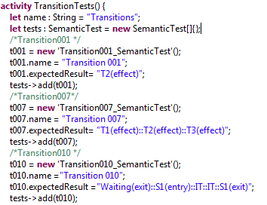
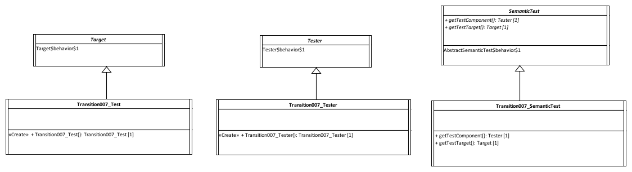
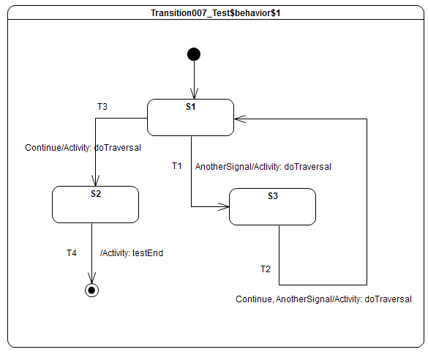
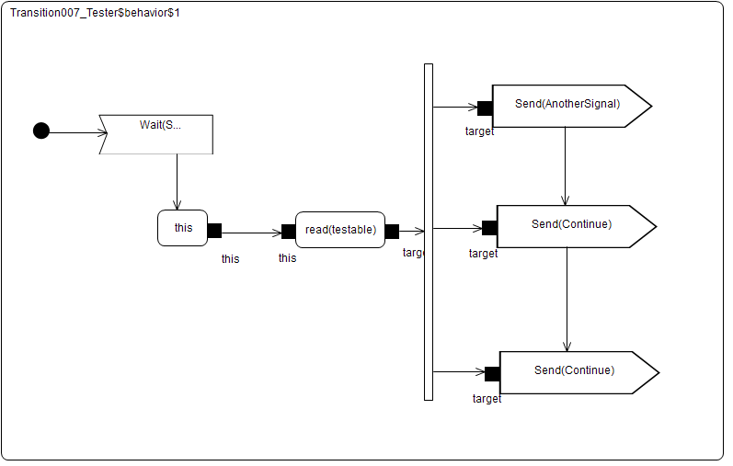
Test Suite: Example Test Definition
Semantic test is instantiated and registered in a semantic test suite.
Expected execution trace

Slide 56
Test Suite: Example Test Execution
Received event occurrences
AnotherSignal – S1
Continue – S3
Continue – S1
Expected trace
T1(effect)::T2(effect)::T3(effect)
Requirement
A transition may own a set of Triggers, each of which specifies an Event whose occurrence, when dispatched, may trigger traversal of a transition.
Step | Event Pool | Configuration | Fired transitions
1 | [] | [] – Initial RTC step | [InitialTransition]
2 | [AnotherSignal, CE(S1)] | [S1] | []
3 | [AnotherSignal] | [S1] | [T1]
4 | [Continue, CE(S3)] | [S3] | []
5 | [Continue] | [S3] | [T2]
6 | [Continue, CE(S1)] | [S1] | []
7 | [Continue] | [S1] | [T3]
8 | [CE(S2)] | [S2] | [T4]

Slide 57
Testing Status: Requirement Coverage
Full support of the requirements
Initial submission

Slide 58
Next Steps
Revised submission
Due in November
Invite review of draft prior to submission
UML urgent issues (for UML 2.5.1)
UMLR-92 UML/OCL spec mismatch-Constraint.context vs Constraint.constrainedElement
UMLR-685 UML 2.5: StateMachine Vertex needs to be made a kind of RedefinableElement instead of State
UMLR-696 The behavior of an OpaqueExpression should be allowed to have input parameters
Moving fUML and PSCS to UML 2.5
To be done as part of PSSM finalization

