Slide 1

Semantic Information Modeling for Federation
SIMF
OMG ADTF
June 2015 – Initial Submission
Cory Casanave

Slide 2
What is SIMF?
Semantic Information Modeling for Federation is an in-progress standards process within OMG
The goal of SIMF is to provide the modeling capabilities to support information federation by leveraging conceptual and logical information modeling with model bridging relations
An important goal of SIMF is to extend the economic lifecycle of many existing running systems that were conceived and built in a time when there were insufficient true conceptual capabilities, by explicitly adding the often implicit semantics and linking the running data representations with a true conceptual model.
Another important goal of SIMF is not to replace any existing standard language but to build bridges between the SIMF Conceptual Schema and the various standard languages such that the users can save substantial amounts of money in their integration and federation efforts.
Issued Dec 2011 - OMG Document: ad/2011-12-10

Slide 3
Pivoting through a conceptual model
The conceptual pivoting approach
A common and growing approach to the data problem leverages abstraction: Defining a domain focused vocabulary with integrity rules and assertions as part of a conceptual model that captures domain semantics. Federation and integration is achieved by relating various logical and physical information structures to the conceptual model
Information federation and integration is achieved via a “pivot” through this conceptual semantic layer. Also known as “Semantic Mediation”

Slide 4
Two primary use cases
Common: SIMF is used to “ground” multiple existing data sources with independently conceived schema.
Federated query use case
A data representation is algorithmically derived from a common domain model, as such it uses the same vocabulary and concepts
Queries and analysis can then be performed across the union of all the disparate data sources using the common domain vocabulary
These queries and analysis will not loose data
Data transformation use case
Rules are added that allow a “destination” data resource using a pre-existing vocabulary to be populated from multiple sources
Such a transformation is likely to loose data as the destination data resource is not likely to have all the concepts of all the sources. Also, some rules may not fire as the information to support them may not be available in the sources – rules ion context are the deciding factor

Slide 5
Submitters
Data Access Technologies, Inc (Model Driven Solutions Division)
PNA-Group, Ltd.
No Magic Inc.
88 Solutions, Inc.
Thematix Partners LLC
Note – Tibco submitted individually but is part of the team.

Slide 6
Primary Input and Collaborators
PNA (Sjir Nijssen) – Fact based modeling approach and community representative
Tibco (Paul Brown) – Information integration vendor perspective, data representation infrastructure layer. Submitted as another initial submission but part of the same effort
Nomagic (Jim Logan) – Modeling tool vendor, focusing on conceptual modeling

Slide 7
SIMF Team – who has been involved?
SIMFTeam is one SIMF group, some are submitters, others contribute
Model Driven Solutions - Cory Casanave, Tom Digre
PNA Group - Sjir Nijssen, Bas van der Laar, John Bulles, Jean Paul Koster, Inge Lemmens
TIBCO – Paul Brown
Nomagic – Jim Logan
TMForum - Alex Zhdankin (Cisco), Nigel Davis (Ciena)
European Space Agency - Serge Valera
Laboratory for Applied Ontology (Brazil) – Giancarlo Guizzardi
Deere – Roger Burkhart
Agile Birds SPRL - Sylvain Guérin
ABN AMRO Bank - Andre Le Cat
Turien Insurance - Jos Rozendaal
ING Bank - Lex Bruil
Pension Fund - Jos Vos
Individuals - Miriam Wesseling
Ed Barkmyer (Former NIST), Comments

Slide 8
Conceptual Modeling
There has been a growing interest in “conceptual modeling” for semantic federation as well as other purposes
Conceptual modeling is done in a variety of languages including UML, OWL, E/R, SBVR and others
We have been using a UML approach to conceptual modeling
A similar UML conceptual modeling approach is being developed as part of the Nomagic product line. The Nomagic product also generates and interprets OWL
The threat/risk approach and the Nomagic approach are very similar and have been combined in the SIMF initial submission

Slide 9
SIMF Components – conceptual models and mappings
Meta Model
Conceptual Modeling MetaModel
Mapping MetaModel
Schema Model
Depends On
Map To
View of
View of
View of
UML Representation
Conceptual Modeling UML Profile
Mapping UML Profile
Schema Model
(From IMM)
Depends On
Map To

Slide 10
Threat/risk– conceptual models and mapping examples
External
Conceptual Modeling Profile (From SIMF)
Mapping Profile (From SIMF)
XSD Profile
(From IMM)
Depends On
Uses
Uses
Uses
Uses
Generic and threat-risk conceptual models
STIX/Cybox Mapping
STIX/Cybox UML Import
STIX/Cybox Mapping
NIEM-UML
More…
More…

Slide 11
SIMF UML Profile Foundation
Conceptual Modeling
Jim Logan

Slide 12
Additional Profile Elements

Slide 13
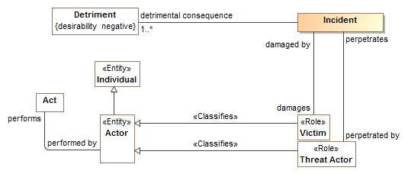
Roles
Roles define what something is for or how it behaves in a certain context, not “what it is”.
A role <<Classifies>> what it can be a role of.
An entity can play any umber of roles and these roles may change over time.
Roles can be contextual

Slide 14
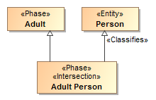
Phases
Phases (or states) are classifications of objects over their lifetime.
Examples: Child, Teenager, Adult or Invoiced, Late, Paid

Slide 15

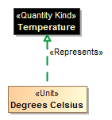

Quantity Kinds
For numeric properties, we want to know what it means (e.g. Temperature), not the kind of number (Real).
<<Quantity Kind>> is an aspect common to mutually comparable quantities represented by one or more units.
A unit represents a quantity kind, there are multiple units representing temperature.
A physical representation would then represent the unit as some kind of number in a specified unit.

Slide 16
Mapping Semantics
High-level mapping as “represents” relations at the type level
Detail mappings as template patterns using UML
Mappings are bi-directional
Mapping patterns are still be proven in prototype

Slide 17
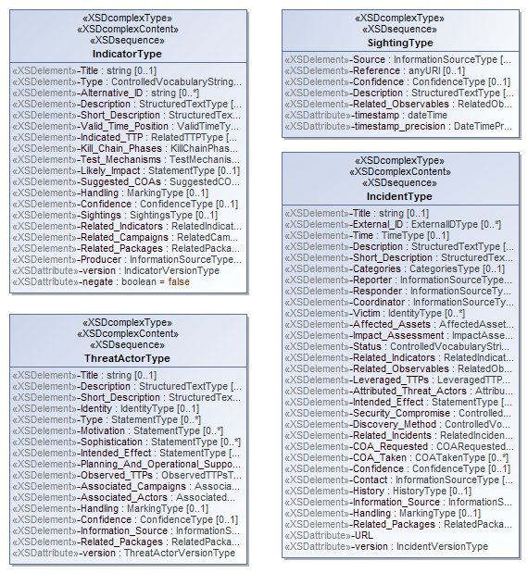
Representing the STIX physical model
<xs:complexContent>
<xs:extension base="stixCommon:IndicatorBaseType">
<xs:sequence>
<xs:element name="Title" type="xs:string" minOccurs="0">
<xs:annotation>
<xs:documentation>The Title field provides a simple title for this Indicator.</xs:documentation>
</xs:annotation>
</xs:element>
<xs:element name="Type" type="stixCommon:ControlledVocabularyStringType" minOccurs="0" maxOccurs="unbounded">
<xs:annotation>
<xs:documentation>Specifies the type or types for this Indicator.</xs:documentation>
<xs:documentation>This field is implemented through the xsi:type controlled vocabulary extension mechanism. The default vocabulary type is IndicatorTypeVocabularyType in the http://stix.mitre.org/default_vocabularies-1 namespace. This type is defined in the stix_default_vocabularies.xsd file or at the URL http://stix.mitre.org/XMLSchema/default_vocabularies/1.1.1/stix_default_vocabularies.xsd.</xs:documentation>
<xs:documentation>Users may also define their own vocabulary using the type extension mechanism, specify a vocabulary name and reference using the attributes, or simply use this as a string field.</xs:documentation>
</xs:annotation>
</xs:element>
<xs:element name="Alternative_ID" type="xs:string" minOccurs="0" maxOccurs="unbounded">
<xs:annotation>
<xs:documentation>Specifies an alternative identifier (or alias) for the cyber threat Indicator.</
XML Schema is reverse engineered into UML

Slide 18
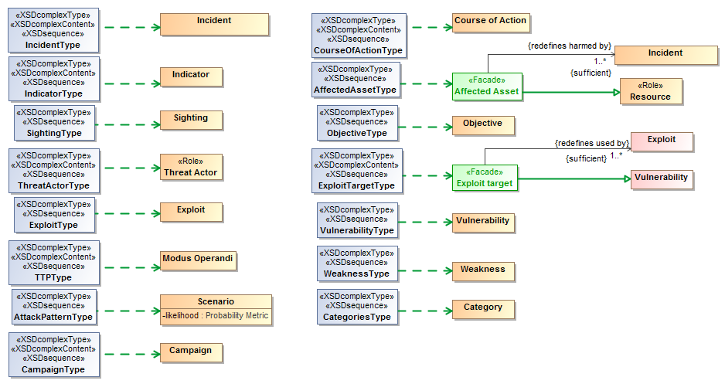
XML Representation represents concept
We start with the high-level classes

Slide 19
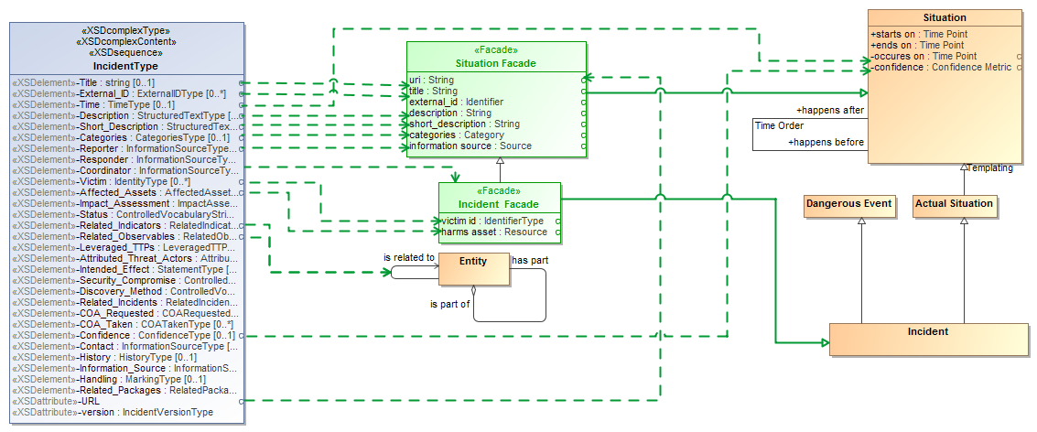
“Facades” provide mapped views of the conceptual model

Slide 20
Physical/logical elements represent concepts (may be in facades)

Slide 21
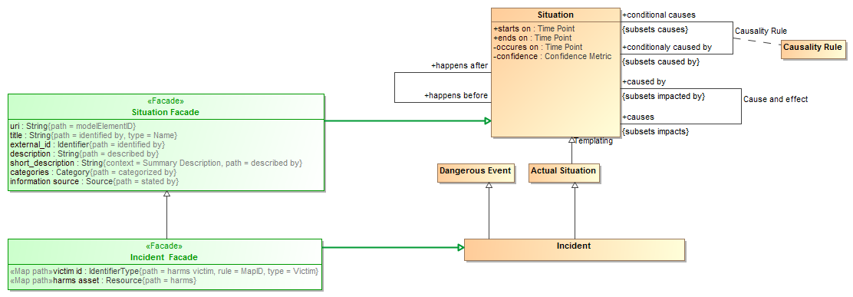
Facades utilize representations and property paths

Slide 22
Facades utilize representations and property paths

Slide 23
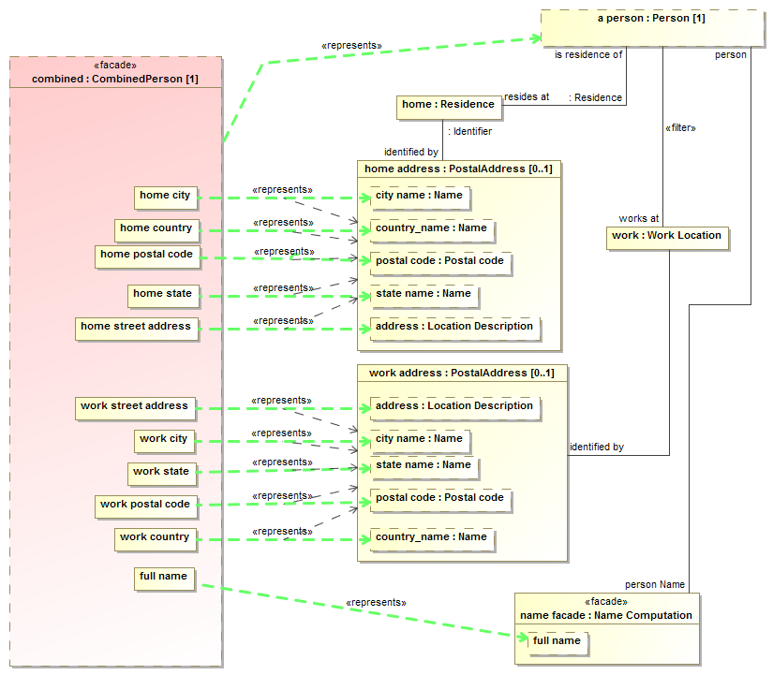
Mapping patterns for complex relations

Slide 24
UML Profile – meta model mapping

Slide 25
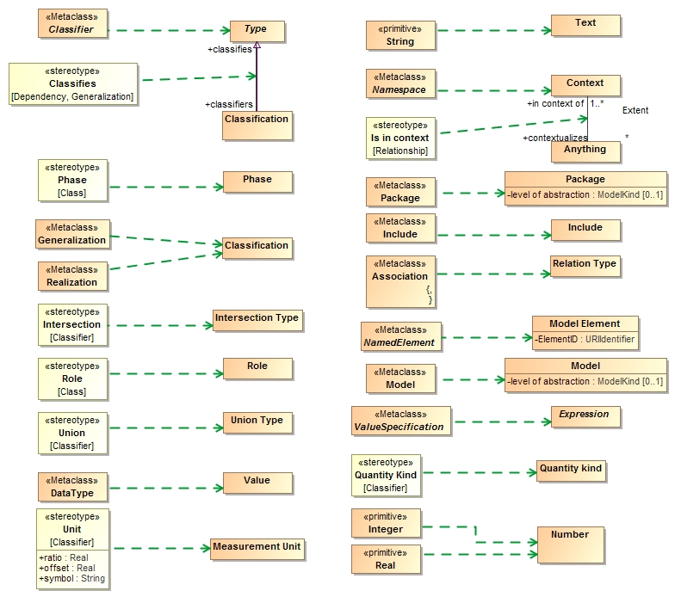

Slide 26
SIMF Meta Model

Slide 27
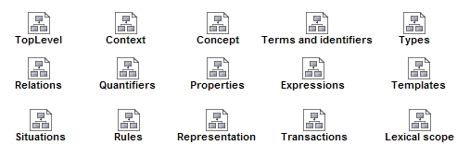
SIMF Packages

Slide 28
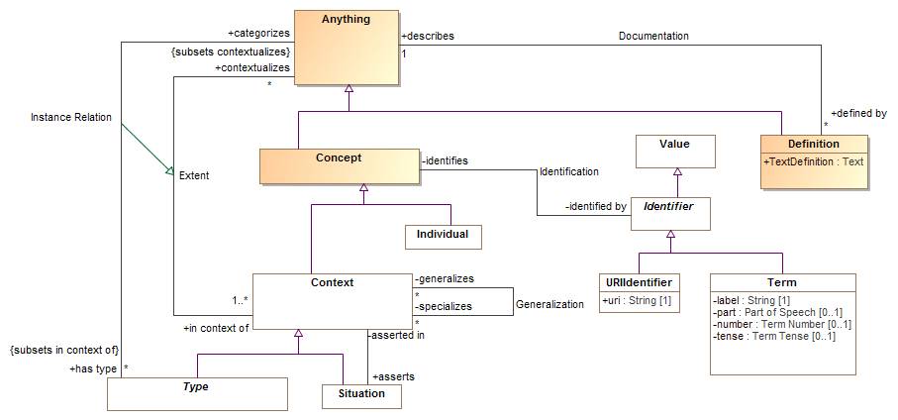
Conceptual top level

Slide 29
Context
In SIMF, a context connects a set of facts with a set of things those facts applies to. The context contextualizes a set of concepts that it applies to (concepts “in” that context). Facts and rules are defined in one or more context and apply to everything those contexts contextualize.
Anything that is asserted is asserted in at least one context (where it is stated –e.g. the model or DBMS), and probably many more.
Any interpretation (computation, inference, query) is based on a perspective that assumes a set of context.
SIMF makes context explicit.

Slide 30
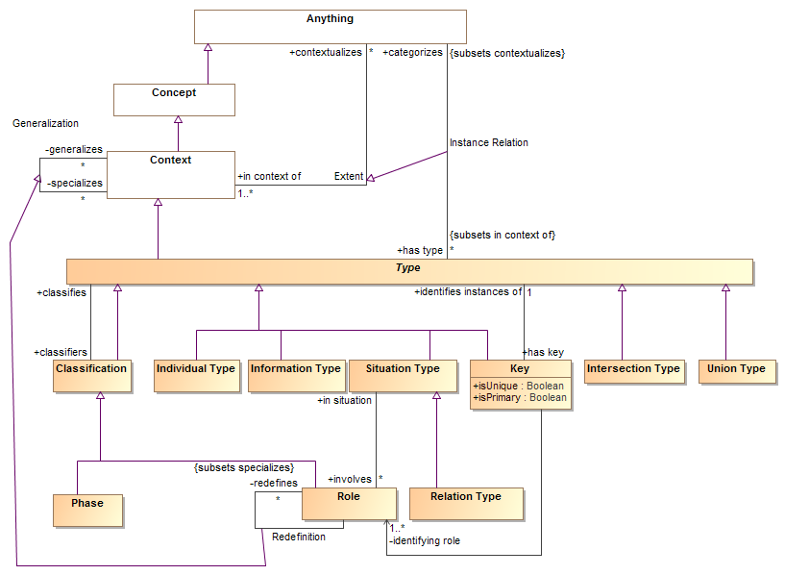
Types

Slide 31
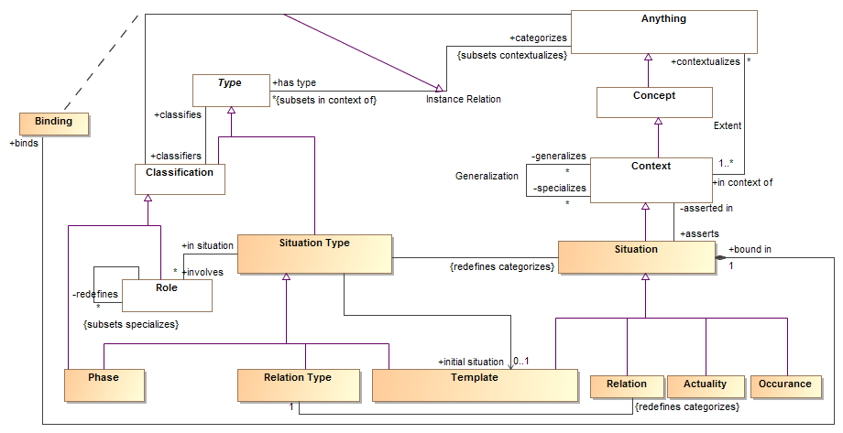
Situations
An identifiable arrangement of individuals, assertions and the relations and assertions between them over a timespan. Any "condition" that exists is a situation

Slide 32
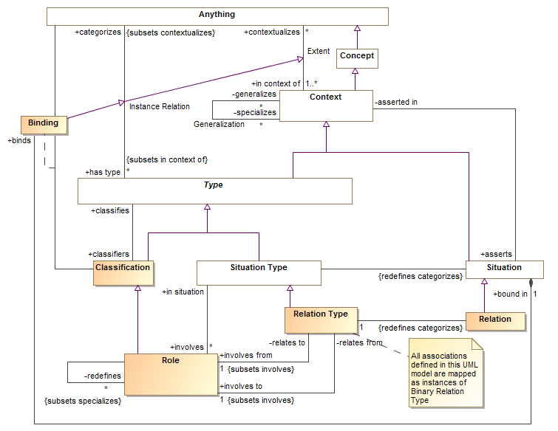
Relations

Slide 33
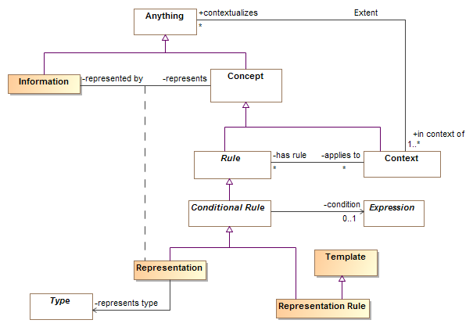
Representation

Slide 34
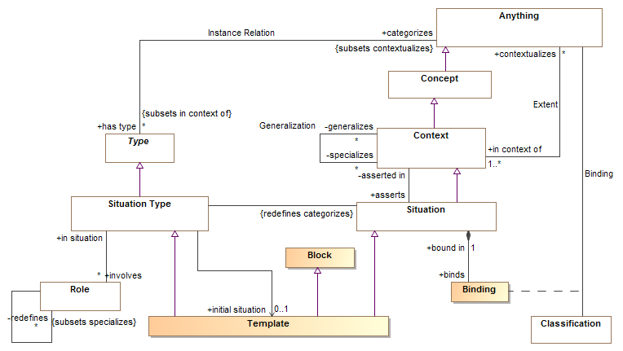
Templates

Slide 35
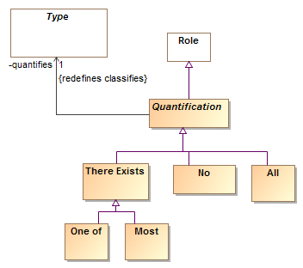
Quantifiers

Slide 36
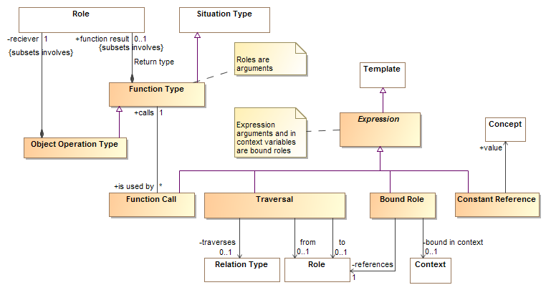
Expressions

Slide 37
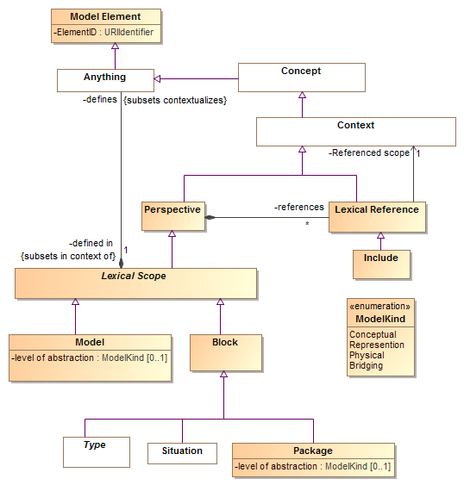
Lexical Scope

Slide 38
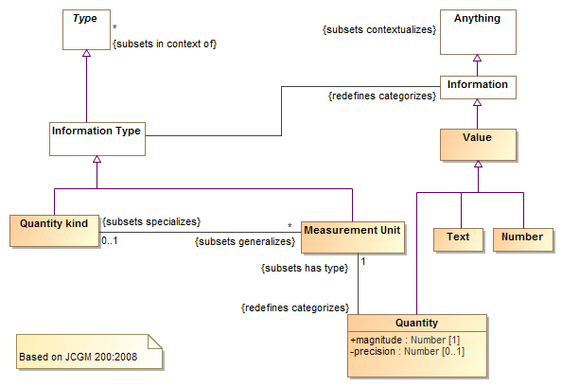
Quantity Kinds & Units

Slide 39
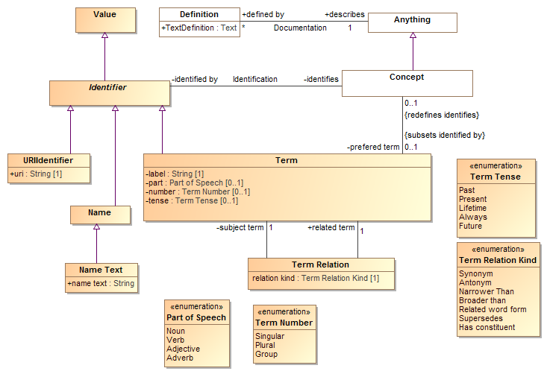
Terms

Slide 40
Prototyping
Prototype is intended to validate models and mappings, it is not efficient or production code (yet). It is implemented in Python and all data is in-memory

Slide 41
Prototype Design
Magicdraw
Currently just does STIX
Conceptual
Model
STIX
XML
SIMF-Python Interpret / Export
Python Mapping Code
Files From Model
Rules
Output
Dictionary Spreadsheet
(Concept Labels)
SIMF/ Python Objects
Map rules
SIMF-XML
Objects
Object
Graph
Map log
(Data seen and mapped or not)
Extend
Rules

Slide 42
Example Dictionary
Dictionary
Example
From Model
Entity kinds/Physical Entity | A thing that has mass and takes up space including people, places and things.
UML2 Metamodel/Generalization
Intent/has intent
Context/Type
RiskThreat/has sighting
Possession/possesses
RiskThreat/damages

Slide 43
Map log example
What was mapped to what
MAP:/stix/core/stix_package/STIXPackage.indicators---MAPPED TO---><Indicator "opensource:indicator-45c112fa-805f-4cc0-b17b-2d98b519ca60" as "defines">
NO VALUE FOR RULE:/stix/core/stix_package/STIXPackage.incidents
NO VALUE FOR RULE:/stix/core/stix_package/STIXPackage.ttps
MAP:/stix/base/Entity.id_---MAPPED TO---><"edge:Package-3ffdccc7-bd56-4491-88d1-be3d966e42f8" as "identified by">
NO VALUE FOR RULE:/stix/base/Entity.idref
NO VALUE FOR RULE:/stix/base/Entity.title
NO VALUE FOR RULE:/stix/base/Entity.description.value
------UNMAPPED properties and get methods-------
IN:/stix/core/stix_package/STIXPackage.version = 1.1.1
IN:/stix/core/stix_package/STIXPackage.related_packages = None
IN:/stix/core/stix_package/STIXPackage.timestamp = 2014-11-23 00:12:45.650946+00:00
IN:/stix/core/stix_package/STIXPackage.campaigns = []
Input data to consider

Slide 44
Example rules*
Represents("/stix/ttp/TTP", "Behavior/Modus Operandi")
Represents("/stix/ttp/TTP.behavior", "Core Concepts/step")
Represents("/stix/ttp/behavior/Behavior", "Process/Plan")
Represents("/stix/ttp/behavior/Behavior.malware", "Process/requires")
Represents("/cybox/common/datetimewithprecision/DateTimeWithPrecision",
"Quantities and units/Time point")
Represents("/cybox/common/datetimewithprecision/DateTimeWithPrecision.value", "Quantity/value")
#Entity properties used for all subtypes
RepresentsID("/stix/base/Entity.id_", "Core Concepts/identified by")
RepresentsID("/stix/base/Entity.idref", "Core Concepts/identified by")
Represents("/stix/base/Entity.title", "Information/has name")
Represents("/stix/base/Entity.description.value", "Information/described by")
From schema and map log
From conceptual dictionary
* Currently in text format

Slide 45
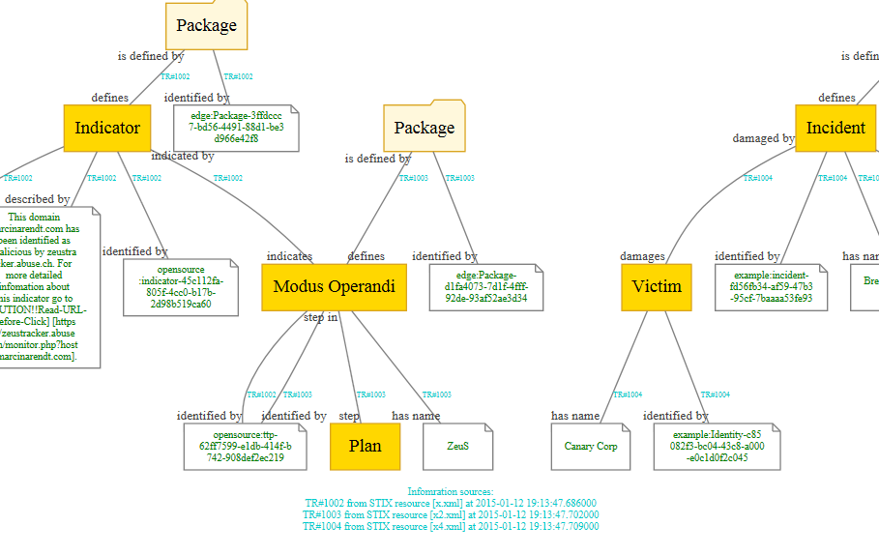
Resulting data graph

Slide 46
Other parts of the spec
Graphical notation – notational
Textual notation - TBD (PNA lead)
Formal specification – partial based on profile
Other mappings TBD

