Slide 1

Semantic Modeling Information for Federation
SMIF
Cory Casanave
Jim Logan

Slide 2
SMIF Goals for Adoption
Formal semantics
Description logic grounding through UML profile
Datalog rules for full semantics. Rule Syntax/Engine TBD
Proof of concept implementation(s)
Nomagic CCM – Modeling and OWL mapping (released)
Model Driven Solutions – Federation Engine (Progressing)
Will provide generation of rules

Slide 3
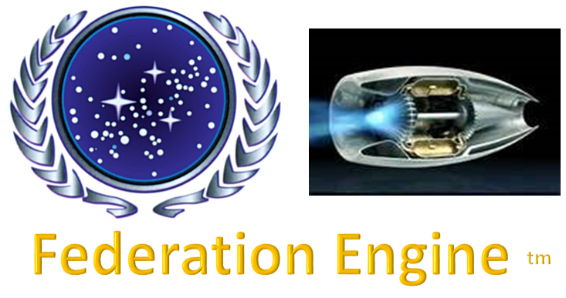
Prototype model & semantics implementation preview
SMIF
UML Models
API Generated from SMIF Model
SMIF Java API
Eclipse UML
UML
Facet
RDF/OWL
Facet
SW Rules
Facet
Java
Facet
Is this a good idea?
Rules
Implements SMIF Semantics as Java code
Each facet provides an adapter between external data and a SMIF counterpart at any meta-level. A SMIF Object may have multiple facets.
Mappings & federations are (conceptually) between SMIF objects.
Planned
“SMIF Full”
RDF Repository
SQL
Facet
XML
Facet
“Flat”
Facet
XMI
Facet
CL/IKL
Facet
Analytics

