Slide 1

Semantic Modeling Information for Federation
SMIF
Cory Casanave
Jim Logan

Slide 2
Status
What we have been asked for
More formal and provable grounding for the SMIF model
POC
Where we hoped to be
Products and an open source foundation released
The formal grounding of SMIF done
Reviews of that formal grounding in progress for adoption next meeting
Where we are – implementation focus
No Magic CCM is “in the marketplace”; still a partial but growing implementation
A full open source implementation is in progress, but not ready
This implementation is intended to generate most of the formal artifacts
It has taken time to get the meta-recursive self generating machinery in place
It will be used to generate a portion of the formal grounding
So, we are asking for another extension – until the June 2018 meeting

Slide 3

Prototype model & semantics implementation preview
SMIF
UML Models
API Generated from SMIF Model
SMIF Java API
Eclipse UML
UML
Facet
RDF/OWL
Facet
SW Rules
Facet
Java
Facet
Is this a good idea?
Rules
Implements SMIF Semantics as Java code
Each facet provides an adapter between external data and a SMIF counterpart at any meta-level. A SMIF Object may have multiple facets.
Mappings & federations are (conceptually) between SMIF objects.
Planned
“SMIF Full”
RDF Repository
SQL
Facet
XML
Facet
“Flat”
Facet
XMI
Facet
CL/IKL
Facet
Analytics

Slide 4
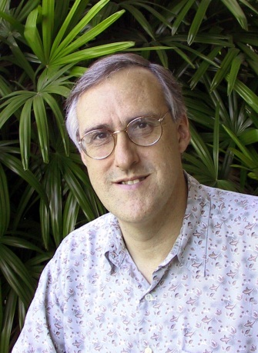
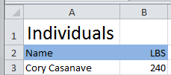

Example of “Pivoting” through a conceptual model
Concept of
“Cory Casanave”
There is an actual “Person”, Cory Casanave
There is a concept of this person shared in this room, right now
Here is one representation of him
“Person” is a shared concept, independent of data structures
There may also be shared agreement that Cory is a person and some other “facts”
“Cory Casanave” is a name for this person
He weighs 240 LBS
There are multiple data representations about Cory Casanave which may or may not agree
Those representations can be grounded in concepts (semantics), assisting federation
Concept of a
“Person”
<PersonType>
<NameText>Cory B. Casanave</NameText>
<Weight-LBS>234</Weight-LBS>
</PersonType>
XML
Representations
.
Excel
UML

Slide 5
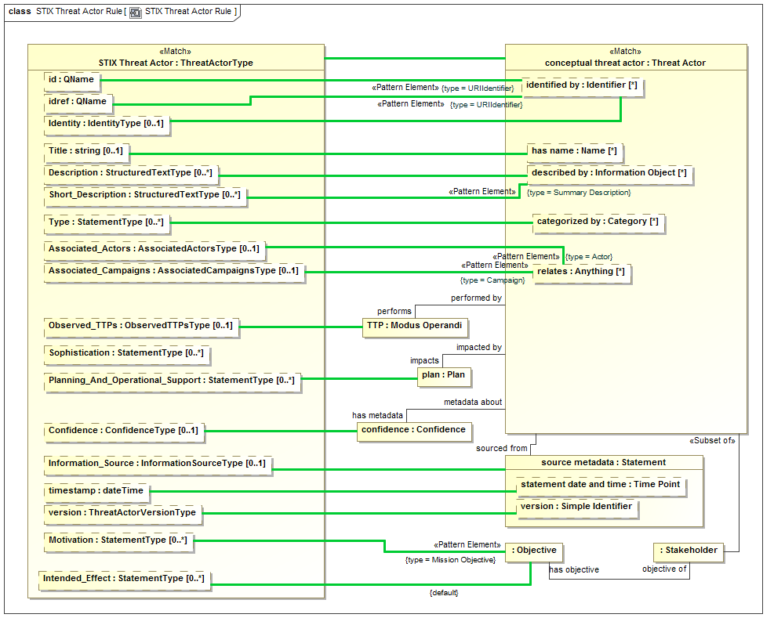

Slide 6
What is the Cameo Concept Modeler?
A partial but growing SMIF profile implementation that is informing the SMIF specification
A No Magic product that has been on the market since 2015
A plugin to MagicDraw 18.x
Part of Cameo EA 18.x
For the Financial Industry Business Ontology (FIBO) efforts:
Diagrams used for the business stakeholder view
Natural language glossary

Slide 7
What does CCM 18.x Do Now?
Ingests existing OWL ontologies
Provides capability for visual domain concept modeling
Provides capability for validation with business SMEs of diagrams and natural-language glossary
Emits OWL ontologies
“Round trips” edited OWL and “sanctioned” FIBO patterns

Slide 8
What will CCM do in version 19.x and beyond?
Record design decisions to forward generate information models in SQL, XML, OWL, SHACL
Connect to Cameo Data Modeler 19.x for generation of SQL and XML schemas
Bidirectionally map multiple information models to reference concept models
Information federation / semantic mediation:
Across multiple systems, query data representing business concepts
Provide the models to be used by runtime information-federation engines
Project federated information for analytics engines
Provide analysis-level models for executable UML (i.e., fUML, Alf, full code generation)

Slide 9
Why reschedule SMIF?
Implementations have been informing the specification:
Discovered a problem with reusable UML constraints
Discovered shortcomings in work with the FIBO team
Valuable experience validating FIBO-V with actual business SMEs
Valuable feedback on profile understandability
Refinement made to the SMIF model
Need stronger formalization and provable grounding of the SMIF kernel
Plan to exceed the requirements of the OMG process by having multiple implementations on adoption, not one year later
Note: Internet standards are based on running code and rough consensus

Slide 10
Motion
Revised submission date: June

