Slide 1

Concept Modeling for Information Federation
Cory Casanave
Conceptual Modeling Concepts

Slide 2
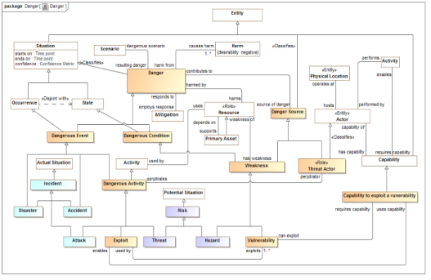
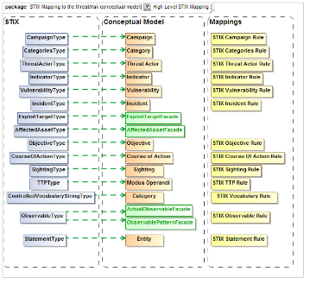
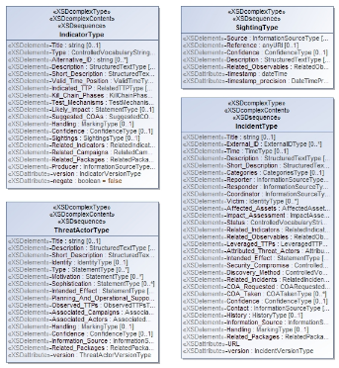
Concept Models for Semantic Mediation
We need to understand
What are the common concepts
How do the various information syntaxes and systems represent those concepts
What are the rules for translating between them in various context
How information and data are governed
Data
Syntax
Represents
Reference
Concepts
Message
Syntax
Represents
Represents
Data
Syntax
Conceptual Reference Model
Mapping Rules
Data & Message Model

Slide 3
Kinds of models
Conceptual reference models
A.K.A. “Concept Models” or “Business Information Models”
Model a subject area, such as a kind of business
The subject of the model is business concepts
Data and Message Models
Model data structures that store or transmit facts
May be optimized for an application or purpose
The subject of the model is data structures
Mapping Models
Model how data structures represent business concepts
May be elaborated to support automated translation, integration or federation of data
The subject of the model is mapping

Slide 4
Important conceptual modeling and mapping capabilities
As easy as possible for domain stakeholders to understand the models as diagrams, tables or text
“First class” n-ary relationships that may have properties and participate in other relationships
Recognition and representation of time, provenance and context – most facts are only true for a limited time and in specific situations
Roles, phases and other “non rigid” classifications that also may be time or situationally dependent
Hierarchies of types, relationship types and properties
Business values as represented by various systems of units

Slide 5
Important features of UML concept modeling
Using the Concept Modeling UML profile – based on the UML (Unified Modeling Language) standard

Slide 6

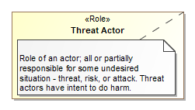
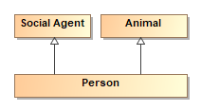

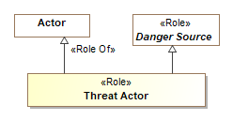


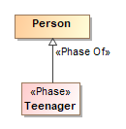
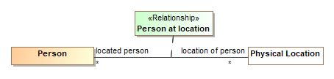
Foundational Conceptual Tools (Meta-Concepts)
Entity Types
Definitions
Specialization
Characteristics
Roles
Associations (Always true between entities)
Values & Units
Phases
Relationships (Independent/Contextual)

Slide 7
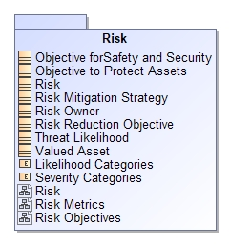
Subject Areas - Organizing Concepts
Subject Areas provide context for the definition and management of a set of concepts
Subject areas may also be used for governance
Subject areas may use or depend on other subject areas
Subject areas may contain other subject areas
Subject areas may be business domain focused or technology focused
Don’t mix-up what is being modeled, the business , data, or applications
Models typically define and/or use multiple subject areas
Subject Areas

Slide 8
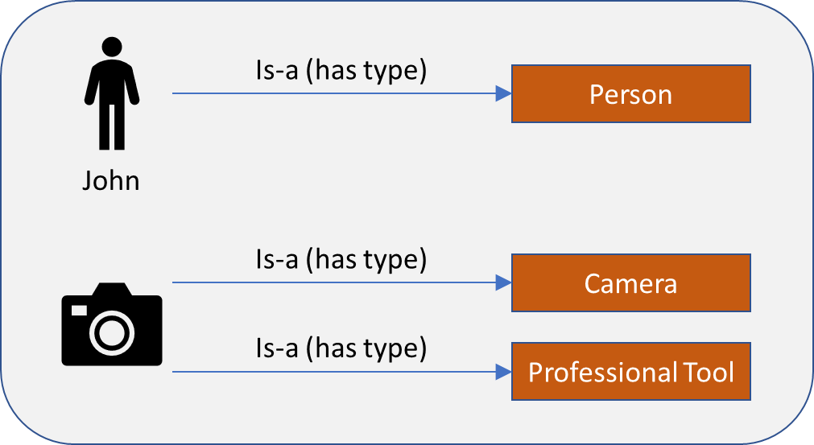
Things and their types
Everything in a model has more or more types
Types define a set of things that qualify as that type
A synonym for type is “Class” or “Classification”. Class is typically used in a more technical context.
Every type has a business focused definition of what it is or means
Not how it is used for a particular application.
Not how it is represented as data.

Slide 9
Specialization
Types may specialize other types
Most types specialize at least one other type and may specialize more than one
A specialized type is known as the “subtype”
A more general type is known as the “supertype”
Everything that is a subtype is implicitly also all of the supertypes
E.g. all people are also animals and social agents
The inverse term “Generalization” is also commonly used

Slide 10
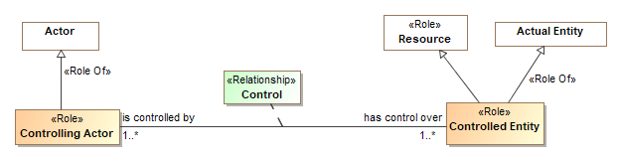
Roles
Roles define what something is for or how it behaves in a certain context, not “what it is”. A “relative thing”
A role is a <<Facet Of>> or <<Role Of>> what it can be a role of.
An entity can play any number of roles and these roles may change over time.
Roles can be contextual and specialize other roles
Roles are usually established by relationships

Slide 11
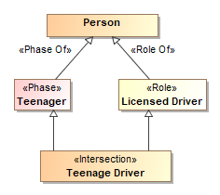
Phases
Phases (or states) are classifications of objects over their lifetime.
Examples: Child, Teenager, Adult or Invoiced, Late, Paid
May be combined with other types using unions and intersection (e.g. teenage driver)
Teenager is a phase of a person
All teenagers who are licensed drivers are teenage drivers

Slide 12
Relationships
Relationships are meaningful atomic concepts involving a set of other entities or relationships. A “Mediating thing”.
There can be any number of related “ends”, but two ends is most common
Relationships are atomic & static “Situations”, the involved ends do not change over the lifetime of the relationship. The context and “truth value” of the relationship may change.
Relationships are temporal – exist for a timeframe. The timeframe of a relationship may or may not match the timeframe of the “ends”
Relationships may be involved in other relationships and may have characteristics
We refer to these independent relationships as “first class” relationships.

Slide 13

Associations
Associations are similar to relationships but:
Not temporal – they exist for the lifetime of the related “ends”
Do not have characteristics
Limited to binary
Also known as “Formal Relations”
Map most directly to simple properties (e.g. OWL or Java)

Slide 14
Characteristics / Attributes
Characteristics (attributes) are features inherent in another type
Most like “properties” in many languages
Usually have a value type as their range
John has a weight of 60 KG
Characteristics are temporal (have a timeframe) & identifiable
John weighed 60kg on March 3rd, 2011
In conceptual reference models, quantity kinds (e.g. Mass) are preferred over specific units (e.g. kg) or data types (e.g. “Real”) as the types of characteristics

Slide 15
Specializing properties
Properties encompass the “ends” of associations and relationships, and characteristics
Like everything else – properties have types (property types) and instances (called bindings)
Properties can be specialized and restricted
Models typically define property types
Specialized properties may be “virtually derived”, not define a new concept but restrict an existing one. These have no name or the same name as their super-property
Property specialization is either a “subset” or redefines (equivalent set)

Slide 16
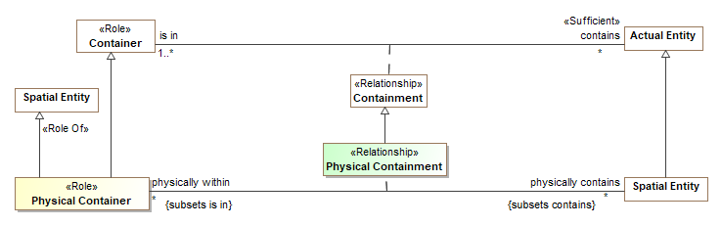
Subset properties
Subset properties define subtypes of other property types (ends of associations or relationships, characteristics, etc).
Extent of subset property is a subset of super-property
May tighten constraints – multiplicity, type, etc.

Slide 17
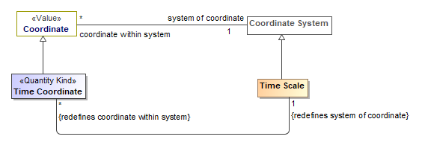
Redefined Properties
Redefined properties define subtypes of other property types (ends of associations or relationships, characteristics, etc) and replace the super-property in the given context.
Extent of redefined property is the same as the extent of super-property
May tighten constraints – multiplicity, type, etc.
Restriction Example

Slide 18
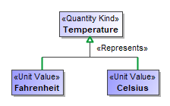

Quantity Kinds & Units
For numeric characteristics, we want to know what it means (e.g. Temperature), not the kind of number (Real).
<<Quantity Kind>> is an aspect common to mutually comparable quantities represented by one or more units.
A “unit value” represents a quantity kind, there are multiple units representing temperature.
A physical representation would then represent the unit as some kind of number in a specified unit.

Slide 19
Incomplete and Disjoint
Subtypes are “complete” if there can be no more subtypes of the supertype
Subtypes of “Animal” are incomplete – there are other kinds of animals
Subtypes are “disjoint” if they can’t be mixed
E.g. the same thing can’t be a cat and a dog
Note: Disjoint may also use a dependency

Slide 20
Type Based Model Theory
Every type represents some kind of thing that exists in our conceived world
Reference models are conceptual, information models are application specific
Multiple inheritance & multiple (instance) classification is supported
Everything has metadata – source (including derivations), provenance & timeframe
Things change – time matters (the world is not static or a snapshot)
E.G. Relationships, situations and characteristics are temporal
Information is contextual (the world is not first order)
Statements are not “deleted”, they go in and out of context
Facts about the world is open, conclusions (and computations) are contextual
Trust in information varies, not everything that can be inferenced should be
Independence from representation (e.g. schema) and processing technologies (including inference engines)
But, we can bind to any of these technologies

