Slide 1

Semantic Modeling for Information Federation
SMIF
Cory Casanave

Slide 2
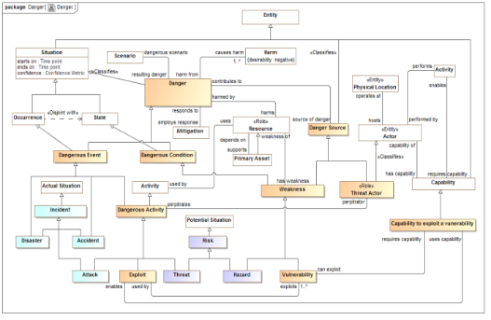
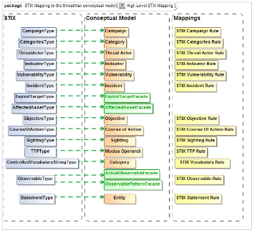
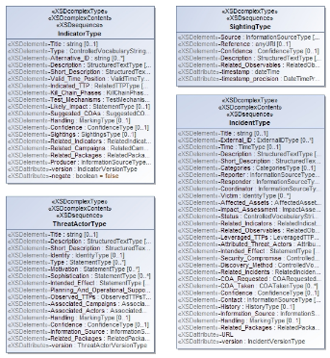
SMIF for Semantic Mediation
We need to understand
What are the common concepts
How do the various information syntaxes represent those concepts
What are the rules for translating between them in various context
Information
Syntax
Represents
Reference
Concepts
Information
Syntax
Represents
Represents
Information
Syntax
Conceptual Model
Mapping Rules
Information Model

Slide 3

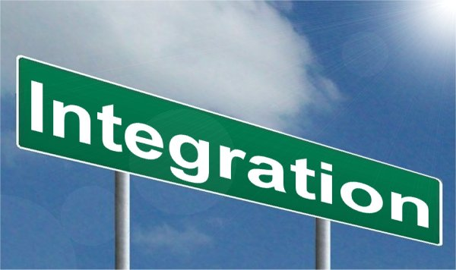
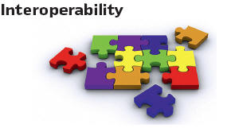



Leveraging Federated Information
T

Slide 4
Conceptual Tools
“Conceptual tools” are the meta-concepts we use to build our models
Raising the level of abstraction
Conceptual models need not be limited to computational paradigms
E.g. OWL-DL is limited by FOL, DL and unary “properties” (no relations)
Examples of conceptual tools (more detail below)
Context
First-class n-ary relationships
Roles and phases
Temporal friendly “situations” and relationships
Ontology does not mean “OWL-DL”, Ontology is about conception of the world(s).
Note that the above can be “painted over” OWL and UML with patterns.

Slide 5
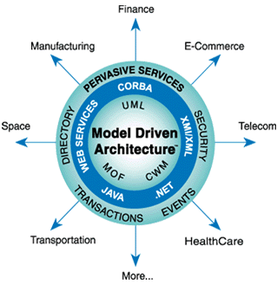
Multiple Technologies
Multiple technologies can be leveraged, integrated and combined based on the same conceptual models using model driven architecture
Linked Data
Ontologies (e.g. OWL)
Rules
Traditional DBMS / SQL
Big Data
NoSQL
Traditional APIs and applications (e.g. Java)
Functional Programming
ETL / Data Wearhouse
Publish/Subscribe
SOA
Application and web servers

Slide 6
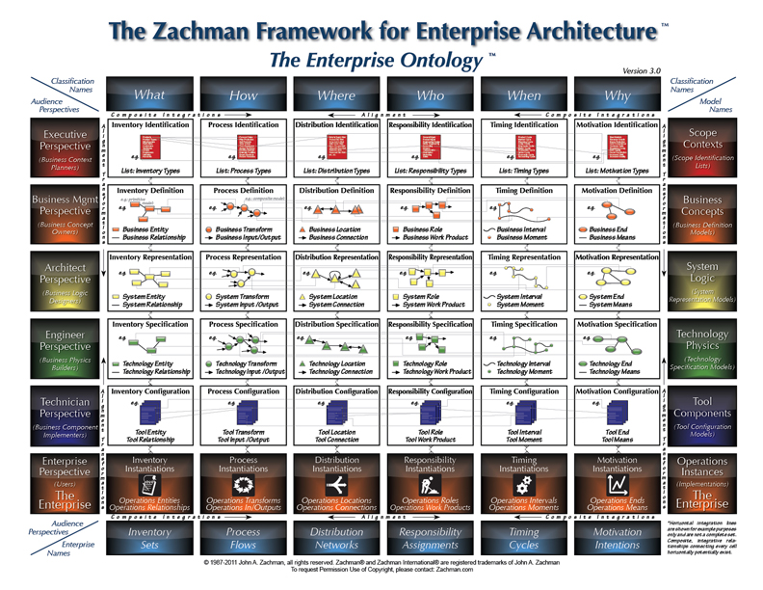
Solution Architecture

Slide 7
Conceptual Models for Mappings and Federation
What are the requirements for conceptual modeling in support of federation?

Slide 8
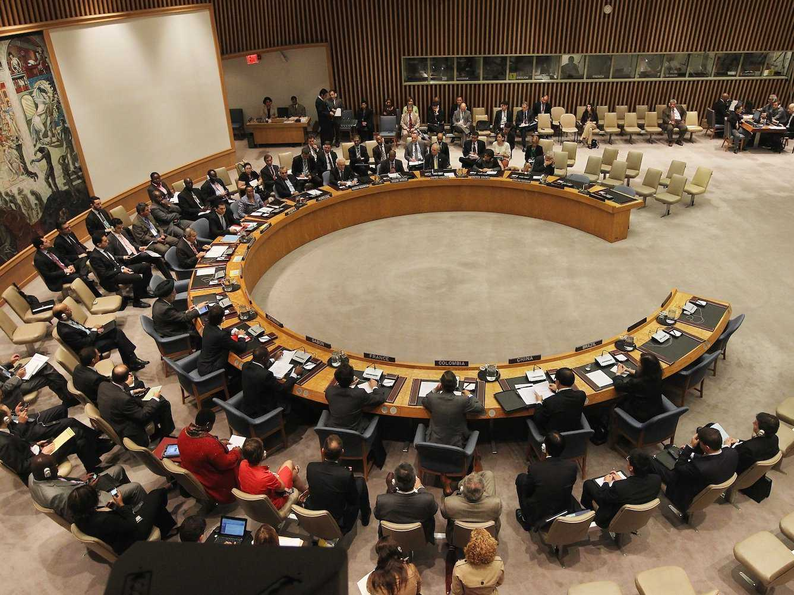

Role of the interpreter

Slide 9
What we expect of interpreters
Retention of meaning across languages, communities and cultures
Communicate what is said without judging, coloring or filtering it
Interpreters have substantial preparation, learning syntax, grammar, vocabulary and cultural idioms.
Interpreters can only communicate what they understand and what can be understood in the languages they deal with – the common concepts
They then communicate what other people said based on how those concepts are expressed in different languages – they communicate the provenance
Interpreters are preforming semantic mediation
Common concepts

Slide 10
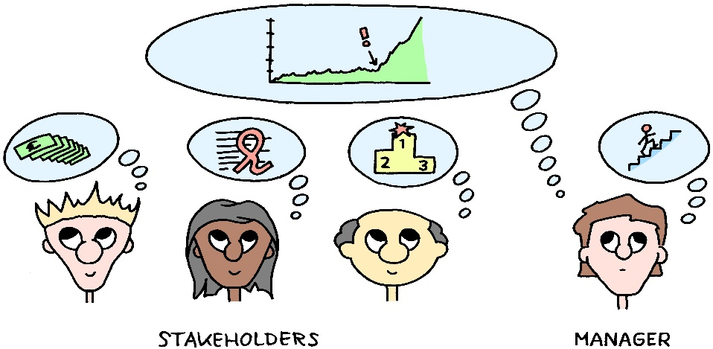

Understandable and precise
Capture, disambiguate and precisely describe stakeholder concepts such that they can enable automation.
Represent these concepts so stakeholders can understand and validate them.

Slide 11
Implications for the role of semantic mediation (conceptual reference models)
Semantic mediation does
Capture shared concepts, this includes types, relationships, individuals and other concept kinds
Define a relationship between patterns of these concepts and patterns of data representations – it is not a word for word translation
Respect the context of the concepts and rules
Maintain the provenance of information
Semantic mediation does not
Define applications that produce or consume information
Assert policy about what is “right”, “common” or “legal”
Structure information for an application perspective
Filter for “data quality”

Slide 12
Implications for SMIF
Conceptual models and mappings, intended for the federation role
Should use stakeholder relevant terms and concepts presented in an understandable way
Should have minimal commitment – only committing to what is necessary to understand and “map” information. E.g. specific units or data representations
Should keep application specifics out of the concepts – how the information is developed is not our concern.
Should contain both the “most generic” sense of a concept as well as any specialization required (and named appropriately) for precise communications
Mappings should be able to be “mixed and matched” with multiple concept modules based on context
Should only contain semantics that have a “ROI” for federation.
E.g. should not be implementing “application rules”, it is up to the “end applications” to enforce rules prior to mediation
Conclusion: Conceptual models for federation may be a subset of (simpler than) conceptual models or operational ontologies intended for applications. Their semantics only need to support the mapping rules for representations.

Slide 13
Example: What is a “Threat Actor”
Example from “Operational threat/risk”

Slide 14
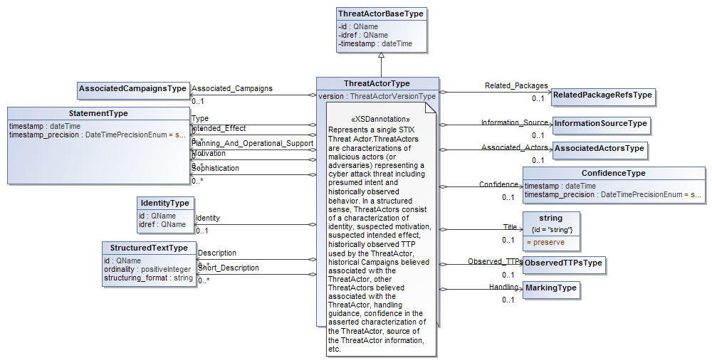
Is this a threat actor? (STIX)
STIX is a large XML Schema

Slide 15
What is a threat actor? (FBI)
The Federal Bureau of Investigation has identified three categories of cyber threat actors:
“ [1] organized crime groups that are primarily threatening the financial services sector, and they are expanding the scope of their attacks; [2] state sponsors — foreign governments that are interested in pilfering data, including intellectual property and research and development data from major manufacturers, government agencies, and defense contractors; and [3] increasingly there are terrorist groups who want to impact this country the same way they did on 9/11 by flying planes into buildings. They are seeking to use the network to challenge the United States by looking at critical infrastructure to disrupt or harm the viability of our way of life.[1]

Slide 16
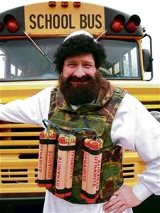
Is this a threat actor?
Threat
Actor?
Our conclusion: Only the “real world” perspective can provide a pivot point between different representations.
Instances of a conceptual “threat actor” are real threat actors, not data about them as data is structured for its application purpose.

Slide 17
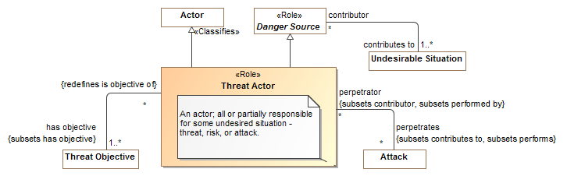
What is a threat actor? (Threat Model)

Slide 18
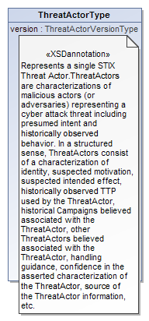
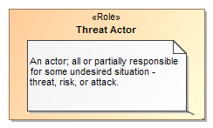

Data represents concepts
Represents
Model Representation

Slide 19
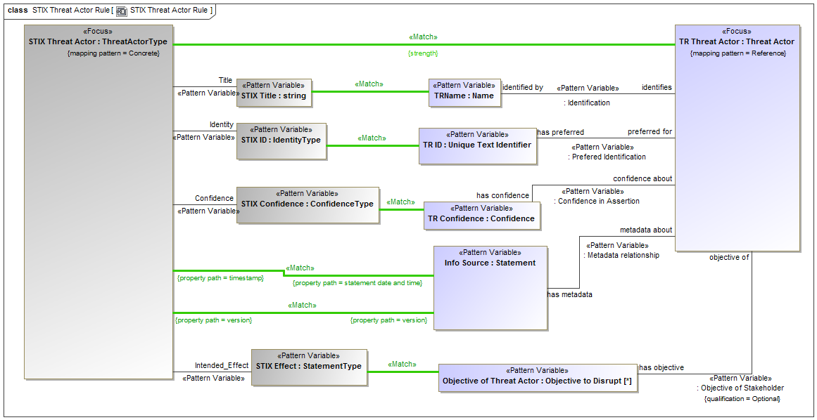
Example of Mapping Pattern (UML Profile)

Slide 20
SMIF Components – conceptual models and mappings to schema
SMIF Conceptual Meta Model
SMIF Conceptual Metamodel
Mapping Metamodel
SMIF Information Metamodel
Depends On
Map To
Represents
Represents
Represents
UML Representation
Conceptual Modeling UML Profile
Mapping UML Profile
Schema Profile
Depends On
Map To

Slide 21
Important conceptual modeling and mapping capabilities
As easy as possible for domain stakeholders to understand the models as diagrams, tables or text
“First class” n-ary relationships that may have properties and participate in other relationships
Recognition and representation of time and context – most relationships are only true for a limited time and in specific situations
Roles, phases and other “non rigid” classifications that also may be time or situationally dependent
Hierarchies of types, relationship types and properties
Business values as represented by various systems of units
Patterns as a basis for real-world situations as well as mapping rules
Note that while some of these features may be difficult for generic FOL reasoners, they are practical for specific conceptual model and mapping rules

Slide 22
Ontology Summit: Semantic Interoperability Communique
Last years Ontology Summit focused on “Ontologies within Semantic Interoperability Ecosystems ”. Full document: http://tiny.cc/Ontolog2016
Supports the value proposition of SMIF
“The United States spent nearly $3.0 trillion on healthcare in 2014 [ . . . ] the efficient use of health information technology will result in considerable cost savings, in addition to saving thousands of lives per year”.
Supports the need for capabilities not currently provided, focused on semantic interoperability
"More mature conceptual modeling & knowledge engineering tools are required to support the design, development and storage of ontologies and vocabularies. [ . . . ] these should be integrated into software development and data management tools that provide support across the IT lifecycle and related operations.“
"There was broad consensus within the Summit that improved software tools and environments are required to support the integration of concepts and data."

Slide 23
Important features of SMIF concept modeling
Using the SMIF UML profile – one projection of the SMIF model

Slide 24


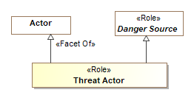

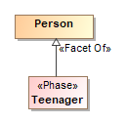
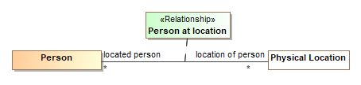
Foundational Conceptual Tools (Meta-Concepts)
Entities & Facets
Propositions
Rigid (Entity) Types
Characteristics
Roles
Associations (Always true between entities)
Phases
Relationships (Independent/Contextual)

Slide 25
Type Based Model Theory
Reference models are conceptual, information models are application specific
Multiple inheritance & multiple (instance) classification is required
Everything has metadata – source (including derivations), provenance & timeframe
Things change – time matters (the world is not static or a snapshot)
E.G. Relationships, situations and characteristics are temporal
Information is contextual (the world is not first order)
Statements are not “deleted”, they go in and out of context (Allows functional)
The world is open, conclusions (computations) are contextual
Trust in information varies, not everything that can be inferenced should be
Independence from representation (e.g. schema) and processing technologies (including inference engines)
But, we can bind to any of these technologies

Slide 26
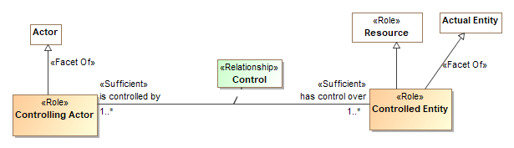
Roles
Roles define what something is for or how it behaves in a certain context, not “what it is”. A “relative thing”
A role is a <<Facet Of>> what it can be a role of.
An entity can play any number of roles and these roles may change over time.
Roles can be contextual and specialize other roles
Roles are usually established by relationships

Slide 27
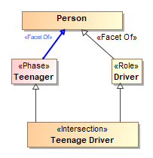
Phases
Phases (or states) are classifications of objects over their lifetime. A “Relative thing”
Examples: Child, Teenager, Adult or Invoiced, Late, Paid
May be combined with other types using unions and intersection (e.g. teenage driver)

Slide 28
Relationships
Relationships are meaningful atomic concepts involving a set of other entities or relationships. A “Mediating thing”.
There can be any number of related “ends”, but two ends is most common
Relationships are atomic & static “Situations”, the involved ends do not change over the lifetime of the relationship. The context and “truth value” of the relationship may change.
Relationships are temporal – exist for a timeframe. The timeframe of a relationship may or may not match the timeframe of the “ends”
Relationships may be involved in other relationships and may have characteristics
We refer to these independent relationships as “first class” relationships.

Slide 29
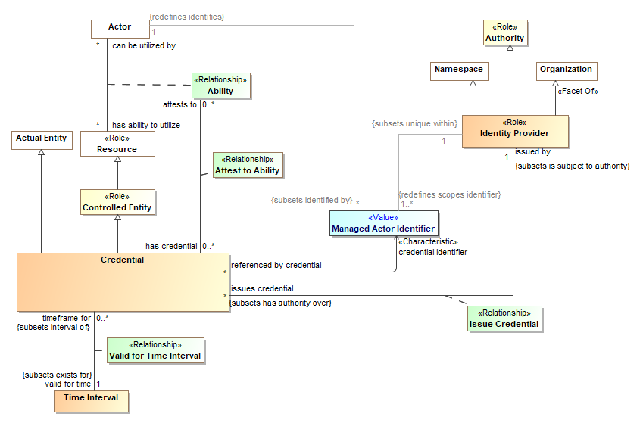
Modeling with first class roles & relationships
(Note that relationships can be temporal – be “true” only for a time period)

Slide 30

Associations
Associations are similar to relationships but:
Not “first class”
Not temporal – they exist for the lifetime of the related “ends”
Limited to binary
Also known as “Formal Relations”
Map most directly to simple properties (e.g. OWL or Java)

Slide 31
Characteristics
Characteristics are features inherent in another type
Most like “properties” in many languages
Usually have a value type as their range
John has a weight of 60 KG
Characteristics are temporal (have a timeframe) & identifiable
John weighed 60kg on March 3rd, 2011
In conceptual reference models quantity kinds (e.g. Mass) are preferred over specific units (e.g. kg) or data types (e.g. “Real”) as the types of characteristics

Slide 32
Specializing properties
Properties encompass the “ends” of associations and relationships, and characteristics
Like everything else – properties have types (property types) and instances (called bindings)
Properties can be specialized and restricted
Models typically define property types
Specialized properties may be “virtually derived”, not define a new concept but restrict an existing one. These have no name or the same name as their super-property
Property specialization is either a “subset” or redefines (equivalent set)

Slide 33
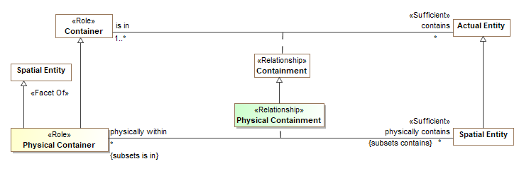
Subset properties
Subset properties define subtypes of other property types (ends of associations or relationships, characteristics, etc).
Extent of subset property is a subset of super-property
May tighten constraints – multiplicity, type, etc.

Slide 34
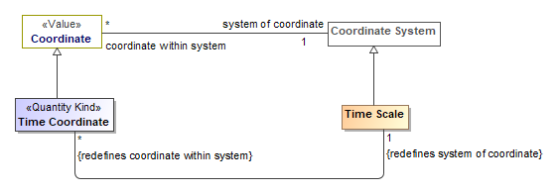
Redefined Properties
Redefined properties define subtypes of other property types (ends of associations or relationships, characteristics, etc) and replace the super-property in the given context.
Extent of redefined property is the same as the extent of super-property
May tighten constraints – multiplicity, type, etc.
Restriction Example

Slide 35
Incomplete and Disjoint (Model)
Note: Disjoint may also use a dependency

Slide 36
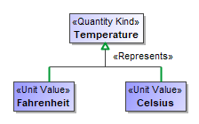

Quantity Kinds & Units
For numeric characteristics, we want to know what it means (e.g. Temperature), not the kind of number (Real).
<<Quantity Kind>> is an aspect common to mutually comparable quantities represented by one or more units.
A “unit value” represents a quantity kind, there are multiple units representing temperature.
A physical representation would then represent the unit as some kind of number in a specified unit.

Slide 37
Situations
Situations contextualize one or more propositions – relationships, associations, characteristics or rules
Situations are “mediating things”
Situations are temporal
Relationships are atomic situations
Situations types / patterns and individuals may be defined
Situations may be
Static or dynamic
Past, present or possible future

Slide 38
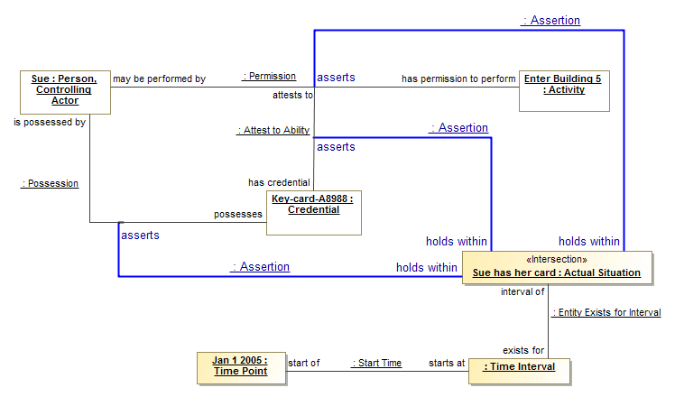
Situations capture “truth” in context (any such truth is subject to trust and likelihood)

Slide 39
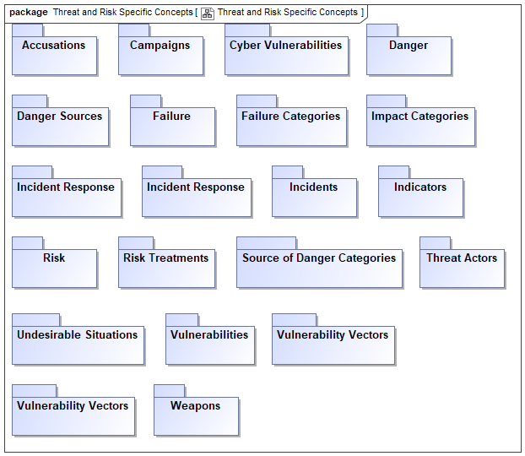
Model Organization
Models may be organized into packages (sub-graphs) and reference or assert other packages

Slide 40
Additional Capabilities, not detailed here
Expressions
Define computations
Patterns
Define sets of entities and relationships with variables, acts as a type.
May be asserted for a type or context
Used as the basis for mapping
In UML, uses structured classifiers
Rules
Define constraints or implications for a context. E.g. Multiplicity.
Mapping Rules
Defines how an information model relates to a conceptual reference model
Based on pattern matching
Multiple mappings are combined to federate or translate information

Slide 41
Summary
Conceptual modeling provides a foundation for interoperability and federation
The UML SMIF UML profile gives users a way to express concepts independent of data
Mapping relations connect data in multiple formats with concepts
This goes a long way to solving the “data problem” – fragmentation, redundancy and isolation.

