Slide 1

Semantic Information Modeling for Federation
SIMF
Using “threat actor” example
Cory Casanave

Slide 2















Operational Threat & Risk Information Sharing and Analytics
TEAM Threat
STIDS 2015

Slide 3
What we need is an integrating framework that supports automated data mapping
Cyber
Crime
Terrorism
Critical Infrastructure
Natural
Disasters
Integrating Framework for Threats and Risks
Sharing & Analytics
Sharing & Analytics
Sharing & Analytics
Sharing & Analytics
Sharing & Analytics
An integrating framework that helps us deal with all aspects of a risk or incident
A federation of risk and threat information sharing and analytics capabilities

Slide 4

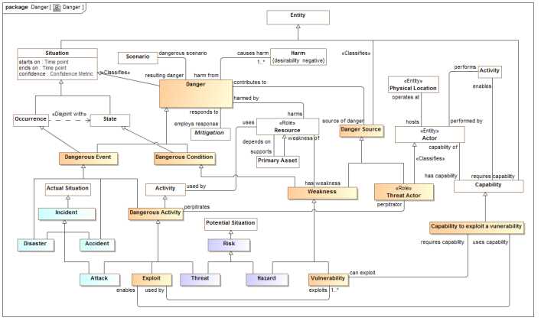
Threat/Risk Conceptual Model Inputs
KDM
(Risk)
NIST Framework
Conceptual Model
NIEM
(General)
STIX
(Cyber)
OGC
(Geo)
EDXL
(Emergency)
FIBO (Finance)
SEI
(Safety)
CAL OES
(Health)
MAP
ISO
(Risk)
ISO
(Units)
RMS
(Custody)
STIX, NIEM, EDXL, Others

Slide 5
What is a “Threat Actor”

Slide 6
What is a threat actor? (Dictionary)
A threat actor, also called a malicious actor, is an entity that is partially or wholly responsible for an incident that impacts – or has the potential to impact -- an organization's security.

Slide 7
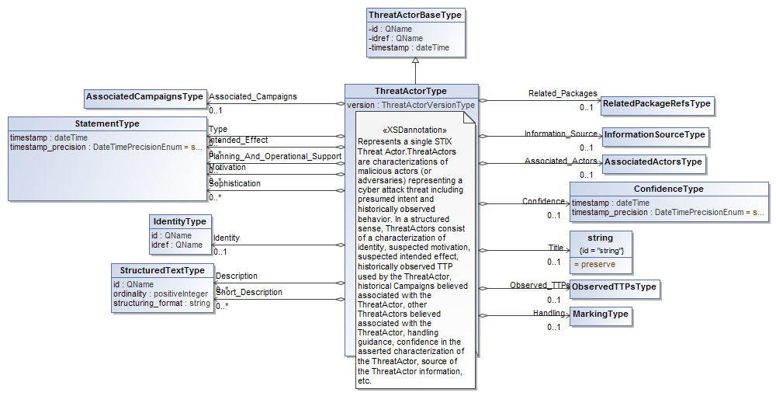
What is a threat actor? (STIX)

Slide 8
What is a threat actor?
The Federal Bureau of Investigation has identified three categories of cyber threat actors:
“ [1] organized crime groups that are primarily threatening the financial services sector, and they are expanding the scope of their attacks; [2] state sponsors — foreign governments that are interested in pilfering data, including intellectual property and research and development data from major manufacturers, government agencies, and defense contractors; and [3] increasingly there are terrorist groups who want to impact this country the same way they did on 9/11 by flying planes into buildings. They are seeking to use the network to challenge the United States by looking at critical infrastructure to disrupt or harm the viability of our way of life.[1]

Slide 9
Is this a threat actor?
(1). d1(x,X,y,Y) T3 (2). i1(y,Y,z,Z) T3 (3). (x < y) ∧ IFD(x,X,y,Y) 1, Definition 7.1 (4). GFD(X,Y) ∧ x::X ∧ y::Y ∧ (F(x,X) → F(y,Y)) 3, (8) (5). (y < z) ∧ IIFD(y,Y,z,Z) 2, Definition 7.3 (6). z::Z ∧ ∃W (Subtype(Z,W) ∧ IFD(y,Y,z,W)) 5, (9) (7). GFD(Y,W) ∧ y::Y ∧ z::W ∧ (F(y,Y) → F(z,W)) 6, (8) (8). (x < z) 3,5,TFP (9). GFD(X,W) 4,7, (7) (10). (x::X) ∧ (z::W) 4,7, EC (11). (F(x,X) → F(z,W)) 4,7,TLI (12). GFD(X,W) ∧ (x::X) ∧ (z::W) (F(x,X) → F(z,W)) 9,10,11,IC (13). IFD(x,X,z,W) 12, (8) (14). z::Z ∧ ∃W (Subtype(Z,W) ∧ IFD(x,X,z,W) 6,13,IC (15). IIFD(x,X,z,Z) 14, (9) (16). (x < z) ∧ IIFD(x,X,z,Z) 8,15, IC (17). i1(x,X,z,Z) 16, Definition 7.3

Slide 10
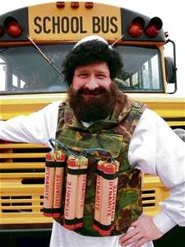
What is a threat actor?
Threat
Actor?

Slide 11
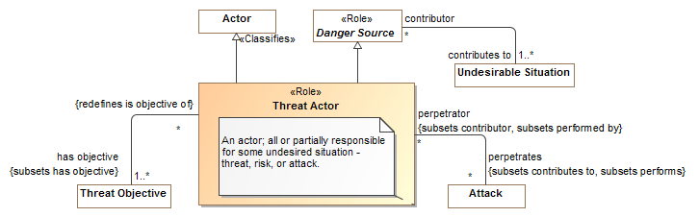
What is a threat actor? (CCM Threat Model)

Slide 12
Radical Thoughts
Any information interoperability, any communications, can only be successful if there is a shared conceptualization of what the information is about.
We get these shared conceptualizations from or shared experience of the world.
We conflate our concept of something with what information we know or find interesting for some purpose.
If we want to federate information, we have to first establish what that information is about in the “real world”.
By identifying and defining these real-world concepts, we have a basis for understanding different ways to describe them.

Slide 13
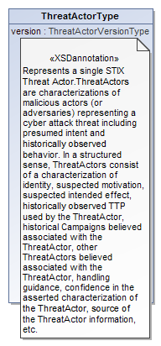
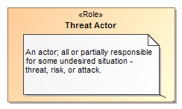
Data represents concepts
Represents

Slide 14
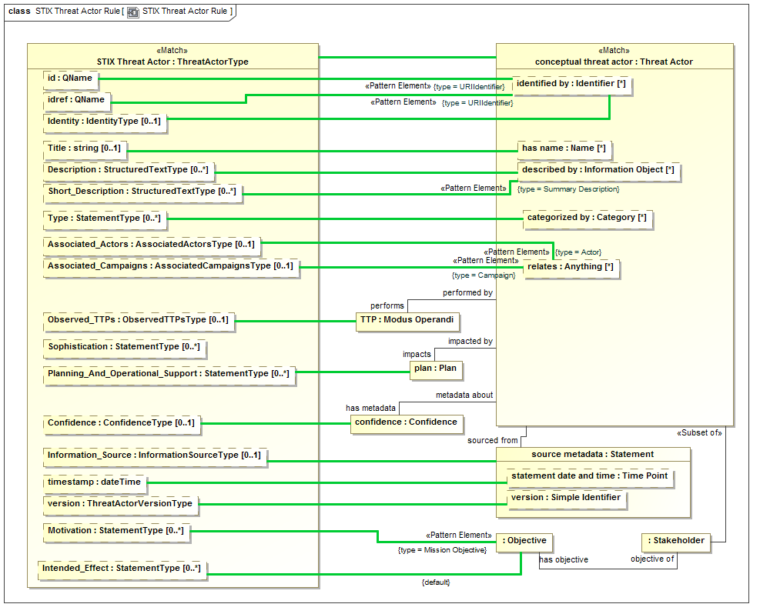

Slide 15
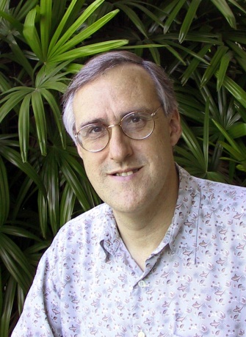
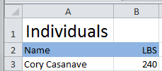

Example of “Pivoting” through a conceptual model
Concept of
“Cory Casanave”
There is an actual “Person”, Cory Casanave
There is a concept of this person shared in this room, right now
Here is one representation of him
“Person” is a shared concept, independent of data structures
There may also be shared agreement that Cory is a person and some other “facts”
“Cory Casanave” is a name for this person
He weighs 240 LBS
There are multiple data representations about Cory Casanave which may or may not agree
Those representations can be grounded in concepts (semantics), assisting federation
Concept of a
“Person”
<PersonType>
<NameText>Cory B. Casanave</NameText>
<Weight-LBS>234</Weight-LBS>
</PersonType>
XML
Representations
.
Excel
UML

