Slide 1

Semantic Modeling for Information Federation
SIMF/SMIF
Enterprise Data World 2017
Cory Casanave

Slide 2
SMIF Enables
Capability – Information Federation, Synthesis & Analytics
Ingest and interpret information and processes from multiple divergent sources
Situational awareness
Federated analytics “Connecting the dots”
Joint missions and desperate industries
Capability – Information Sharing & Brokerage
Translate information between diverse sources and consumers
Configurable gateways for diverse schema and protocols
Capability – Design for Interoperability
Instead of designing “from scratch”, use conceptual models as the foundation for new systems. This reduces cost and errors while building in interoperability. Leverages MDA model execution & Code/Schema Generation. Can forward engineer to semantic web.

Slide 3
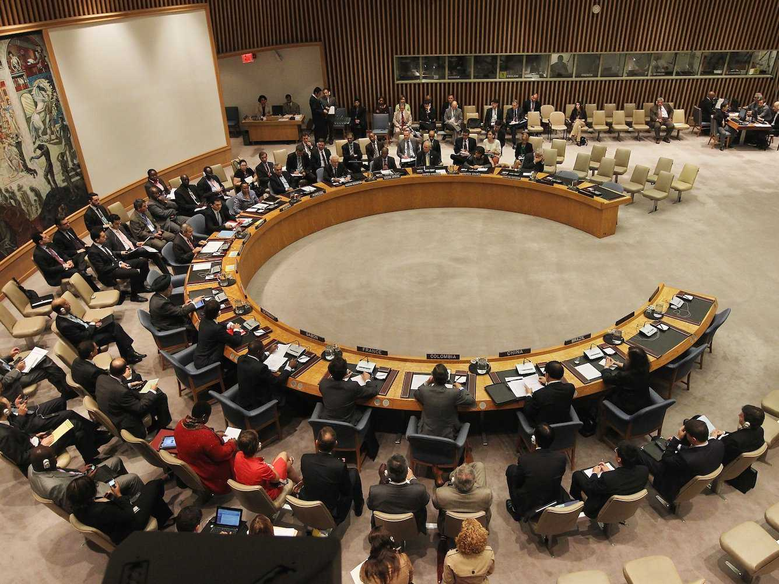

Role of the interpreter

Slide 4
What we expect of interpreters
Retention of meaning across languages, communities and cultures
Communicate what is said without judging, coloring or filtering it
Interpreters leverage substantial preparation, learning syntax, grammar, vocabulary and cultural idioms.
Interpreters can only communicate what they understand and what can be understood in the languages they deal with – the common concepts
They then communicate what other people said based on how those concepts are expressed in different languages – they communicate the provenance
Interpreters are preforming semantic mediation
Common concepts

Slide 5
What is in SMIF?
Conceptual modeling language
High level concepts like entities, roles, relationships and phases
Bi-directional data / concept mapping language
Pattern based correlation
UML Profile notation & syntax (other notations anticipated)
Supported with industry tools and well known notation
Mapping to RDF/OWL (Other mappings anticipated)
Leveraging OWL ontologies for inference and RDF graphs

Slide 6
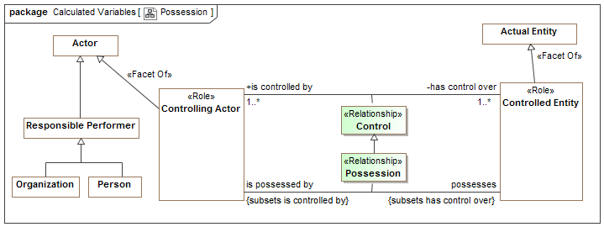
Example of Modeling Style (UML Profile)
Control Possession relationships are “first class” – have a timeframe, can be part of cause and effect, etc.
“Controlling Actor” is a role – people and organizations can play this role
Both entity classes and relationships form hierarchies
There are multiple ways “data structures” could be arranged to represent this information or a subset of it – that is the subject of mappings.

Slide 7
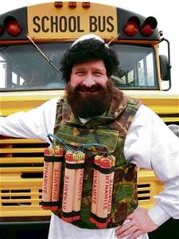
What is a threat actor?
Dictionary
A threat actor, also called a malicious actor, is an entity that is partially or wholly responsible for an incident that impacts – or has the potential to impact -- an organization's security.
Threat
Actor?

Slide 8
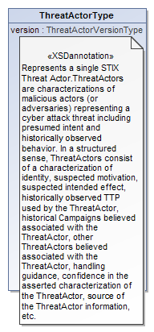
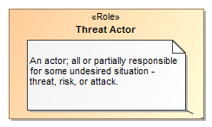
Data represents concepts
Represents

Slide 9
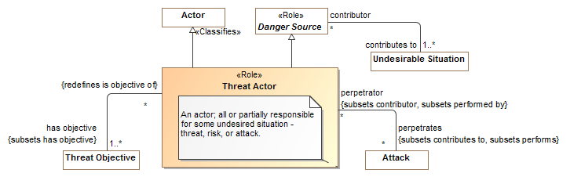
What is a threat actor? (SMIF Threat Model)

Slide 10
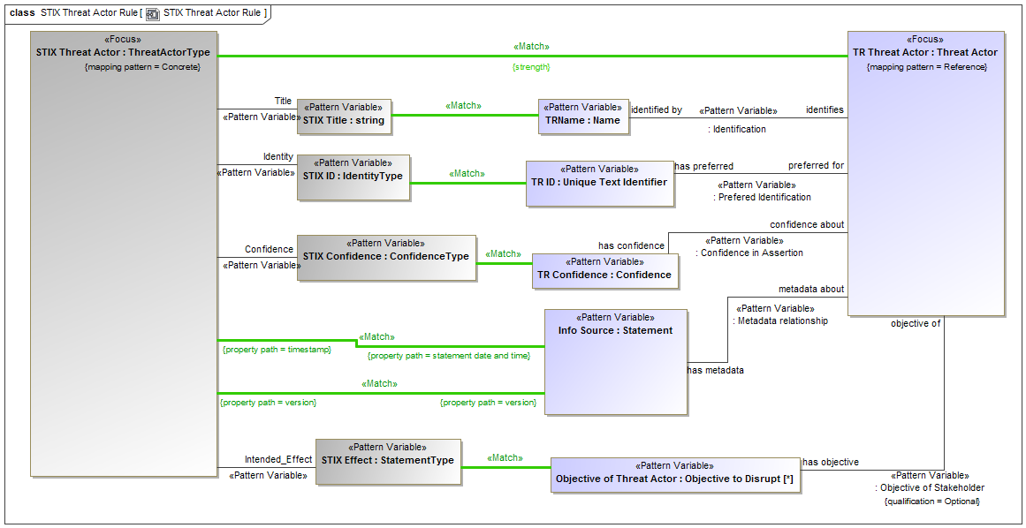
Example of Mapping Pattern (UML Profile)

Slide 11


SMIF is being used
FIBO
Operational Threat & Risk
Wide scale model of concepts in the financial domain
Interoperability and data federation of threat and risk information – cyber and physical

Slide 12
Backup slides

Slide 13
Supporting an integrating framework Enabling automated data federation & mapping
Finance
Banking
Investment
Insurance
Others..
Integrating Framework for Threats and Risks
Sharing & Analytics
Sharing & Analytics
Sharing & Analytics
Sharing & Analytics
Sharing & Analytics

Slide 14
Supporting an integrating framework Enabling automated data federation & mapping
Cyber
Crime
Terrorism
Critical Infrastructure
Natural
Disasters
Integrating Framework for Threats and Risks
Sharing & Analytics
Sharing & Analytics
Sharing & Analytics
Sharing & Analytics
Sharing & Analytics
An integrating framework that helps us deal with all aspects of a risk or incident
A federation of risk and threat information sharing and analytics capabilities

Slide 15
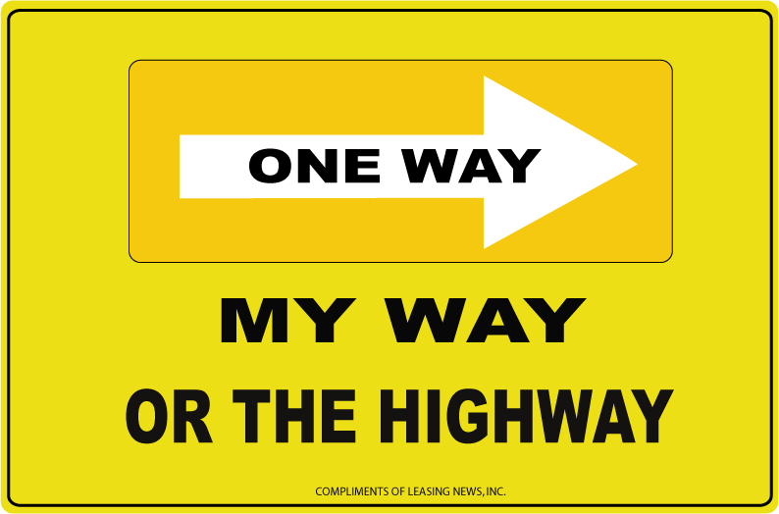

Shift in information sharing approach
Schema Based
Concept Based
Ask every stakeholder and system to adapt to externally imposed fixed schema, change in schema or systems requires development
Ask every stakeholder to map their schema to shared concepts, data mappings are automated & agile

Slide 16
Comparison with OWL-DL
It is possible to create patterns in OWL to represent these kinds of concepts.
But that is different from how OWL is normally used, to represent a “snapshot” in time that is “true” universally and for all time.
For our needs this “context free” owl is insufficient.
A “full” mapping to OWL requires reification of relationships and contextual assertions (as seen in situations). This can then be validated using OWL, but it is of limited use for OWL reasoning.
Implementing the mappings (which is our purpose) would best be done with rule engines or procedural code, but it could operate over an RDF graph or MOF instances.
For other purposes a “SMIF Lite” mapping to OWL can provide more typical OWL, by making a “snapshot” assumption in a fixed context. This is what is being used for FIBO.

