Slide 1


Information Federation with Reference Concept Libraries
SMIF
Using threat and risk examples
Cory Casanave

Slide 2
Semantic Modeling for Information Federation (SMIF)
Capability – Information Federation, Synthesis & Analytics
Ingest and interpret information and processes from multiple divergent sources
Situational awareness
Federated analytics “Connecting the dots”
Joint missions and desperate industries
Risk reduction
Capability – Information Sharing & Brokerage
Translate information between diverse sources and consumers
Configurable gateways for diverse schema and protocols
Systems integration
Capability – Design for Interoperability
Instead of designing “from scratch”, use conceptual models as the foundation for new systems. This reduces cost and errors while building in interoperability. Leverages MDA model execution & Code/Schema Generation. Can forward engineer to semantic web.

Slide 3

Frictionless World Ideal
Everything works with everything else, securely
Information from multiple sources can be correlated, analyzed and leveraged – accurately
We can collaborate with anyone – inside or outside of our enterprise – instantly
This is an ideal, we will never get there. But…

Slide 4

Where are we? How far can we go?
How do we get to 8?
0
2
8
10
Frictionless Scale
Frictionless Scale
First
Computers
Now
Art of the possible
Impossible
Ideal
Things work together because they were designed to work together
Independently conceived things work together
ATM Cards and worldwide sharing of cat videos
Most processes, services and information I care about are easily available

Slide 5
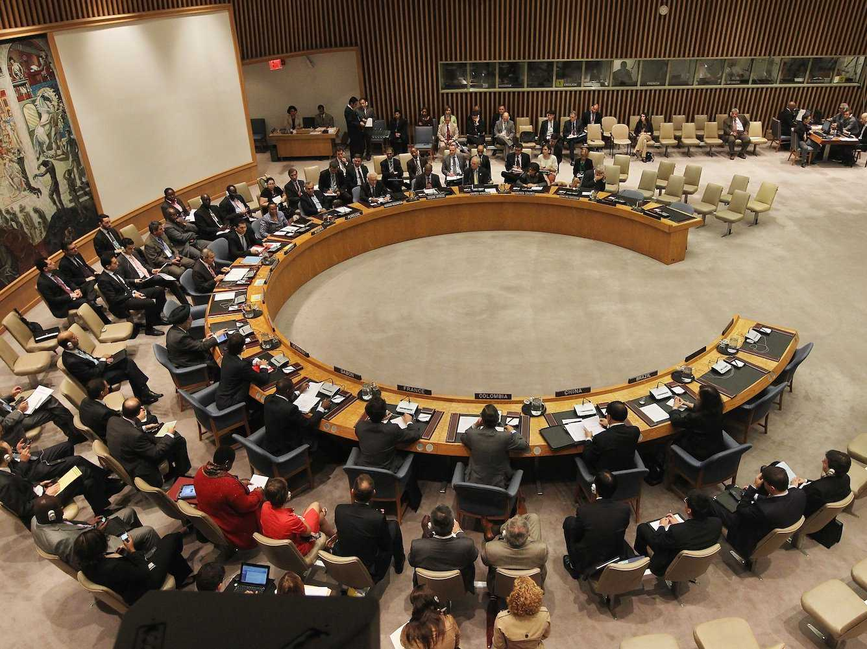

Analogy: Role of the interpreter

Slide 6
What we expect of interpreters
Retention of meaning across languages, communities and cultures
Communicate what is said without judging, coloring or filtering it
Interpreters leverage substantial preparation; learning syntax, grammar, vocabulary and cultural idioms.
Interpreters can only communicate what they understand and what can be understood in the languages they deal with – the common concepts
They then communicate what other people said based on how those concepts are expressed in different languages – they also communicate the provenance
Interpreters are preforming semantic mediation
Common concepts

Slide 7

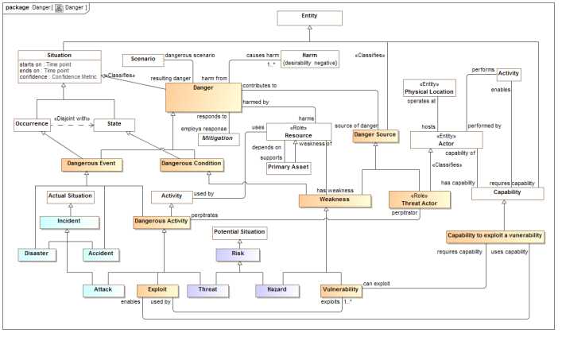
Threat information example
STIX
Cyber Information
Federated conceptual reference model
NIEM
(Justice and public safety)

Slide 8

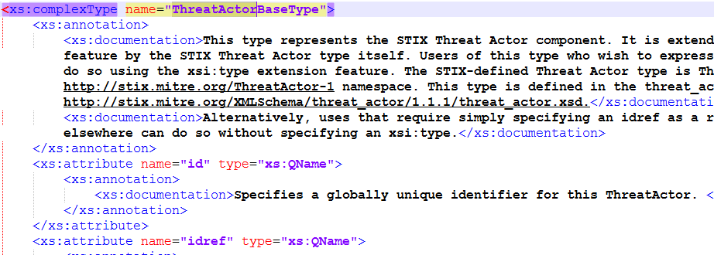
Example: What is a threat actor?
Dictionary
A threat actor, also called a malicious actor, is an entity that is partially or wholly responsible for an incident that impacts – or has the potential to impact -- an organization's security.
Threat
Actor
Data
About
Data element, not a threat actor.

Slide 9
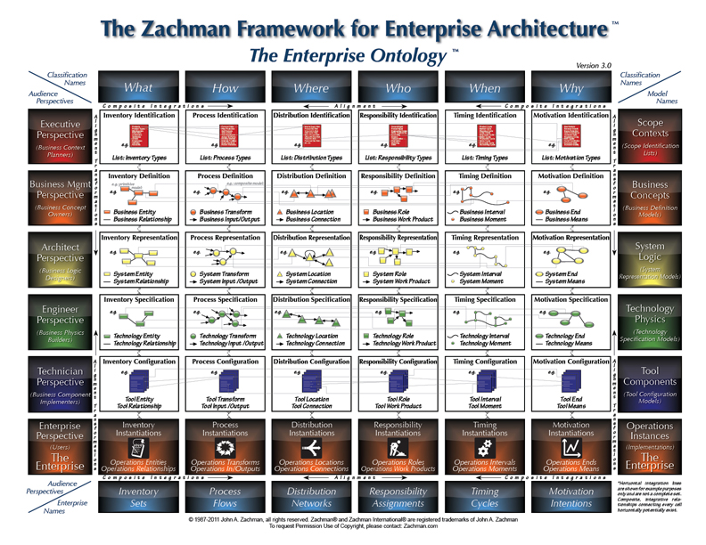
Solution Architecture

Slide 10
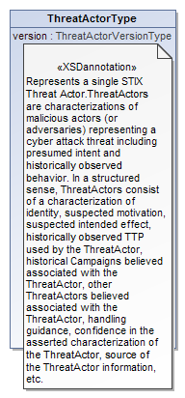
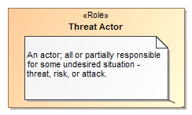
Data represents concepts
Represents
We want to “reference” the business perspective Conceptual reference model) from the solution architecture (data, process and services perspectives).

Slide 11
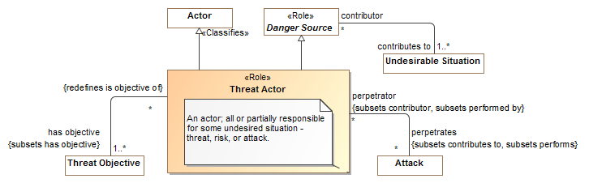
What is a threat actor? (SMIF Threat Model)

Slide 12
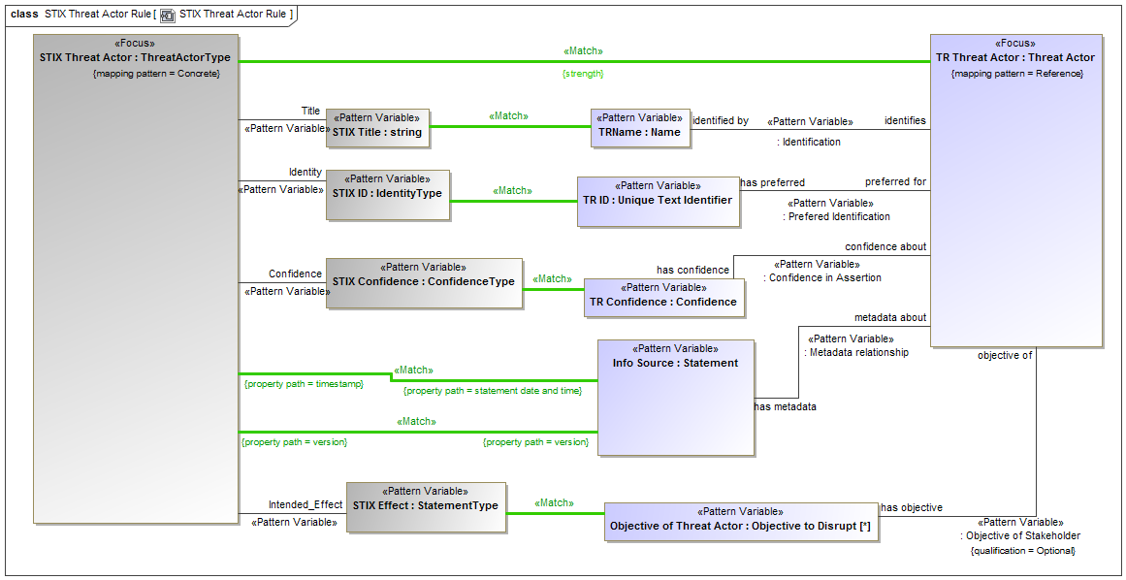
Example of Mapping Pattern (UML Profile)

Slide 13


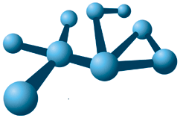
SMIF is being used
FIBO
Operational Threat & Risk
Wide scale model of concepts in the financial domain
Federated Concept Library
Interoperability and data federation of threat and risk information – cyber and physical

Slide 14
Conceptual Reference models Vs System Design Models
Most models that have been creating are design models
They represent the design of particular systems
They constrain the model to the needs of that design
The model concepts represent the solution
Design models are hugely valuable.
They facilitate critical team level thinking
They can validate the design as consistent
They can validate the deign meets requirement
Models can be simulated
Models can be used to generate solutions (from code to hardware)
BUT

Slide 15
Design Models
Design models are (of course) about a specific design – application or system
They fall down when you try and use them to federate designs, integrate systems, share data
Independently designed systems can’t be integrated with design models unless every system shares the same design (Designed may be standard interfaces)
These could be UML, Ontologies or other models of the system
Design Model-A
Design Model-B
Copy
Copy
Copy
Co-System
Co-System
???
Independent System
Design Model-A
Design Model-A
Design Model-B

Slide 16
Conceptual Reference Models
A reference model provides a library of concepts that “ground” the semantics of the designs
The design model elements represent data about the reference concepts by referencing them
They are not directly coupled with the design – only use what is needed.
Conceptual
Reference
Model
References
References
Design Model-A
Design Model-B
Copy
Copy
Copy
Co-System
Co-System
Semantic
Federation
Independent System
Design Model-A
Design Model-A
Design Model-B

Slide 17
Anti-pattern
Don’t couple implementations directly to reference models.
Conceptual
Reference
Models
Copy
Copy
Copy
Co-System
Co-System
Semantic
Federation
Independent System
CRM
CRM
CRM

Slide 18
This works well
Conceptual
Reference
Models
Automated
Forward
Engineering
(SDA)
References
References
Design Model-A
Design Model-B
Copy
Copy
Copy
Co-System
Co-System
Semantic
Federation
Independent System
Design Model-A
Design Model-A
Design Model-B

Slide 19
Mapping Semantics
High-level mapping as “represents” relations at the type level
Detail mappings as template patterns using UML
Mappings are bi-directional
Concept
Data
Represents

Slide 20
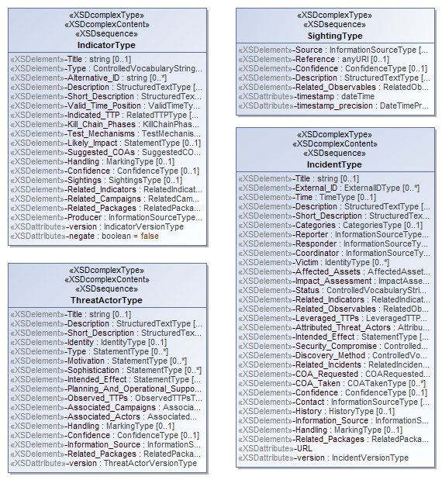
Representing the STIX physical model
<xs:complexContent>
<xs:extension base="stixCommon:IndicatorBaseType">
<xs:sequence>
<xs:element name="Title" type="xs:string" minOccurs="0">
<xs:annotation>
<xs:documentation>The Title field provides a simple title for this Indicator.</xs:documentation>
</xs:annotation>
</xs:element>
<xs:element name="Type" type="stixCommon:ControlledVocabularyStringType" minOccurs="0" maxOccurs="unbounded">
<xs:annotation>
<xs:documentation>Specifies the type or types for this Indicator.</xs:documentation>
<xs:documentation>This field is implemented through the xsi:type controlled vocabulary extension mechanism. The default vocabulary type is IndicatorTypeVocabularyType in the http://stix.mitre.org/default_vocabularies-1 namespace. This type is defined in the stix_default_vocabularies.xsd file or at the URL http://stix.mitre.org/XMLSchema/default_vocabularies/1.1.1/stix_default_vocabularies.xsd.</xs:documentation>
<xs:documentation>Users may also define their own vocabulary using the type extension mechanism, specify a vocabulary name and reference using the attributes, or simply use this as a string field.</xs:documentation>
</xs:annotation>
</xs:element>
<xs:element name="Alternative_ID" type="xs:string" minOccurs="0" maxOccurs="unbounded">
<xs:annotation>
<xs:documentation>Specifies an alternative identifier (or alias) for the cyber threat Indicator.</
XML Schema is reverse engineered into UML. Next version of STIX will have native UML model.

Slide 21
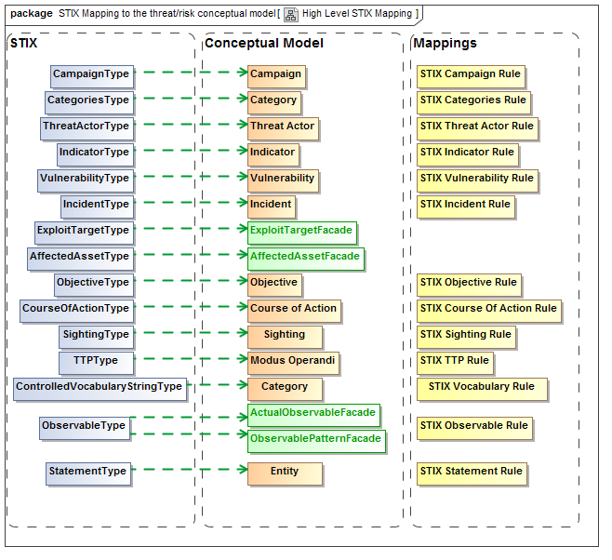
XML Element represents concept
Mapping
Rule
Represents
STIX XSD
Concepts
Green line is “Represents”
Rules specify mapping details

Slide 22
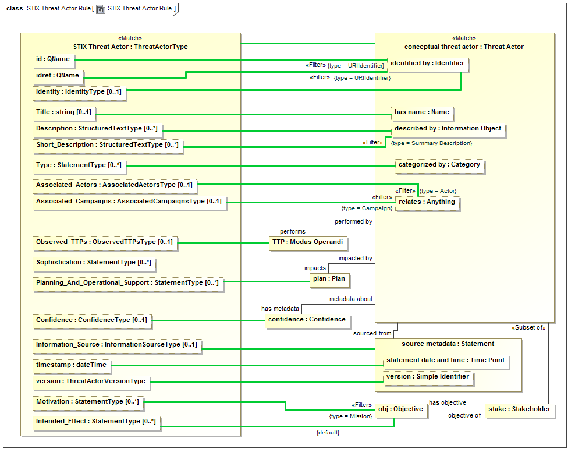

Slide 23
Example STIX source data
<stix:Incident id="example:incident-fd56fb34-af59-47b3-95cf-7baaaa53fe93" timestamp="2017-08-28T16:42:52.859547+00:00" xsi:type='incident:IncidentType' version="1.1.1">
<incident:Title>Breach of Canary Corp</incident:Title>
<incident:Time>
<incident:Incident_Discovery precision="second">2013-01-13T00:00:00</incident:Incident_Discovery>
</incident:Time>
<incident:Description>Intrusion into enterprise network</incident:Description>
<incident:Reporter>
<stixCommon:Description>The person who reported it</stixCommon:Description>
<stixCommon:Identity id="example:Identity-5db269cf-e603-4df9-ae8c-51ff295abfaa">
<stixCommon:Name>Sample Investigations, LLC</stixCommon:Name>
</stixCommon:Identity>
<stixCommon:Time>
<cyboxCommon:Produced_Time>2017-03-11T00:00:00</cyboxCommon:Produced_Time>
</stixCommon:Time>
</incident:Reporter>
<incident:Victim id="example:Identity-c85082f3-bc04-43c8-a000-e0c1d0f2c045">
<stixCommon:Name>Canary Corp</stixCommon:Name>
</incident:Victim>
<incident:Impact_Assessment>
<incident:Effects>
<incident:Effect xsi:type="stixVocabs:IncidentEffectVocab-1.0">Financial Loss</incident:Effect>
</incident:Effects>
</incident:Impact_Assessment>
<incident:Confidence timestamp="2017-08-28T16:42:52.859570+00:00">
<stixCommon:Value xsi:type="stixVocabs:HighMediumLowVocab-1.0">High</stixCommon:Value>
</incident:Confidence>
</stix:Incident>

Slide 24
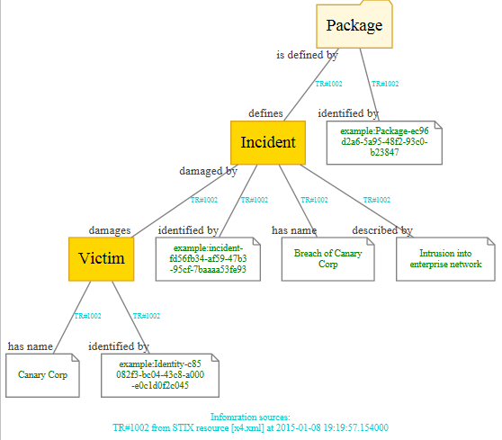
Example of mapped data graph
Provenance

Slide 25
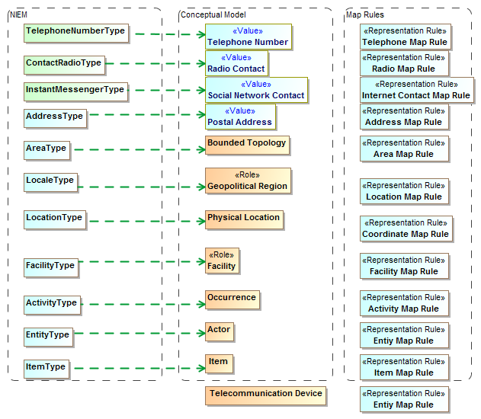
NIEM Mapping summary (1)

Slide 26
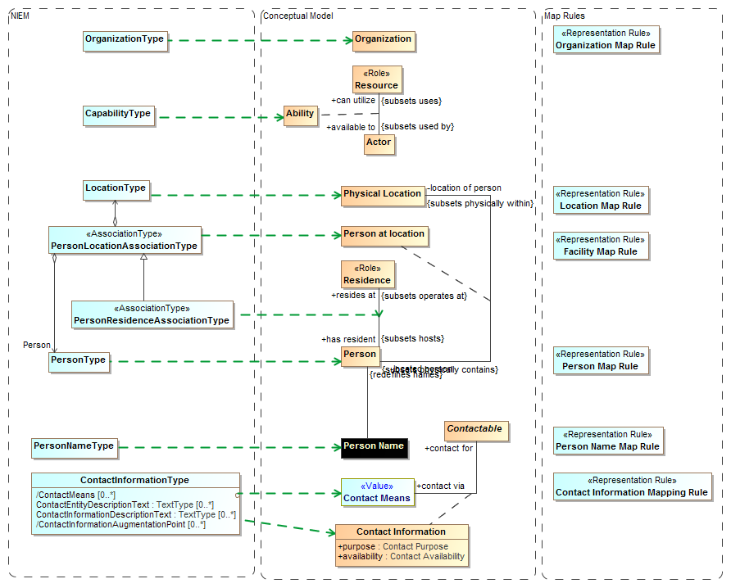

Slide 27






Forming a federation space
Integration Space
Conceptual
Reference
Models
Information Sharing
Systems Integration
Federated Analytics

Slide 28


What is needed to federate information?
User
Data
Multiple
Standard Language
SMIF
ESB
Data Exchange Connectors
Analytics
Implements
Defines
Conceptlibries .org + Yours
Conceptual Reference Model
Realizes
Semantic Mediation Engine
Federation Engine
Modeling Tool
Manages
Mapping
Model
Magicdraw
CCM
Std or User Supplied
Data Model
Graph Data Repository
RDF DBMS

Slide 29
What is in SMIF*?
Conceptual modeling language
High level concepts like entities, roles, relationships and phases
Bi-directional data / concept mapping language
Pattern based correlation
UML Profile notation & syntax (other notations anticipated)
Supported with industry tools and well known notation
Mapping to RDF/OWL (Other mappings anticipated)
Leveraging OWL ontologies for inference and RDF graphs
* Draft standard in progress in the OMG

Slide 30

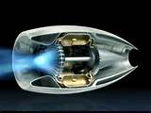
Federation Engine
Under
Construction
User & Shared
Data
Analytics
NIEM
View
STIX
View
KDM
View
Virtual & ETL Data
Conceptual
View
Semantic Mediator
(Rules, Inference & Code)
Federated Repository
RDF (Stardog)

Slide 31
What if I don’t have a federation engine?
A model semantics driven engine is the most efficient and agile
But, if you don’t have one handy
Use the mappings as a specification for “traditional” methods
Syntax mapping – e.g. XSLT
ETL Tools
Code

Slide 32
ConceptLibraries.org
Federating data and systems with concept models requires, well, concept models.
To be mapped, data elements need to be mapped through the same concept
There is no expectation of any single “true” concept model
We need to collect and curate a library of reference concepts
ConceptLibraries.org (a github site) is intended for this purpose
ConceptLibraries.org is being announced today, we invite your participations
The models are open source and intended for community use, refinement and extension
It is “seeded” with three libraries
The domain independent federated concept library
The FIBO financial business ontology
The draft OMG threat/risk model

Slide 33
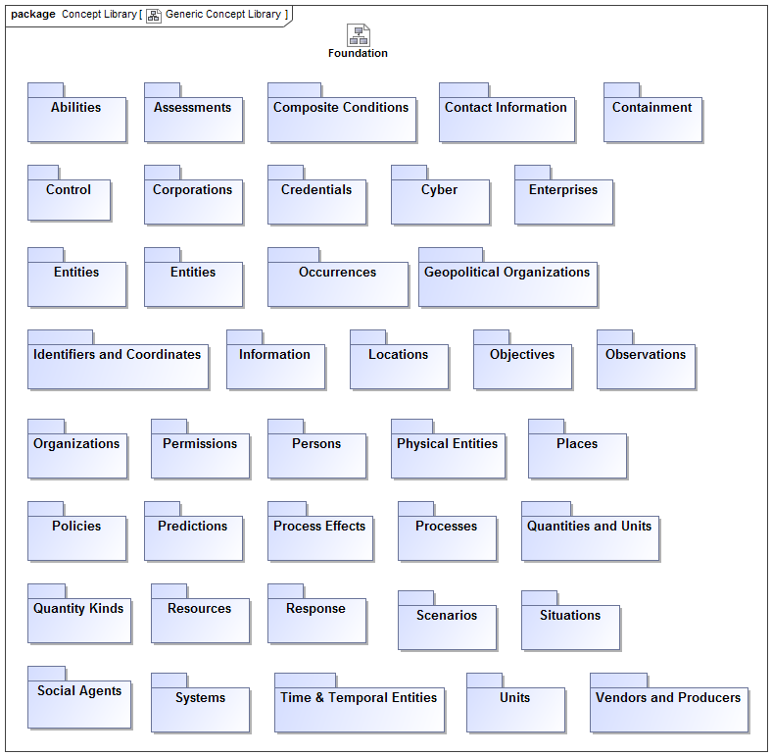

Slide 34
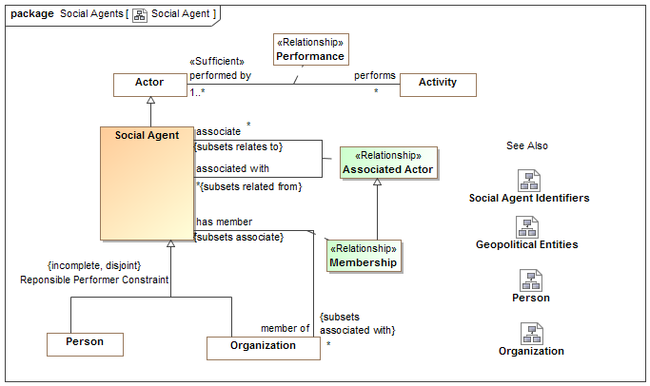
Example Concept Module

Slide 35
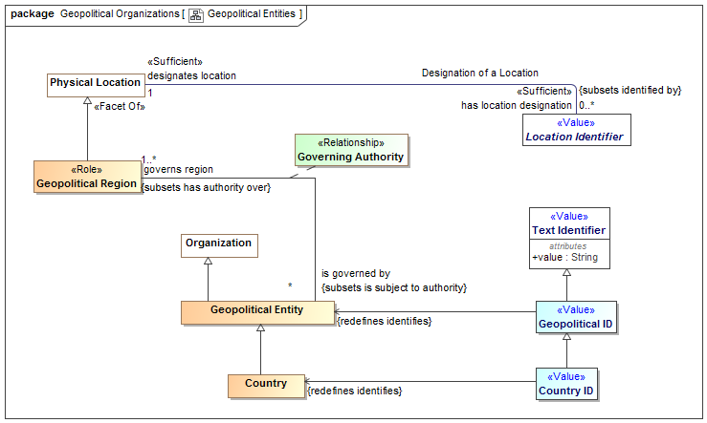
Example Concept Module

Slide 36
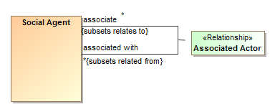
Every Concept has a Definition
Classes, relationships, relationship-ends and properties are all individual concepts
Social Agent
Model-Generated Definition:
A kind of Actor. A valid occurrence may have the following properties:
constrained by any number of occurrences of Policy.
Definition: An actor that may have responsibilities - people and organizations. Actors in general may include automated entities and even, in some context, animals. Social agent excludes these other kinds of actors by including (at this time) only people and organizations. What responsibilities a particular person or organization may have at any particular time is the subject of law and social constructs. A social agent is distinguished in that a person or organization may have such responsibilities in their lifetime. [NIEM] EntityType [DOLCE] Social Agent
Social Agent:

Slide 37
Summary
The combination of:
The SMIF standard-in-progress
Magicdraw-CCM
Reference concept libraries
Mappings to data formats of interest
Runtime federation engine
Provides the foundation for a wide-scale information federations, sharing and analytics capabilities
Consider pilot projects to prove this capability in your environment.
Consider participating in extending and refining concept libraries.
Contact: Cory Casanave: cory-c@modeldriven.com

Slide 38
Backup

Slide 39
Comparing SMIF and OWL
SMIF
OWL
Conceptual models defined for federation
Focus on understandable domain concepts
Includes mapping language - Assumes data is “messy”
N-Ary first class relationships
Provides for common restrictions and assertions
Context as a first-class concept
Intended to cross viewpoints
UML Profile understandable
Defines needed domain “meta concepts” like roles , phases and units
OWL can be generated and augmented
Ontologies defined for general inference
Focus on inference
Has no mapping language - Assumes data is consistent
Directed “triples” without identity
Provides more general restrictions and assertions
Limited to first order concepts
Intended to represent a viewpoint
UML Profile difficult
Common domain meta concepts are not part of the language
OWL is base language

