Slide 1

Semantic Information Modeling for Federation
SIMF
OMG Architecture Ecosystem / ADTF
April 2016
Cory Casanave

Slide 2
What is SIMF?
Semantic Information Modeling for Federation is an in-progress standards process within OMG
The goal of SIMF is to provide the modeling capabilities to support information federation by leveraging conceptual and logical information modeling with model bridging relations
An important goal of SIMF is to extend the economic lifecycle of many existing running systems that were conceived and built in a time when there were insufficient true conceptual capabilities, by explicitly adding the often implicit semantics and linking the running data representations with a true conceptual model.
Another important goal of SIMF is not to replace any existing standard language but to build bridges between the SIMF Conceptual Schema and the various standard languages such that the users can save substantial amounts of money in their integration and federation efforts.
Issued Dec 2011 - OMG Document: ad/2011-12-10

Slide 3
Proposition
Problem statement
Federation (information sharing, interoperability, shared services, etc.) is the problem of this decade – it is costing productivity, lives and billions trillions of dollars annually. It is the pre-requisite to solving many problems in the large. It is a problem faced by most CIOs in government and industry.
We are calling this the “data problem”
A problem not solved…
None of the standards we have directly target this problem. Not: UML, OWL, LoD, E/R, SOA, DoDAF, XML Schema, Common Logic or SBVR , etc.
With all these solutions – we still have a pervasive problem!
While not ideal, the standards above can and are used for federation, but, they are all built for other purposes and repurposed to solve the data problem. Experts can pull these technologies together to solve a specific problem, we want to make it easy to do so with an integrated and standardized approach supporting mainstream solutions and internet-scale federation.
We can make a substantial dent in the data problem with new standards derived from current technologies and practices. This is the “SIMF” Initiative.

Slide 4
SIMF Principles
The intent of SIMF is not to replace other standards but to make it economically more feasible that various standards can cooperate.
In that sense SIMF is not a competitor to any existing OMG standard.
It is the aim of SIMF to extend the economic life of existing applications as well as to support new applications
It is the intention of the submission team to extensively test the proposed standard set of concepts and languages before submission and make the test results available.
SIMF does use conceptual models (reference models) as “pivot points” between different representations.
SIMF does assume that some concepts will be agreed on by some communities as some agreement is required for any communication.
SIMF does not assume any universal or all encompassing conceptual model

Slide 5
Pivoting through a conceptual model
The conceptual pivoting approach
A common and growing approach to the data problem leverages abstraction: Defining a domain focused vocabulary with integrity rules and assertions as part of a conceptual model that captures domain semantics. Federation and integration is achieved by relating various logical and physical information structures to the conceptual model
Information federation and integration is achieved via a “pivot” through this conceptual semantic layer
This approach is used, in part, in existing standards such as CCTS (Core Components), ISO 20022 and is currently being utilized in OMG for finance.
In the majority of cases the “tool” used to represent these common semantics and links is a spreadsheet, but UML and OWL are also used.

Slide 6
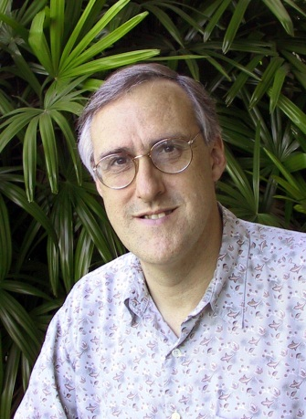
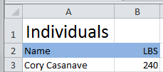

Example of “Pivoting” through a conceptual model
Concept of
“Cory Casanave”
There is an actual “Person”, Cory Casanave
There is a concept of this person shared in this room, right now
Here is one representation of him
“Person” is a shared concept, independent of data structures
There may also be shared agreement that Cory is a person and some other “facts”
“Cory Casanave” is a name for this person
He weighs 240 LBS
There are multiple data representations about Cory Casanave which may or may not agree
Those representations can be grounded in concepts (semantics), assisting federation
Concept of a
“Person”
<PersonType>
<NameText>Cory B. Casanave</NameText>
<Weight-LBS>234</Weight-LBS>
</PersonType>
XML
Representations
.
Excel
UML

Slide 7
SIMF Architecture
Model Bridging Relations
Subject focused conceptual models define the concepts, predicates, integrity rules and terms of a domain that can be related to each other
Kernel
Conceptual Domain Models
SIMF Scope
Solution focused logical information elements represent information structures and integrity rules that can use and extend other information
Logical Information
Models
Technology focused physical data schema are grounded in logical data models which define their context and semantics
Physical Data Schema

Slide 8
SIMF Components – conceptual models and mappings
Meta Model
Conceptual Modeling MetaModel
Mapping MetaModel
Schema Model
Depends On
Map To
View of
View of
View of
UML Representation
Conceptual Modeling UML Profile
Mapping UML Profile
Schema Model
(From IMM)
Depends On
Map To

Slide 9
Comparing SIMF and OWL
SIMF
OWL
Conceptual models defined for federation
Focus on understandable domain concepts
Includes mapping language - Assumes data is “messy”
N-Ary first class relationships
Provides for common restrictions and assertions
Context as a first-class concept
Intended to cross viewpoints
UML Profile understandable
Defines needed domain “meta concepts” like roles , phases and units
OWL can be generated and augmented
Ontologies defined for general inference
Focus on inference
Has no mapping language - Assumes data is consistent
Directed “triples” without identity
Provides more general restrictions and assertions
Limited to first order concepts
Intended to represent a viewpoint
UML Profile difficult
Common domain meta concepts are not part of the language
OWL is base language

Slide 10
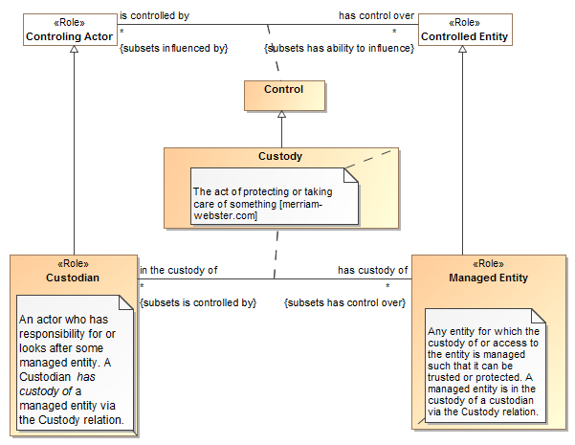
Example Snippet

Slide 11
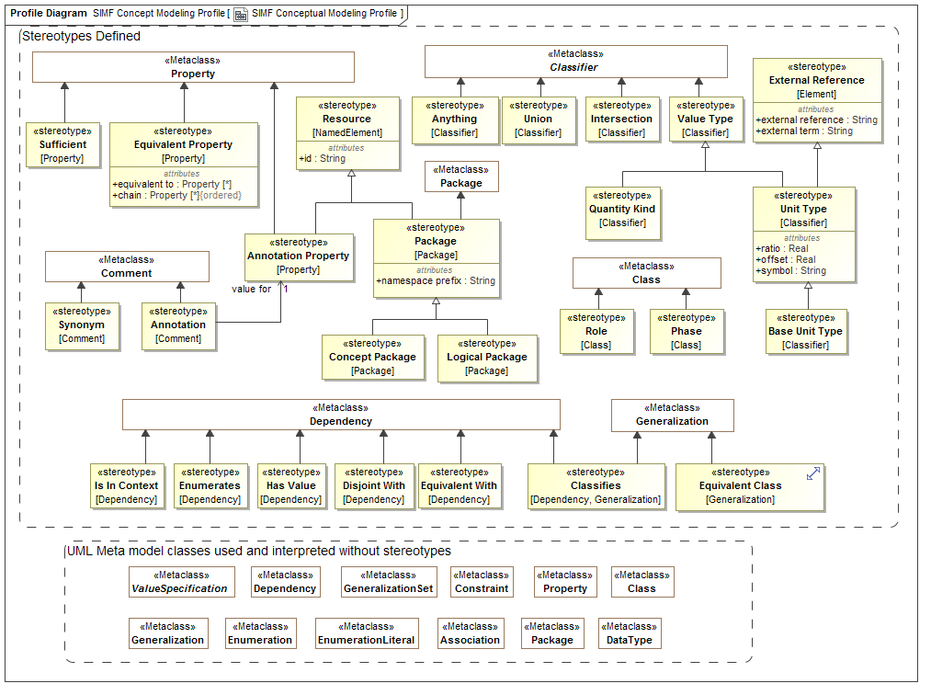

Slide 12
Mappings
Pattern based
Bi-directional
1..n mappings, pivoting through conceptual models

Slide 13
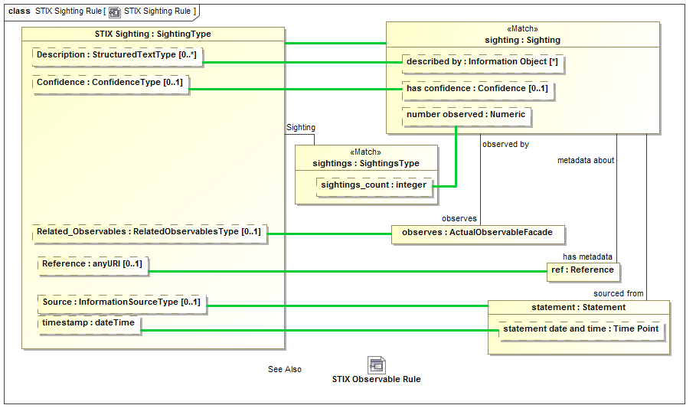
Mapping Example

Slide 14
