Slide 1
Semantic Information Modeling for Federation
SIMF
Cory Casanave
Jim Logan (jlogan@nomagic.com)
With Examples in Cameo Concept Modeler

Slide 2
Where we are
We are nearing completion of SIMF
It is needed as a foundation for both threat/risk and FIBO, which also provide examples of use
We have focused on the requirements demonstrated by these two initiatives
We are asking for another revised submission in September and then a vote
We are asking for review and input to start now, to facilitate easier adoption in September.
Areas still improving
Formalization of the kernel
OWL mapping
Refinement of terminology
Mapping prototype
Better support for OntoUML

Slide 3
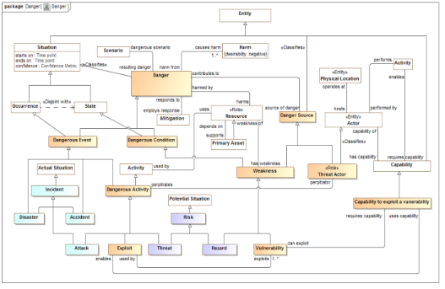
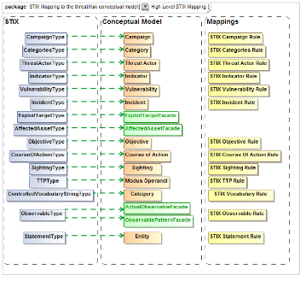
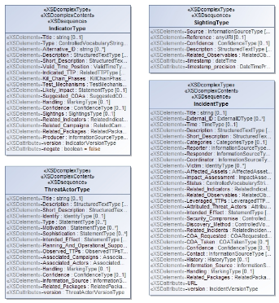
SIMF for semantic mediation
We need to understand
What are the common concepts
How do the various information syntaxes represent those concepts
What are the rules for translating between them in various context
Information
Syntax
Represents
Common Concepts
Information
Syntax
Represents
Represents
Information
Syntax
Conceptual Model
Mapping Rules
Information Model

Slide 4
Conceptual Models for Mappings and Federation
What are the requirements for conceptual modeling in support of federation?

Slide 5
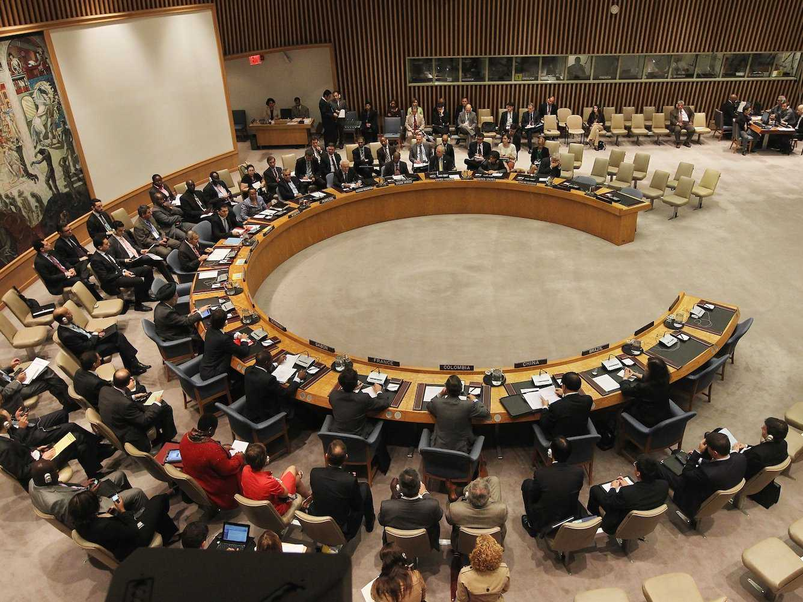

Role of the interpreter

Slide 6
What we expect of interpreters
Retention of meaning across languages, communities and cultures
Communicate what is said without judging, coloring or filtering it
Interpreters have substantial preparation, learning syntax, grammar, vocabulary and cultural idioms.
Interpreters can only communicate what they understand and what can be understood in the languages they deal with – the common concepts
They then communicate what other people said based on how those concepts are expressed in different languages – they communicate the provenance
Interpreters are preforming semantic mediation
Common concepts

Slide 7
Implications for the role of semantic mediation
Semantic mediation does
Capture shared concepts, this includes types, relationships, individuals and other concept kinds
Define a relationship between patterns of these concepts and patterns of data representations – it is not a word for word translation
Respect the context of the concepts and rules
Maintain the provenance of information
Semantic mediation does not
Define applications that produce or consume information
Assert policy about what is “right”, “common” or “legal”
Structure information for a stakeholders perspective
Filter for “data quality”

Slide 8
Implications for SIMF
Conceptual models and mappings, intended for the federation role
Should use stakeholder relevant terms and concepts presented in an understandable way
Should have minimal commitment – only committing to what is necessary to understand and “map” information. E.g. specific units or data representations
Should keep application specifics out of the concepts – how the information is developed is not our concern.
Should contain both the “most generic” sense of a concept as well as any specialization required for precise communications
Mappings should be able to be “mixed and matched” with multiple concept modules based on context
Should only contain semantics that have a “ROI” for federation.
E.g. should not be implementing “business rules”, it is up to the “end applications” to enforce rules prior to mediation
Conclusion: Conceptual models for federation may be a subset of (simpler than) conceptual models or operational ontologies intended for applications. Their semantics only need to support the mapping rules for representations.

Slide 9
What is a “Threat Actor”
Example from “Operational threat/risk”

Slide 10
What is a threat actor? (Dictionary)
A threat actor, also called a malicious actor, is an entity that is partially or wholly responsible for an incident that impacts – or has the potential to impact -- an organization's security.

Slide 11
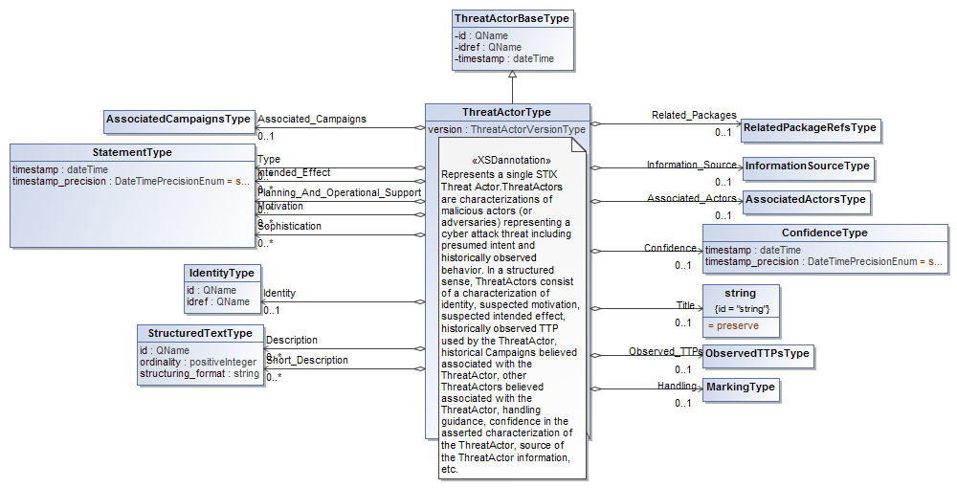
What is a threat actor? (STIX)
STIX is a large XML Schema

Slide 12
What is a threat actor? (FBI)
The Federal Bureau of Investigation has identified three categories of cyber threat actors:
“ [1] organized crime groups that are primarily threatening the financial services sector, and they are expanding the scope of their attacks; [2] state sponsors — foreign governments that are interested in pilfering data, including intellectual property and research and development data from major manufacturers, government agencies, and defense contractors; and [3] increasingly there are terrorist groups who want to impact this country the same way they did on 9/11 by flying planes into buildings. They are seeking to use the network to challenge the United States by looking at critical infrastructure to disrupt or harm the viability of our way of life.[1]

Slide 13
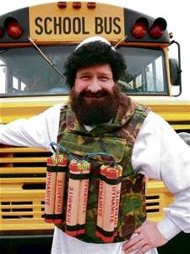
Is this a threat actor?
Threat
Actor?
Our conclusion: Only the “real world” perspective can provide a pivot point between different representations.
Instances of a conceptual “threat actor” are real threat actors, not data about them as data is structured for its application purpose.

Slide 14
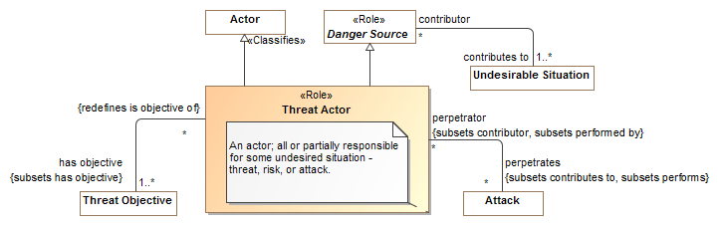
What is a threat actor? (Threat Model)

Slide 15
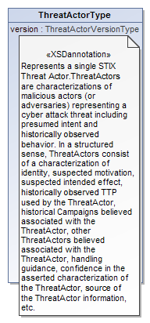
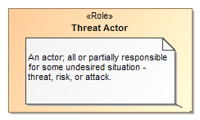

Data represents concepts
Represents
Model Representation

Slide 16
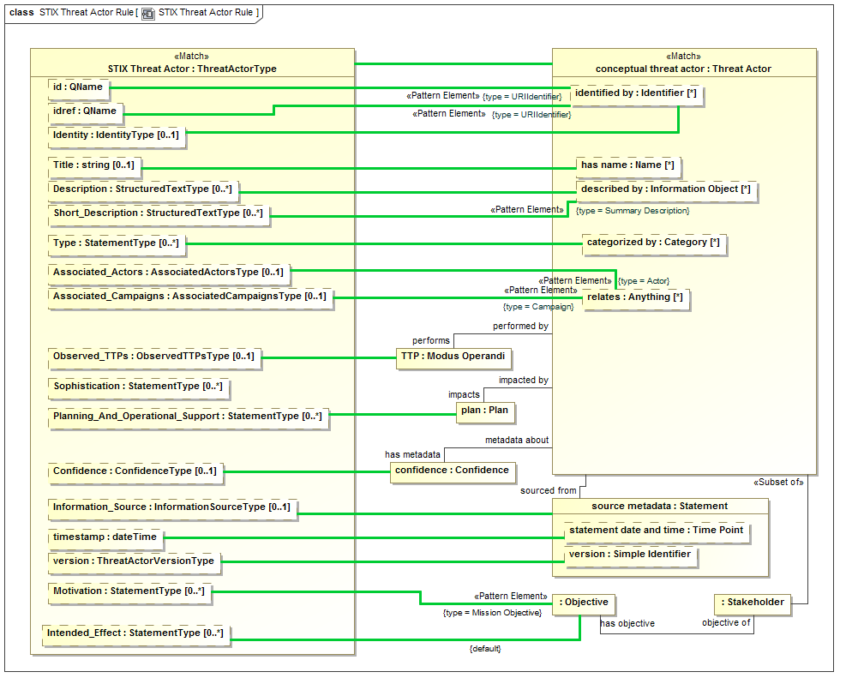
Example Only

Slide 17
SIMF Components – conceptual models and mappings to schema
SIMF Conceptual Meta Model
SIMF Conceptual Metamodel
Mapping Metamodel
SIMF Information Metamodel
Depends On
Map To
Represents
Represents
Represents
UML Representation
Conceptual Modeling UML Profile
Mapping UML Profile
Schema Profile
Depends On
Map To

Slide 18
Important conceptual modeling and mapping capabilities
As easy as possible for domain stakeholders to understand the models as diagrams, tables or text
“First class” n-ary relationships that may have properties and participate in other relationships
Recognition and representation of time and context – most relationships are only true for a limited time and in specific situations
Roles, phases and other “non rigid” classifications that also may be time or situationally dependent
Hierarchies of types, relationship types and properties
Business values as represented by various systems of units
Patterns as a basis for real-world situations as well as mapping rules
Note that while some of these features may be difficult for generic FOL reasoners, they are practical for specific conceptual model and mapping rules

Slide 19
Ontology Summit: Semantic Interoperability Communique
This years Ontology Summit focused on “Ontologies within Semantic Interoperability Ecosystems ”. Full document: http://tiny.cc/Ontolog2016
Supports the value proposition of SIMF
“The United States spent nearly $3.0 trillion on healthcare in 2014 [ . . . ] the efficient use of health information technology will result in considerable cost savings, in addition to saving thousands of lives per year”.
Supports the need for capabilities not currently provided, focused on semantic interoperability
"More mature conceptual modeling & knowledge engineering tools are required to support the design, development and storage of ontologies and vocabularies. [ . . . ] these should be integrated into software development and data management tools that provide support across the IT lifecycle and related operations.“
"There was broad consensus within the Summit that improved software tools and environments are required to support the integration of concepts and data."

Slide 20
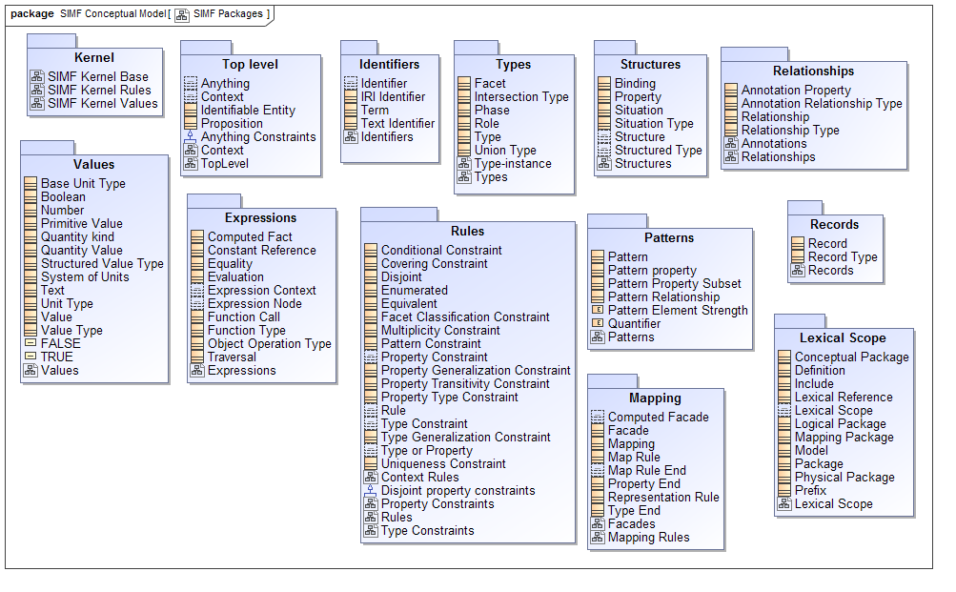
SIMF Meta Model Packages

Slide 21
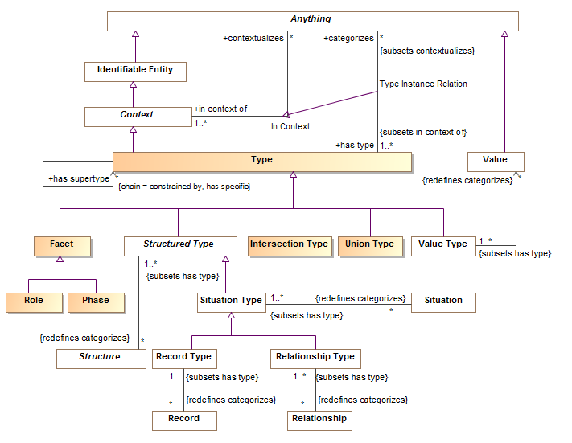

Slide 22
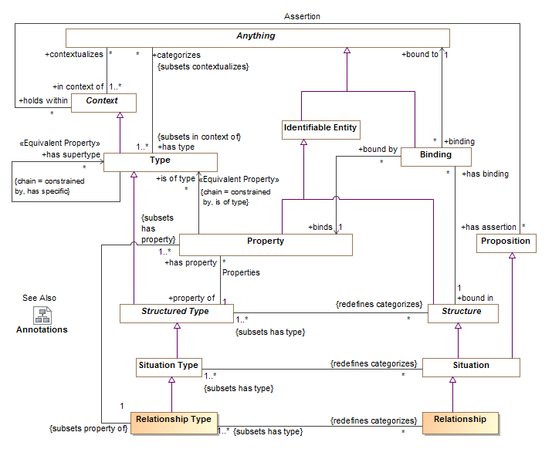

Slide 23
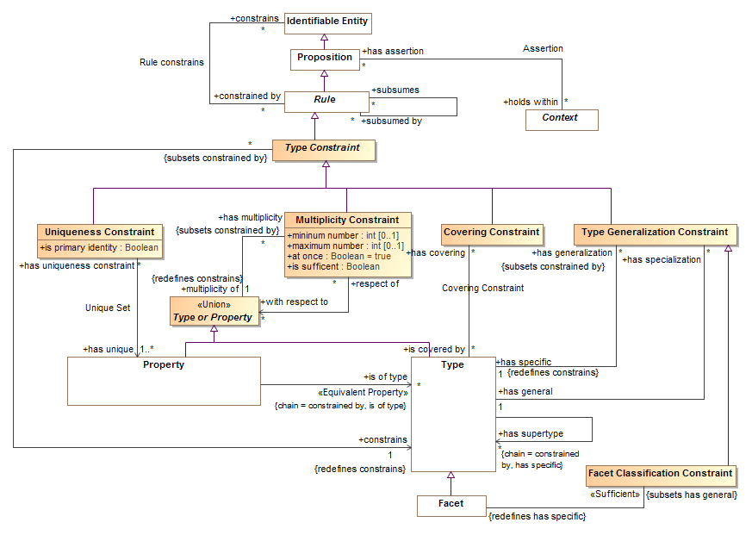
Rules
Type Constraints
14 point

Slide 24
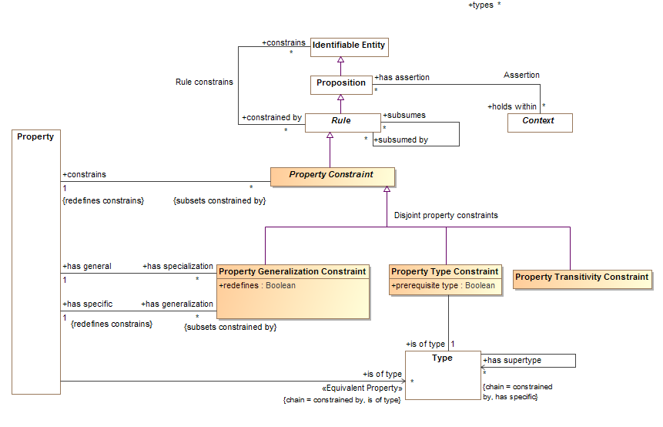
Property Constraints

Slide 25
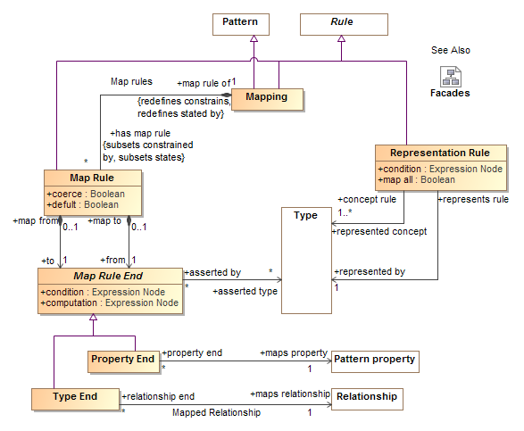
Mapping Rules

Slide 26
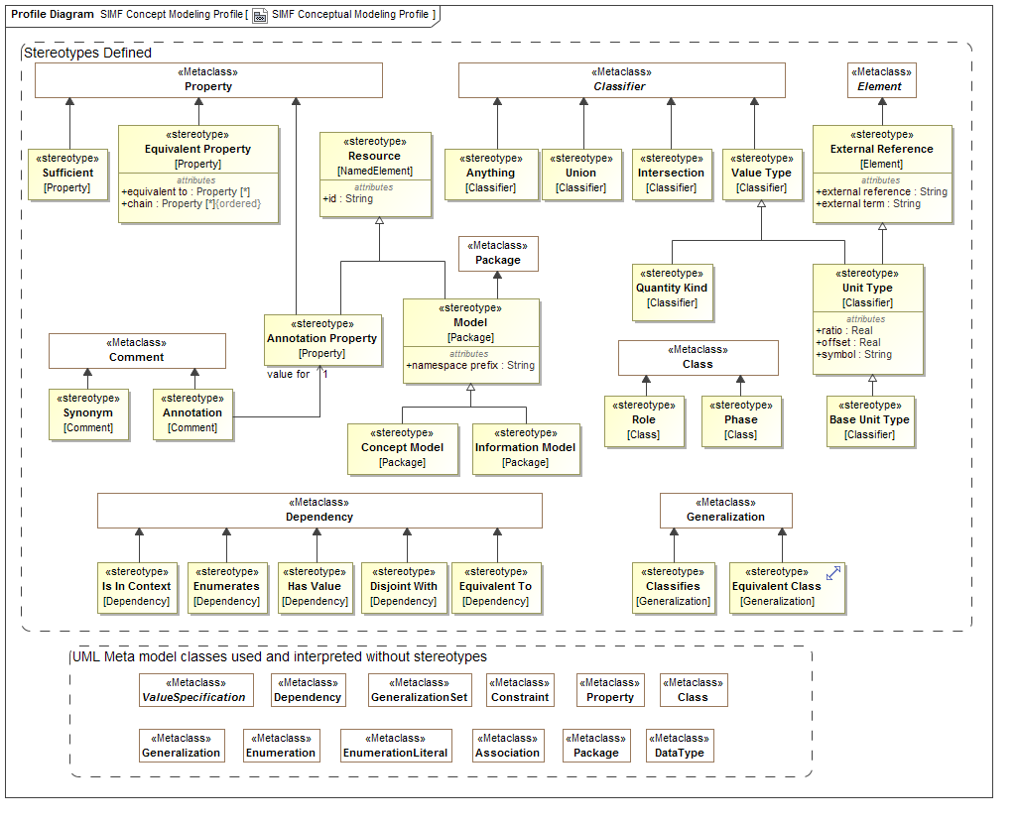
Conceptual Model Profile

Slide 27
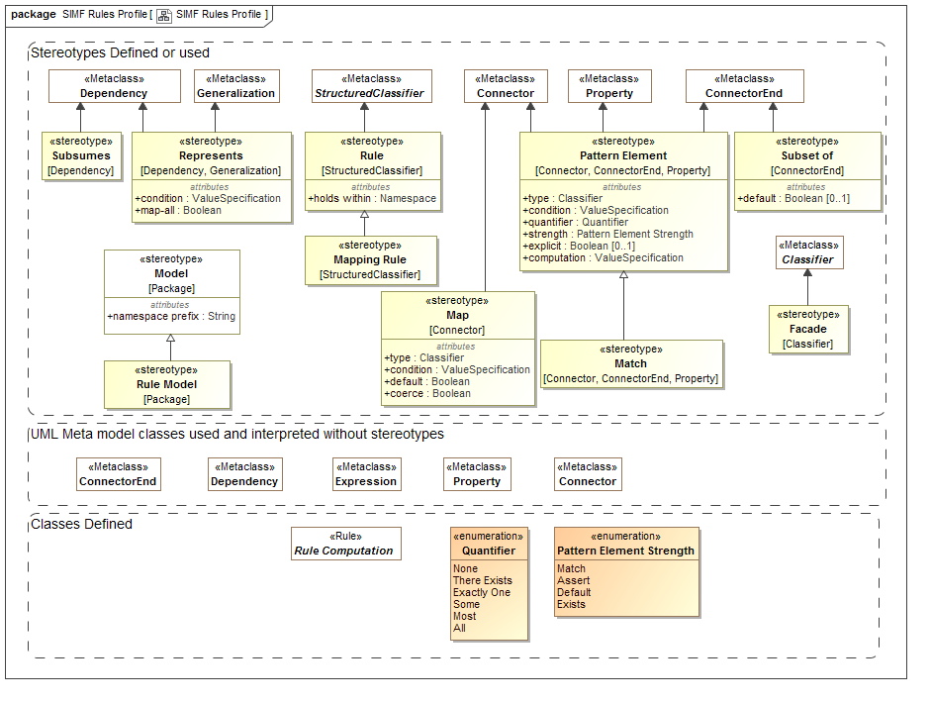
SIMF Rules Profile

Slide 28
SIMF Conceptual Modeling Profile
Jim Logan

