Slide 1

Semantic Modeling Information for Federation
SMIF
Cory Casanave
Jim Logan

Slide 2
Where we are
We are nearing completion of SIMF, but we didn’t get as much done over the summer as we would have liked.
It is needed as a foundation for both threat/risk and FIBO, which also provide examples of use. Ability to represent existing FIBO has been validated by importing existing ontologies and exporting OWL.
We have focused on the requirements demonstrated by these two initiatives
We are asking for another revised submission May 8th
We are asking for review, participation and input to start now, to facilitate easier and faster adoption
Available as OMG Document: ad/2016-12-01 and 02
Areas still improving
Formalization of the kernel, both grounding in upper ontologies and use of rules
OWL mapping – both “SMIF Full” and “SMIF Lite”
More extensive documentation with worked examples

Slide 3
What is needed in SMIF to solve the problems faced for threat and risk information federation?
Chains of causation, enablement and dependency for entities and the relationships between them
Source, trust and likelihood of information at a fine-grain level
Roles and phases of people places and things – dynamically assigned but about a common individual identity
Understanding of when things are true and under what context, particularly for relationships
Understanding patterns for mediating actions as well as mapping
Mapping of data thought the conceptual reference model

Slide 4
Causation and dependency example
Interdependent situations
Sue’s Purse left open
Key-card stolen
Allows entry to building 5
Electric Grid System has vulnerability to virus KX555
KX555 Virus can be inserted via USB stick
Node of Electric Grid system is in building 5
Source and trust in information
Key card was disabled by Sam 4 hours after report of loss
Next day, Sam was fired for falsifying reports
Recognizing a pattern and responding
Recognize “indicator” of system at risk
building and “enclosed” system was vulnerable for time period
Respond with initiating remediation action
Make sure key-card was canceled
Deep system diagnostics to detect potential virus

Slide 5
What can we deduce for this?
Every “fact”: event, situation, relationship, characteristic, entity
Are parts of these chains of causation and dependency
Are temporal – exist for specific timeframes
Are subject to attack
Are fundamental to business rules and policies
Can be referenced in patterns and actual situations
The world is not “flat”, change is fundamental
With very few exceptions, relationships are “first class” and temporal
Think “association classes” in UML with temporal relationships
Data that is to be integrated is contextual and time can not be ignored
Need what is called “4D” capabilities in ontologies, but simplified
But, it is not our job, in this specification, to reason over such facts – our job it to make sure these facts are accurately federated and translated

Slide 6
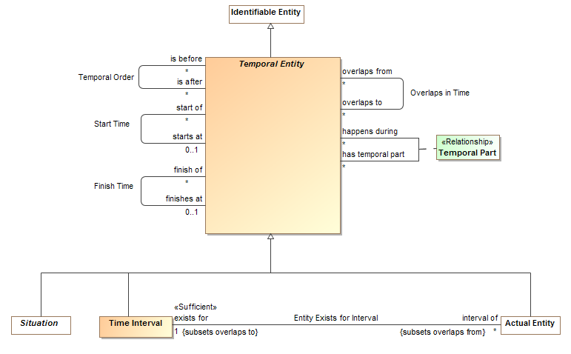
Taking time into account

Slide 7
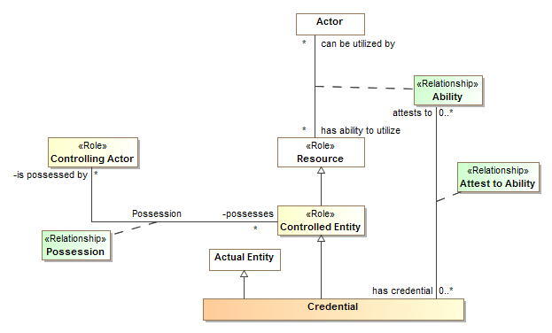
Modeling with first class relationships
(Note that relationships are temporal entities)

Slide 8
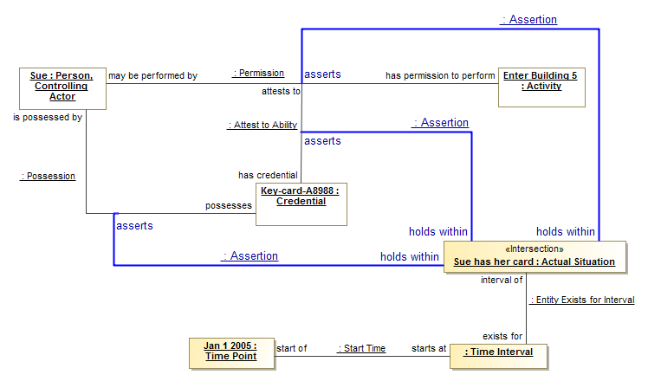
Situations capture “truth” in context (any such truth is subject to trust and likelihood)

Slide 9
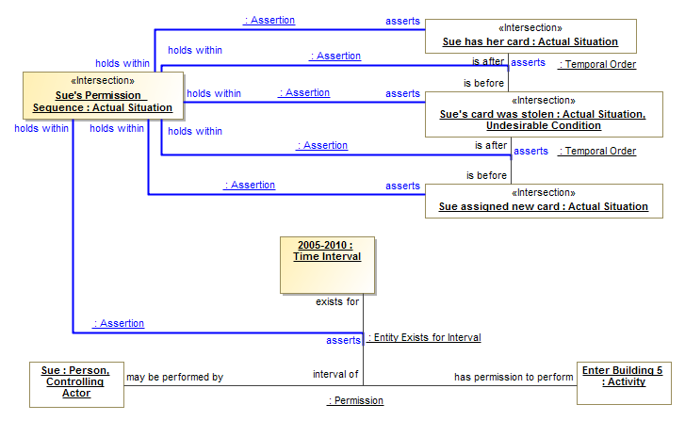
We must represent the relationships between situations, in other situations

Slide 10
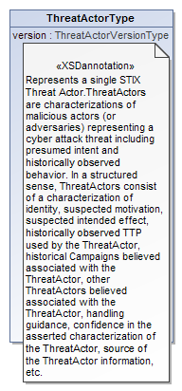
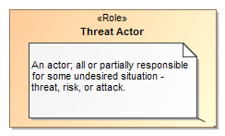

Data represents concepts
Represents
Model Representation

Slide 11
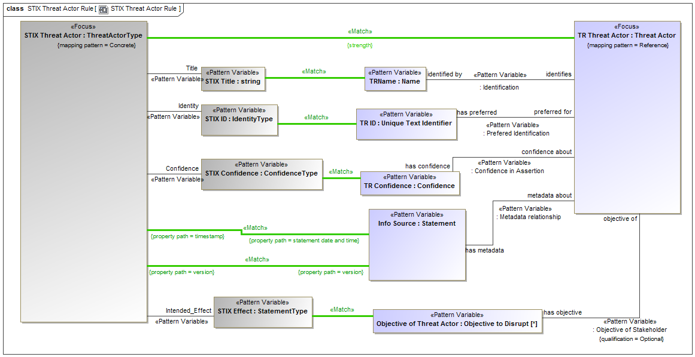
We then need to map these concepts
Patterns of concrete data structures to patterns of reference concepts

Slide 12
Comparison with OWL-DL
It is possible to create patterns in OWL to represent these kinds of concepts.
But that is different from how OWL is normally used, to represent a “snapshot” in time that is “true” universally and for all time.
For our needs this “context free” owl is insufficient.
A “full” mapping to OWL requires reification of relationships and contextual assertions (as seen in situations). This can then be validated using OWL, but it is of limited use for OWL reasoning.
Implementing the mappings (which is our purpose) would best be done with rule engines or procedural code, but it could operate over an RDF graph or MOF instances.
For other purposes a “SMIF Lite” mapping to OWL can provide more typical OWL, by making a “snapshot” assumption in a fixed context. This is what is being used for FIBO.

Slide 13
SMIF in FIBO
The Cameo Concept Modeler (CCM) is a subset of SMIF-Lite
The FIBO team has been using CCM:
To validate FIBO OWL models with SMEs
To author new OWL models
Working with the FIBO team is giving us insight into:
“fitness for purpose” for conceptual modeling and validation
Identifying and enforcing “best practices” for resulting ontologies
High-level patterns
Identifying gaps (e.g., cascading restrictions)
This experience has proved out SMIF-Lite

Slide 14
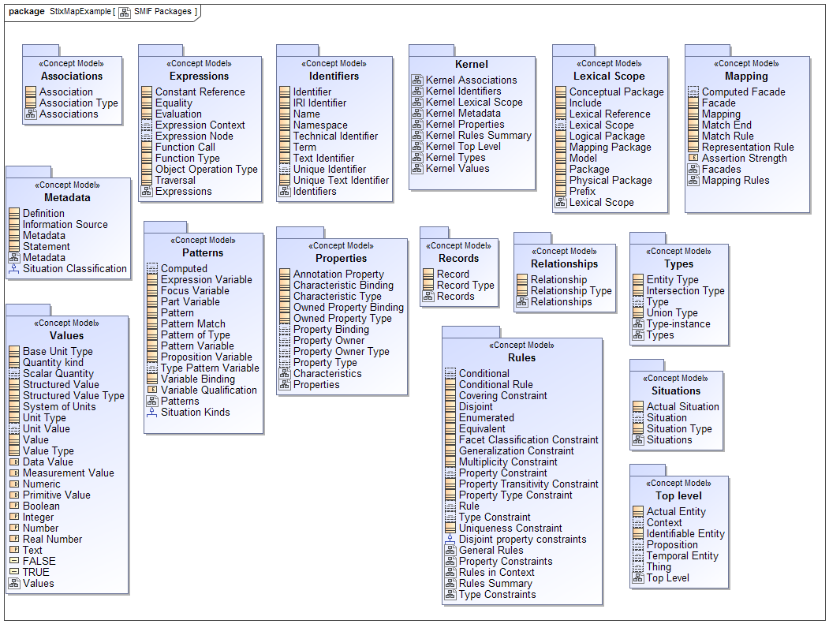

Slide 15
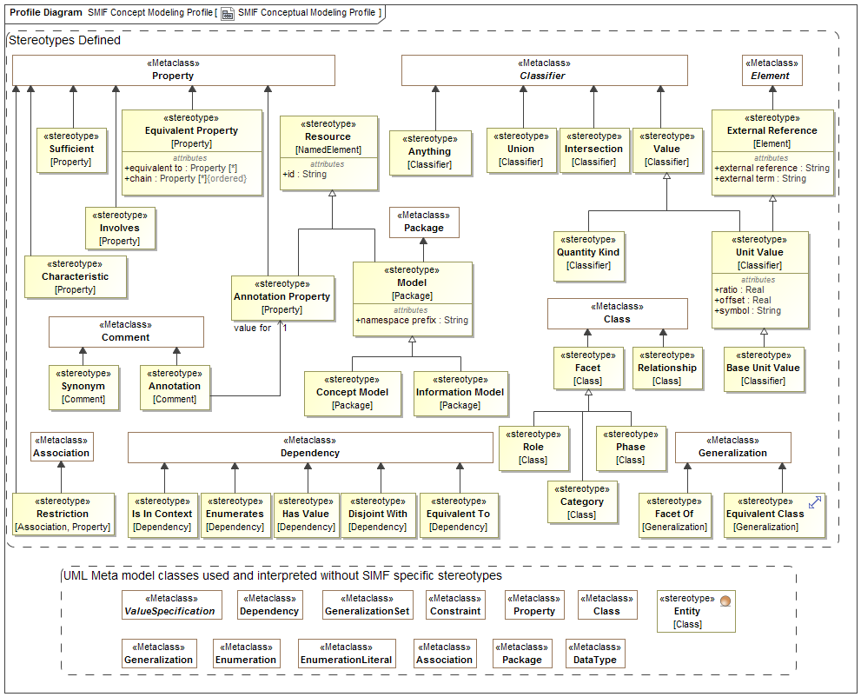

Slide 16
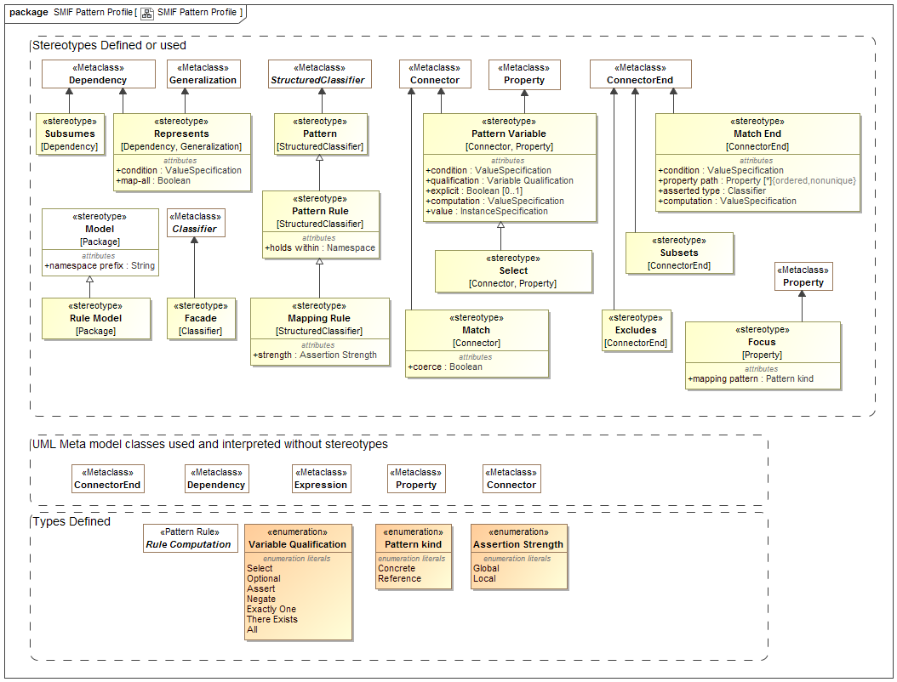

Slide 17
What has changed?
Addition of “Association” and “Characteristic” as well as first-class relationship
Some simplification of mapping model and changes in profile do to “discovered” UML constraint
Much more documentation on semantics and references to formal models
Critical review of model

Slide 18
Still to do
Formalize OWL mappings
Possible Rules Model
Continued improvement of documentation
Compare terminology to UML and OWL

Slide 19
Motion
Revised submission date: May-8

