Slide 1
Foundational Ontology and Conceptual Data Modeling: The OntoUML approach
Giancarlo Guizzardi
Computer Science Department
Federal University of
Espírito Santo (UFES),
Brazil
SIMF Team Meeting
Part 1

Slide 2
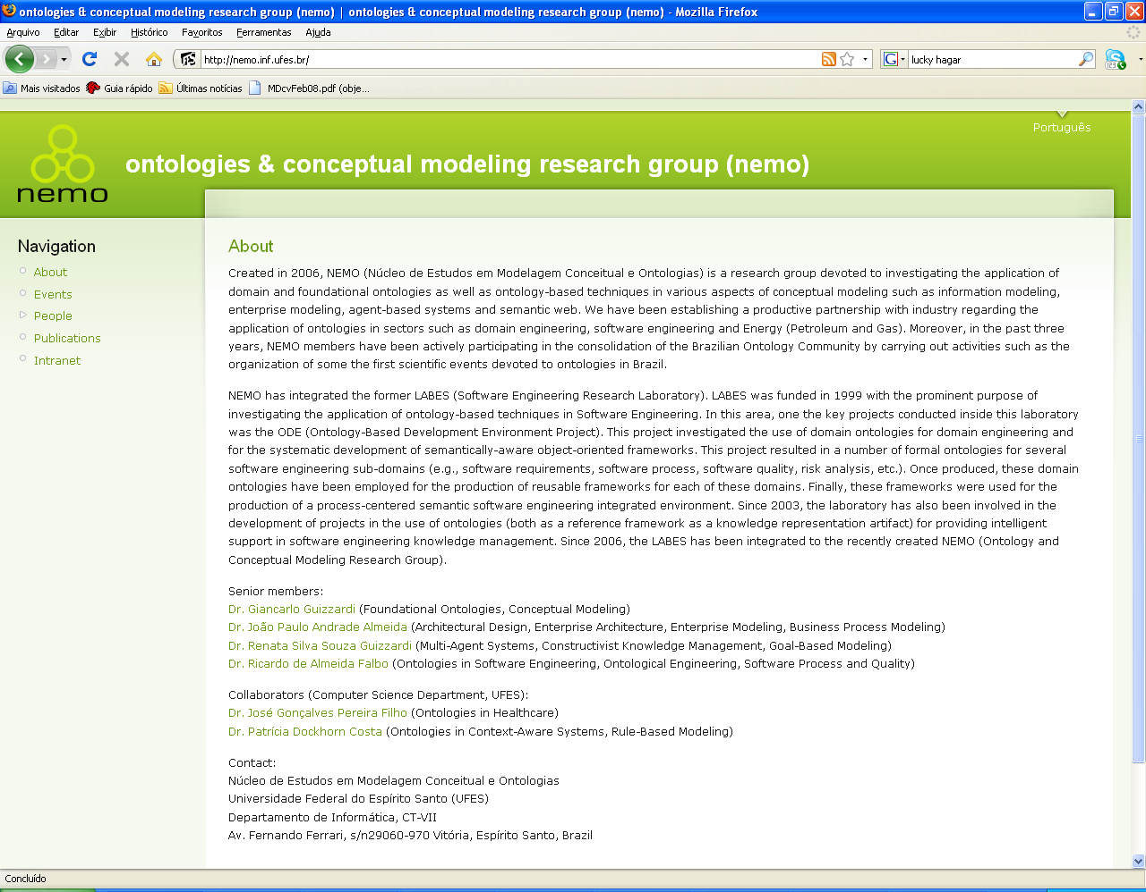
http://nemo.inf.ufes.br/

Slide 3
“What are ontologies and why we need them?” [1]
Reference Model of Consensus to support different types of Semantic Interoperability Tasks
Explicit, declarative and machine processable artifact coding a domain model to enable efficient automated reasoning

Slide 4
We need to recognize that There is not Silver Bullet! and start seing ontology engineering from an engineering perspective

Slide 5
What is Conceptual Modeling?
“the activity of formally describing some aspects of the physical and social world around us for purposes of understanding and communication…Conceptual modelling supports structuring and inferential facilities that are psychologically grounded. After all, the descriptions that arise from conceptual modelling activities are intended to be used by humans, not machines... The adequacy of a conceptual modelling notation rests on its contribution to the construction of models of reality that promote a common understanding of that reality among their human users.”
John Mylopoulos

Slide 6
A Software Engineering view…
Conceptual Modeling
Implementation₁
Implementation₂
Implementation₃

Slide 7
A Software Engineering view…
Conceptual Modeling
DESIGN
Implementation₁
Implementation₂
Implementation₃

Slide 8
…transported to Ontological Engineering
Ontology as a
Conceptual Model
Ontology as
Implementation₁
(SHOIN/OWL-DL,
DLR_{US})
Ontology as
Implementation₂
(CASL)
Ontology as
Implementation₃
(Alloy, F-Logic…)

Slide 9
…transported to Ontological Engineering
Ontology as a
Conceptual Model
DESIGN
Ontology as
Implementation₁
(SHOIN/OWL-DL,
DLR_{US})
Ontology as
Implementation₂
(CASL)
Ontology as
Implementation₃
(Alloy, F-Logic…)

Slide 10
2. We need ontology representations languages which are based on Truly Ontological Distinctions

Slide 11
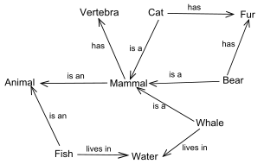
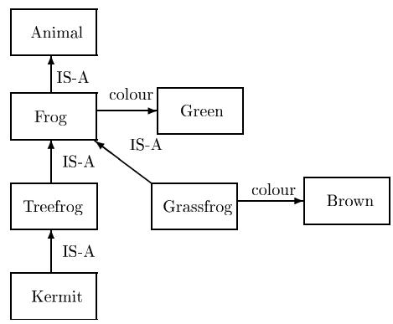
Semantic Networks
(Collins & Quillian, 1967)

Slide 12
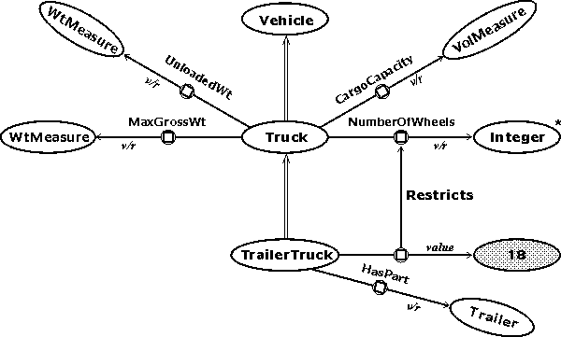
KL-ONE (Brachman, 1979)

Slide 13
KL-ONE (Brachman, 1979)
Todos os TrailerTrucks são Trucks
TrailerTrucks tem NumberOfWheels=18
Notes:
Tipos traduzidos em predicados e axiomas

Slide 14
The Logical Level
∃x Apple(x) ∧ Red(x)

Slide 15
The Epistemological Level
Apple
Red
color = red
sort = apple

Slide 16
The Epistemological Level
Why ???
Apple
Red
color = red
sort = apple

Slide 17
The Ontological Level
sortal universal
characterizing
Universal
Apple
Red
color = red
sort = apple

Slide 18
Formal Ontology
To uncover and analyze the general categories and principles that describe reality is the very business of philosophical Formal Ontology
Formal Ontology (Husserl): a discipline that deals with formal ontological structures (e.g. theory of parts, theory of wholes, types and instantiation, identity, dependence, unity) which apply to all material domains in reality.

Slide 19
Foundational Ontology
We name a foundational ontology the product of the discipline of formal ontology in philosophy
A foundational ontology is a formal framework of generic (i.e. domain independent) real-world concepts that can be used to talk about material domains.

Slide 20


Slide 21


Slide 22
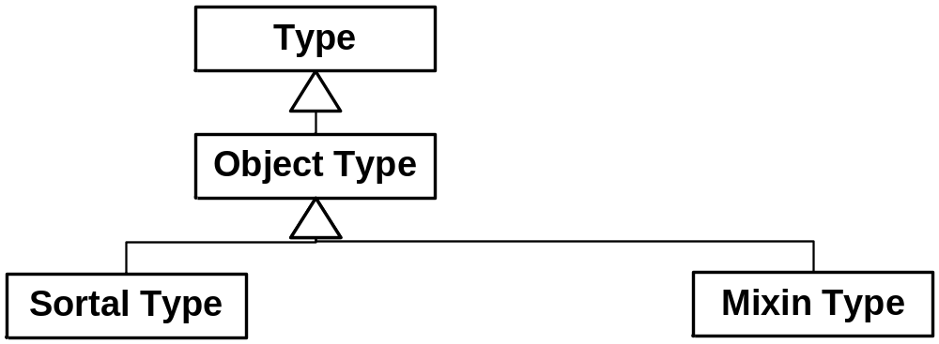
Distinctions Among Object Types [2]
{Person, Apple}
{Insurable Item, Red}

Slide 23
Rigidity
A type T is rigid if for every instance x of T, x is necessarily (in the modal sense) an instance of T. In other words, if x instantiates T in a given world w, then x must instantiate T in every possible world w’:
R(T) =_{def} □(∀x T(x) → □(T(x)))

Slide 24
Anti-Rigidity
A types T is anti-rigid if for every instance x of T, x is possibly (in the modal sense) not an instance of T. In other words, if x instantiates T in a given world w, then there is a possible world w’ in which x does not instantiate T:
AR(T) =def □(∀x T(x) → ◊(¬T(x)))

Slide 25
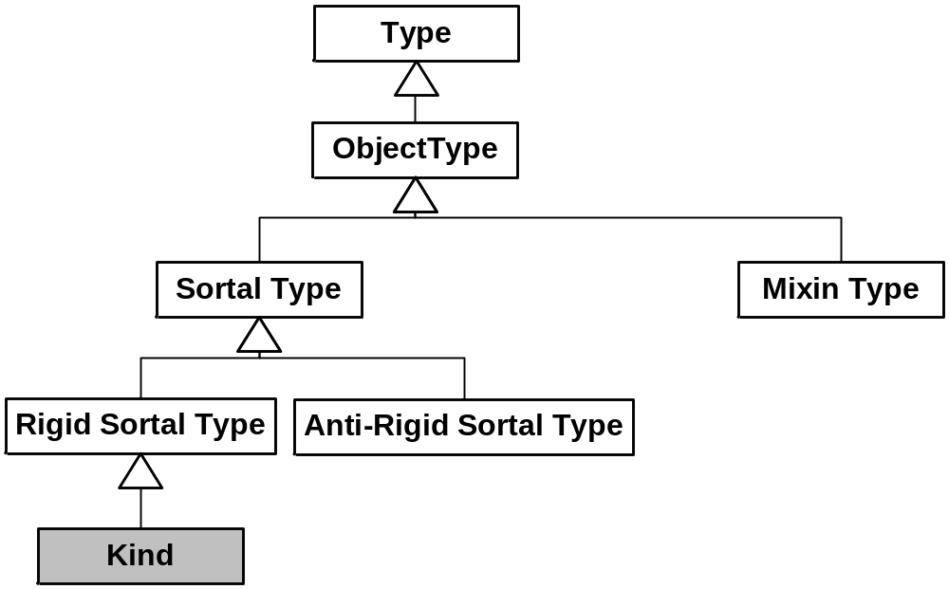
Distinctions Among Object Types
{Insurable Item}
{Student, Teenager}
{Person}

Slide 26


Unique principle of Identity
X
Y

Slide 27
Unique principle of Identity
X
Y

Slide 28
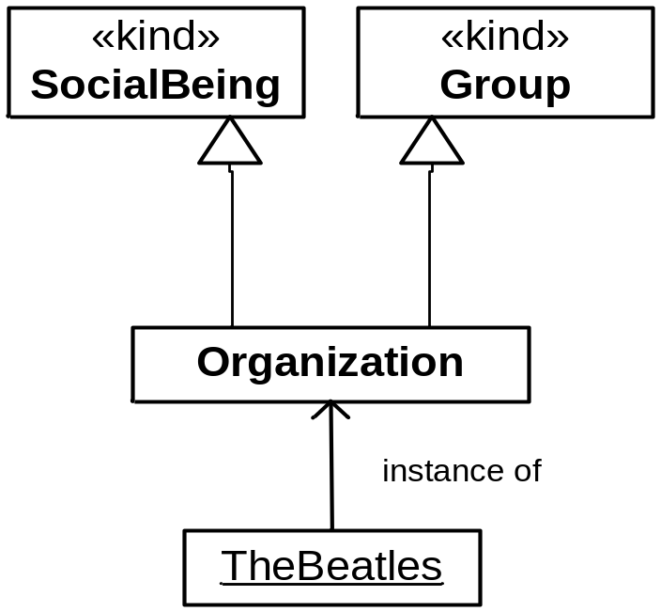

Slide 29
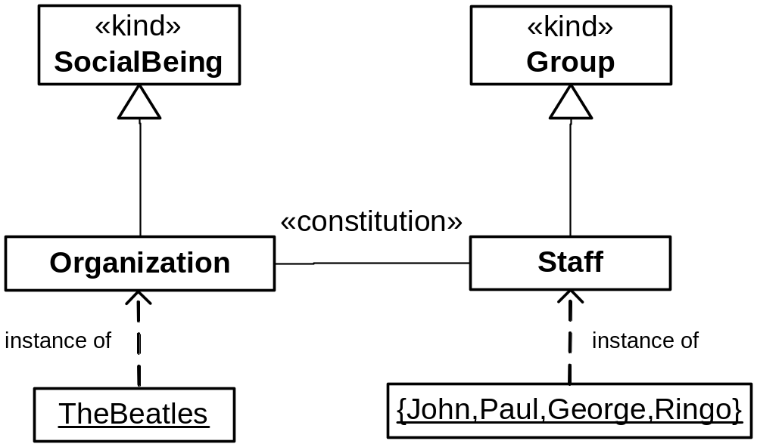

Slide 30
Relational Dependence
A type T is relationally dependent on another type P via relation R iff for every instance x of T there is an instance y of P such that x and y are related via R:
R(T,P,R) =_{def} □(∀x T(x) → ∃y P(y) ∧ R(x,y))

Slide 31
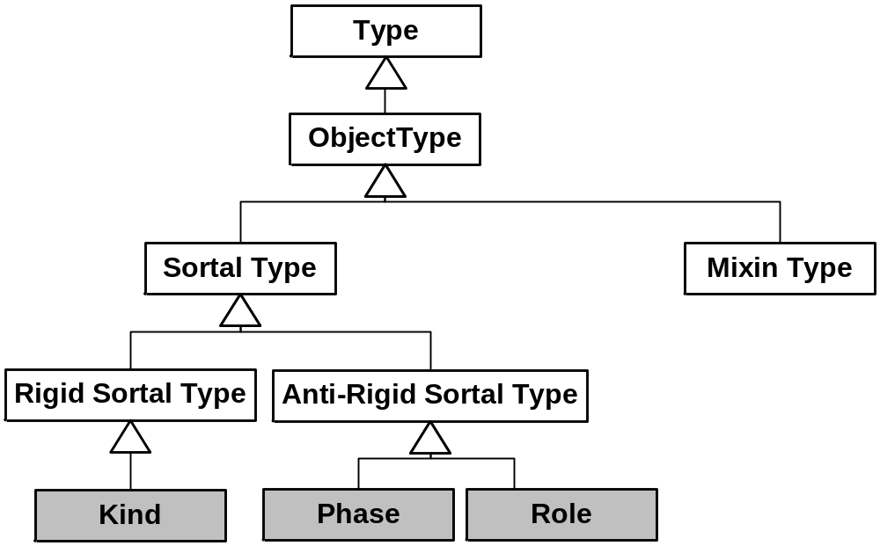
Distinctions Among Object Types
{Insurable Item}
{Person}
{Teenager,
Living Person}
{Student,
Employee}

Slide 32
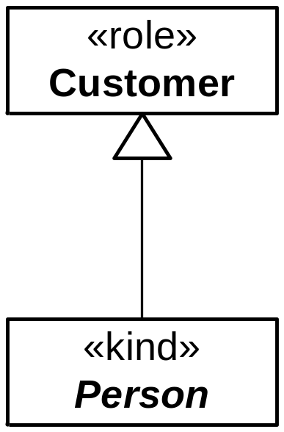
A rigid type cannot be a subtype of a an anti-rigid type.

Slide 33
Subtyping with Rigid and Anti-Rigid Types
∀x Person(x) → □Person(x)
∀x Student(x) → ◊¬Student(x)
□(Person(x) → Student(x))
Person(John)
Student(John)
□Person(John)
□Student(John)
□Student(John) ∧ ◊¬Student(John)
Student
Person

Slide 34
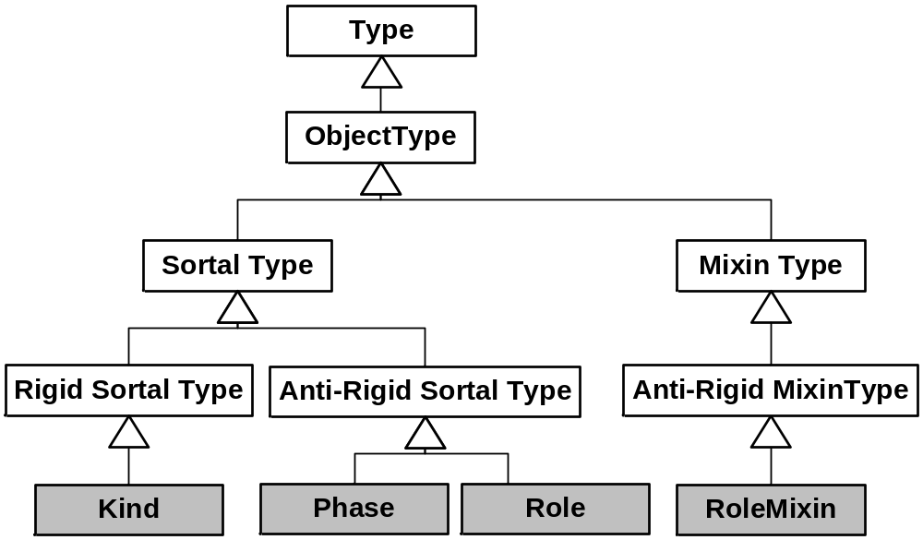
Distinctions Among Object Types
{Person}
{Teenager,
Living Person}
{Student,
Employee}
{Customer}

Slide 35
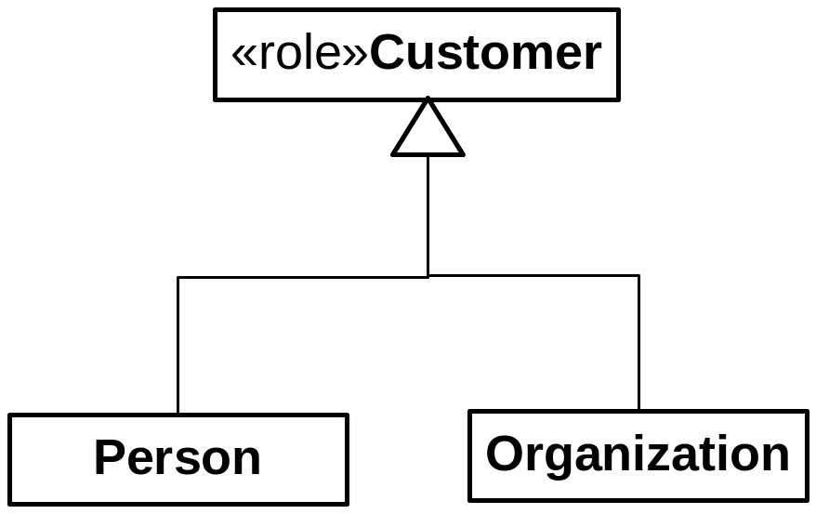
Roles with Disjoint Allowed Types

Slide 36
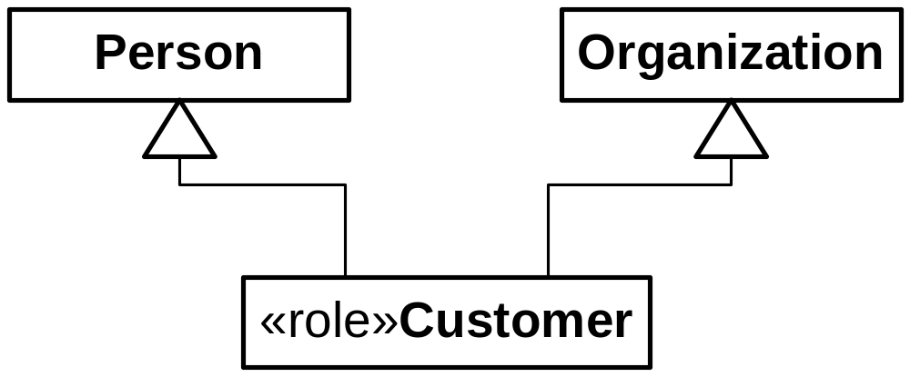
Roles with Disjoint Allowed Types

Slide 37
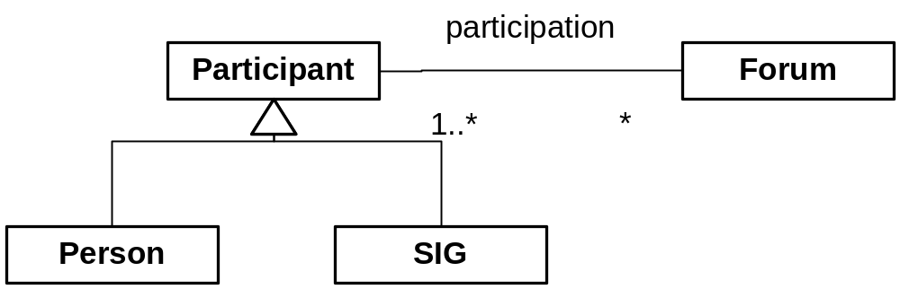

Slide 38
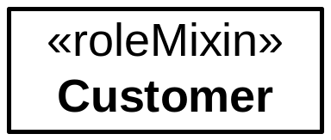
Roles with Disjoint Admissible Types

Slide 39
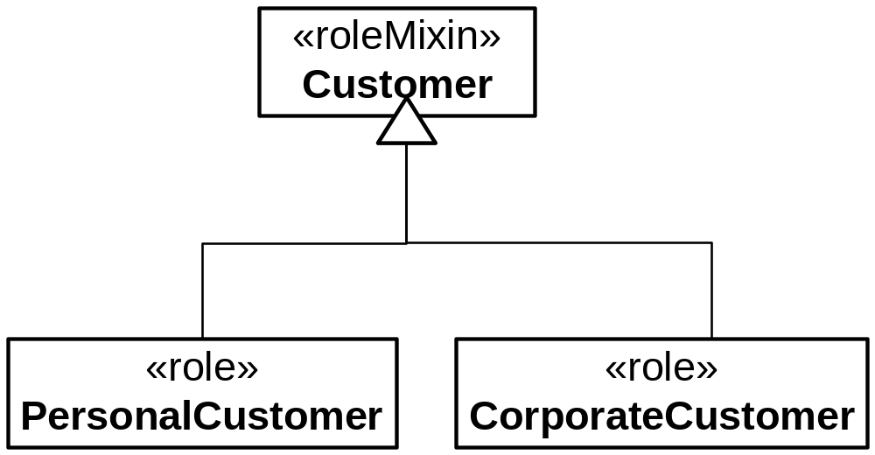
Roles with Disjoint Allowed Types

Slide 40
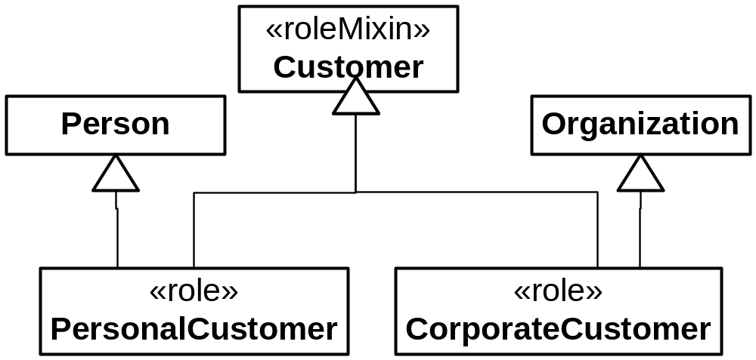
Roles with Disjoint Allowed Types [2]

Slide 41
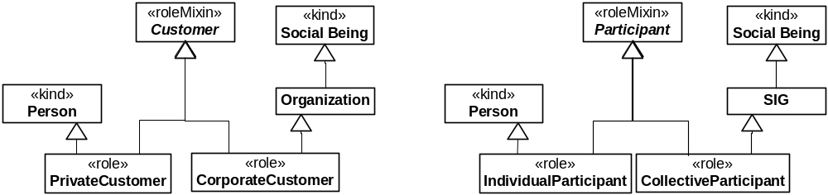

Slide 42
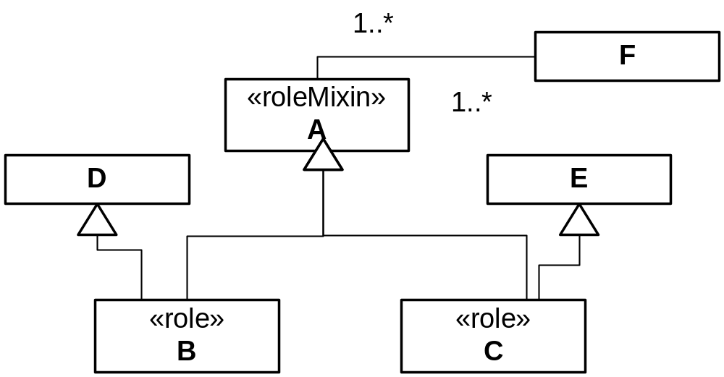
Roles with Disjoint Admissible Types [2]

Slide 43
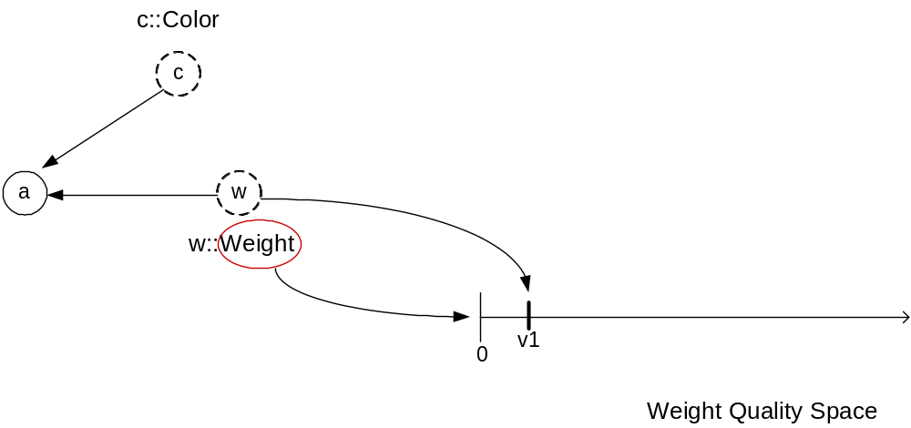
Quality, Quale, Quality Space [3]
Notes:
E cor… ?

Slide 44
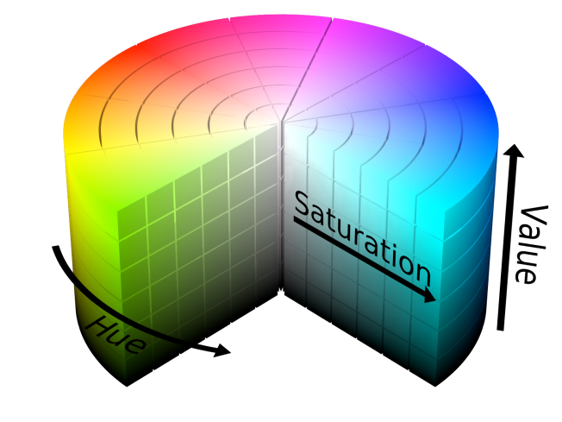
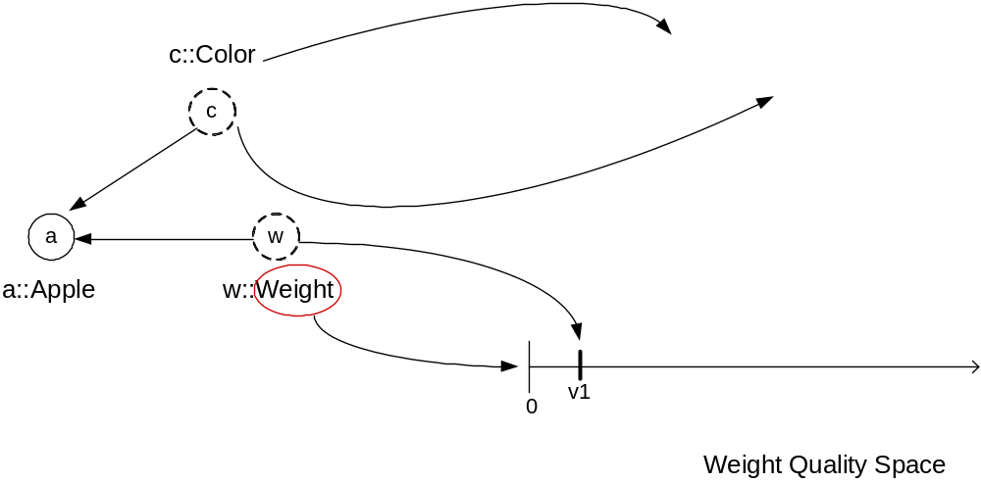
Quality, Quale, Quality Space
Color Quality Space
v2

Slide 45
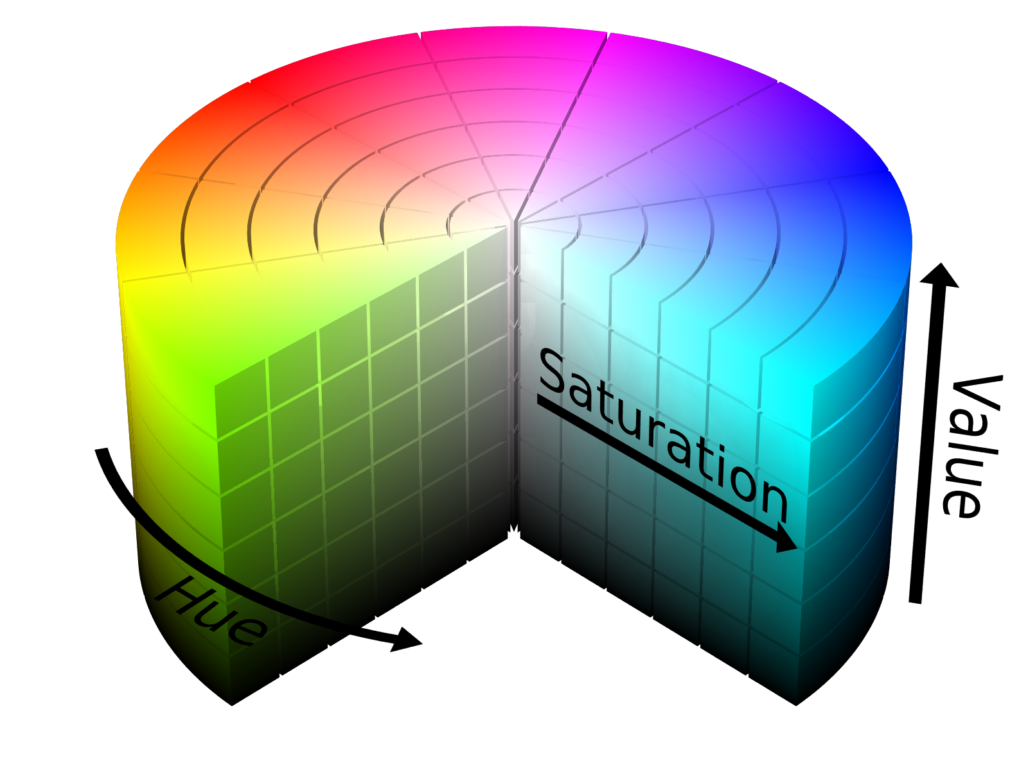
Quality Space with Multiple Quality Dimensions
By http://commons.wikimedia.org/wiki/User:SharkD

Slide 46
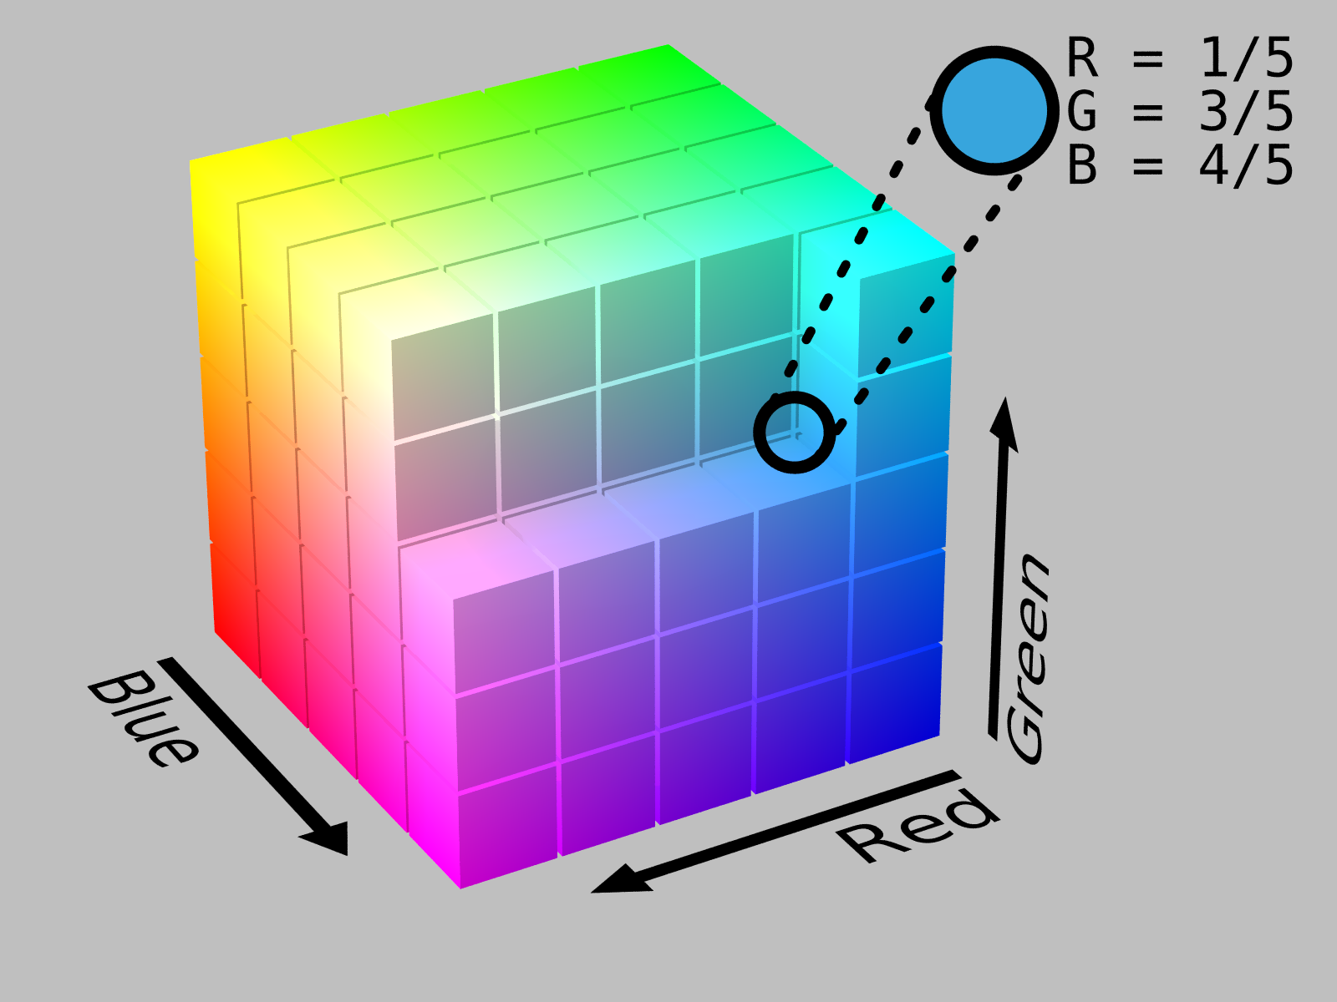
Quality Space with Multiple Quality Dimensions
By http://commons.wikimedia.org/wiki/User:SharkD

Slide 47
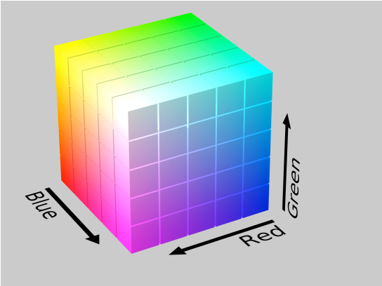
Alternative Quality Spaces
Color Quality Space
v2

Slide 48
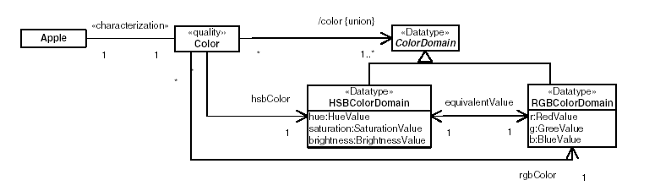
Explicit Representation of Qualities and Quality Spaces

Slide 49
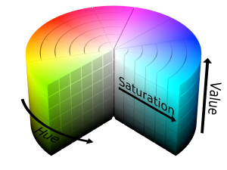
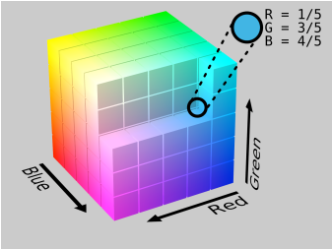
Explicit Representation of Qualities and Quality Spaces
HSBColorDomain
i
<h1,s1,b1>
a::Apple
c::Color
equivalence
RGBColorDomain
<r1,g1,b1>
Notes:
Tipicamente colapsados em um úinico atributo com tipo específico, impossível identificar a propriedade independentemente dos espaços utilizados.

Slide 50
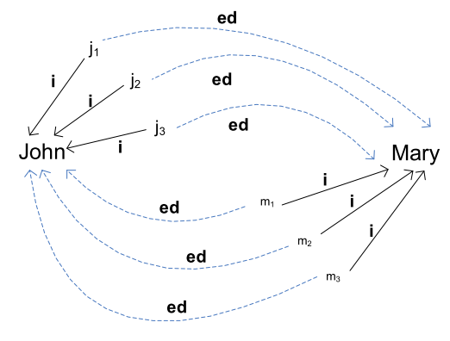
Externally Dependent Moment

Slide 51
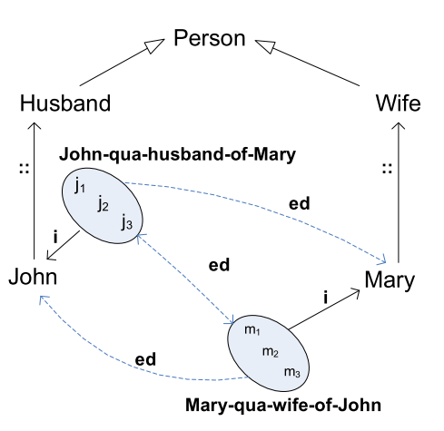
Externally Dependent Moment

Slide 52
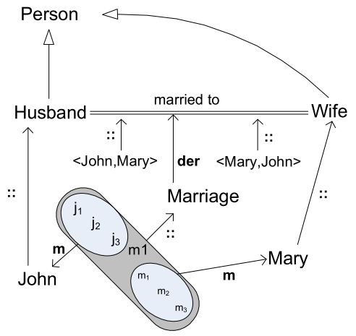
Externally Dependent Moment

Slide 53
Formal Relations [4]
heavier (Paul, John)?
John
Paul

Slide 54
Formal Relations
0
vJ
vP
Weight Quality Dimension
WeightValues
w1
w2
John
Paul

Slide 55
Formal Relations
0
vJ
vP
Weight Quality Dimension
WeightValues
w1
w2
heavier (Paul, John)?
John
vP > vJ ?
Paul

Slide 56
0
vJ
vP
Weight Quality Dimension
WeightValues
w1
w2
heavier (Paul, John)?
John
Paul
Notice that the meta-properties of this relation are derived from the meta-properties of the underlying quality structure

Slide 57
0
vJ
vP
Weight Quality Dimension
WeightValues
w1
w2
Totally Ordered Domain
(reflexive, asymmetric,
Transitive, total)
John
Paul

Slide 58
0
vJ
vP
Weight Quality Dimension
WeightValues
w1
Totally Ordered Relation
(reflexive, asymmetric,
Transitive, total)
w2
John
Paul
heavier (Paul, John)?

Slide 59
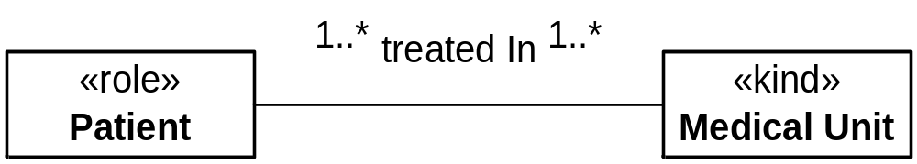
Material Relations

Slide 60
Material Relations
How are these cardinality constraints to be interpreted ?
  In a treatment, a patient is treated by several medical units, and a patient can participate in many treatments
  In a treatment, a patient is treated by several medical units, but a patient can only participate in one treatment
  In a treatment, several patients can be treated by one medical unit, and a medical unit can participate in many treatments
  In a treatment, a patient is treated by one medical unit, and a patient can participate in many treatments
  ...

Slide 61
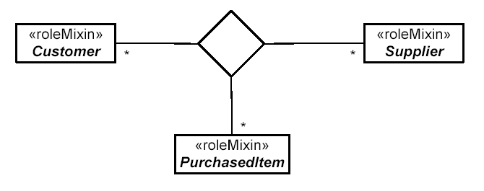
The problem is even worse in n-ary associations (with n > 2)

Slide 62
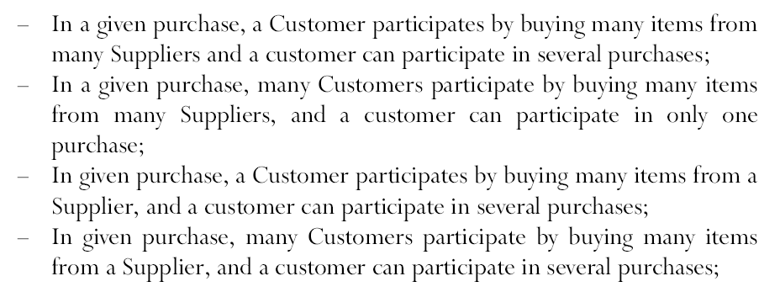

Slide 63
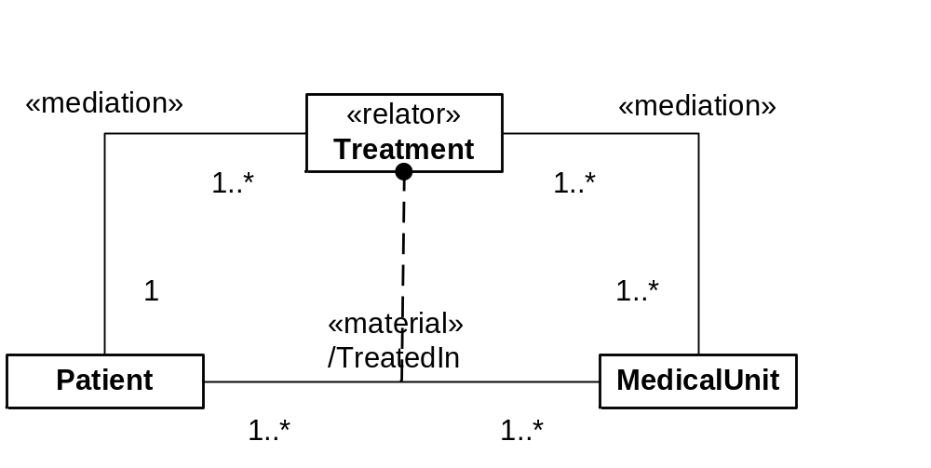
Explicit Representation for Material Relations

Slide 64
Material Relations
As seen before from a relator and mediation relation we can derive several material relations
Asides from all the benefits previously mentioned, perhaps the most important contribution of explicitly considering relations is to force the modeler to answer the fundamental question of what is truthmaker of that relation

Slide 65

Material Relations
Yet another example:
  Modeling that a graduate student have one or more supervisors and a supervisor can supervise one or more students

Slide 66
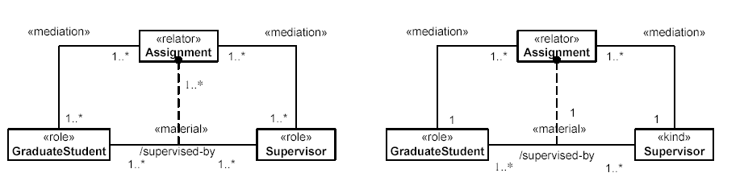
Material Relations
Yet another example:
  Modeling that a graduate student have one or more supervisors and a supervisor can supervise one or more students

Slide 67
References
[1] Guizzardi, G., Theoretical Foundations and Engineering Tools for Building Ontologies as Reference Conceptual Models, Semantic Web Journal, Editors-in-Chief: Pascal Hitzler and Krzysztof Janowicz, IOS Press, Amsterdam, 2010.
[2] Guizzardi, G.; Wagner, G.; Guarino, N.; van Sinderen, M. “An Ontologically Well-Founded Profile for UML Conceptual Models”, 6th International Conference on Advances in Information Systems Engineering (CAiSE), Latvia, 2004.
[3] Guizzardi, G.; Masolo, C.; Borgo, S. “In the Defense of a Trope-Based Ontology for Conceptual Modeling: An Example with the Foundations of Attributes, Weak Entities and Datatypes”, 25th International Conference on Conceptual Modeling (ER’2006), Arizona, USA, 2006.
[4] Guizzardi, G., Wagner, G. What’s in a Relationship: An Ontological Analysis, 27th International Conference on Conceptual Modeling (ER'2008), Barcelona, Spain, Lecture Notes in Computer Science. , v.5231, p.83 - 97, 2008.

Slide 68


http://nemo.inf.ufes.br/
gguizzardi@inf.ufes.br

