Slide 1
Foundational Ontology and Conceptual Data Modeling: The OntoUML approach
Giancarlo Guizzardi
Computer Science Department
Federal University of
Espírito Santo (UFES),
Brazil
SIMF Meeting
Part II

Slide 2
2. We need ontology representations languages which are based on Truly Ontological Distinctions

Slide 3

Ground Mereology
Parthood is irreflexive, i.e., nothing is part of itself
∀x ¬(x<x)
Parthood is anti-symmetric, i.e., if X is part of Y
then Y cannot be part of X
∀x,y (x < y) → ¬(y < x)
Parthood is transitive, i.e., if X is part of Y
and Y is part of Z then X is part of Z
∀x,y,z (x < y) ∧ (y < z) → (x < z)

Slide 4
Weak Supplementation
Mininum Mereology takes the partial order axioms of Ground Mereology and includes the so-called WSP (Weal Supplementation Property)
X
Y
?

Slide 5
Weak Supplementation
X
Y
?
X
Y
Z
Weak Supplementation Principle
If Y is part of X and if parthood is irreflexive
Then there must be another part of X which
is complementary to Y
∀x,y (y < x) → ∃z (z < x) ∧ (z ∫ y)

Slide 6
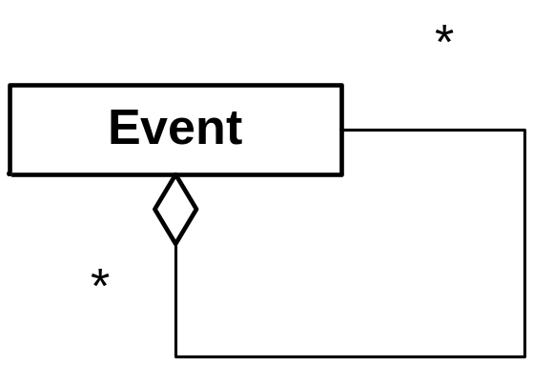
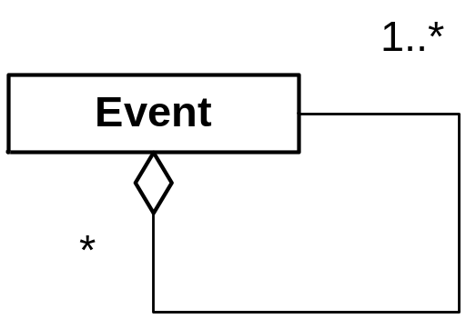
Weak Supplementation Principle

Slide 7
Weak Supplementation Principle

Slide 8


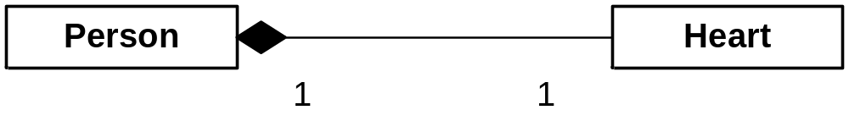
John
partOf
John’s Heart
John’s Heart

Slide 9

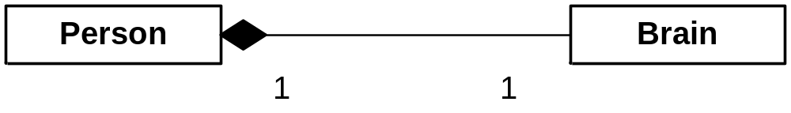
John
partOf
John’s Brain

Slide 10
John
partOf
John’s Heart
John’s Heart
□(∀x Person(x) → (□(ε(x) → ∃!y Heart(y) ∧ (y < x))))

Slide 11

John
partOf
John’s Brain
□(∀x Person (x) →(∃!y Brain(y) ∧ □(ε(x) → (y < x))))

Slide 12
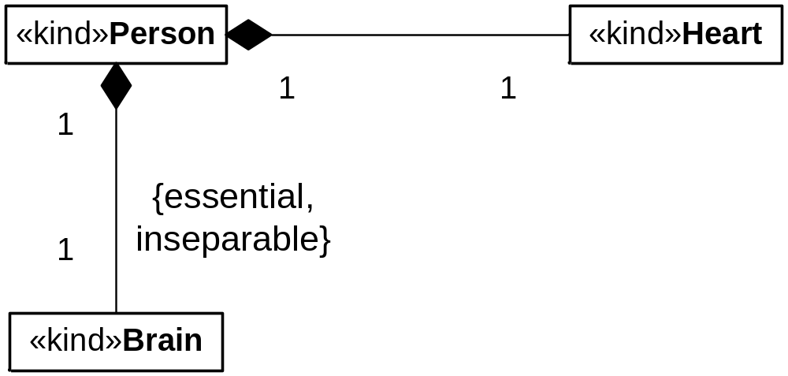
John’s Heart
partOf
partOf

Slide 13
Parts of Anti-Rigid Object Types
“every boxer must have a hand”
“every functional brain must part of a person”

Slide 14
Every Functional Brain must be part of a Person...
□(∀x Functional Brain(x) →
(□(ε(x) → ∃y Person(y) ∧ (X < y))))
□(∀x Functional Brain (x) →
(∃y Person(y) □(ε(x) → (X < y))))

Slide 15
Every Functional Brain must be part of a Person...
□(∀x Functional Brain(x) →
(□(ε(x) → ∃y Person(y) ∧ (y < x))))
□(∀x Functional Brain (x) →
(∃y Person(y) □(ε(x) → (y < x))))

Slide 16
De Re/De Dicto Modalities
(i) The queen of the Netherlands is necessarily queen;
(ii) The number of planets in the solar system is necessarily even.

Slide 17
Sentence (i)
The queen of the Netherlands is necessarily queen:
∀x QueenOfTheNetherlands(x) → □(Queen(x))
DE RE
□(∀x QueenOfTheNetherlands(x) → Queen(x))
DE DICTO

Slide 18
Sentence (i)
The queen of the Netherlands is necessarily queen:
∀x QueenOfTheNetherlands(x) → □(Queen(x))
DE RE
□(∀x QueenOfTheNetherlands(x) → Queen(x))
DE DICTO

Slide 19
Sentence (ii)
The number of planets in the solar system is necessarily even:
∀x NumberOfPlanets(x) → □(Even(x)))
DE RE
DE DICTO
□(∀x NumberOfPlanets(x) → Even(x)))

Slide 20
Sentence (ii)
The number of planets in the solar system is necessarily even:
∀x NumberOfPlanets(x) → □(Even(x)))
DE RE
DE DICTO
□(∀x NumberOfPlanets(x) → Even(x)))

Slide 21
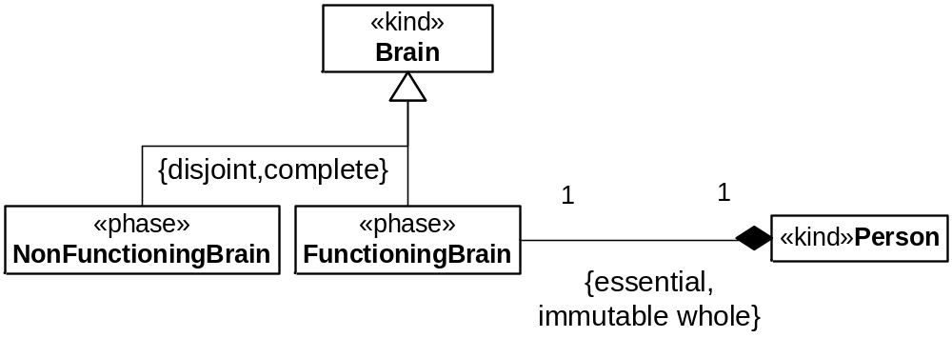
Example of Immutable Whole

Slide 22
Example of Immutable Whole
□(∀x FunctioningBrain(x) → ∃!y Person(y) ∧ □(ε(x) ∧ FunctioningBrain(x) → (x < y)))

Slide 23
Example of Immutable Whole
□(∀x Person (x) → ∃!y FunctioningBrain(y)
□(ε(x) → FunctioningBrain(y) ∧ (y < x)))
□(∀x FunctioningBrain(x) → ∃!y Person(y) ∧ □(ε(x) ∧ FunctioningBrain(x) → (x < y)))

Slide 24
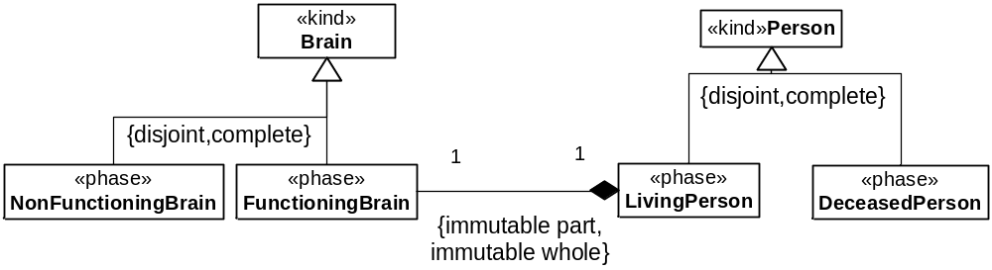
Immutable Whole and Immutable Part
□(∀x LivingPerson (x) → ∃!y FunctioningBrain(y)
□(ε(x) ∧ LivingPerson(y) → FunctioningBraing(x) ∧ (y < x)))
□(∀x FunctioningBrain(x) → ∃!y LivingPerson(y) ∧ □(ε(x)
∧ FunctioningBrain(x) → LivingPerson(y) ∧ (x < y)))

Slide 25
Further Distinctions among Part-Whole relations
  specific dependence with de re modality: Essential Parts
  generic dependence with de re modality: Mandatory parts
  specific dependence with de dicto modality: Immutable parts

Slide 26
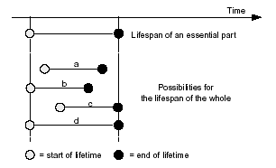
Lifetime Dependency (Essential Parts)

Slide 27
3. We need Patterns
Design Patterns
Analysis Patterns
Transformation Patterns
Anti-Patterns

Slide 28
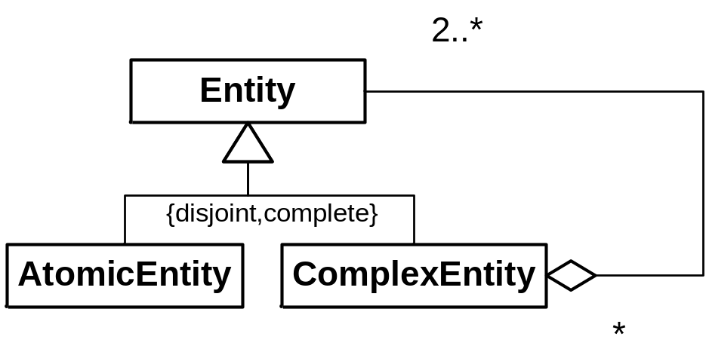
Weak Supplementation Pattern

Slide 29
Weak Supplementation Pattern
AtomicEntity(x) =_{def} ¬∃y (y < x)

Slide 30

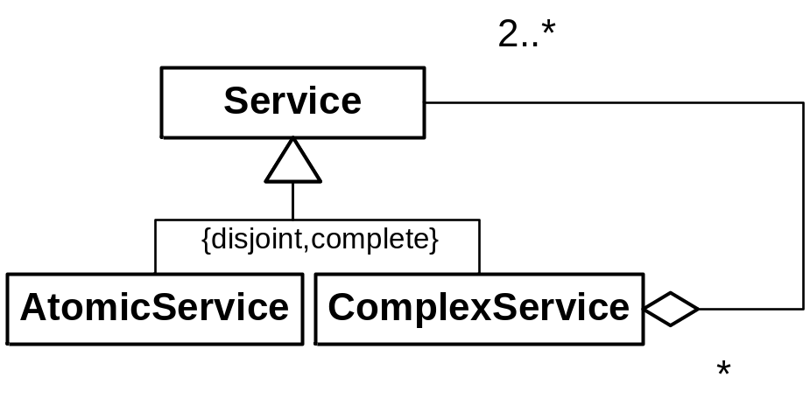
Weak Supplementation Pattern

Slide 31
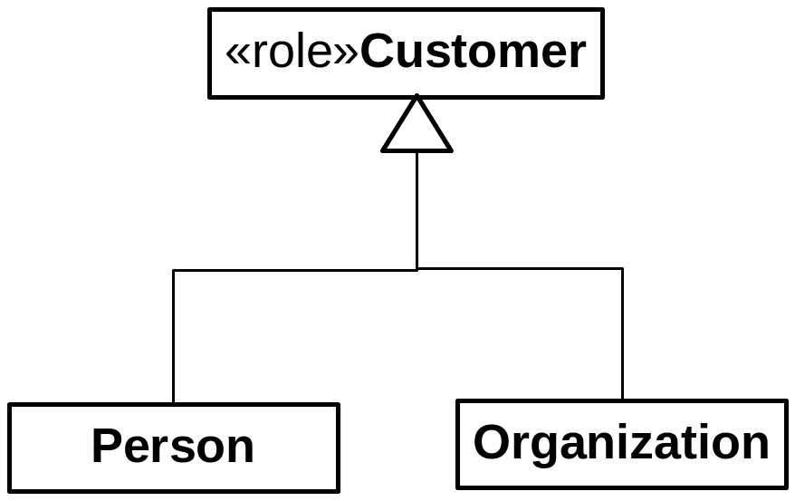
Roles with Disjoint Allowed Types

Slide 32
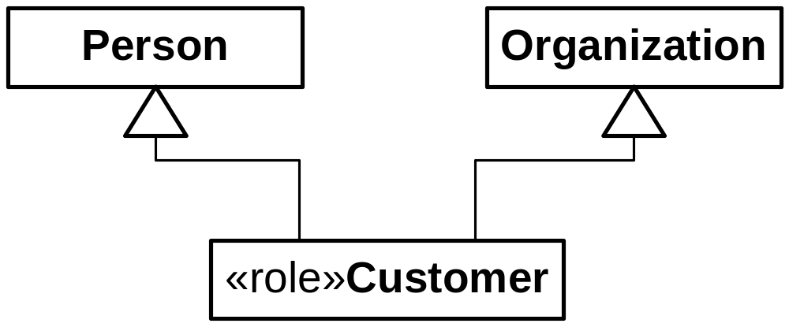
Roles with Disjoint Allowed Types

Slide 33
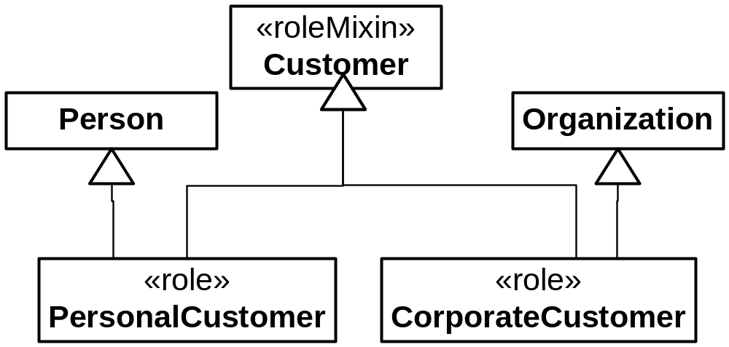
Roles with Disjoint Allowed Types

Slide 34
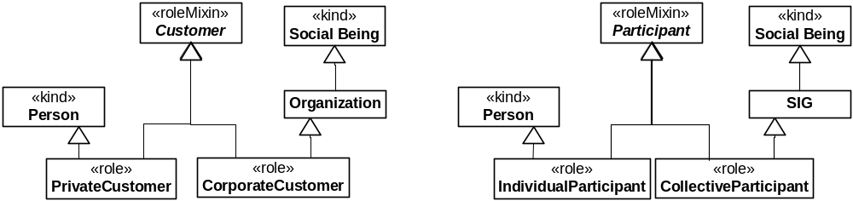

Slide 35
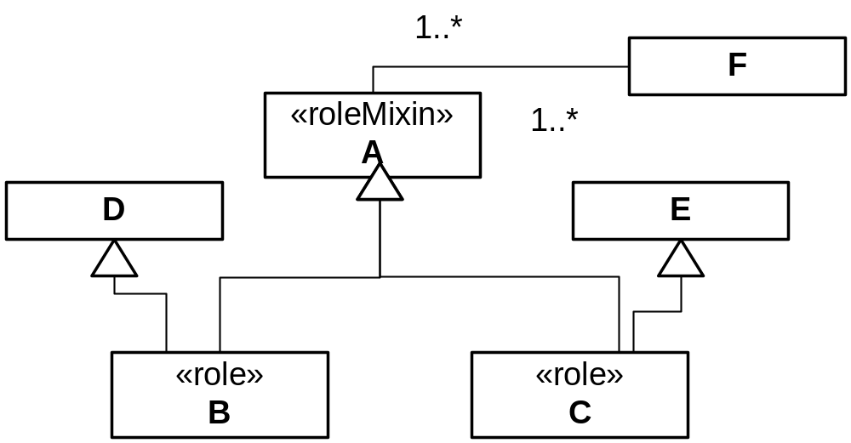
Roles with Disjoint Admissible Types

Slide 36
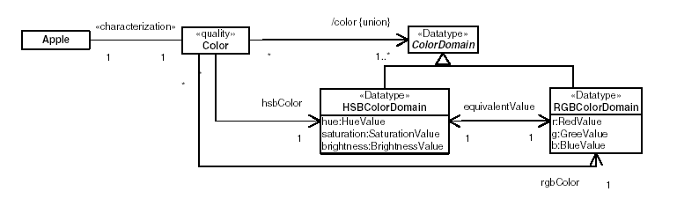
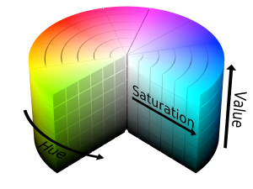
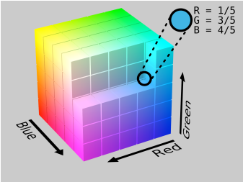
Explicit Representation of Qualities and Quality Spaces
HSBColorDomain
i
<h1,s1,b1>
a::Apple
c::Color
equivalence
RGBColorDomain
<r1,g1,b1>
Notes:
Tipicamente colapsados em um úinico atributo com tipo específico, impossível identificar a propriedade independentemente dos espaços utilizados.

Slide 37
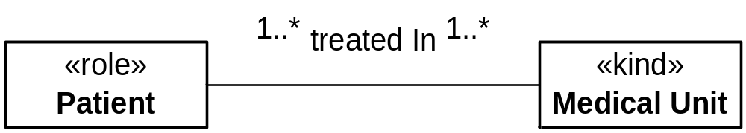
Material Relations

Slide 38
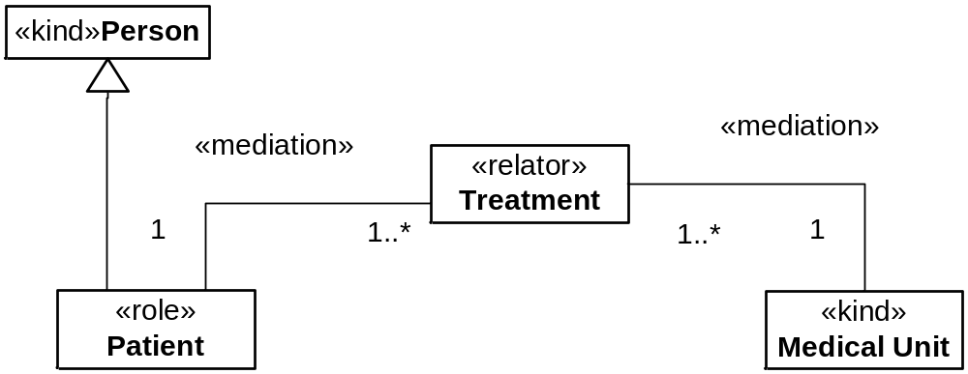
Explicit Representation for Material Relations
No ambiguity in this case!

Slide 39
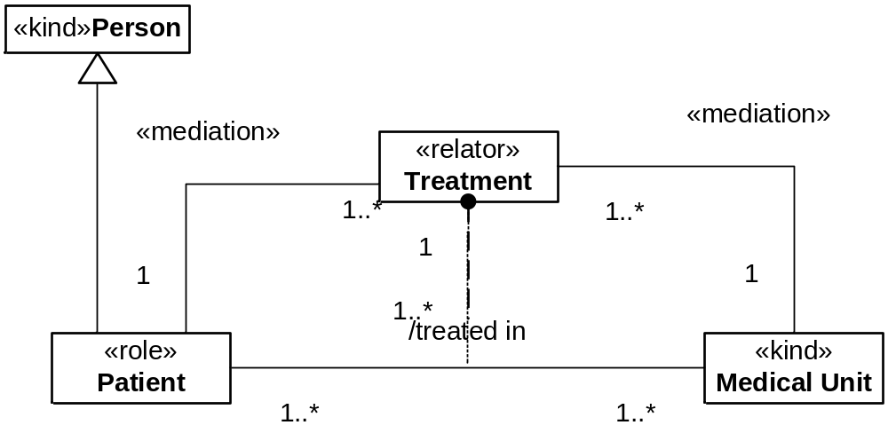
The Problem of Collapsing Cardinality Constraints
‹‹ material ››
single-tuple cardinality constraints

Slide 40
The Problem of Collapsing Cardinality Constraints
‹‹ material ››
multiple-tuple cardinality constraints

Slide 41
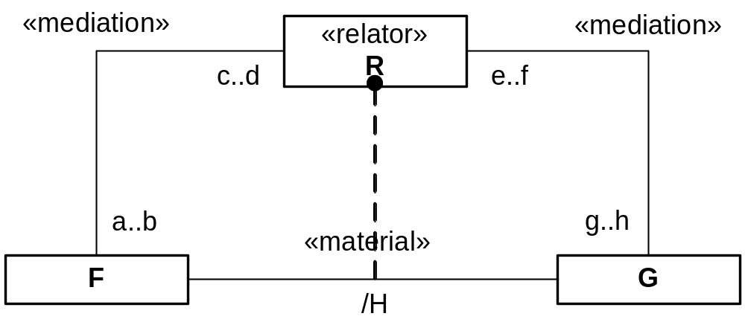
Deriving Cardinality Constraints

Slide 42
Deriving Cardinality Constraints
ε..φ
b x h
a x g
α..β
γ..δ
f x b
d x h

Slide 43
Relators and Relations

Slide 44
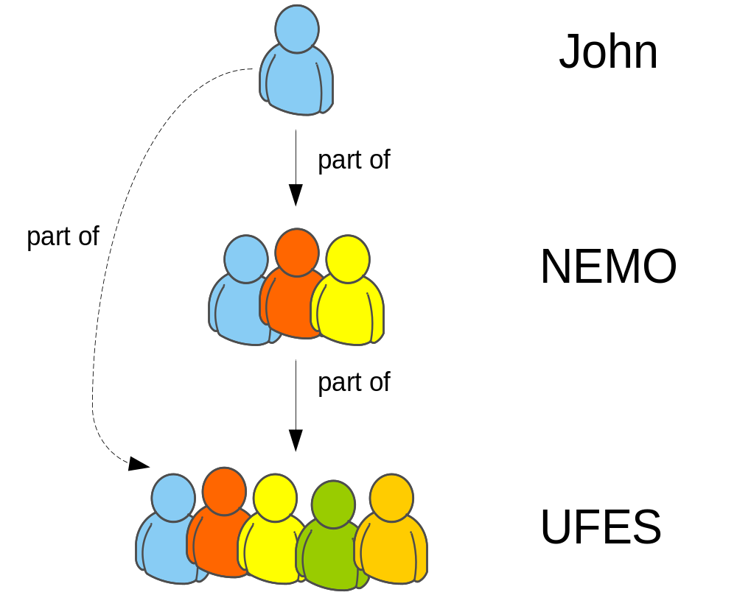

Slide 45
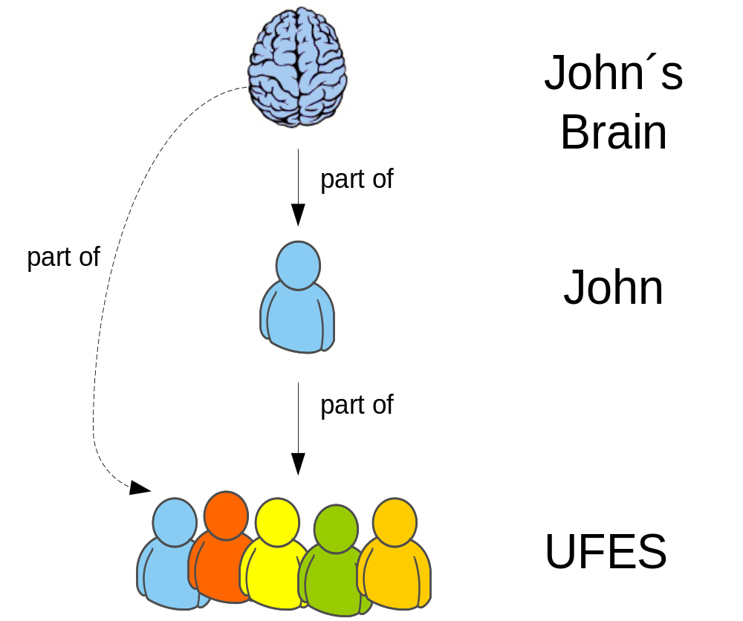

Slide 47
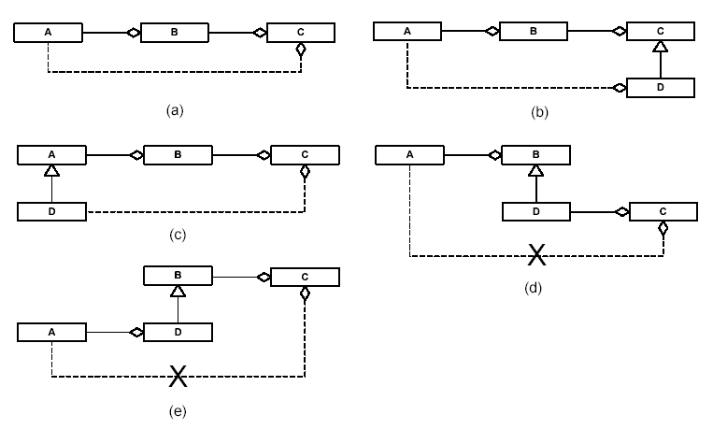

Slide 48
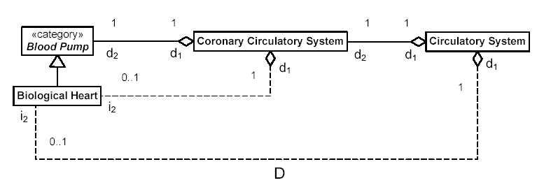
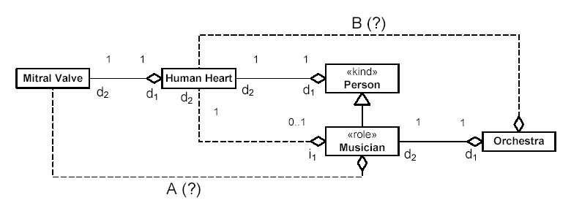

Slide 49
4. We need tools to create, verify, validate and handle the complexity of the produced models

Slide 50
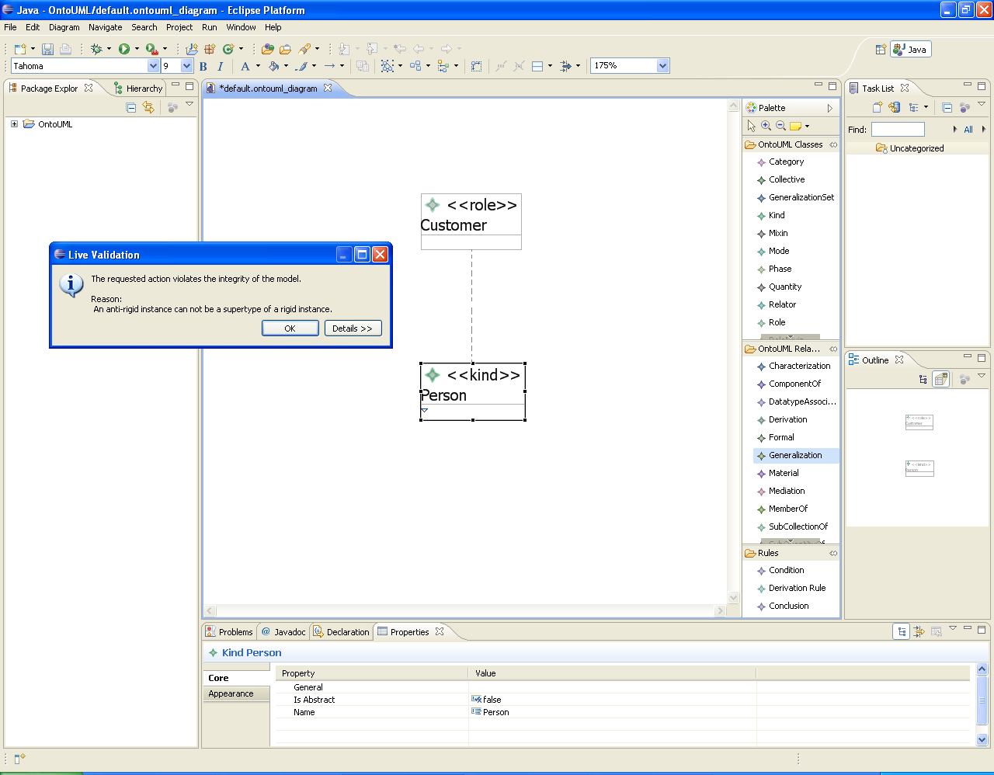

Slide 51
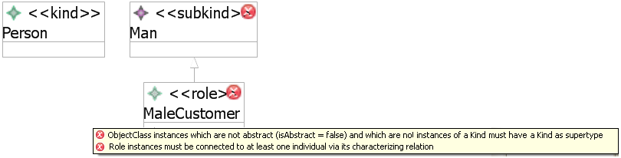

Slide 52
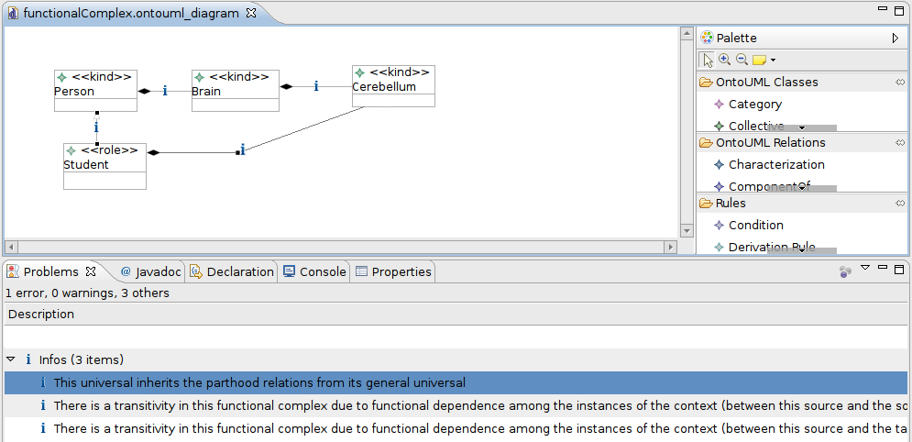
Tool Support
The underlying algorithm merely has to check structural properties of the
diagram and not the content of involved nodes

Slide 53
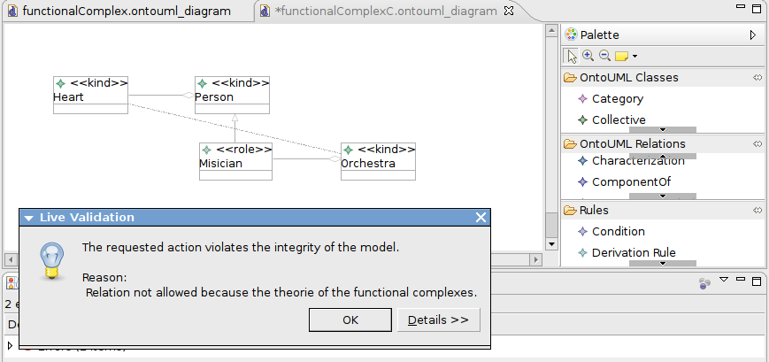

Slide 54
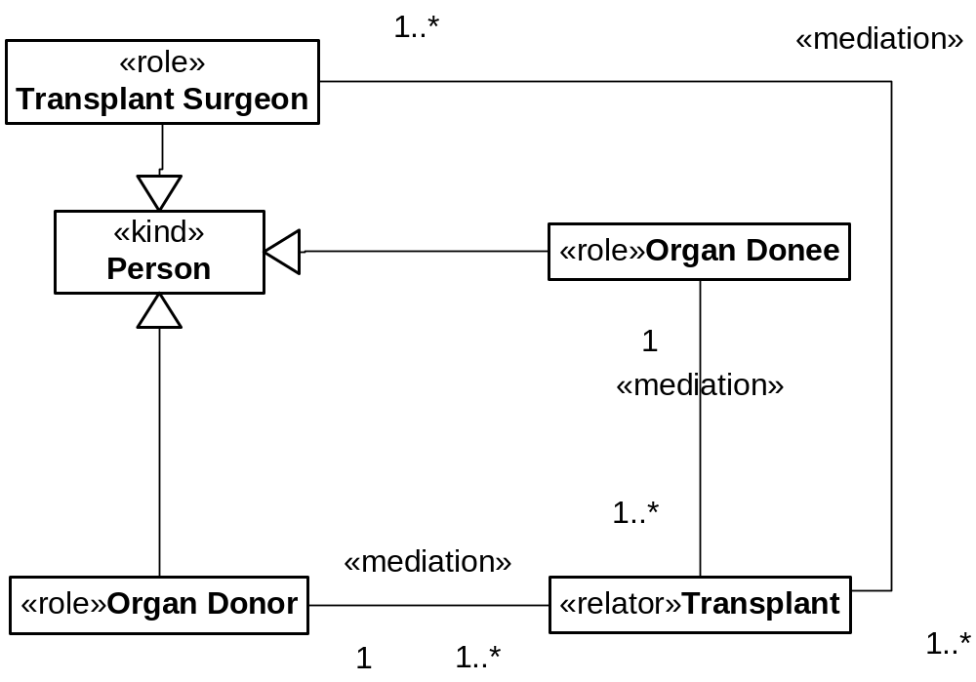

Slide 55
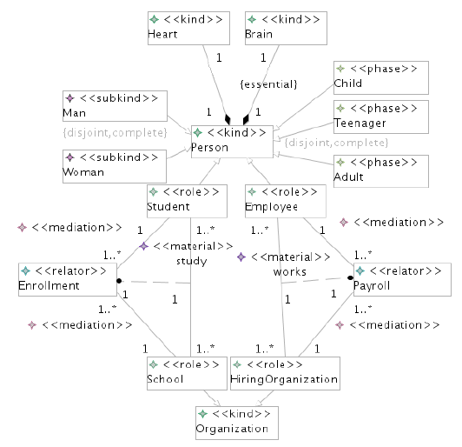
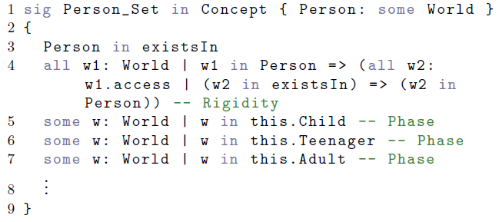
ATL Transformation
Simulation and Visualization
Alloy Analyzer + OntoUML visual Plugin

Slide 56
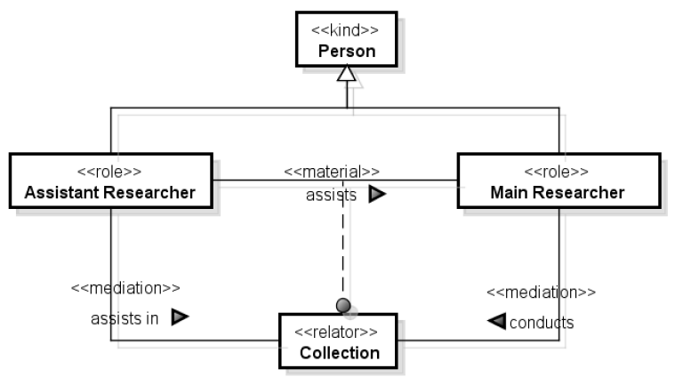

Slide 57
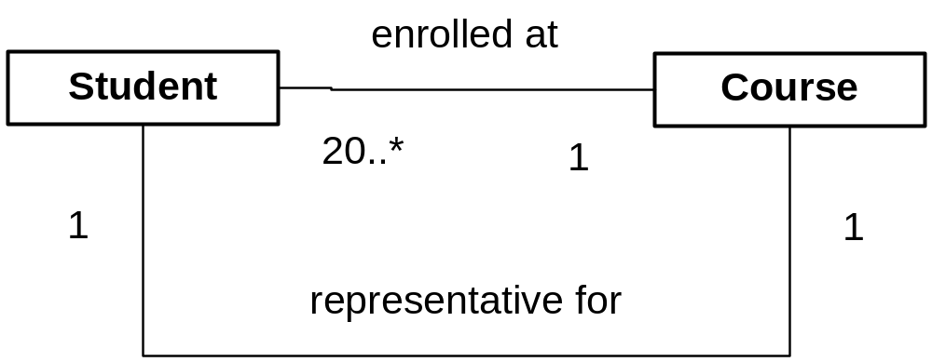

Slide 58
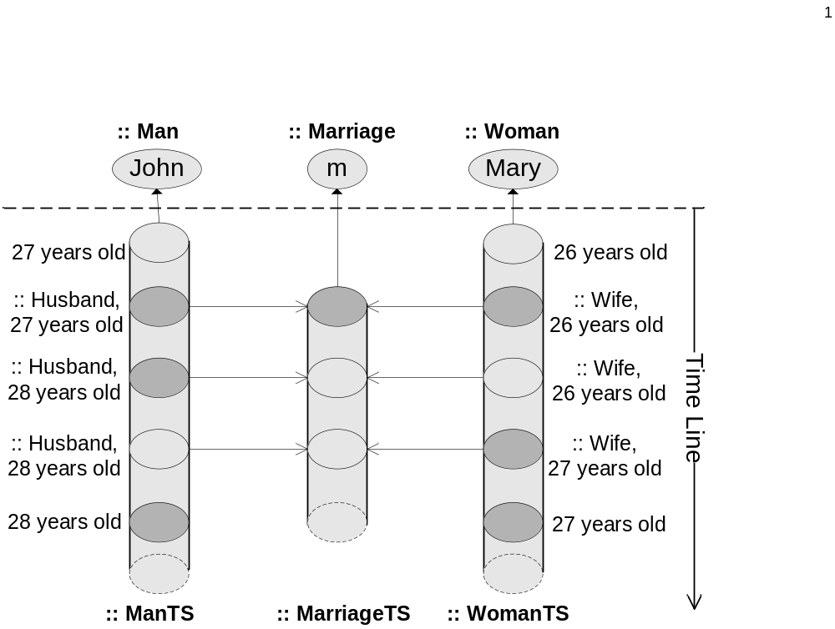

Slide 59


Slide 60
Unified Foundational Ontology (UFO)
UFO-C (SOCIAL ASPECTS)
(Agents, Intentional States, Goals, Actions,
Norms, Social Commitments/Claims, Social Dependency Relations…)
UFO-A (STRUCTURAL ASPECTS)
(Objects, their types, their parts/wholes,
the roles they play,
their intrinsic and relational properties
Property value spaces…)
UFO-B (DYNAMIC ASPECTS)
(Events and their parts,
Relations between events,
Object participation in events,
Temporal properties of entities, Time…)

Slide 61


http://nemo.inf.ufes.br/
gguizzardi@inf.ufes.br

