Slide 1
Vocabulary for Terminology Work (VTW): An ontology for representing a model for conceptual / terminological representation
Elisa Kendall, Thematix Partners LLC
OMG Technical Meeting
26 March 2014

Slide 2
Terminology Identification, Alignment, Mapping Requirements at OMG
Common Terminology Services 2 (CTS2) builds on an ad hoc model for terminology and metadata for repository management
Based loosely on ISO 11179 (Metadata Registration)
Bits of ISO 1087 (Vocabulary for Terminology Work)
The Financial Industry Business Ontology (FIBO) family of standards must support
Identification of legal entities, their jurisdictions and ownership control hierarchies
Identification of financial contracts and instruments
Data lineage, governance, quality in general
The Financial Instrument Global Identifier (FIGI) ontology links identifiers to instruments
Requirements for representing language, country, currency codes, exchange codes and related ticker symbols, etc. in finance, and many coding systems in healthcare, are driving the need for a consistent pattern for mapping code systems to their conceptual domains
SBVR includes fragments of ISO 1087 as an inherent part of the methodology for structuring vocabularies

Slide 3
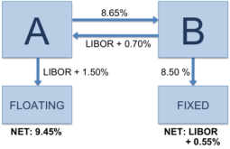

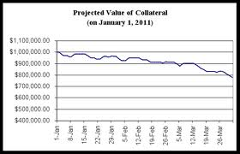

Example Use Case: Risk Mitigation
ISDA Master Agreement
Schedules
Credit Support Annex
Schedules
Transaction
Repository, et.al.
Events
Credit Rating Agency
FpML
Downgrade Counterparty
Credit
Capture Semantics of Contractual Provisions
OTC Derivative Confirm
Financial Shocks
FIBO Operational
Ontologies
FIBO Operational
Ontologies
FIBO
Ontologies
Counterparties
Reduce Value of
Collateral
Axioms and Rules
Default Events
Market Reference Data
Identify Key Contractual Events
Infer
Counterparty
Transitive Exposures
Classify
Contract
Type by Cash Flow
Termination Events
Classify Counterparties into Risk Categories for Analytics
Increase Collateral
Infer
Capital, Liquidity
Risks et al.
Risk Analyst
Identify Key Contractual Actions
Transfer Payments
**Report on OTC Derivatives Data Reporting and Aggregation Requirements, the International Organization of Securities Commissioners (IOSCO), August 2011
* W. Brammertz, “Unified Financial Analysis: The Missing Links of Finance”, 2009
***Joint Study on the Feasibility of Mandating Algorithmic Descriptions for Derivatives, SEC/CFTC, April 2011
-- courtesy David Newman, Wells Fargo, & Mike Bennett, EDM Council

Slide 4
Example: Disclosures
Pre-defined & ad hoc workflow templates per the trigger event type (e.g., new account or offer, change in customer or broker status, account lifecycle event, calendar event, client request, regulatory requirement, etc.), source for disclosure requirement, & nature of the distribution, task structure and expertise requirements, expertise to personnel mapping, personnel availability, workflow status & state changes
Workflow Project Creation / Initiation, Monitoring & Management
Status updates
Workflow Management Interface
Trigger/Docket event details
Trigger event for disclosure issuance occurs
Populated workflow w/ tasks assigned to systems & team, status & issue alerts
Project requirements, expertise demands
Information Definition & Task Management Capability & Knowledge Base
Task Planning, Task & Docket Management
Disclosure analysis and assembly task assignments, monitoring alerts
Content Management & Search Capability, Registries, Repositories
Draft disclosures & disclosure templates
Compliance & legal personnel collaborate to develop completed disclosure documentation for dissemination
Collaborative Development & Management
Disclosure analysis rules based on type, sources for disclosure content, nature and medium for distribution, recipient type and whether mass or targeted, product definitions, disclosure content libraries and resources, including prior disclosures for the same product, task definitions, draft & revised disclosure templates, & provenance detail
Existing Compliance & Client Systems Interface
Research queries, search results, disclosure approvals
Disclosure Analysis, Aggregation, & Composition Support
Distribution Management Capability & Knowledge Base
Dissemination rules & lists, final disclosures for distribution
Dissemination instructions, including internal subscriptions to disclosures based on product and product line, delivery requirements, client dissemination rules, …
4

Slide 5
Vocabulary for Terminology Work (VTW) – ISO 1087
Provides standard terminology for representing concepts, concept systems and relationships among terms
Greater depth than the W3C Simple Knowledge Organization System (SKOS)
Richer than what SBVR currently supports; required for mapping SBVR vocabularies to OWL
ISO 11179, which depends on ISO 1087, adds
Pattern for representing identification and identifiers
Pattern for mapping conceptual domains to value domains, including concepts such as countries, legal entities, financial instruments to the identifiers and codes (values) used in automated systems
Patterns for documenting metadata / terminology / ontology registration and governance in a distributed master data management environment
Submission will include a multi-module ontology in English and French, high fidelity to the original specification, mapping ontology to SKOS, and discussion of the mapping to SBVR with the mapping ontology used for conversion of the Date Time Vocabulary (DTV) to OWL
Current submission team: Adaptive, Institute for Defense Analyses, Mayo Clinic, Thematix, Unisys, Visumpoint

Slide 6
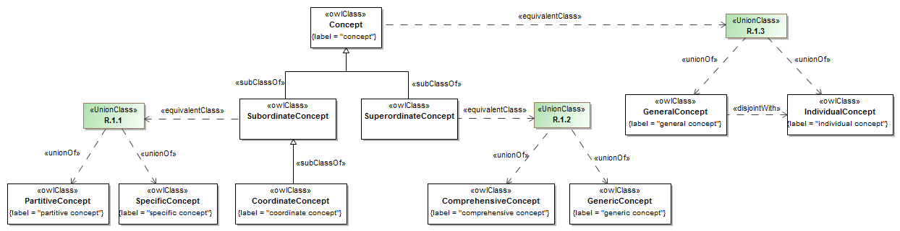
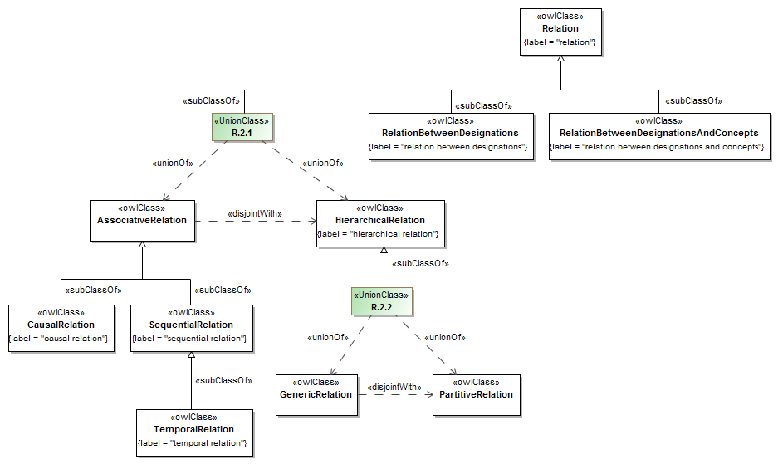
Concept & Relation Hierarchies

Slide 7
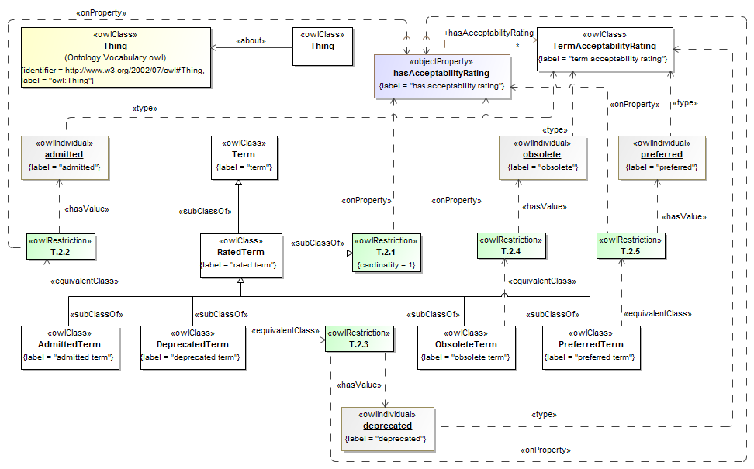
Rated Terms

Slide 8
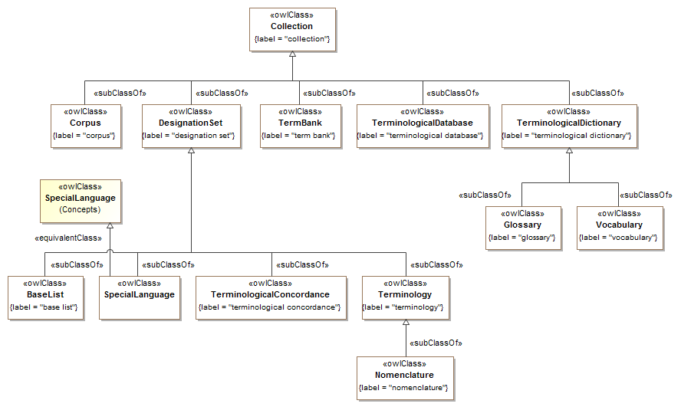
Collections & Term Banks

Slide 9
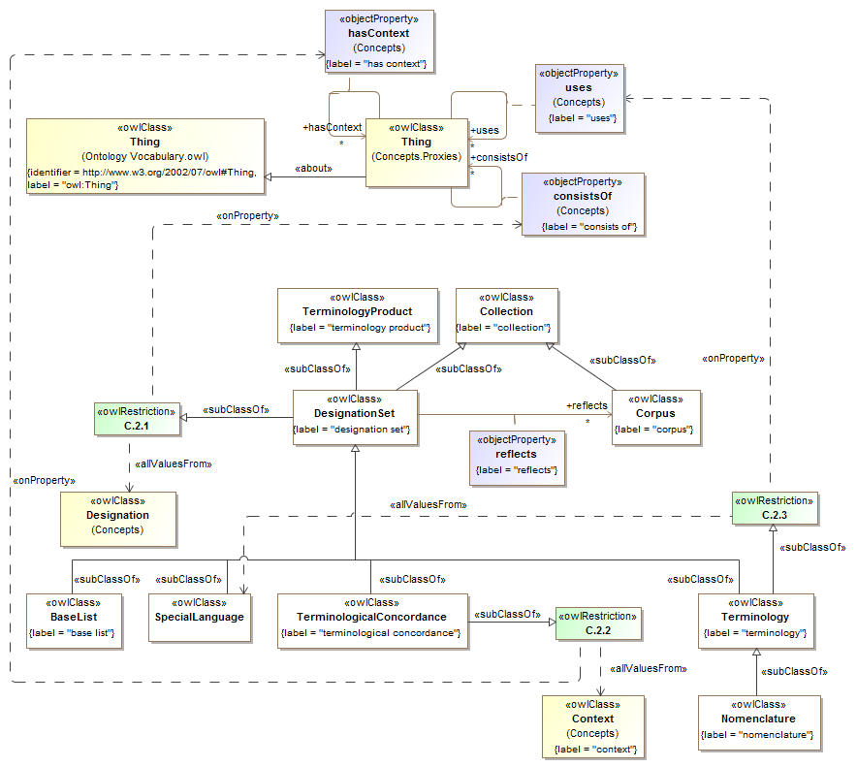
Designation Sets

Slide 10
Roadmap
Ontology for ISO 1087-1 is complete, in use for the last 10+ years for government applications
Specification from an OMG perspective is well underway
Plan is to engage the TC 37 and SBVR communities to vet it once a draft document is available
Could be submitted to OMG as either an RFC or via the RFP process later this year
Ontology for ISO 11179-3 is not quite as complete, needs revision for the latest revision of the standard (published 2013), also in use for the last 10+ years for government applications
Specification from an OMG perspective is in work
SC32 is already engaged, and very interested in the work to inform the next revision of the standard
Could be submitted to OMG as either an RFC or via the RFP process, late 2014 or early 2015
Ontologies for language, country, and currency codes are in various stages of development, could be submitted, again through either process

