Slide 1
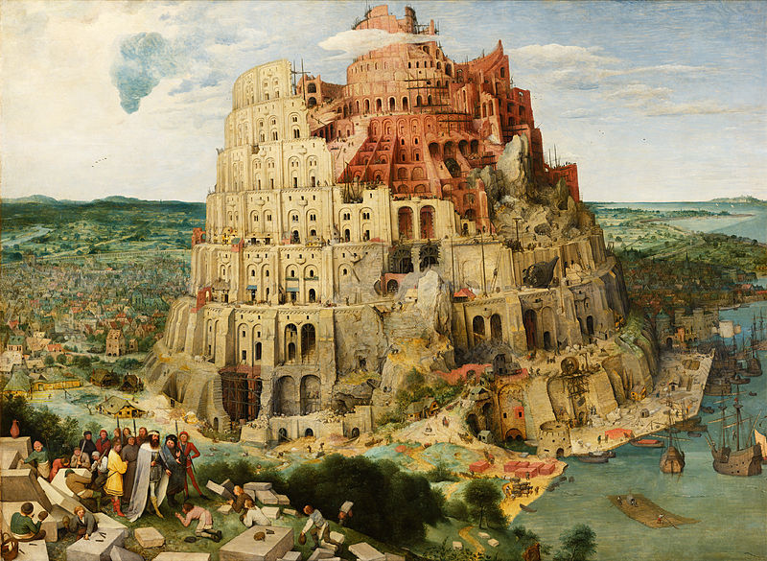
Concept Representation Language:
Avoiding the Tower of Babel
Paul C. Brown
Principal Software Architect

Slide 2
Topics
Motivation
Concept Representation Language
Orders-Shipments Example
Current Status and Future Plans

Slide 3
The Languages of the SIMF World
Models
SIMF Models - CDM, LIM, PDS
Schema Languages – XSD, RDBMS, XSLT, COBOL Copy Book
Mappings
CDM-CDM, CDM-LIM, LIM-PDS (one for each target schema)
XSD - PDS (generic), XSLT-PDS
Mappings Between Mappings
PDS-LIM-CDM-LIM-PDS => PDS-PDS (for XSLT)

Slide 4
Conclusions
Too many languages!
Learning curve too severe for SIMF casual use
Mapping problem becomes exponentially complex
There must be a better way…
Need a uniform approach (meta-model) for all these representations and mappings
Must be simple!

Slide 5
What’s Wrong with Existing Models?
Relations are not first-class elements!

Slide 6
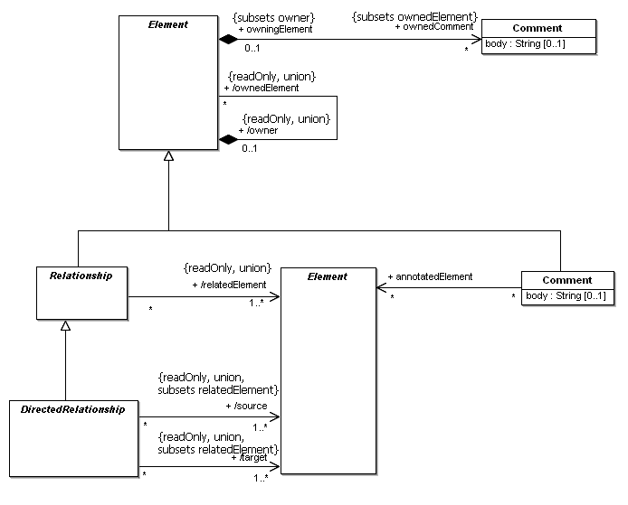
UML Core Abstractions Get Close...
… but their instantiable refinements lose capabilities
e.g. instantiable relationships cannot own other elements

Slide 7

RDF Gets Close…
… but triples have no identity
Necessary to establish mappings between models

Slide 8
The Analogy Problem
Central to the SIMF objectives
Solution requires that relations be treated as first-class citizens

Slide 9
Topics
Motivation
Concept Representation Language
Foundation Concept Space and Graphic Representation
Orders-Shipments Example
Current Status and Future Plans

Slide 10

Element
The representation of a concept
Unique identifier (UUID)
commonName and definition are aids for human understanding
Optional URI
Version is experimental

Slide 11
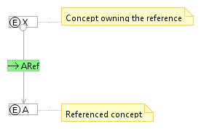

Reference
The reference has an identity of its own
referencedElementVersion is experimental

Slide 12
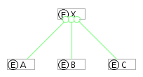
Owned Elements (the Context relation)
Owned elements are part of the definition of the parent
Neither exists without the other

Slide 13
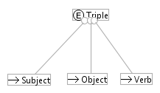
An Example: Triple
An element that owns three references
Each reference is to a concept (the top of the abstraction hierarchy)
All concepts are refinements of this concept

Slide 14
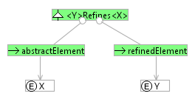
Refinement
Can represent generalization and instantiation
Both can be defined as refinements of refinement!
Can represents other refinement notions as well
Restriction, extension, choice…

Slide 15
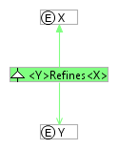
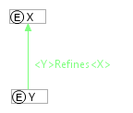
Refinement Graphic Notation

Slide 16

Constraint
Constraint owns reference(s) to the constrained element(s)
Expression indicates the constraint
count(<childCommonName>) == 1
Expression will eventually become an element with children

Slide 17
The Full Concept Representation Language
Claim: CRL can represent any language

Slide 18
Stored Representation
<?xml version="1.0" encoding="UTF-8"?>
<schema targetNamespace="http://simf.omg.org/ConceptSpace" elementFormDefault="unqualified" xmlns="http://www.w3.org/2001/XMLSchema" xmlns:tns="http://simf.omg.org/ConceptSpace">
<element name="document" type="tns:Document"></element>
<complexType name="Document">
<sequence>
<element name="conceptSpace" type="tns:Element" maxOccurs="unbounded" minOccurs="1"></element>
</sequence>
</complexType>
<complexType name="Element">
<sequence>
<element name="uri" type="string" maxOccurs="1" minOccurs="1"> </element>
<element name="commonName" type="string" maxOccurs="1" minOccurs="1"> </element>
<element name="definition" type="string" maxOccurs="1" minOccurs="1"> </element>
<element name="version" type="string" maxOccurs="1" minOccurs="1"></element>
<element name="disambiguator" type="string" maxOccurs="1" minOccurs="1"></element>
<element name="ownedConcepts" type="tns:Element" minOccurs="0" maxOccurs="unbounded"> </element>
</sequence>
</complexType>
<complexType name="Reference">
<complexContent>
<extension base="tns:Element">
<sequence>
<element name="referencedElement" type="string" maxOccurs="1" minOccurs="1"></element>
<element name="referencedElementVersion" type="string" maxOccurs="1" minOccurs="1"></element>
</sequence>
</extension>
</complexContent>
</complexType>
<complexType name="Constraint">
<complexContent>
<extension base="tns:Element">
<sequence>
<element name="constraintExpression" type="string" maxOccurs="1" minOccurs="1"></element>
</sequence>
</extension>
</complexContent>
</complexType>
<complexType name="Refinement">
<complexContent>
<extension base="tns:Element">
<sequence>
<element name="parent" type="string" maxOccurs="1" minOccurs="1"></element>
<element name="child" type="string" maxOccurs="1" minOccurs="1"></element>
</sequence>
</extension>
</complexContent>
</complexType>
</schema>

Slide 19
Topics
Motivation
Concept Representation Language
Foundation Concept Space and Graphic Representation
Orders-Shipments Example
Current Status and Future Plans

Slide 20
Orders-Shipments Problem
Conceptual Domain Model
Order-centric XML
Shipment-centric XML

Slide 21
Orders-Shipments Solution Structure

Slide 22
Orders LIM-CDM Mapping

Slide 23
Current Status
Concept Representation Language implemented
ecore, XML, round-trip
XML Schema – PDS import/export implemented
Tested with XMLSchema.xsd, schema-for-xslt20.xsd, OrdersPDS.xsd
Graphic editor built out of MagicDraw EMF, GMF
Create and edit concept spaces
Load, store Concept Spaces
Import/export XML schema
Cannot display elements owned by relations

Slide 24
Future Plans
Implement patterns
Mapping definitions used to synthesize target namespaces
Use patterns to generate LIM-LIM mapping from LIM-CDM-LIM mapping
Use patterns to generate XSLT (PDS-PDS mapping) from LIM-LIM mapping
Implement Eclipse editor capable of representing full language

Slide 25
Pattern Mapping Concept
Design step 1: identify pattern of concepts to be recognized and the pattern of target concepts to be generated
Design step 2: define a set of mappings between concepts
Execution Step 1: algorithmically identify refinements of the pattern to be recognized
Execution step 2: generate corresponding refinements of the target pattern
Generate refinements of this pattern
Recognize refinements of this pattern

Slide 26
Summary
Multiple models are an inescapable reality
Different levels of abstraction
Different semantics
A uniform approach is needed to deal with this situation
Represent various models and the mappings between them
Concept Representation Language (CRL)
Goal: simplest possible set of concepts capable of representing all models and mappings
Element, Reference, Constraint, Context, Refinement
Claim: if it can be written down, it can be represented in CRL
Both models and mappings
An invitation – help me beat it up!

