Slide 1

Semantic Information Modeling for Federation
SIMF
OMG Architecture Ecosystem / ADTF
March 2014
Cory Casanave

Slide 2
What is SIMF?
Semantic Information Modeling for Federation is an in-progress standards process within OMG
The goal of SIMF is to provide the modeling capabilities to support information federation by leveraging conceptual and logical information modeling with model bridging relations
An important goal of SIMF is to extend the economic lifecycle of many existing running systems that were conceived and built in a time when there were insufficient true conceptual capabilities, by explicitly adding the often implicit semantics and linking the running data representations with a true conceptual model.
Another important goal of SIMF is not to replace any existing standard language but to build bridges between the SIMF Conceptual Schema and the various standard languages such that the users can save substantial amounts of money in their integration and federation efforts.
Issued Dec 2011 - OMG Document: ad/2011-12-10

Slide 3
AESIG/SIMF History
AESIG was Formed in 2009
Started with a lot of discussion, some good ideas but not a lot got done
Artifacts on http://www.omgwiki.org/architecture-ecosystem/doku.php
Intent is to revive use of the wiki for outreach
Initial RFP effort focused on a meta model (language) integration – the “Architecture Ecosystem Foundation” RFP
This never got off the ground, was not issued
Eventually focused on “Semantic Information Modeling for Federation” (SIMF)
Issued Dec 2011 - OMG Document: ad/2011-12-10
Since issuing SIMF, AESIG has not been meeting – waiting for SIMF progress
AESIG met Sunday to review SIMF progress

Slide 4
SIMFTeam Introduction – who we are
SIMFTeam is one SIMF group, some are submitters, others contribute
Model Driven Solutions - Cory Casanave, Tom Digre
PNA Group - Sjir Nijssen, Bas van der Laar, John Bulles, Jean Paul Koster, Inge Lemmens
TIBCO – Paul Brown
TMForum - Alex Zhdankin (Cisco), Nigel Davis (Ciena)
European Space Agency - Serge Valera
Laboratory for Applied Ontology (Brazil) – Giancarlo Guizzardi
Deere – Roger Burkhart
Agile Birds SPRL - Sylvain Guérin
ABN AMRO Bank - Andre Le Cat
Turien Insurance - Jos Rozendaal
ING Bank - Lex Bruil
Pension Fund - Jos Vos
NIST - Ed Barkmeyer (Comment)
Individuals - Miriam Wesseling
One of the SIMF submitters (PNA) has very recently won an EU public tender from the Dutch Tax Office to annotate and explicitly model all the semantics explicitly and implicitly available (including context sensitivity) in laws and regulations to be used by legal experts, service providers and IT expert, to produce the precise, technology-independent and complete specifications, using a provisional version (to be part of the SIMF submission) of a what they call semantic-conceptual model and providing a Linked Open Data interface.

Slide 5
Status and strategy
Submissions due this meeting, a decision was made not to submit yet
The submission group was on a path to create initial submissions
We decided that it was better not to submit yet, to enable us to do outreach and bring in more participants
We will be publishing interim results on the AESIG wiki
http://www.omgwiki.org/architecture-ecosystem/doku.php
Prototype implementations are being developed
Tibco, PNA & MDS
We propose submissions be moved as follows
LOI Deadline: October 1st , 2014
Initial submissions & Voting list : November 10th, 2014
Revised submissions: August 24th 2015
What follows is intended to show progress to motivate participation

Slide 6
SIMF Update

Slide 7
Proposition
Problem statement
Federation (information sharing, interoperability, shared services, etc.) is the problem of this decade – it is costing productivity, lives and billions trillions of dollars annually. It is the pre-requisite to solving many problems in the large. It is a problem faced by most CIOs in government and industry.
We are calling this the “data problem”
A problem not solved…
None of the standards we have directly target this problem. Not: UML, OWL, LoD, E/R, SOA, DoDAF, XML Schema, Common Logic or SBVR , etc.
With all these solutions – we still have a pervasive problem!
While not ideal, the standards above can and are used for federation, but, they are all built for other purposes and repurposed to solve the data problem. Experts can pull these technologies together to solve a specific problem, we want to make it easy to do so with an integrated and standardized approach supporting mainstream solutions and internet-scale federation.
We can make a substantial dent in the data problem with new standards derived from current technologies and practices. This is the “SIMF” Initiative.

Slide 8
SIMF Principles
The intent of SIMF is not to replace other standards but to make it economically more feasible that various standards can cooperate.
In that sense SIMF is not a competitor to any existing OMG standard.
It is the aim of SIMF to extend the economic life of existing applications as well as to support new applications
It is the intention of the submission team to extensively test the proposed standard set of concepts and languages before submission and make the test results available.
SIMF does use conceptual models (reference models) as “pivot points” between different representations.
SIMF does assume that some concepts will be agreed on by some communities as some agreement is required for any communication.
SIMF does not assume any universal or all encompassing conceptual model

Slide 9
Pivoting through a conceptual model
The conceptual pivoting approach
A common and growing approach to the data problem leverages abstraction: Defining a domain focused vocabulary with integrity rules and assertions as part of a conceptual model that captures domain semantics. Federation and integration is achieved by relating various logical and physical information structures to the conceptual model
Information federation and integration is achieved via a “pivot” through this conceptual semantic layer
This approach is used, in part, in existing standards such as CCTS (Core Components), ISO 20022 and is currently being utilized in OMG for finance.
In the majority of cases the “tool” used to represent these common semantics and links is a spreadsheet, but UML and OWL are also used.

Slide 10
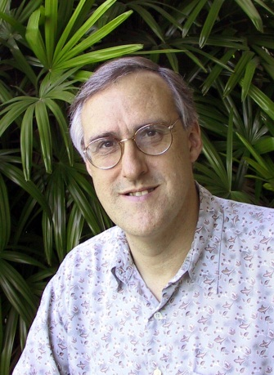
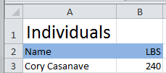

Example of “Pivoting” through a conceptual model
Concept of
“Cory Casanave”
There is an actual “Person”, Cory Casanave
There is a concept of this person shared in this room, right now
Here is one representation of him
“Person” is a shared concept, independent of data structures
There may also be shared agreement that Cory is a person and some other “facts”
“Cory Casanave” is a name for this person
He weighs 240 LBS
There are multiple data representations about Cory Casanave which may or may not agree
Those representations can be grounded in concepts (semantics), assisting federation
Concept of a
“Person”
<PersonType>
<NameText>Cory B. Casanave</NameText>
<Weight-LBS>234</Weight-LBS>
</PersonType>
XML
Representations
.
Excel
UML

Slide 11
Two use cases
Common: SIMF is used to “ground” multiple existing data sources with independently conceived schema.
Federated query use case
A data representation is algorithmically derived from a common domain model, as such it uses the same vocabulary and concepts
Queries and analysis can then be performed across the union of all the disparate data sources using the common domain vocabulary
These queries and analysis will not loose data
Data transformation use case
Rules are added that allow a “destination” data resource using a pre-existing vocabulary to be populated from multiple sources
Such a transformation is likely to loose data as the destination data resource is not likely to have all the concepts of all the sources. Also, some rules may not fire as the information to support them may not be available in the sources – rules ion context are the deciding factor

Slide 12
Questions SIMF needs to address
How do we model domain concepts?
How do we understand different representations of data about domain concepts?
What rules do we need to go from domain concepts to a particular representation for a particular purpose?
How do we deal with conflicting definitions and facts?
How do we factor in the context under which different concepts and rules apply?

Slide 13
SIMF Architecture
Model Bridging Relations
Subject focused conceptual models define the concepts, predicates, integrity rules and terms of a domain that can be related to each other
Kernel
Conceptual Domain Models
SIMF Scope
Solution focused logical information elements represent information structures and integrity rules that can use and extend other information
Logical Information
Models
Technology focused physical data schema are grounded in logical data models which define their context and semantics
Physical Data Schema

Slide 14
SIMF Language Definition
Defined
Using
OMG Diagram Definition
Kernel
Ontology
SIMF Conceptual Model
Defined
Using
Conceptual Domain
Concepts
Represented
In
SIMF
Kernel
SIMF Notation
Graphical + Textual
Grounds
Model Bridging
Concepts
For
Logical Information
Concepts
SIMF Metamodel
Defined
Using
LIM
CDM
Defined
Using
Optional
Formal Logic
Defined
Using
RDF
Semantic
Bridge
Semantic
Bridge
OMG MOF/SMOF
Defines
XML

Slide 15
Summary of SIMF Requirements
Conceptual Model of SIMF expressed in SIMF notation
Conceptual Domain Model
Logical Information Model
Model Bridging Relations
Grounding in formal logic (Common Logic Default)
Textual and graphical notations
Bridging to common information modeling languages
ER, SQL DDL, XSD, UML, SBVR, OWL, RDFS
Metamodel and exchange format for OMG-MOF and (Optionally) RDF

Slide 16
How does SIMF relate to…
As a federation capability, “overlap” with other views of information, semantics and conceptual models is required and intended.
So if your saying : We can do that with {OWL, Rules, UML, EMF, XSLT, CL, My Product…} we want to listen.
It is expected that other standards will be proposed by submitters to fulfill requirements as part of the SIMF specification
Since there are multiple choices for what to reuse and how these existing standards should be integrated into the SIMF solution, the choice of standards to leverage for the SIMF domain specific language is the purview of the submitter and not prescribed by the RFP. It is intended that SIMF build on existing languages!

Slide 17
MDS Submission

Slide 18
Pivoting with a Semantic Hook
“Source”
Data
Representation
Data representations (Schema & Instances)
Model data for a purpose using a technology
“Instances” are data structures (e.g. SQL tables or XML documents) – “facts” about the things in the world from some perspective
Conceptual Domain Models (CDM)
A conception of the world by a group of stakeholders – less purpose specific
“Instances” are things in the world – so can’t be in models
Using abstraction, we can have multiple representations of facts about the world in different data structures and technologies
Rules define how domain concepts can be represented in a particular form – rules can be simple and generic or heavyweight and specific, depending on the representation.
“Target”
Data
Representation
Represent
Rules
Conceptual Domain Models
(Models of the world)

Slide 19
“Simple” Example Name & Address
NIEM (National Information Exchange Model) & FPML (Financial Products Markup Language).
Both XML Schema imported into UML for visualization
This example uses UML notation, which is not ideal for the purpose
But should be understandable to this audience

Slide 20
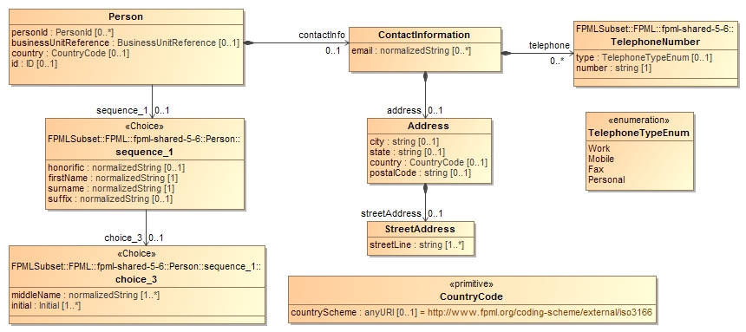
Person name and address - FPML

Slide 21
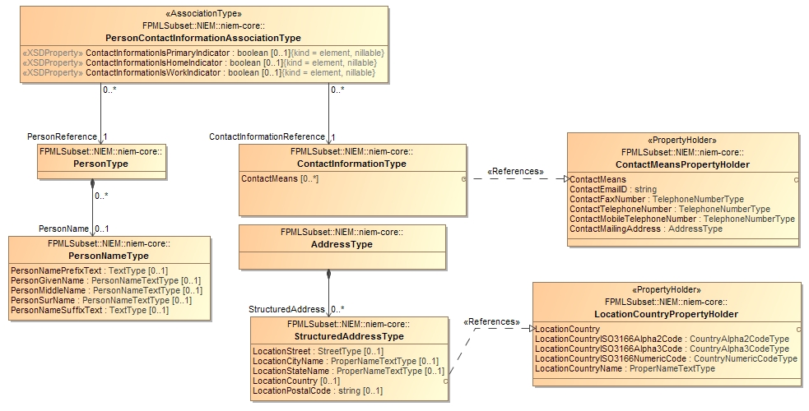
Person name and address – “NIEM*”
* This is one potential NIEM “subset”, there is more variability within NIEM

Slide 22

Foundational domain concept - Person (People)
All the human beings that have, do or will exist - real or imagined

Slide 23
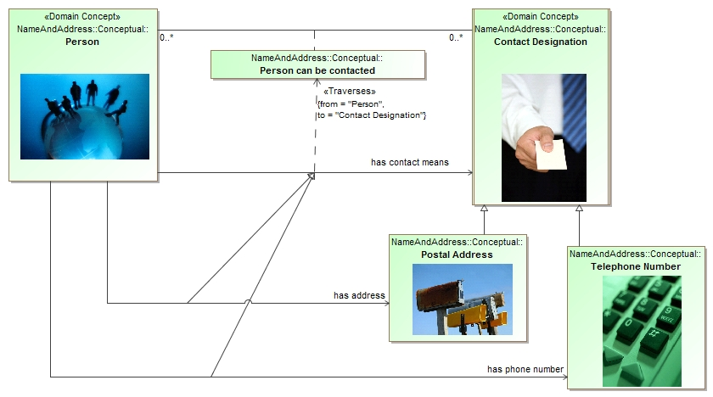
Specialized (constrained) relations

Slide 24
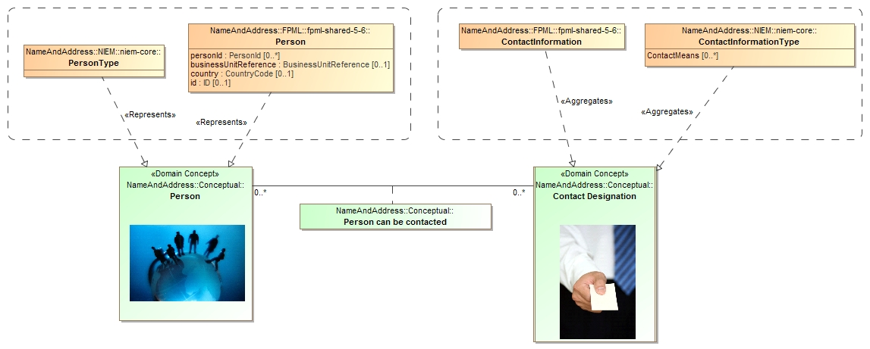
Path between classes

Slide 25
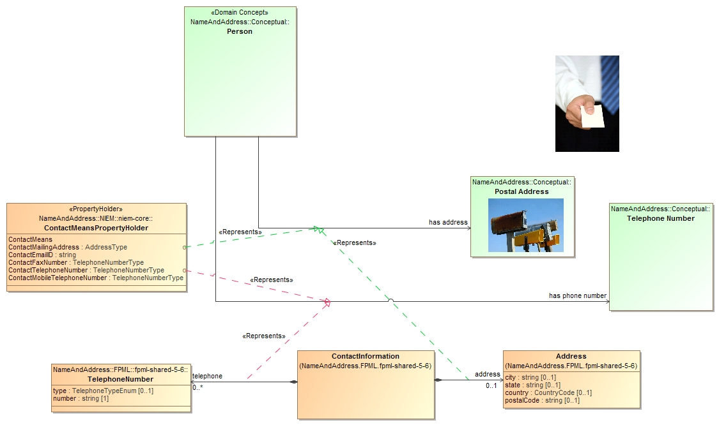
Path between properties/relations

Slide 26
Conceptual Model Example
Marriage

Slide 27
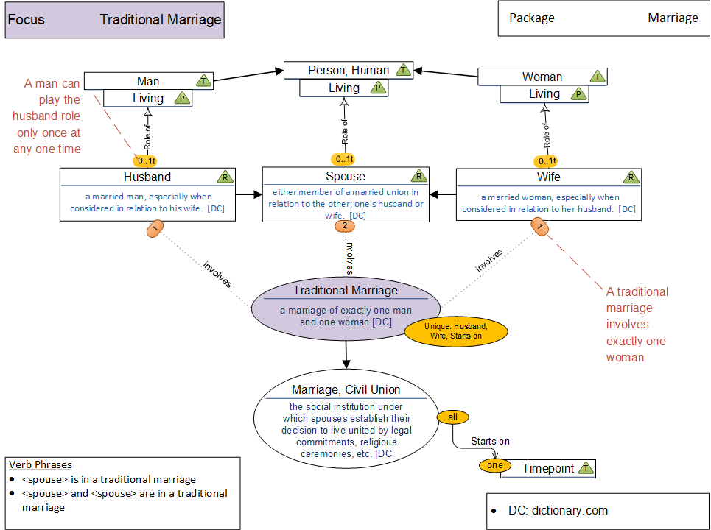
Context
Rule in context

Slide 28
Concepts & Meta Model

Slide 29
Example of SIMF concepts
Concept
Context
Types & “Instances”
Relations (Reified and verb forms, connected)
Situations
Properties
Expressions
Rules
Quantifiers
Representation
Generalization
Equivalence
Naming
Model structure & Lexical Scope

Slide 30
Context
In SIMF, a context connects a set of facts with a set of things those facts applies to. The context contextualizes a set of concepts that it applies to (concepts “in” that context). Facts and rules are defined in one or more context and apply to everything those contexts contextualize.
Anything that is asserted is asserted in at least one context (where it is stated –e.g. the model or DBMS), and probably many more.
Any interpretation (computation, inference, query) is based on a perspective that assumes a set of context.
SIMF makes context explicit.

Slide 31
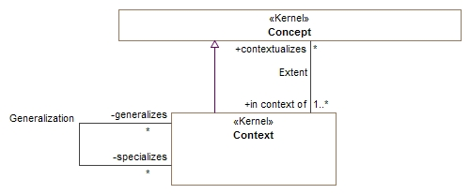

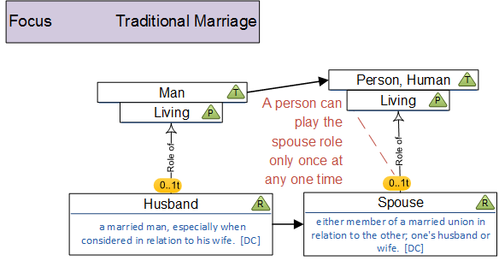
Context
Rules

Slide 32
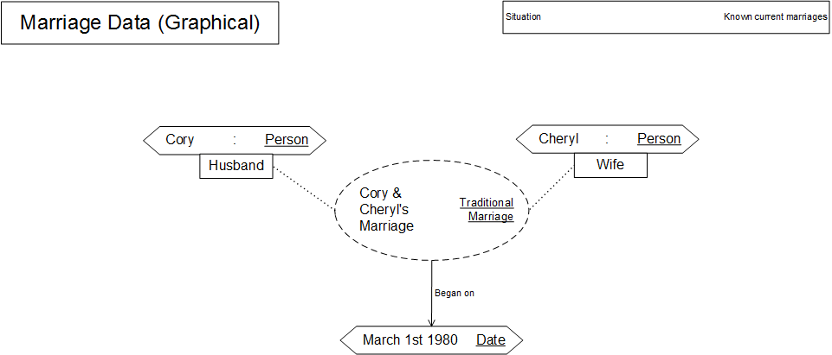
Concept
In Context
Rule Applies

Slide 33
A Few contextual dimensions
Location
Drivers in VA are subject to the radar detector law
Source of assertion (Source model)
What NIST says about units of measure
Time
From January 20th, 2001- January 20th, 2009 George W. Bush was president
Situations
It was 72 Degrees Fahrenheit in this room at 6 AM today

Slide 34
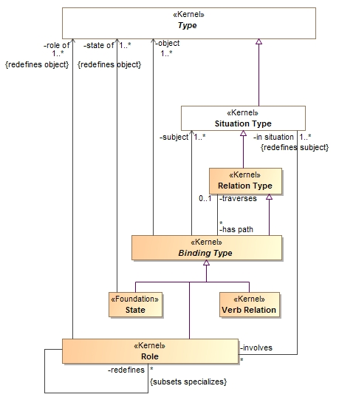
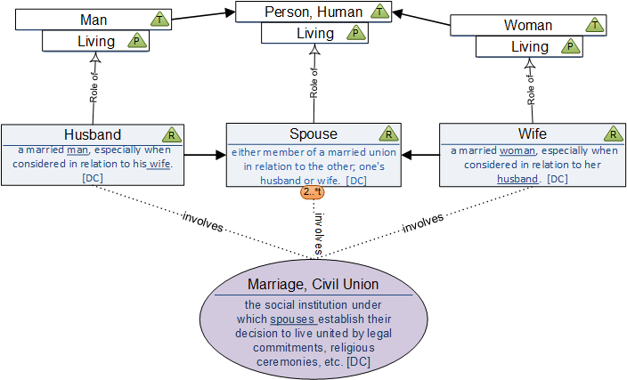
Relation Types

Slide 35
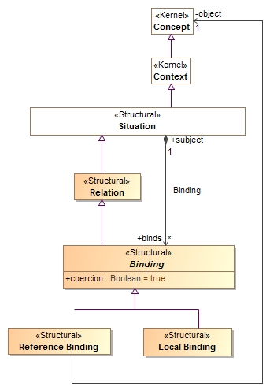
Relations

Slide 36
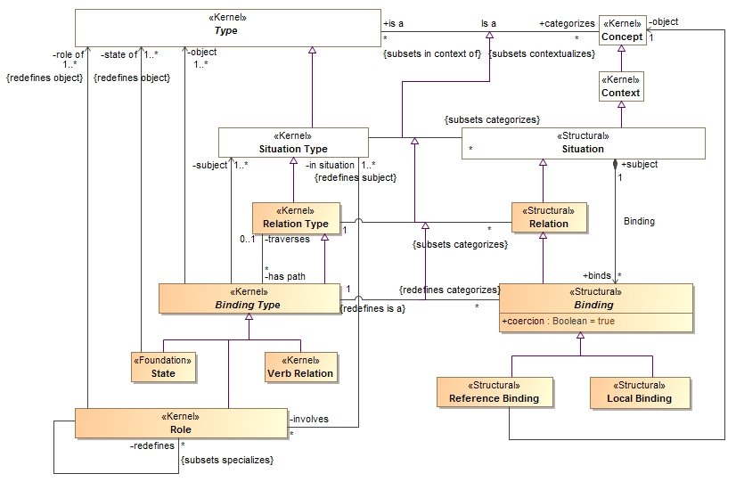
Relation types and instances

Slide 37
Spares

Slide 38
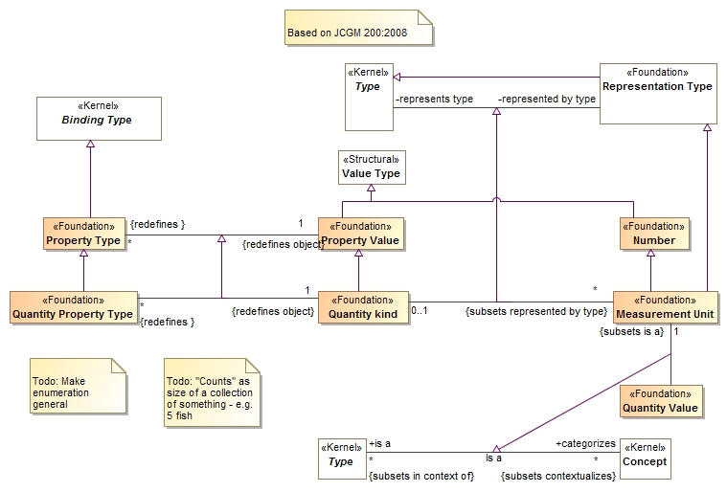
Properties

Slide 39
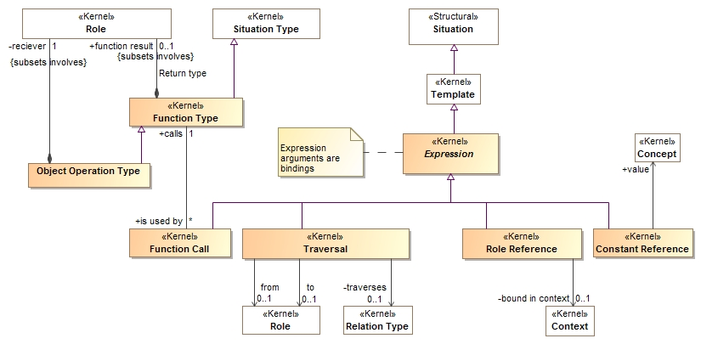
Expressions

Slide 40
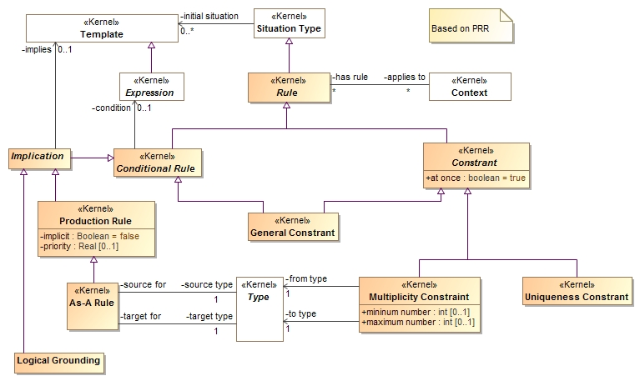
Rules

Slide 41
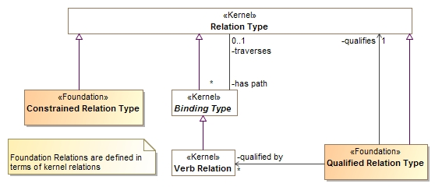
Foundation Relations
A constrained relation type must specialize another relation. The constrained relation may introduce new roles and rules that correspond to subtypes of the more general relation. If the more general relation is used and any of the role types match the specialized relation, the specialized relation in used instead.
A relation that holds under some condition. E.g. "in the past": john liked sue (in the past is implied and populates “qualified by”)

Slide 42
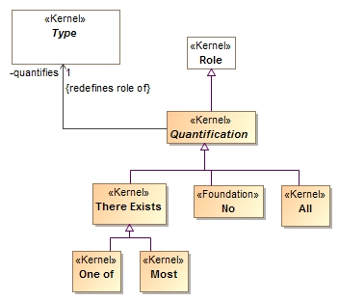
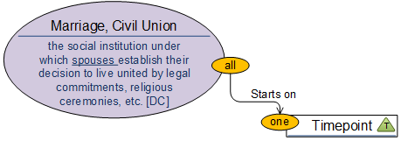
Quantifiers

Slide 43
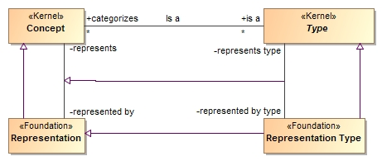
Representation
Not done

Slide 44
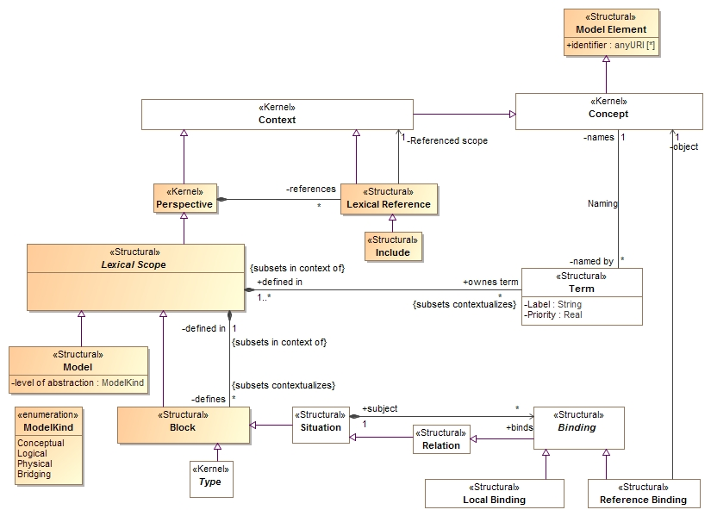
Model Structure & Lexical Scope

Slide 45
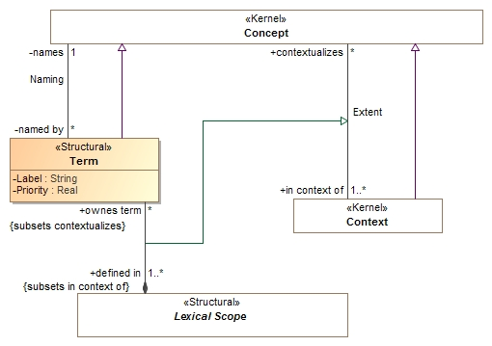
Naming

Slide 46
SIMF and Linked Data
Linked data provides a platform for data to be ubiquitously available and linked
The linking and semantics of the links is not well defined
OWL has largely not proved successful for wide-scale federation of independently conceived data – it is fragile, lacks expressability and is not stakeholder friendly
Linked Data (RDF) could become the delivery platform for data described using SIMF
OWL and RuleML Semantics can contribute to SIMF semantics, perhaps also be used as part of an implementation
XSD Data structures will be federated with the SIMF conceptual model
RDF representation of SIMF models provide for a SEMWEB definition
Perhaps this could become the design language for Semantically Linked Data (SDL)?

