Slide 1
Threat/Risk Submission Pictures

Slide 2
Conceptual Model Layering
Threat and Risk Specific Concepts – Fundamental “wide and shallow” risk and threat concepts/ E.G. Risk, threat, danger, consequence
Generic Concepts – Provides concepts and links across multiple viewpoints, not just threat/risk. E.G. Person, Objective
Foundational Concepts – Fundamental concepts for modeling anything: Entities, Roles, Relations, Types, Information, Rules, Identity, Etc…

Slide 3
Cyber
Crime
Terrorism
Critical Infrastructure
Natural
Disasters
Integrating Framework for Threats and Risks
Sharing & Analytics
Sharing & Analytics
Sharing & Analytics
Sharing & Analytics
Sharing & Analytics

Slide 4






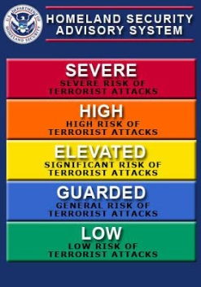
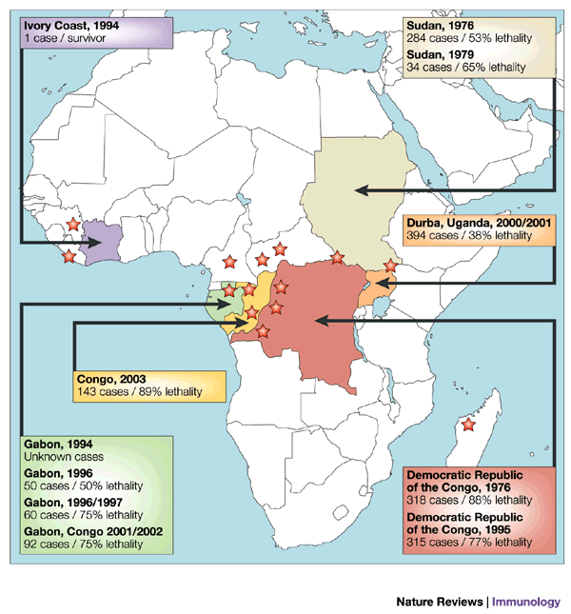
Stakeholder Knowledge
Capabilities
Federation
Analytics
Simulation
Data

Slide 5
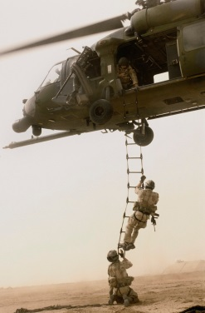
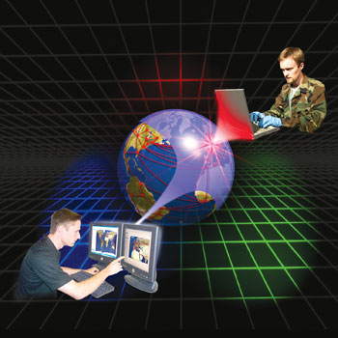
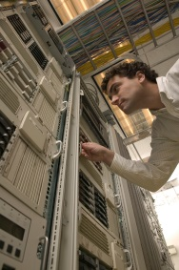
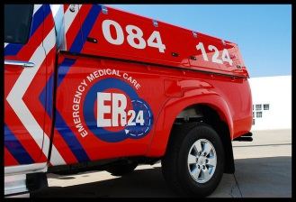
Stakeholder roles in our community
Risk/Threat
Information Sources
Data Fusion
& Brokering
Analysts
Responders
Vendors & Service Providers
One organization may play multiple roles

Slide 6
Past
Future
1
Now
Attack
Creating sharable content
system
2
Similar attack is mitigated
3
Indicators,
Patterns,
Courses of actions,
Other useful knowledge
4
Sharing
Mitigation

Slide 7


