Slide 1


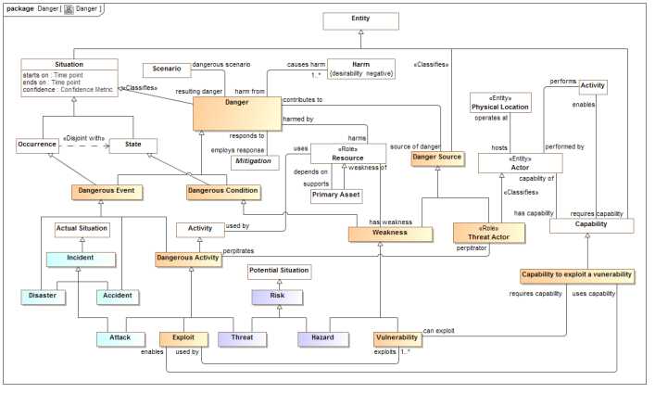
Threat/Risk
Reference Ontology
NIEM
(General)
KDM
(Risk)
NIST Framework
STIX
(Cyber)
OGC
(Geo)
EDXL
(Emergency)
FIBO (Finance)
SEI
(Safety)
CAL OES
(Health)
ISO
(Risk)
ISO
(Units)
RMS
(Custody)
Data Schema
XML, SQL, JSON, Etc.
Operational Ontologies
(OWL, FLORA-2, Etc)
Reference Models
Data Transformations
Vocabularies

