Slide 1

Threat and Risk Information Sharing and Federation
Building Capabilities Based on the Evolving Standard
Cory Casanave
Model Driven Solutions

Slide 2
What we need is an integrating framework that supports automated data mapping
Cyber
Crime
Terrorism
IOT &
Critical Infrastructure
Natural
Disasters
Integrating Framework for Threats and Risks
Sharing & Analytics
Sharing & Analytics
Sharing & Analytics
Sharing & Analytics
Sharing & Analytics
An integrating framework that helps us deal with all aspects of a risk or incident
A federation of risk and threat information sharing and analytics capabilities

Slide 3
Situational awareness across cyber/physical threats and risks
Cyber
System Analysis
(Design Time)
Architecture
Design
Assurance
System Focus
Situational Awareness
(Real Time)
Threat information sharing
Threat information federation
Real-time analytics
Information focus
Externally visible subsystems
Vulnerabilities
Attack Vectors
Integrations: UML, UAF, Etc.
Integrations:
NIEM, STIX, EDXL, OGC, SEI, Etc.
Physical

Slide 4
Using Concepts to Share, Federate and Integrate Information
Is a threat actor “data”?

Slide 5
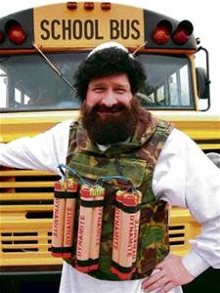
What is a threat actor?
Dictionary
A threat actor, also called a malicious actor, is an entity that is partially or wholly responsible for an incident that impacts – or has the potential to impact -- an organization's security.
Threat
Actor?
A threat actor is not a schema, it is a real person or organization threatening to cause undesirable impacts.
We can use that concept to federate or translate between multiple schema and data sources.

Slide 6
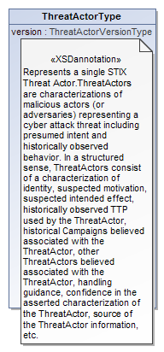
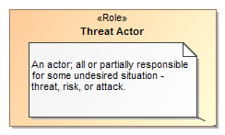
Data represents concepts
Represents

Slide 7
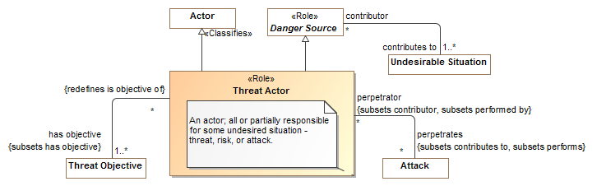
What is a threat actor? (SMIF Threat Model)

Slide 8
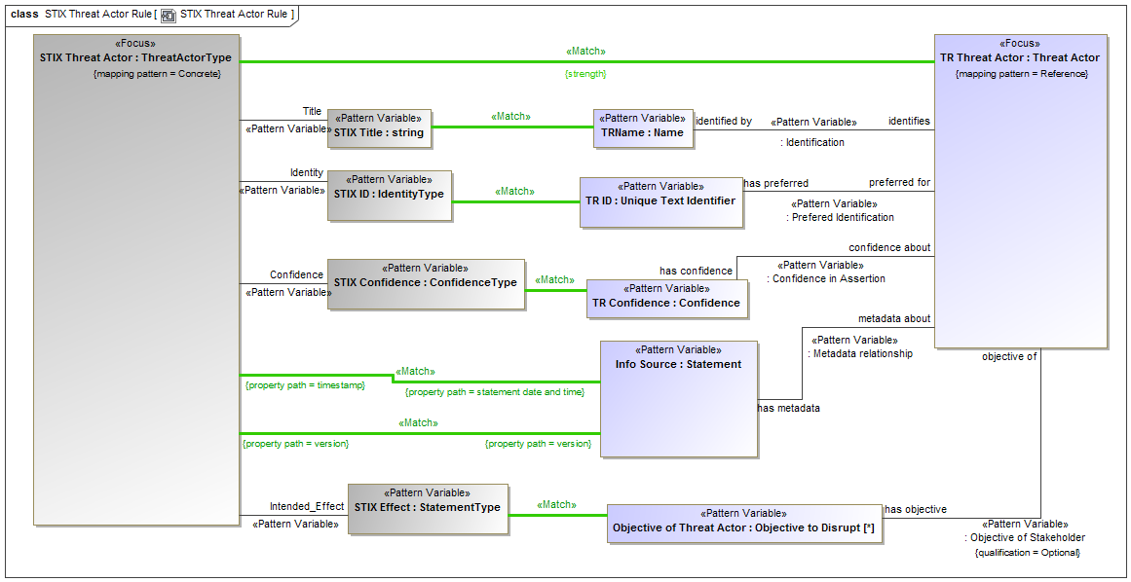
Example of Mapping Pattern (UML Profile)

Slide 9
Draft Standard
A standards effort for Threat and Risk information sharing and federation is coming to conclusion
More information here: https://github.com/ModelDriven/ThreatRisk/
However, a standard is not a capability. We present multiple options for mission critical capabilities leveraging this standard

Slide 10
What the Threat/Risk standard provides
The threat / risk standard provides a “Conceptual Model” that defines the concepts, ontology and vocabulary of the threat and risk domain
The concepts include both Cyber and Physical threats and risks as well as the context of those threats and risks to out citizens, enterprises and systems.
It also provides a “mapping” of those concepts to “STIX” and “NIEM Core”. Other mappings may be added.
Data in these and other mapped data formats can then be combined (federated) or translated to both “connect the dots” and communicate the results.

Slide 11
Capabilities that leverage the standard
A standard specifies how to do something, it is not a System, Process, Product or Service.
Such Systems, Processes, Products or Services provide the capabilities that help organizations improve their situational awareness to combat or mediate the impact of terrorism, cyber crime, natural disasters, or other threats.
The following presents potential Threat & Risk use cases and capabilities that could leverage the standard. Each of these potential capabilities would require additional investment.
Most of these capabilities could be “horizontal” in nature, benefitting multiple organizations. Specific projects could be horizontal or specific to a partner’s mission need.
Note that the use cases and capabilities expressed here are only examples, there are thousands of potential applications of the fundamental ability to connect and federate.

Slide 12
Example use cases
Protection of critical infrastructure through information sharing and analytics. Specific use cases for the electric grid (Duke Energy)
Large company understanding and acting on its threat/risk landscape
Fusion center “connecting the dots” by federating multiple data sources
California Governor’s Office of Emergency Services fusing BioWatch and other data for better decision making
Integration of STIX (Cyber) data with physical threats and risks for all-hazards
Retail Sector Point of Sales Attack
Securing the supply chain for Air Force avionics
Physical attack on Transformer Yields Cyber and Kinetic Effects
Threat to electronic healthcare records
DoD Information Sharing Portal
Federating information for evaluating the trust of individuals and organizations
Victim information compromise
Theft of laptop exposes credentials resulting in loss of confidential information
State Cybercrime Investigation
Aligning risk models along the dependencies between systems

Slide 13
Capability: Federation & Analytics Engine
Mission need: Combine information from multiple information sources, organizations and technologies to “connect the dots” with advanced analytics.
Capability: Federation engine uses technical adapters to ingest data sources. This data is mapped to a common format based on the threat/risk model. Multiple analytics tools consume this information to “connect the dots” and assist human analysts.
What is required: Technologies exist to get the data. Semantic rule-based technologies would be leveraged to translate multiple incoming formats to a common one, based on the shared vocabulary. Existing analytics and visualization tools would provide the “front end” capability for analysts.

Slide 14
Use case: Information Sharing and Analysis Organizations (ISAOs) Integration
Problem: There are multiple ISAO organization, each focused on a particular kind of problem or domain. There is currently no way to federate and analyze the information across all the ISAOS.
Capability: An “Federation & Analytics Engine” capability could enable an ISAO for federating the information of other ISAOs and for assisting the communications between them.

Slide 15
Use Case: Trust and Clearance Information
Problem: Evaluating the trustworthiness of individuals for entry, citizenship or access to sensitive information requires access to and evaluating the connections between diverse information sources.
Capability: An “Federation & Analytics Engine” capability could enable an organization, such as DSS, to have a composite view of public, personal and governmental information on individuals as well as the organizations they are in contact with and the activates they have participated in.

Slide 16
Use Case: Cyber Threat Analytics
Problem: Evaluation of Cyber Threats goes beyond technical network and application intrusion to include social, political, geographic and physical factors.
Capability: An “Federation & Analytics Engine” capability could enable technology based Cyber Intrusion information to be combined with public, private and commercial information on people, organizations and activities to better detect and mediate cyber threats.

Slide 17
Capability: Threat and Risk “Data Lake”
Mission Need: Multiple organizations have information that is a “piece of the puzzle” and is best combined and shared as a trusted community. However, the information has no consistency or common vocabulary.
Capability: The threat and risk conceptual model is the basis for the schema of a flexible information repository managed by a trusted partner. Member organizations populate the repository in their own data formats, these are then mapped to the data lake based on threat/risk mappings.
What is required: A flexible “graph database” and query would be the technical foundation of the repository, populated based on mapping rules. Any number of frameworks can provide for the raw data mapping. OMG Information Exchange Framework (IEF)is utilized to provide the subset of that information that each party is entitled to have access to.

Slide 18
Use Case: Cyber Intrusions
Problem: Individual organizations are capturing information on cyber intrusions – their sources and targets. Multiple products capture analyze these intrusions. However, intrusions across federal and state governments are not considered together.
Capability: A Cyber-intrusion data lake would allow for the federation of intrusion information and for multiple tools to analyze that information, across multiple organizations. Information sensitive to a particular organization would not be visible to unauthorized partners.

Slide 19
Use Case: Emergency Response Facilities
Problem: In the case of a natural or man-made disaster facilities capable of addressing individuals medical, housing, security and nutrition needs may need to be located and accessed quickly and with minimal ability to coordinate.
Capability: A data lake of facilities capable of assisting individuals in needs as well as their capacities and status would allow multiple first responder organizations to better optimize the available resources and address critical needs quickly.

Slide 20
Capability: Threat Information Translation
Mission Need: Information system programmed for a specific information format may need to produce or consumer information in another format.
Capability: An information translator based on the threat/risk model is able to receive a message in one format and translate that information to another format and vocabulary.
What is needed: The translation engine capability would utilize existing messaging infrastructures and add the capability to map the data based on conceptual models and existing data schema.

Slide 21
Use Case: STIX to NIEM Translation
Problem: Detailed cyber threat information is communicated via “STIX” and a subset of this information may be relevant for law enforcement. However, the STIXC information is more complex than law enforcement would need and not in a form they can receive it.
Capability: An information translator would receive STIX information from a variety of sources, filter that information for applicability, and produce NIEM “Suspicious Activity Reports” (SAR) for cyber events that require action.
What is required: The NIEM mapping to the conceptual model would be augmented with the SAR schema. The runtime capability would use user-defined filtering rules to map the incoming STIX data to a SAR. This would result in a SAR report for applicable cyber events.

Slide 22
Summary
The threat/risk conceptual model is the foundation for capabilities to share, integrate and analyze threats and risks across Cyber, Cyber/Physical and other domains.
If you have or need such information, get involved. Review / Prototype, Extend!
Join us!
Contact: cory-c@modeldriven.com

