Slide 1
Design Overview

Slide 2
Generated Packages
fUML.Library.* - generated
fUML.Semantics.* - generated
fUML.Syntax.* - generated
fUML.Test.* - generated
fUML.Utility.* - generated

Slide 3
Custom Packages
Technologies
Stream Parsing (StAX)
XML Schema
Java Data Binding
XML

Slide 4
Custom Packages
fuml.model.* - runtime metadata
fuml.xmi.* - XMI import processing
fuml.xmi.stream.* - Stream imports
fuml.xmi.bind.* - XML Schema
fuml.xmi.validation .* - XMI Validation
fuml.assembly .* - creates fUML object-graphs
fuml.library .* - loads fUML libraries
fuml.event .* - event support

Slide 5
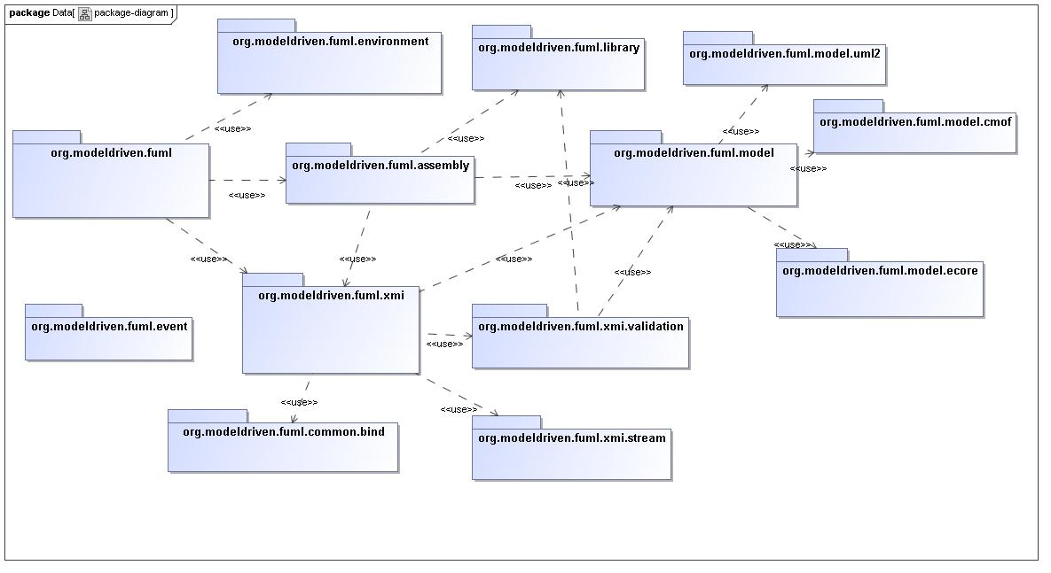
Custom Packages

Slide 6
org.modeldriven.fuml.model
Runtime available fUML metadata
Loads configurable set of metadata files
Fast Lookups: Package, Classifier, Property, Multiplicity, Defaults etc..
(XML Schema) Generated Java Model
Performs metadata document merge (initial)

Slide 7
org.modeldriven.fuml.xmi
Visitor pattern based
  Encapsulates traversal logic
Abstracts stream/data-binding processing
Abstracts internal/external processing

Slide 8
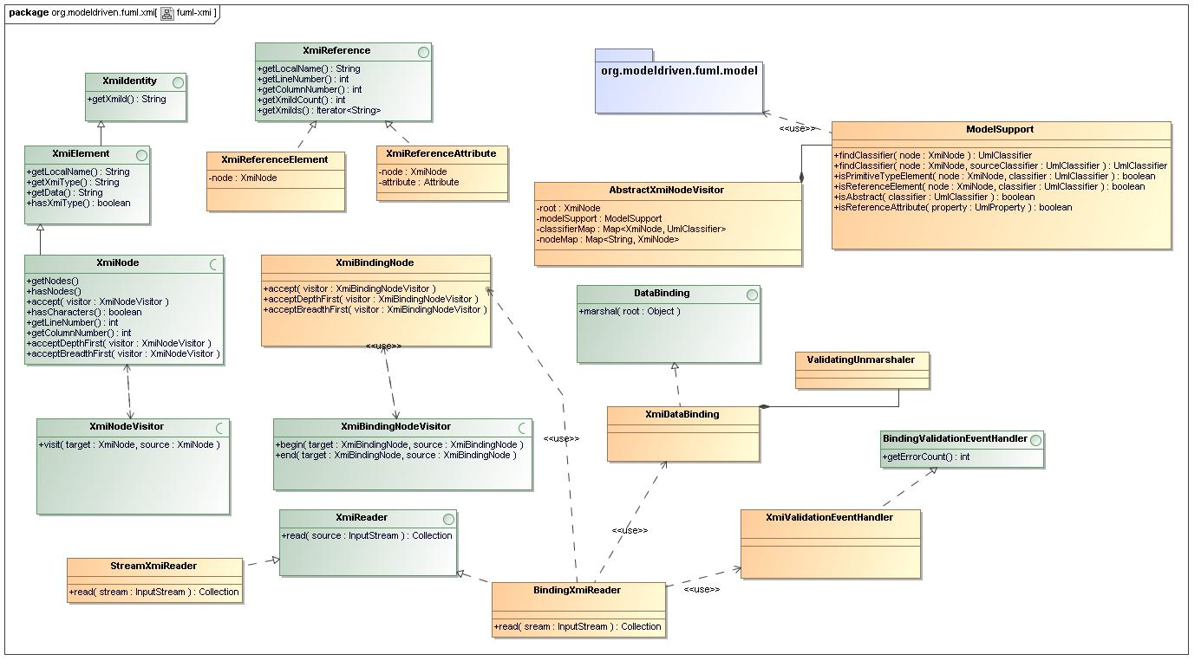
org.modeldriven.fuml.xmi
Class Diagram

Slide 9
org.modeldriven.fuml.xmi.stream
StAX (stream) pull-parser
  Flexible – event based and stream based
  Efficient – only read events you want
External XMI imports
Internal/External Library imports

Slide 10
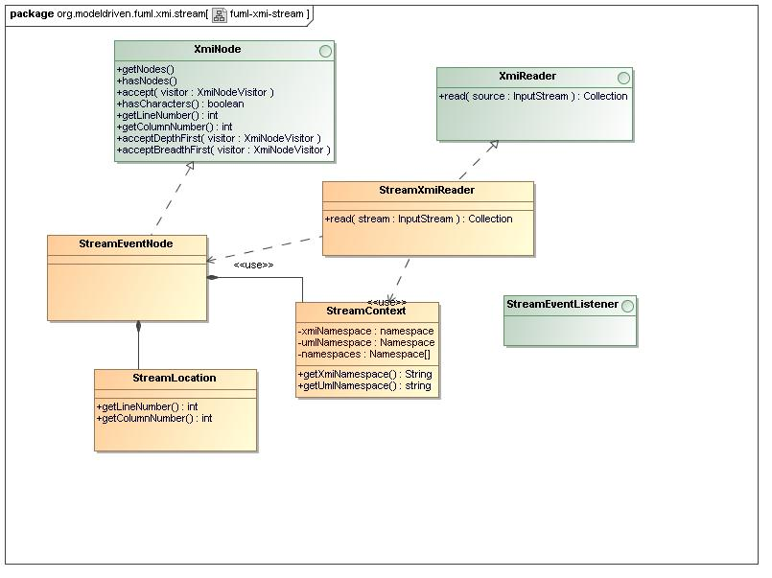
org.modeldriven.fuml.xmi.stream
Class Diagram

Slide 11
org.modeldriven.fuml.xmi.bind
JAXB Data-Binding based
XML Schema based (problematic for external imports)
Controlled internal metadata imports

Slide 12
org.modeldriven.fuml.xmi.validation
Strict model-driven XMI validation
Visitor pattern based
2-level Error classification
Detailed error messages
Detachable from execution environment

Slide 13
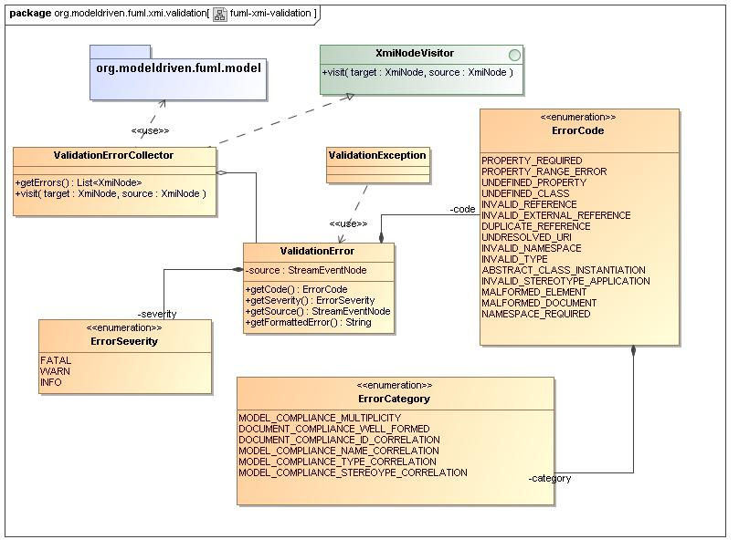
org.modeldriven.fuml.xmi.validation
Class Diagram

Slide 14
org.modeldriven.fuml.assembly
"Direct-to-fUML" approach
Visitor pattern based
3-stage assembly
  primitive features
  reference features
  hierarchical relationships

Slide 15
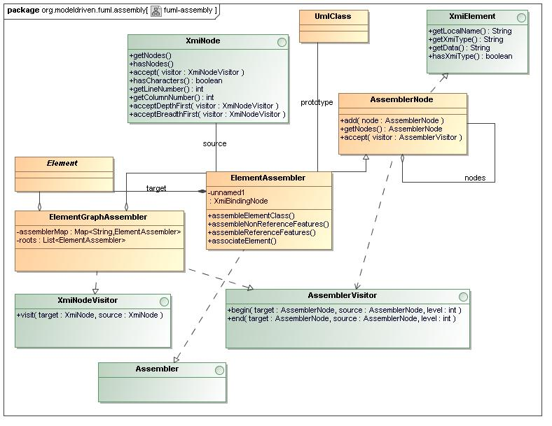
org.modeldriven.fuml.assembly
Class Diagram

Slide 16
org.modeldriven.fuml.library
Loads configurable set of XMI files
Performs strict model-driven validation
Assembles fUML object graph(s)
Cross references root elements with URIs

Slide 17
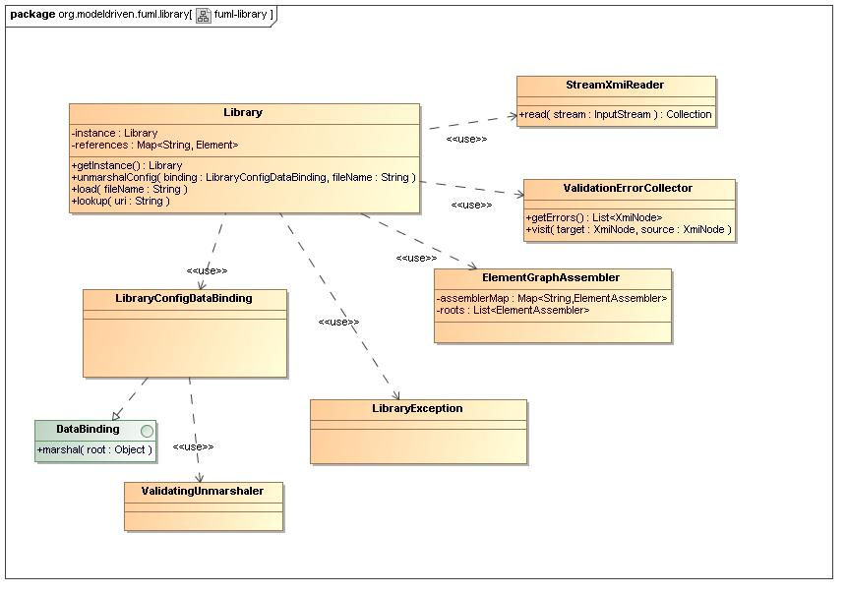
org.modeldriven.fuml.library
Class Diagram

Slide 18
org.modeldriven.fuml.event
Support web applications
Support third-party tools
Discuss!

Slide 19
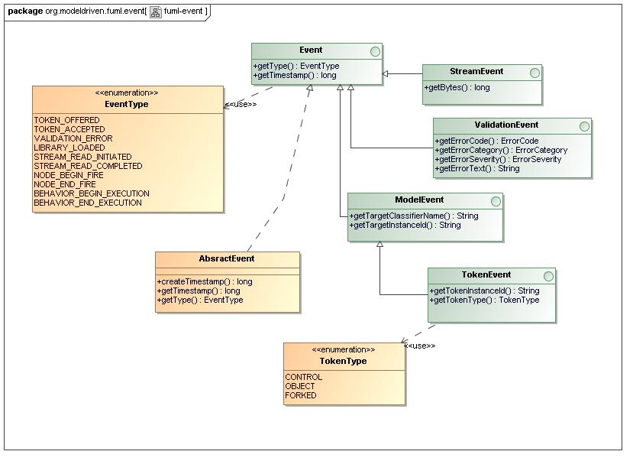
org.modeldriven.fuml.event
Class Diagram

