Slide 1
BIOE 437 / BIOE 537 Computational Systems Biology Verification and Validation of Models
Joseph L. Hellerstein*
Herbert Sauro**
November, 2023
*eScience Institute, Computer Science & Engineering
**BioEngineering
Notes:
Diverse students. Some with bio-backgrounds; some without. Some with CS background; some with very limited. Two separate courses combined because of a substantial shared curriculum.

Slide 2
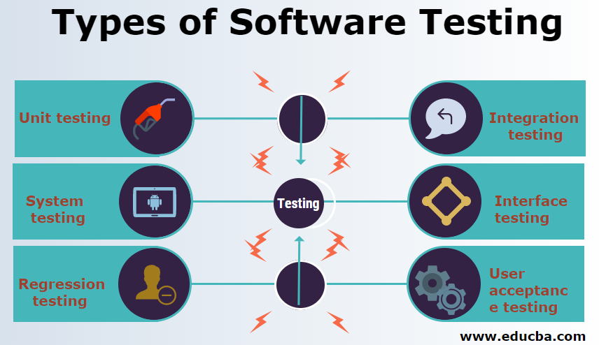
Static Errors

Slide 3
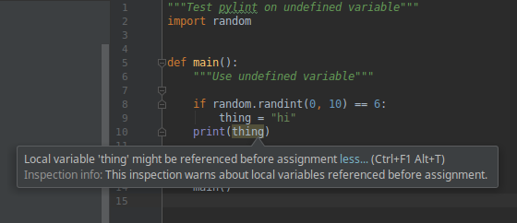
Software Linting Catches Static Errors
Static error: An error that can be detected without executing program codes.

Slide 4
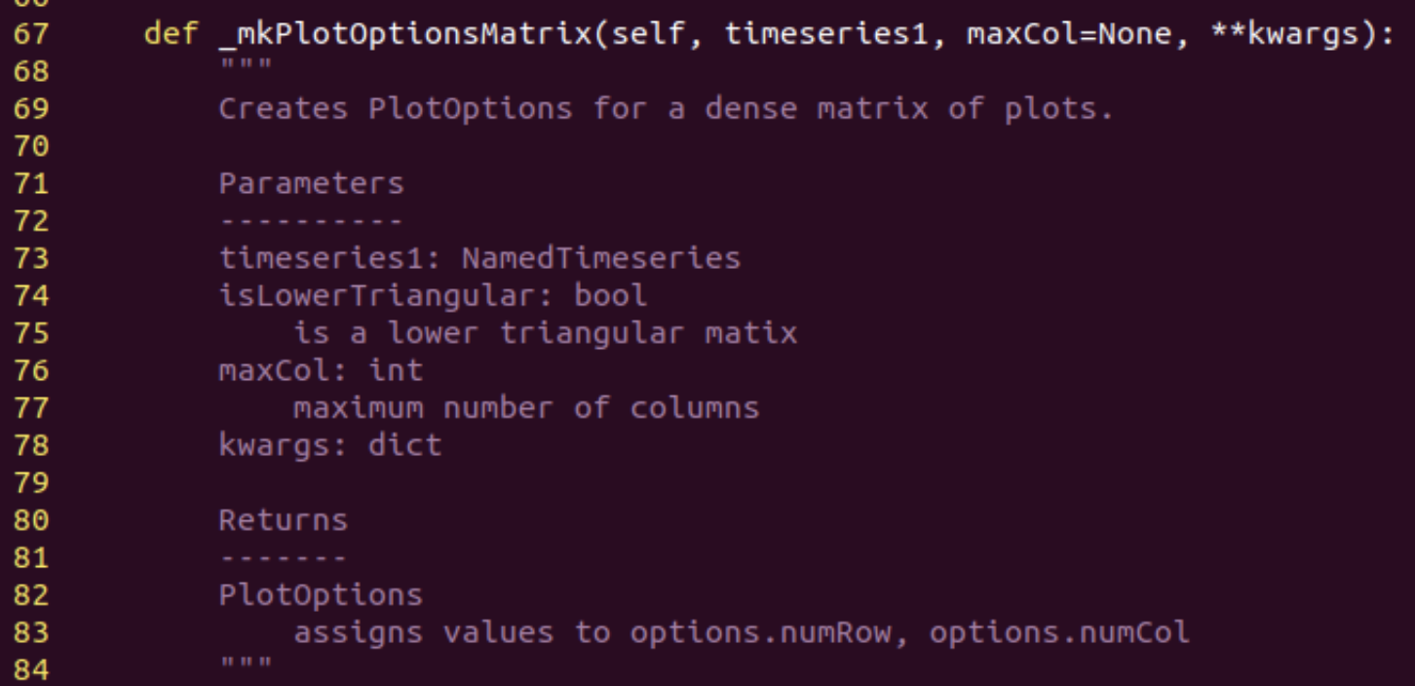
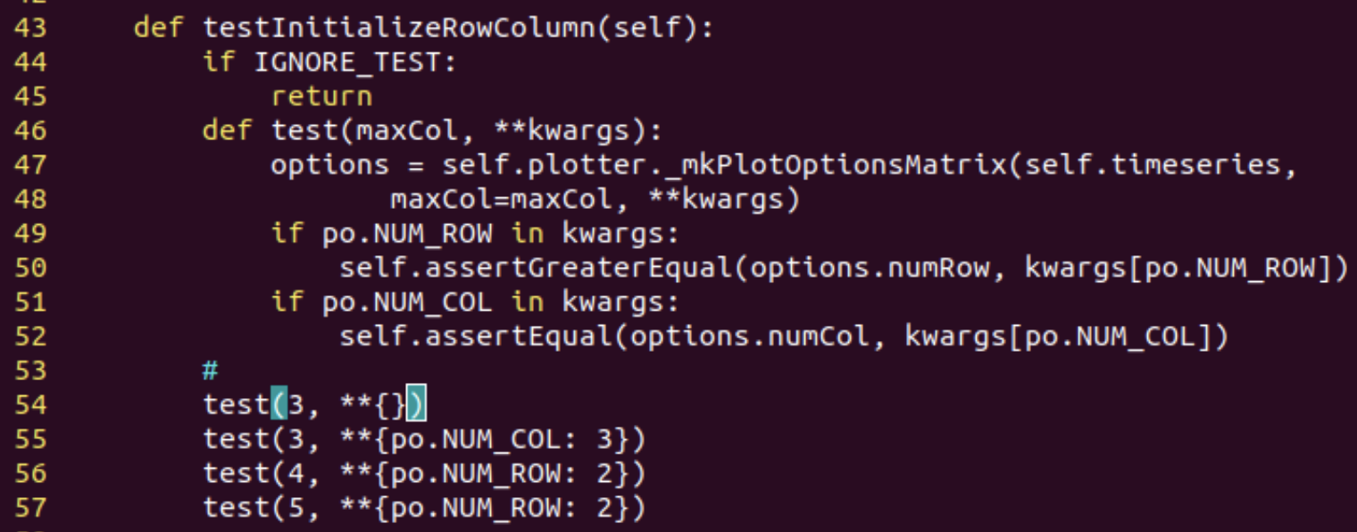
Unit Testing
 | No. Modules (Files) | Lines of Code
Package codes | 26 | ~6,000
Test codes | 33 | ~4,000
TOTAL | 59 | ~10,000
Mostly unit tests
Separate tests for each function ensures that all statements are executed.
Test code calls function.
Test code has assertions that verify predicates.

Slide 5
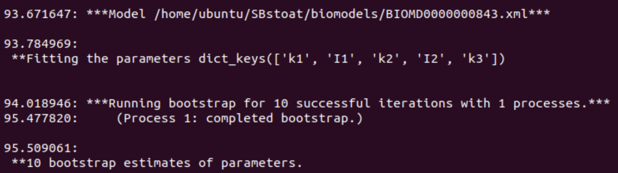
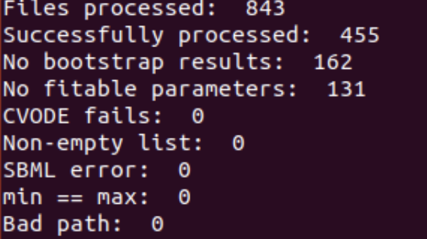
System Testing
Verify that codes operate as expected under normal conditions.
SBstoat System Testing: process ~800 models in BioModels.
Collect success/failure for each model.
Summary

Slide 6
Static Testing of BioMedical Models

Slide 7
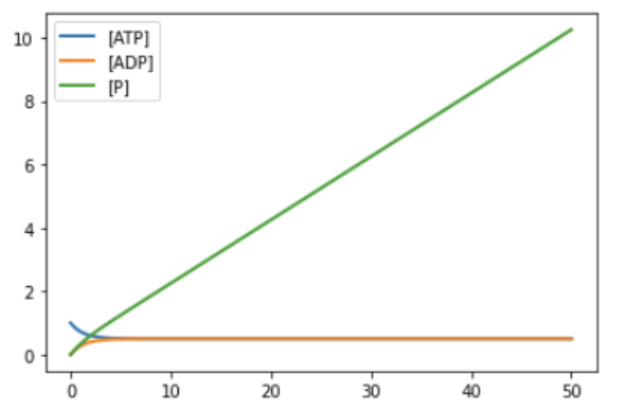
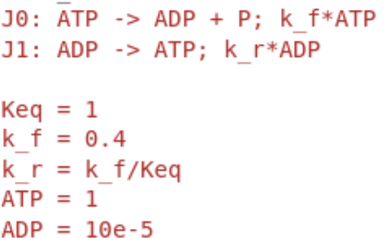
What’s Wrong With This Model?
Why does [P] increase without bound?
We have treated inorganic phosphate inconsistently.
P is included in J0
P is not included in J1
Broadly referred to as a mass balance error.

Slide 8

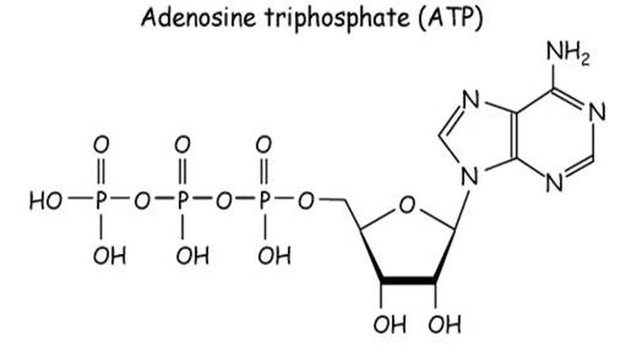

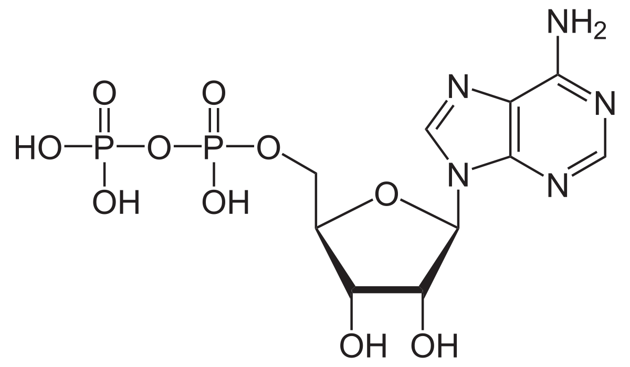
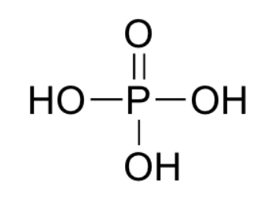
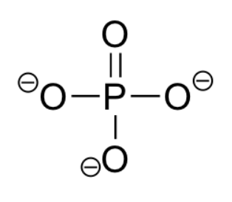

What Do We Mean by Mass Balance Errors
Is there mass missing in this reaction?
ATP
{
Has extra O and 2H.
In this reaction?
ADP
P?
Mass balanced.
Notes:
Even if we ignore the issue of protonation (which Pi), we still have a missing O when we add the atoms in Pi to ADP. This is because we haven’t included water in the reaction.

Slide 9

True Mass Balance May Not Be Desirable
True mass balance precludes having implicit chemical species
Present in large quantities so that concentration does not change (e.g., water)
Appeal of implicit chemical species
Simpler reactions
More efficient simulation

Slide 10
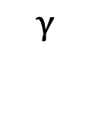


Moieties
A moiety refers to a collection of chemical species that have similar chemical functions.
Example: Variations in the chemical structure of inorganic phosphates.
Instances of inorganic phosphate moieties

Slide 11


Moiety Analysis
Moiety analysis provides a way to check consistency of reactions while having flexibility about the exact chemical formula
Chemical species are represented by their moiety structure
A reaction is “moiety preserving” if the counts of moieties in the reactants is the same as the counts in the products.
Molecule
Moiety | ATP | ADP | P
A | 1 | 1 | 0
P | 3 | 2 | 1
Moiety | ATP | ADP + P | Equal
A | 1 | 1 | Yes
P | 3 | 3 | Yes
Moiety | ATP | ADP | Equal
A | 1 | 1 | Yes
P | 3 | 2 | No
Implicit chemical species: P

Slide 12
Challenges With Moiety Analysis
Requires database of moiety structures for chemical species
Requires annotating models to identify chemical species
Moiety | ATP | ADP | P
A | 1 | 1 | 0
P | 3 | 2 | 1

Slide 13


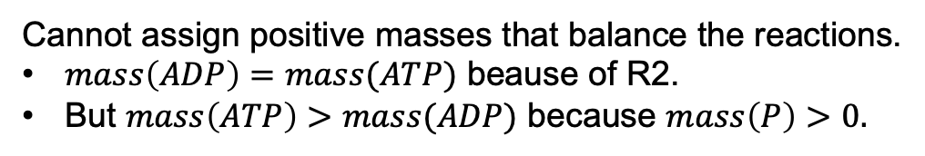

Stoichiometric inconsistency: There is no assignment of positive values of mass to chemical species such that all reactions are mass balanced.
Example

Slide 14




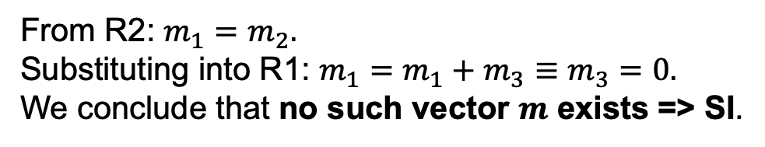
Finding Stoichiometric Inconsistencies (SI)
Stoichiometric inconsistency: There is no assignment of positive values of mass to chemical species such that all reactions are mass balanced.
1. Construct the mass equations for the reactions.
Is there way to detect SI in general?

Slide 15
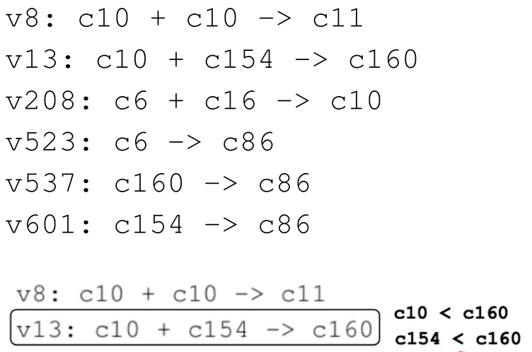

Finding More Complicated Mass Balance Errors
Part of ErbB signaling (BioModels 255)

Slide 16


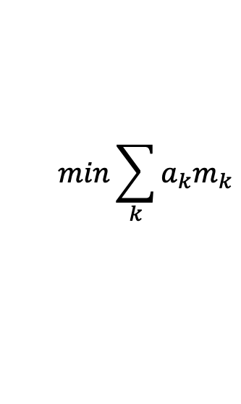
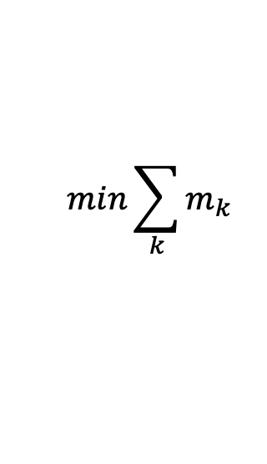

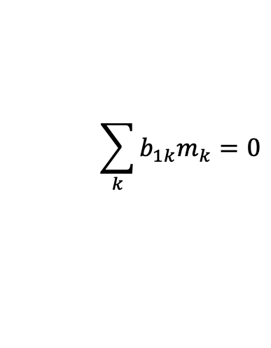
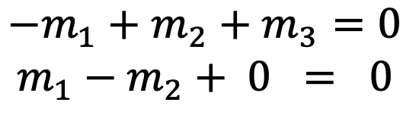
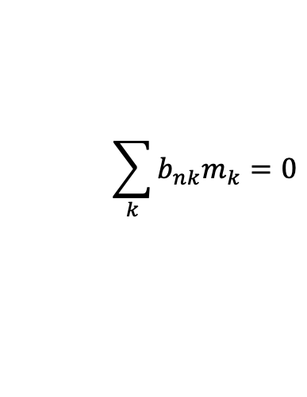






SI as a Linear Program
SI for ATP Hydrolysis
Linear Program
Constraints:
Feasibility problem: Verify constraints.
SI ⬄ Cannot solve feasibility.
Notes:
If we ignore the maximization, then this is a feasibility problem.

Slide 17

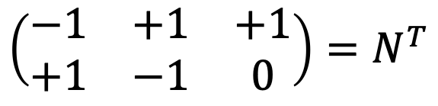
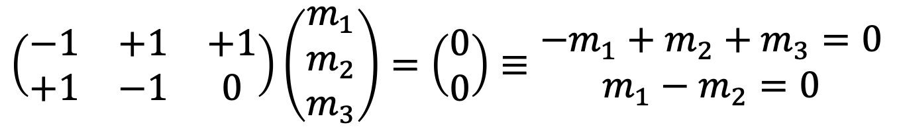
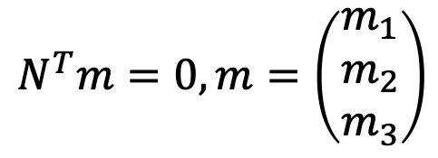
Equality constraints are determined by the stoichiometry matrix.
Transpose of stoichiometry matrix
ATP
ADP
P
R1
R2
Mass balance means that the sum of masses of reactants equals the sum of masses of the products for all reactions.
Matrix representation of the equality constraints.

Slide 18
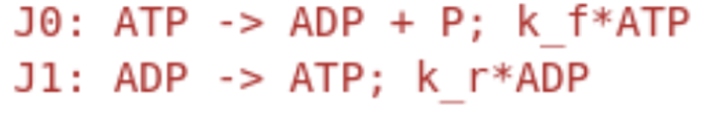
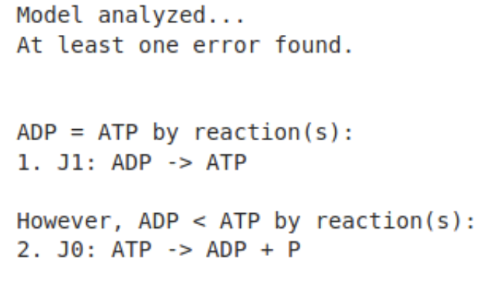
GAMES: Graphical Analysis of Mass Equivalent Sets
Isolates the cause of stoichiometric inconsistencies so that they can be resolved.
Isolation is accomplished by showing that a small subset of reactions explains the SI. These reactions are the focus for error remediation.

Slide 19
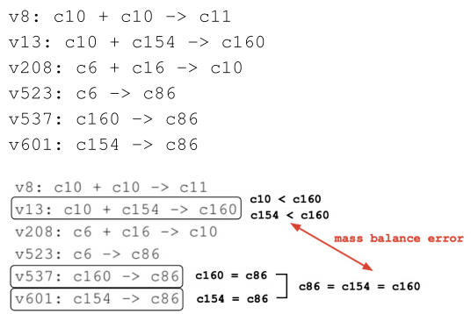
Isolating ErbB Signaling (BioModels 255)
Is there a stoichiometric inconsistency here? Where?
Isolating errors is required to remediate complex errors.

Slide 20
GAMES: Graphical Analysis of Mass Equivalent Sets
C6=C86=c154=c160
v537, v601, v503
v13
Graphical Algorithm
1.Form MEQs
2. Construct pseudo reactions using MEQs
3. Construct MEQ Graph, where arc means “greater than”
4. Look for and report cycles in MEQ Graph
Explain SI by the cycle.
Issue – Cannot handle multi-multi reactions.
Extended Algorithm – Incorporate multi-multi reactions.

Slide 21
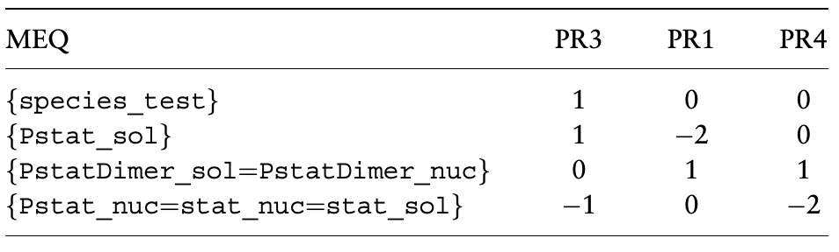
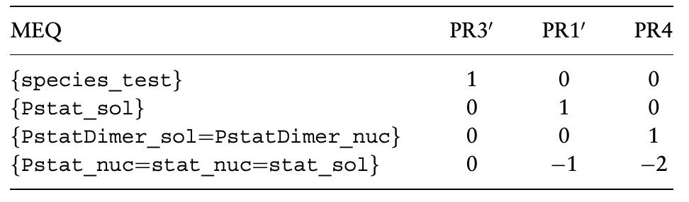
Extended GAMES
PR = Pseudo Reaction
SI exists if the non-zero terms for a PR are all of one sign.

Slide 22
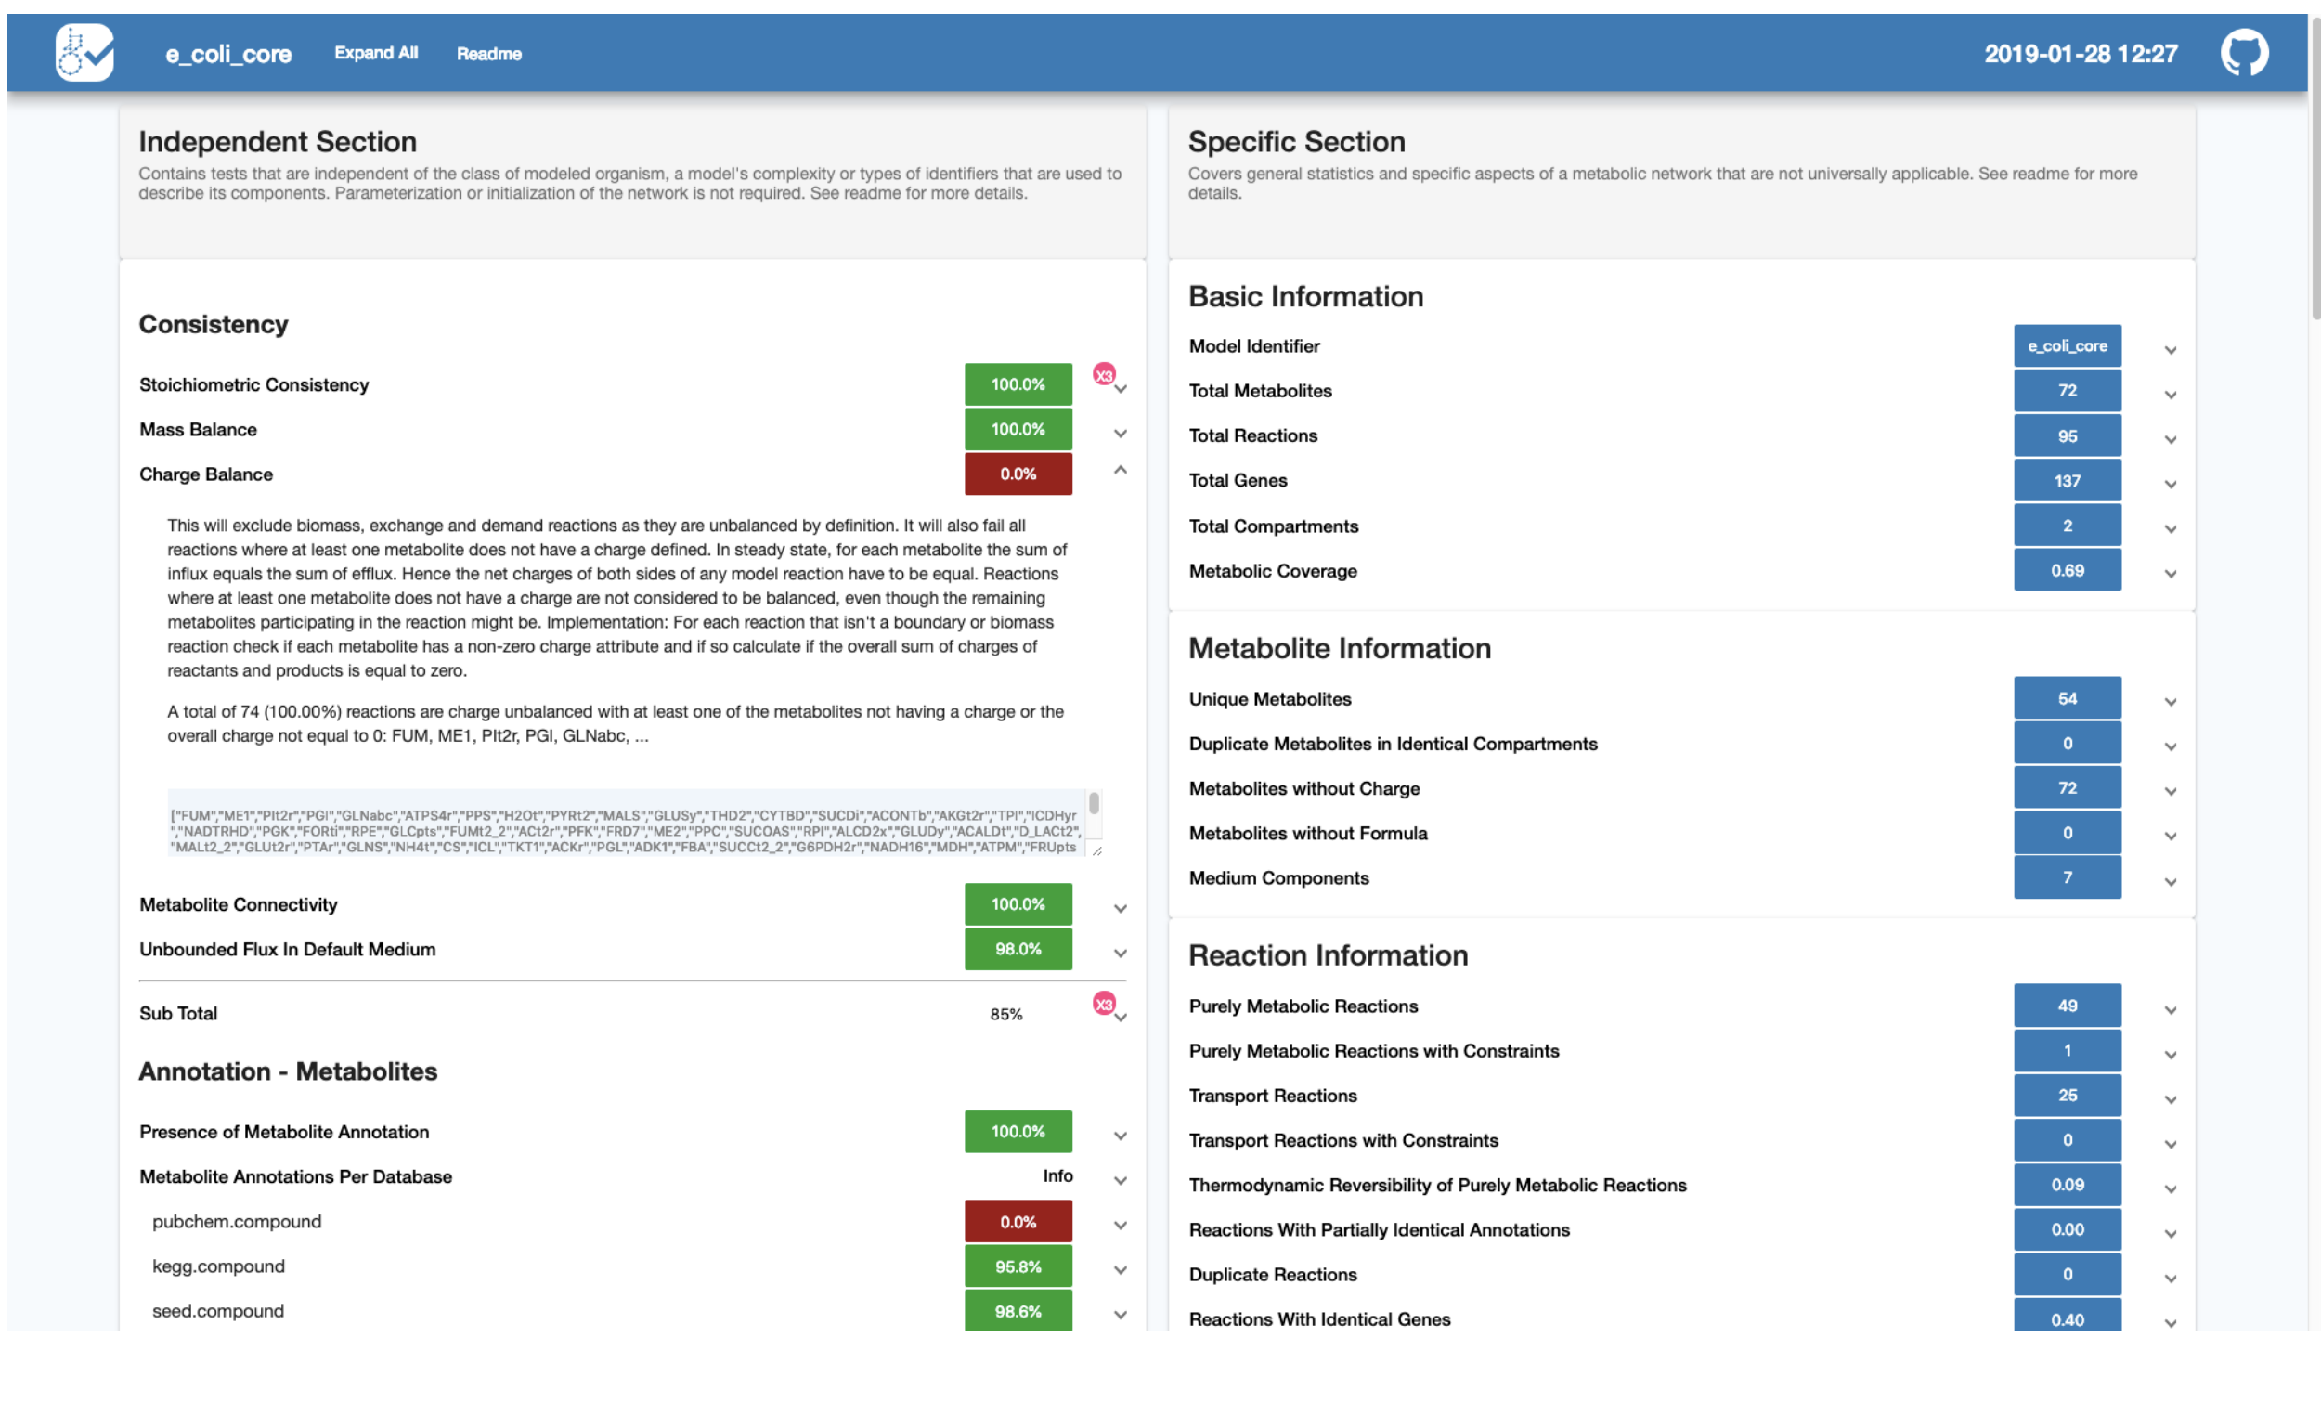
Other Static Analyses: MEMOTE*
*Nature Biotechnology, March, 2020.

Slide 23
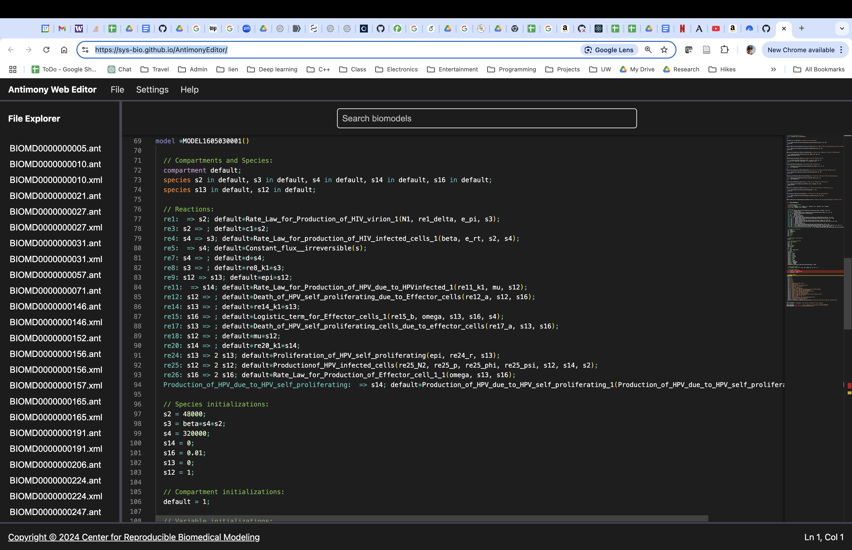
Source Editor for Antimony Models: Antimony Web Editor (AWE)
https://sys-bio.github.io/AntimonyEditor/

