Slide 1
BIOE 437 / BIOE 537 Computational Systems Biology Design of Experiments (DOE): Overview
Joseph L. Hellerstein*
Herbert Sauro**
October, 2023
*eScience Institute, Computer Science & Engineering
**BioEngineering
Notes:
Diverse students. Some with bio-backgrounds; some without. Some with CS background; some with very limited. Two separate courses combined because of a substantial shared curriculum.

Slide 2

Design of Experiments (DOE) is exemplified by optimizing industrial processes.

Slide 3
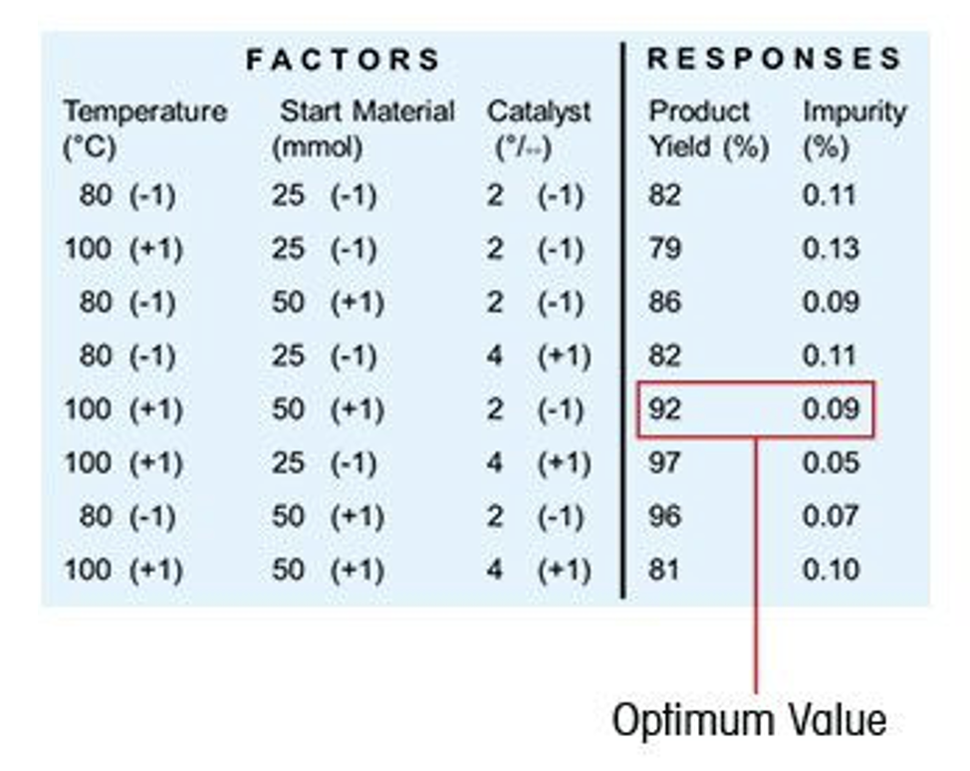
Motivation
Find relationship between inputs (factors) and outputs (responses).
$$Yield=EffectOfTemperature+EffectOfMaterial+EffectOfCatalyst$$

Slide 4
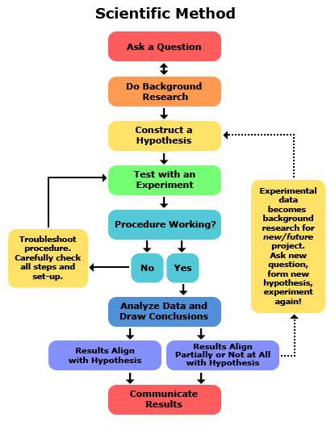
Design of experiments (DOE)
An experimental design is developed to address a research or business question.

Slide 5
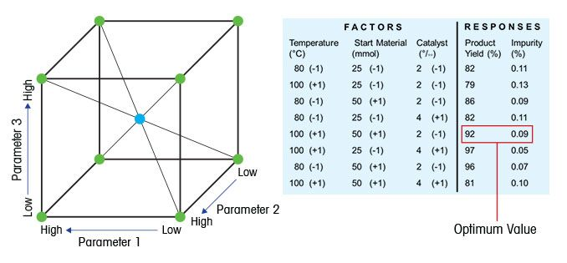
Key Concepts in Design of Experiments (DOE)
Factor: Something changed in the experiment (e.g., parameter)
Level of factor: Value/setting of a factor (something that is controlled)
Condition: The levels assigned to factors for an experiment
Response: Measured result of an experiment
An experiment is done under one condition.
Experiments are designed for a purpose, like finding the best combination factor levels for a chemical process.
An experimental design specifies the:
the collection of conditions considered
response values to measure

Slide 6
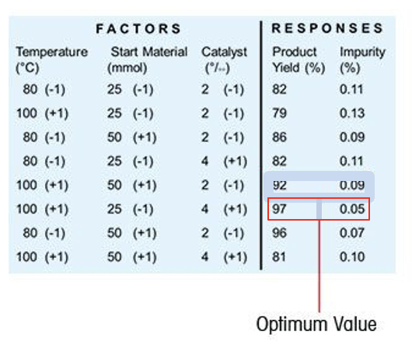
Visualizing Conditions
4
2
quantity
25
catalyst
catalyst
4
50
25
2
100
80
quantity
100
temperature
50
80
temperature
Each vertex is a condition, a combination of factor levels.
A condition corresponds to a row in the table.

Slide 7
The Baseline Perspective
2
quantity
25
catalyst
4
50
100
temperature
Factor: Something changed in the experiment (e.g., parameter)
Level of factor: Value/setting of a factor.
Response: Measured result of an experiment
Baseline
Since there are often a large number of factors, an experiment is specified by the levels of factors that are not at their baseline values.

Slide 8
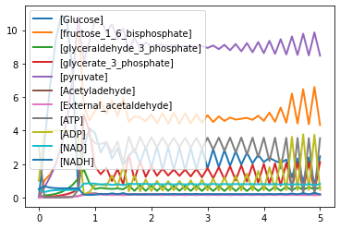
Wolf Model
Reaction Rates and kinetic constants
J0: J0_inputFlux;
J1: J1_k1*Glucose*ATP*(1/(1 + (ATP/J1_Ki)^J1_n))
J2: J2_k*fructose_1_6_bisphosphate;
J3: J3_k*glyceraldehyde_3_phosphate*NADH
J4: (J4_kg*J4_kp*glyceraldehyde_3_phosphate*NAD*ADP
- J4_ka*J4_kk*glycerate_3_phosphate*ATP*NADH)
/(J4_ka*NADH + J4_kp*ADP)
J5: J5_k*glycerate_3_phosphate*ADP;
J6: J6_k*pyruvate*B
J7: J7_k*Acetyladehyde*NADH
J8: J8_k1*Acetyladehyde - J8_k2*External_acetaldehyde
J9: J9_k*ATP;
J10: J10_k*External_acetaldehyde;
Notes:
Why isn’t there a 0% change in 1WD?

Slide 9
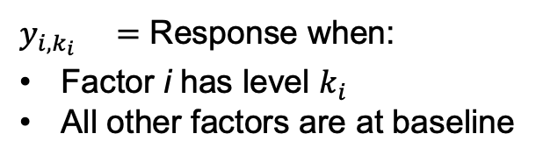
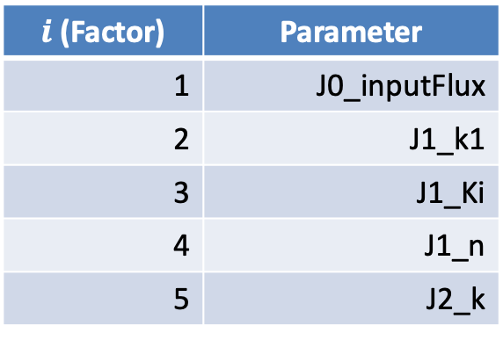



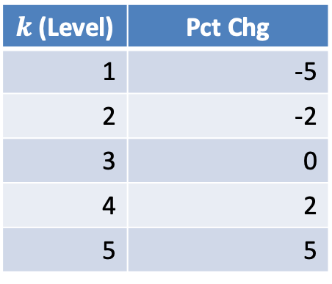
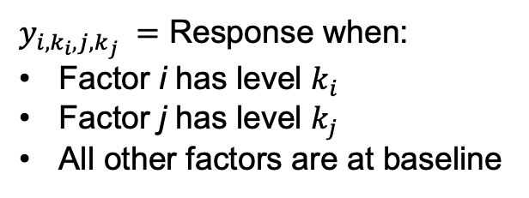
Specifying Experiments (Condition)
${y_{i,k_{i}}}_{} =$ Response when:
Factor i has level $k_{i}$
All other factors are at baseline
$y_{i,k_{i},j,k_{j}} =$ Response when:
Factor i has level $k_{i}$
Factor j has level $k_{j}$
All other factors are at baseline
In the Wolf model, the factors are 16 parameters. Consider 5 levels.
$i$ (Factor) | Parameter
1 | J0_inputFlux
2 | J1_k1
3 | J1_Ki
4 | J1_n
5 | J2_k
$k$ (Level) | Pct Chg
1 | -5
2 | -2
3 | 0
4 | 2
5 | 5
Parameter 1 | Pct Chg 1 | Parameter 2 | Pct Chg 2
J1_k1 | -2 | J1_n | 5
J1_Ki | -5 | J2_k | 2
J1_k1 | -2
Experiment conducted for $y_{2,2,4,5 }?$
Experiment conducted for $y_{3,1,5,4 }?$
Experiment conducted for $y_{2,2 }?$
Notes:
This is a lot of notation. Needed to scale to a large number of factors and levels.
The number of subscripts is two times the number of factors not at their baseline value.

Slide 10
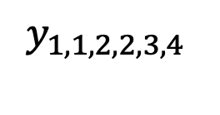
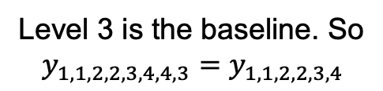
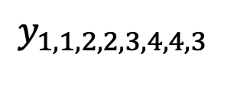
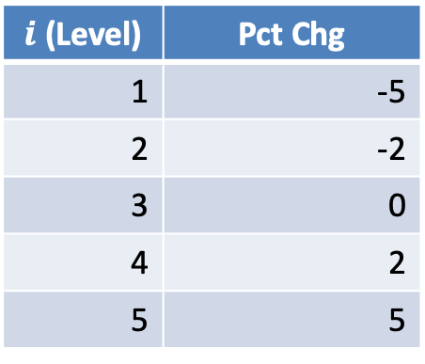
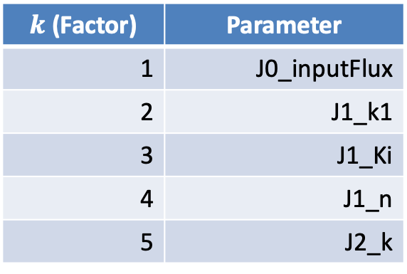
More Complicated Experiments
$k$ (Factor) | Parameter
1 | J0_inputFlux
2 | J1_k1
3 | J1_Ki
4 | J1_n
5 | J2_k
$i$ (Level) | Pct Chg
1 | -5
2 | -2
3 | 0
4 | 2
5 | 5
$$y_{1,1,2,2,3,4}$$
$$y_{1,1,2,2,3,4,4,3}$$
Parameter | Pct Chg
J0_inputFlux | -5
J1_k1 | -2
J1_Ki | 2
Level 3 is the baseline. So
$$y_{1,1,2,2,3,4,4,3}=y_{1,1,2,2,3,4}$$
Notes:
This is a lot of notation. Needed to scale to a large number of factors and levels.
The number of subscripts is two times the number of factors not at their baseline value.

Slide 11
Types of Experimental Designs (Condition Specifications)
2
quantity
25
catalyst
4
50
Baseline
100
80
temperature
One way design: A condition has at most one factor that changes from baseline.
Two way design: A condition has at most two factors that change from baseline.

Slide 12
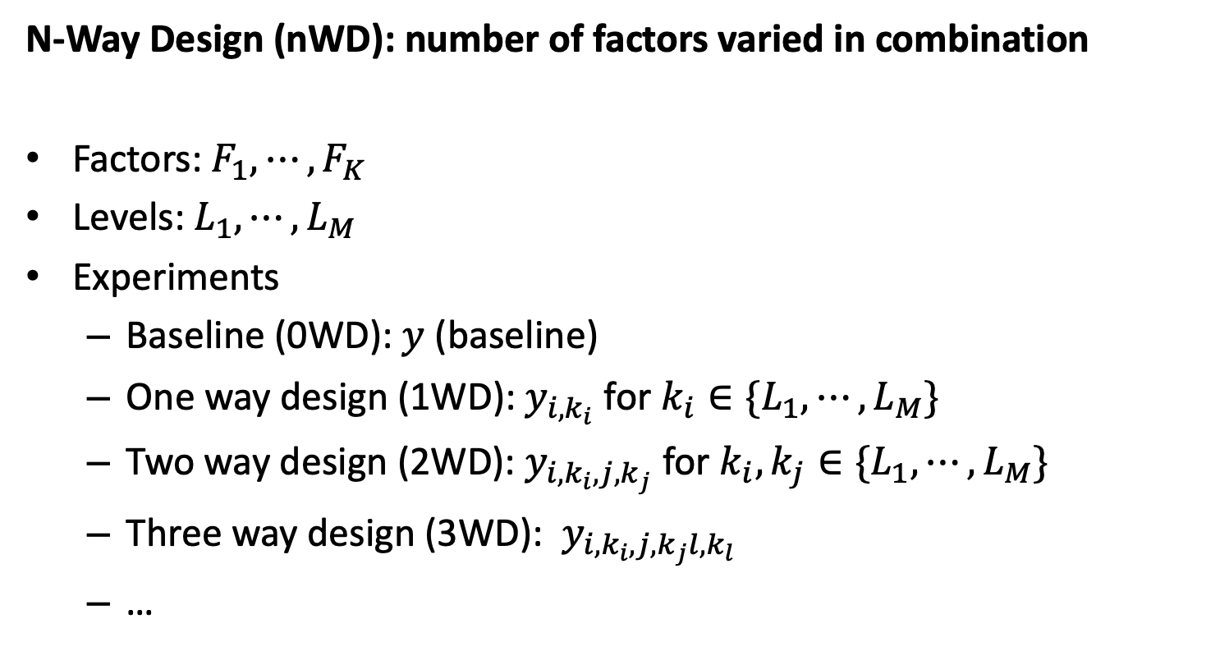
Notation for Specifying Conditions
N-Way Design (nWD): number of factors varied in combination
Factors: $F_{1},⋯,F_{K}$
Levels: $L_{1},⋯,L_{M}$
Experiments
Baseline (0WD): $y$ (baseline)
One way design (1WD): $y_{i,k_{i}}$ for $k_{i}∈\{L_{1},⋯,L_{M}\}$
Two way design (2WD): $y_{i,k_{i},j, k_{j}}$ for $k_{i},k_{j}∈\{L_{1},⋯,L_{M}\}$
Three way design (3WD): $y_{i,k_{i},j, k_{j}l,k_{l}}$
…

Slide 13
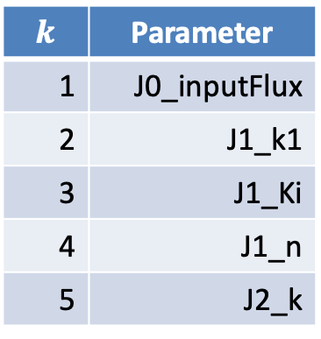
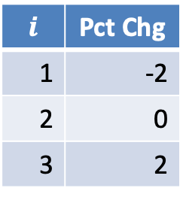
Experiments for nWD (Wolf): Part 1
$k$ | Parameter
1 | J0_inputFlux
2 | J1_k1
3 | J1_Ki
4 | J1_n
5 | J2_k
1WD:
0WD
0WD +
All parameters at
0 Pct Chg
Parameter | Pct Chg
J0_inputFlux | -2
J0_inputFlux | 2
J1_k1 | -2
J1_k1 | 2
J1_Ki | -2
J1_Ki | 2
J1_n | -2
J1_n | 2
J2_k | -2
J2_k | 2
$i$ | Pct Chg
1 | -2
2 | 0
3 | 2
Notes:
Why isn’t there a 0% change in 1WD?

Slide 14
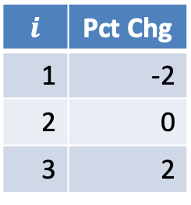
Set of Experiments (Wolf): Part 2
$k$ | Parameter
1 | J0_inputFlux
2 | J1_k1
3 | J1_Ki
4 | J1_n
5 | J2_k
P1 | %1 | P2 | %2
J0_inputFlux | -2 | J1_k1 | -2
J0_inputFlux | -2 | J1_k1 | 2
J0_inputFlux | -2 | J1_Ki | -2
J0_inputFlux | -2 | J1_Ki | 2
J0_inputFlux | -2 | J1_n | -2
J0_inputFlux | -2 | J1_n | 2
J0_inputFlux | -2 | J2_k | -2
J0_inputFlux | -2 | J2_k | 2
J0_inputFlux | 2 | J1_k1 | -2
J0_inputFlux | 2 | J1_k1 | 2
J0_inputFlux | 2 | J1_Ki | -2
J0_inputFlux | 2 | J1_Ki | 2
J0_inputFlux | 2 | J1_n | -2
J0_inputFlux | 2 | J1_n | 2
J0_inputFlux | 2 | J2_k | -2
J0_inputFlux | 2 | J2_k | 2
J1_k1 | -2 | J1_Ki | -2
J1_k1 | -2 | J1_Ki | 2
J1_k1 | -2 | J1_n | -2
J1_k1 | -2 | J1_n | 2
$i$ | Pct Chg
1 | -2
2 | 0
3 | 2
2WD: 0WD + 1WD +
Notes:
Why isn’t there a 0% change in 2WD?

Slide 15
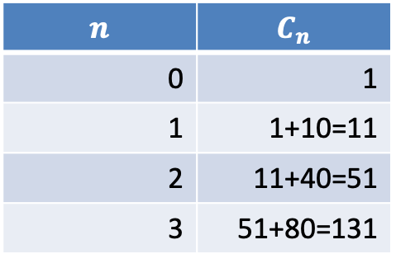
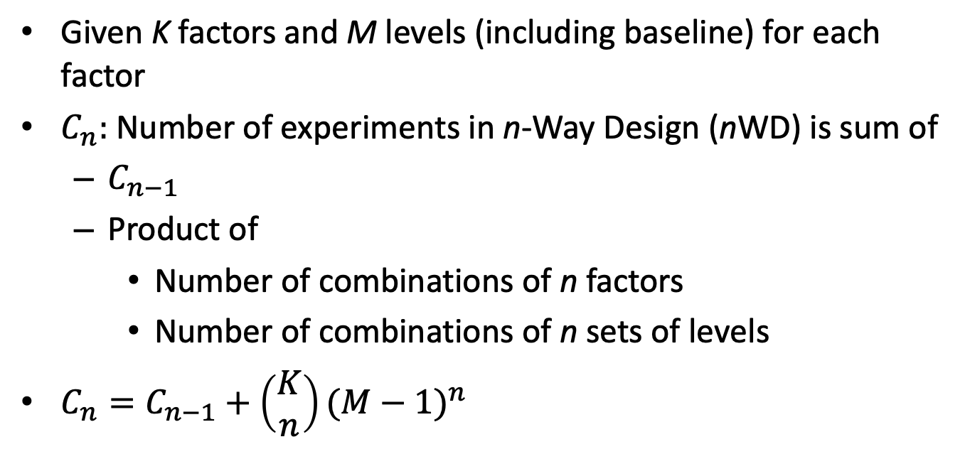

Counting the Number of Conditions in nWD
Given K factors and M levels (including baseline) for each factor
$C_{n}:$Number of experiments in n-Way Design (nWD) is sum of
$C_{n−1}$
Product of
Number of combinations of n factors
Number of combinations of n sets of levels
$C_{n}=C_{n−1}+\left(\begin{matrix}K \\ n\end{matrix}\right){(M−1)}^{n}$
$$K=5, M=3$$
$$n$$ | $$C_{n}$$
0 | 1
1 | 1+10=11
2 | 11+40=51
3 | 51+80=131

Slide 16



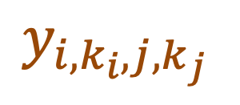

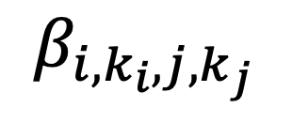

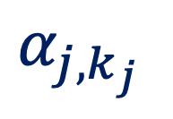

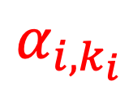
Decomposing the Responses
$$y_{i, k_{i},j,k_{j} }=μ+α_{i,k_{i} }+α_{j,k_{j} }+β_{i,k_{i},j,k_{j}}$$
Why decompose responses?
Provides a way to understand the effect of factors and levels.
Explicit understanding of assumptions of experiment.
$μ$ is the baseline ($k_{i}=0=k_{j}$)
$α_{i,k_{i}}=$ Effect of factor i level k_{i} in a 1WD
$α_{j,k_{j}}=$ Effect of factor j level k_{j} in a 1WD
$β_{i,k_{i},j,k_{j}}=$ Effect of interactions
$$y_{i,k_{i},j,k_{j} }$$
$$α_{j,k_{j} }$$
$$α_{i,k_{i}}$$
$$β_{i,k_{i},j,k_{j} }$$
$$μ$$
Notes:
In practice,there are replications at the same level.

Slide 17

Relationships Between Factors & Responses
Hypothesis for 1WD:
$$y_{i, k_{i},j,k_{j} }=μ+α_{i,k_{i} }+α_{j,k_{j} }+β_{i,k_{i},j,k_{j}}$$
$μ$ is the baseline ($k_{i}=0=k_{j}$)
$α_{i,k_{i}}=$ Effect of factor i level k_{i} in a 1WD
$α_{j,k_{j}}=$ Effect of factor j level k_{j} in a 1WD
$β_{i,k_{i},j,k_{j}}=$ Effect of interactions
$$y_{i,k_{i},j,k_{j} }$$
$$α_{j,k_{j} }$$
$$α_{i,k_{i}}$$
$$β_{i,k_{i},j,k_{j} }$$
$$μ$$
Notes:
In practice,there are replications at the same level.

Slide 18

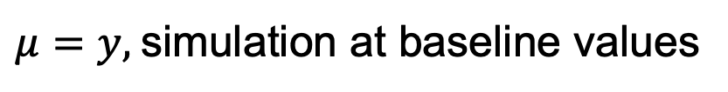







Calculating nWD Parameters
$$y_{i,k_{i},j,k_{j} }$$
$$β_{i,k_{i},j,k_{j} }$$
$$α_{j,k_{j} }$$
$$α_{i,k_{i}}$$
$$μ$$
$$y_{i, k_{i},j,k_{j} }=μ+α_{i,k_{i} }+α_{j,k_{j} }+β_{i,k_{i},j,k_{j}}$$
$μ=y,$simulation at baseline values
$$α_{i,k_{i}}=y_{i,k_{i}}−μ$$
$$β_{i,k_{i},j,k_{j}}=y_{i,k_{i},j,k_{j}}−μ−α_{i,k_{i}}−α_{j,k_{j}}$$
Notes:
In practice,there are replications at the same level.

Slide 19


$$y_{i, k_{i} }=μ+α_{i,k_{i} }$$
$${α_{i,k_{i} }=y}_{i, k_{i} }−μ$$

Slide 20
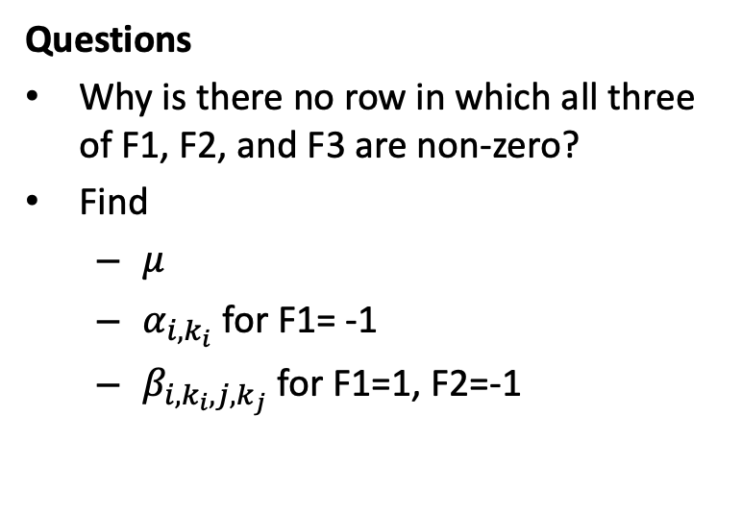
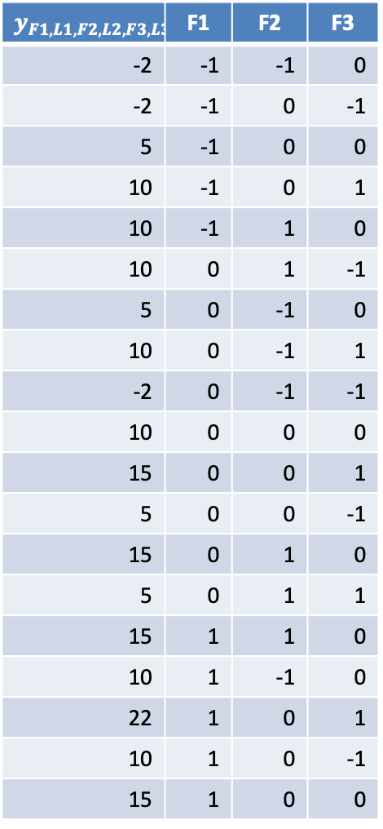
Exercise: 2WD
$$y_{F1,L1,F2,L2,F3,L3}$$ | F1 | F2 | F3
-2 | -1 | -1 | 0
-2 | -1 | 0 | -1
5 | -1 | 0 | 0
10 | -1 | 0 | 1
10 | -1 | 1 | 0
10 | 0 | 1 | -1
5 | 0 | -1 | 0
10 | 0 | -1 | 1
-2 | 0 | -1 | -1
10 | 0 | 0 | 0
15 | 0 | 0 | 1
5 | 0 | 0 | -1
15 | 0 | 1 | 0
5 | 0 | 1 | 1
15 | 1 | 1 | 0
10 | 1 | -1 | 0
22 | 1 | 0 | 1
10 | 1 | 0 | -1
15 | 1 | 0 | 0
Factors: F1, F2, F3
Level values: -1, 0, 1 (0 is baseline)
Questions
Why is there no row in which all three of F1, F2, and F3 are non-zero?
Find
$μ$
$α_{i,k_{i}}$ for F1= -1
$β_{i,k_{i},j,k_{j}}$ for F1=1, F2=-1
Notes:
Mu = 10
-1: -5
1: 5
-1,-1: -2
-1,1 & 1, -1: 0
1,1: 2

Slide 21
Other Considerations
Replicas?
Can be used in constructing folds
Can quantify effect of stochastics (Analysis of Variance)
Reducing the complexity of nWD
Focus on interaction between high impact factors
Strategic selection of the number of levels
Only explore more levels for those factors that have large impact
Notes:
More common to have 50 or so parameters.

Slide 22
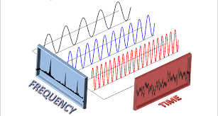
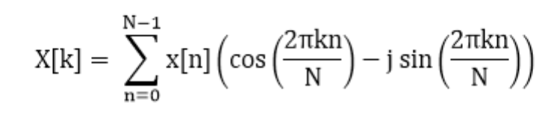
Fourier Transform Basics
{
N
The Fourier transform extracts frequency information from a time series by finding intervals k for which X[k] is large, for k in 1..N
If X[k] is large, then there is an oscillation at a frequency proportional to k/N.

