Slide 1
BIOE 437 / BIOE 537 Computational Systems Biology Design of Experiments: Programming
Joseph L. Hellerstein*
Herbert Sauro**
November, 2023
*eScience Institute, Computer Science & Engineering
**BioEngineering
Notes:
Diverse students. Some with bio-backgrounds; some without. Some with CS background; some with very limited. Two separate courses combined because of a substantial shared curriculum.

Slide 2
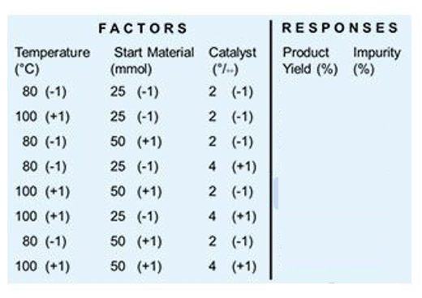

Key Concepts in Design of Experiments (DOE)
(experiment) condition
Factor: Something changed in the experiment (e.g., parameter)
Level of factor: Value/setting of a factor (something that is controlled)
Condition: The levels assigned to factors for an experiment
Response: Measured result of an experiment
An experiment is done under one condition.
An experimental design specifies the:
the collection of conditions considered
response values to measure

Slide 3
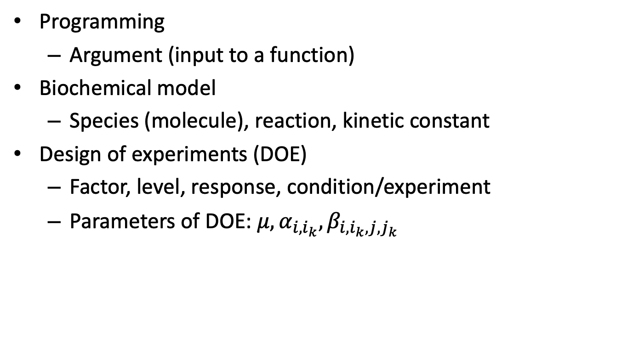
Terminology By Context
Programming
Argument (input to a function)
Biochemical model
Species (molecule), reaction, kinetic constant
Design of experiments (DOE)
Factor, level, response, condition/experiment
Parameters of DOE: $μ, α_{i,i_{k}},β_{i,i_{k},j,j_{k}}$

Slide 4



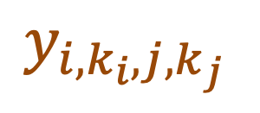

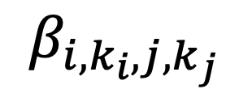

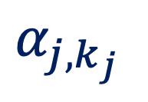

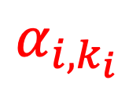
Decomposing the Responses
$$y_{i, k_{i},j,k_{j} }=μ+α_{i,k_{i} }+α_{j,k_{j} }+β_{i,k_{i},j,k_{j}}$$
Why decompose responses?
Provides a way to understand the effect of factors and levels.
Explicit understanding of assumptions of experiment.
$μ$ is the baseline ($k_{i}=0=k_{j}$)
$α_{i,k_{i}}=$ Effect of factor i level k_{i} in a 1WD
$α_{j,k_{j}}=$ Effect of factor j level k_{j} in a 1WD
$β_{i,k_{i},j,k_{j}}=$ Effect of interactions
$$y_{i,k_{i},j,k_{j} }$$
$$α_{j,k_{j} }$$
$$α_{i,k_{i}}$$
$$β_{i,k_{i},j,k_{j} }$$
$$μ$$
Notes:
In practice,there are replications at the same level.

Slide 5

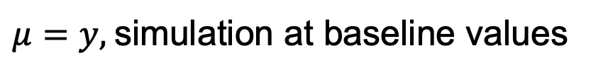







Calculating 2WD Parameters
$$y_{i,k_{i},j,k_{j} }$$
$$α_{i,k_{i}}$$
$$β_{i,k_{i},j,k_{j} }$$
$$α_{j,k_{j} }$$
Measured
$$μ$$
{
$$y_{i, k_{i},j,k_{j} }=μ+α_{i,k_{i} }+α_{j,k_{j} }+β_{i,k_{i},j,k_{j}}$$
Calculated
$μ=y,$simulation at baseline values
$$α_{i,k_{i}}=y_{i,k_{i}}−μ$$
$$β_{i,k_{i},j,k_{j}}=y_{i,k_{i},j,k_{j}}−μ−α_{i,k_{i}}−α_{j,k_{j}}$$
Notes:
In practice,there are replications at the same level.

Slide 6
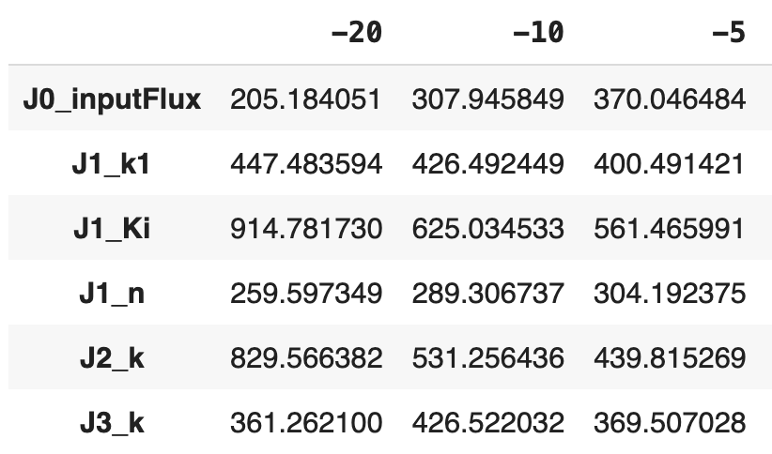
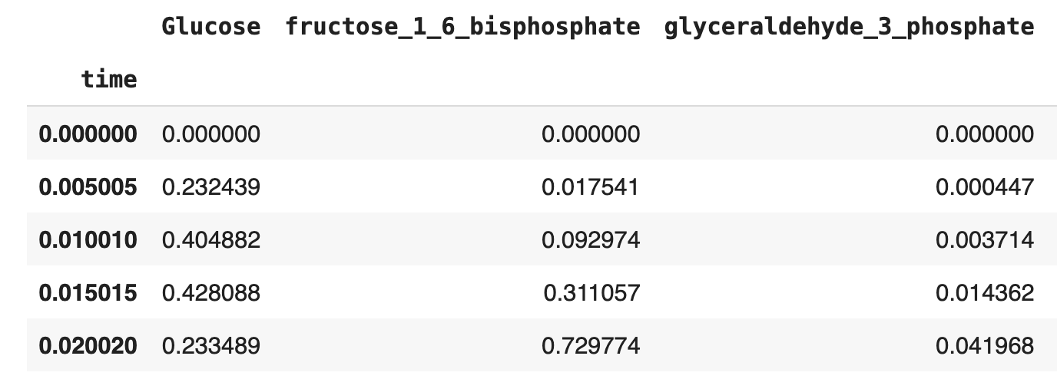

Key DOE Data Structures
Parameter1WDDataFrame ($y_{i{,k}_{i}})$
Response1WDDataFrame (y)
Columns: Chemical species
Rows: Time
Values: float
Columns: Percent change (level)
Rows: Factor
Values: float
Notes:
Note that the Parameter DataFrame includes a list of the factors and their levels.

Slide 7
Summary of Functions For Calculating DOE Parameters in a 1WD
Function with arguments
Function returns
runSimulations(factor, percents=[10, 20],
model)
dict(
10: Response1WDDataFrame,
20: Response1WDDataFrame)
calculatePeakFrequency(molecule,
Response1WDDataFrame)
(peak_freq, amplitude)
calculate1WDParameters(
Response1WDDataFrame)
(mu, Parameter1WDDataFrame)
runStudy(factors, percents, molecule)
(mu, Parameter1WDDataFrame)

Slide 8
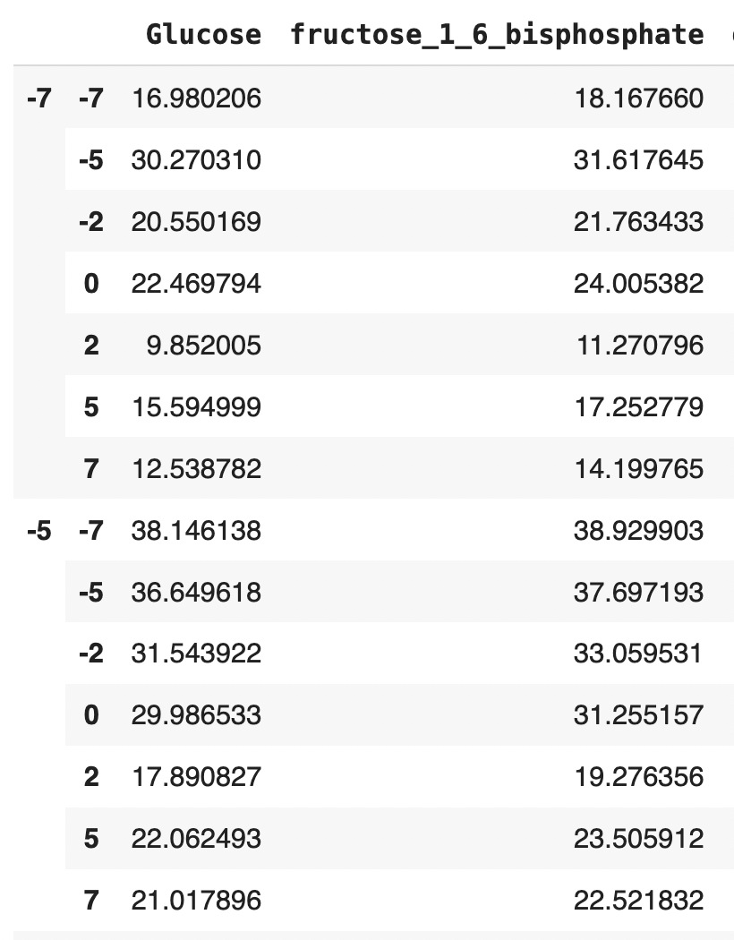

2WD Response Data
Response1WDDataFrame (y)
Response2WDDataFrame (y)
(J0_inputFlux, J1_k1)
Parameter1WDDataFrame ($α_{i{,k}_{i}})$
Columns: Chemical species
Index name: factor1, factor2
Row name: %factor1, %factor2
Values: peak amplitude
Notes:
Want to make the data self-describing

Slide 9
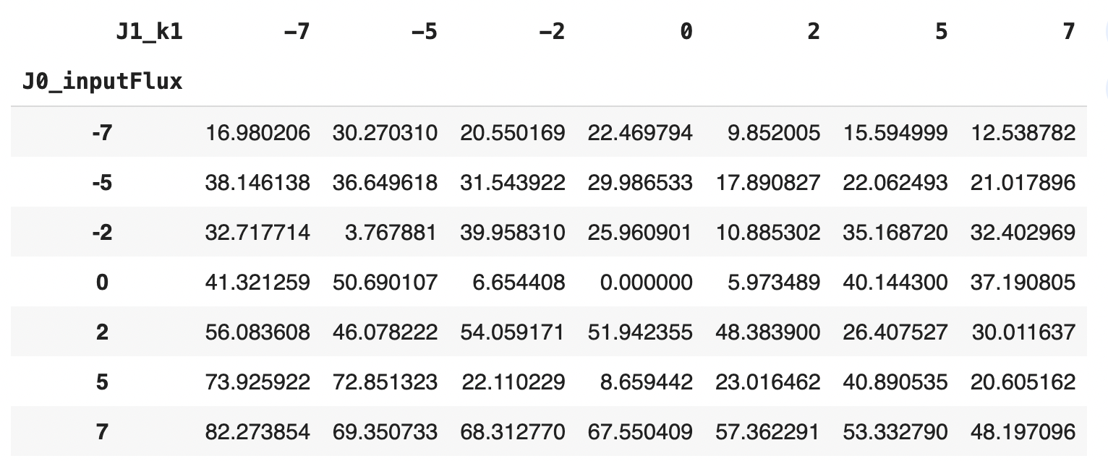
InteractionDataFrame
Response2WDDataFrame (y)
Interaction2WDDataFrame (y)
(J0_inputFlux, J1_k1)
Columns: %factor1
Row: %factor2
Values: peak amplitude
Columns: Chemical species
Index name: factor1, factor2
Row name: %factor1, %factor2
Values: peak amplitude

Slide 10
Summary of Functions For Calculating DOE Parameters in a 2WD
Function with arguments
Function returns
runExperiments2WD(model,
factor1, factor2,
percents1, percents2)
Response2WDDataFrame
calc1WDParameters(
response2WDDataFrame)
Float(mu), DataFrame,
DataFrame
Mu by molecule
runStudy2WD(model, factor1,
factor2, percents)
(Series,
response2WDDataFrame,
response2WDDataFrame,
response2WDDataFrame)
alpha for factor 1
alpha for factor 2
beta

Slide 11
BACKUP

Slide 12
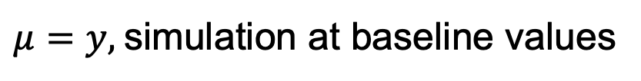


Calculating 2WD Parameters
$$y_{i,k_{i},j,k_{j} }$$
$$α_{i,k_{i}}$$
$$β_{i,k_{i},j,k_{j} }$$
$$α_{j,k_{j} }$$
$$μ$$
$$y_{i, k_{i},j,k_{j} }=μ+α_{i,k_{i} }+α_{j,k_{j} }+β_{i,k_{i},j,k_{j}}$$
$μ=y,$simulation at baseline values
$$α_{i,k_{i}}=y_{i,k_{i}}−μ$$
$$β_{i,k_{i},j,k_{j}}=y_{i,k_{i},j,k_{j}}−μ−α_{i,k_{i}}−α_{j,k_{j}}$$
Notes:
In practice,there are replications at the same level.

Slide 13
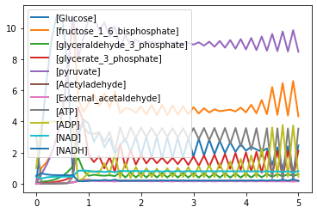

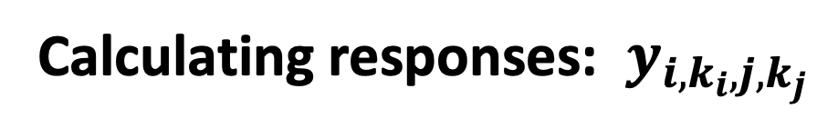



Calculating responses: $y_{i,k_{i},j,k_{j}}$
$$y_{i,k_{i},j,k_{j} }$$
$$α_{i,k_{i}}$$
$$β_{i,k_{i},j,k_{j} }$$
$$α_{j,k_{j} }$$
$$y_{i,k_{i},j,k_{j} }$$
$$μ$$
The response may not be computed by the simulation.
What is a response of interest in this simulation?
Frequency of oscillation
Amplitude at the frequency of oscillation
Other?
Notes:
In practice,there are replications at the same level.

Slide 14

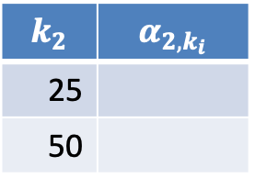
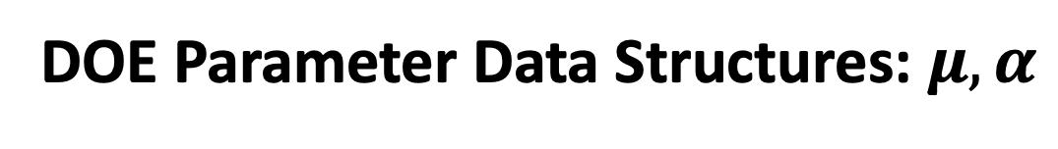

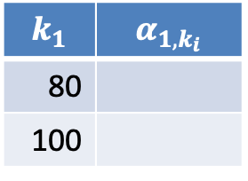



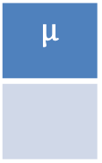



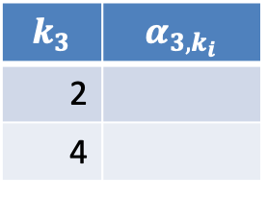
DOE Parameter Data Structures: $μ,α$
$$y_{i,k_{i},j,k_{j} }$$
$$α_{j,k_{j} }$$
$$α_{i,k_{i}}$$
$$μ$$
$$y_{i, k_{i},j,k_{j} }=μ+α_{i,k_{i} }+α_{j,k_{j} }+β_{i,k_{i},j,k_{j}}$$
Temperature
Material
Catalyst
$$μ$$
$$k_{1}$$ | $$α_{1,k_{i}}$$
80
100
$$k_{2}$$ | $$α_{2,k_{i}}$$
25
50
$$k_{3}$$ | $$α_{3,k_{i}}$$
2
4
float
indexed list
indexed list
indexed list
$k_{1}$is the index for Temperature.
$k_{2}$is the index for Material.
$k_{3}$is the index for Catalyst.
Notes:
In practice,there are replications at the same level.

Slide 15


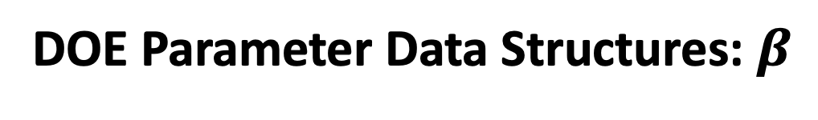








DOE Parameter Data Structures: $β$
$$y_{i,k_{i},j,k_{j} }$$
$$α_{i,k_{i}}$$
$$β_{i,k_{i},j,k_{j} }$$
$$α_{j,k_{j} }$$
$$μ$$
$$y_{i, k_{i},j,k_{j} }=μ+α_{i,k_{i} }+α_{j,k_{j} }+β_{i,k_{i},j,k_{j}}$$
Temperature ($k_{1}$) | Material ($k_{2}$) | $$β_{1,k_{1},2,k_{2} }$$
80 | 25
80 | 50
100 | 25
100 | 50
indexed table
$k_{1},k_{2}$is the index for Temperature, Material.
Temperature ($k_{1}$) | Catalyst ($k_{3}$) | $$β_{1,k_{1},3,k_{3} }$$
indexed table
Material ($k_{2}$) | Catalyst ($k_{3}$) | $$β_{1,k_{1},3,k_{3} }$$
indexed table
Notes:
In practice,there are replications at the same level.

Slide 16

Calculating DOE Parameters: A Programmer’s View
$$y_{i,k_{i},j,k_{j} }$$
$$β_{i,k_{i},j,k_{j} }$$
$$α_{j,k_{j} }$$
$$α_{i,k_{i}}$$
$$μ$$
$$y_{i, k_{i},j,k_{j} }=μ+α_{i,k_{i} }+α_{j,k_{j} }+β_{i,k_{i},j,k_{j}}$$
float
indexed table
indexed list
indexed list
indexed table
What is the data structure for the response?
Notes:
In practice,there are replications at the same level.

Slide 17
Next Step: Calculating 2WD Parameters
$$y_{i,k_{i},j,k_{j} }$$
$$β_{i,k_{i},j,k_{j} }$$
$$α_{j,k_{j} }$$
$$α_{i,k_{i}}$$
$$μ$$
$$y_{i, k_{i},j,k_{j} }=μ+α_{i,k_{i} }+α_{j,k_{j} }+β_{i,k_{i},j,k_{j}}$$
$μ=y,$simulation at baseline values
$$α_{i,k_{i}}=y_{i,k_{i}}−μ$$
$$β_{i,k_{i},j,k_{j}}=y_{i,k_{i},j,k_{j}}−μ−α_{i,k_{i}}−α_{j,k_{j}}$$
Notes:
In practice,there are replications at the same level.

