Slide 1
BIOE 537 Computational Systems Biology Creating Python Packages
Joseph L. Hellerstein*
Herbert Sauro**
*eScience Institute, Computer Science & Engineering
**BioEngineering
Notes:
Diverse students. Some with bio-backgrounds; some without. Some with CS background; some with very limited. Two separate courses combined because of a substantial shared curriculum.

Slide 2
Agenda*
Specification documents
Functional specification
Component specifications
GitHub & git
Creating and updating files using git
Repository structure
Unit Tests
Packages
PyPI
Creating a package
*Topics in grey are not discussed here.

Slide 3
Setup for Windows (You Should Have Done This Already)
Open the Microsoft Store
Start>search “Microsoft Store”
Find “git bash” and install it

Slide 4
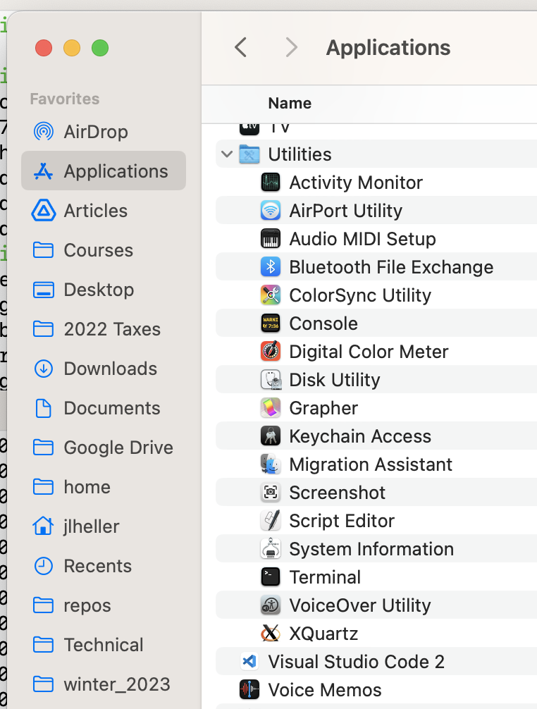
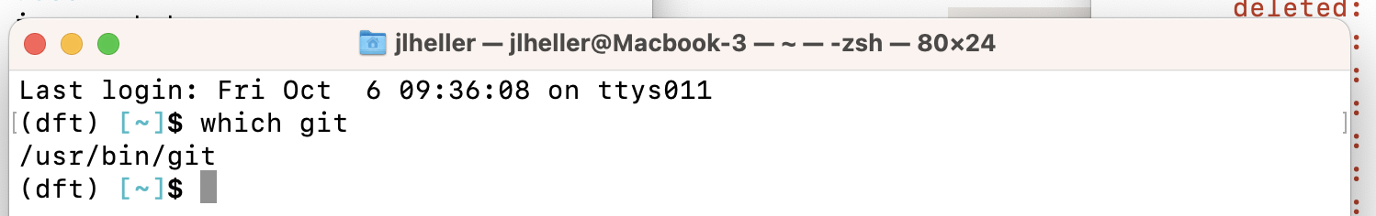
Setup for Mac (You Should Have Done This Already)
Open Applications>Utilities>Terminal
Type in Terminal: which git. If not present
Download git

Slide 5
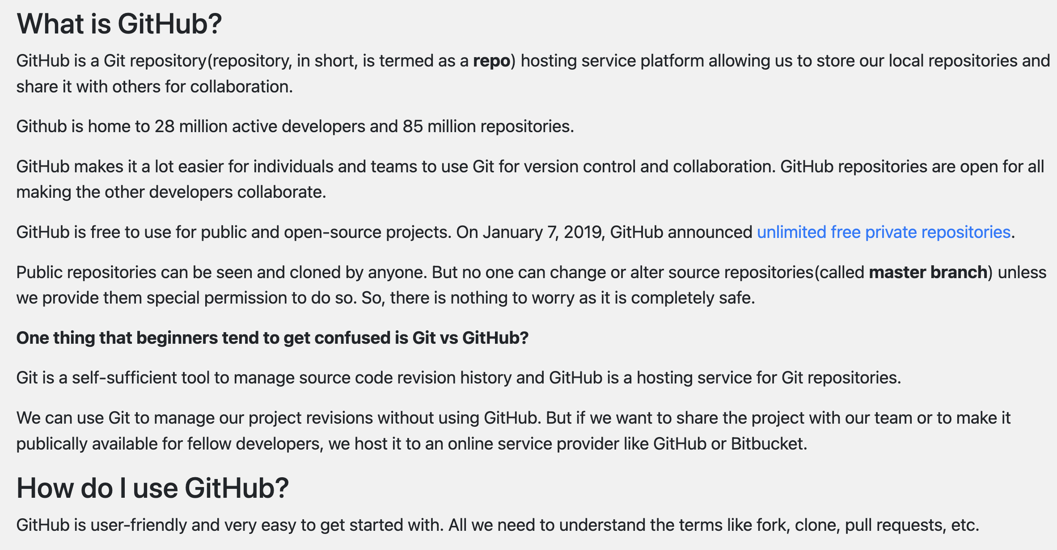
GitHub: What & Why

Slide 6
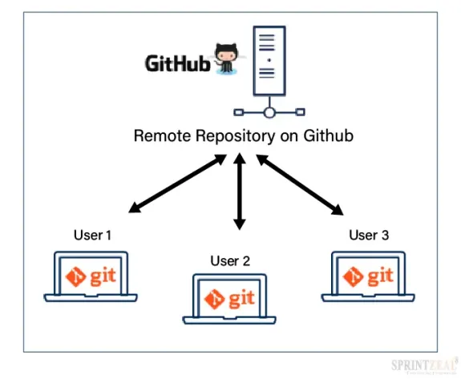
GitHub Client Server Architecture

Slide 7
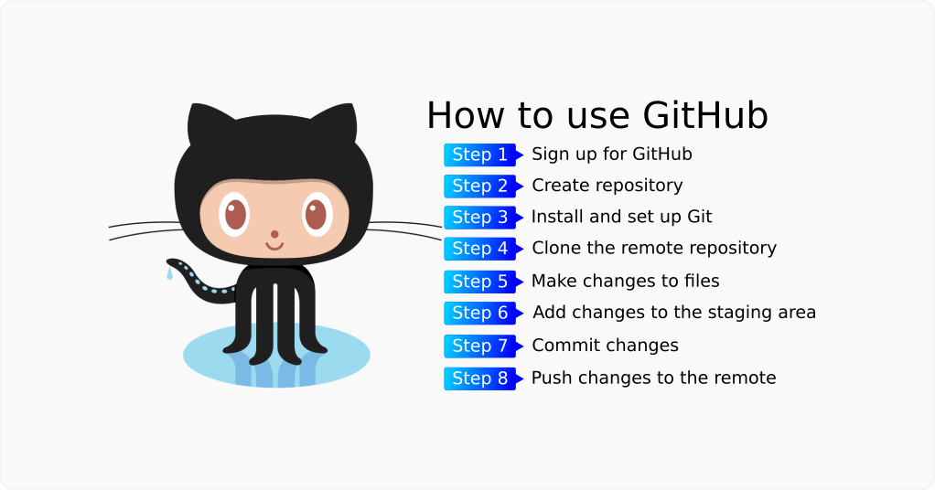

Slide 8
Initialize git on Machine
git config --global user.name "John Doe"
git config --global user.email johndoe@email.com

Slide 9
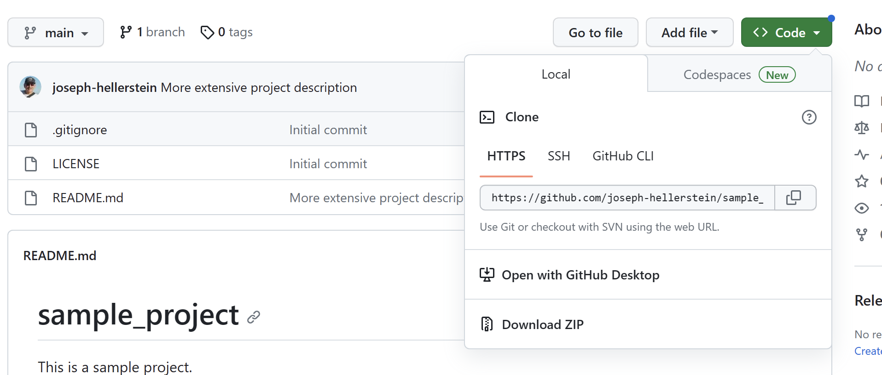
Creating a GitHub Repository
Browse to github.com and login.
Create a new repository with:
Public
MIT license
Python ignore file
Copy the github URL for the project

Slide 10
Managing the Repository
mkdir <folder> creates a folder
rmdir <folder> removes a folder
rm <file> removes a file
Creating and changing files
Windows: notepad (a gitbash command)
Mac: textedit (Applications>textedit)
git commit –am “<message>” Commits changes in the repository
git push Pushes changes to GitHub
git clone <repository path> Make a local copy of a repo

Slide 11
Open a Terminal (Git Bash) Window
Create a directory for this class
mkdir 437
Move into the directory
cd 437
Clone the repository that you created:
git clone https://github.com/joseph-hellerstein/sample_project.git

Slide 12
Running Python
python program.py Runs the python program
Debugging hints
Use print statements
Use python debugger by inserting
import pdb; pdb.set_trace()

Slide 13
Unit Tests
Tests for individual functions to check for errors.
Structure (given module my_function.py that contains def greet that returns “goodbye” to “hello”)
import unittest
from my_function import greet
class TestFunctions(unittest.TestCase):
def testGreet(self):
result = greet(“hello”)
self.assertTrue(result == “goodbye”)
if __name__ == '__main__':
unittest.main()

Slide 14
Example Repository From Class

Slide 15
Mechanics of a Package
See this page

