Slide 1



Validating Model Accuracy With Cross Validation
Joseph L. Hellerstein^{1,2}
¹eScience Institute
²Department of Computer Science & Engineering
November, 2023

Slide 2
Modeling Workflow
Develop Mechanistic Model
(Tellurium, Antimony)
Estimate Parameter Values
(Parameter estimation)
Evaluate Model Quality
Do Studies
(DOE)

Slide 3

Parameter Estimation Accuracy
Data A
Data B
Construct Model
Estimate Parameters
Validate Accuracy
A modeling dilemma
Data A $≠$Data B are collected separately.
But this doubles the data requirements.
Save on data collection by making Data A = Data B.
But this biases the last step.

Slide 4
Cross Validation Uses Data Efficiently
S2
S3
S4
observations
Data
S2
S3
S4
}
Test data
}
Training data
Data
A fold is a separation of the full dataset into training data and test data.
If there are N folds, then every observation is test data for exactly one fold.

Slide 5






Cross Validation Uses Data Efficiently
S1
S2
S3
S4
Divide data set into N Folds.
Fold = Training Data + Test Data
time
Data
Train 1
Test 1
{
Use training data to estimate parameters for each fold.
Train 2
Test 2
{
Use test data to quantify quality of parameter estimates.
Train 3
Test 3
{
Evaluate Accuracy
Evaluation
Consistent values of parameters?
Good quality measures?

Slide 6
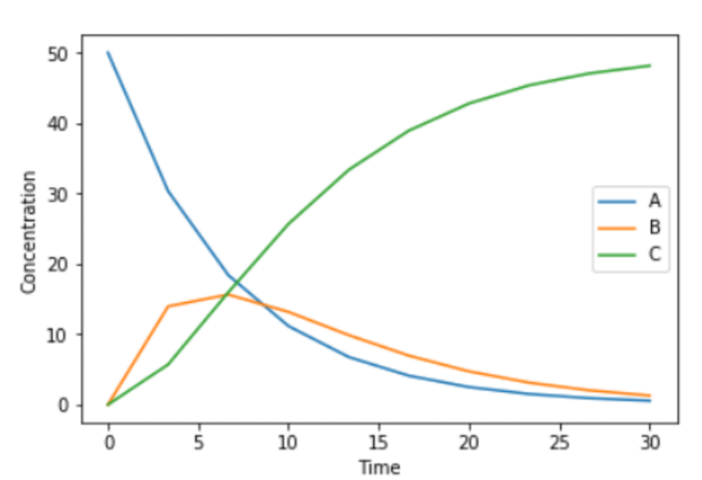
Choosing Folds Choose Wisely
X
Folds have very different dynamics
Folds have similar dynamics

