Slide 1
BIOE 437 / BIOE 537 Computational Systems Biology Design of Experiments: Programming
Joseph L. Hellerstein*
Herbert Sauro**
November, 2022
*eScience Institute, Computer Science & Engineering
**BioEngineering
Notes:
Diverse students. Some with bio-backgrounds; some without. Some with CS background; some with very limited. Two separate courses combined because of a substantial shared curriculum.

Slide 2
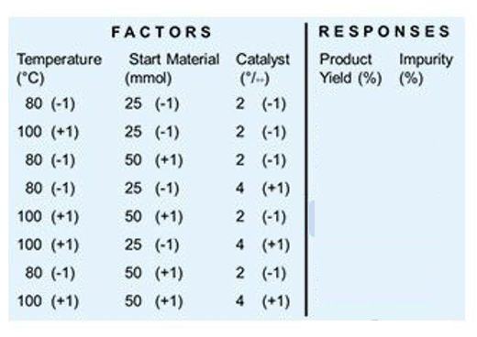

Key Concepts in Design of Experiments (DOE)
(experiment) condition
Factor: Something changed in the experiment (e.g., parameter)
Level of factor: Value/setting of a factor (something that is controlled)
Condition: The levels assigned to factors for an experiment
Response: Measured result of an experiment
An experiment is done under one condition.
An experimental design specifies the:
the collection of conditions considered
response values to measure

Slide 3

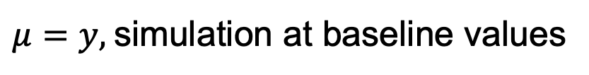







Calculating 2WD Parameters
$$y_{i,k_{i},j,k_{j} }$$
$$α_{i,k_{i}}$$
$$β_{i,k_{i},j,k_{j} }$$
$$α_{j,k_{j} }$$
$$μ$$
$$y_{i, k_{i},j,k_{j} }=μ+α_{i,k_{i} }+α_{j,k_{j} }+β_{i,k_{i},j,k_{j}}$$
$μ=y,$simulation at baseline values
$$α_{i,k_{i}}=y_{i,k_{i}}−μ$$
$$β_{i,k_{i},j,k_{j}}=y_{i,k_{i},j,k_{j}}−μ−α_{i,k_{i}}−α_{j,k_{j}}$$
Notes:
In practice,there are replications at the same level.

Slide 4
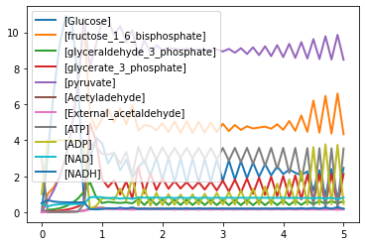

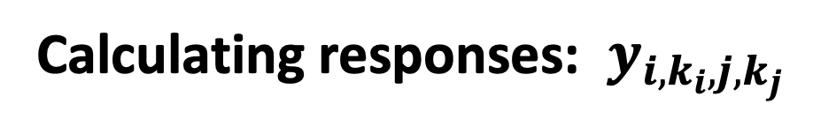



Calculating responses: $y_{i,k_{i},j,k_{j}}$
$$y_{i,k_{i},j,k_{j} }$$
$$α_{i,k_{i}}$$
$$β_{i,k_{i},j,k_{j} }$$
$$α_{j,k_{j} }$$
$$y_{i,k_{i},j,k_{j} }$$
$$μ$$
The response may not be computed by the simulation.
What is a response of interest in this simulation?
Frequency of oscillation
Amplitude at the frequency of oscillation
Other?
Notes:
In practice,there are replications at the same level.

Slide 5

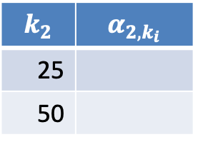
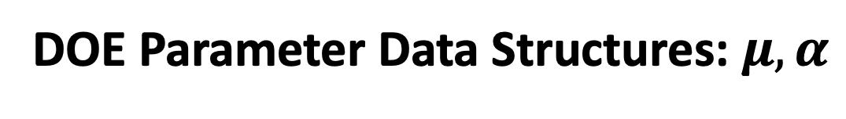

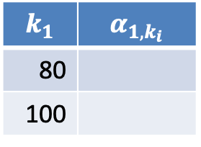



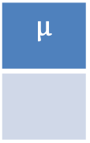



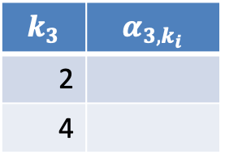
DOE Parameter Data Structures: $μ,α$
$$y_{i,k_{i},j,k_{j} }$$
$$α_{j,k_{j} }$$
$$α_{i,k_{i}}$$
$$μ$$
$$y_{i, k_{i},j,k_{j} }=μ+α_{i,k_{i} }+α_{j,k_{j} }+β_{i,k_{i},j,k_{j}}$$
Temperature
Material
Catalyst
$$μ$$
$$k_{1}$$ | $$α_{1,k_{i}}$$
80
100
$$k_{2}$$ | $$α_{2,k_{i}}$$
25
50
$$k_{3}$$ | $$α_{3,k_{i}}$$
2
4
float
indexed list
indexed list
indexed list
$k_{1}$is the index for Temperature.
$k_{2}$is the index for Material.
$k_{3}$is the index for Catalyst.
Notes:
In practice,there are replications at the same level.

Slide 6


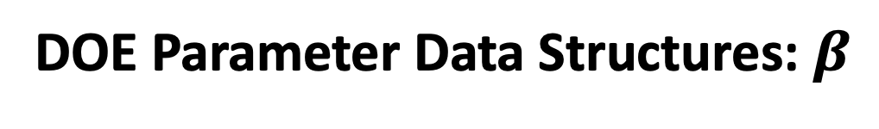








DOE Parameter Data Structures: $β$
$$y_{i,k_{i},j,k_{j} }$$
$$α_{i,k_{i}}$$
$$β_{i,k_{i},j,k_{j} }$$
$$α_{j,k_{j} }$$
$$μ$$
$$y_{i, k_{i},j,k_{j} }=μ+α_{i,k_{i} }+α_{j,k_{j} }+β_{i,k_{i},j,k_{j}}$$
Temperature ($k_{1}$) | Material ($k_{2}$) | $$β_{1,k_{1},2,k_{2} }$$
80 | 25
80 | 50
100 | 25
100 | 50
indexed table
$k_{1},k_{2}$is the index for Temperature, Material.
Temperature ($k_{1}$) | Catalyst ($k_{3}$) | $$β_{1,k_{1},3,k_{3} }$$
indexed table
Material ($k_{2}$) | Catalyst ($k_{3}$) | $$β_{1,k_{1},3,k_{3} }$$
indexed table
Notes:
In practice,there are replications at the same level.

Slide 7

Calculating DOE Parameters: A Programmer’s View
$$y_{i,k_{i},j,k_{j} }$$
$$β_{i,k_{i},j,k_{j} }$$
$$α_{j,k_{j} }$$
$$α_{i,k_{i}}$$
$$μ$$
$$y_{i, k_{i},j,k_{j} }=μ+α_{i,k_{i} }+α_{j,k_{j} }+β_{i,k_{i},j,k_{j}}$$
float
indexed table
indexed list
indexed list
indexed table
What is the data structure for the response?
Notes:
In practice,there are replications at the same level.

Slide 8
Next Step: Calculating 2WD Parameters
$$y_{i,k_{i},j,k_{j} }$$
$$β_{i,k_{i},j,k_{j} }$$
$$α_{j,k_{j} }$$
$$α_{i,k_{i}}$$
$$μ$$
$$y_{i, k_{i},j,k_{j} }=μ+α_{i,k_{i} }+α_{j,k_{j} }+β_{i,k_{i},j,k_{j}}$$
$μ=y,$simulation at baseline values
$$α_{i,k_{i}}=y_{i,k_{i}}−μ$$
$$β_{i,k_{i},j,k_{j}}=y_{i,k_{i},j,k_{j}}−μ−α_{i,k_{i}}−α_{j,k_{j}}$$
Notes:
In practice,there are replications at the same level.

Slide 9
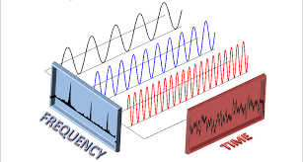
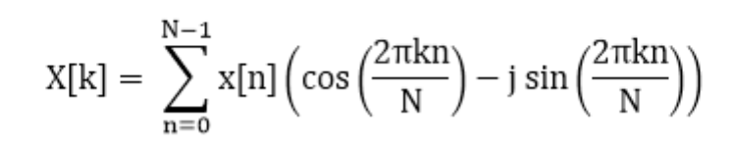
Fourier Transform Basics
{
N
The Fourier transform extracts frequency information from a time series by finding intervals k for which X[k] is large, for k in 1..N
If X[k] is large, then there is an oscillation at a frequency proportional to k/N.

